Slide 1
UITF: T-cathode and Small shield
Experimental data @200 [kV]
07/07/2019
Gabriel Palacios

Slide 2
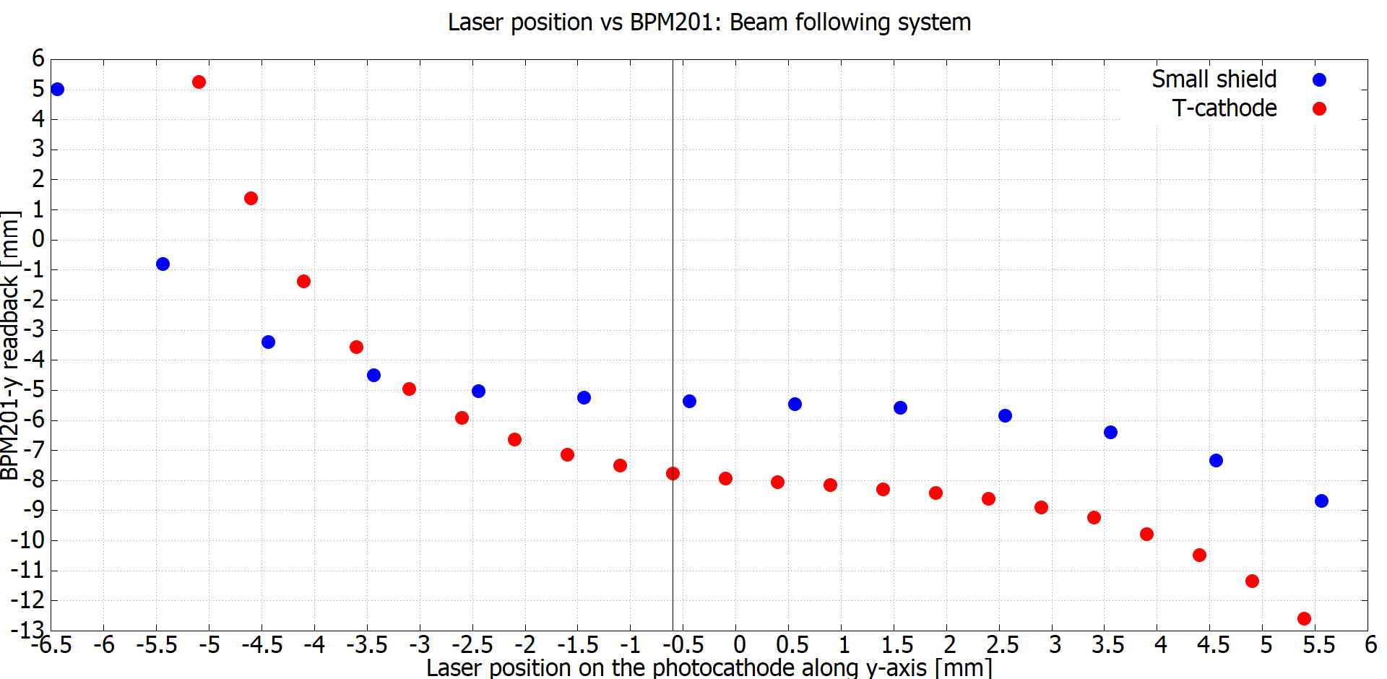
Vertically: Small shield is better…that was unexpected
0.9 [mm] difference between: -5.0 and -5.9
2.7 [mm] difference between: -5.8 and -8.5
15.2%
31.1%
31.7%
2.4 [mm] difference between: -5.3 and -7.7

Slide 3
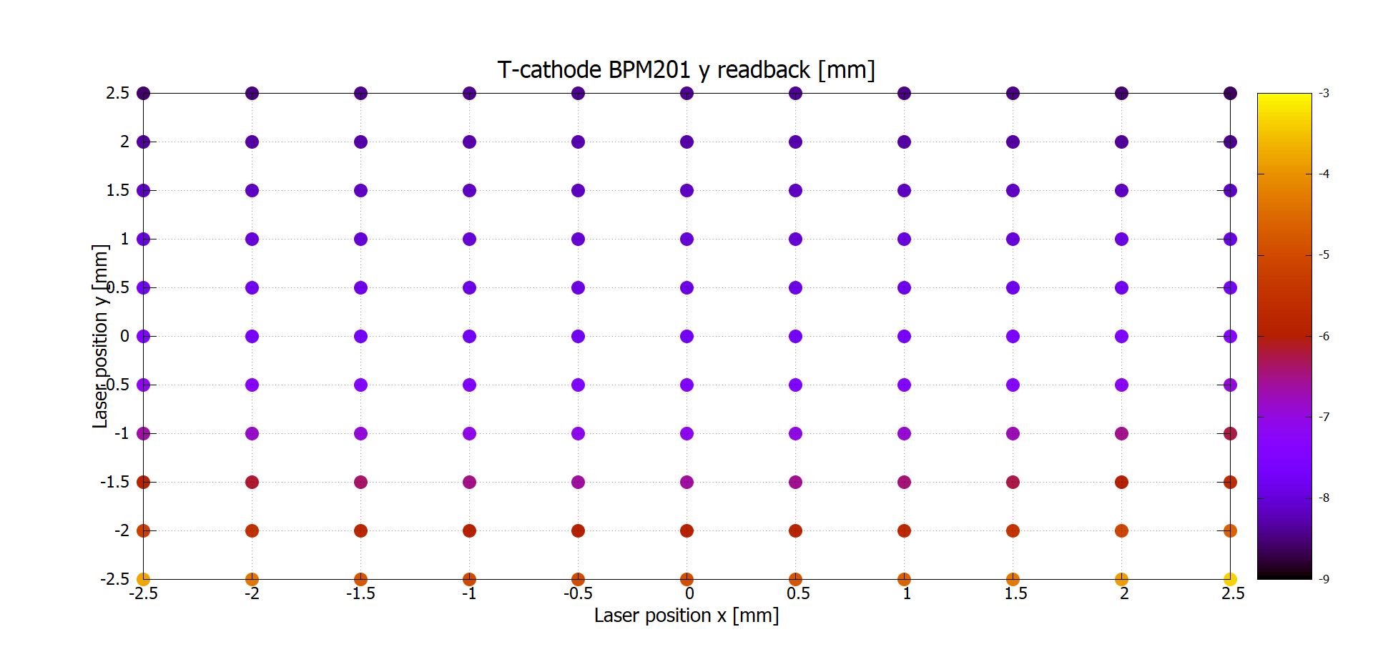
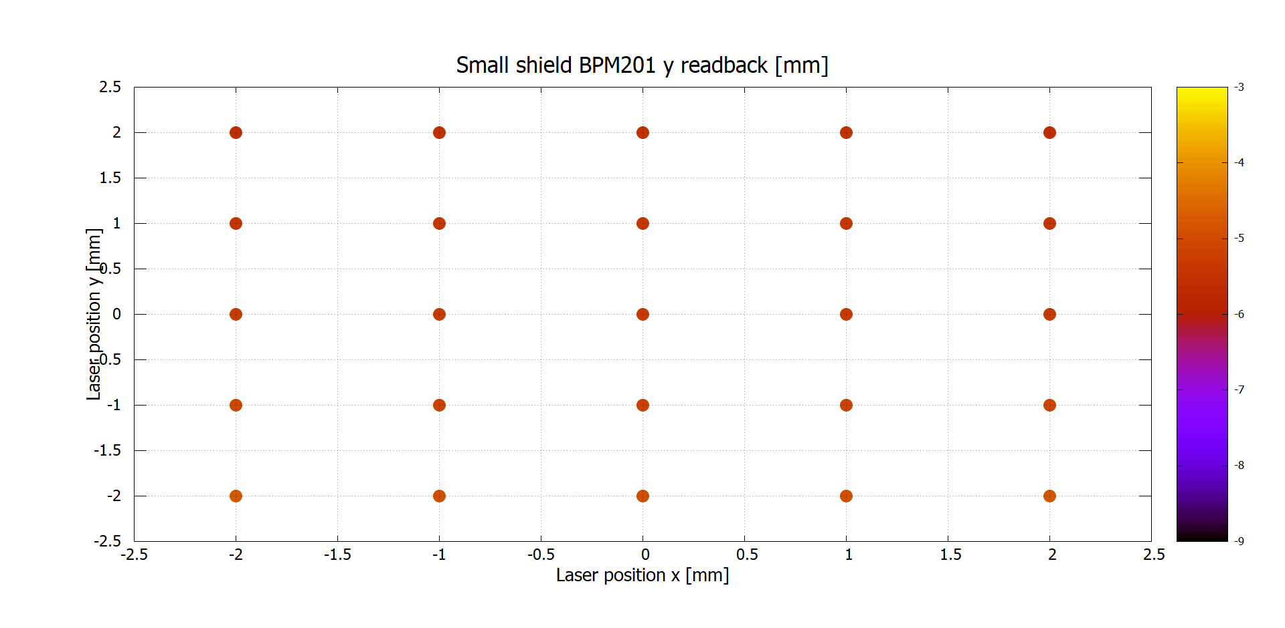

Slide 4
BFS

Slide 5
BFS

Slide 6
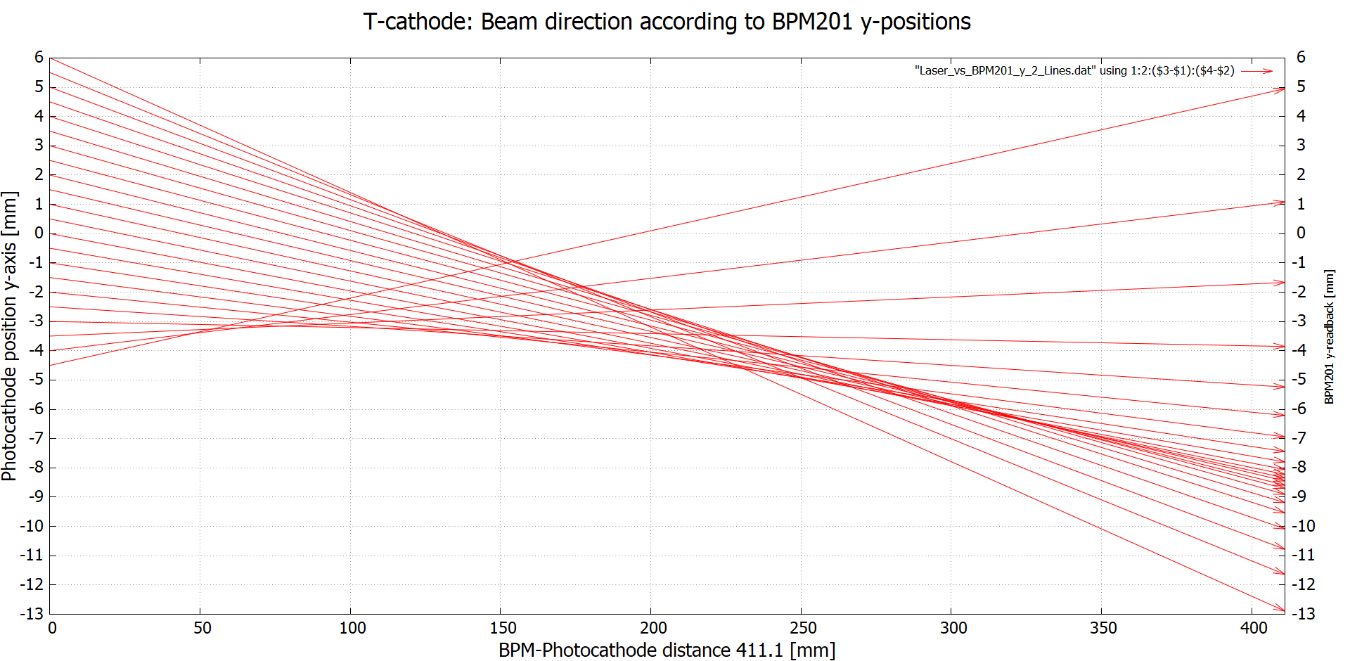
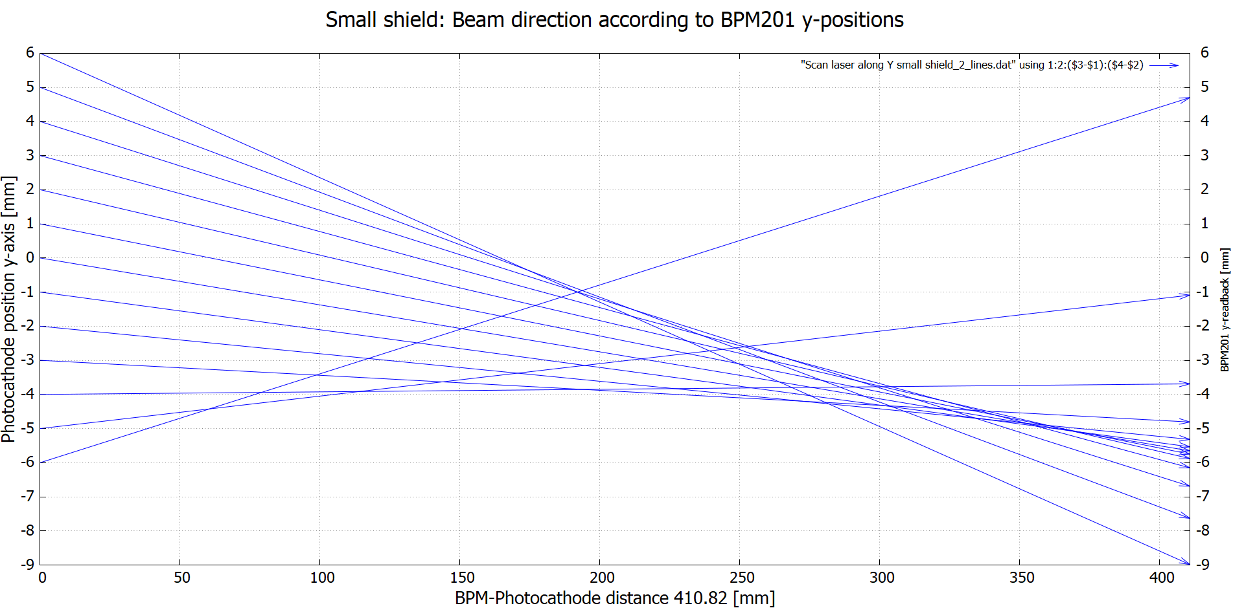

Slide 9
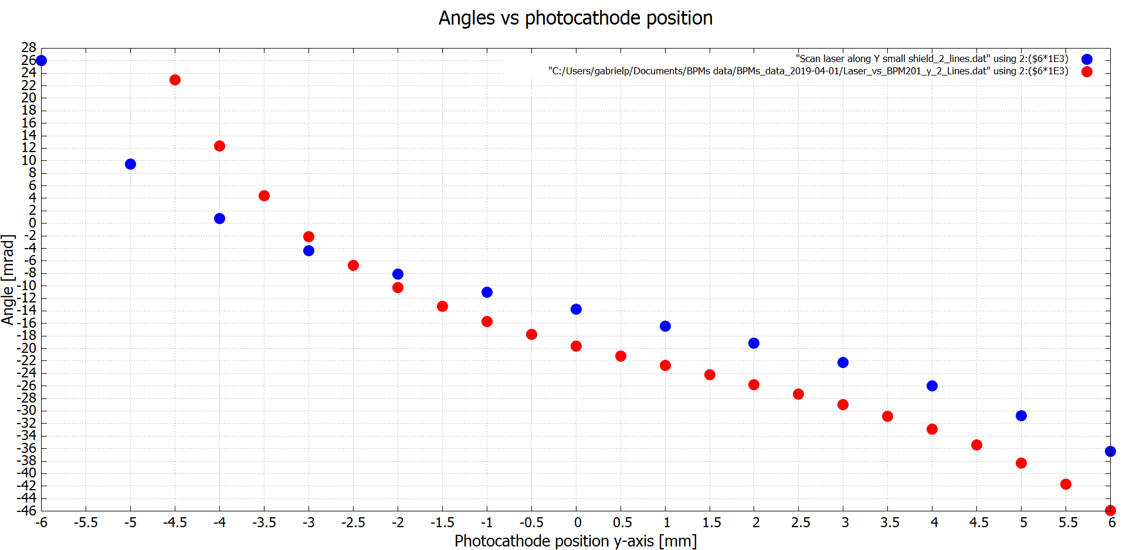

Slide 10
Centered in solenoid lens
How much correction do we need (MBHK101H&V) to center the beam in the first solenoid lens, as we change the position of the beam along the x-axis and y-axis on the photocathode

Slide 11
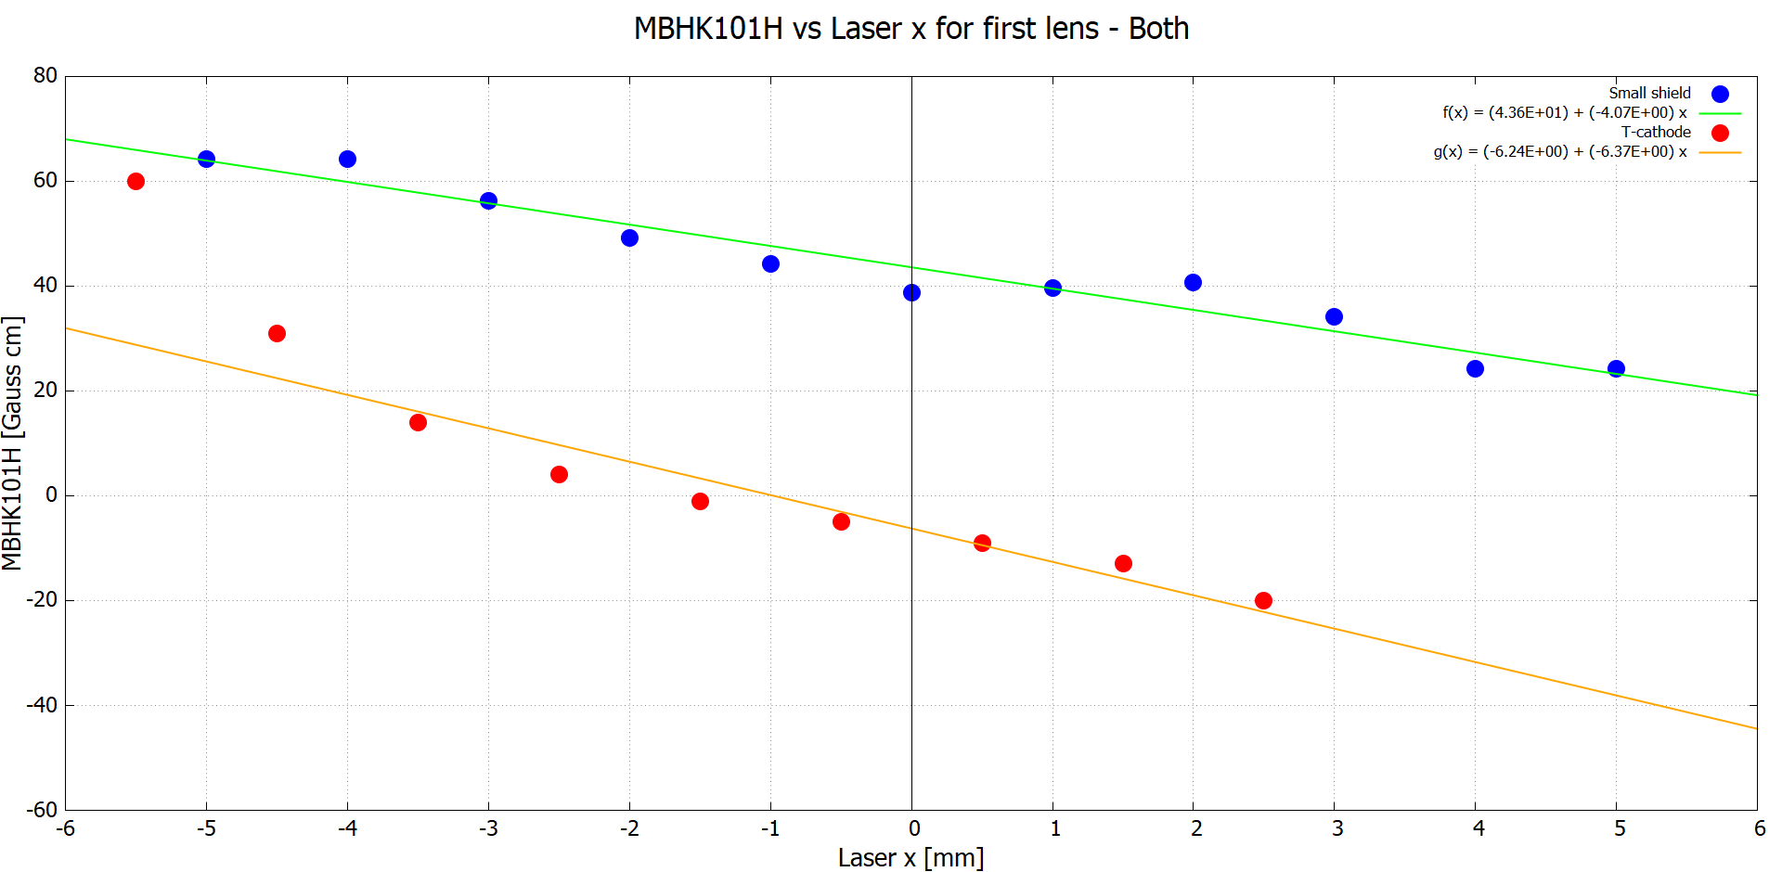
42.3 [Gauss cm] difference between: 56.2 and 13.9
43.6 [Gauss cm] difference between: 38.9 and -4.7
53.6 [Gauss cm] difference between: 33.8 and -19.8
Notice that for the T-cathode, y=1.5 [mm], not zero! :S

Slide 12
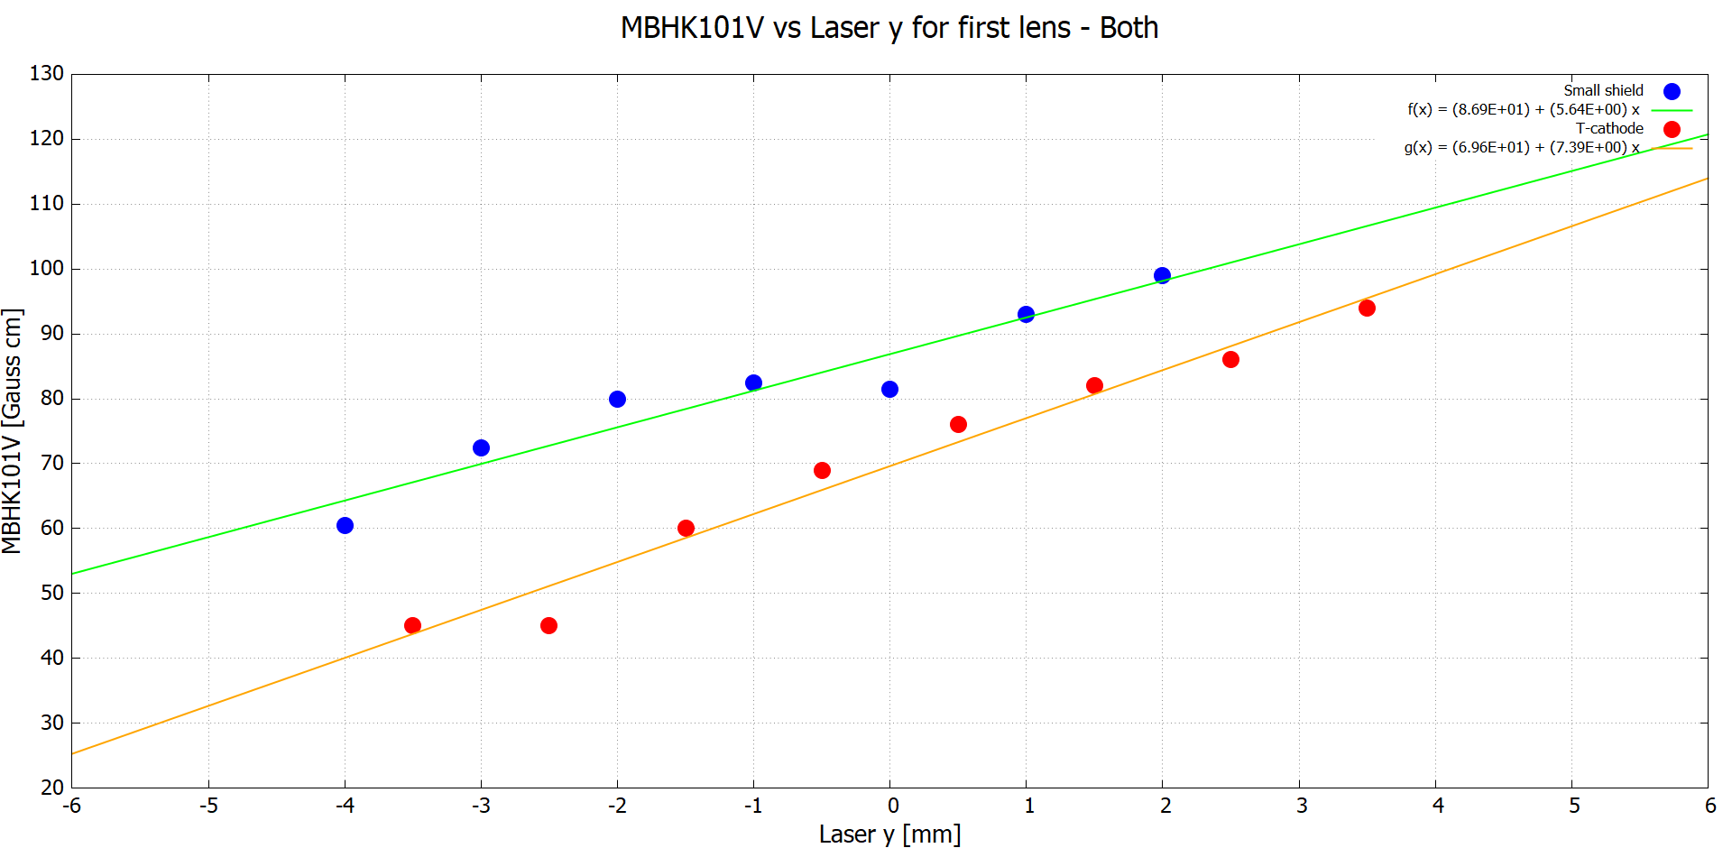
13 [Gauss cm] difference between: 69 and 82
12.6 [Gauss cm] difference between: 98.9 and 86.3
27 [Gauss cm] difference between: 72.6 and 45.0
Notice that for the T-cathode, x=-1.5 [mm], not zero! :S

Slide 13
Conclusions
Horizontal BPM
The SS has a slight left-kick. It would require correction for 1 mm extra.
The shield seems to bring electrostatic center closer to PC center and reduce asymmetry.
Vertical BPM
The SS has a worst down-kick. This was already present at the T-cathode. Requires correction for ~2.5 mm extra.
The shield seems to bring electrostatic center closer to PC center exacerbate asymmetry.
Solenoid centering method would need more testing.
Not apples-to-apples.
Small number of data points due to Dithering issues.
User errors.
RECALL: Electrostatic simulations show SS has better electric field around triple-point (due among other things to insulator shape, triple-point curvature) than T-cathode!
Better than bigger shield for sure!
Field emission / HV processing was better or worst?
I’ve heard better emittance for big shield (?) Simulations inconclusive yet.

Slide 14
Fin

Slide 15
Extras
XY-stage steps to mm
S&A

Slide 16
Details of experimental data
UITF gun
T-cathode and Small shield both @200 [kV]
Bulk GaAs activated with with Cs and NF₃
Data taken with BPM 201 (on top of corrector 101H&V)
Data taken with first solenoid lens

Slide 17
12 [mm] radius photocathode.
6000 [steps] in x-axis
6000 [steps] in y-axis
Then $\frac{12 [mm]}{6000 [steps]}=0.002\frac{[mm]}{[steps]}$
I know this can be done with the scan data,
Bare with me

Slide 18
BFS coordinates for both
 | X [mm] | Y [mm]
T-cathode (PC face) | 9.056* | -0.6
Small shield (PC face) | 9.13 ± 0.074 | -0.44
BPM201 | 12.6 | 0.3
BPM203 | 3.6 | 1.2
*calculated using alpha= 1.1464 degrees

Slide 19
Corrected positions according to S&A
D=64.262 mm * tan(1.1464 deg)
=1.286 mm
x_SS=x_T + D
= 7.77 mm + 1.286 mm
=9.056 mm
Then:
error=9.13 mm - 9.056 mm
= 0.074 mm

Slide 20
Corrected positions according to S&A
9.056 mm

Slide 21
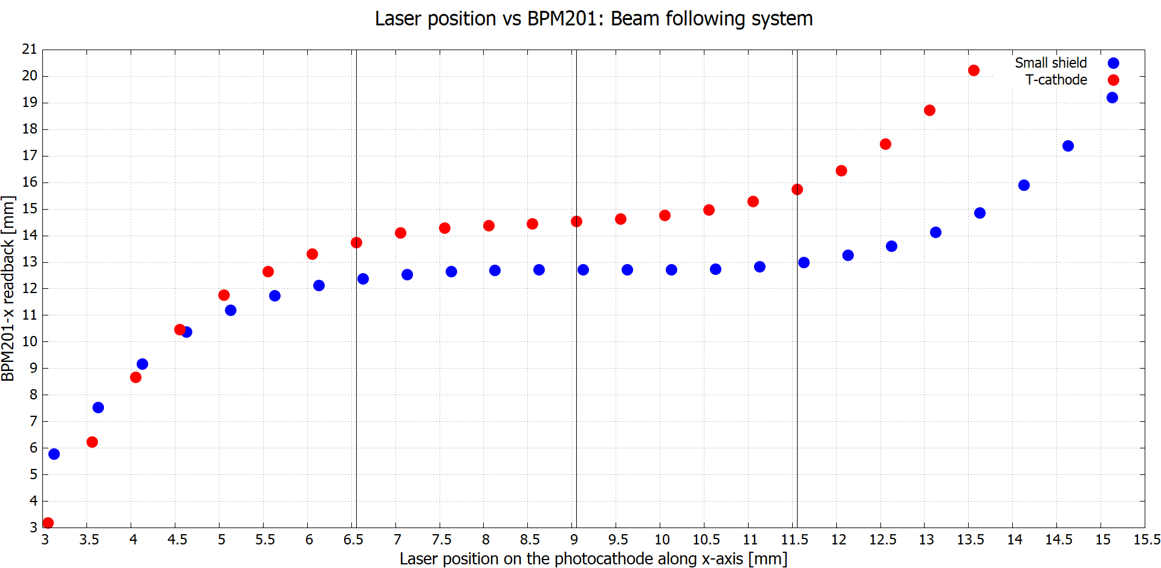
Horizontally: If we shoot from
-2.5 [mm]<Photocathode< 2.5 [mm] we just need to correct for an max of ~2.7 [mm]
1.8 [mm] difference between: 14.5 and 12.7
17.1%
12.4%
9.4%
2.7 [mm] difference between: 15.7 and 13
1.3 [mm] difference between: 13.7 and 12.4

Slide 22
Recall simulations
Just a recap of the simulations

Slide 23
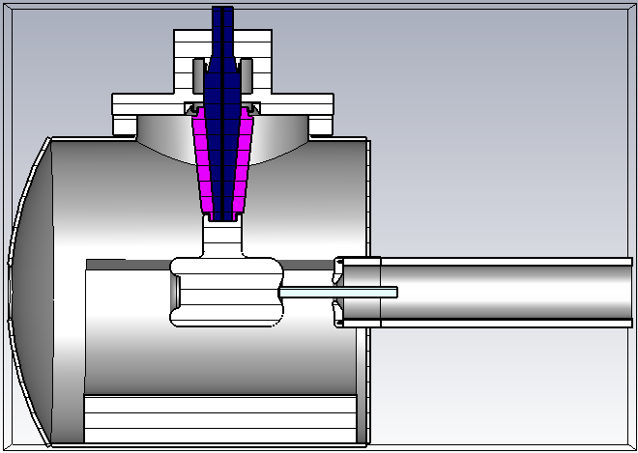
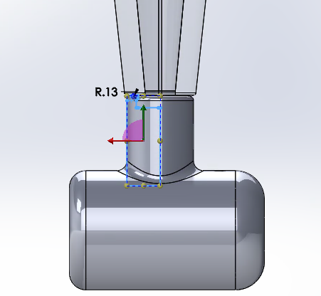
Models: T-cathode

Slide 24
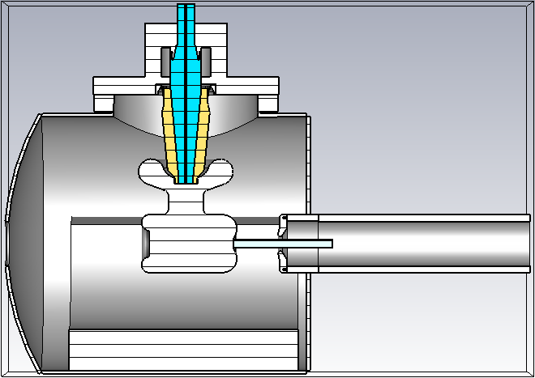
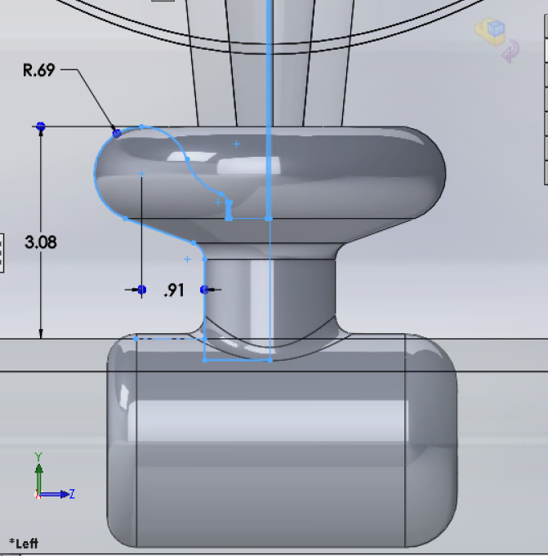
Models: Mushroom

Slide 25
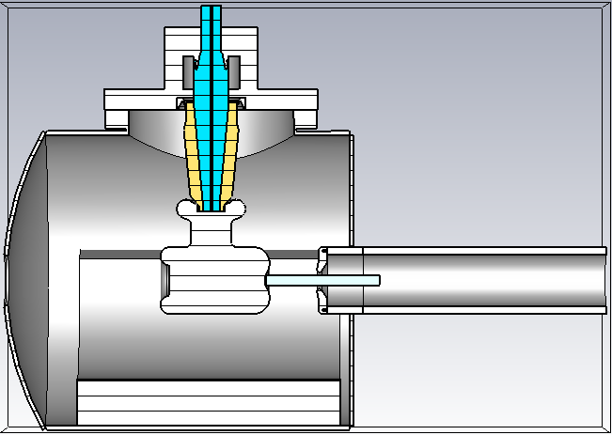
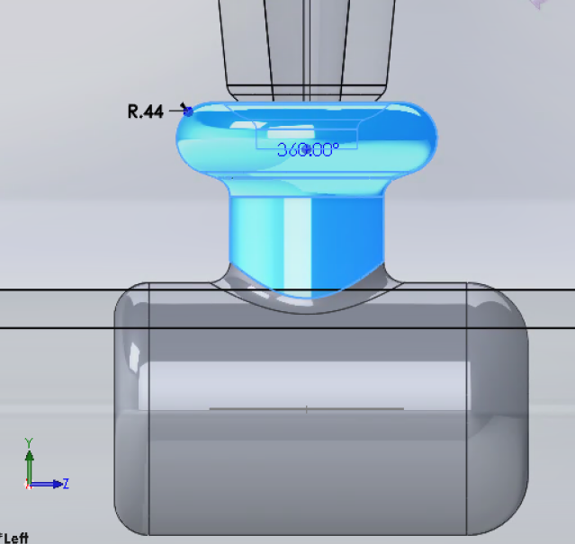
Models: Small mushroom

Slide 26
CST results: Transverse electric field at C-a gap axis
All the data sets correspond to the center line in the cathode-anode gap. Different colors represent different shields.
0.176
~52.8% difference between 0.176 and 0.083
0.108
0.083
~23.14% difference between 0.108 and 0.083

Slide 27
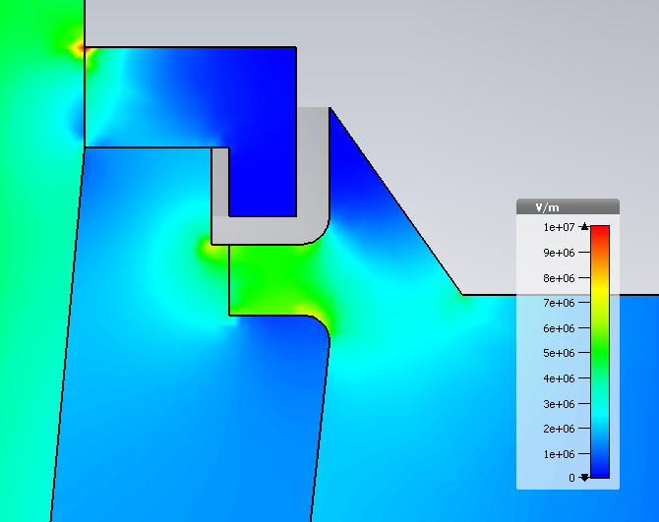
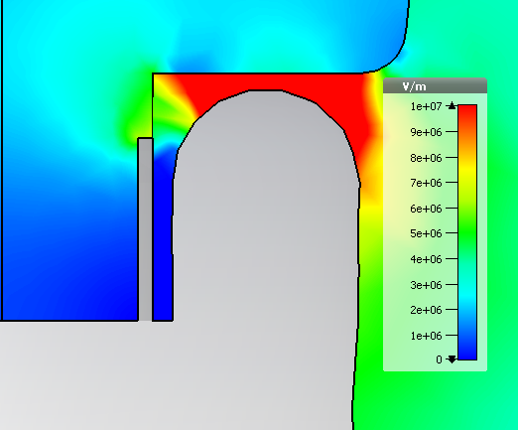
CST results: Electric field norm– No shield
Triple points:
Upper flange:5MV/m
29MV/m at cusp
Triple points:
Cathode: 3.6MV/m
6.5MV/m
7.9MV/m
4.87 MV/m

Slide 28
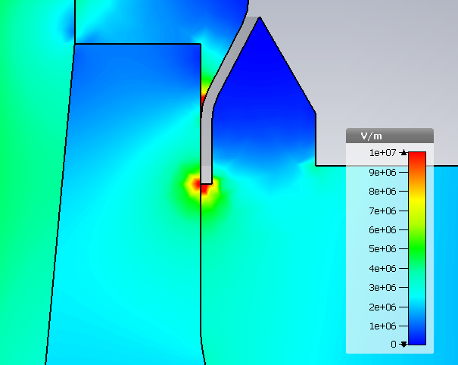
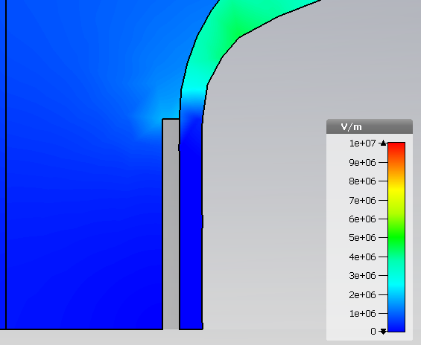
CST results: Electric field norm– original shield
Triple points:
Upper flange:10MV/m
7.2MV/m
5.6MV/m
Triple points:
Cathode: 0.6MV/m
7.9MV/m
4.85 MV/m

Slide 29
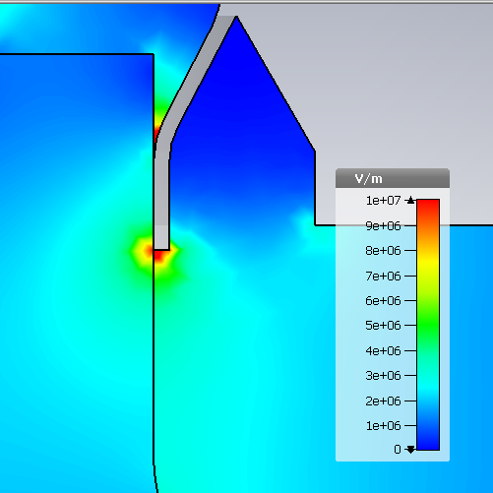
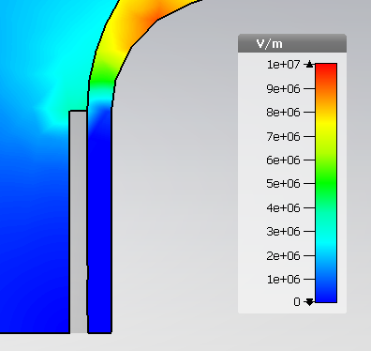
CST results: Electric field norm– Shield 8
Triple points:
Upper flange:11MV/m
7.9MV/m
6.5MV/m
Triple points:
Cathode: 1.2MV/m
8.08MV/m
4.86 MV/m

Slide 30
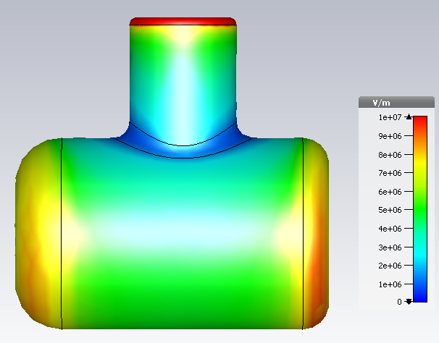
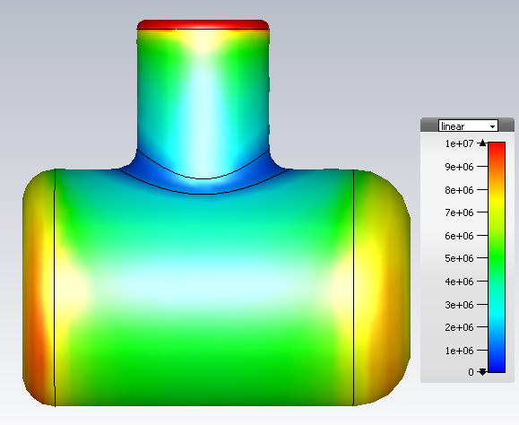
CST results: Electric field norm– T-shape

Slide 31
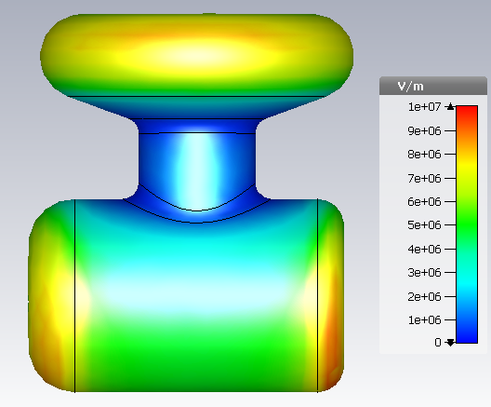
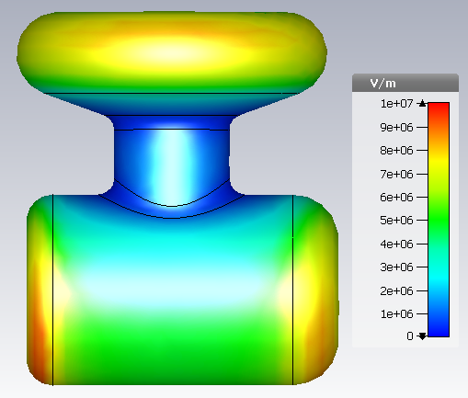
CST results: Electric field norm– Mushroom

Slide 32
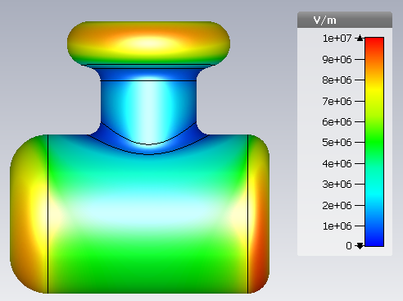
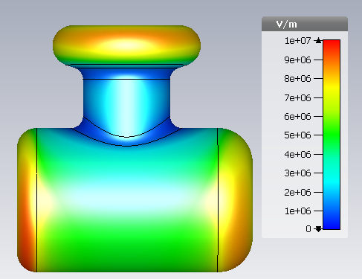
CST results: Electric field norm– Shield 8

