Slide 1
200 kV guns comparison using CST Microwave studio + GPT
Gabriel Palacios
gabrielp@jlab.org 03/04/18

Slide 2
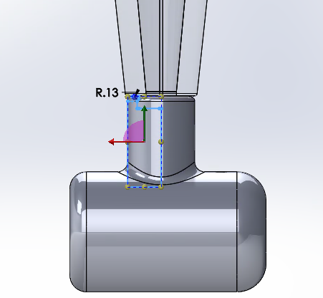
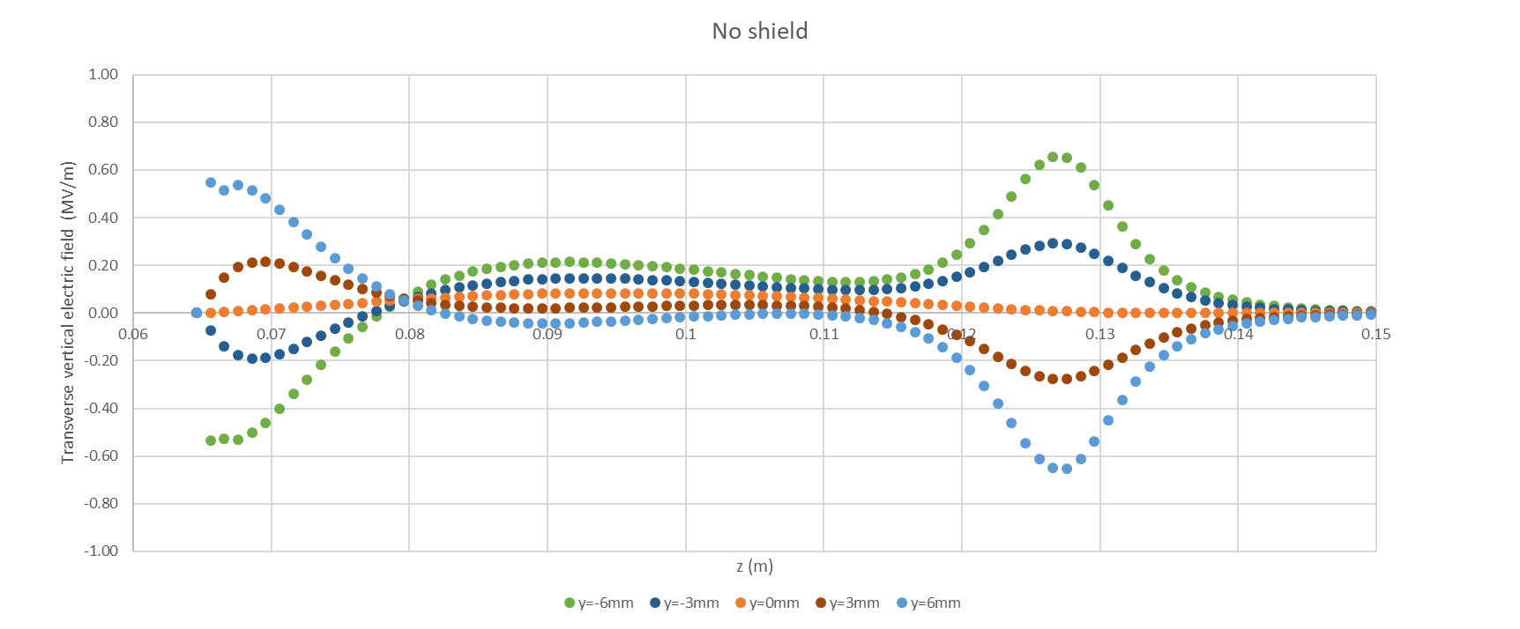
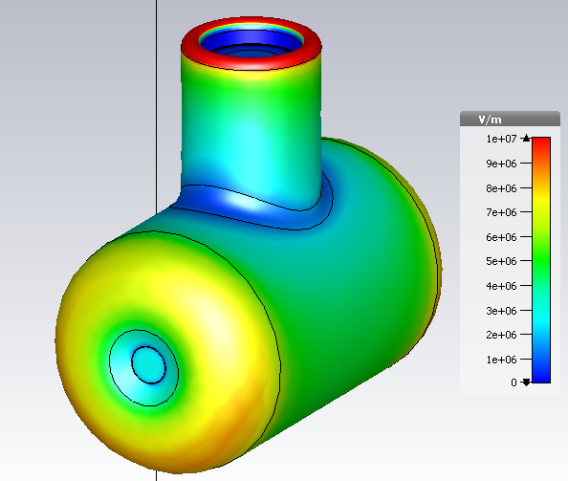
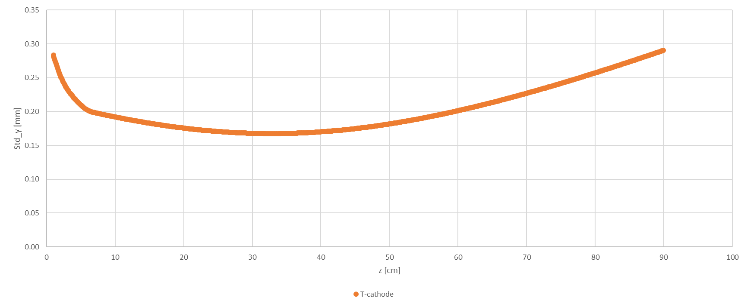
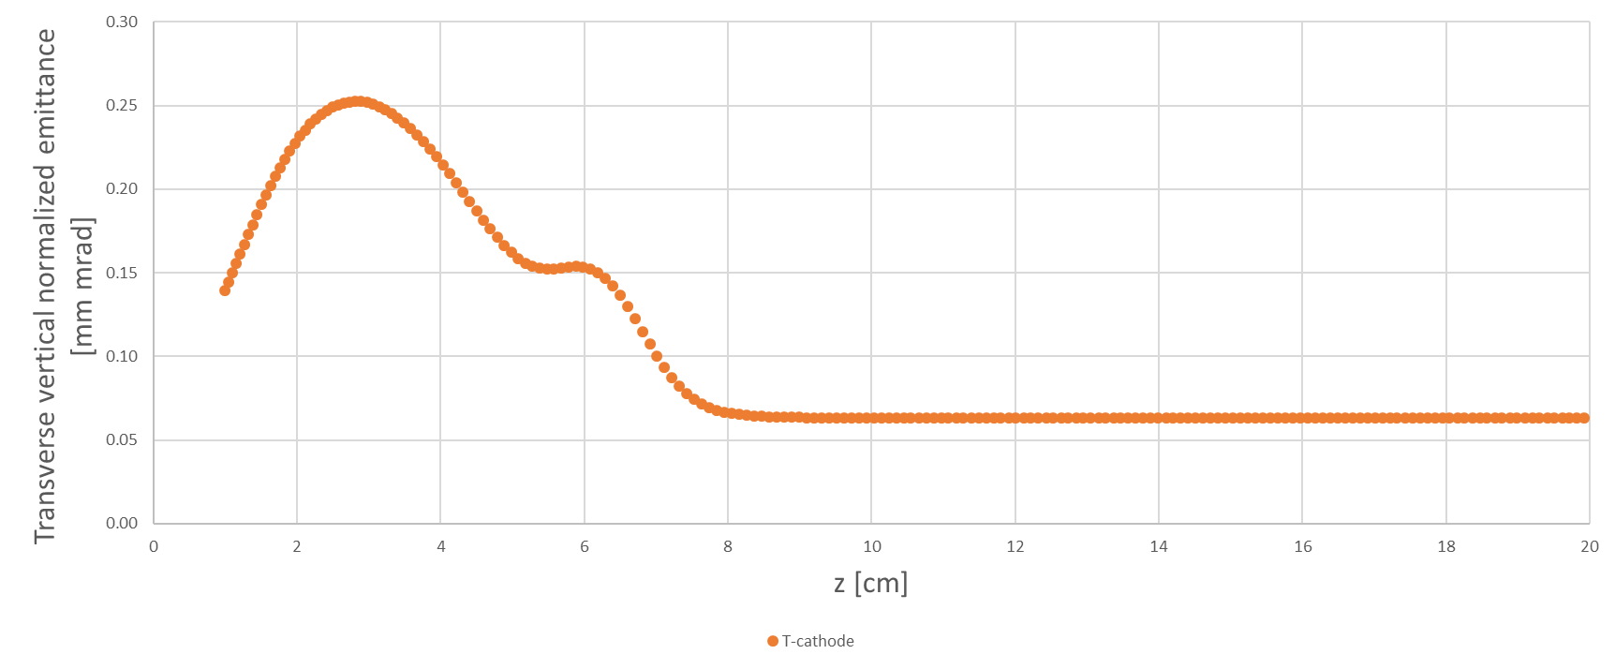
Summary
E-field color maps
Solidworks
Field maps
Surface E-field color maps
Standard deviation
Emittance
For T-cathode, Mushroom, small mushroom, sphere (3 anode configurations). All @200 [kV] bias and grounded anode.
GPT: SC-ON, 10000 particles, Gaussian laser, Qbunch -4E-14 [C], XYrms 0.32E-3 [m], Trms 20E-12 [s], MTE 0.0166 [eV]

Slide 3
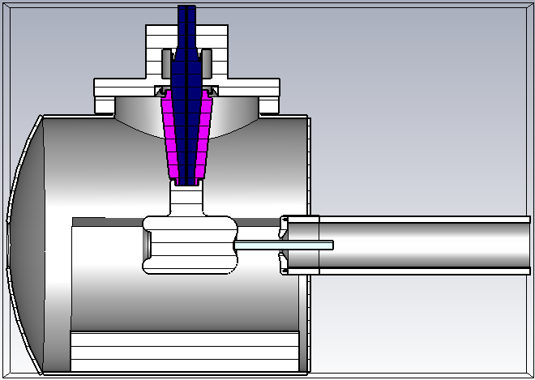
Models: T-cathode

Slide 4
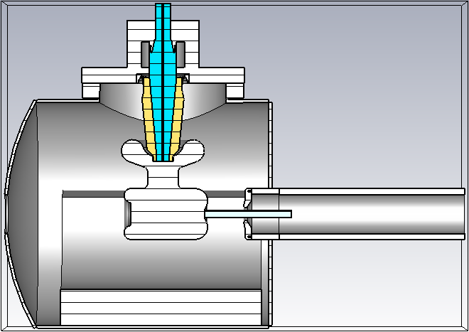
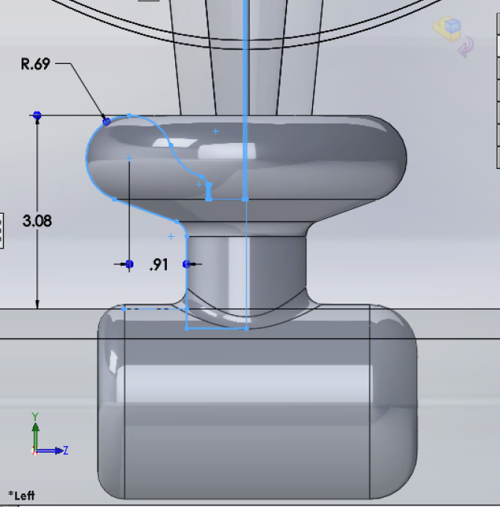
Models: Mushroom

Slide 5
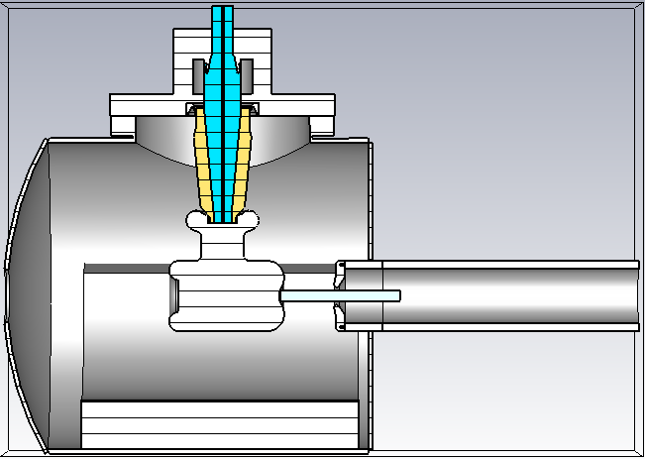
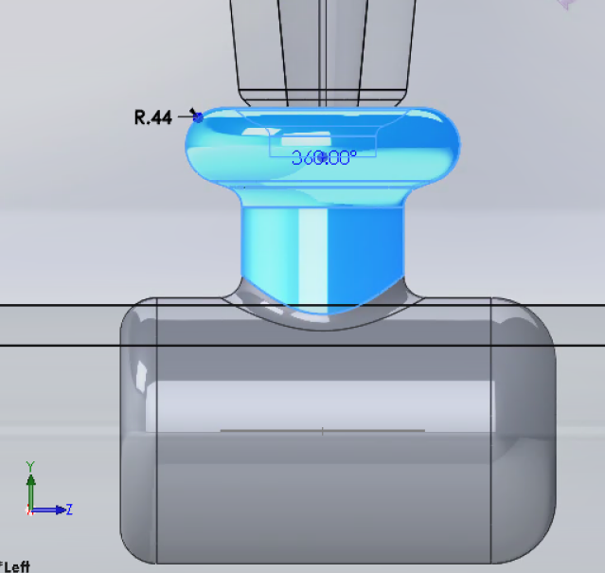
Models: Small mushroom

Slide 6
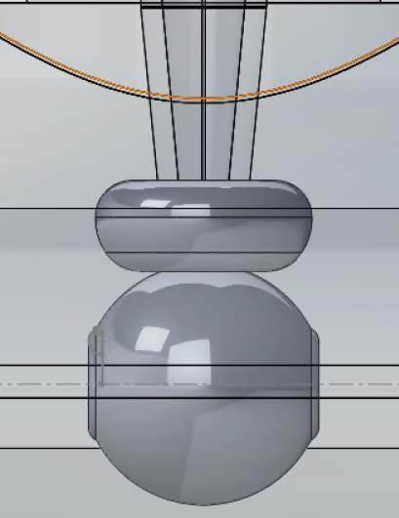
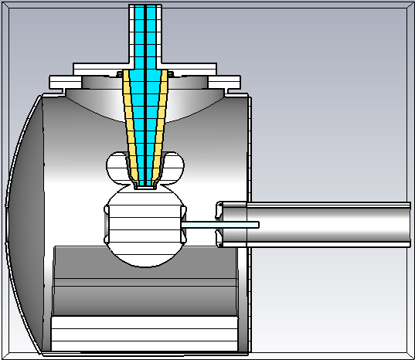
Models: Sphere, 6cm gap, short anode

Slide 7
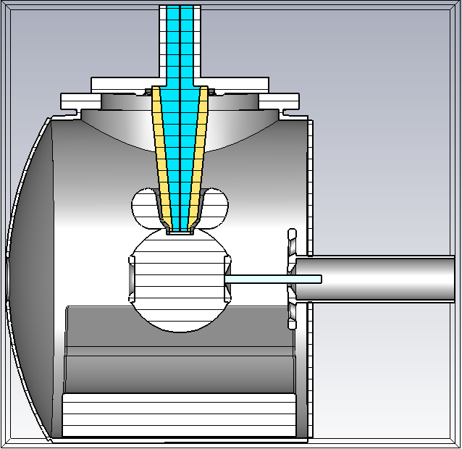
Models: Sphere, 9cm gap, large anode

Slide 8
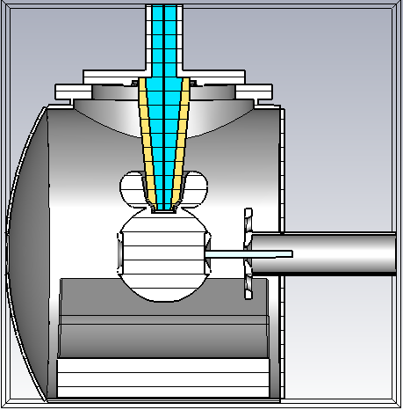
Models: Sphere, 6cm gap, large anode

Slide 9
Cathode-anode gap:
The data for the following plots was probed along a horizontal line on the cathode-anode gap as a function of vertical position on the photocathode surface (varying from y=-6mm to 6mm.)

Slide 10
CST results: Transverse electric field – T-shape
The different colors show how the transverse electric field changes as a function of height on the photocathode in the interval -6mm<y<6mm along a horizontal line in the cathode-anode gap
0.252 gap between 0.21 and -0.042
Note: offset in z due to CST model photocathode not in 0,0 coordinates

Slide 11
CST results: Transverse electric field – Mushroom
The different colors show how the transverse electric field changes as a function of height on the photocathode in the interval -6mm<y<6mm along a horizontal line in the cathode-anode gap
0.191 gap between 0.27 and 0.079
Note: offset in z due to CST model photocathode not in 0,0 coordinates

Slide 12
CST results: Transverse electric field – Small mushroom
The different colors show how the transverse electric field changes as a function of height on the photocathode in the interval -6mm<y<6mm along a horizontal line in the cathode-anode gap
0.257 gap between 0.22 and -0.037
Note: offset in z due to CST model photocathode not in 0,0 coordinates

Slide 13
CST results: Transverse electric field – Sphere, 6 cm gap, short anode
The different colors show how the transverse electric field changes as a function of height on the photocathode in the interval -6mm<y<6mm along a horizontal line in the cathode-anode gap
0.014 gap between 0.10 and 0.086
Note: offset in z due to CST model photocathode not in 0,0 coordinates

Slide 14
CST results: Transverse electric field – Sphere, 9 cm gap, large anode
The different colors show how the transverse electric field changes as a function of height on the photocathode in the interval -6mm<y<6mm along a horizontal line in the cathode-anode gap
0.25 gap between 0.39 and 0.14
Note: offset in z due to CST model photocathode not in 0,0 coordinates

Slide 15
CST results: Transverse electric field – Sphere, 6 cm gap, large anode
The different colors show how the transverse electric field changes as a function of height on the photocathode in the interval -6mm<y<6mm along a horizontal line in the cathode-anode gap
0.01 gap between 0.06 and 0.05
Note: offset in z due to CST model photocathode not in 0,0 coordinates

Slide 16
Comparing all models at the c-a gap only for the y=0 electric field line

Slide 17
CST results: Transverse electric field at C-a gap axis
All the data sets correspond to the center line in the cathode-anode gap. Different colors represent different shields.
~12% difference between 0.17 and 0.15
~53% difference between 0.17 and 0.08

Slide 18
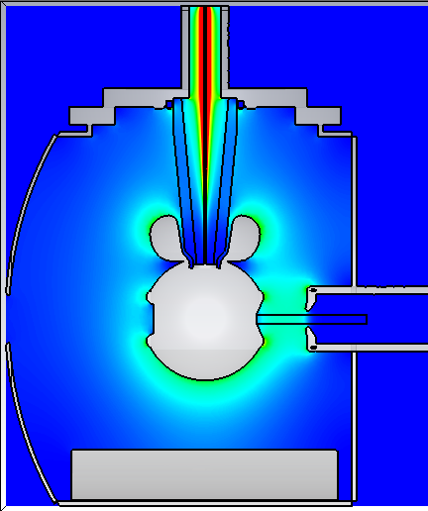
CST model at 200 kV T-electrode on R28 white insulator vs spherical electrode on R30 insulator 6 cm anode-cathode gap and CEBAF anode
5.5MV/m
29MV/m at cusp
6.5MV/m
6.3MV/m
7.9MV/m
7.2MV/m
4.87 MV/m
4.6 MV/m

Slide 19
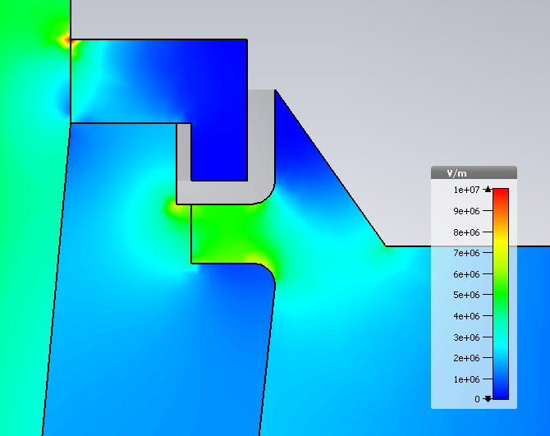
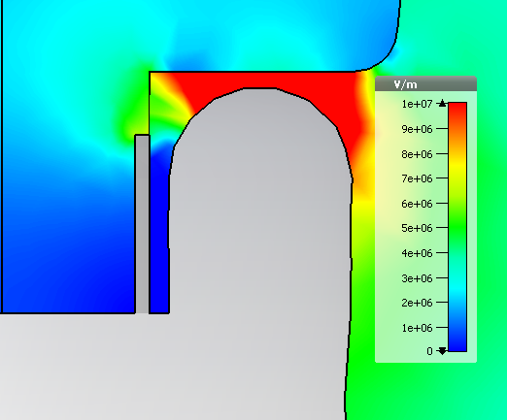
CST results 200 kV T-electrode on white insulator: Electric field norm– No shield
Triple points:
Upper flange:5MV/m
29MV/m at cusp
6.5MV/m
Triple points:
Cathode: 3.6MV/m
4.87 MV/m
7.9MV/m

Slide 20
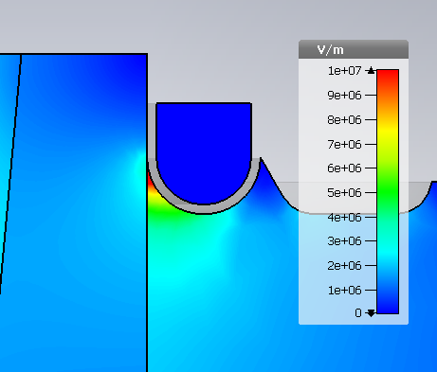
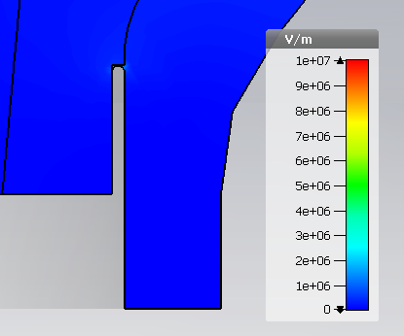
CST results 200 kV UITF gun: Electric field norm– Sphere 6cm gap CEBAF-type anode
Triple points:
Upper flange:9.7MV/m
5.5MV/m
6.3MV/m
7.2MV/m
Triple points:
Cathode: 0.3MV/m
4.6 MV/m

Slide 21
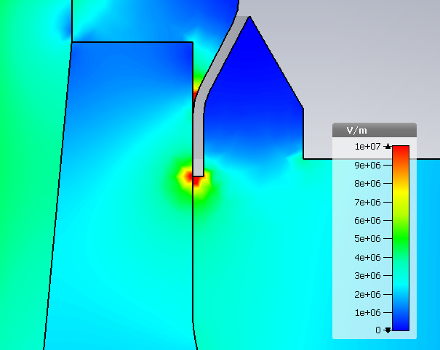
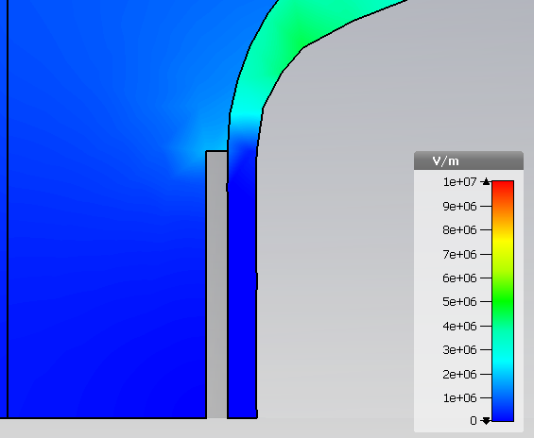
CST results: Electric field norm– original shield
Triple points:
Upper flange:10MV/m
7.2MV/m
5.6MV/m
Triple points:
Cathode: 0.6MV/m
7.9MV/m
4.85 MV/m

Slide 22
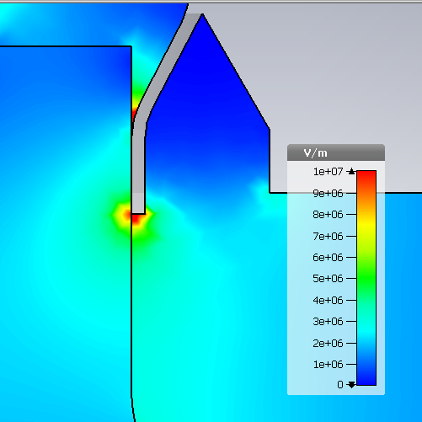
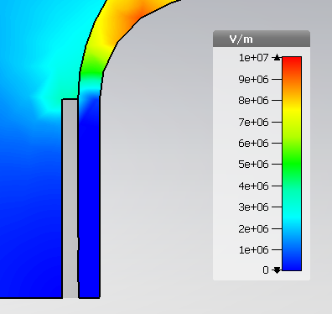
CST results: Electric field norm– Shield 8
Triple points:
Upper flange:11MV/m
7.9MV/m
6.5MV/m
Triple points:
Cathode: 1.2MV/m
8.08MV/m
4.86 MV/m

Slide 23
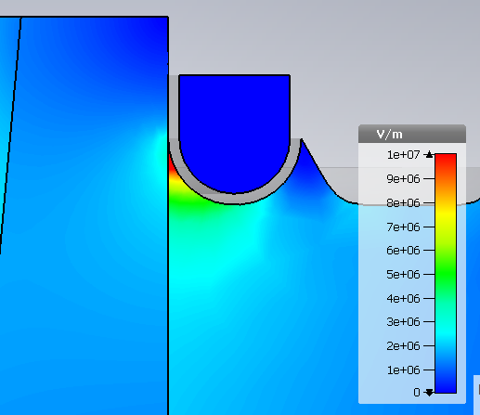
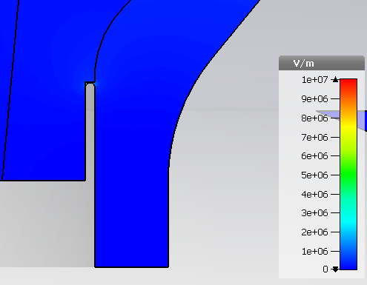
CST results: Electric field norm– Sphere 6cm gap large anode
Triple points:
Upper flange:10MV/m
5.8MV/m
6.9MV/m
Triple points:
Cathode: 0.3MV/m
7.8MV/m
4.6 MV/m

Slide 24
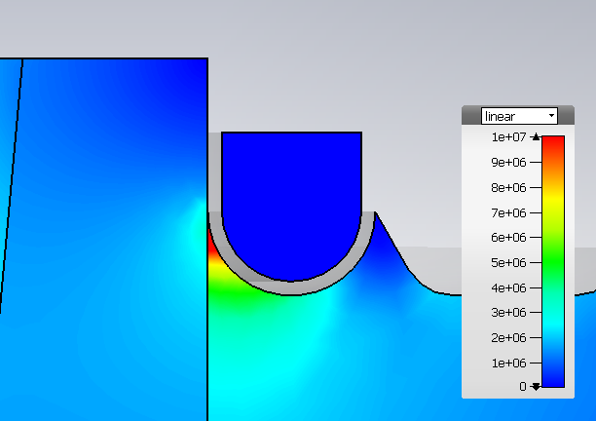
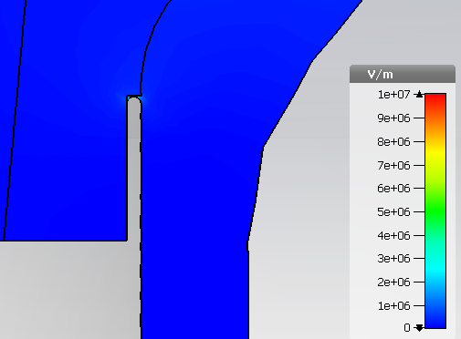
CST results GTS gun: Electric field norm– Sphere 9 cm gap large anode
Triple points:
Upper flange:10MV/m
5.5MV/m
5.2MV/m
Triple points:
Cathode: 0.3MV/m
6.4MV/m
4.5 MV/m

Slide 25
Electric field norm:
On the metallic surface
Pics are sadly not to scale, in all of them the cathode (horizontal cylinder) size is the same.

Slide 26
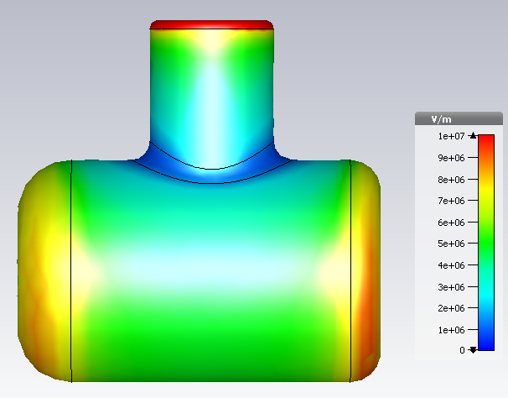
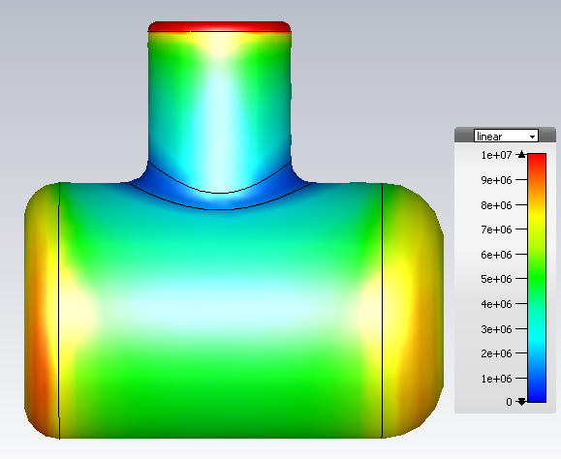
CST results: Electric field norm– T-shape

Slide 27
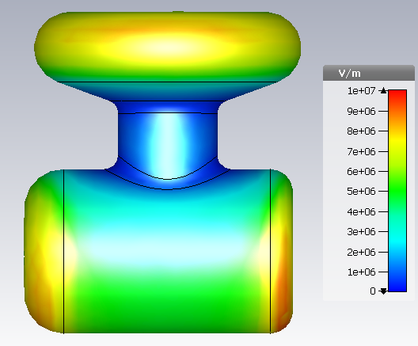
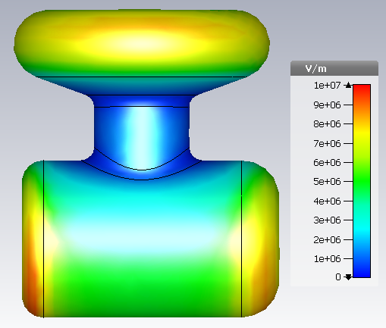
CST results: Electric field norm– Mushroom

Slide 28
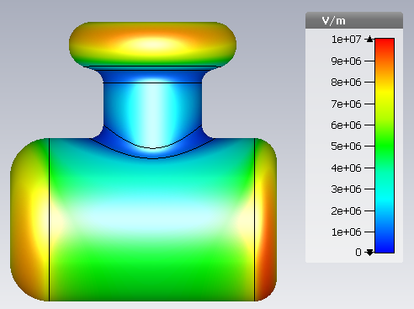
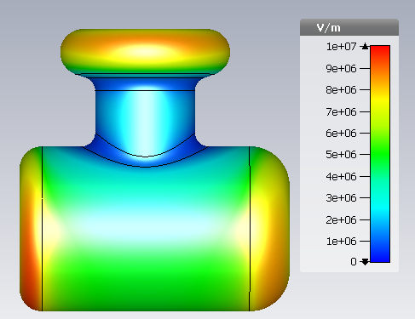
CST results: Electric field norm– Shield 8

Slide 29
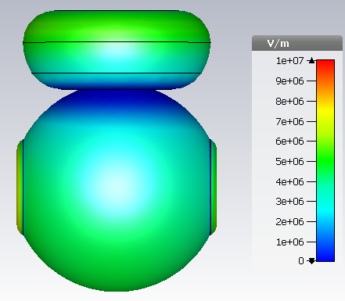
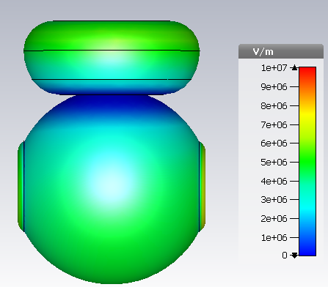
CST results: Electric field norm– Sphere 6cm gap short anode

Slide 30
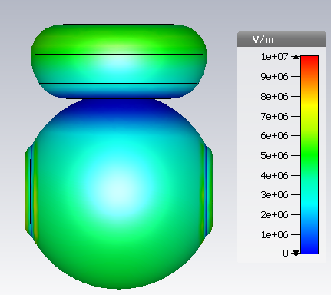
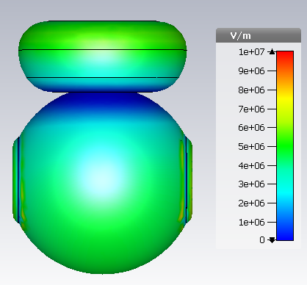
CST results: Electric field norm– Sphere 9cm gap large anode

Slide 31
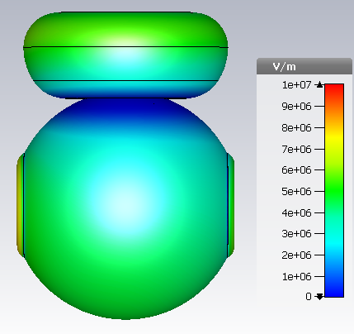
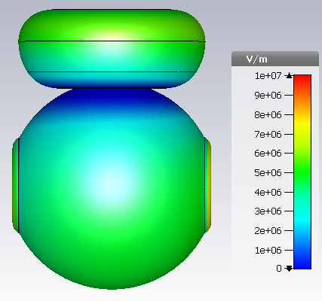
CST results: Electric field norm– Sphere 6cm gap large anode

Slide 32
GPT
Important note!
The plots contain all electrodes, but the apples-to apples-comparison is not *entirely* valid between T-cathode-like shapes and Sphere-cathode-like shapes, since the vacuum chambers are also different.

Slide 33
GPT: Transverse horizontal Normalized emittance

Slide 34
GPT: Transverse vertical Normalized emittance
Difference with T-cathode at red line:
~29%
~7%
~52%
~71%
~37%

Slide 35
GPT: Longitudinal Normalized emittance

Slide 36
Standard deviation X

Slide 37
Standard deviation Y

Slide 38
Fin.

Slide 39
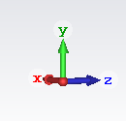
CST frame of reference:
y
x
z
X goes into the page.

