Slide 1

Polarized Beams – A Tale of Two Leptons
The production of Highly Spin Polarized Positrons
using MeV Energy Spin Polarized Electrons
(…or why polarized electrons may be like Red-Billed Oxpeckers)
Joe Grames
Center for Injectors & Sources
Jefferson Laboratory

Slide 2

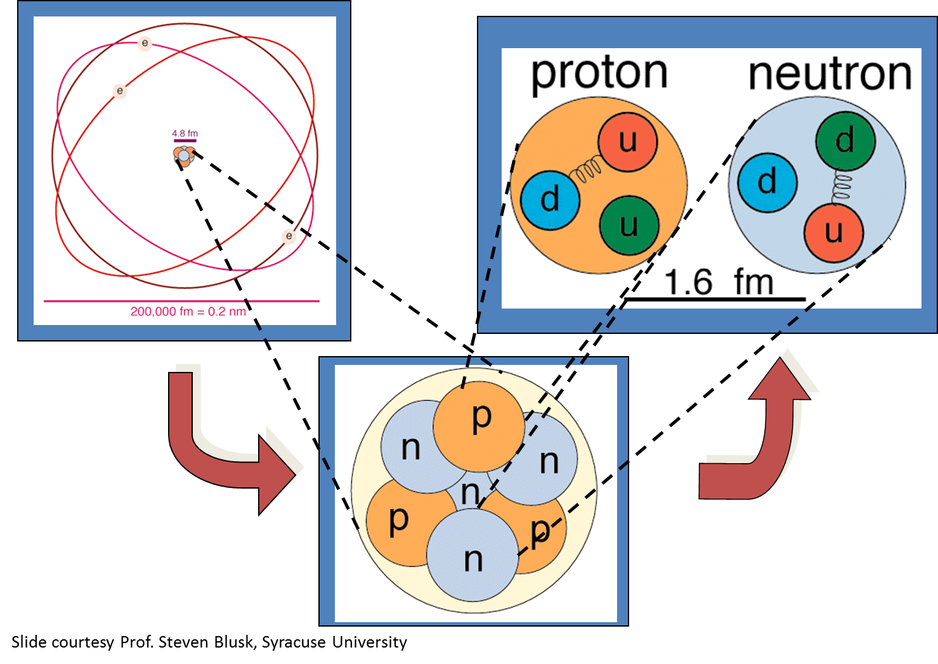
Thomas Jefferson National Accelerator Facility is a U.S. Department of Energy Office of Science national laboratory located in Newport News, VA
• Deliver discovery-caliber research of the atomic nucleus, its constituents, and their interactions
• Apply advanced particle accelerator to develop new basic research capabilities
• Over 1500 Users from 230 Institutions and 30 Countries; over 1/3rd of U.S. Ph.D’s in Nucl. Phy.

Slide 3

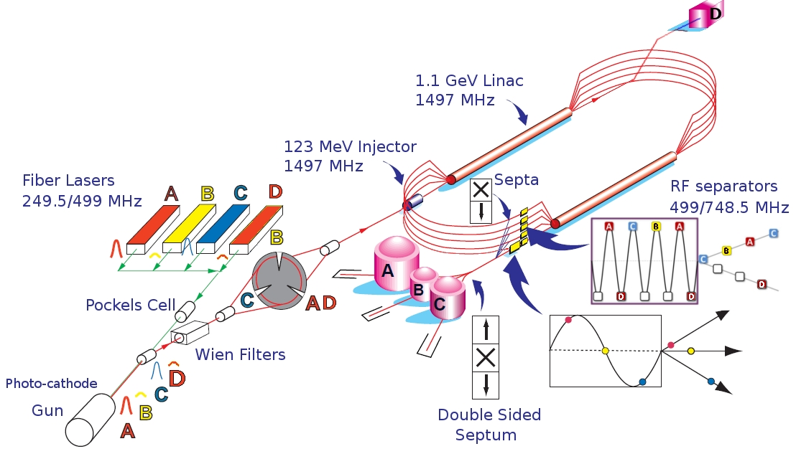
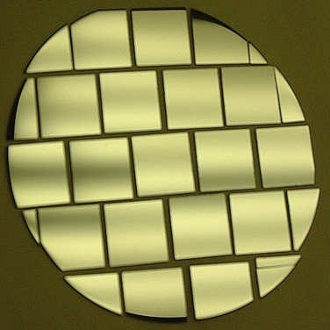
CEBAF Accelerator
Multiplicity: 4 Halls Simultaneously
Electron Polarization: 85-90%
Max Energy: 11 GeV(ABC) / 12 GeV(D)
Max Power: 1 MW => 85 μA @ 11 GeV
CHL: Two 4.5kW plants @ 2.1 K
C100: 17.5 MV/m
GaAs/GaAsP

Slide 4
Outline
  Positron physics motivation at Jefferson Lab
  CEBAF Injector PEPPo Experiment
  Polarized Positron R&D Opportunities
  Outlook

Slide 5
Why Polarized Positrons at JLab?
Polarized Electrons have supported some of the highest impact results from the JLab program:
  The strangeness distribution in the nucleon (HAPPEX and G0)
  Precision Tests of the Standard Model (Q_{Weak})
  Measurement of the neutron skin in ²⁰⁸Pb
  Polarization transfer measurement of G_{E}/G_{M} for the proton
Unpolarized positron beams provide a key tool for further pushing the precision of electron scattering experiments
  Comparison of e⁻ with e⁺ tests our understanding of two photon effects
Polarized positrons beams provide essential tool
  Unraveling nucleon structure through the measurement of charge-sensitive General Parton Distributions
  Expand the nature of these tests (e.g. for G_{E}/G_{M} via polarization transfer)
Beam Quality | Electron Beam (Delivered) | Positron Beam (Desired)
Average Intensity | > 200 μA | > 100 nA (5 x 10¹¹ e+/s)
Duty Factor | 100% (cw) | 100% (cw)
Bunch Frequency | 499 MHz (or sub-harmonic) | 499 MHz (or sub-harmonic)
Polarization (orientation) | > 85% (4π control) | > 50% (4π control)
Helicity Control | Rapid reversal (> 30 Hz) | Rapid reversal (> 30 Hz)

Slide 6

Polarized Positrons at an Electron Ion Collider
A polarized positron injector suitable for the Jefferson Lab Electron Ion Collider (JLEIC) has also been considered.
L ≥10³³cm⁻²s⁻¹ P_{e+}≥40%
I_{ave} > 10 nA (~10¹⁰ e+/s)
I_{peak} > 4 μA (~10¹³ e+/s)
e⁺
Challenge is accumulating high positron bunch charge with high rep rate.

Slide 7
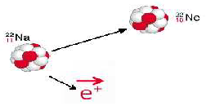




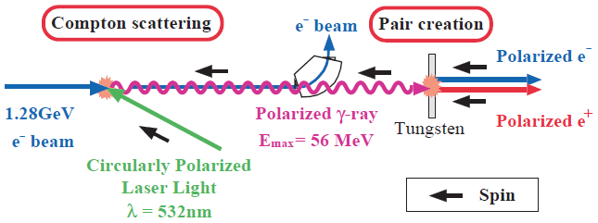
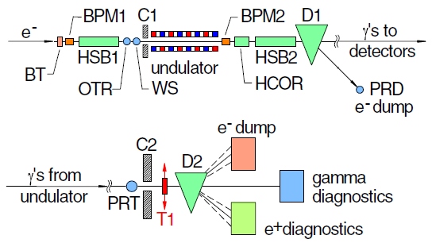
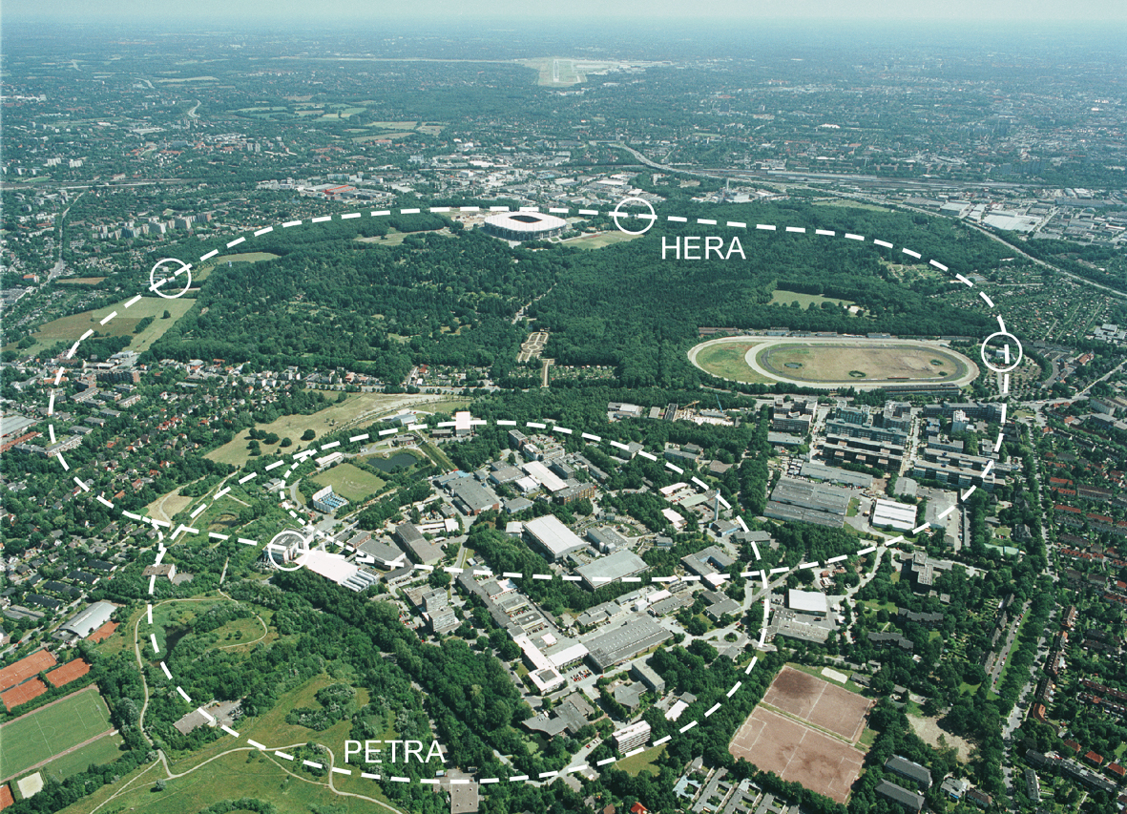
Methods for Generating Polarized Positrons
Polarized β⁺ Decay
L.A. Page & M. Heinberg. Phys. Rev.
106(6):1220-1224 (1957)
Sokolov-Ternov Effect
D. Barber , AIP Conf. Proc. 588, 338 (2001)
Polarized due to parity non-conservation in the weak interaction
HERA 27.5 GeV e+/e-
P(e⁺) ~ 40 %
P(e⁺) ~ 70 %
Compton Backscattering (KEK)
T. Omori et al, PRL 96 (2006) 114801
Helical Undulator (SLAC E166)
G. Alexander et al, PRL 100 (2008) 210801
KEK 1.28 GeV
SLAC 47.7GeV
P(e⁺) = 73 ± 15_{(stat)} ± 19_{(syst)} %
P(e⁺) = 80 ± 7_{(stat)} ± 9_{(syst)} %

Slide 8
Photo-Emission from GaAs
Dipole layers of
Cesium + NF₃
Reduce Work Function
Negative Electron Affinity (NEA)
Bare GaAs surface
Large Work Function
Positive Electron Affinity (PEA)
NEA Surface Activation
PEA=4.07 eV
-
Conduction
Band
-
χ^{NEA} ~ 0.2 eV
E_{gap}
Valence
Band
+
Light
GaAs
Vacuum
GaAs
Vacuum

Slide 9
Spin Polarized Photoemission from Bulk GaAs
E
E
J
S_{1/2}
-1/2
+1/2
S_{1/2}
σ+
σ-
E_{gap}=1.42 eV
3
1
1
3
P_{3/2}
E_{F}
P_{3/2}
Δ=0.34 eV
-3/2
-1/2
+1/2
+3/2
P_{1/2}
-1/2
+1/2
P_{1/2}
k
σ+: Right circularly polarized light
σ- : Left circularly polarized light
m_{j}
Laser excitation from P_{3/2} to S_{1/2} : E_{gap} < E_{γ} < E_{gap}+Δ
Electron Polarization:
Reverse electron polarization by reversing light polarization

Slide 10
JLab’s e⁻ Beams Provide the Basis for e⁺ Beams
Strained GaAs:
GaAs on GaAsP
Strained Superlattice GaAs:
Layers of GaAs on GaAsP
Bulk GaAs
100 nm
100 nm
625 μm
2 μm
14 Layers
350 μm
QE ~ 5%, 30 mA/W
Pol ~ 35% @ 780 nm
QE ~ 0.2%, 1 mA/W
Pol ~ 75% @ 850 nm
QE ~ 1%, 6 mA/W
Pol ~ 89% @ 780 nm
P_{e-} 35% 35% 75% 75% 85% 89%
I_{e-} 30μA 100μA 50μA 100μA 150μA 200μA
1995 1998 1999 2000 2004 2012 2018
Figure-of-Merit (P²I) has improved by a factor of 43
over the span of the CEBAF “6 GeV era”

Slide 11



Polarized Electrons for Polarized Positrons
E.G. Bessonov, A.A. Mikhailichenko, EPAC (1996) A.P. Potylitsin, NIM A398 (1997) 395
Polarized Bremsstrahlung
Polarized Pair Creation
P_{circ}(γ) / P_{z} (e⁻)
P_{z} (e⁺) / P_{circ} (γ)
E_{γ} / T_{e-}
T_{e+} / (E_{γ} – 2m_{e+})
E.A. Kuraev, Y.M. Bystritskiy, M. Shatnev, E.Tomasi-Gustafsson, PRC 81 (2010) 055208

Slide 12
The PEPPo Collaboration
P. Adderley¹, A. Adeyemi⁴, P. Aguilera¹, M. Ali¹, H. Areti¹, M. Baylac², J. Benesch¹, G. Bosson²,
B. Cade¹, A. Camsonne¹, L. Cardman¹, J. Clark¹, P. Cole⁵, S. Covert¹, C. Cuevas¹, O. Dadoun³,
D. Dale⁵, J. Dumas^{1,2}, E. Fanchini², T. Forest⁵, E. Forman¹, A. Freyberger¹, E. Froidefond²,
S. Golge⁶, J. Grames¹, P. Guèye⁴, J. Hansknecht¹, P. Harrell¹, J. Hoskins⁸, C. Hyde⁷, R. Kazimi¹,
Y. Kim^{1,5}, D. Machie¹, K. Mahoney¹, R. Mammei¹, M. Marton², J. McCarter⁹, M. McCaughan¹,
M. McHugh¹⁰, D. McNulty⁵, T. Michaelides¹, R. Michaels¹, C. Muñoz Camacho¹¹, J.-F. Muraz²,
K. Myers¹², A. Opper¹⁰, M. Poelker¹, J.-S. Réal², L. Richardson¹, S. Setiniyazi⁵, M. Stutzman¹,
R. Suleiman¹, C. Tennant¹, C.-Y. Tsai¹³, D. Turner¹, A. Variola³, E. Voutier^{2,11}, Y. Wang¹, Y. Zhang¹²
¹Jefferson Lab, Newport News, VA, US, ² LPSC, Grenoble, France, ³LAL, Orsay, France
⁴ Hampton University, Hampton, VA, USA ⁵ Idaho State University & IAC, Pocatello, ID, USA
⁶ North Carolina University, Durham, NC, USA ⁷ Old Dominion University, Norfolk, VA, US
⁸ The College of William & Mary, Williamsburg, VA, USA ⁹ University of Virginia, Charlottesville, VA, USA ¹⁰ George Washington University, Washington, DC, USA ¹¹ IPN, Orsay, France
¹² Rutgers University, Piscataway, NJ, USA ¹³ Virginia Tech, Blacksburg, VA, USA
PEPPo possible due to support from SLAC E166, DESY, Princeton, Cornell, International Linear Collider Project and the Jefferson Science Associates

Slide 13

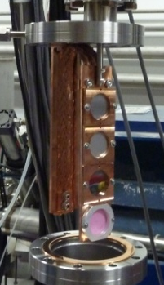
PEPPo Demonstrated Efficient e⁺ Production
The purpose of the PEPPo (Polarized Electrons for Polarized Positrons) experiment at the CEBAF Injector was to demonstrate the feasibility of using bremsstrahlung radiation of MeV energy Polarized Electrons for the efficient production of Polarized Positrons.
J. Grames, E. Voutier et al., JLab Experiment E12-11-105 (2011)

Slide 14
PEPPo: Principle of Operation
Polarized Electrons
(< 10 MeV/c) strike production target
Polarized Electrons
(< 10 MeV/c) strike production target
Positron Transverse and Longitudinal Phase Space Selection
S₁
e⁺
D
e⁻
e⁻
e⁻
T₁
T₁
1. BREMSSTRAHLUNG
Longitudinal e⁻ (P_{e-}) produce elliptical γ whose circular (P_{γ}) component is proportional to P_{e-}
2. PAIR PRODUCTION
In the same target, γ produce e⁺e⁻ pairs and transfer Pγ into longitudinal (P_{e+}) and transverse polarization averages to zero
S₂
P_{T}
D
Calorimeter
e⁺
T₂
3. Phase Space Definition
The emittance of the positron beam is defined by slits and magnetic fields
Compton Transmission Polarimeter
4. COMPTON TRANSMISSION POLARIMETER
Polarized e⁺ convert into polarized γ (P_{γ}) whose transmission through a polarized iron target (P_{T}) depends on P_{γ}.P_{T}

Slide 15
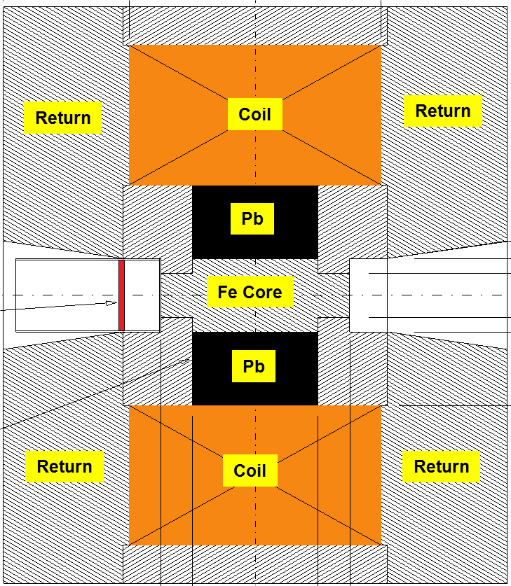
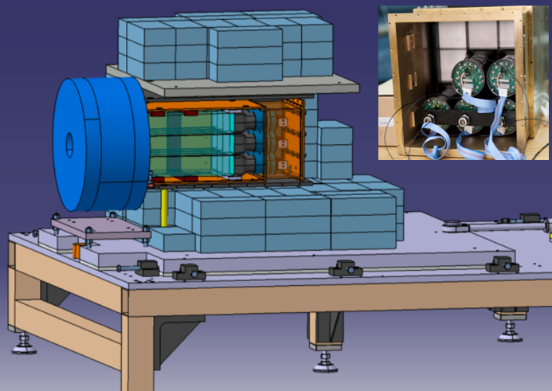
Compton Transmission Polarimetry
Polarized positrons incident on a target produce polarized bremsstrahlung, which is then analyzed via the Compton scattering transmission asymmetry through a magnetized target.
Target (Densimet D17K) 90.5% W, 7%, 2.5% Cu
P_{e+}
γ
e⁺
Fe Core
P_{T} = 7.06% ± 0.05% _{(sys1)} ± 0.07% _{(sys2)}
μ1 - Compton absorption coefficient
L - target length
P₃ - photon polarization (long.)
P_{e} - electron/positron polarization
P_{T} - target polarization
A_{e} - analyzing power

Slide 16
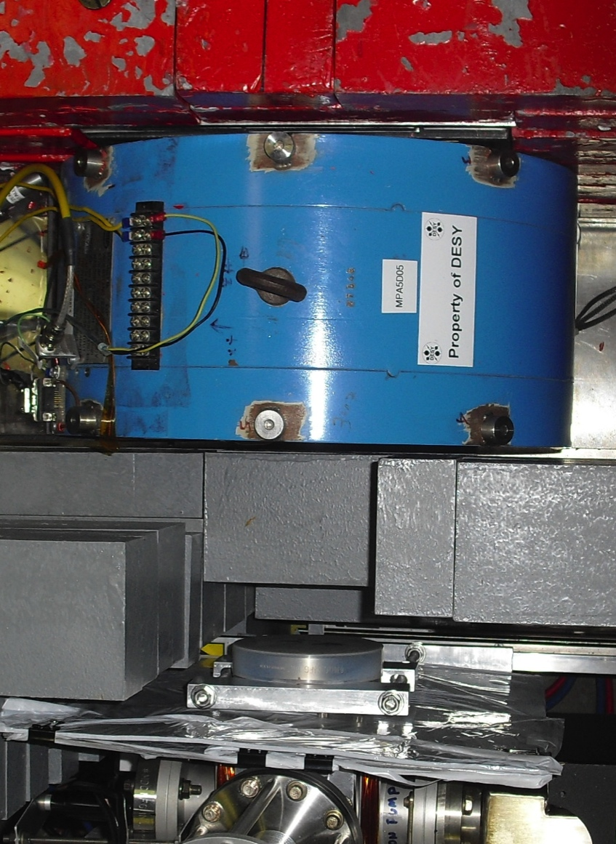
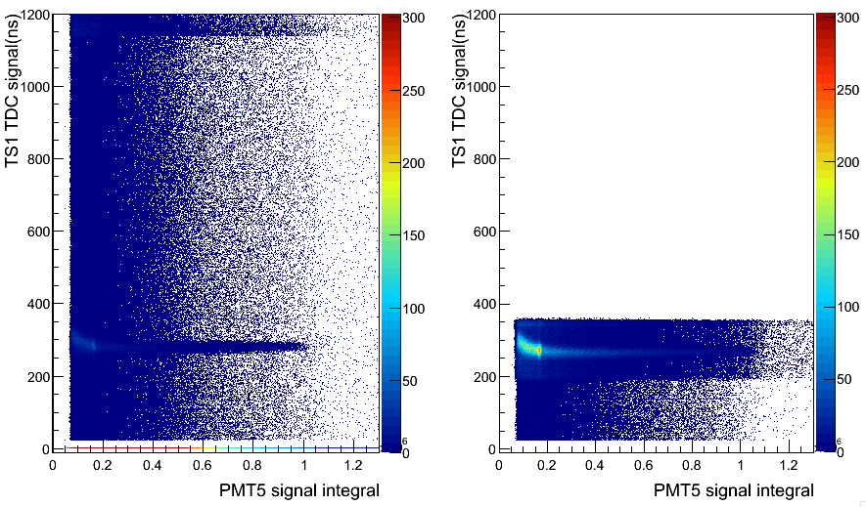
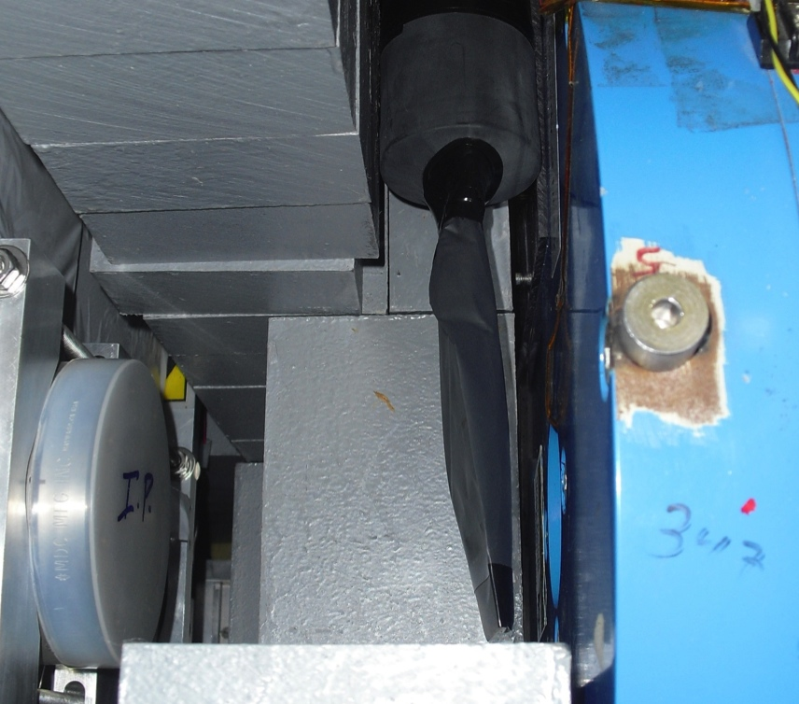
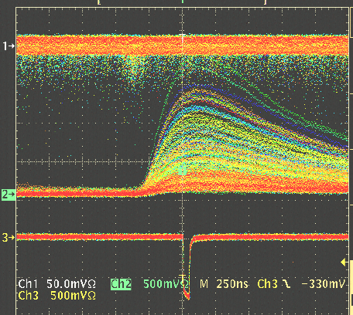
Compton Transmission Polarimeter
Positrons are detected by coincidence between a thin charge sensitive scintillator in front of the reconversion target and the central polarimeter crystal.
C
A
L
O
R
I
M
E
T
E
R
Background
WITHOUT
Coincidence
e+
γ
Reconversion
Target
10mil Al window
Trigger Scintillator
Trigger Scintillator
WITH
Coincidence
Calorimeter
Coincidence

Slide 17
Energy Integrated Asymmetry
511 keV from e+ annihilation at rest
Bremsstrahlung
end-point
Energy (FADC units)
Accidentals
Time (TDC units)

Slide 18

PEPPo Experiment Result
(PEPPo Collaboration) D. Abbott et al. , Phys. Rev. Lett. 116 (2016) 214801
PEPPo demonstrated efficient polarization transfer of 8.2 MeV/c polarized electrons to positrons, expanding polarized positron production using MeV electron beam energies.
electron beam polarization
85.2 ± 0.6 ± 0.7 %
Whenever producing e⁺ from e⁻, polarization is coming for free, if initial electrons are polarized.

Slide 19
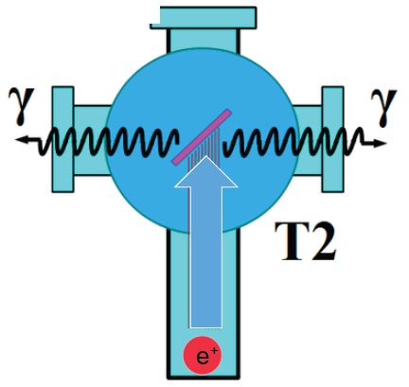
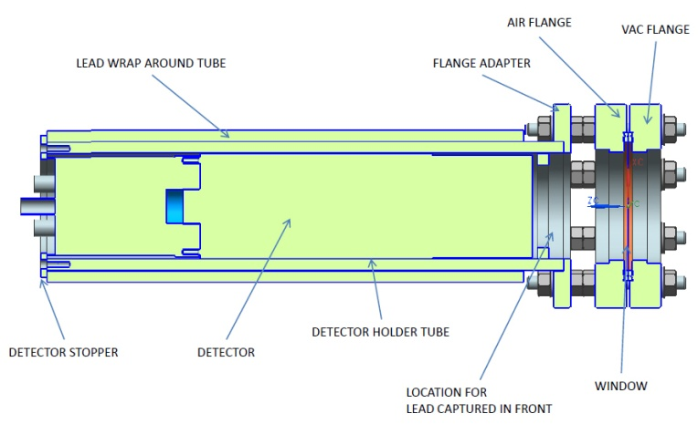
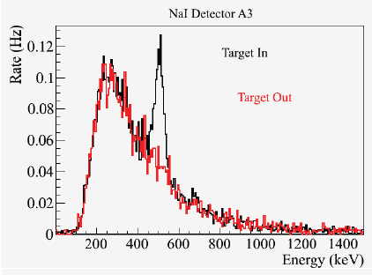
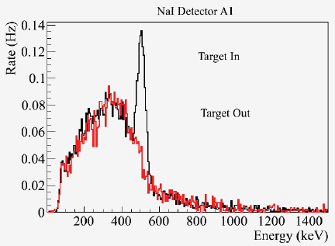
Positron Yield at MeV Energies
S₁
Two NaI detectors measured coincidence of back-to-back photons emitted by annihilation of positrons in a viewscreen.
e⁻
e⁺
D
T₁
p_{e-}= 8.2 MeV/c
A3
Viewscreen 0.011 thick @ 45 deg to beam line
99.5% aluminum oxide Al₂O₃
0.5% chromium doped Al₂O₃/Al₂O₃Cr₂O₃
D
e⁺
T₂
S₂
p_{e+}= 4 MeV/c
A1
For these data we had a yield of ~10⁻⁵ e⁺/e⁻
A3
A1

Slide 20



20
Figure of Merit (E_{e-} = 60 MeV)
R. Dollan, K. Laihem, A. Schälicke, NIM A 559 (2006) 185,
J. Dumas, J. Grames, E. Voutier, JPos09, AIP 1160 (2009) 120
J. Dumas, Doctorate Thesis (2011)
The polarization distribution of generated positrons is dominated by low-energy events.
The positron energy at the optimum FoM (P²I) is about half of the electron beam energy.
Producing highly polarized positron beams with intensities > 100 nA with typical injector energies (10-100 MeV) requires polarized electron beam intensities of >1-10 milliAmps
Optimum
FoM
Optimum energy

Slide 21
  Superlattice Performance >1 mA Encouraging
W. Liu et al., Appl. Phys. Lett. 109, 252104 (2016)
SLAC: First GaAs photogun
JLAB: Low-P Bulk GaAs
JLAB: High-P GaAs/GaAsP
?
Intensity (mA)
Year

Slide 22


Source Operation using GaAs/GaAsP >1 mA
  A electron source operating at 1 mA for one week produces 605 C.
  Recent tests demonstrate photocathode charge lifetimes 300-450 C for beam intensities > 1 mA.

Slide 23
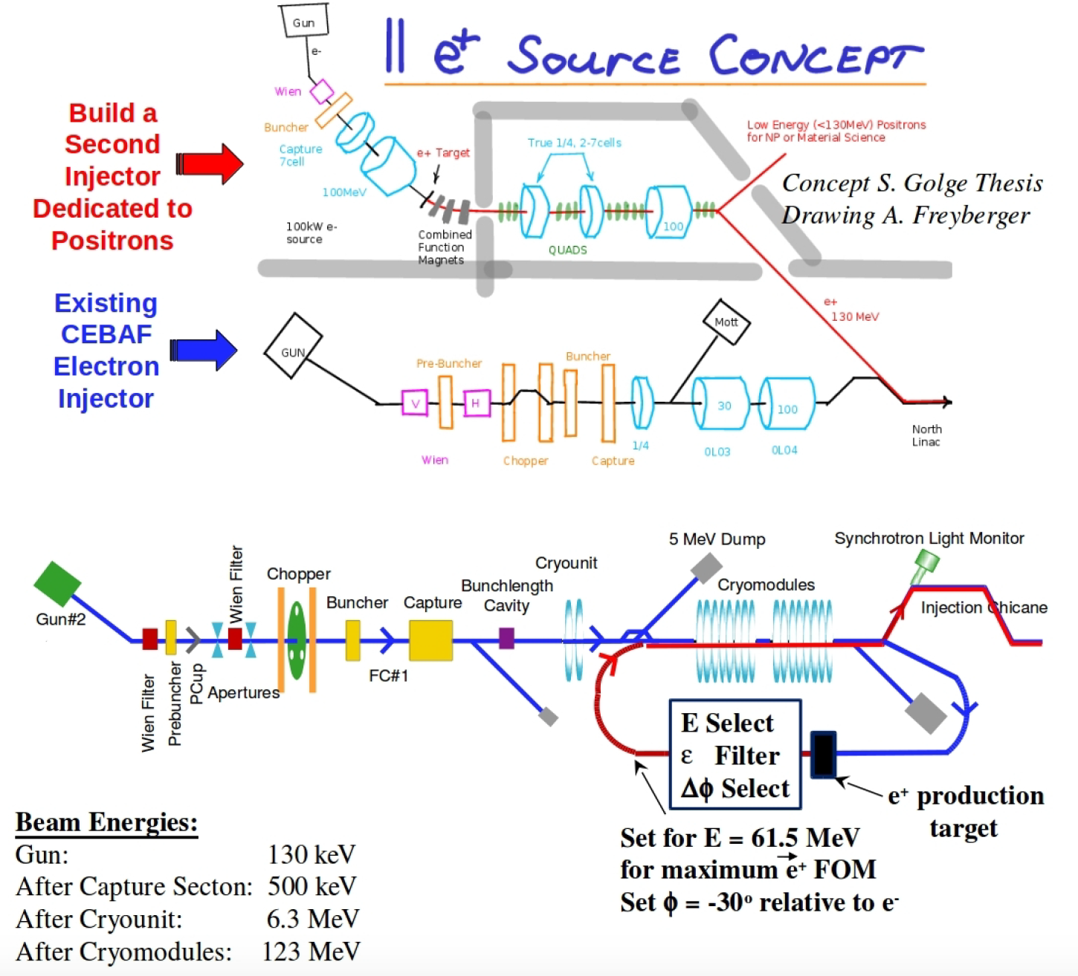
Polarized Positron Injector Concepts Abound
We have explored concepts with varying level of detail (theses, proposals, and yes…napkins).
The common denominator at JLab is leveraging our skills: Polarized Beams, SRF, Photoinjectors, High energy beams, etc).
A polarized e+ injector at Jlab would be novel in various ways:
  mA polarized e- source
  fast helicity reversal
  cw/short pulse bunches
  high power target > 10 kW
  srf acceleration

Slide 24
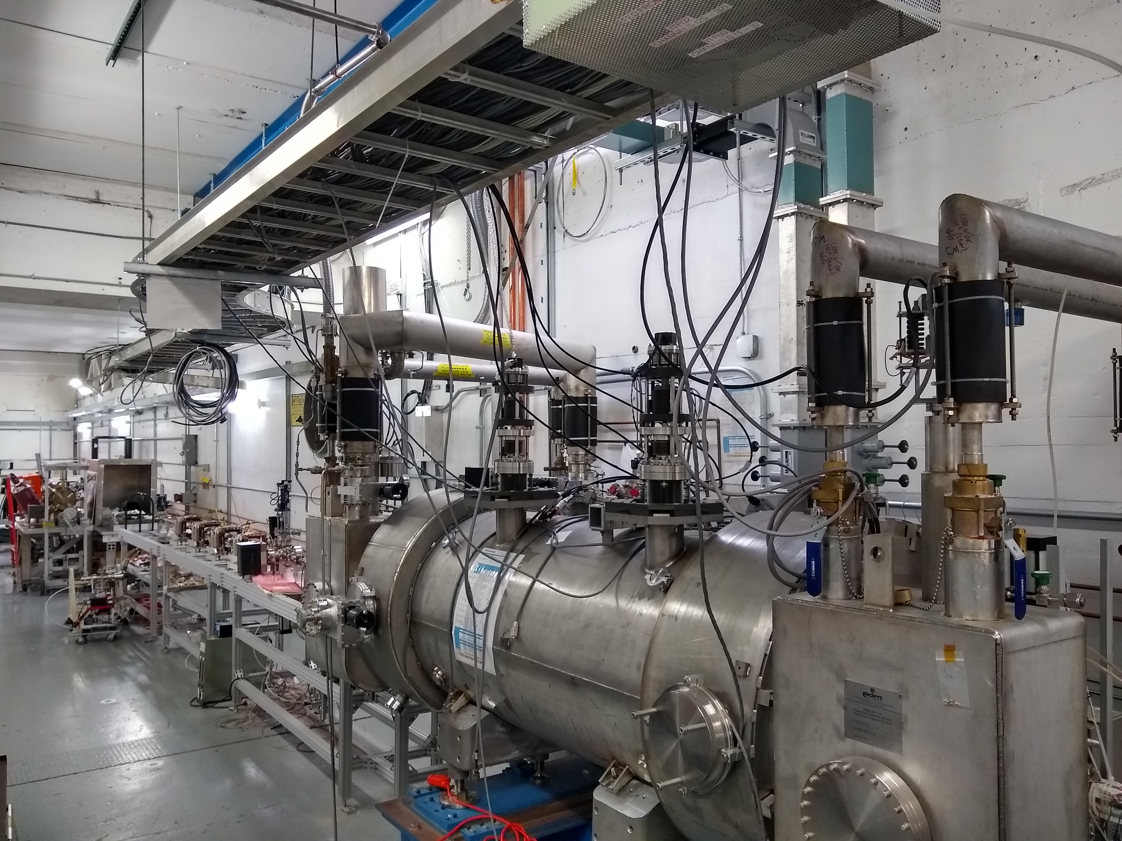
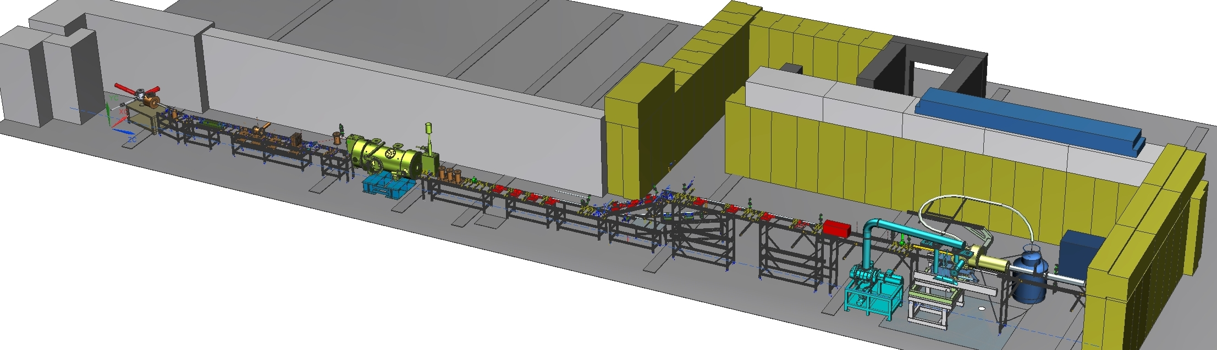
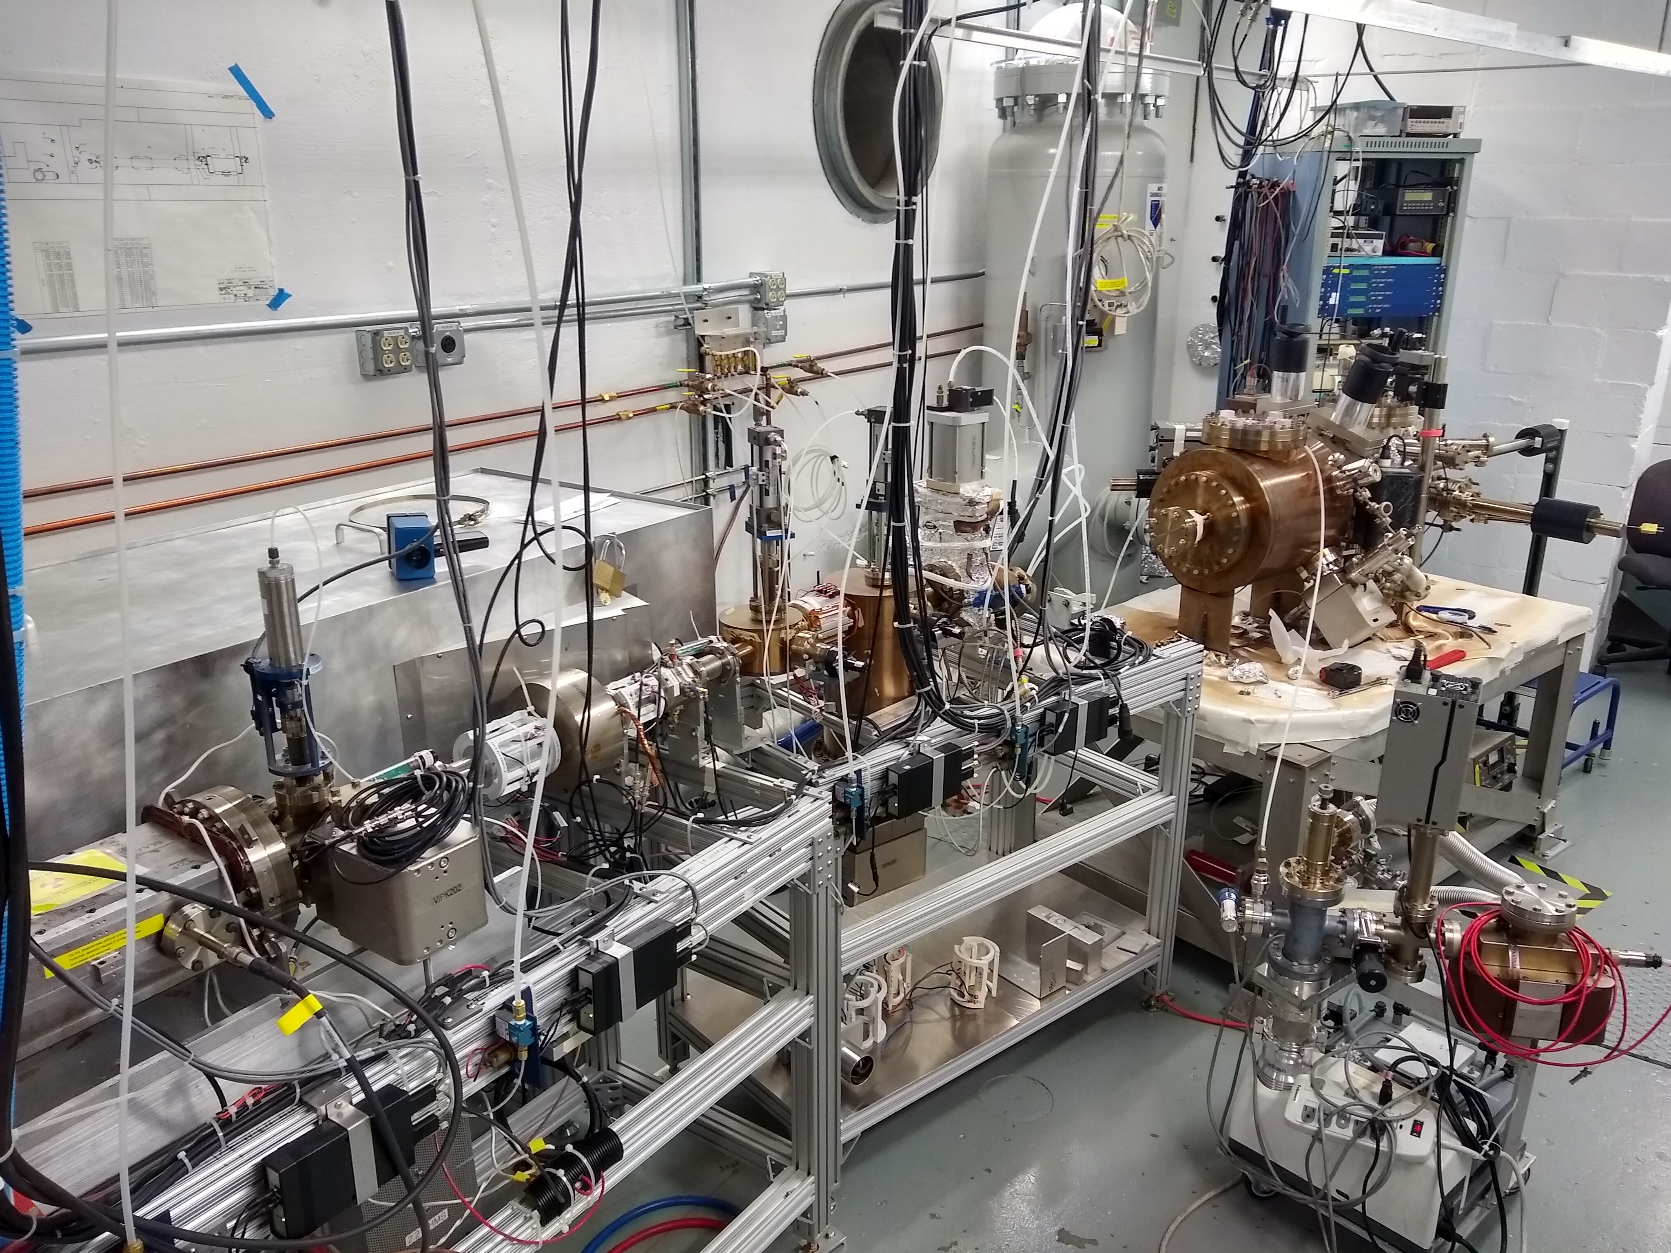
Upgraded Injector Test Facility
A new injector facility for research and design is coming on-line soon
Polarized electron beams
Beam energy up to 10 MeV
Beam intensity up to 100 μA (100 nA initially)
THIS AREA could be used to test key apparatus for a polarized positron source (target and collection).

Slide 25
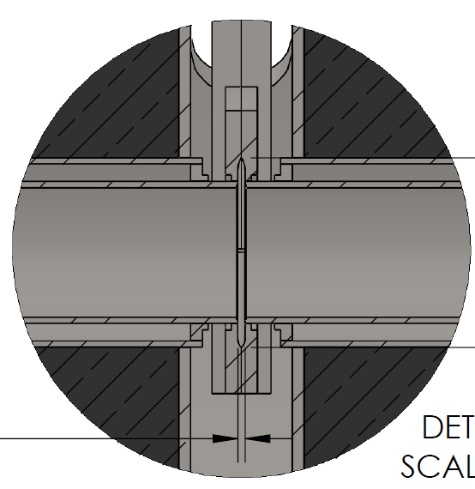
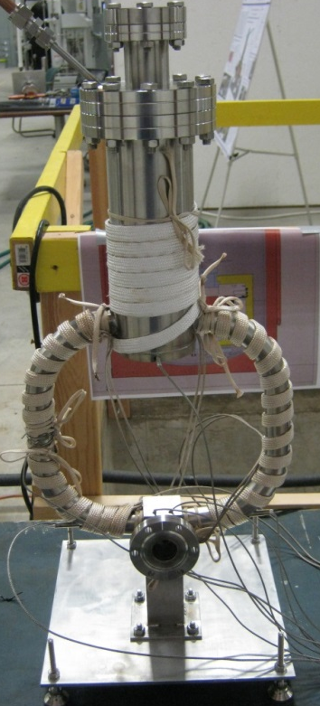
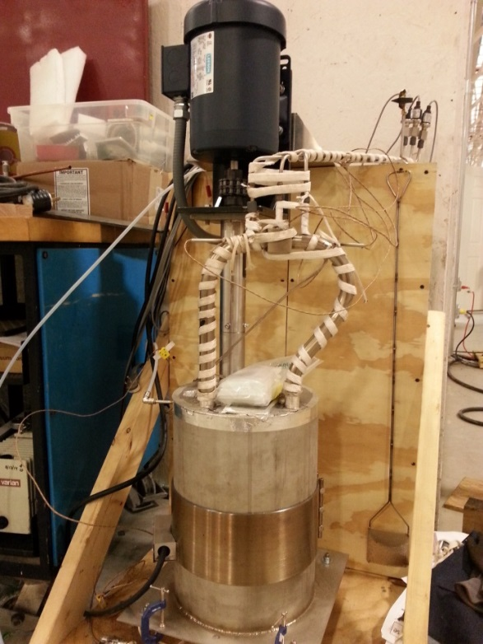
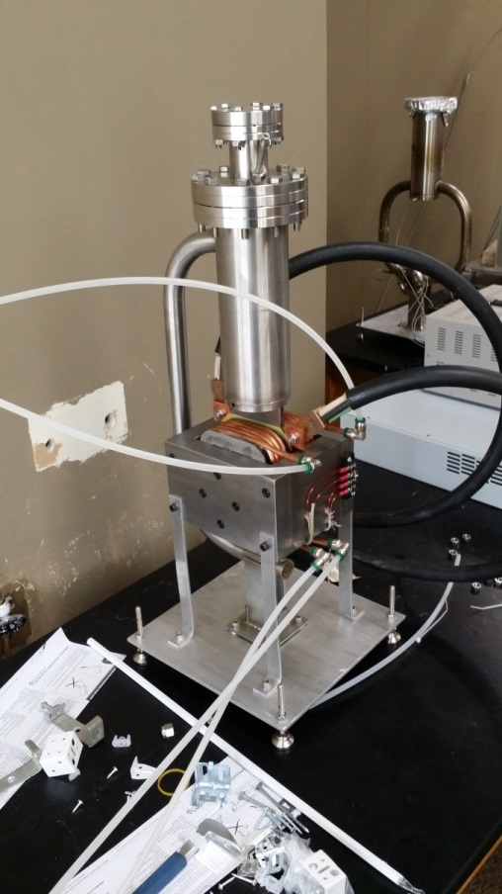

High Power Target R&D
Liquid Metal Target – lead-bismuth eutectic (LBE)
  High Z = 82, 83
  Low melting point: 124°C
  High boiling point: 1670°C
Multiple LBE targets tested on various accelerators
  Natural Circulation
  Mechanical Pumping
  Electromagnetic Pumping
Approaching 10 kW power level, CW
Stainless Steel Windows (0.25mm)
LBE (2mm)
Output (e⁻,e⁺,γ)
Input (e⁻)

Slide 26
Summary and Outlook
Jefferson Lab Users are making the physics case to lab management for high energy polarized positron physics program at CEBAF.
PEPPo demonstrated high positron polarization from moderate energy polarized electrons with a small footprint (cost, energy, radioactivity)
Progress of mA-sources is promising for the development of polarized positron beams with intensity >100 nA (5 x 10¹¹ e+/sec).
Next priority goal is building and testing a collection system to define and optimize the transverse/longitudinal phase space for RF acceleration.
A comprehensive plan, supported by JLab Management, that can be successfully executed is essential for large-scale positron program at JLab.
Collaboration of synergistic technological R&D is possible, especially leveraging JLab skills, provided labor and funding are identified.

Slide 27

Synergy
The Hippopotamus and Red-Billed Oxpecker share a positive and synergistic relationship.

