Slide 1
Radiation Level at Positron Target Area
Distributions of positrons, electrons and photons at target in forward and backward directions (Geant4)
Energy spectra, phase-space and time distributions
Radiation levels near the target (FLUKA)
Comparison 60 MeV e⁺ with 10 MeV e⁺
A. Ushakov

Slide 2
Primary Electron Beam and Target
Beam Energy: 120 MeV
Beam Current: 1 mA
Beam Size: σ_{x} = σ_{y} = 1 mm
No Energy Spread
No Beam Divergence
Beam Start at 10 mm from Target Exit Side
Target Material: Pure Tungsten
Target Thickness: 4 mm
Target Radius: 30 mm
Target Exit Side at Z = 0

Slide 3
Yield, Energy and Power of Particles at Target (Geant4)
Forward Direction
Photon Yield | 7.5 | ph/e-
Average Energy of Photons | 7.9 | MeV
Average Power of Photons | 59.2 | kW
Electron Yield | 1.12 | e-/e-
Average Energy of Electrons | 35.2 | MeV
Average Power of Electrons | 39.3 | kW
Positron Yield | 0.24 | e+/e-
Average Energy of Positrons | 16.9 | MeV
Average Power of Positrons | 4.0 | kW
Total Power | 102.5 | kW
Backward Direction
Photon Yield | 0.39 | ph/e-
Average Energy of Photons | 1.03 | MeV
Average Power of Photons | 0.40 | kW
Electron Yield | 0.014 | e-/e-
Average Energy of Electrons | 2.18 | MeV
Average Power of Electrons | 0.03 | kW
Positron Yield | 0.001 | e+/e-
Average Energy of Positrons | 4.21 | MeV
Average Power of Positrons | 0.005 | kW
Total Power | 0.44 | kW
Power Deposition in Target | 16.84 | kW

Slide 4
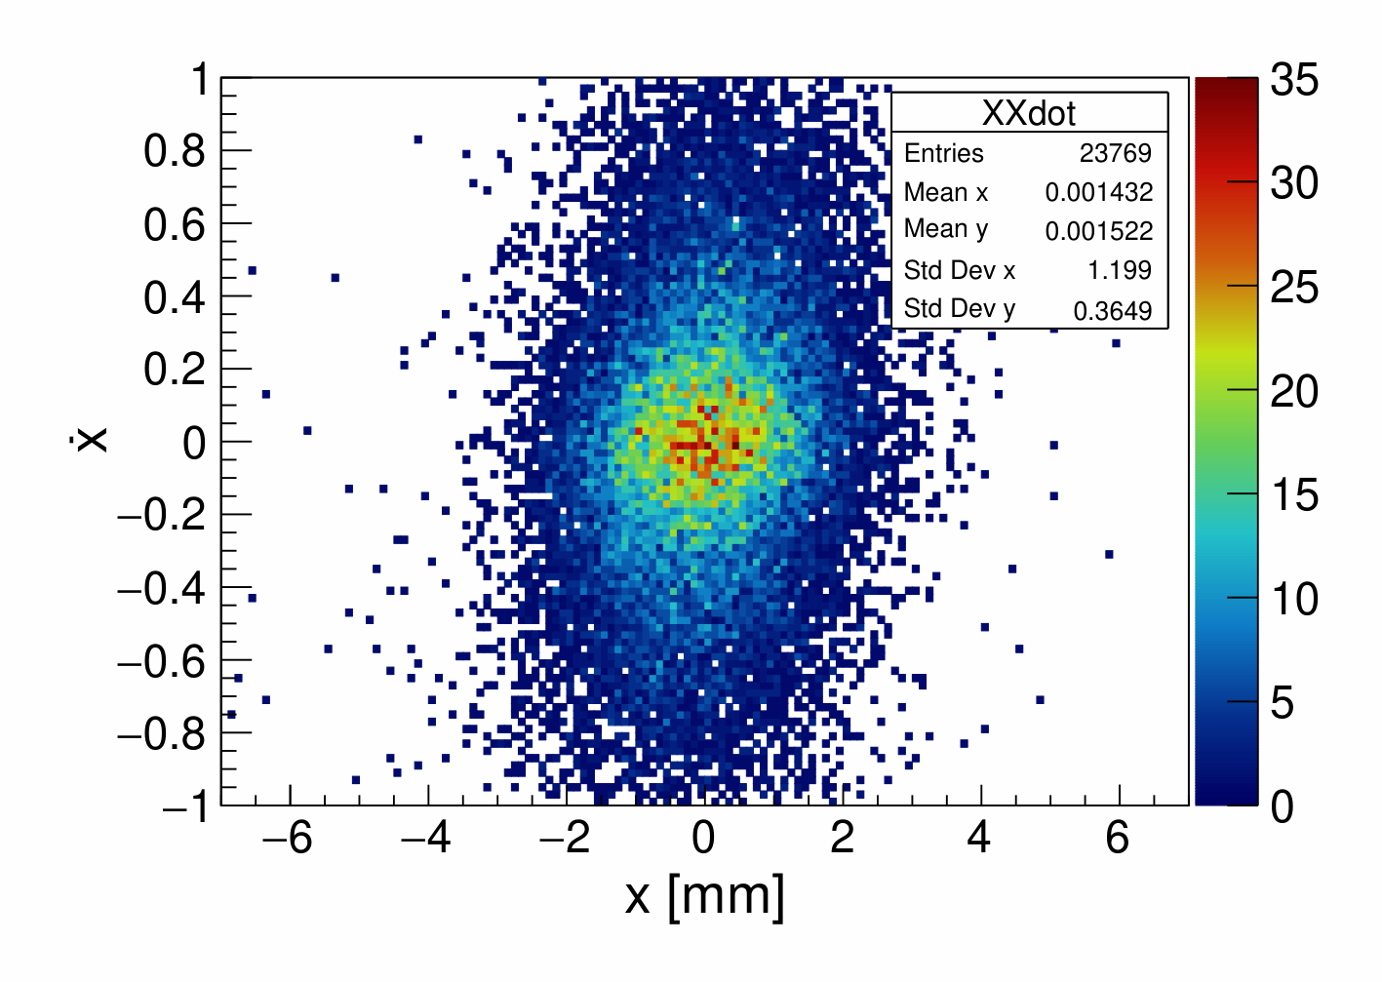
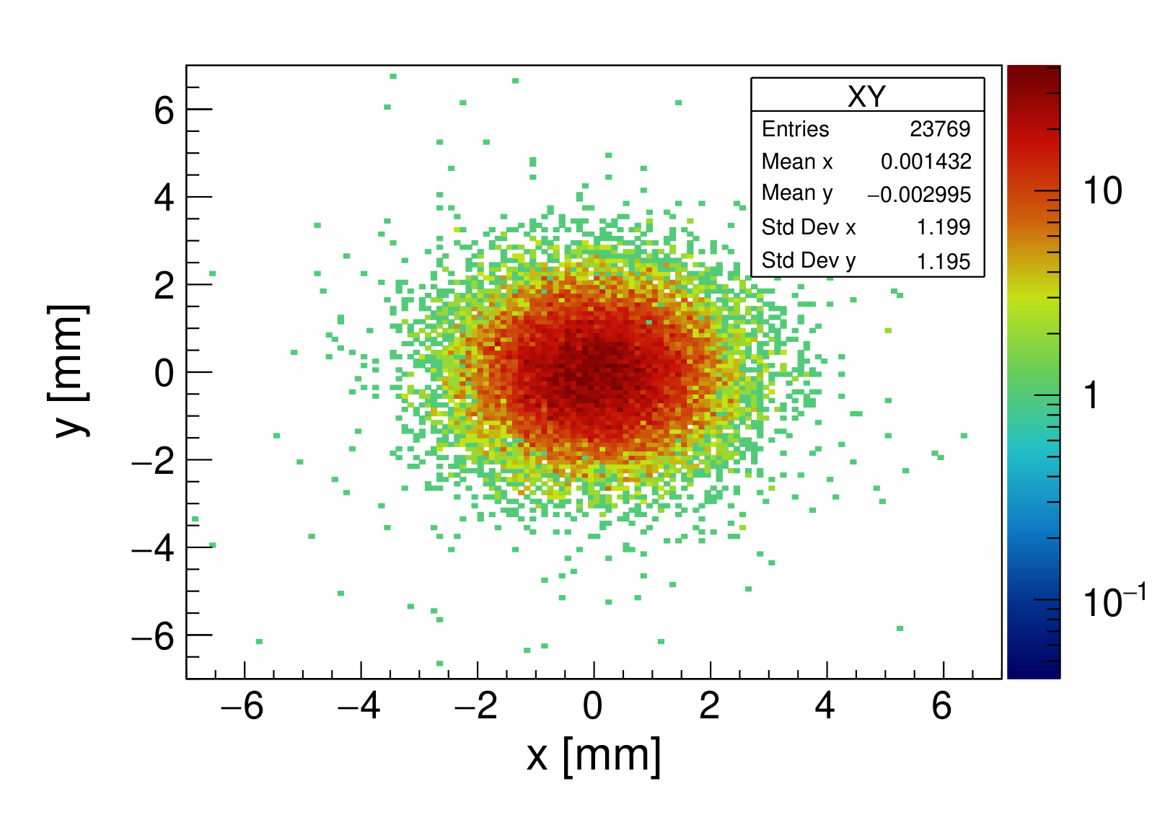
Positrons at Exit Side of Target: Phase Space and Y vs X
Number of primary electrons: 10⁵
Phase Space
Y vs X
Y_{e+} = 0.24 e⁺/e⁻
σ_{x} = 1.2 mm
σ_{x’} = 0.365
Mean E_{e+} = 16.9 MeV
ε_{x} = 0.43 mm·rad
ε_{norm x} = 14.7 mm·rad

Slide 5
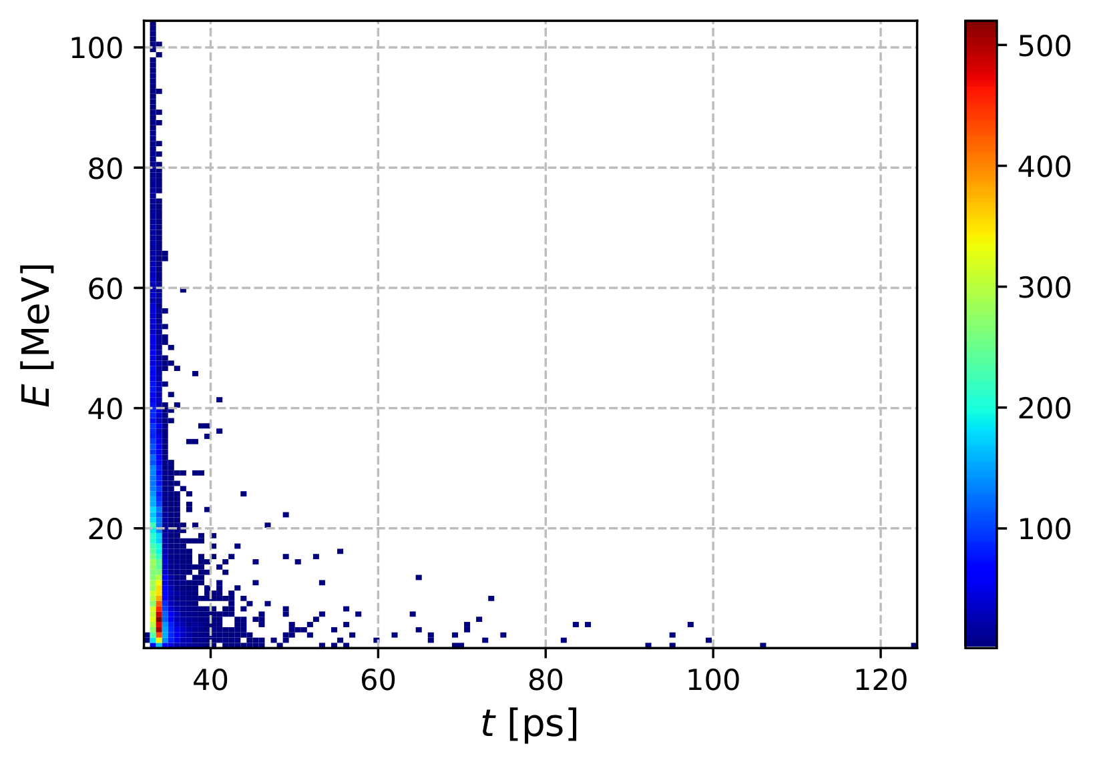
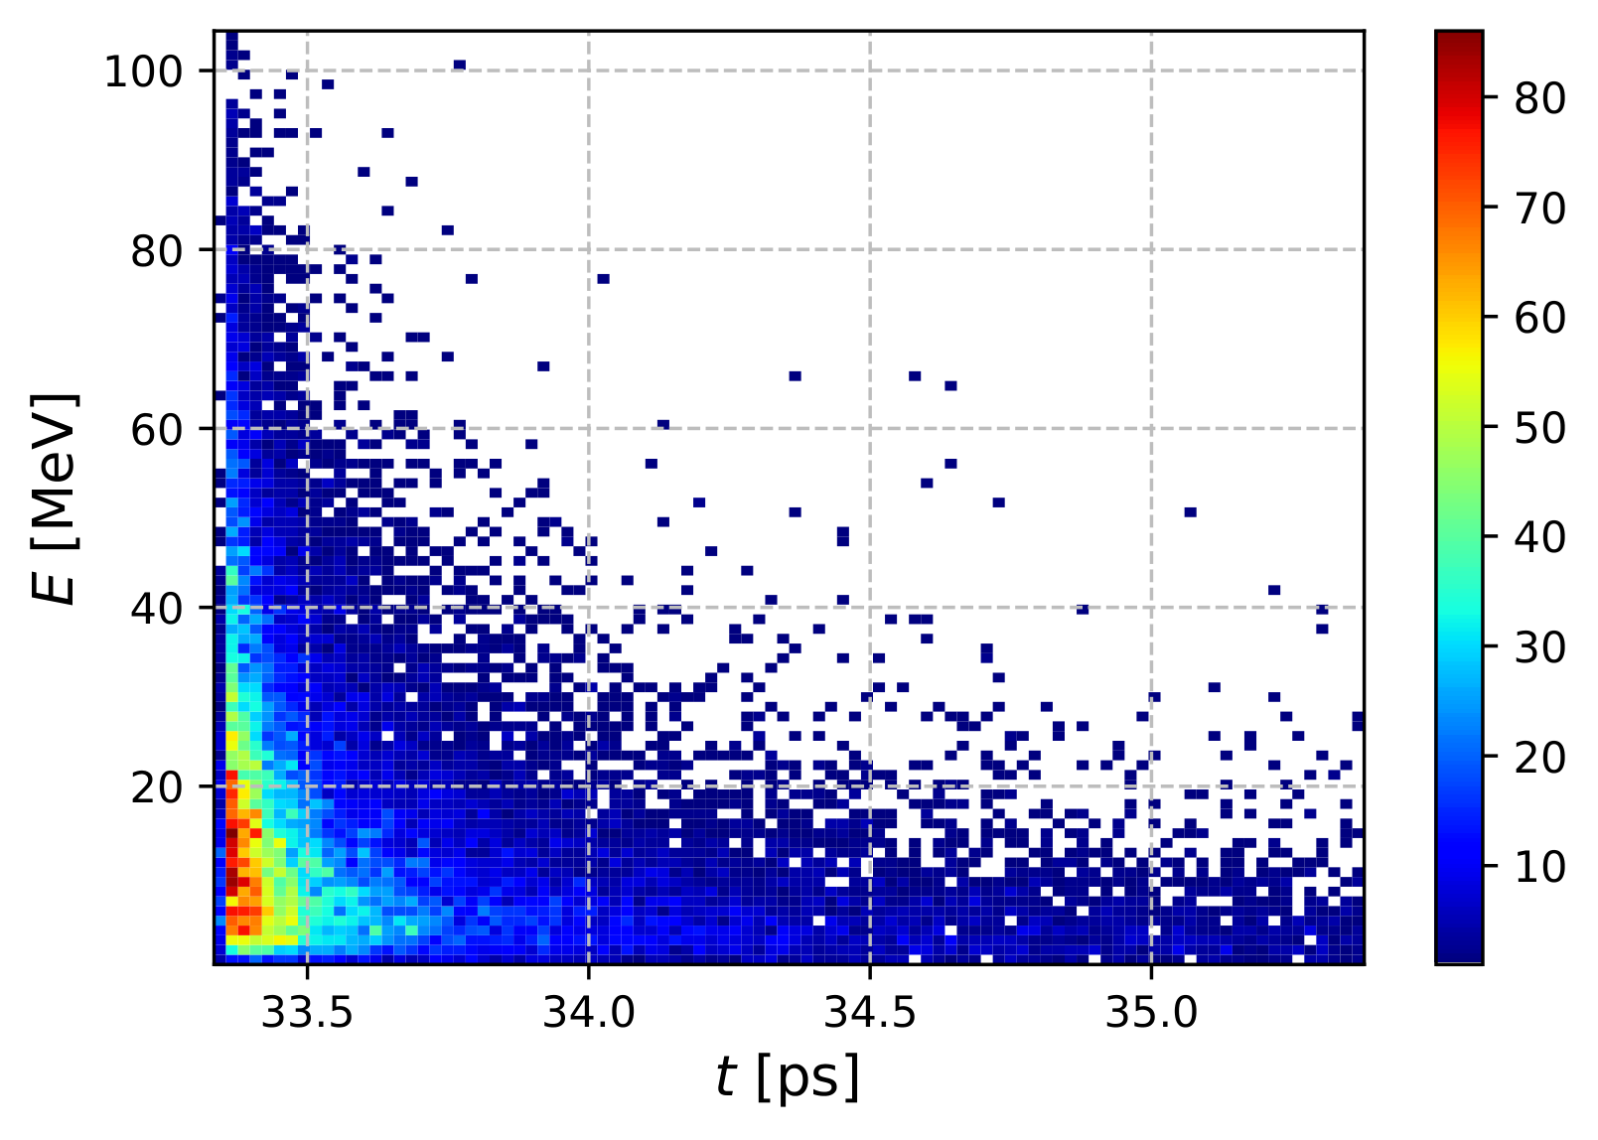
Positrons at Exit Side of Target: Energy vs Time
All Positrons
With 2 ps Time Cut
N_{e+} = 23769
σ_{t} = 2 ps
σ_{E} = 16 MeV
N_{e+} = 22039
σ_{E} = 16.2 MeV

Slide 6
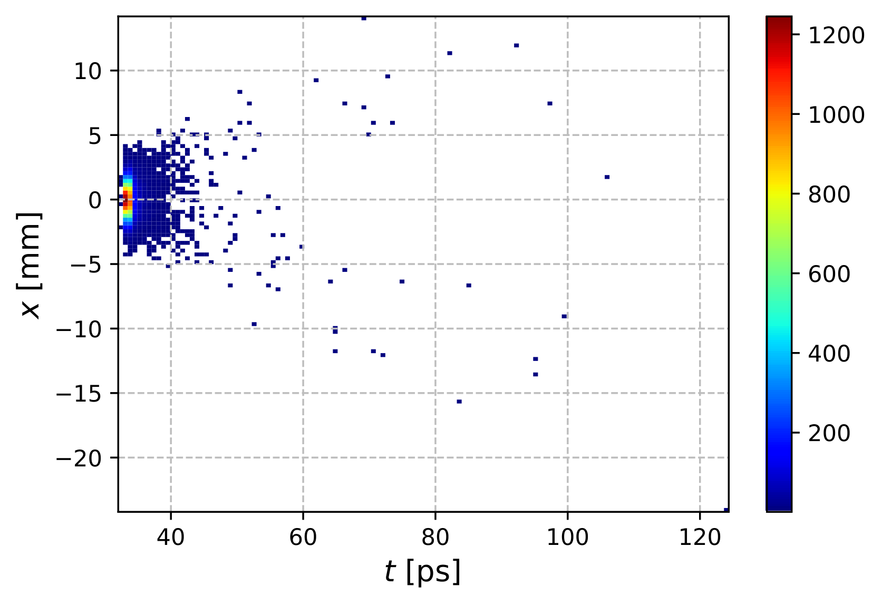
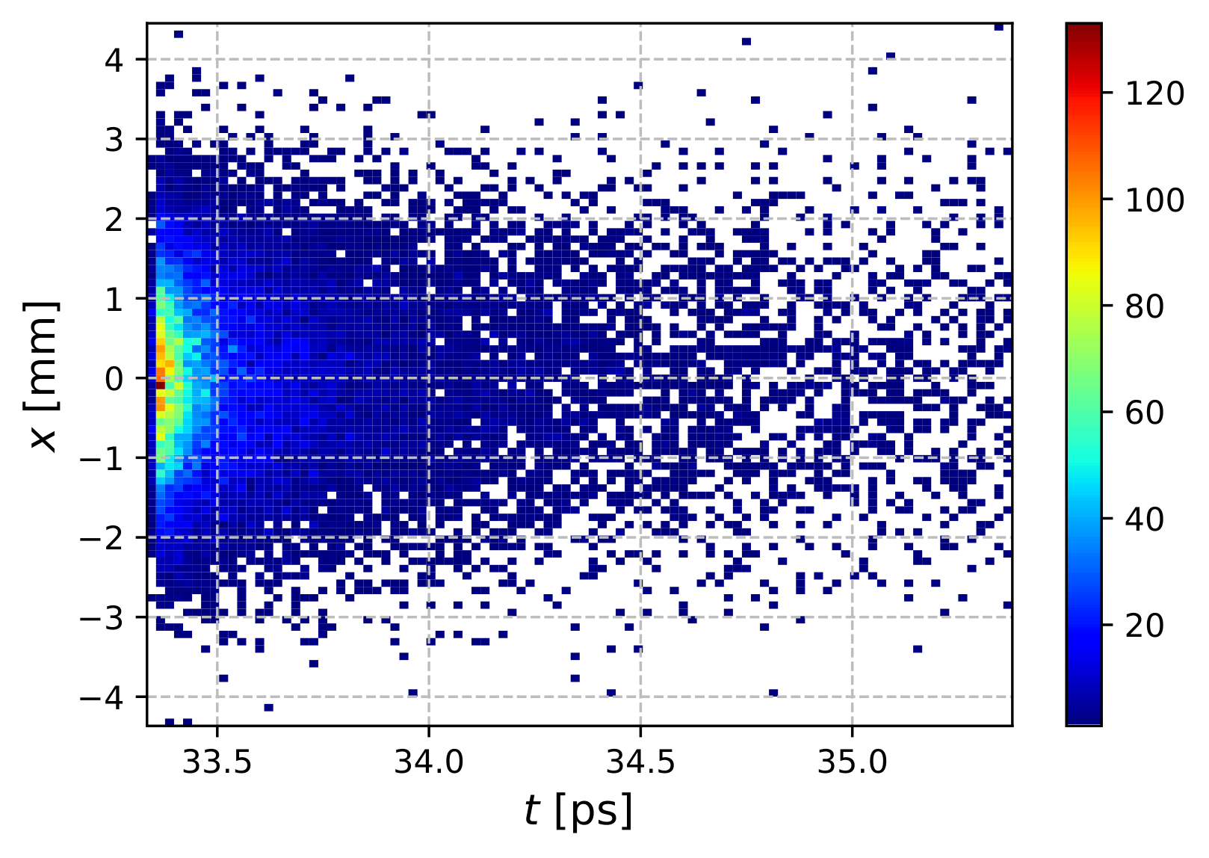
Positrons at Exit Side of Target: X vs Time
All Positrons
With 2 ps Time Cut
N_{e+} = 23769
σ_{t} = 2 ps
σ_{x} = 1.2 mm
N_{e+} = 22039
σ_{x} = 1.08 mm

Slide 7
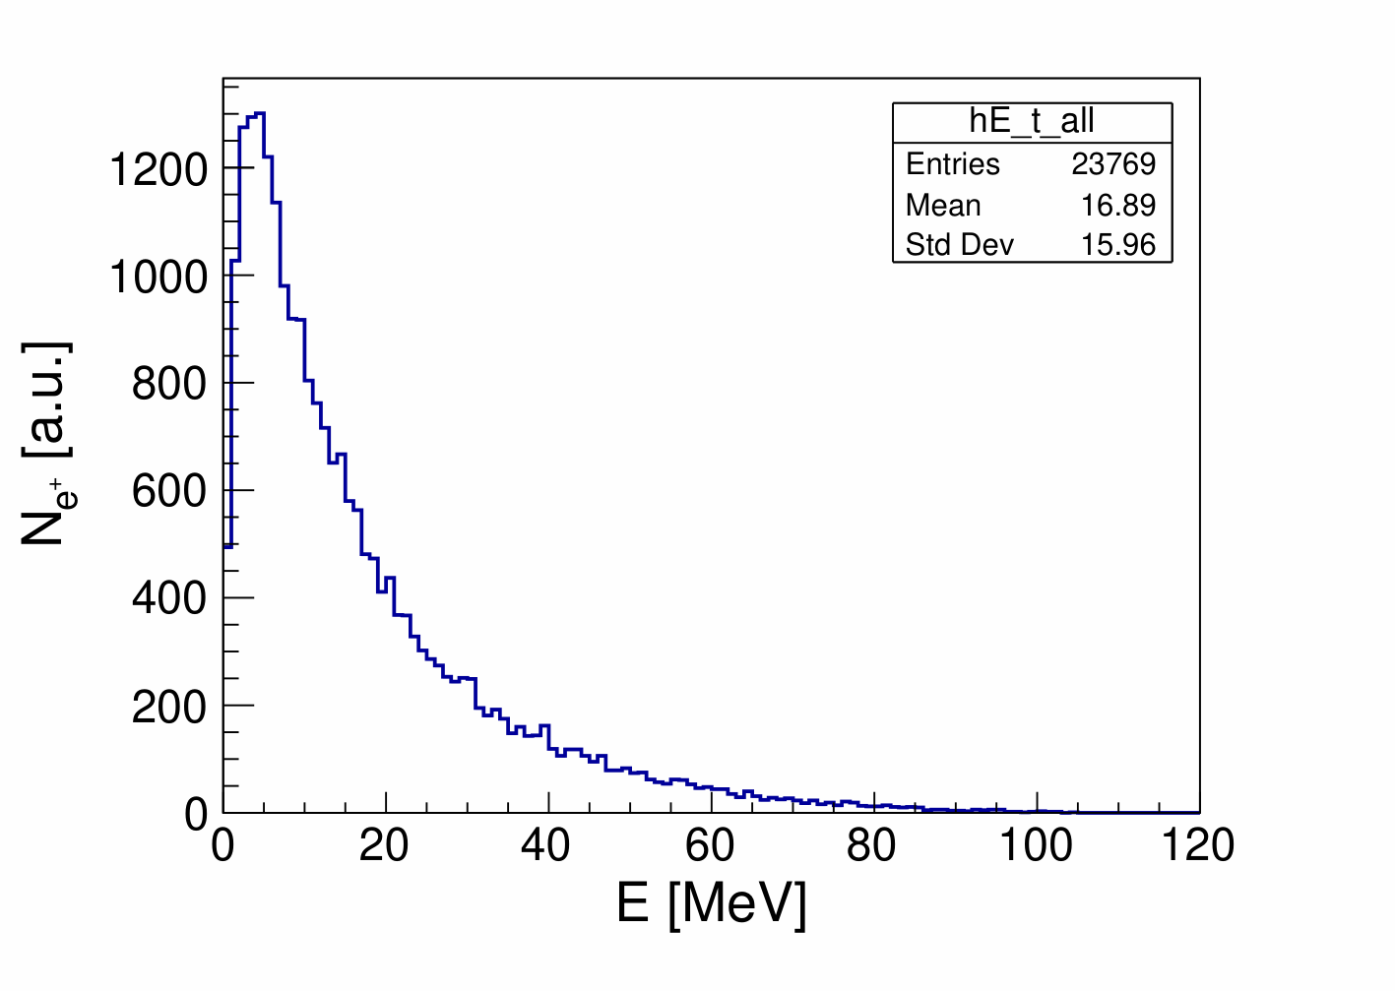
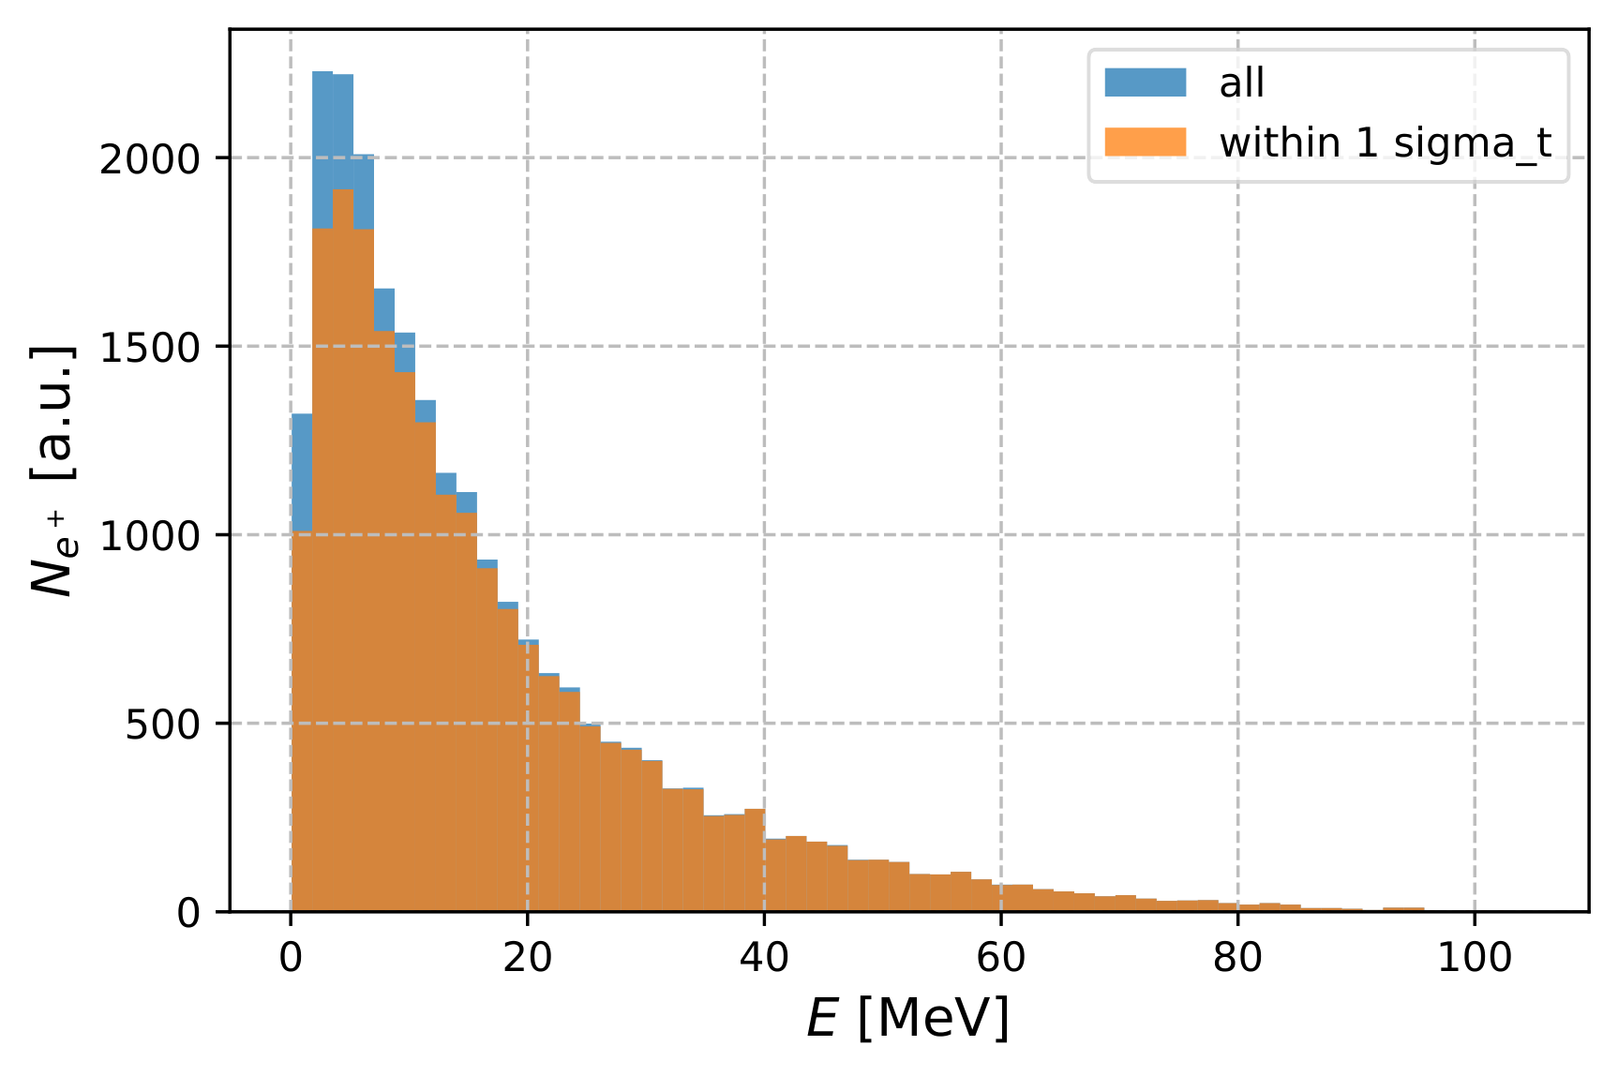
Positrons at Target Exit: Distribution of Energy
All Positrons
2 ps Time Cut
Mean E_{e+} = 16.89 MeV
Mean E_{e+} = 17.73 MeV with 2 ps time cut

Slide 8
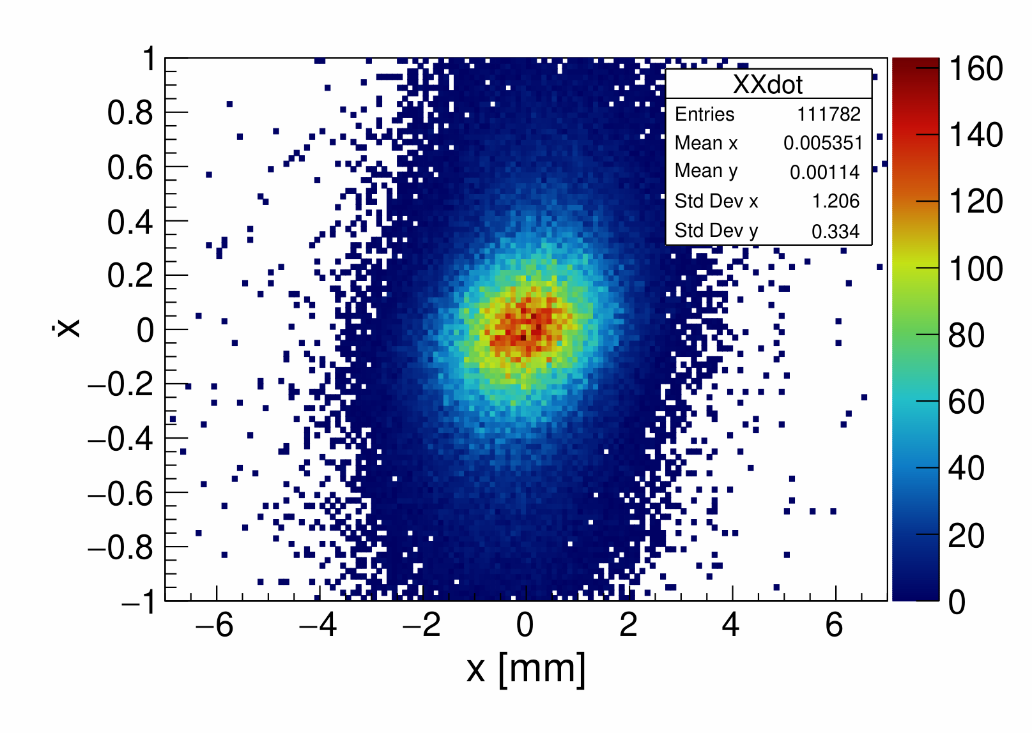
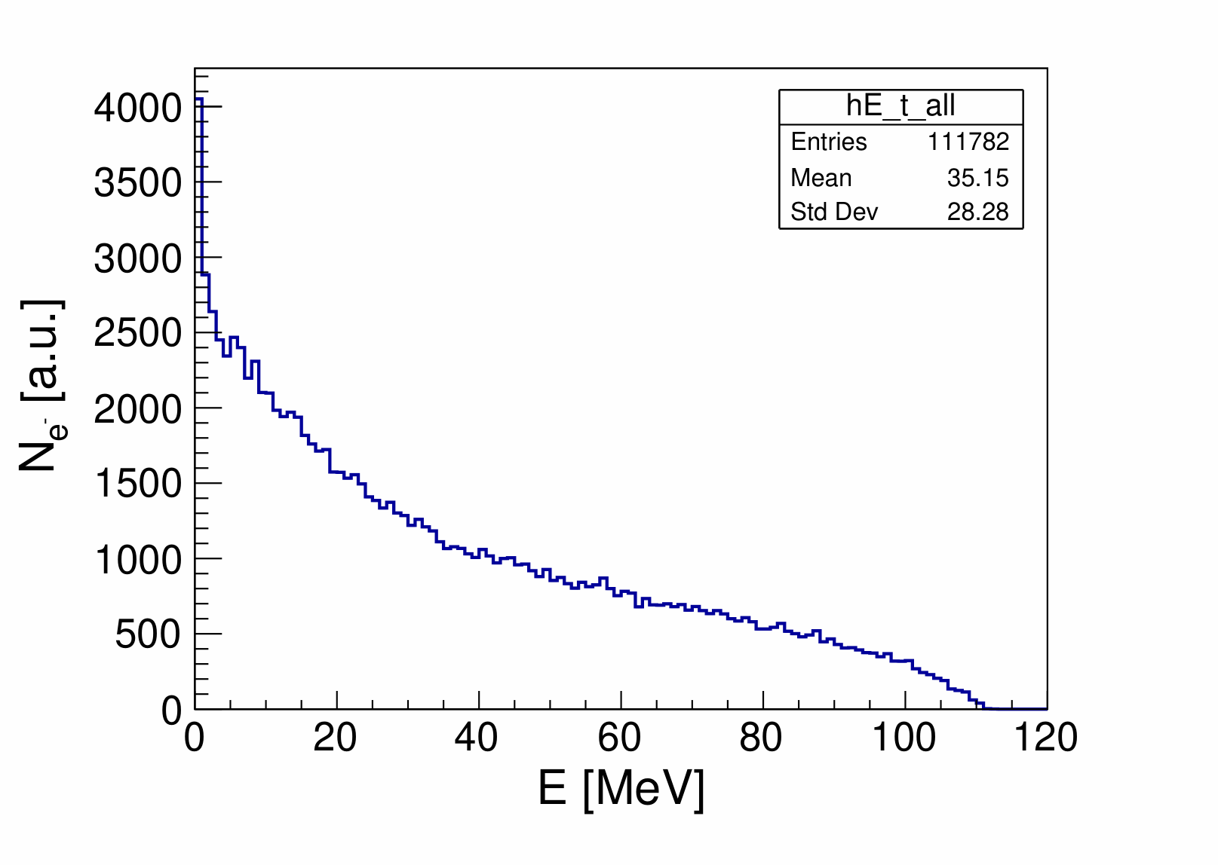
Electrons at Exit Side of Target: Phase Space and Energy Distribution
Phase Space
Energy Distribution
σ_{x’} = 0.334
Mean E = 31.2 MeV
σ_{E} = 28.3 MeV
Y_{e-} = 1.12 e⁺/e⁻
σ_{x} = 1.2 mm
ε_{x} = 0.39 mm·rad
ε_{norm x} = 27.5 mm·rad

Slide 9
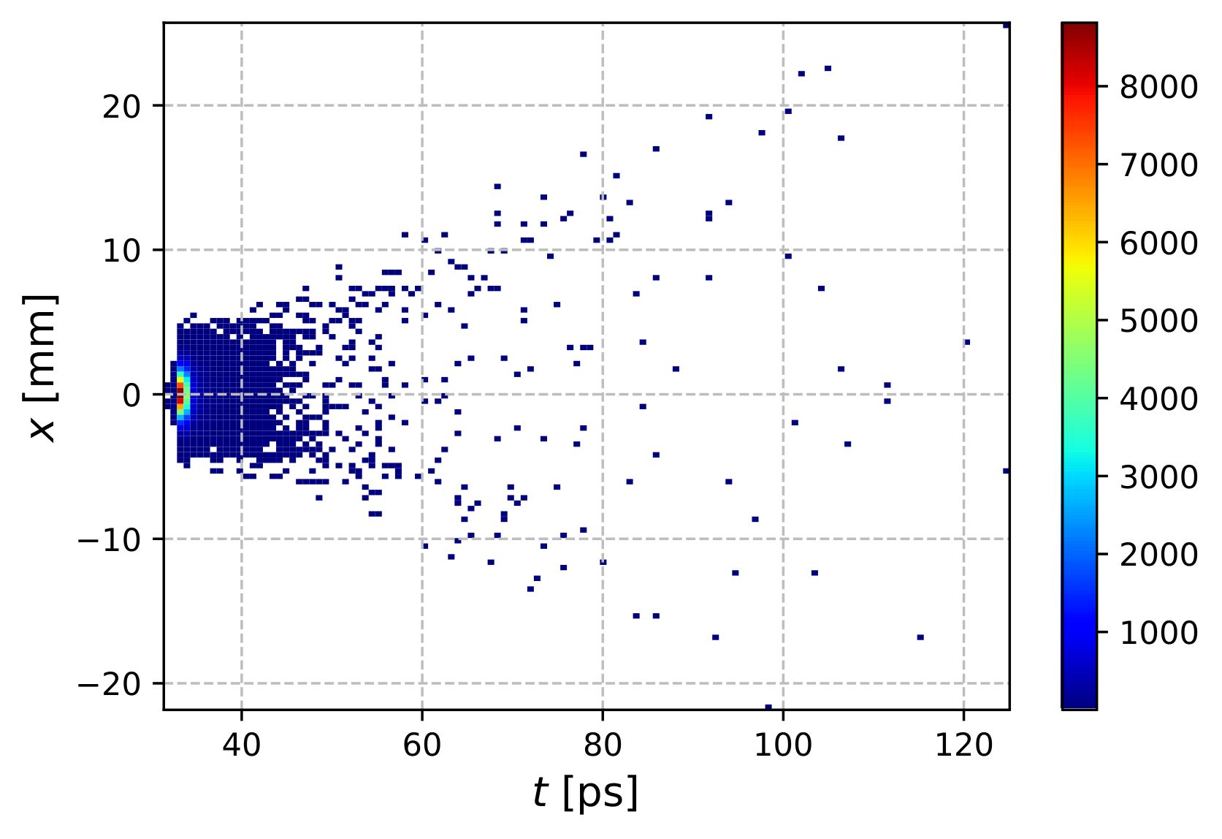
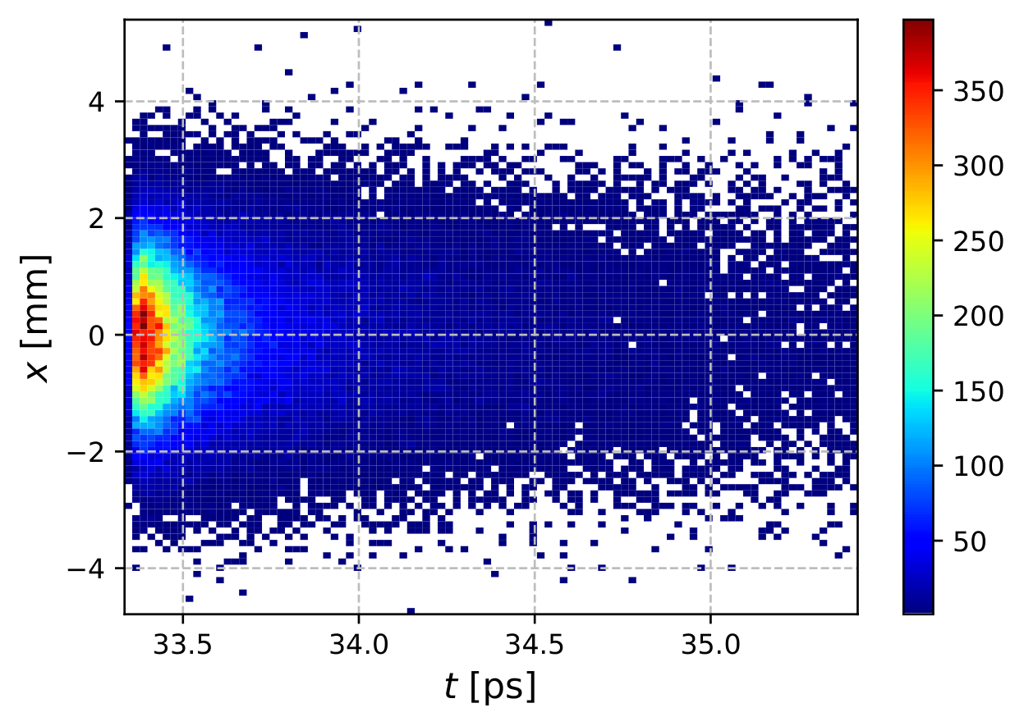
Electrons at Exit Side of Target: X vs Time
All Electrons
With 2 ps Time Cut
N_{e-} = 111782
σ_{t} = 2 ps
σ_{x} = 1.2 mm
N_{e+} = 105181
σ_{x} = 1.1 mm

Slide 10
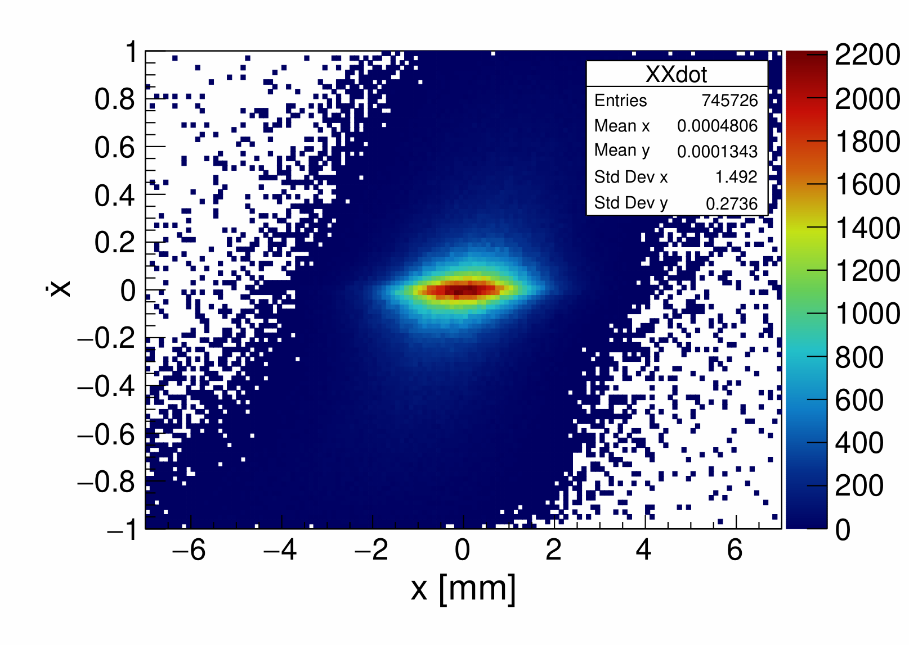
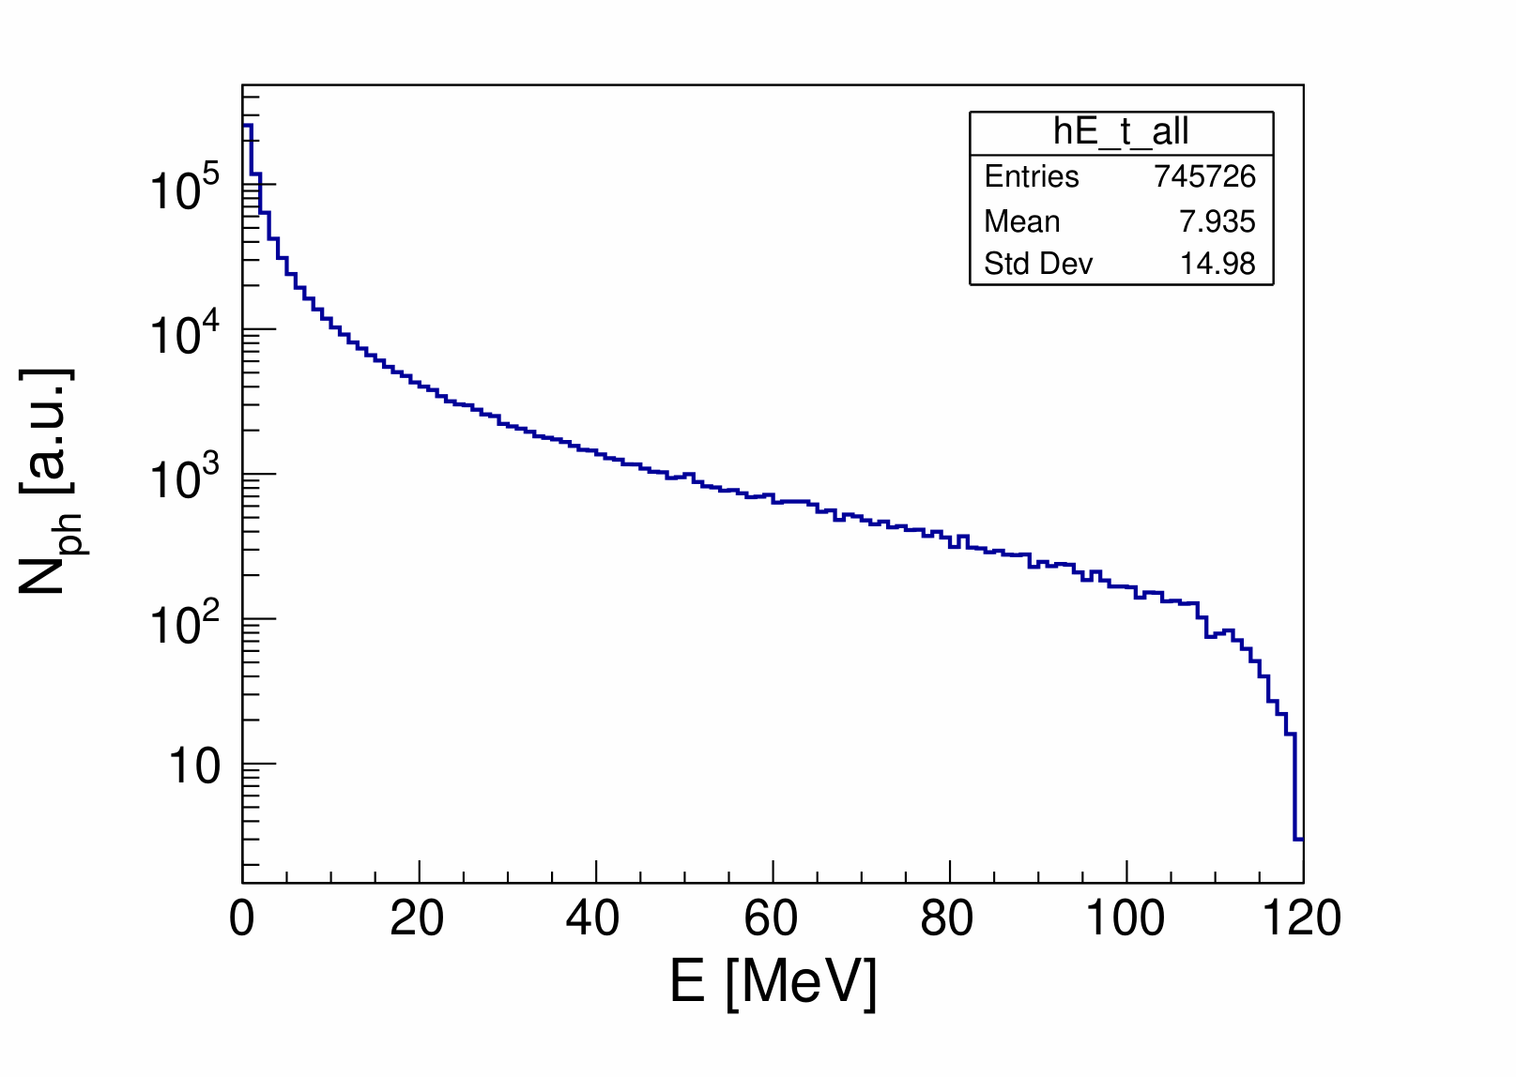
Photons at Exit Side of Target: Phase Space and Energy Distribution
Phase Space
Energy Distribution
N_{ph} = 745726
σ_{x} = 1.5 mm
σ_{x’} = 0.274
Mean E = 7.9 MeV

Slide 11
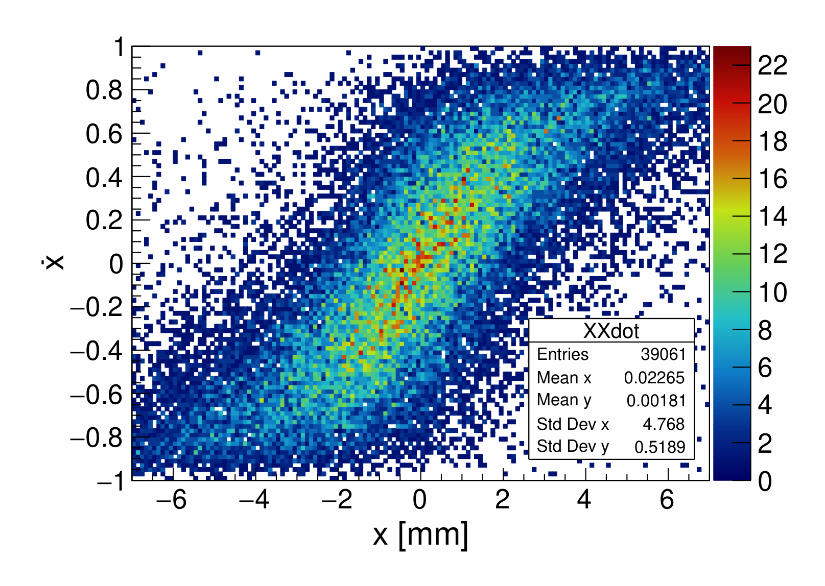
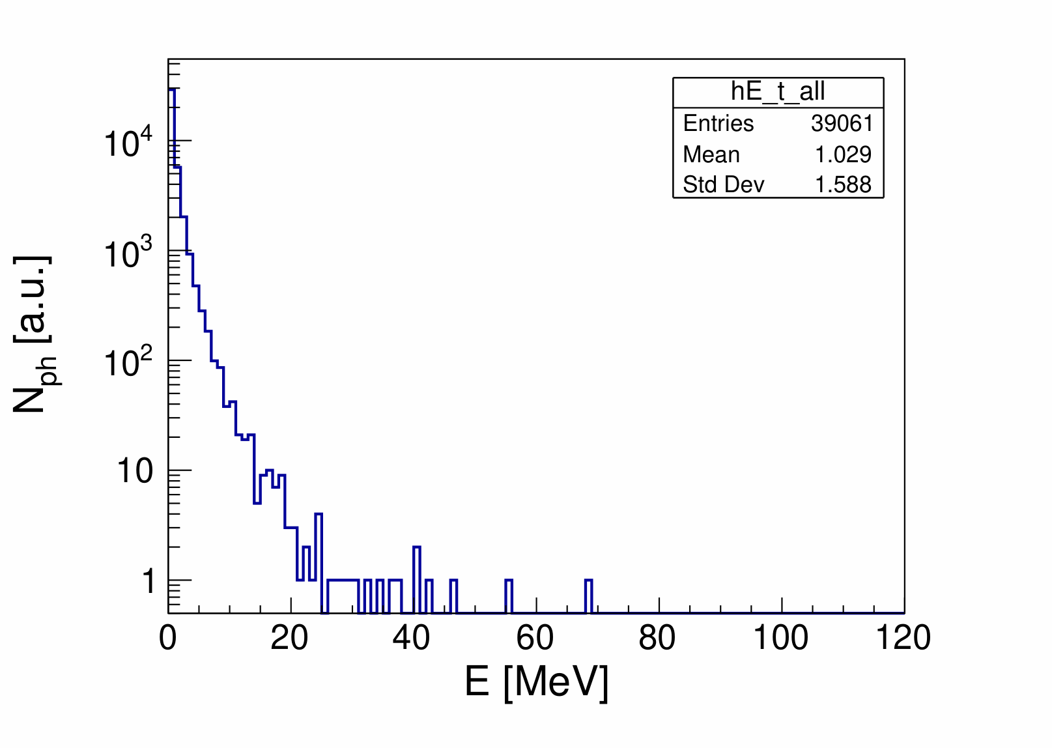
Back-Scattered Photons: Phase Space and Energy Distribution
Phase Space
Energy Distribution
N_{ph} = 39061
σ_{x} = 4.8 mm
σ_{x’} = 0.52
Mean E = 1.0 MeV

Slide 12
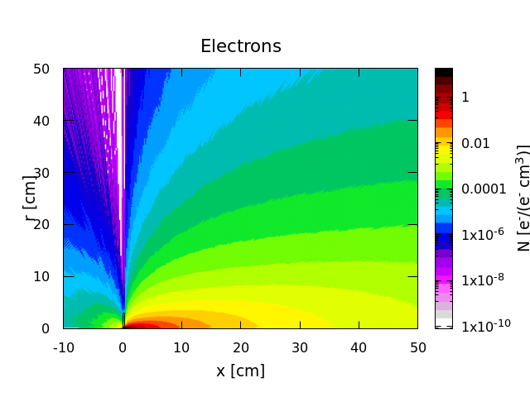
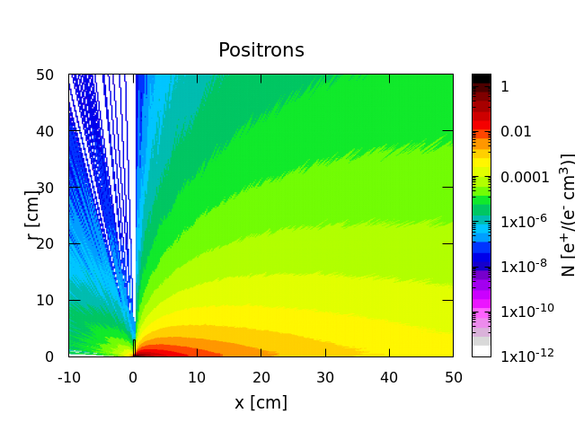
Distributions of Electrons and Positrons (FLUKA)

Slide 13
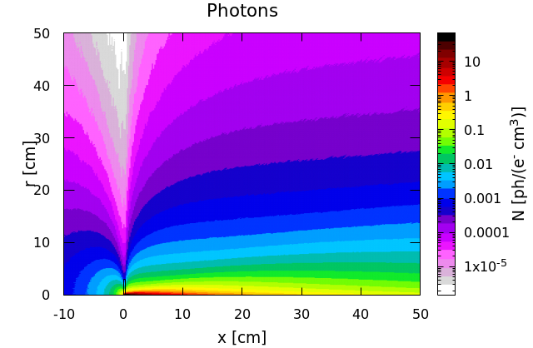
Photon Distribution (FLUKA)

Slide 14
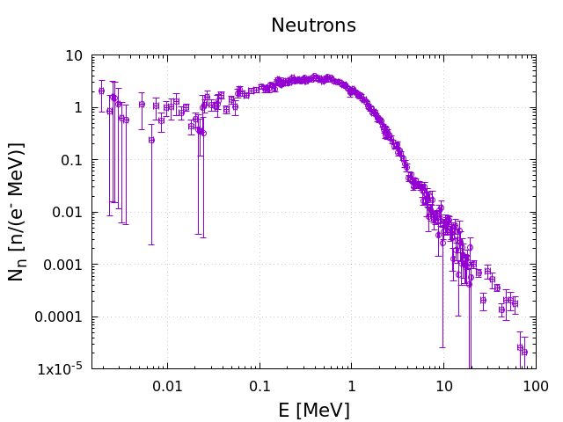
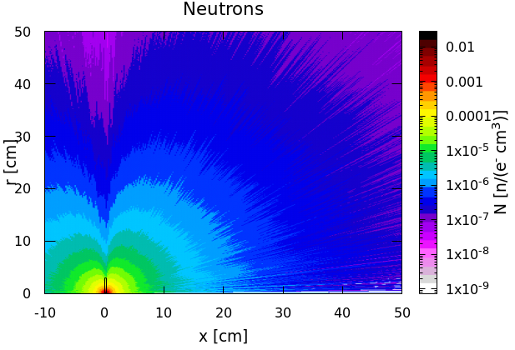
Neutron Distribution (FLUKA)
Neutron Yield = 4.7·10⁻³ n/e⁻

Slide 15
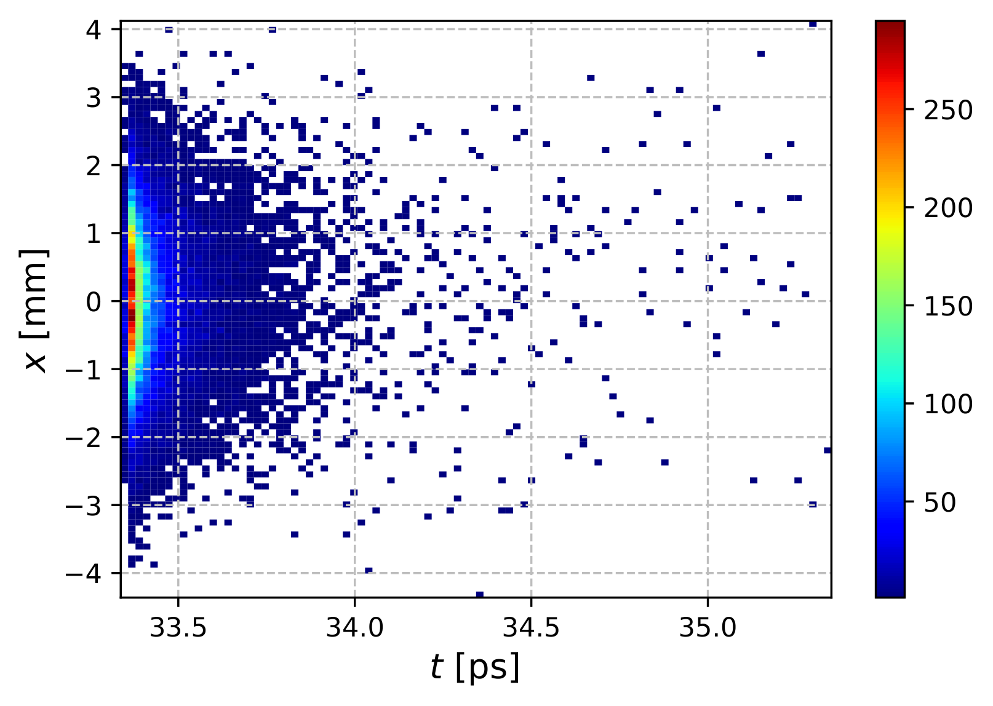
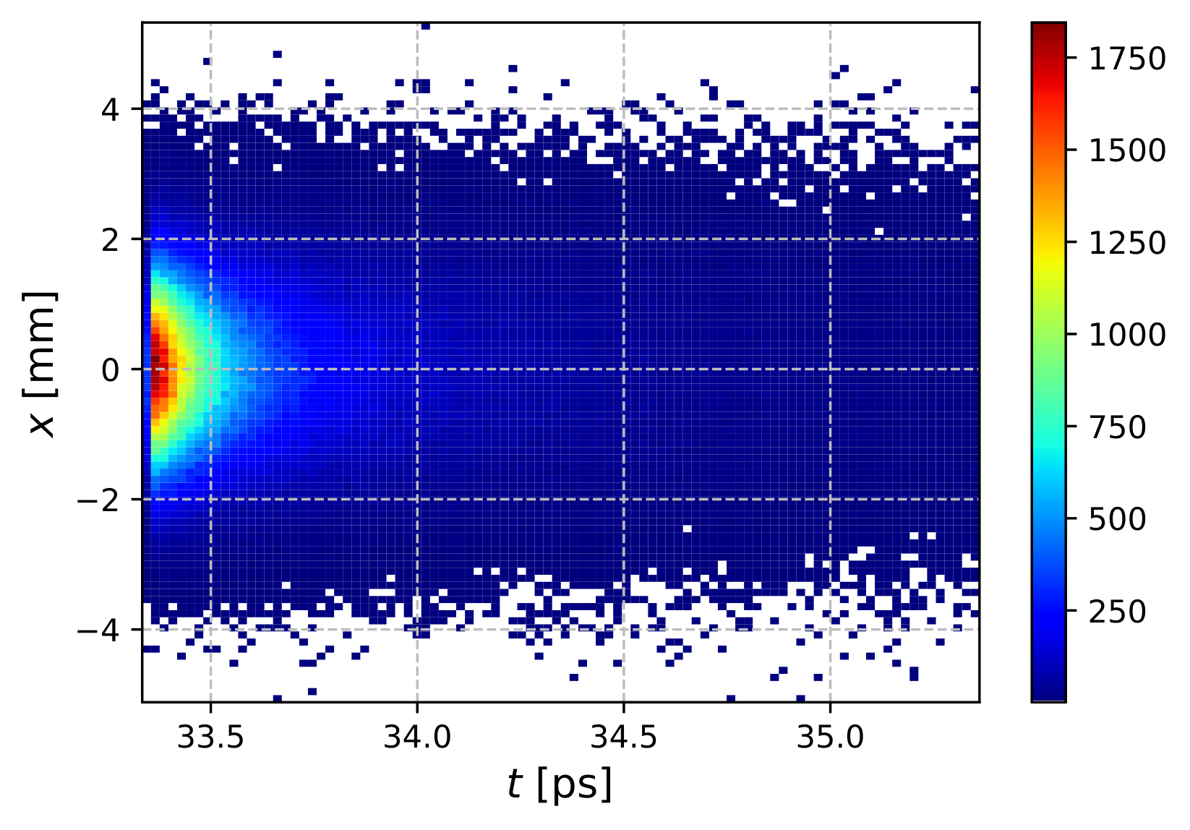
X vs Time for 60$±$3 MeV e⁺ and 10$±$3 MeV e⁺
Number of primary electrons: 10⁷
60 MeV e⁺
10 MeV e⁺
N_{e+} = 26093
σ_{t} = 0.14 ps
σ_{x} = 1.04 mm
N_{e+} = 481098
σ_{t} = 0.4 ps
σ_{x} = 1.09 mm

Slide 16
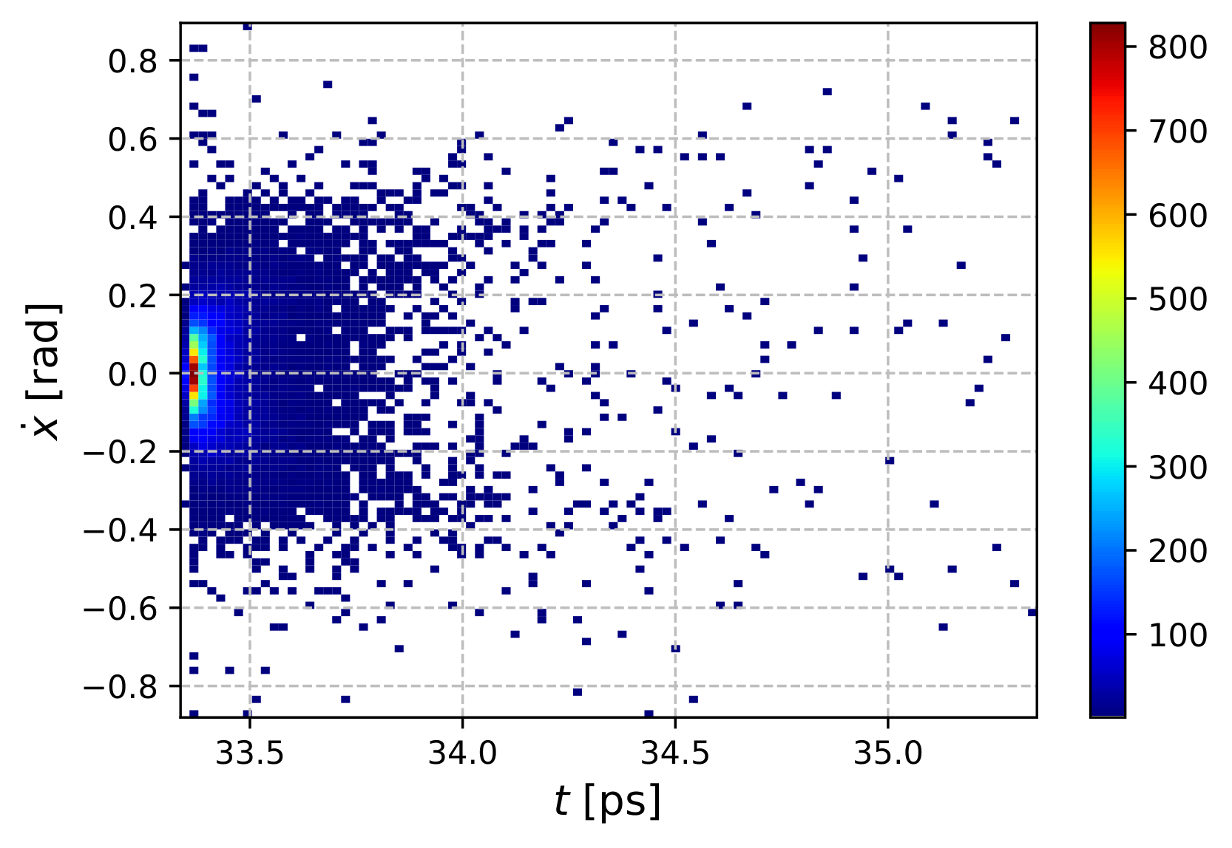
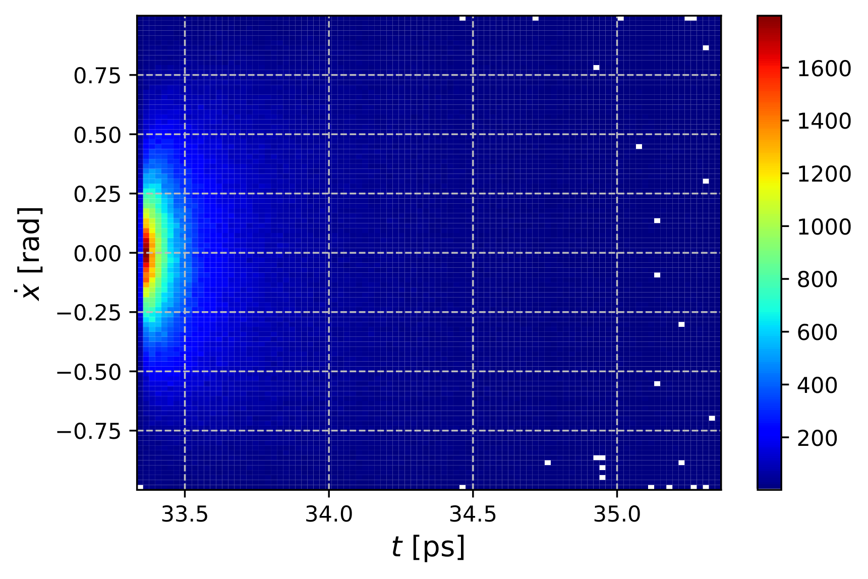
X’ vs Time for 60$±$3 MeV e⁺ and 10$±$3 MeV e⁺
60 MeV e⁺
10 MeV e⁺
N_{e+} = 26093
σ_{t} = 0.14 ps
σ_{x’} = 0.14
N_{e+} = 481098
σ_{t} = 0.4 ps
σ_{x'} = 0.39

Slide 17
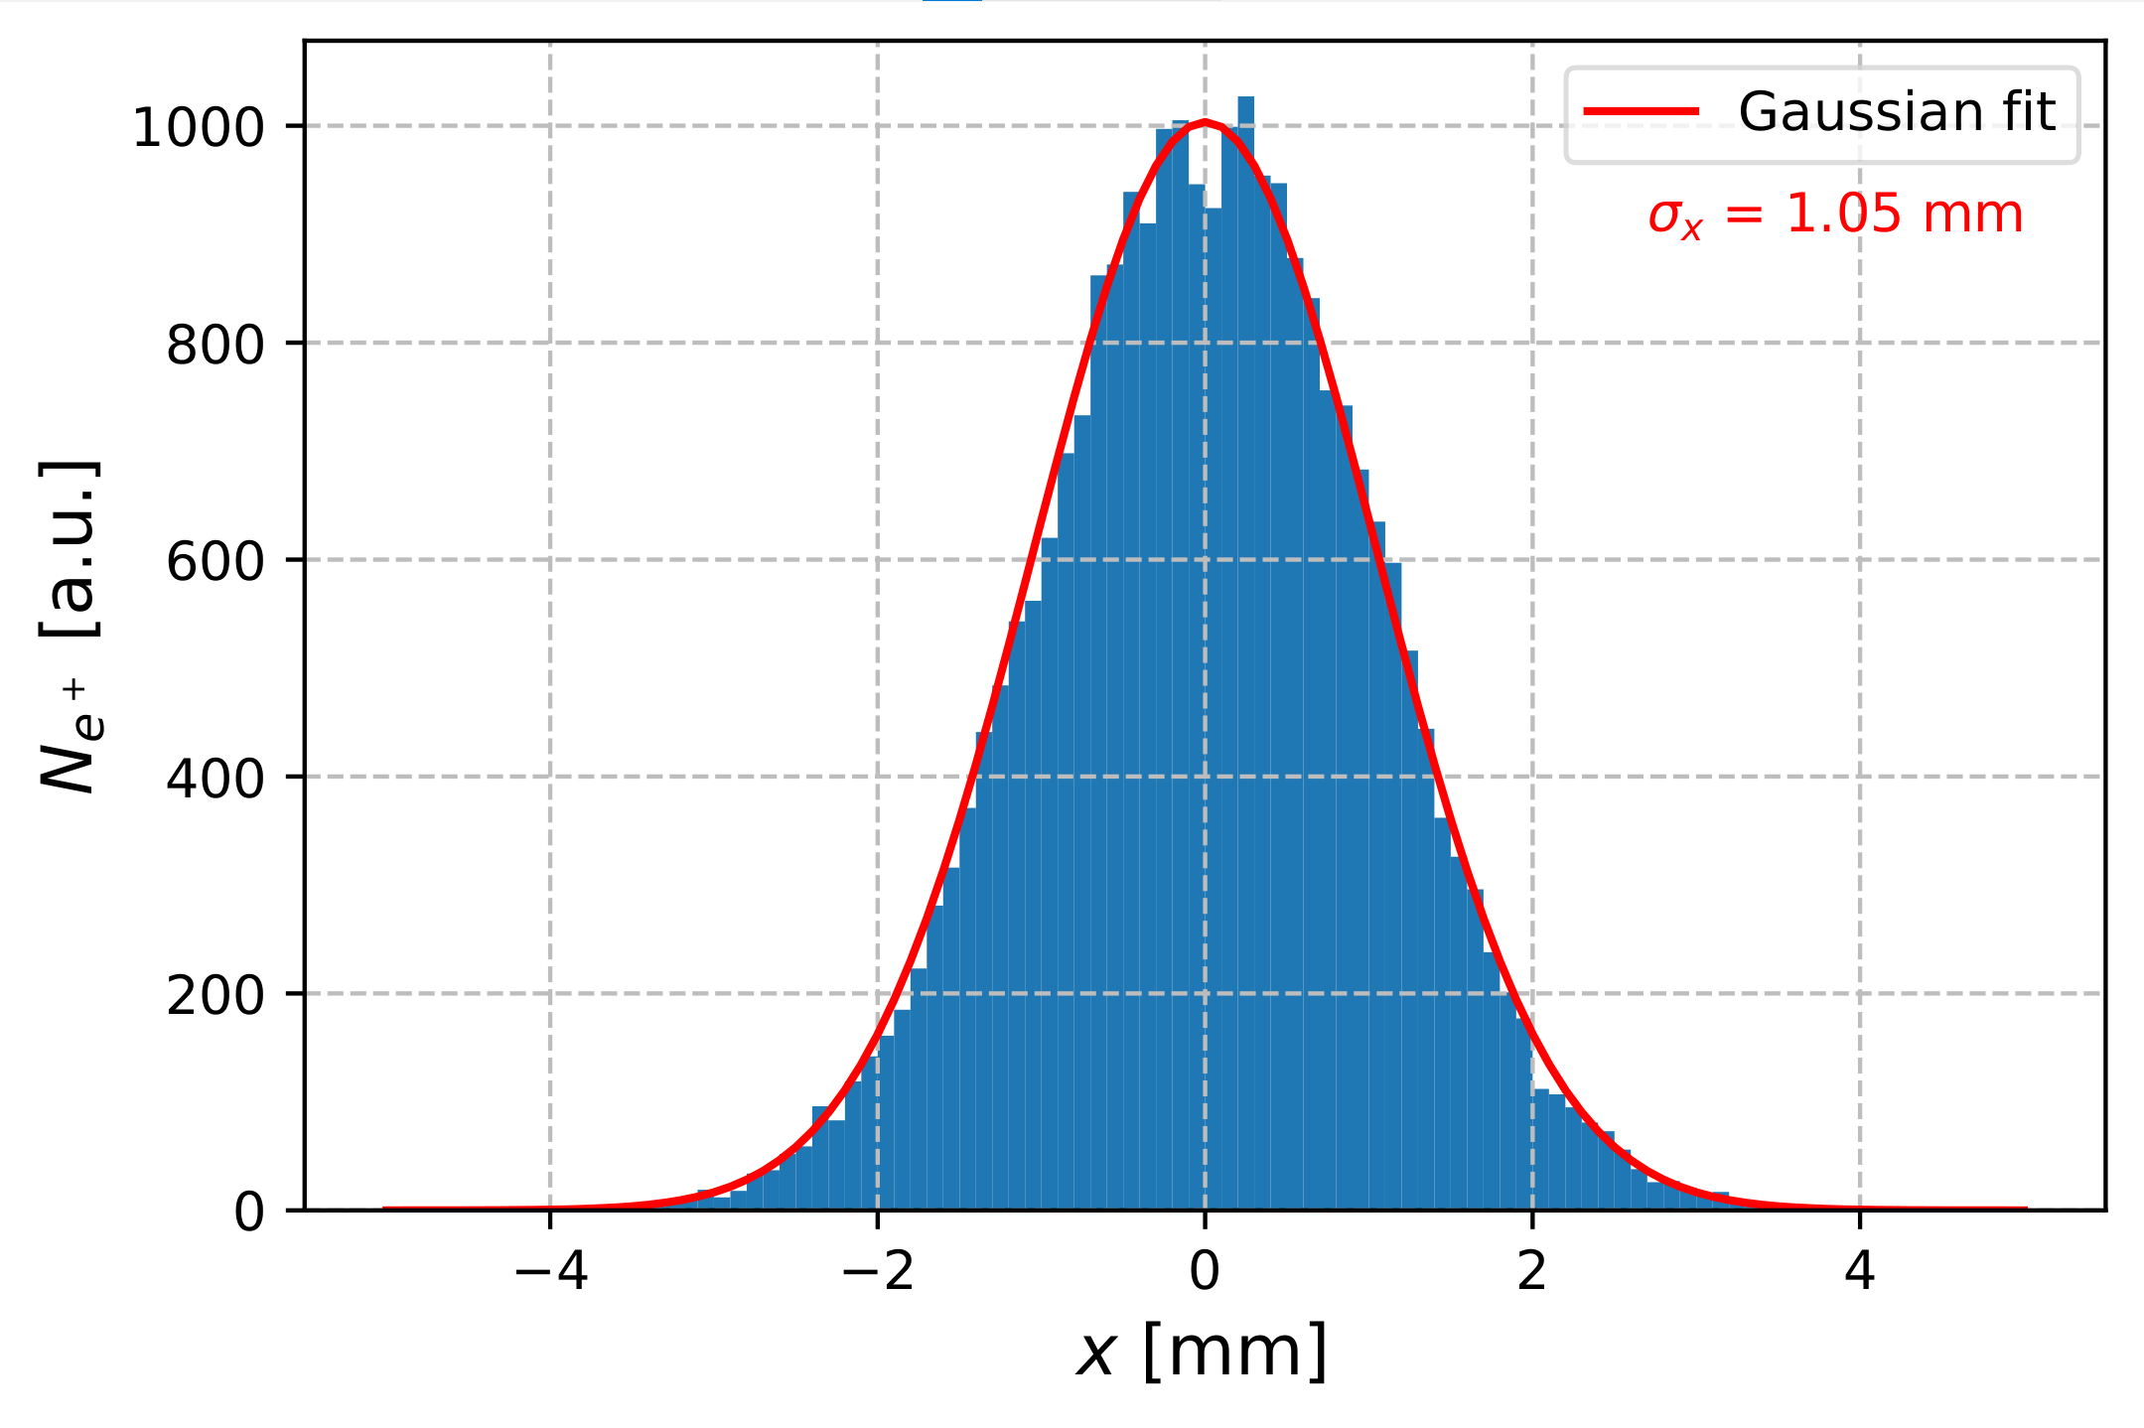
X Distributions of e⁺ in Forward Direction. E_{e+} = 60 MeV $±$ 5%
N_{e-} = 10⁷
N_{e+} = 26093

Slide 18
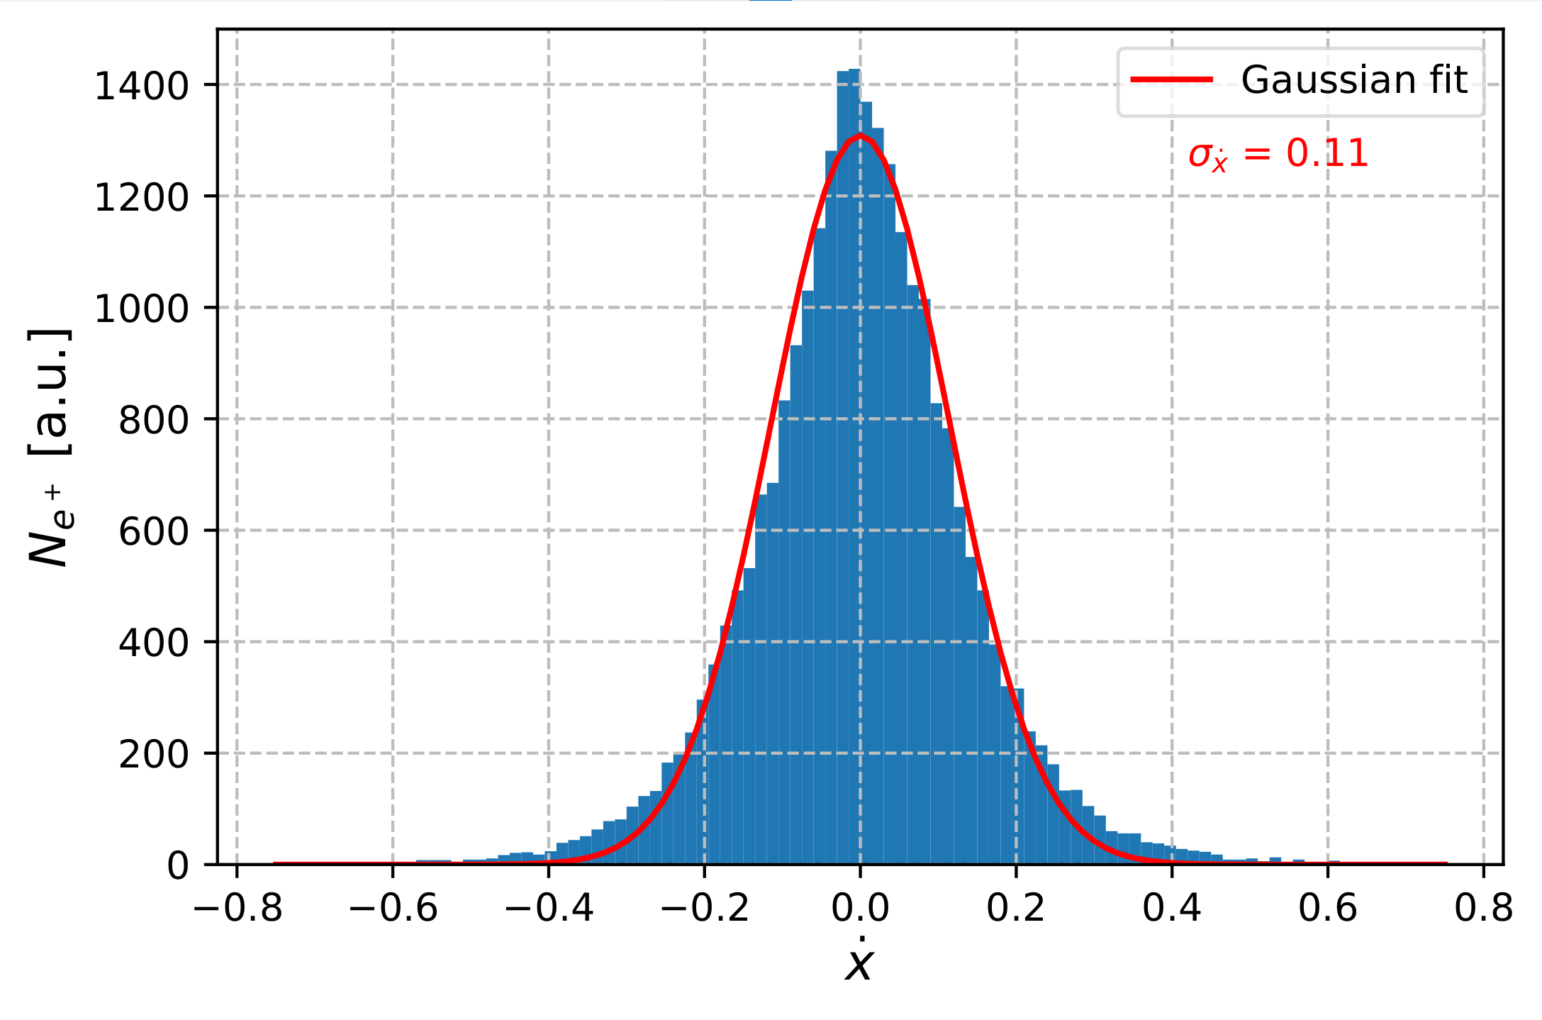
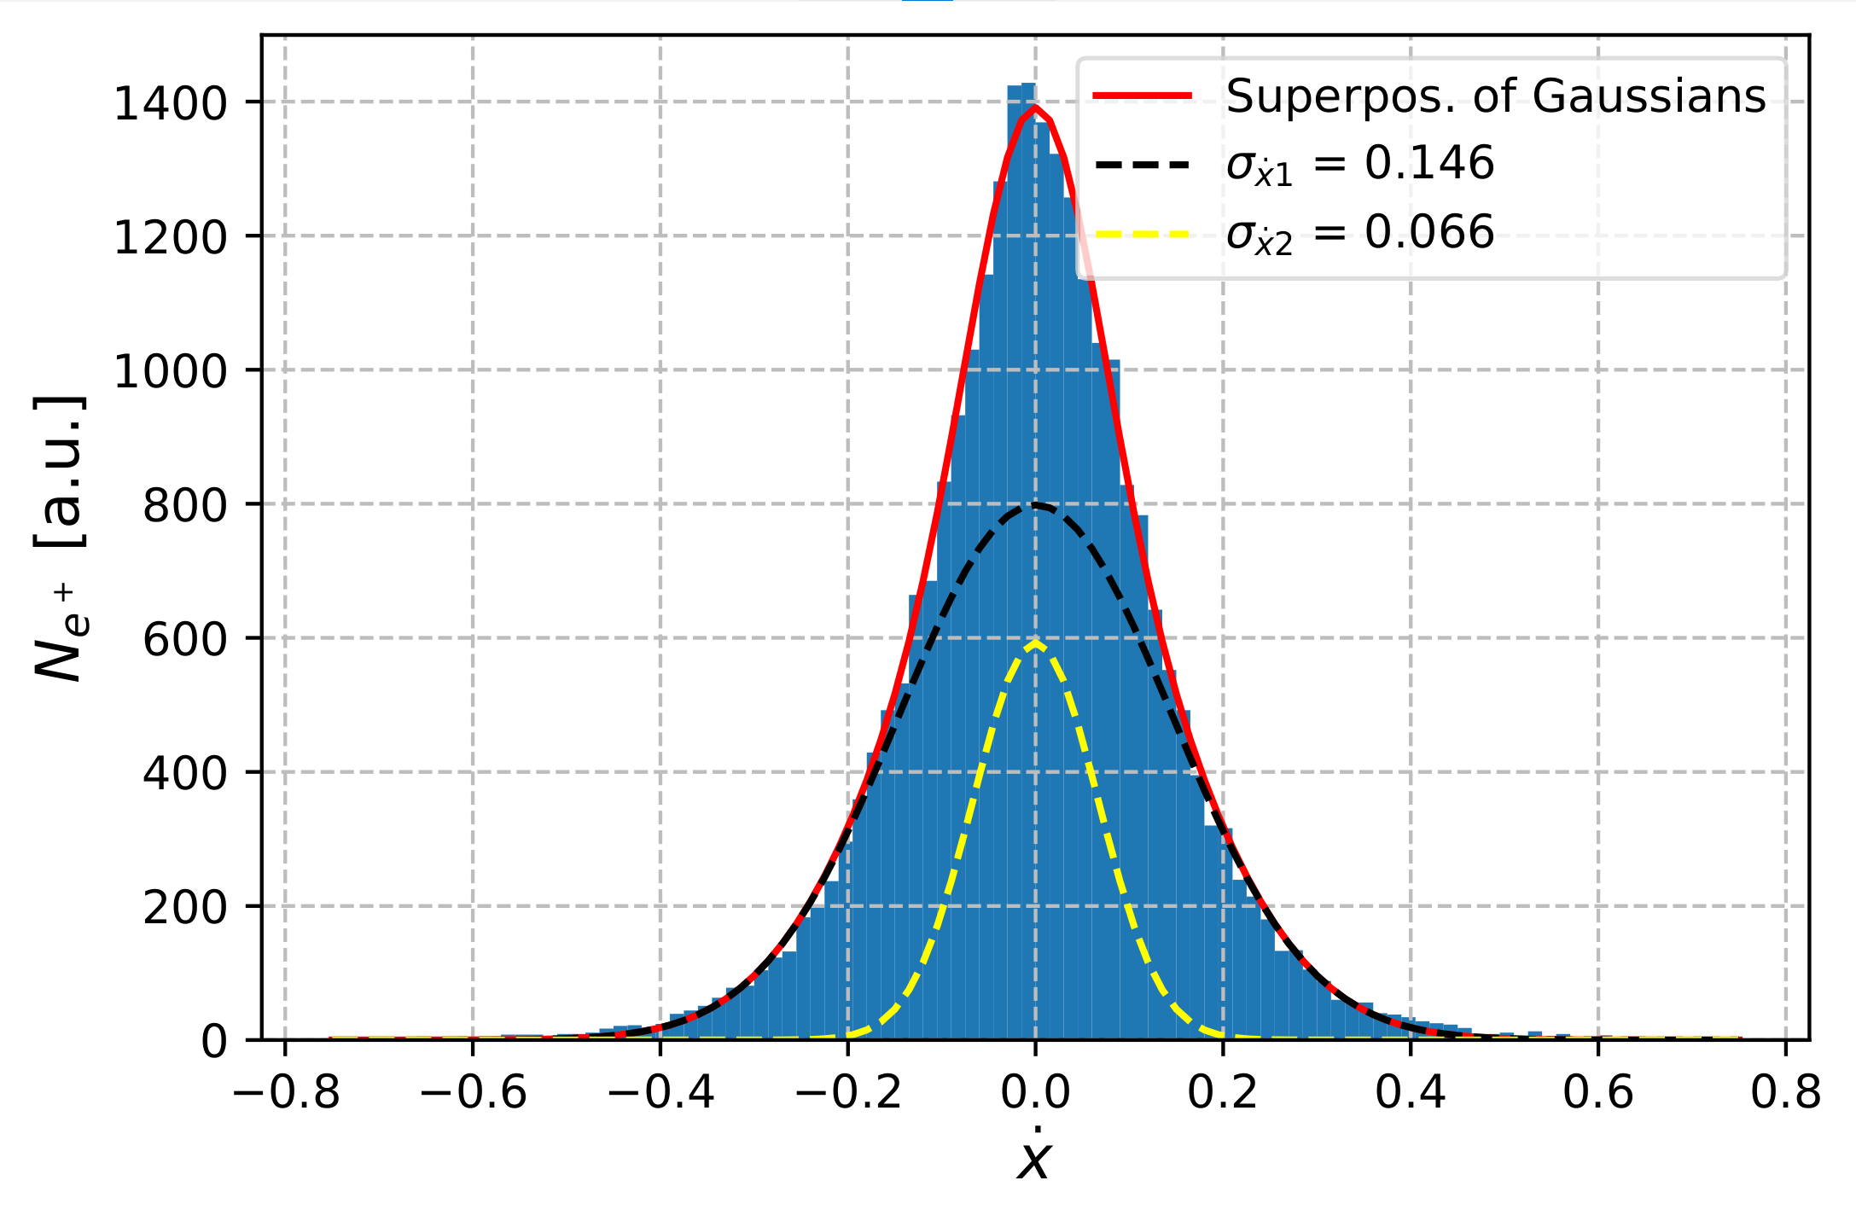
X’ Distribution of e⁺ in Forward Direction. E_{e+} = 60 MeV $±$ 5%
N_{e-} = 10⁷
N_{e+} = 26093

Slide 19
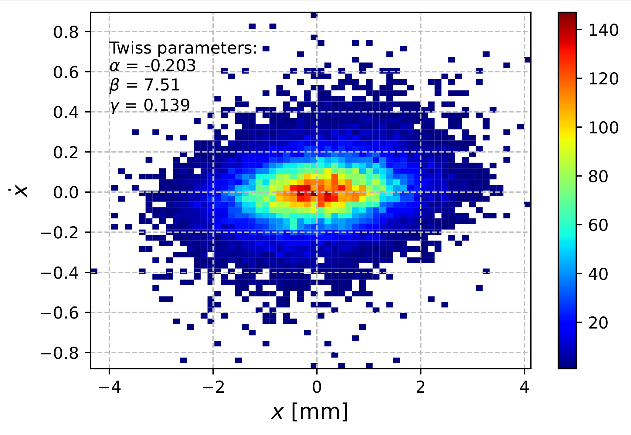
X-X’ Phase Space of Positrons in Forward Direction. E_{e+} = 60 MeV $±$ 5%
Mean E = 59.85 MeV
ε_{x} = 0.143 mm·rad
ε_{norm x} = 16.9 mm·rad
N_{e-} = 10⁷
N_{e+} = 26093

Slide 20
Next Steps
Add magnetic field(s)
Track positrons and electrons
Find optimal field distribution(s) for 60 MeV and 10 MeV positrons
Calculate energy deposited by beams in magnet

