Slide 1
FE-SEM foil thickness measurements

Slide 2
Process
Mount sister foils to Si wafers
Static for thinner foils
“glue” with aerodag carbon suspension for thicker
Mamun makes images
Use ImageJ software to measure .tiff images saved from FE-SEM process

Slide 3
Comparison of edge find tool
Analyzed images 05 and 06 with edge contrast on or off
Find that the edge contrast tends to skew measurements slightly larger
Variation between images larger than variation between images
Conclusion:
make sure to go on inside edges of “edge find” line to get more accurate results

Slide 4
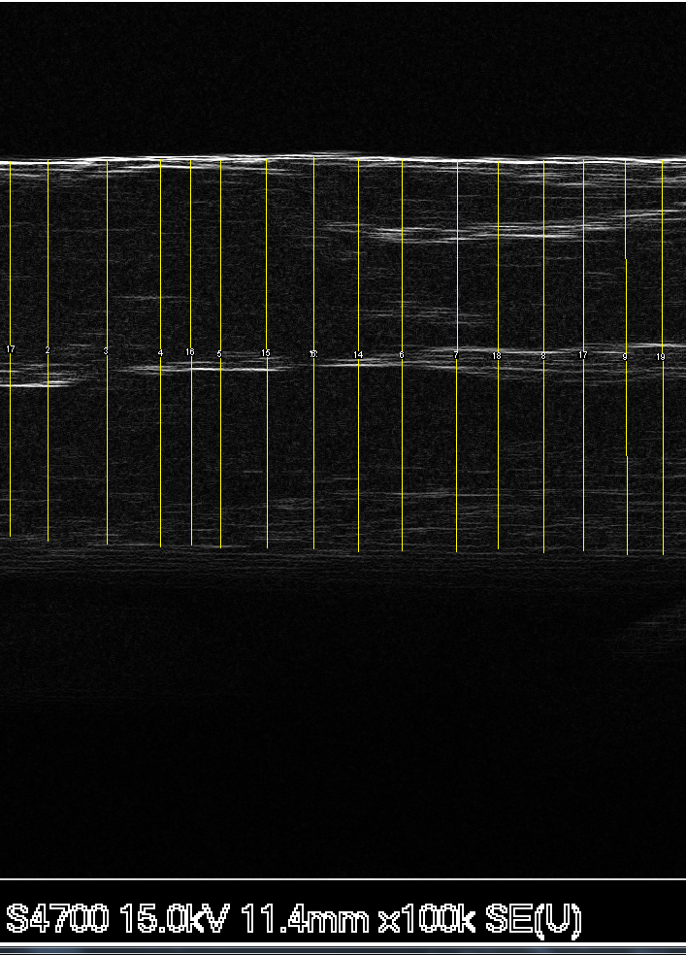
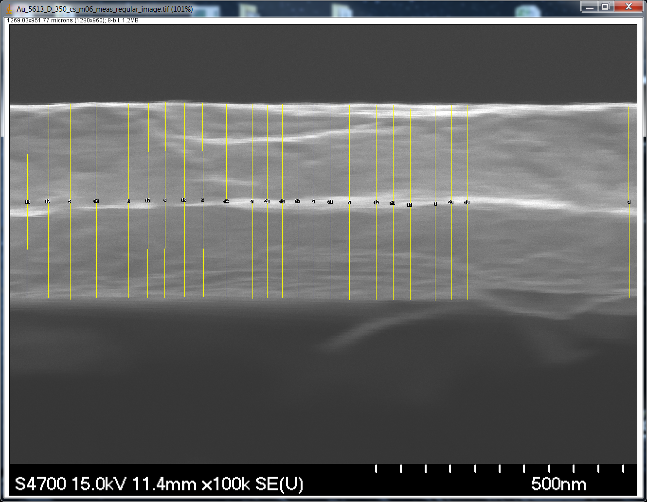
Image 06 Measurement with and without edge find

Slide 5
Image 05: original image, edge find

Slide 6
Statistical analysis of points measured spots selected by eye, original image

Slide 7
Thickness distribution, edge find 5613D image05, spots selected by eye

Slide 8
Statistics from even distribution 5613 M05 even stripe distance (don’t skip any oddities)

Slide 9
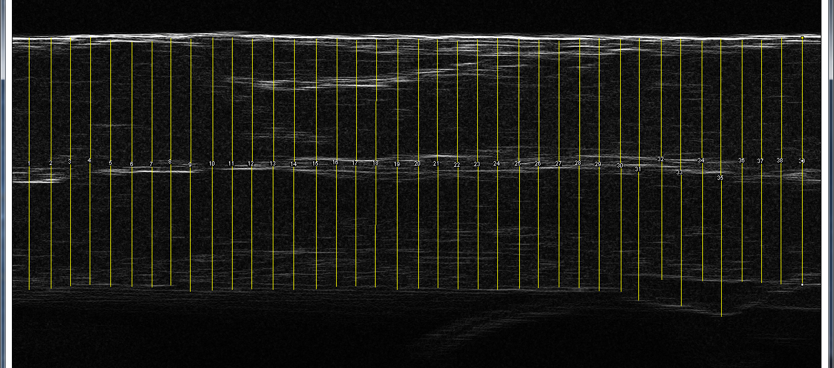
5613D
Image 03: 360 ± 17 nm
Image 05: 397 ± 10 nm
Image 06: 392 ± 10.5 nm

Slide 10
Conclusions: 5613D
Edge find image,
Weighted mean
0.392 microns ± 0.0036
Original image,
Weighted mean
0.388 microns ± 0.0022
Even stripes image,
Weighted mean
0.389 microns ± 0.0066
Thickness is robust to within
error bars for any of the methods

Slide 11
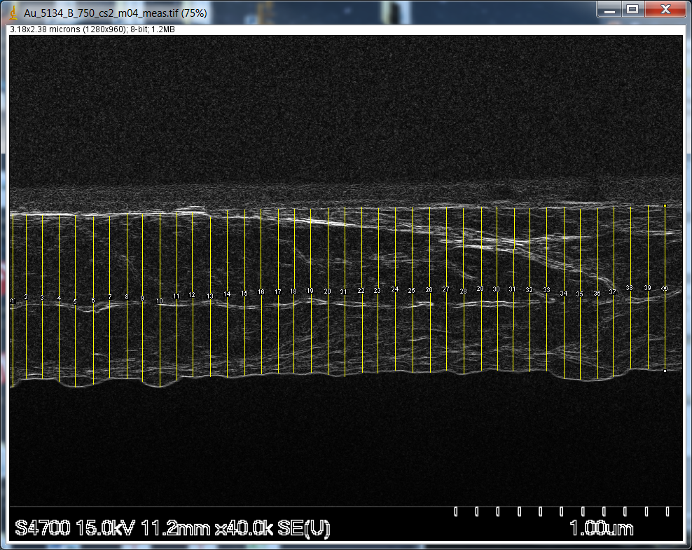
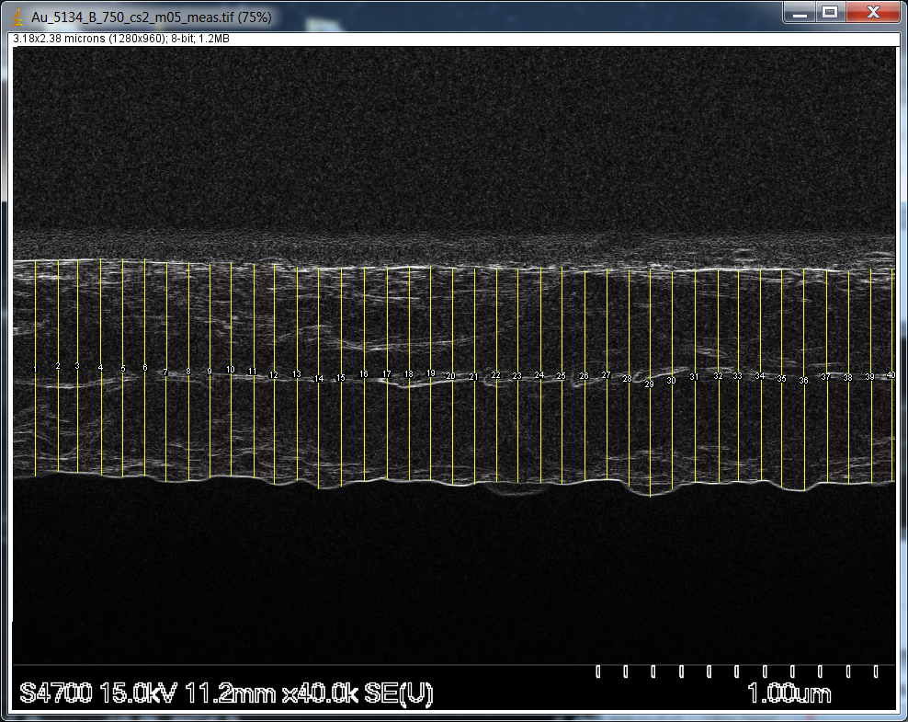
Foil 5134
782 ± 16 nm
772 ± 13 nm
Average: 776 nm ± 10.1

Slide 12
Foil 6809
Image 03: 54.005 +/- 3.443
Image 04: 51.254 ± 2.766 nm
51.539 ± 2.766
Image 06: 51.824 ± 2.252 nm

Slide 13
Ladder position | Foil number | Quoted thickness (nm) | Measured thickness (nm)
13 | 6845 | 50 ± 5 | 51.539 ± 2.766
1 | 7029 | 225 ± 22.5
8 | 5613 | 350 ± 35 | 389 ± 6.6
5 | 5275 | 500 ± 50
2 | 7028 | 625 ± 62.5
4 | 5134 | 750 ± 75 | 776 nm ± 10.1
3 | 3057 | 870 ± 87
15 | 5385 | 1000 ± 100

