Slide 1
An update on the fiber laser system design for the CEBAF photo-injector.
John Hansknecht
Electron Gun Group

Slide 2
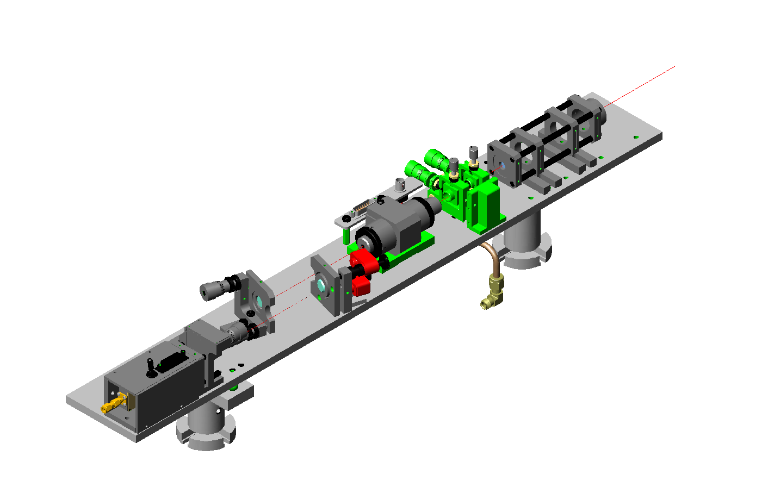
Diode Laser system (50mW)
Notes:
Laser swap space. Partially reflective mirrors. Dichroic mirrors. Polarized combining.

Slide 3
1997 Laser Pulse Structure
Beam amplitude is customized for the specific halls at the laser rather than at the chopper.
Individual hall laser can be shut-off if hall does not want beam.
Individual Tune and viewer limited modes.
Notes:
Important notes to drive home. Perfect structure IF

Slide 4
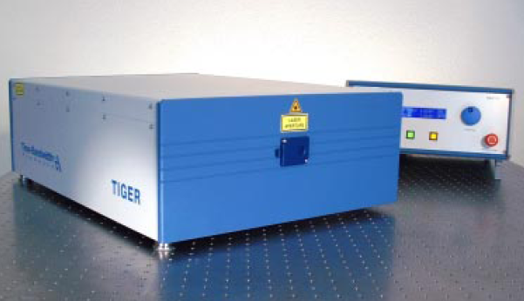
2001-2002
New technology available- (SESAM technology) Commercial Ti-Sapphire laser that provides superior reliability and performance over our injection-seeded and AOM mode-locked Ti-Sapphire lasers.
g0 31MHz experiment would not have been successful were it not for this laser.
Laser was so successful that we purchased several for 499MHz as well.
Laser table controls upgraded to provide fine control for the correction of current and position asymmetries.
500mW

Slide 5
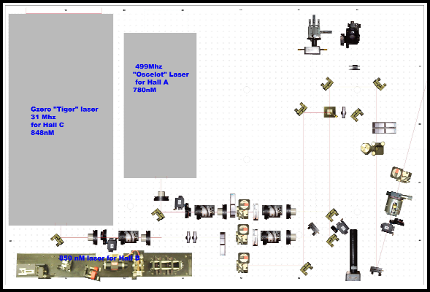
2002 – Present Laser Table

Slide 6
New laser system design.
Pre-Amp
Pre-Amp
Pre-Amp

Slide 7
Laser Amplifier and Second Harmonic Generation
Notes:
Potassium Titanyl Phosphate or LiNo3

Slide 8
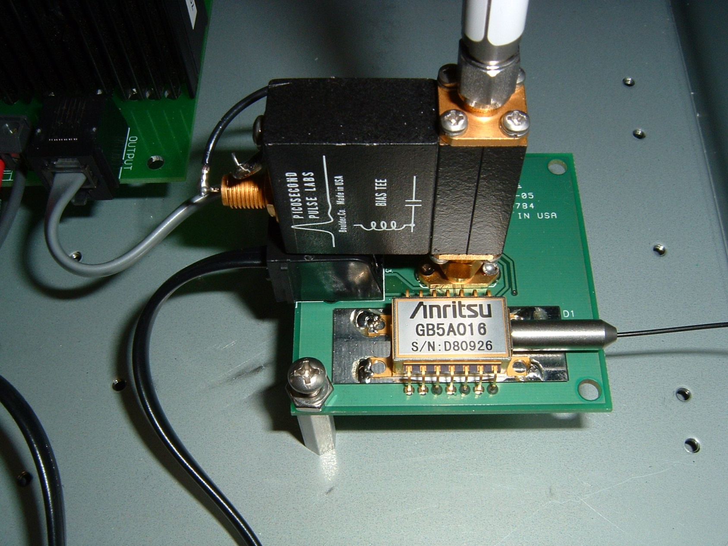
Laser Seed with direct Rf input

Slide 9
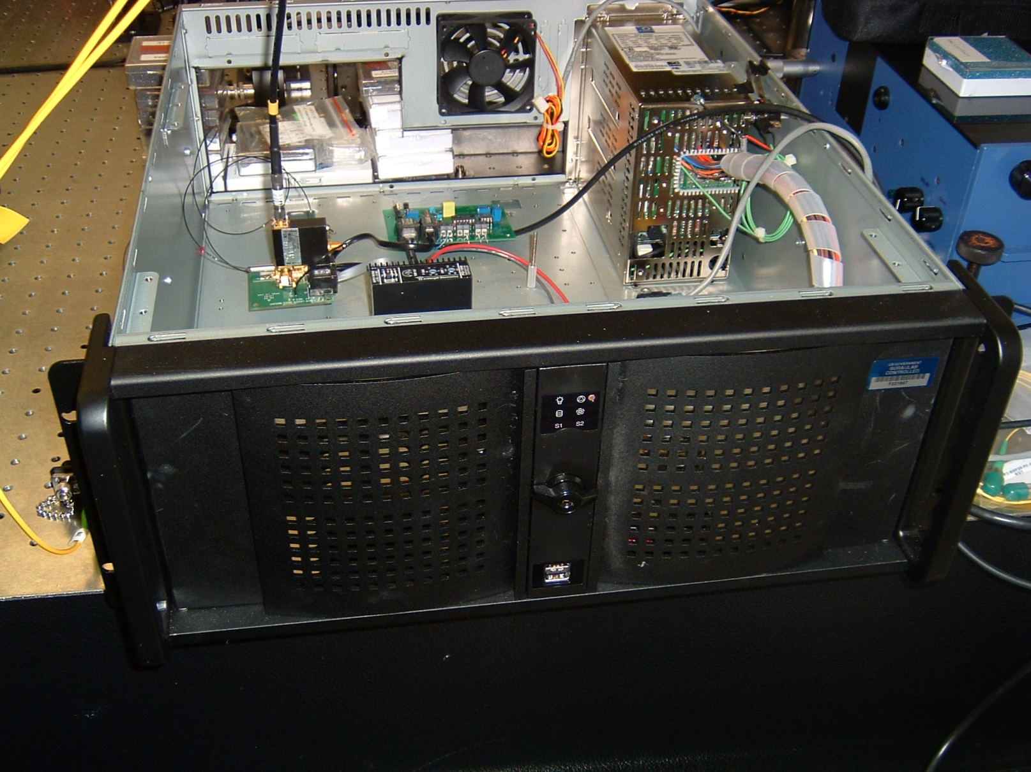
Seed & PreAmp Chassis

Slide 10
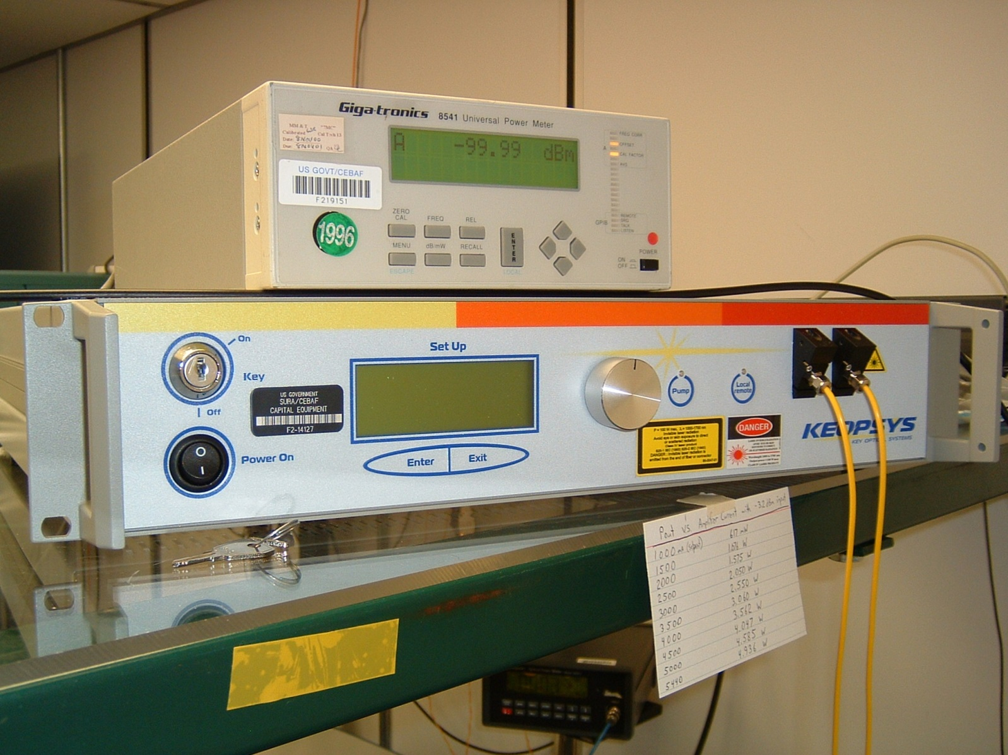
Fiber Laser Amplifier

Slide 11
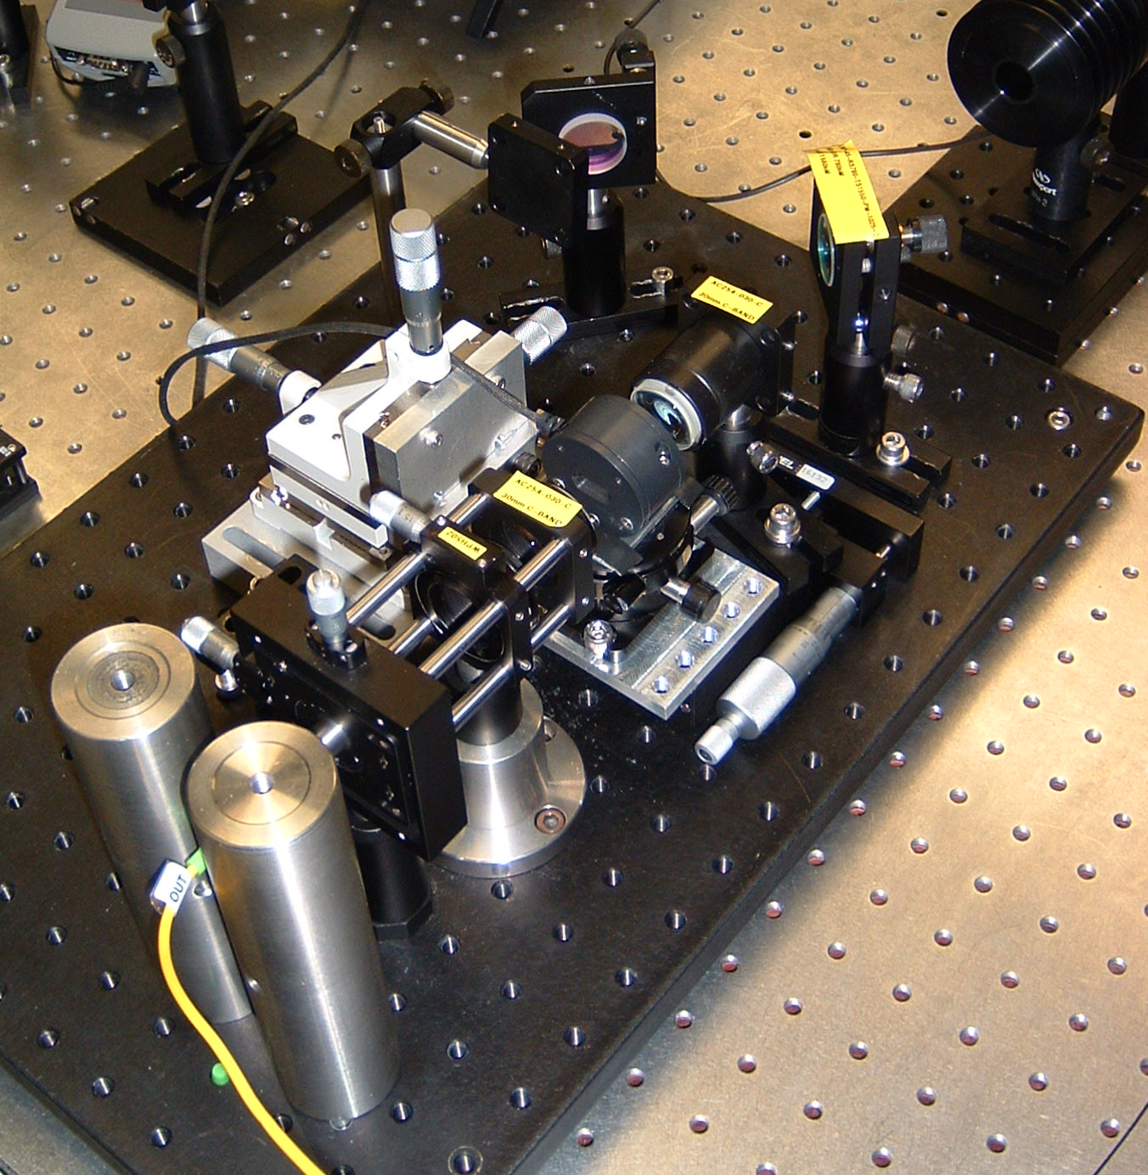
Second Harmonic Generator

Slide 12
Periodically Polled Lithium Niobate Second Harmonic Generator (PPLN SHG)

Slide 13
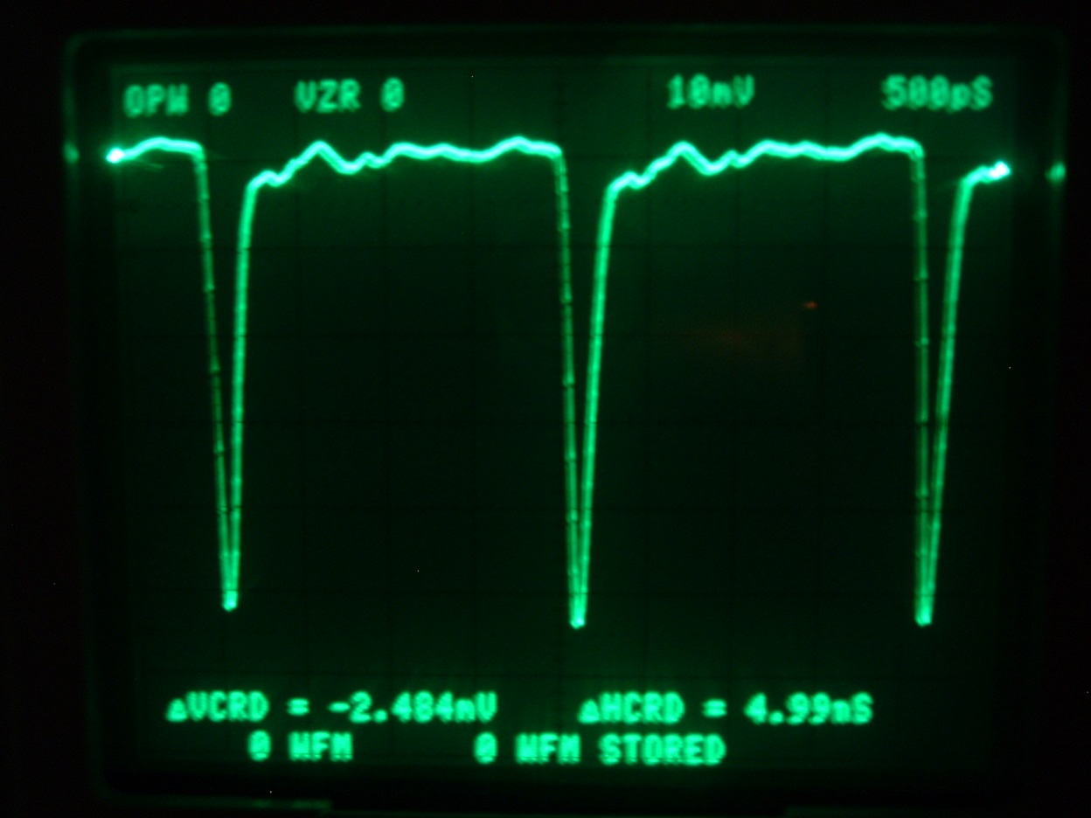
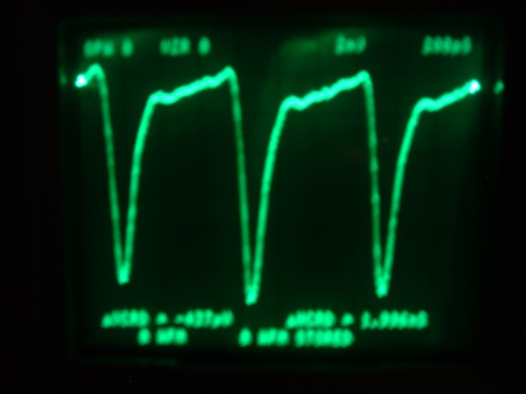
Results !!
1.497 Ghz
499 Mhz

Slide 14
Confirm measurements before publishing!

Slide 17
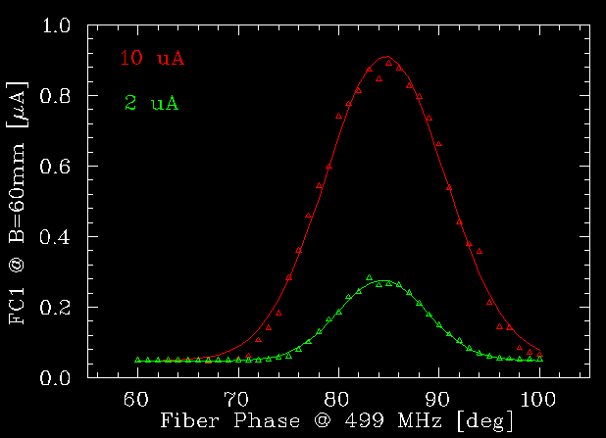

Slide 18
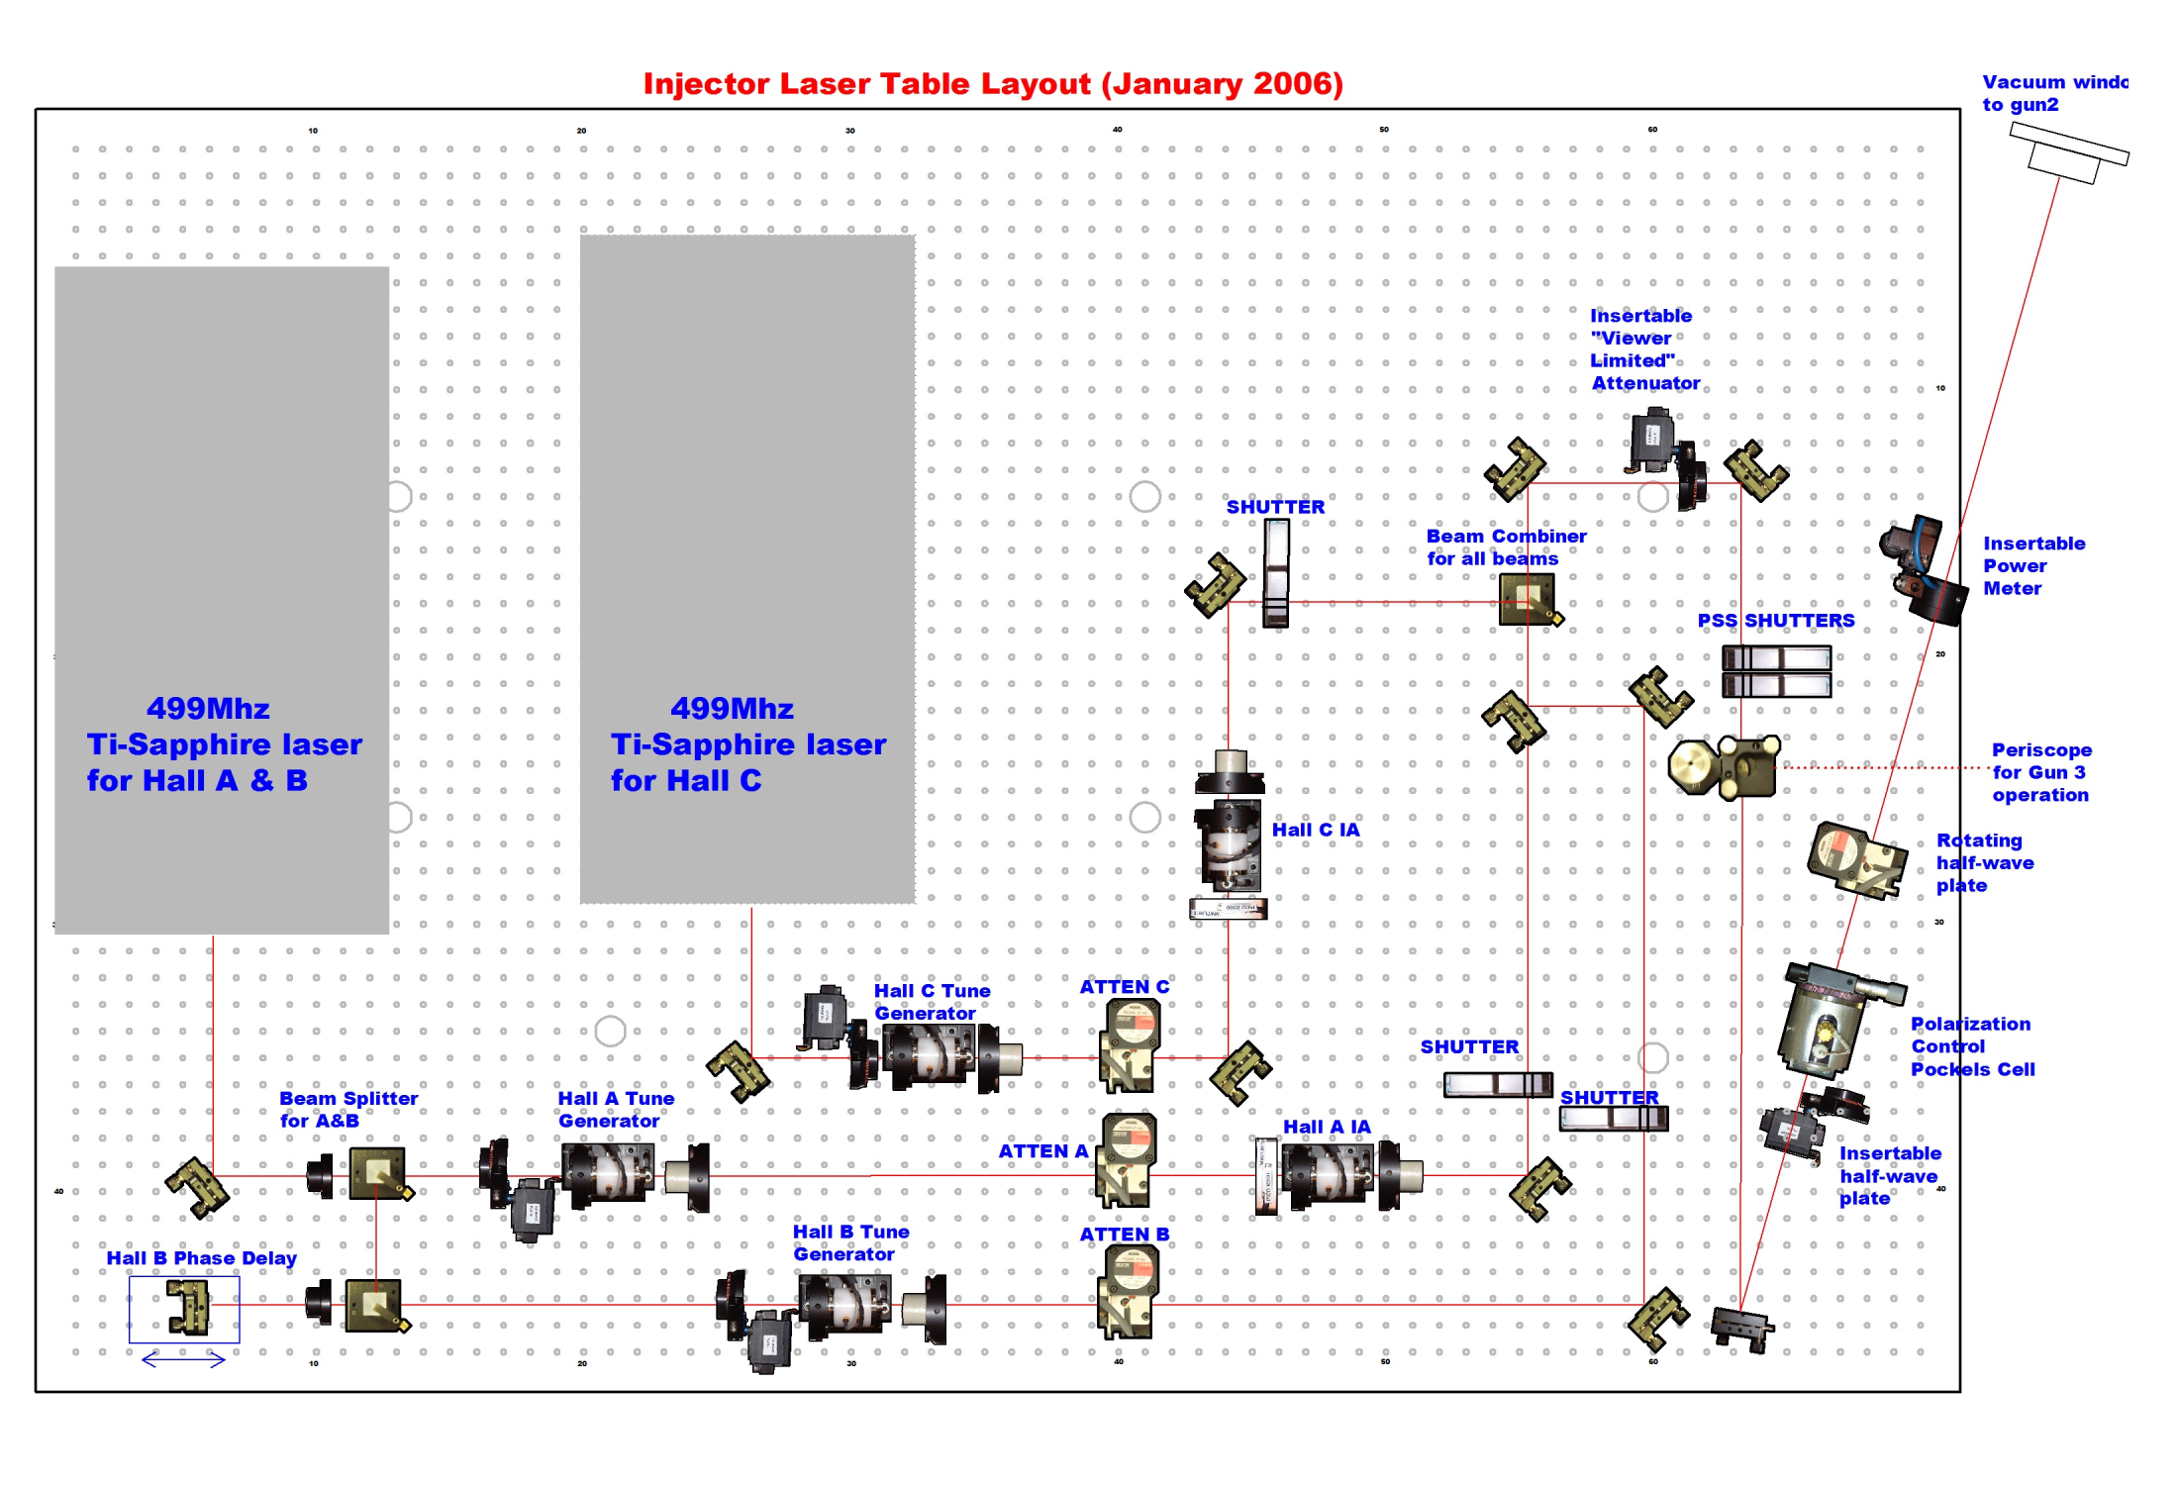
January 2006 Laser Table Layout

