Slide 1
PEPPo Experiment Readiness Review
April 20, 2012
Presenters: J. Grames, E. Voutier
Outline
Present Status
Response to January Review Action Items
High Level Experimental Run Plan
Status of the Documentation
Summary

Slide 2
Outline
Present Status
Response to January Review Action Items
High Level Experimental Run Plan
Status of the Documentation
Summary

Slide 3
Beam Line Vacuum Components
Vacuum - Base pressure good/stable 4x10⁻⁸ torr; now interlocked to PEPPo and Injector valves
Target Ladder – Works reliably & reproducibly; thermal calculation done (see later slide)
Beam Position Monitors – Works reliably, fast S/H cards connected to DAQ
Beam Cavity Monitor - New receiver works great, limit ~1nA, FSD tested OK from 2nA to 1uA
Faraday Cup – Works reliably; new software works; current monitoring good to ~50pA
Viewers – Work reliably; 3 enabled cw safe OK; insertion ITV5D03 less than beam position
=> (Update) 4/19 measured beam offset 5mm, 5/18-increase depth
Collimators – Moves to IN/OUT limit switches OK; software upgrade due for calibrated motion
=> (Update) ATLIS #12315 software upgrade, 4/19-first pass, 5/18-due date

Slide 4
Beam Line Magnets
5 MeV Dipole – Reliable & reproducible
Quads – Work OK; polarities checked
Correctors – Work OK; polarities checked; increase MCSxx, MPD5D03A PS limits
=> (Update) ATLIS #12341 submitted to increase limits
Capture Solenoid – Magnet/PS OK to max 300A
Spectrometer– Magnet/PS OK to 195A (8MeV); MMF map confusing
=> (Update) Using E166 map near term; resolve MMF map (or remap) long term
Transport Solenoid – Low current coil OK; retrofit high current coil May 18th
=> (Update) Shop agreed new coil by 5/11; MMF to map, ready for 5/18 install
Low Current PS – All 1A/10A trims work OK
High Current PS – Expert controls good, reproducible; need hysteresis “wrapper”
=> (Update) Software working job, complete controls 5/1

Slide 5
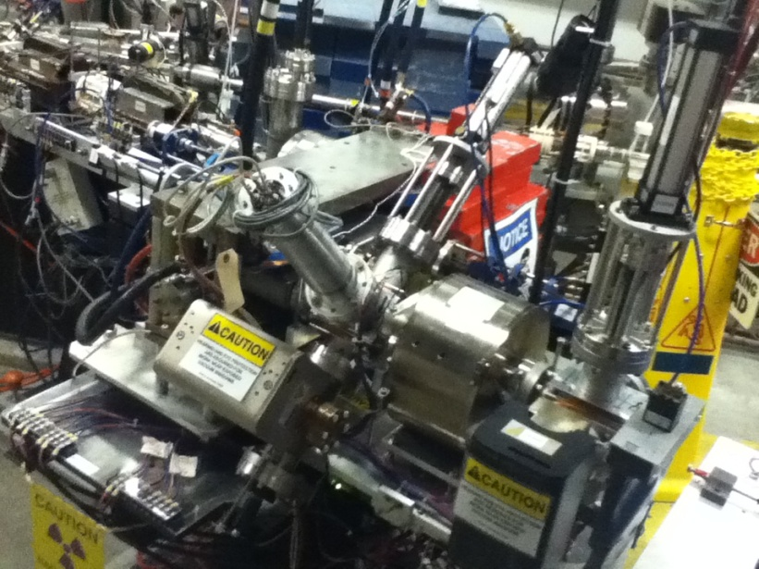
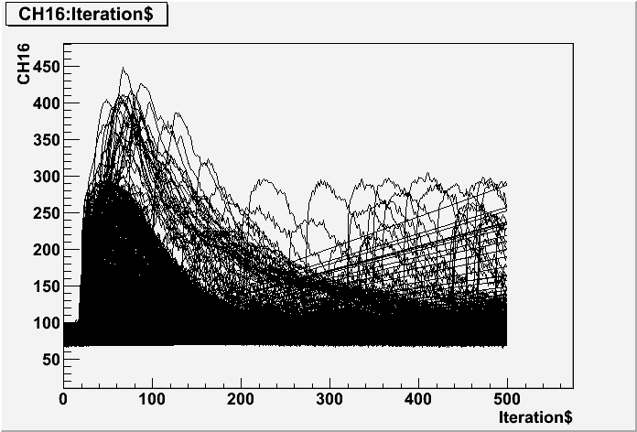
Annihilation Detector
Parameter | Component | Status
Hardware | Detectors PMT read-out and cabling | 100% 100%
Electronics | FADC 250 based read-out | 100%
Analysis | Data decoder and ntuples Analysis macros | 100% 100%
The annihilation counters and associated DAQ are operational and are currently tested during beam-time studies for 511 keV γ coincidence detection.

Slide 6
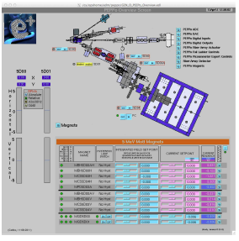
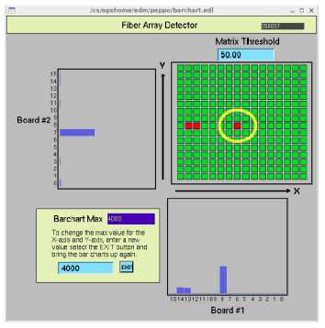
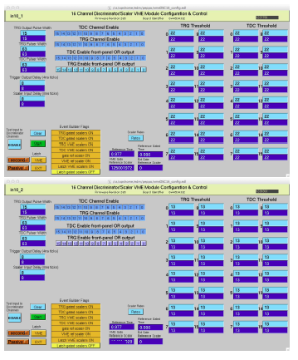
Fiber Array Detector
Parameter | Component | Status
Hardware | Detector PMT read-out and cabling | 100% 100%
Software | EPICS read-out Data display Data recording | 100% 100% 100%

Slide 7
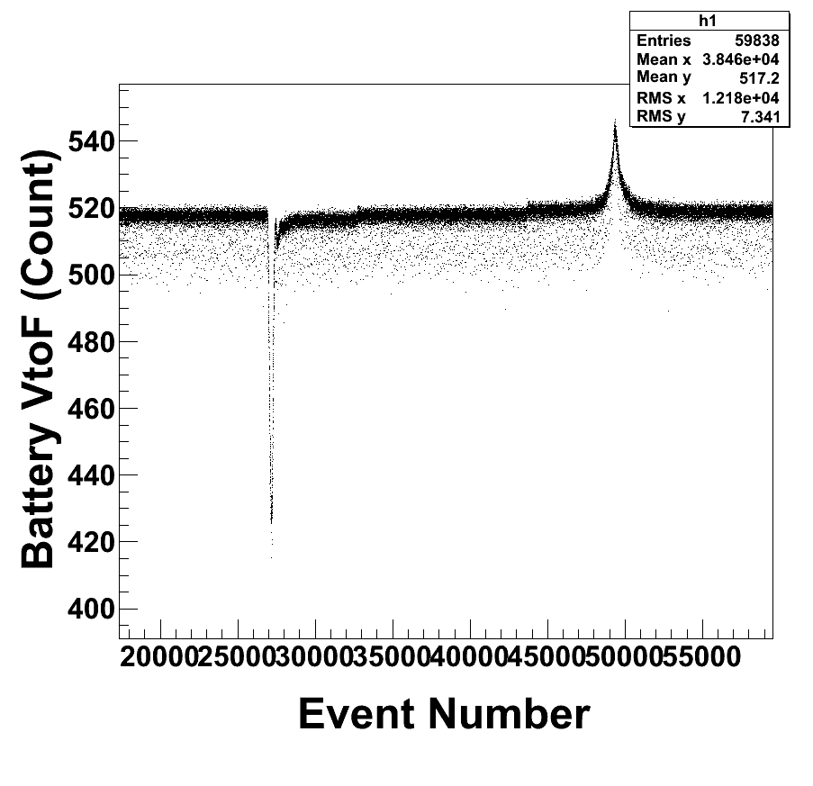
Compton Transmission Detector
Parameter | Component | Status
Hardware | Detectors (CsI crystals, Cosmic paddles, LED controller) Shielding Analyzing magnet (power supply, control, measurement) | 100% 100% 100%
Electronics | FADC 250 based read-out Final cabling | 100% 100%
Analysis | Data decoder and ntuples Online monitoring histograms Analysis macros Analyzing power simulations Pick-up coils analysis | 100% 85% 100% 75% 50%
Experimental Method
The signal delivered by the pick-up coils upon analyzing magnet powering or polarity change is read by a VtoF+Scaler setup.
The flux measurements are compared to the magnet model expectations relying on the measured field map.

Slide 8
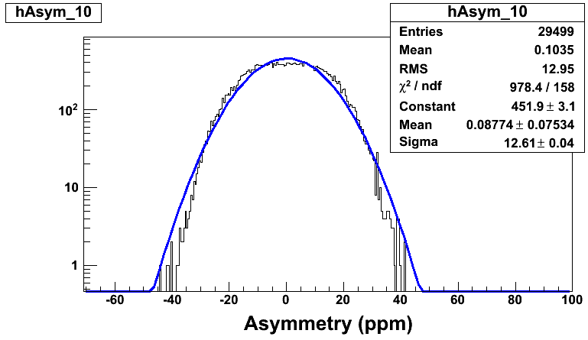
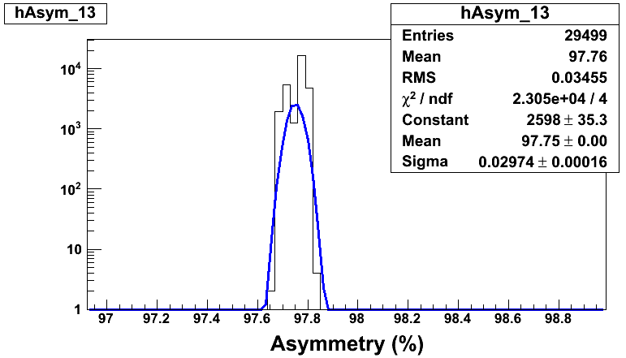
Data Acquisition Hardware
Parameter | Component | Status
Hardware | FADC 250 modules Trigger interface module (buffering mode) Electronics modules and cabling | 100% 100% 100%
Firmware | FADC 250 firmware for integrated mode | 100%
Data Handling | Mass storage | 50%
Battery signal asymmetry
Helicity signal asymmetry

Slide 9
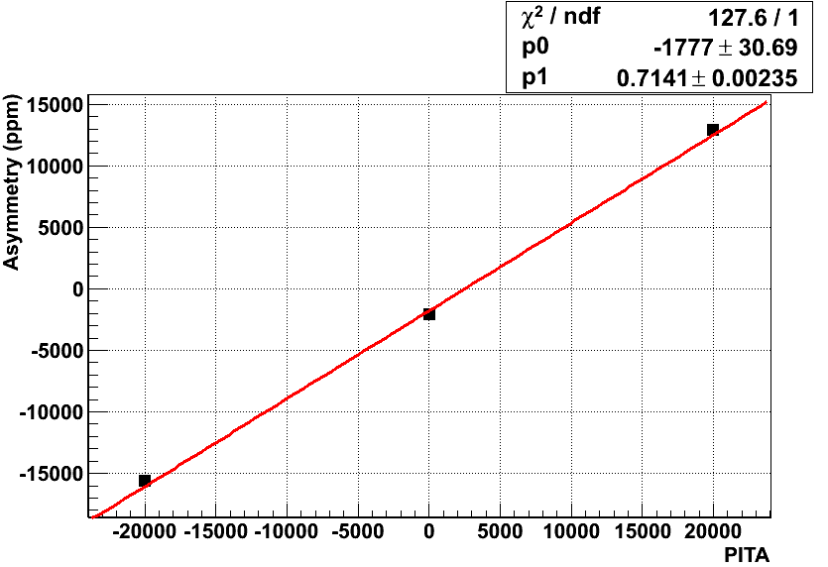
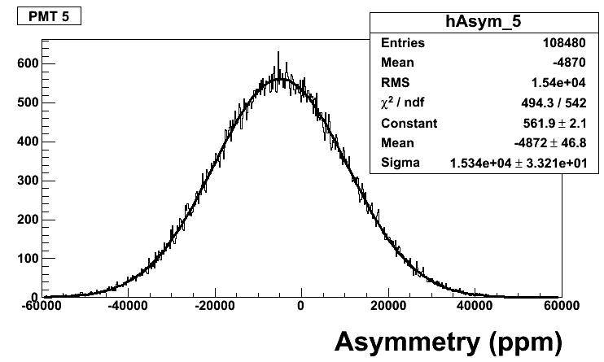
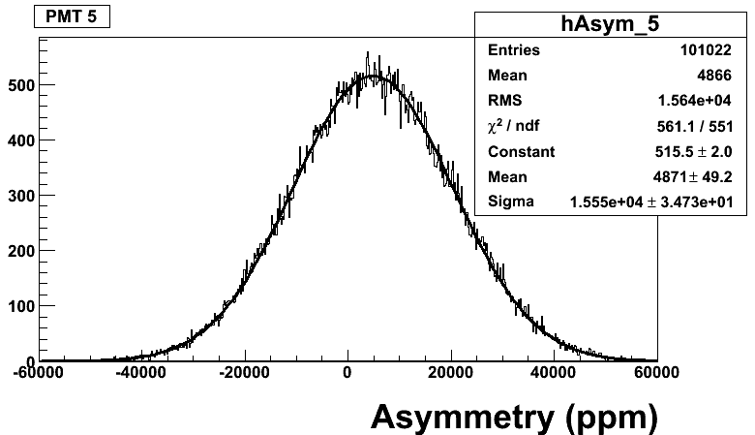
Data Analysis
Parameter | Component | Status
Decoder | Sample mode Semi-integrated mode Integrated mode | 100% 100% 100%
Software | Ntuple maker Online monitoring Online scaler read-out | 100% 85% 75%
Analysis | Compton asymmetry macros Beam charge asymmetry macro Beam position asymmetry macro Pick-up coils macro | 100% 100% 100% -
I = 0 A
PITA scan measured with the
Compton Detector
I = -60 A
I = +60 A
Electron beam Compton asymmetry measured with the polarimeter

Slide 10
Outline
Present Status
Response to January Review Action Items
High Level Experimental Run Plan
Status of the Documentation
Summary

Slide 11
Response to January Review Action Items
Readiness Review Recommendation
RR#1 – Provide an approved RSAD, ESAD, COO
RR#2 – Address SRF vacuum protection before/after LSD
RR#3 – Interlock PEPPo valve to PEPPo vacuum
RR#4 – Investigate radiation hardness of vacuum window epoxy
RR#5 – Implement machine protection
RR#6 – Ensure PEPPo magnets do not impact NP program
RR#7 – Provide target thermal analysis and proposed restrictions
RR#8 – Evaluate rapid access
RR#9 – Develop operational procedures

Slide 12
Response to RR#1 – Provide an approved RSAD, ESAD, COO
RadCon provided an RSAD shortly after the initial safety readiness review.
PEPPo developed a COO & ESAD based upon the style and function used by Physics
The proposed documents are provided at the Positron wiki :

Slide 13
Response to RR#2 – Address SRF vacuum protection before & after LSD
Before the LSD (PEPPo Beam Studies) – Potential to impact the NP program
Implement BCM FSD upstream of PEPPo
Implement BLM FSD at PEPPo beam line branch point
Implement Injector/PEPPo valve interlock to PEPPo vacuum
Limit maximum current to 1 microAmp cw
After the LSD (PEPPo Experiment) – No risk to the NP program
Implement same BCM, BLM and VACUUM FSD/Interlocks
Beam current limits set by target ladder heating calculation (see later slide)

Slide 14
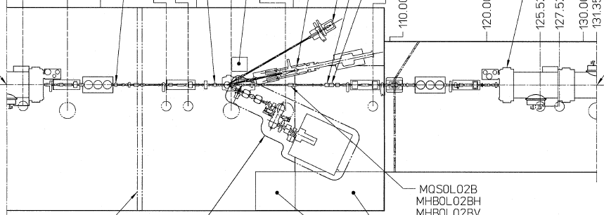
Response to RR#3 – Interlock PEPPo valve to PEPPo vacuum
Three injector vacuum valves are interlocked to the PEPPo vacuum
Closure of valves pulls and FSD, turns beam off
Interlock threshold is 100uA
PEPPo base vacuum corresponds to ~15uA, and is stable
V
V
V
4 Ion Pumps

Slide 15
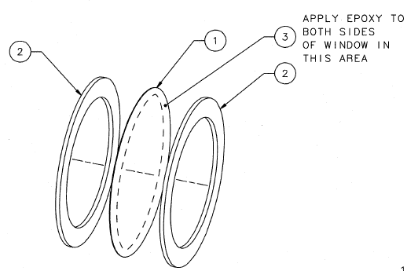
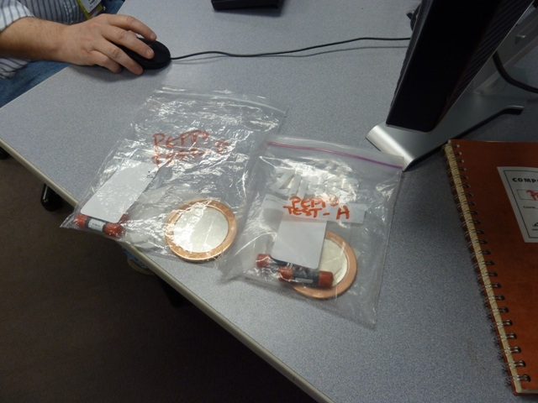
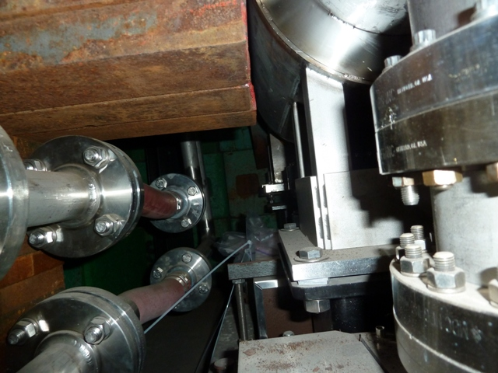
Response to RR#4 – Investigate radiation hardness of vacuum window epoxy
Al window
(0.010”)
Burst Test Analysis (Target Group)
0.010” Al failed edge gasket 165 psi
4.5”
Copper
Gasket
4.5”
Copper
Gasket
Test Window | Leak Test | RadCon Dose | Pressure Test (170 psi max)
A | Good | 97 kRad | No failure
B | Good | 70 kRad | No failure
Two windows + redundant dosimetry
FEL 10 MeV dump

Slide 16
Response to RR#5 – Implement machine protection
Implement BCM FSD upstream of PEPPo
Implement BLM FSD at PEPPo beam line branch point
Implement Injector/PEPPo valve interlock to PEPPo vacuum
I
R
V
V
I
R
V
R
V

Slide 17
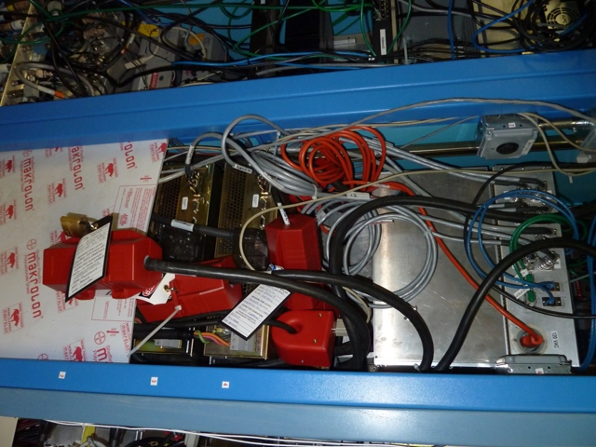
Response to RR#6 – Ensure PEPPo magnets do not impact NP program
Tested if any magnet disturbs injector beam
Spectrometer MPD5D03 deflect beam <0.5mm
Administratively lock out MPD5D03 PS during NP

Slide 18
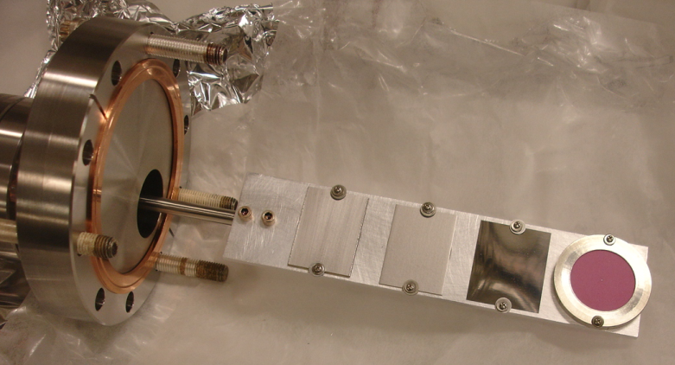
Response to RR#7 – Provide target thermal analysis and proposed restrictions
Engineering Analysis Performed
Inputs:
Geometry/materials to ANSYS
dE/dx from Geant4
150C limit boundary condition
Outputs:
Power deposition <1.1W
Independent of target thickness
Max current calculated for 1.1W
1.1W on 1mm W
Incoming electron kinetic energy [MeV] |  |  | 2 | 5 | 8 | 10
Element Name | Material | Thickness [mm] | Max Current [uA] for 1.1W
Production Target = 0.1mm | Tungsten | 0.1 | 3.5 | 6.07 | 6.62 | 6.96
Production Target = 0.5mm | Tungsten | 0.5 | 1.09 | 0.65 | 0.81 | 0.92
Production Target = 1mm | Tungsten | 1 | 1.08 | 0.43 | 0.36 | 0.35
Production Target = 2mm | Tungsten | 2 | 1.07 | 0.41 | 0.26 | 0.22
Installed

Slide 19
Response to RR#8 – Evaluate rapid access
(Agreed) Experiment liaison will coordinate with RadCon for energies >7 MeV
(Done) A detector connected to rapid access system will be placed in proximity to target

Slide 20
Response to RR#9 – Develop operational procedures
Control Documents
List of machine protection issues and controls
List of machine protection FSD interlocks
List of personnel protection issues and controls
Online Documentation & “How To” Procedures
https://positron.jlab.org/wiki/index.php/Shift_Takers_Online_Documentation_and_Procedures
Alarms & Malfunctions
Checklists
Beam Setup
Beam Line Elements
Annihilation Detector
Fiber Array Detector
Compton Detector
Data Acquisition
Analyzer
About 50% complete
Priority are “new” items
Trending to complete by May 1st (see later slide)

Slide 21
Outline
Present Status
Response to January Review Action Items
High Level Experimental Run Plan
Status of the Documentation
Summary

Slide 22
High Level Experimental Run Plan
PAC38 Approved Plan
 | p(e⁻) (MeV/c) | I(e⁻) | P(e⁻) (%) | Time (h)
Commissioning | 2 – 6 | 1 nA – 1 µA | ≥ 85 | 105
Mott Measurements | 6 | 1 – 5 µA | ≥ 85 | 10
e⁻ Calibration | 2 – 6 | 30 pA – 1 nA | ≥ 85 | 85
Detector Measurements | 6.8 | 1 – 4 µA | ≥ 85 | 36
e⁺ Measurements | 6.8 | 1 – 4 µA | ≥ 85 | 100
Total |  |  |  | 336
NPES Scheduled Plan
May 25-June 8 (24/7) => 336 hours
June 8-June 29 (nights/weekends) =>360 hours

Slide 23
Part 1 - Commissioning
1. Commission electron beam & diagnostics to production target T1
Learn range of cryounit gradients
Define BPM values for extraction orbit to T1
Commission region 1 as spectrometer (use 5 MeV dipole)
Characterize optics (quads) to set beam size at T1
Measure radiation & vacuum level w/ cw beam on T1 targets
2. Commission electron beam & diagnostics to reconversion target T2
Measured spectrometer current for orbit to T2
Commission location of collimators w/ beam
Commission fiber array detector thresholds/position w/ beam
Define orbit to T2
Characterize optics (quads + solenoids) for beam size at T2
3. Commission detectors with beam to reconversion target T2
Test configuration DAQ modes (sample, e+ semi-integrated, e- integrated)
Checkout of the Compton and Annihilation detectors

Slide 24
Part 2 – Calibrations
1. Calibrate electron analyzing power at Compton & Mott (T1 OUT)
Compton
Collect sample (spectra) and integrated (asymmetry)
Characterize analyzing magnet asymmetry vs. magnetization
Systematic studies of beam position/angle/spot size/polarization
Mott
Collect asymmetry vs. gold target thickness @ Mott
Systematic studies of beam position/angle/spot size
2. Calibrate spectrometer/Compton with degraded electron beam (T1 IN)
Spectrometer vs. 3 targets
Scans of spectrometer, collimators, capture, transport solenoids
Compton vs. 3 targets
(Electron Mode) Measure depolarization vs. target thickness of e-
(Positron Mode) Background measurements at Compton
3. Calibrate annihilation detector
Collect sample and semi-integrated data in e- and e+ mode
Systematic studies and background suppression

Slide 25
Part 3 – Data Taking
Compton electron analyzing power
Collect e- analyzing power in fine ~0.5 MeV increments
Positron polarization
Set electron beam to highest energy (maximize yield)
Select positron momentum (spectrometer magnet)
Optimize collection (capture solenoids) w/ AC, FA
Measure experimental asymmetry @ Compton
3. Characterize positron polarization vs. target thickness
Repeat steps in #2 for the three target foils (0.1, 0.5, 1.0 mm)
4. Repeat #2/#3 for 1-2 more different electron beam energies

Slide 26
Outline
Present Status
Response to January Review Action Items
High Level Experimental Run Plan
Status of the Documentation
Summary

Slide 27
Status of the Documentation
Documentation | Status
Alarms & Malfunctions | FSD Response Alarms Response
Checklists | End of Run Checklist Shift Checklist
Beam Setup | How to setup and measure the electron beam energy How to setup and measure the electron beam polarization How to setup Region 1 => electron beam only, production target How to setup Region 2 => electron or positron mode, spectrometer/collimator How to setup Region 3 => electron or positron mode, annihilation detector How to setup Region 4 => electron or positron mode, Compton polarimeter/fiber array
Beam Line Elements | How to use the injector beam current monitor How to use PEPPo beam position monitors How to use PEPPo view screens How to use the PEPPo Faraday cup How to use any of the beam line magnets How to use the production target ladder How to insert/remove the reconversion target
Annihilation Detector | How to operate the Annihilation Detector
Fiber Array Detector | How to operate the PEPPo fiber array detector How to move the fiber array detector IN/OUT
Compton Detector | How to control the voltage supply to the polarimeter PMTs How to measure the analyzing target polarization How to move the polarimeter
Data Acquisition | How to Run CODA How to use the VME discriminator
Analyzer | How to Decode a run How to use the root file analyzer How to analyze data

Slide 28
Outline
Present Status
Response to January Review Action Items
High Level Experimental Run Plan
Status of the Documentation
Summary

Slide 29
Summary
PEPPo experiment is scheduled to start 5 weeks from today.
We anticipate being ready to perform the experiment.
Final Tasks
Shift run plan and staffing
Cross training from system experts to shift takers
Final installation tasks the week of May 18-24
Install new high current solenoid
Final surveys
Detector source calibrations
(?) Install cooled target ladder

