Slide 1
Thermo-Mechanical Simulations for Positron Target
Developing a framework for evaluating the structural integrity of solid positron targets through simulations
Sohaib Bhatti
Mentors:
Andriy Ushakov
Joe Grames

Slide 2
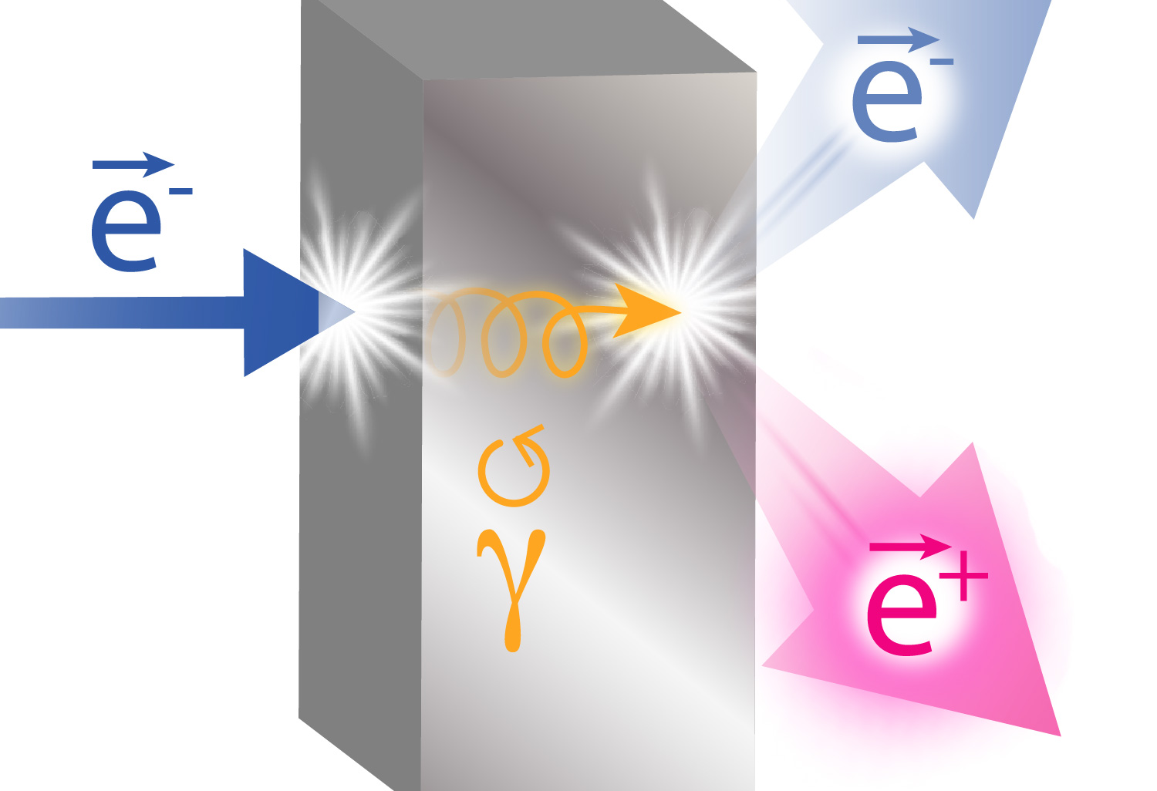
Ce⁺BAF
Jefferson Lab aims to deliver spin-polarized positron beams to CEBAF
The positron beam is generated from polarized bremsstrahlung and pair production from an electron beam hitting the target: tungsten foil
Resulting thermal energy deposition may result in target failure

Slide 3
Design Considerations + Software
Design considerations
Is the temperature high enough to melt the target?
Are the thermal stresses higher than yield?
What is the impact of the cyclic nature of the stresses?
Software
Particle physics Monte Carlo simulations — FLUKA
Computer aided engineering — Ansys
Computation fluid dynamics — Fluent
Finite element analysis — Mechanical
Cooling Loop
Target

Slide 4
Simulation Framework
Target Geometry
CAD from LDRD
FLUKA
Energy Deposition Profile
Ansys Fluent
Cooling
Ansys Mechanical (Heat)
Thermal Effect of Heat Transfer
System Coupling
Combine Thermal Effects
Ansys Mechanical (Structural)
Thermal Stresses and Fatigue

Slide 5
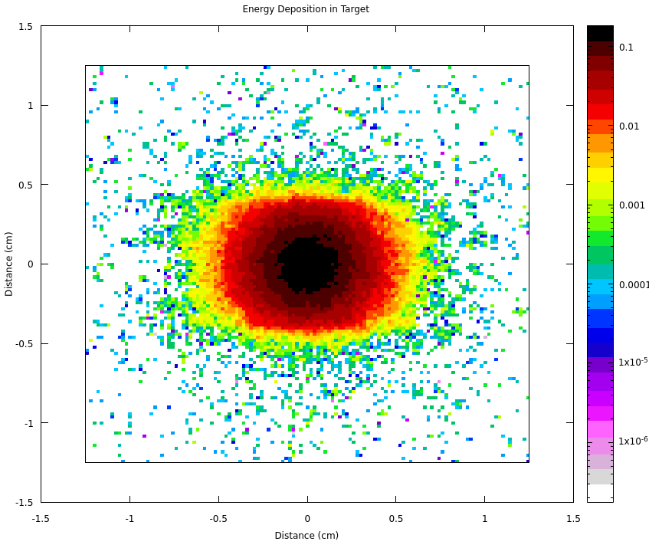
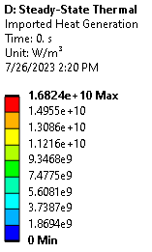
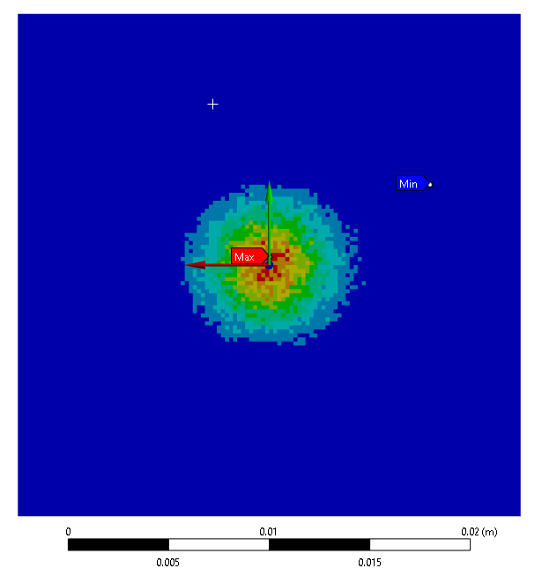
FLUKA
Geometry imported into FLUKA
Beam parameters were set:
Energy: 7 MeV
Current: 100 μA
Energy deposited: 57%
After post-processing, spatial energy deposition was found

Slide 6
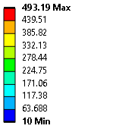
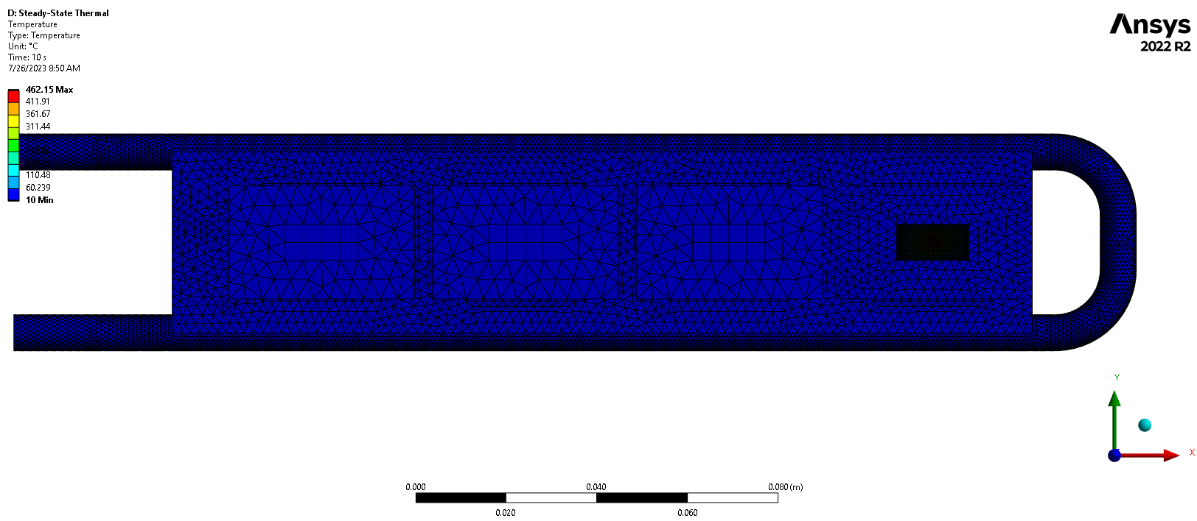
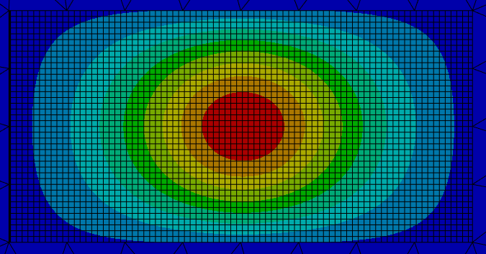
Heat Transfer Simulation
Ansys Mechanical
A steady state thermal simulation with the data from FLUKA
Boundary conditions account for vacuum
Radiation was neglected due to forced cooling
Steady state temperature profile was returned
(°C)

Slide 7
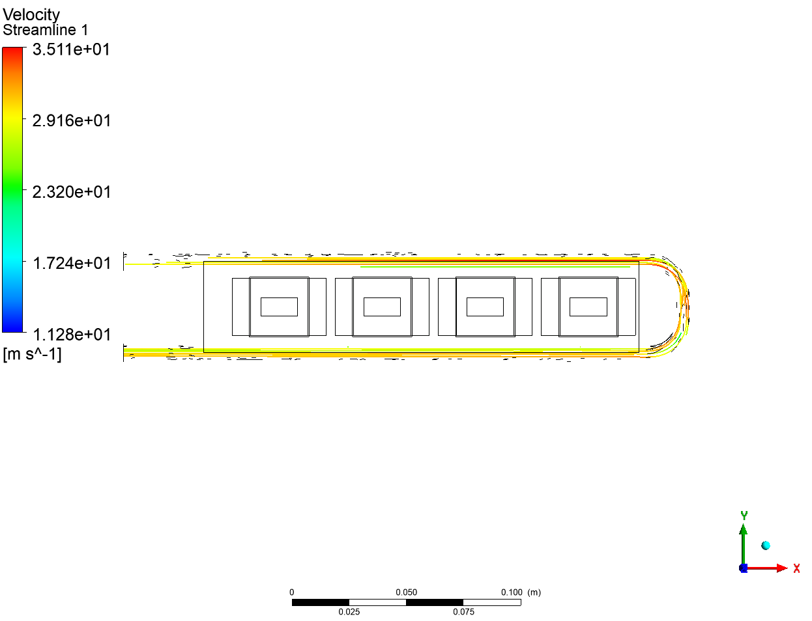
Computational Fluid Dynamics Simulation
Ansys Fluent
A steady state CFD simulation to find the cooling effect of the coolant running through pipe
Model:
Energy equation on
k-ω turbulence model
$\dot{m}=0.8 kg/s$
Inlet temp: 20 °C
Post-processing to verify velocity and heat flux
Results coupled with thermal simulation

Slide 8
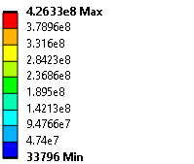
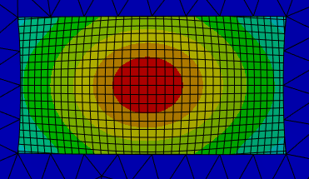
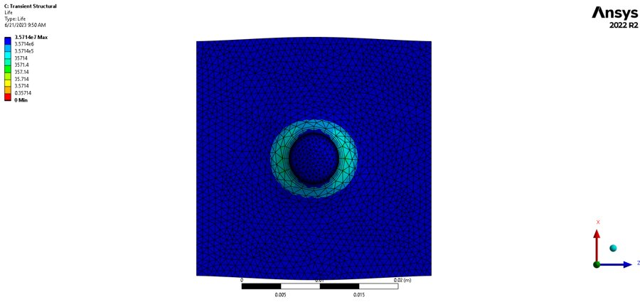
Structural Simulation
Ansys Mechanical
Thermal effects were imported into structural simulation
Boundary conditions:
Fixed edge to support frame
Fatigue tool to find long term damage
(Pa)

Slide 9
Summary and Future Work
This project developed a framework to quickly test the lifetimes of various target designs
The framework takes into account:
Energy deposition by the electron beam
Resulting temperature gradients
Cooling
Resulting thermal stresses
Fatigue damage
Future work:
Run transient analyses for beam off times
Refine and optimize mesh
Test different targets

Slide 10
Sohaib Bhatti
sbhatti@jlab.org
Energy deposition in FLUKA
Heat Transfer in Mechanical
CFD in Fluent
Structural in Mechanical

