Slide 1
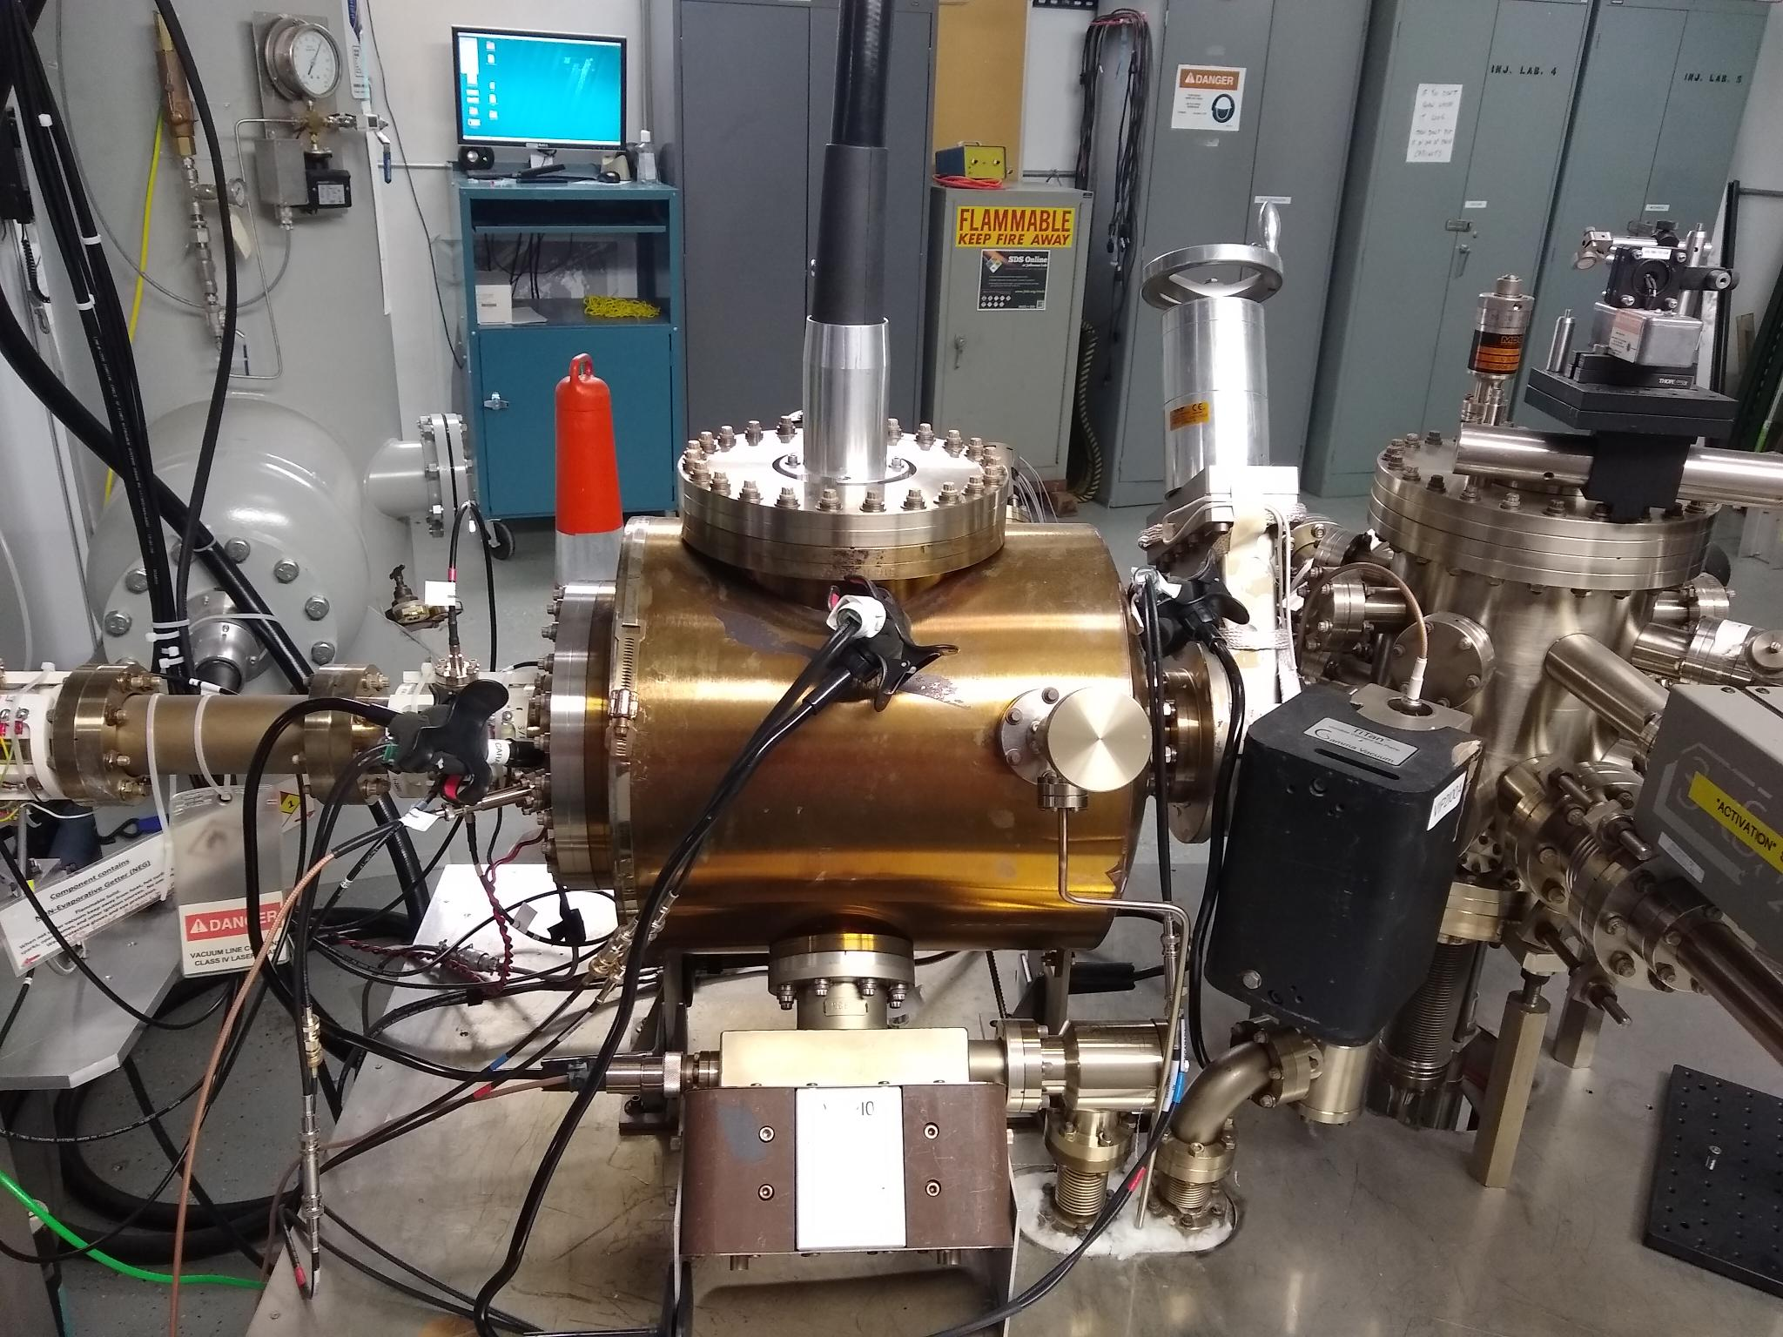
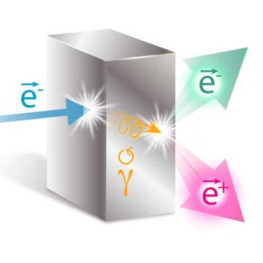
High intensity polarized beam photogun to drive a positron source
Towards 5X the beam current of the state-of-the-art CEBAF photogun
15 cm
Carlos Hernandez-Garcia for the Ce⁺BAF team
CEBAF
130 keV
polarized
GTS
300 keV
un-polarized
Prototype
500 kV
The European Workshop on Photocathodes for Particle Accelerator Applications, Dresden Germany 17-19 September 2024

Slide 2
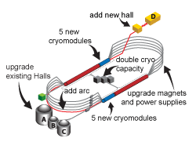
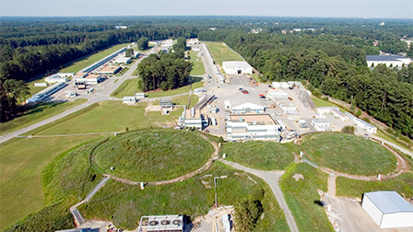
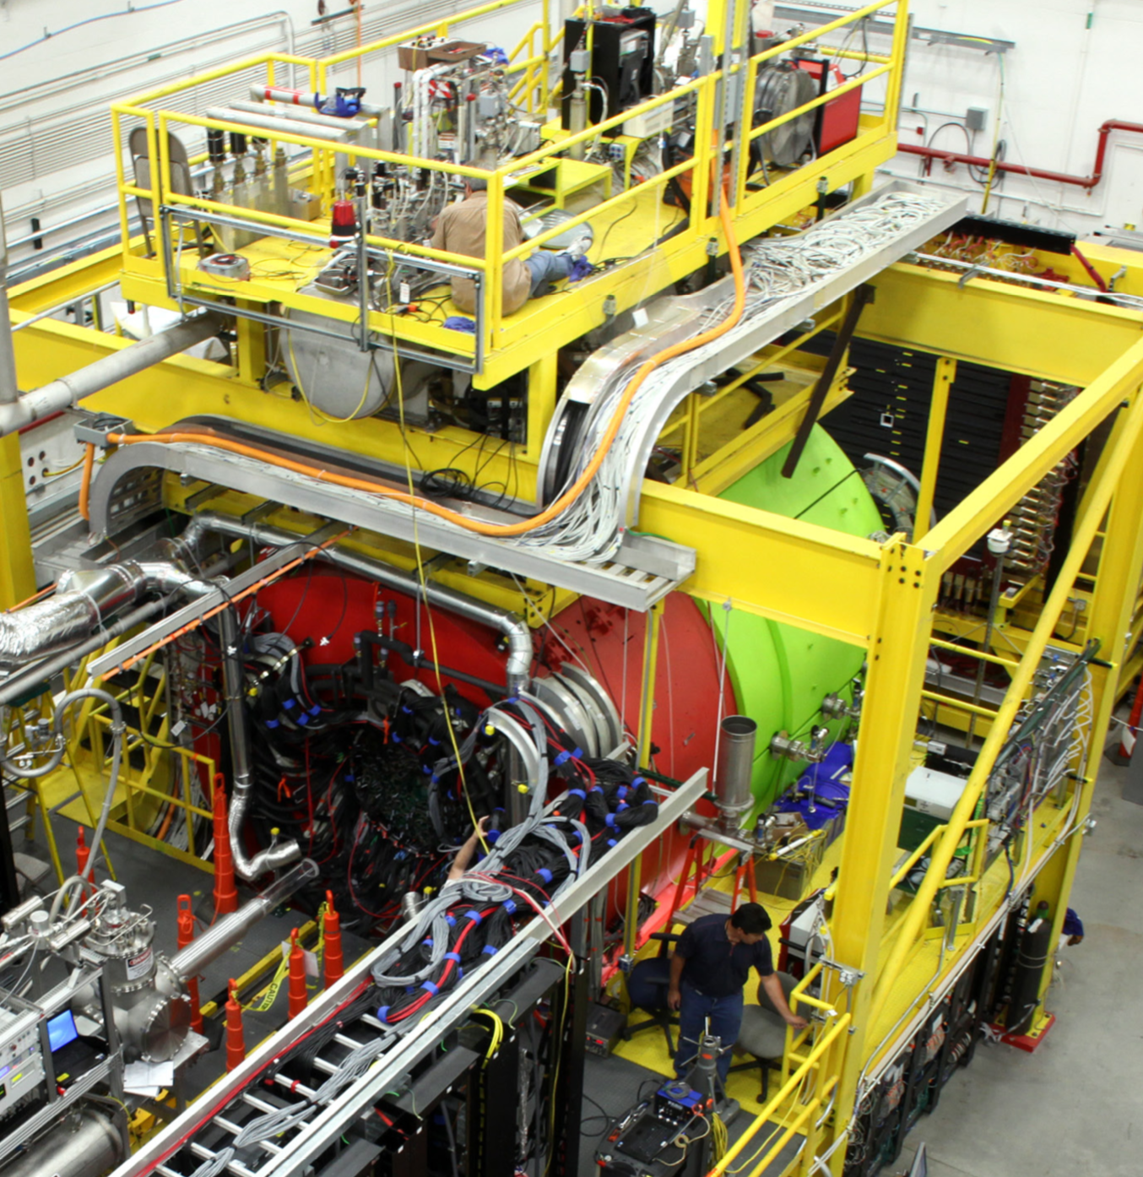
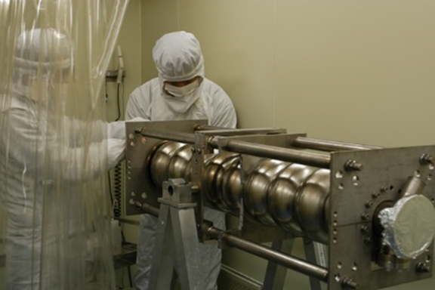
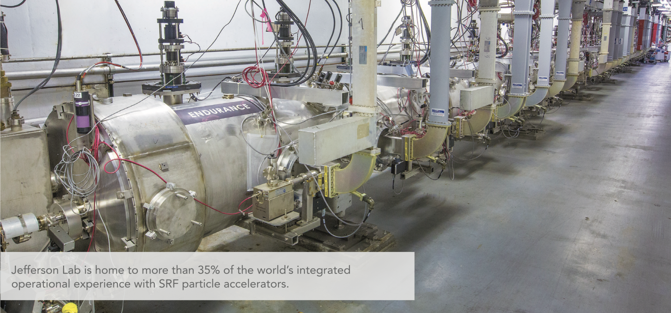
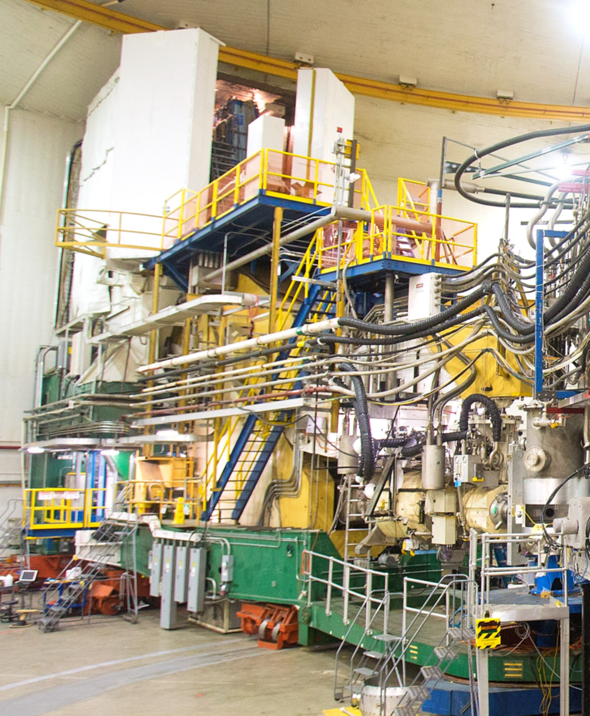
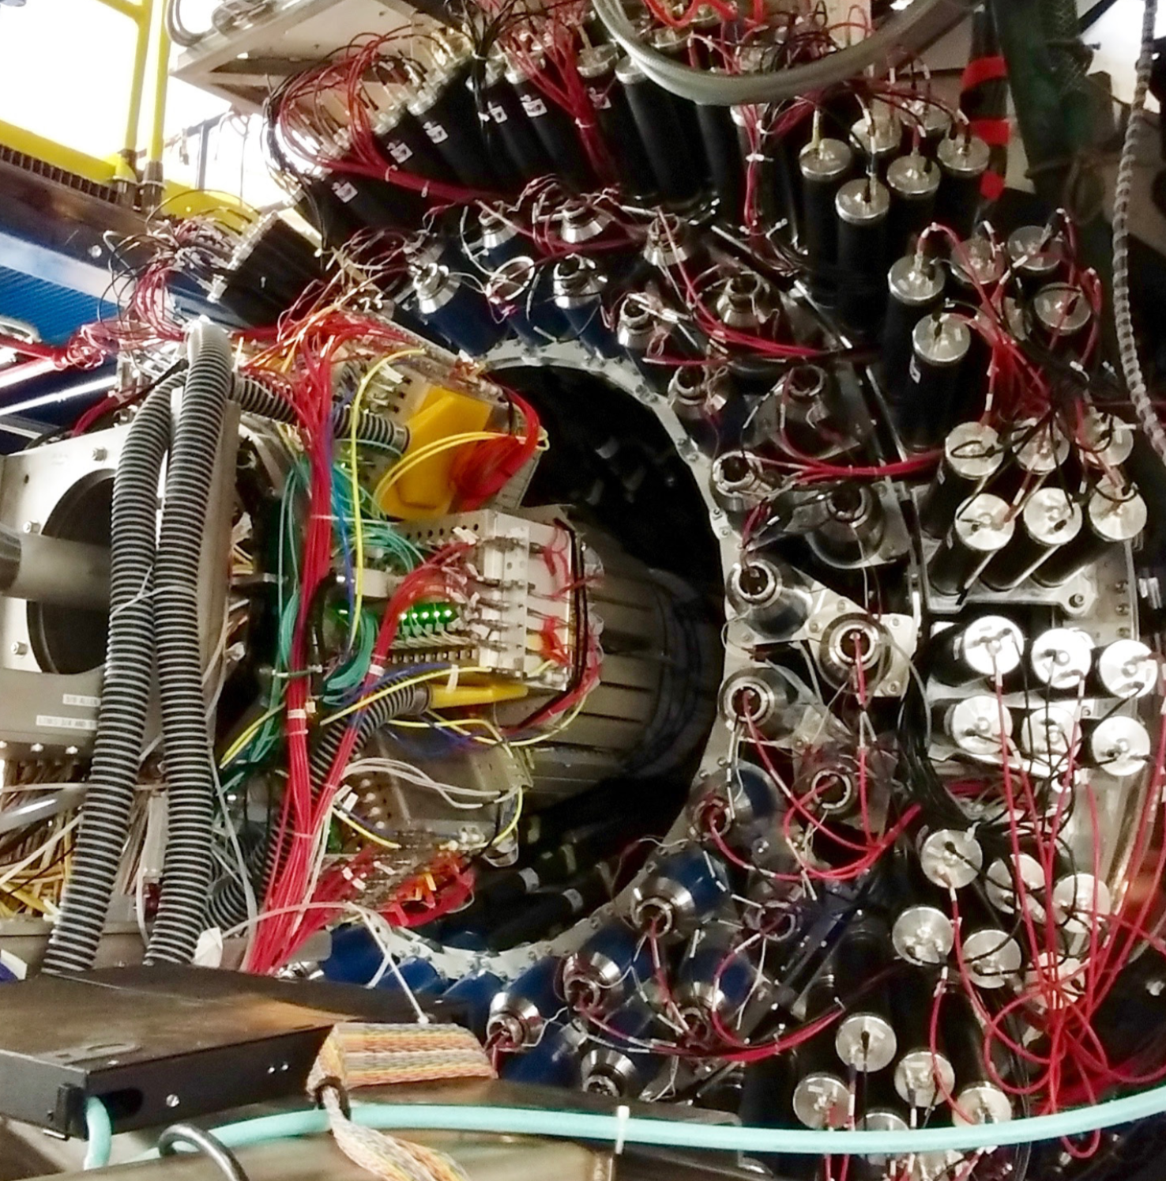
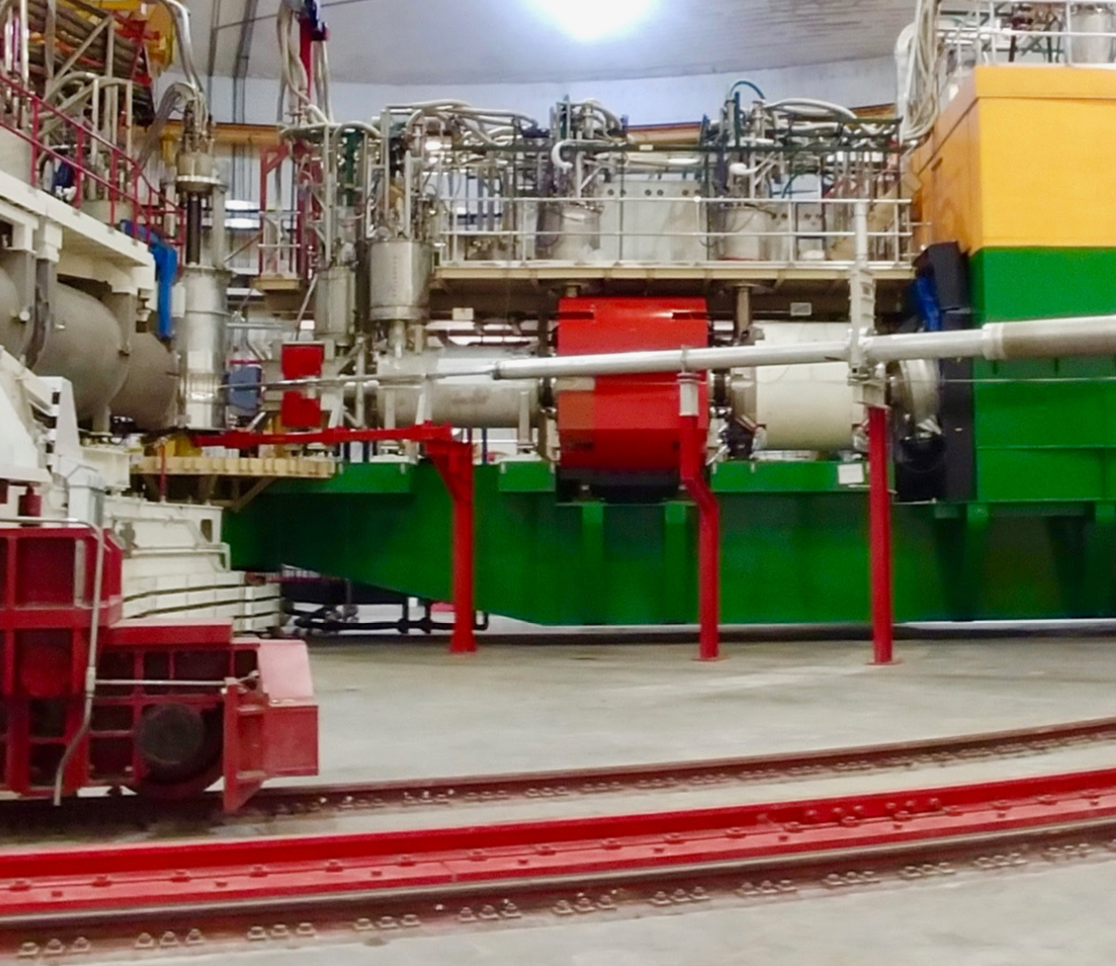
The Jefferson Lab Continuous Electron Beam Accelerator Facility (CEBAF) provides high polarization CW beam to four nuclear physics experimental halls
The electron source is based on a 200 kV DC photogun with strained super lattice GaAs photocathode
The accelerator is based on SRF linacs providing ~ 1 GeV / pass
D
A
B
C

Slide 3
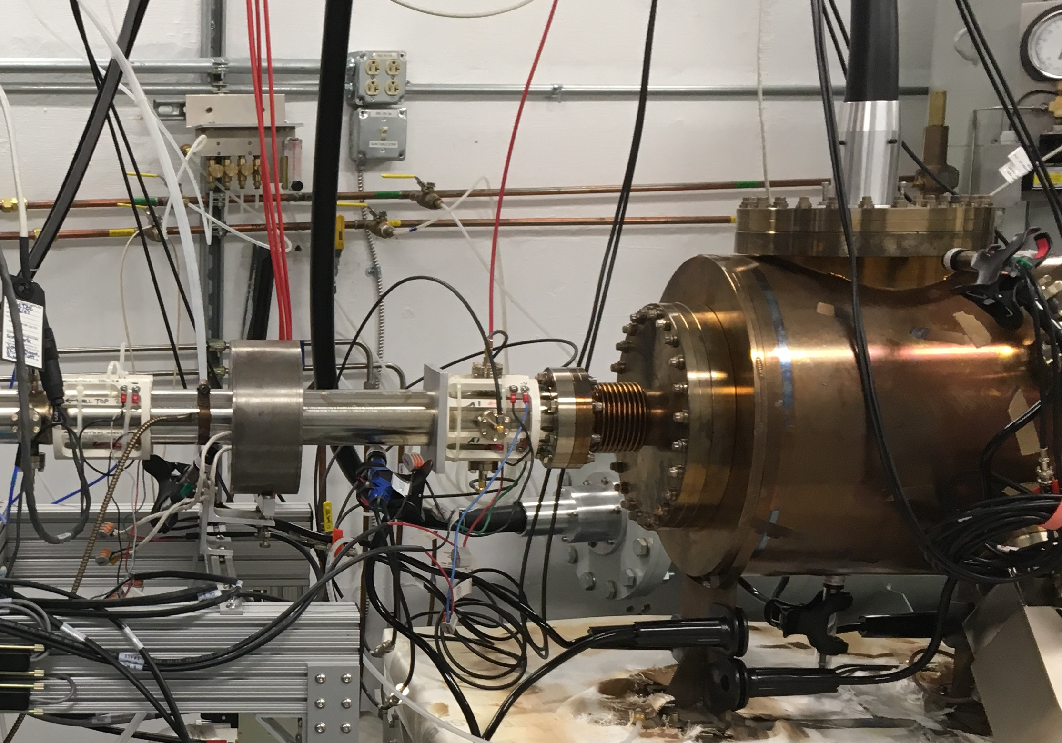
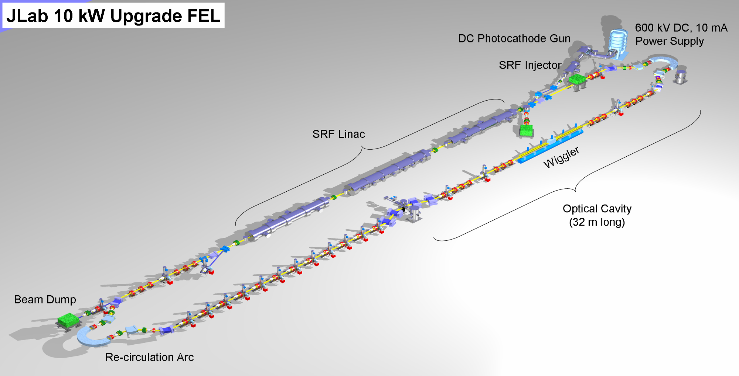
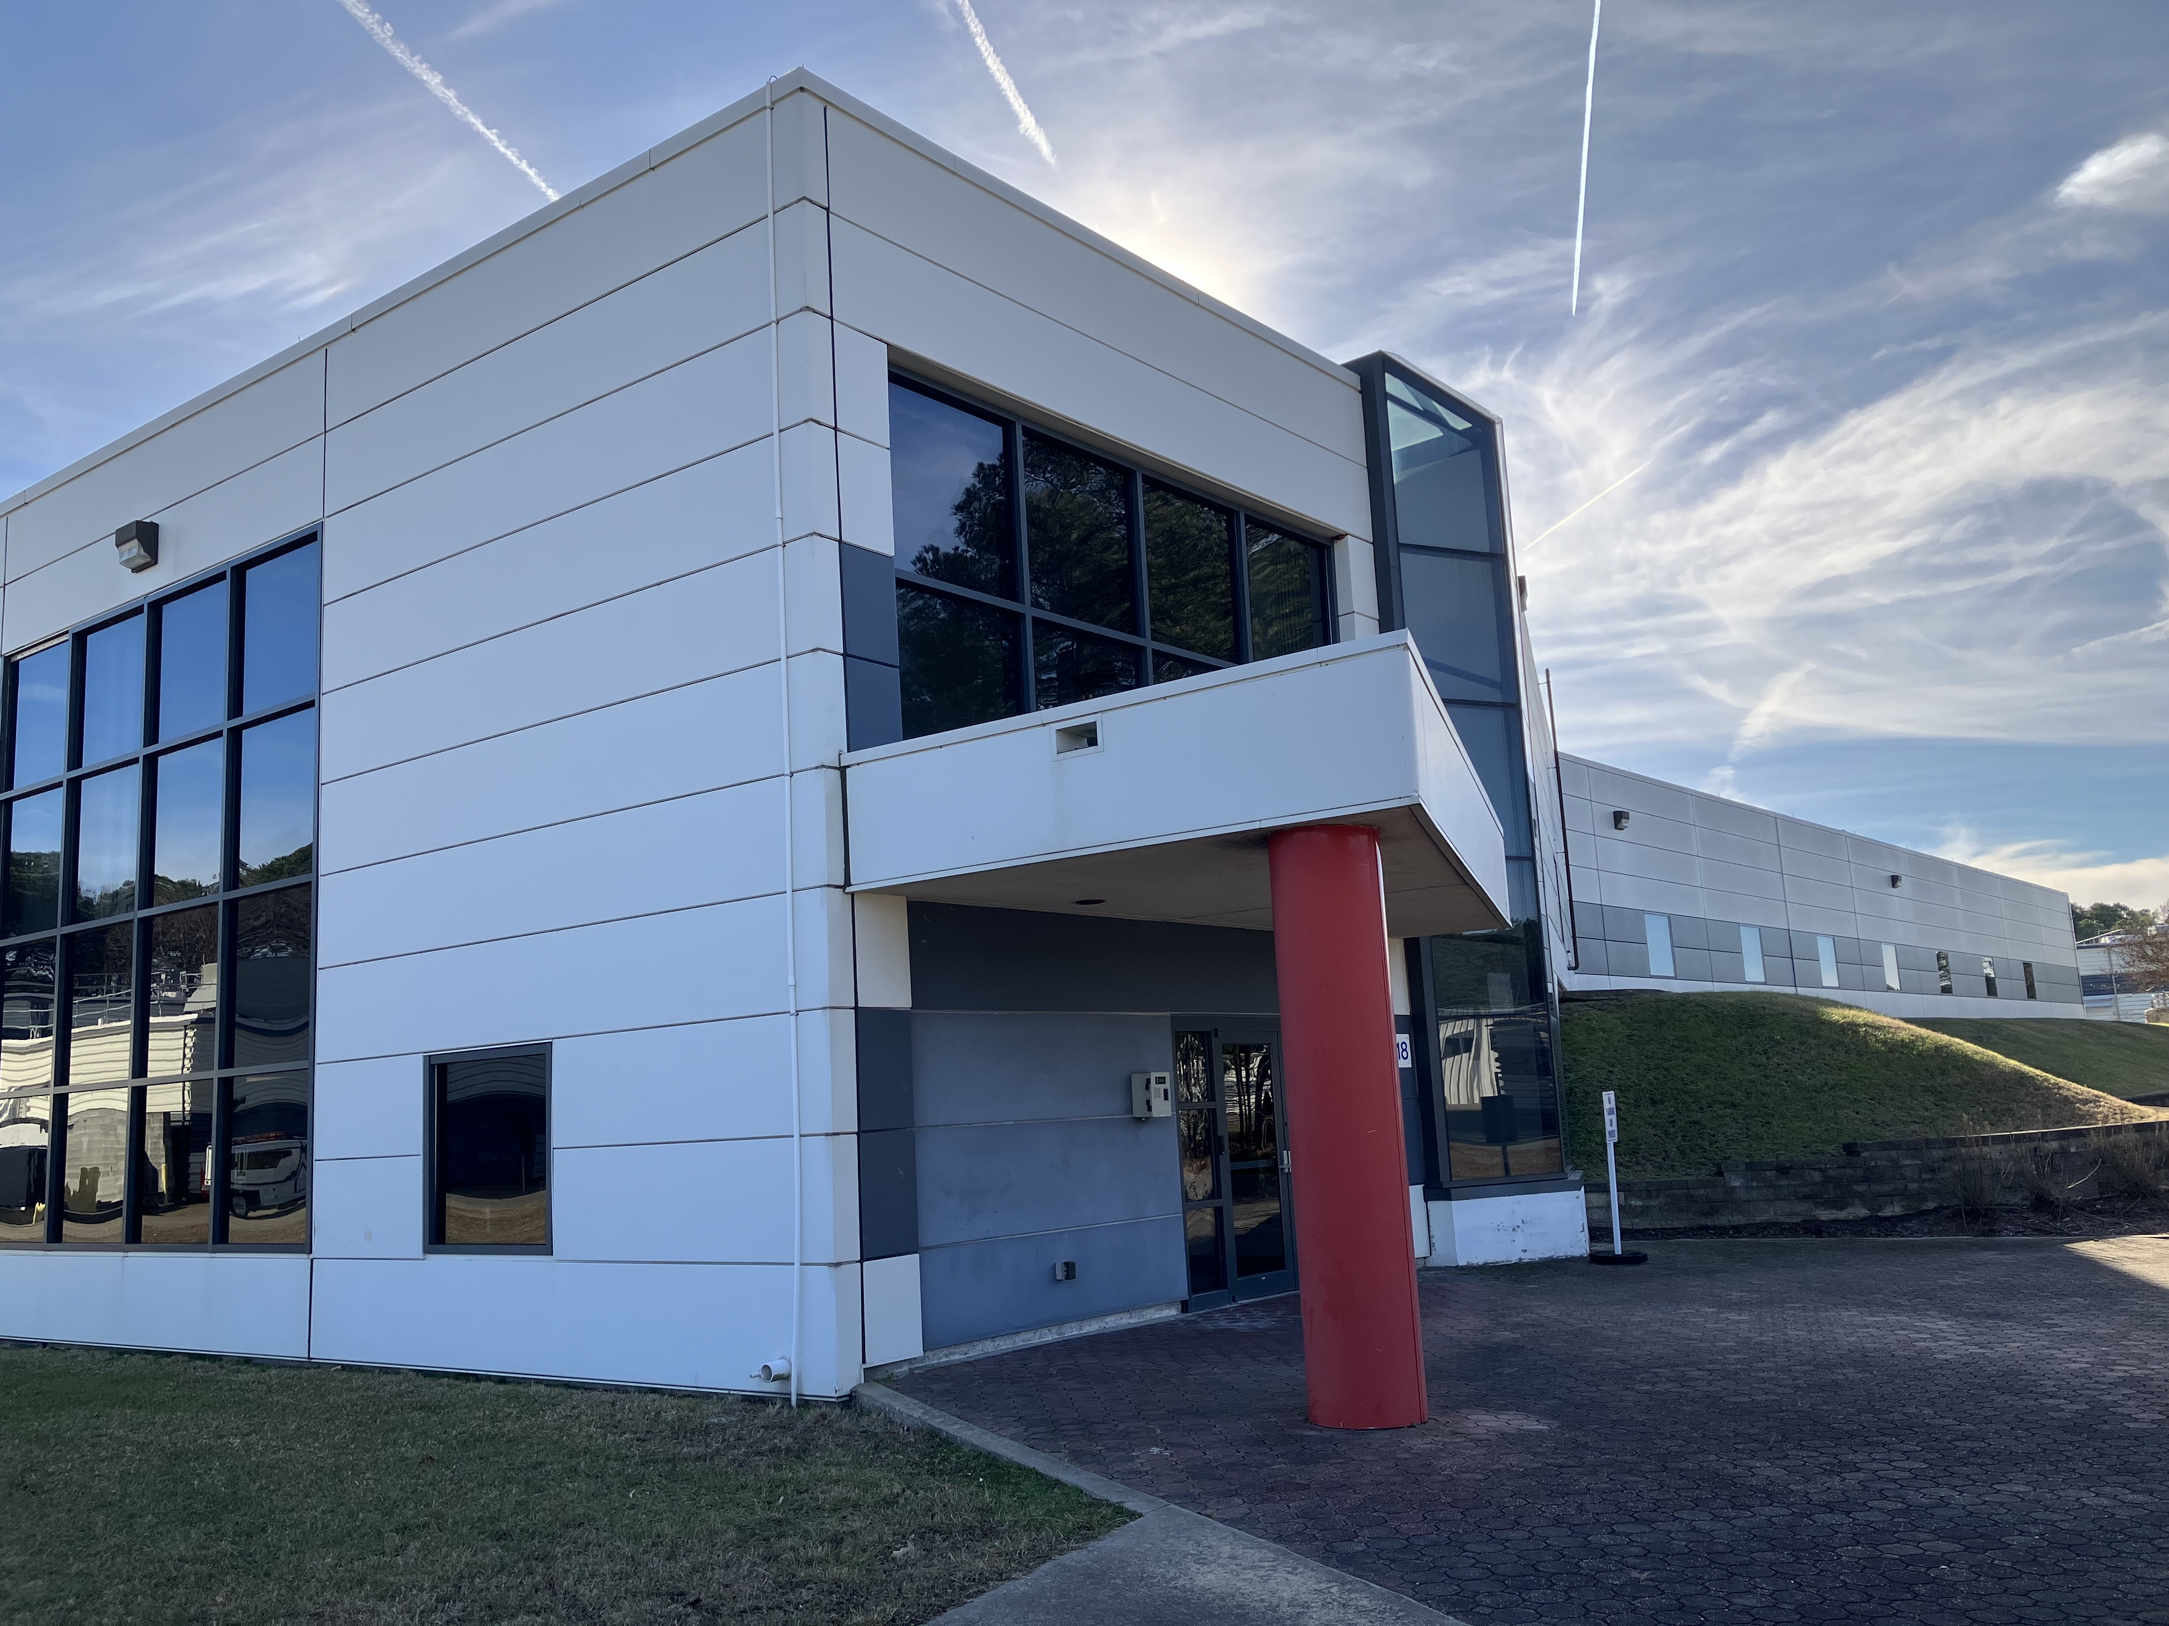
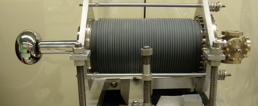
The Jefferson Lab site hosts two additional accelerators
The Upgrade Injector Test Facility UITF is a testbed accelerator based on a 10 MeV SRF booster and 200 kV DC photogun with a variety of photocathodes
The 10 kW IR-FEL was based on an ERL SRF linac at 150 MeV and 8 mA CW using a 350 kV DC photogun with bulk GaAs (unpolarized beam)
Evaluation of polarized hydrogen targets (HDIce)
Irradiation of wastewater with electron beam
Demonstrated > 1 MW of recirculated beam power
Holds the world record at 14 kW CW in the IR

Slide 4

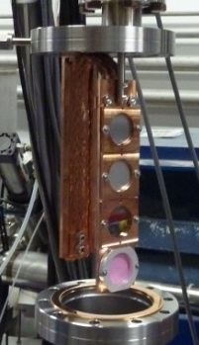
PEPPo Experiment : Feasibility Demonstration at the CEBAF Injector
PEPPo (Polarized Electrons for Polarized Positrons) => demonstrate feasibility of using bremsstrahlung radiation of MeV energy Polarized Electrons for production of Polarized Positrons.
J. Grames, E. Voutier et al.,JLab Experiment E12-11-105 (2011)
D. Abbott et al., Phys. Rev. Lett. 116 (2016) 214801
8 MeV, 1μA, 85% polarization
Tungsten (1mm)
PEPPo possible due to support from SLAC E166, DESY, Princeton, Cornell, International Linear Collider Project and the Jefferson Science Associates

Slide 5

The JLab proposed e+ source: Ce⁺BAF
JLab Low Energy Recirculator Facility
Provide JLab users
  100 nA e+ with polarization > 60%
  1 uA of e+ (with lower polarization)
Polarized e- injector > 120 MeV
High current polarized e-source > 1 mA
e+ beam to CEBAF
> 100 kW target & cw-collection beam line

Slide 6
A photogun generating 1 mA CW beam will produce:
  86 Coulombs in a day
  600 Coulombs in a week
  2400 Coulombs in a month
Consequently the photocathode 1/e charge lifetime should be >1 kC, meaning the photogun can operate:
for ~ one month without intervention or
for a few weeks at a time at even higher beam current levels

Slide 7
What does a photogun need to provide for generating > 1 mA CW polarized beam?
  High polarization photocathodes with high QE > 1%
  Vacuum chamber with total Pressure < 1e-12 Torr
  High Voltage w/o field emission
    To manage space charge and beam transmission
  Long 1/e charge lifetime t > 1000 Coulombs

Slide 8
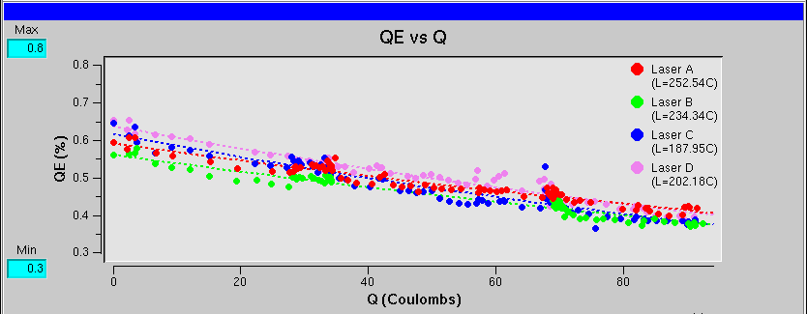
CEBAF polarized e- source @ 1 mA?
High polarization at 1 mA
[µA]
Gun2 Photocathode (Fall 2016 – Spring 2017)
QE = QE₀ e ^{-(Q/Lifetime)}
We have demonstrated polarization from the CEBAF PES remains steady up to 1 mA/499 MHz
The charge lifetime (at 0.2 mA) is about 200 C
This would provide only 2-3 days of positrons
Lifetime ~200 C (σ_{4D} ~ 1mm, I~200 μA)
Slide by J. Grames
Gun vacuum ~ 1x10⁻¹² Torr

Slide 9
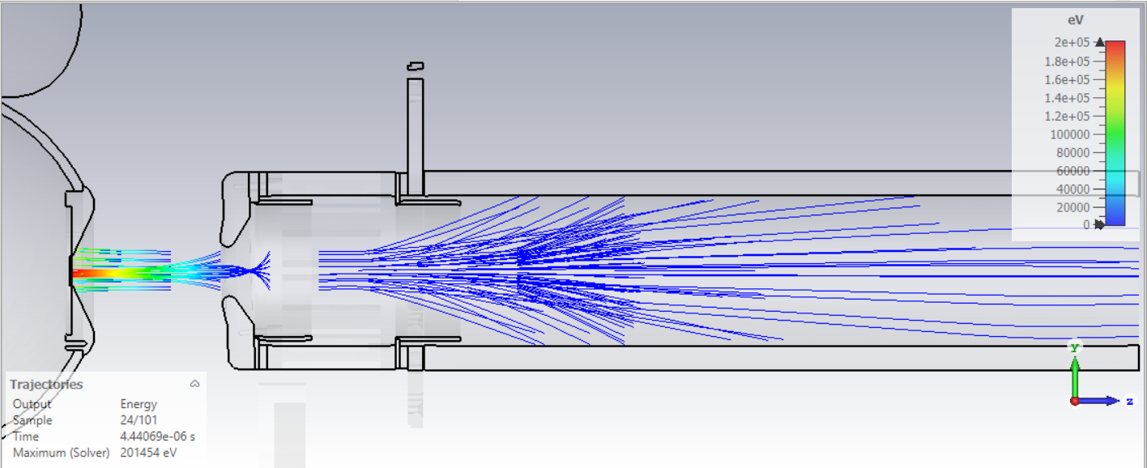
CEBAF GaAs/GaAsP photocathode lifetime improvement with biased anode
Ions downstream of the anode are repelled back towards the beamline by the positive anode potential
Improving charge lifetime of CEBAF photogun
Graphic by G. Palacios Serrano
J. T. Yoskowitz et al., 12th Int. Particle Acc. Conf. IPAC2021, Campinas, SP, Brazil, doi:10.18429/JACoW-IPAC2021-WEPAB104
With a >400 C lifetime we could operate at 1 mA for almost 1 week

Slide 10
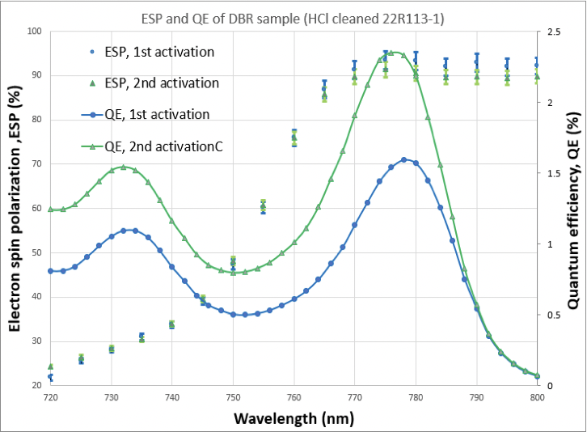
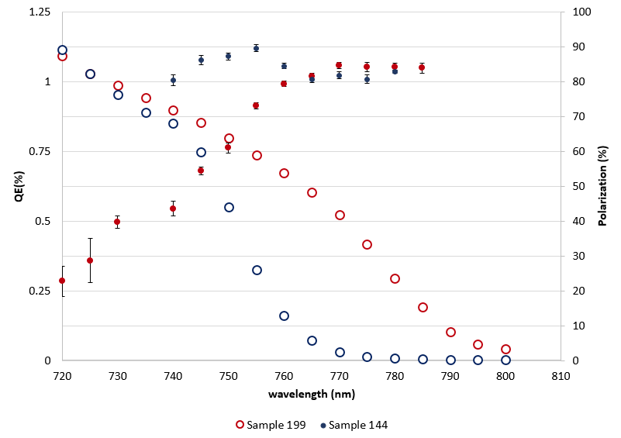
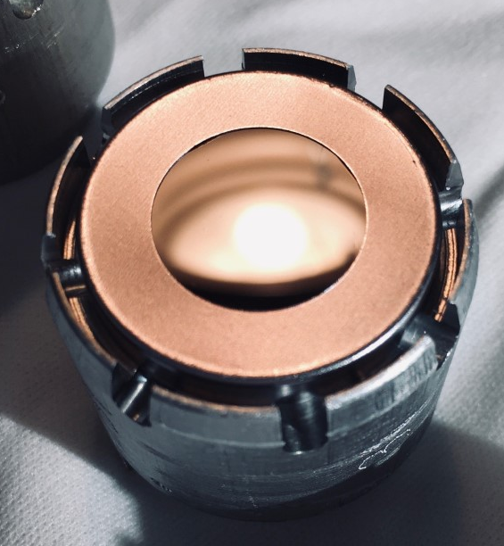
Developing polarized photocathodes with > 1% QE
JLAB-ODU-BNL
JLAB-UCSB
CEBAF
  Strained Super Lattice
  GaAs/GaAsP
  ~ 85% pol, ~0.3% QE
  MOCVD
  GaAs/GaAsP-DBR
  ~ 90% pol, ~ 2% QE
  CBE/MBE
  GaAs/GaAs/P
  InGaAs/InAlGaAs
  ~85% pol, ~ 1% QE
780 nm
780 nm
780 nm
B. Belfore et al., Appl. Phys. Lett. 123, 222102 (2023); doi: 10.1063/5.0170106
Graph courtesy S. Marsillac (ODU)
Graph courtesy M. Stutzman (JLab)

Slide 11
GaAs/GaAsP charge lifetime at milliamp beam current
Results from PSTP’17 suggests increasing laser spot size is viable to exceed >500 C lifetime; however we need to build another gun to test this assertion.
Test performed with un-biased anode
4𝜎 ~ 10 mm
Days
Trend we want to realize
CEBAF (<1 mm²)
4𝜎 ~ 1 mm
J. Grames, P. Adderley, J. Hansknecht, R. Kazimi, M. Poelker, D. Moser, M. Stutzman, S. Zhang, “Milliampere beam studies using high polarization photocathodes at the CEBAF Photoinjector” Polarized Sources, Targets and Polarimeters Workshop, Dajeon South Korea (2017)

Slide 12
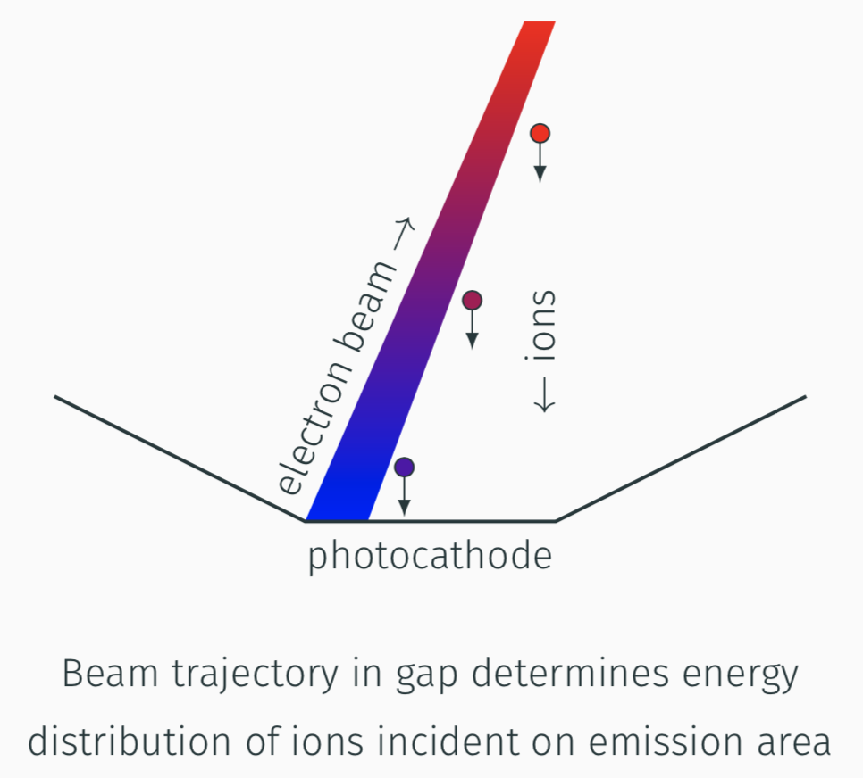
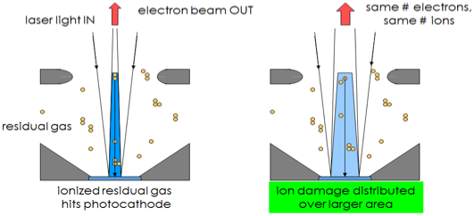
Dominant limitation of photocathode lifetime: ion back-bombardment
Electron beam ionizes residual gas within accelerating gap
Ions are accelerated toward the photocathode
Ions striking photocathode surface locally degrade its quantum efficiency (QE)
Additionally shifting emission site away from electrostatic center contributes to lessen QE degradation
Graphic by J. Grames
Graphic by M. Bruker

Slide 13
Polarized electron source for Ce⁺BAF
We want to deliver > 1 mA for weeks on end…
Two weeks @ 1 mA ≈ 1 kC
By increasing the laser size and biasing the anode charge lifetimes of 1 kC might be possible
Shifted laser spot
Ce⁺BAF
Gun Charge in 2 weeks [Coulombs]
anode biasing
CEBAF
large laser size
Gun Current to make positrons [mA]
Slide by J. Grames

Slide 14
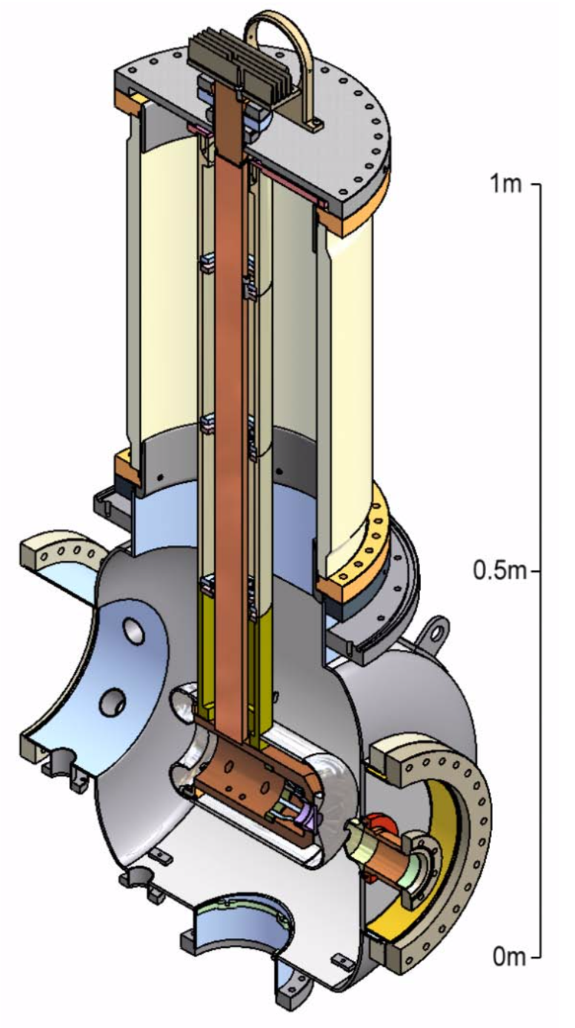
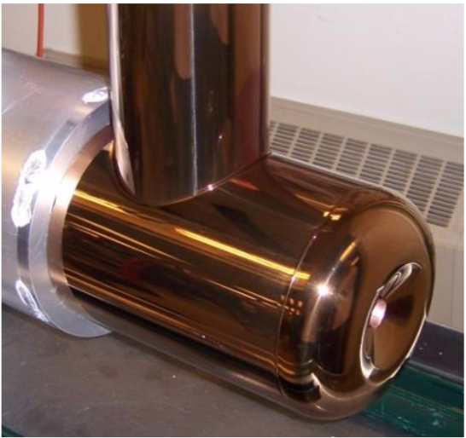
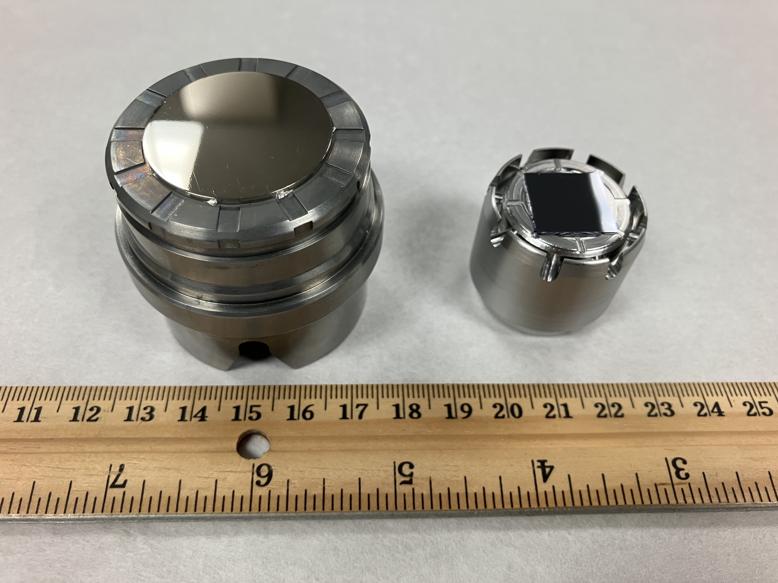
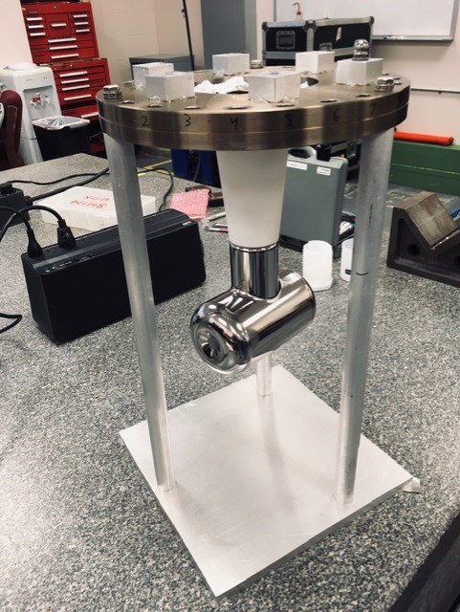
Larger size electrodes are needed for large size laser spot on photocathode
The Cornell photogun demonstrated up to 65 mA CW non-polarized beam from a ~ 4 mm diameter laser spot
Prototype photocathode puck
CEBAF photocathode puck
Cornell electrode
30 cm
CEBAF electrode
15 cm
B. Dunham et al., APPLIED PHYSICS LETTERS 102, 034105 (2013)

Slide 15
What else does a photogun need to provide for generating > 1 mA CW polarized beam?
  High Voltage
  Low limit
  Photocathode surface charge limit
  Space charge within the electron bunch
  High limit
  Field emission
  Minimum energy required for beam capture by the MeV SRF booster
  Commercial supply chain challenges manufacturing compact conical insulators
  High voltage power supply ($0.5 M, needs SF₆)
  High voltage commercial components operational limits
CEBAF photogun performance
200 kV, no field emission
~0.2 mA CW from 4𝜎 ~ 1 mm laser spot
~ 85% polarization
beam injected to SRF booster
JLab FEL photogun performance
350 kV, some field emission
10 mA CW from 4𝜎 ~ 8 mm laser spot
Non-polarized beam injected to SRF booster

Slide 16
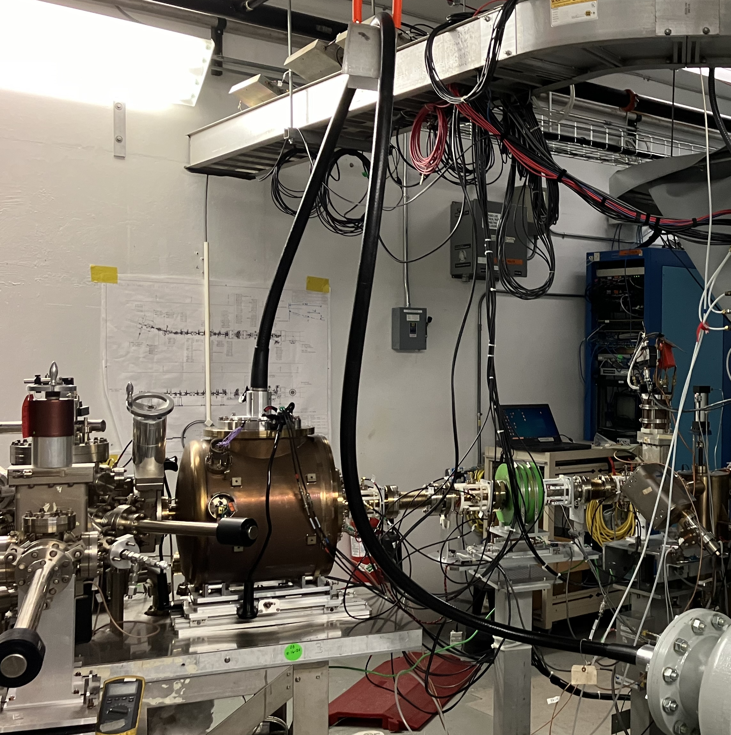
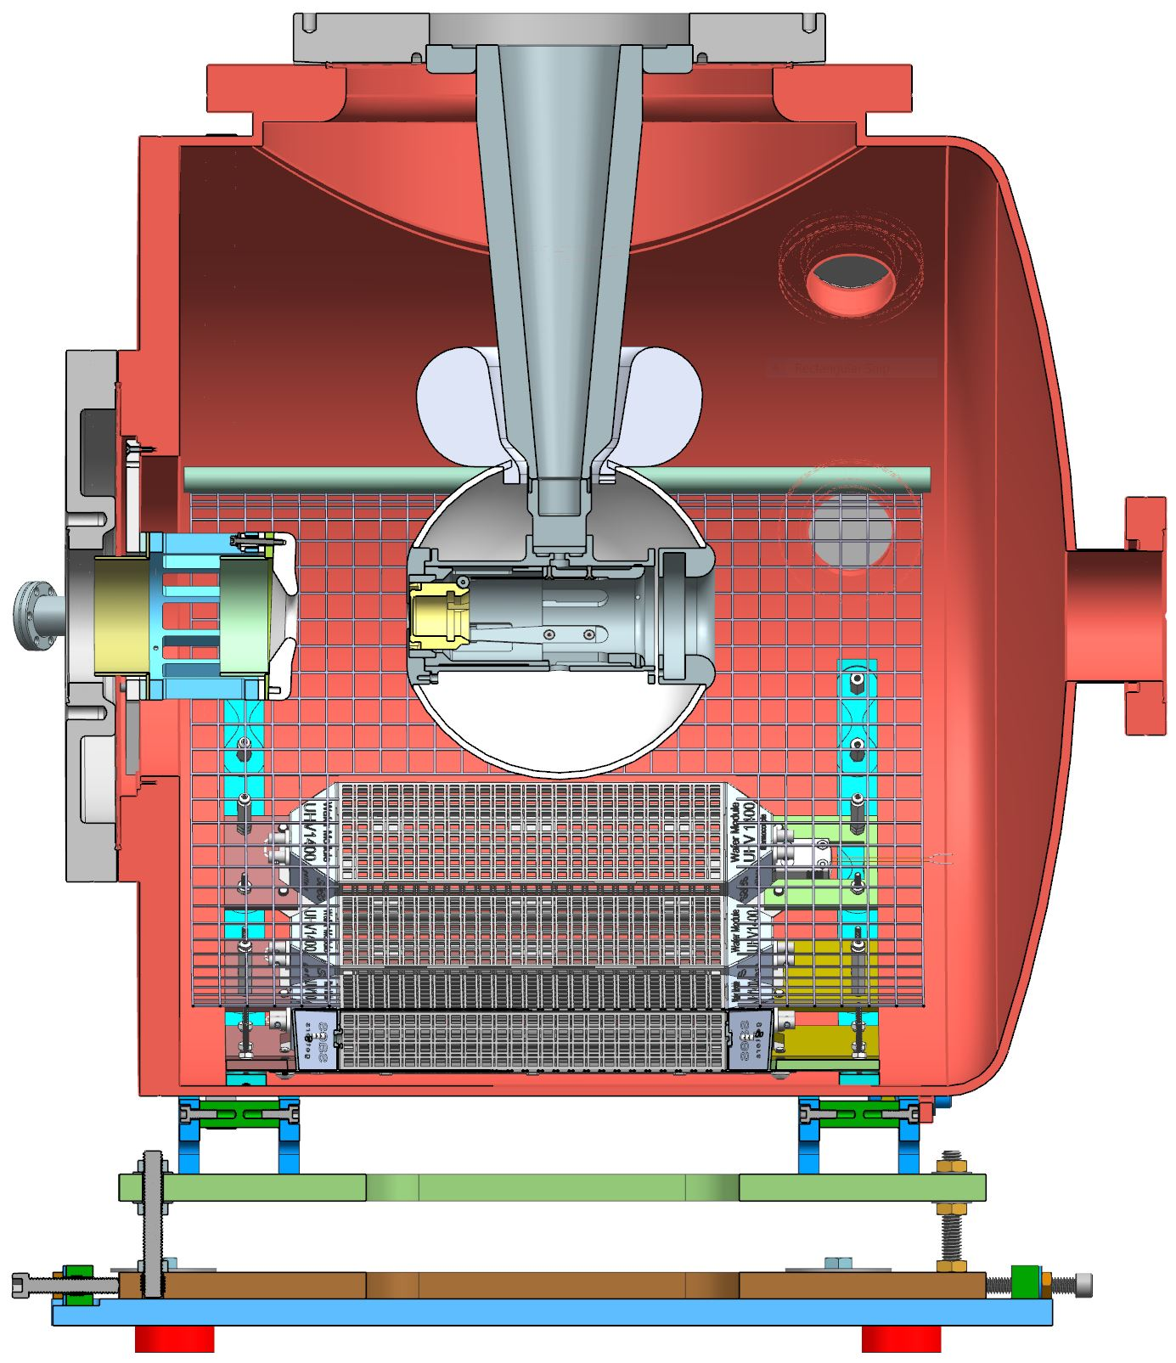
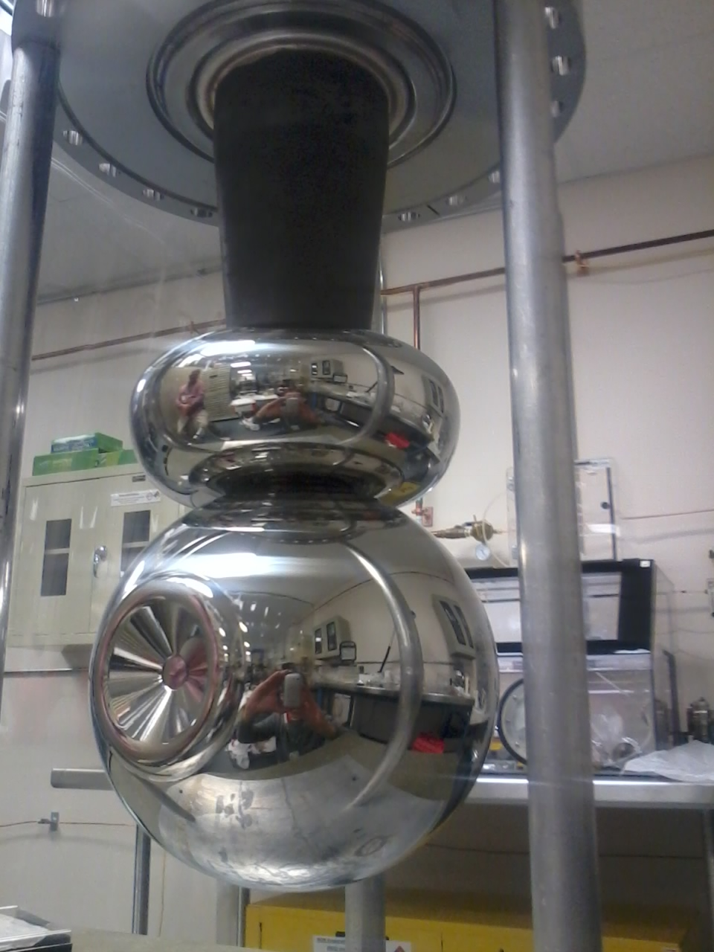
Inverted insulator polarized photogun
“Inverted-insulator” high voltage design: the insulator extends into the vacuum chamber from the top serving as the cathode electrode support structure.
Uses commercial high voltage cable
Compact design leads to exceptional vacuum ~10⁻¹² Torr vacuum
Less metal aids in minimizing field emission (200 kV)
Photocathode load-lock chamber attached to the back end
15 cm
CEBAF inverted insulator photogun

Slide 17
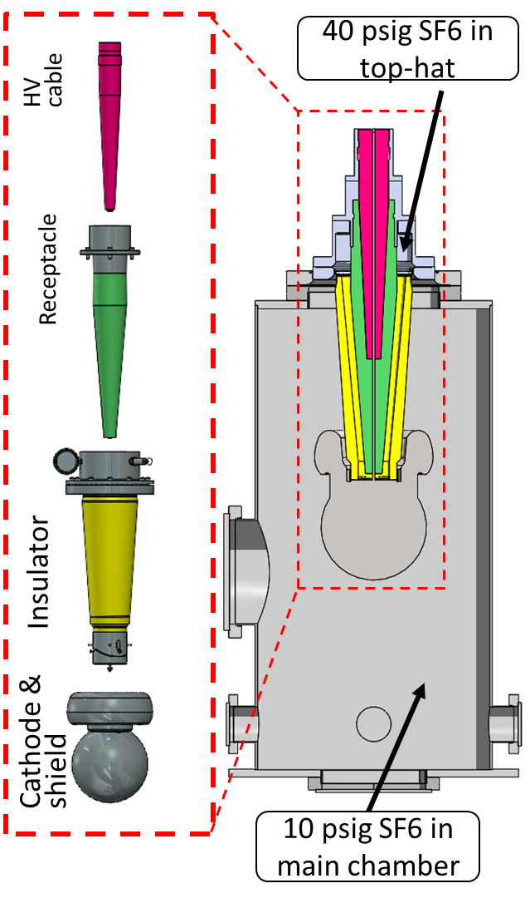
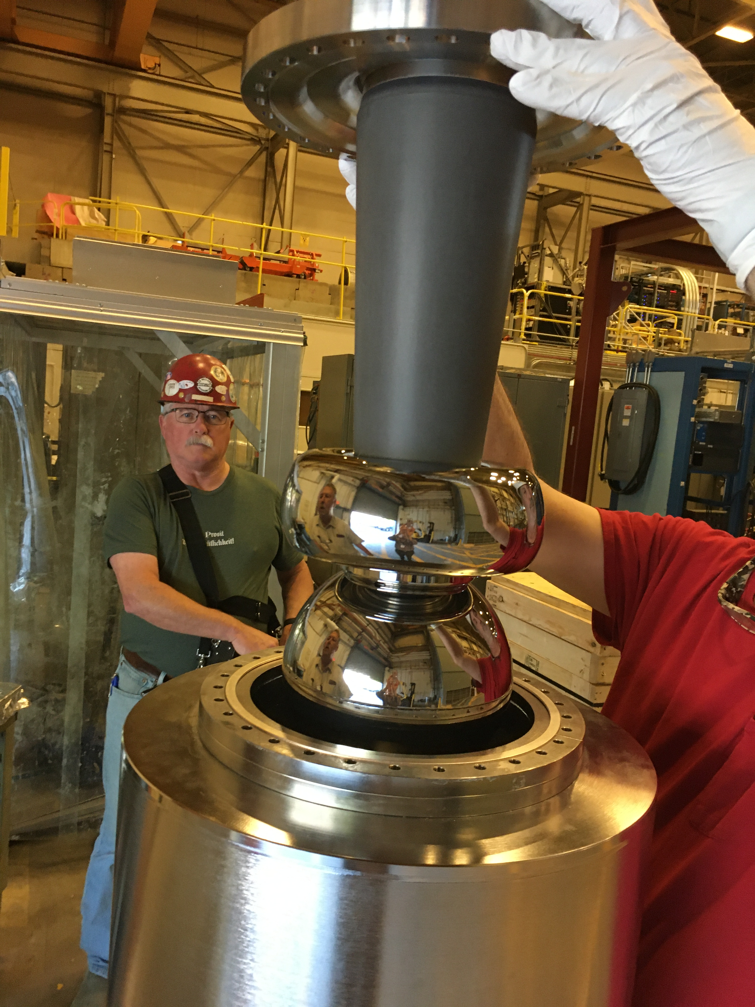
Addressing the high voltage limit for a 1 mA polarized photogun
Field emission free operation:
  Requires ~ 100 kV higher than operating voltage for field emission high voltage processing
Minimum gun voltage for beam capture by SRF booster:
  ~ 300 kV
There is no conical insulator capable of > 400 kV
  A compact, conical insulator is instrumental in the photogun design to minimize vacuum chamber volume and area
  A large insulator is required also for supporting larger electrodes
JLab demonstrated (2023) 500 kV using a very large, custom inverted insulator with SF₆ intervening volume mating to a modified HV cable receptacle
  This proof of principle is not directly applicable to a photogun design
There is no cable that fits this insulator
SF₆ intervening layer
18 in
C. Hernandez-Garcia EWPAA, Dresden Germany, 17-19 Sep, 2024

Slide 18
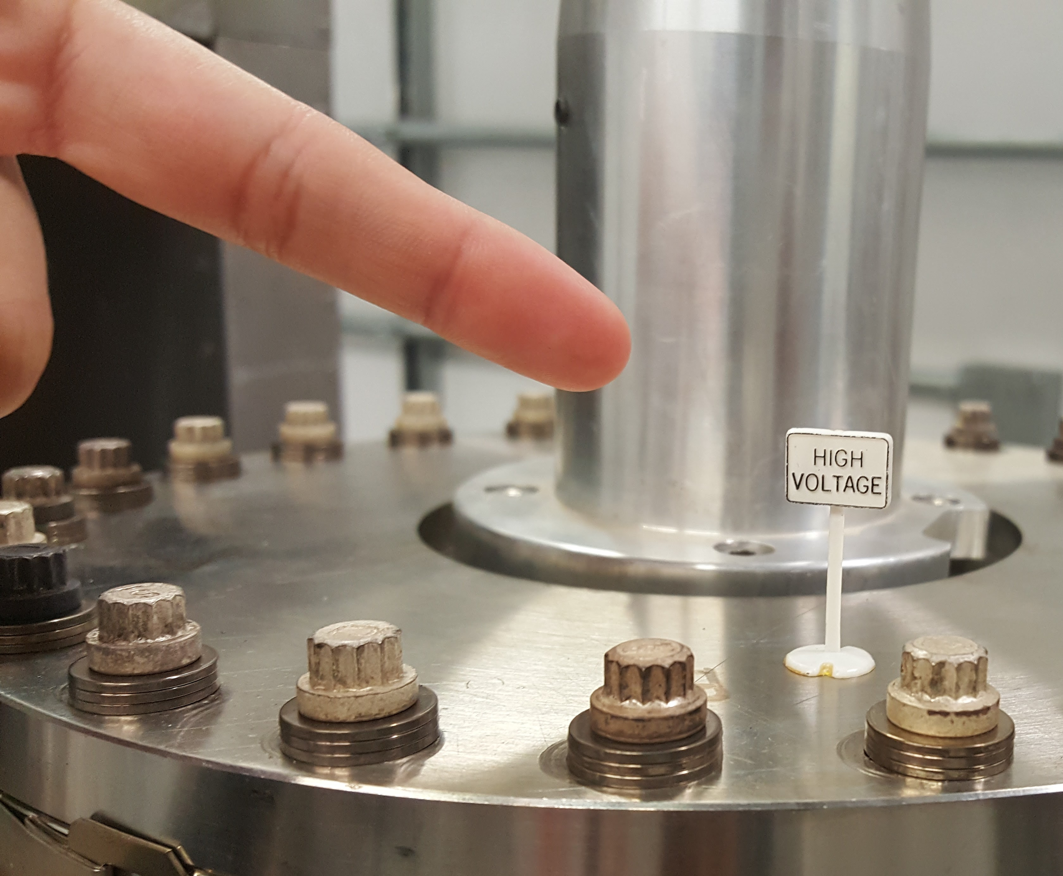
Summary
High-intensity, high-polarization photogun for the proposed JLab Ce+BAF polarized positron source.
The positron source will require:
  a CW electron beam of > 1 mA at 120 MeV with > 90% polarization
To be practical for a user program, a photogun operating at 1 mA should deliver a total charge of ~ 2 kC with high polarization for a month without intervention
The limiting factor is ion-back bombardment on the delicate strained-superlattice photocathode
Large electrodes to accommodate large laser spot sizes and large conical insulators to operate at > 300 kV for beam capture into an SRF booster.
Achieving > 200 kV operation w/o field emission in inverted insulators photoguns is still challenging
Significant progress has been made over the past two decades at several laboratories such as BNL, Cornell and JLab.
C. Hernandez-Garcia IJCLab Seminar. September 13, 2024, Orsay France

Slide 19
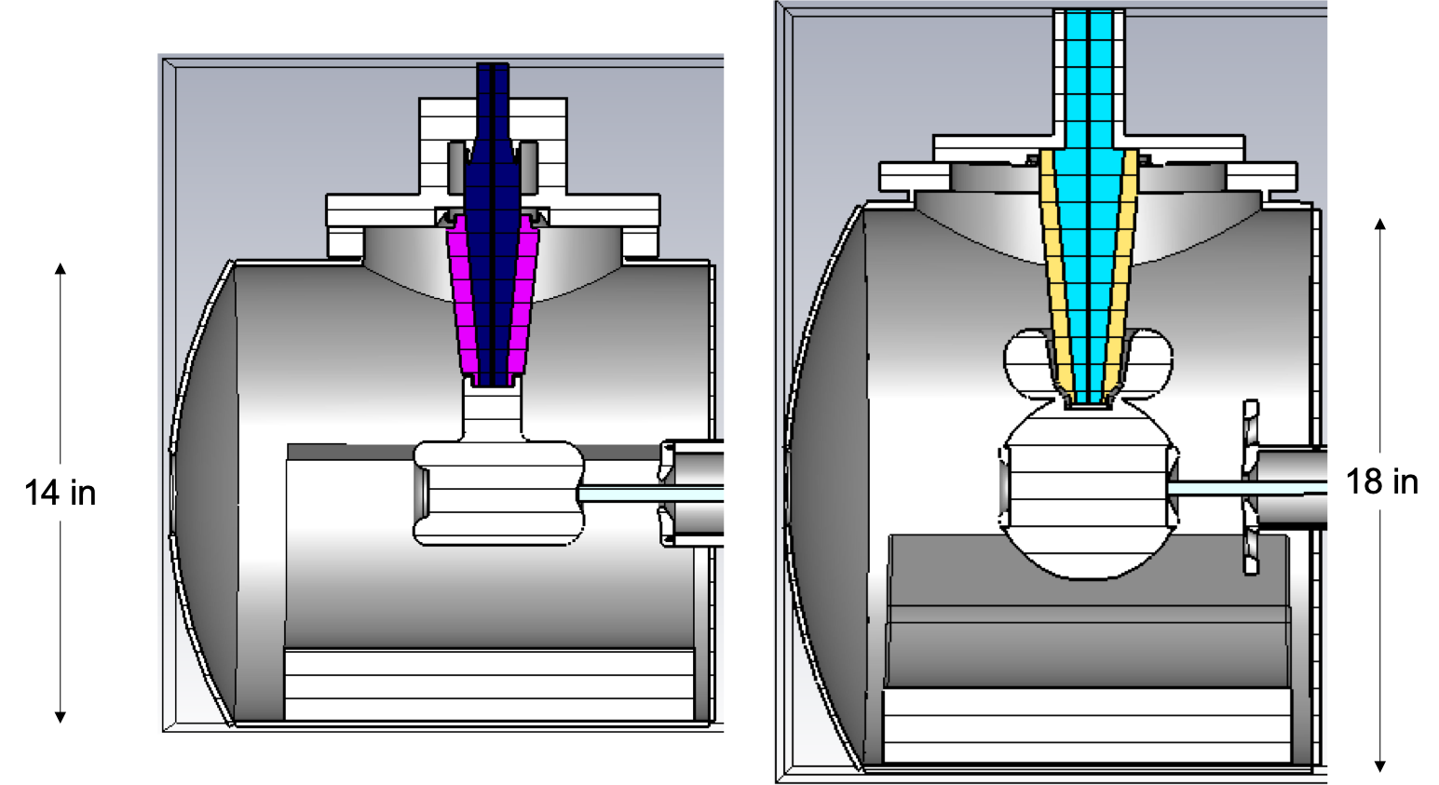
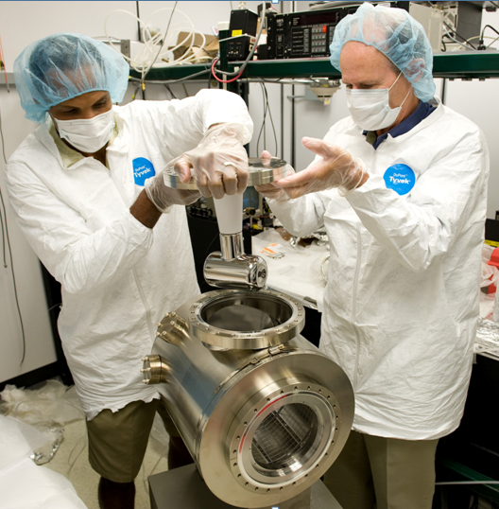
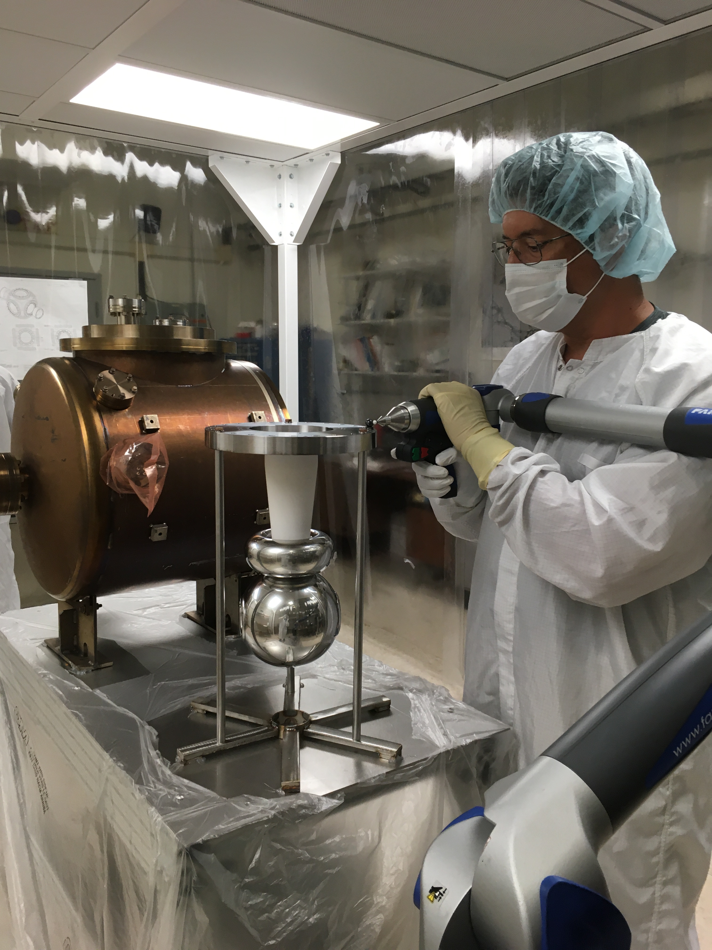
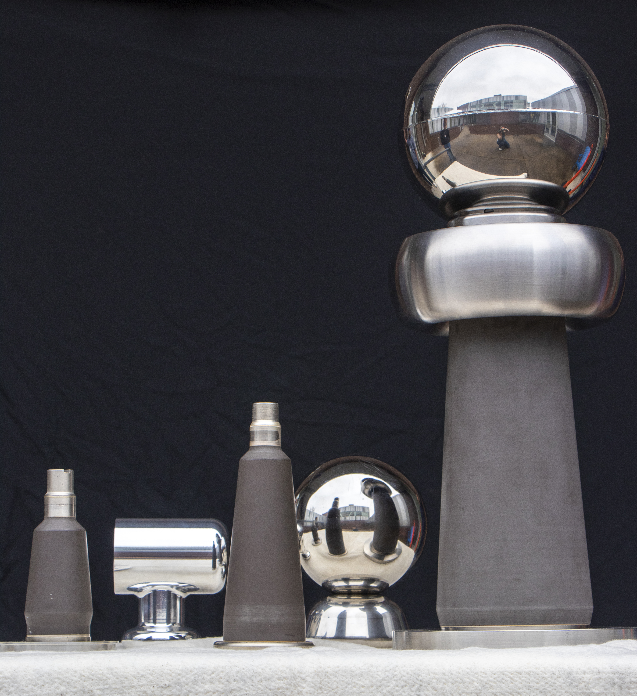
JLab has demonstrated capability to develop and operate high intensity, high polarization photoguns using inverted geometry insulators
THANK YOU!!!
On behalf of the JLab Photogun Team!...
Maximum applied voltage without breakdown
Achieved!
500 kV
concept
375 kV
R30
250 kV
R28
CEBAF 130 keV 0.2 mA CW > 80% polarized beam
Gun Test Stand (GTS)
keV, 5 mA CW magnetized beam
CEBAF
GTS
SF₆ intervening volume
test

Slide 20
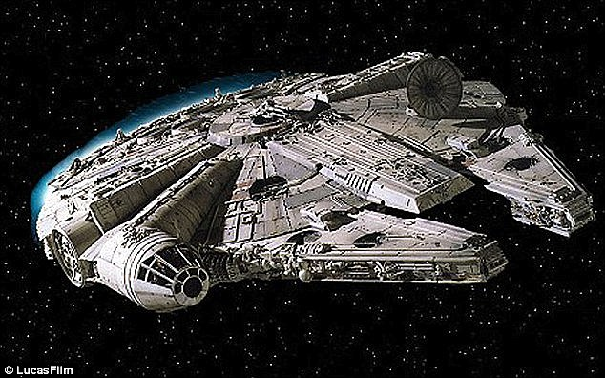
Backup!!!

Slide 21
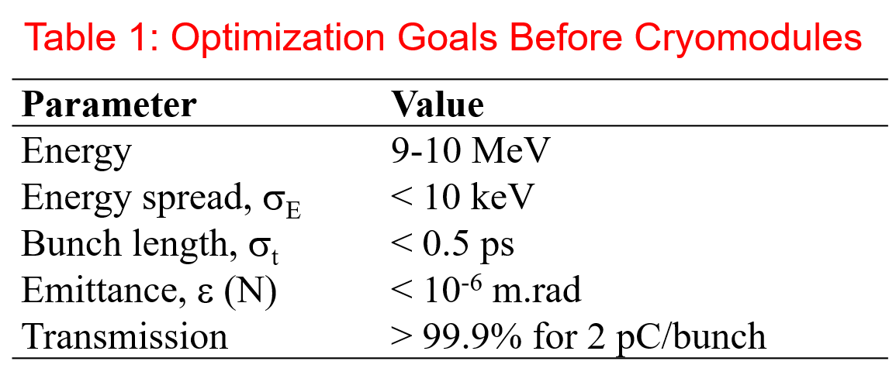
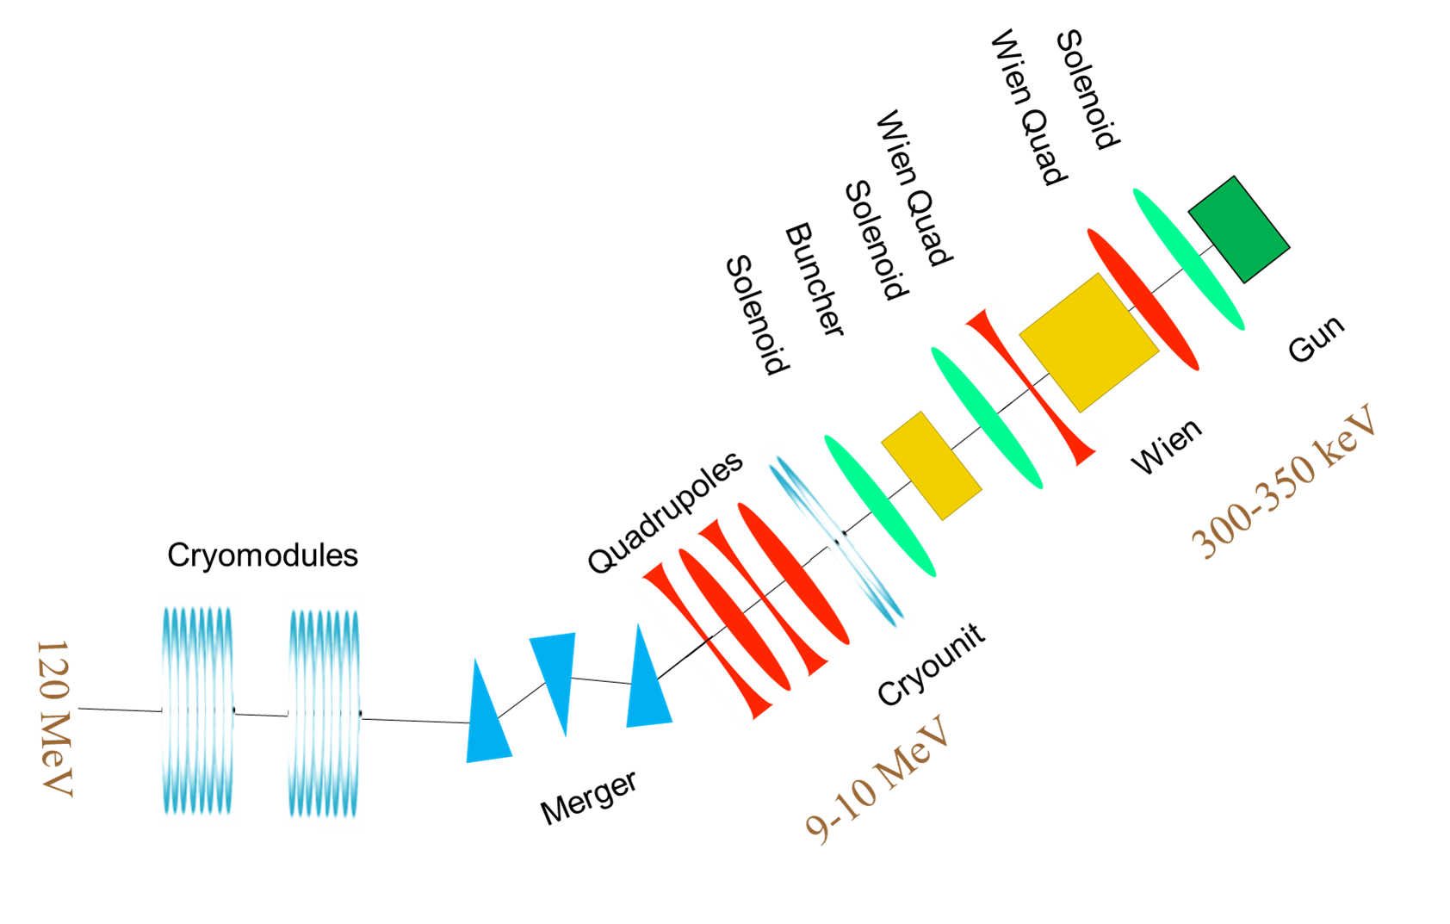
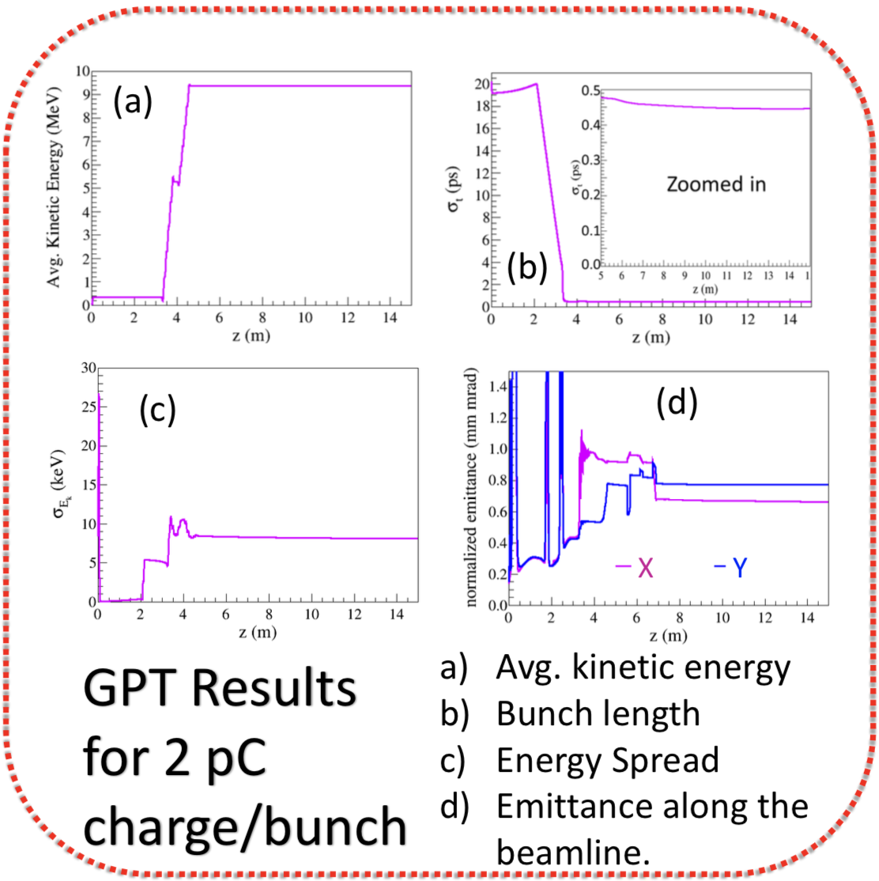
Progress developing the milliampere polarized electron beam injector
We are developing a ~3 year R&D plan to demonstrate the ~mA beam, from a photogun through a 10 MeV SRF booster
Beam dynamics modeling from the photogun to the booster is in progress
The SRF booster in LERF can accelerate 10 mA CW beam up to 10 MeV, but it has a helium leak
Injector model and simulations by
A. Hofler and R. Kazimi

Slide 22
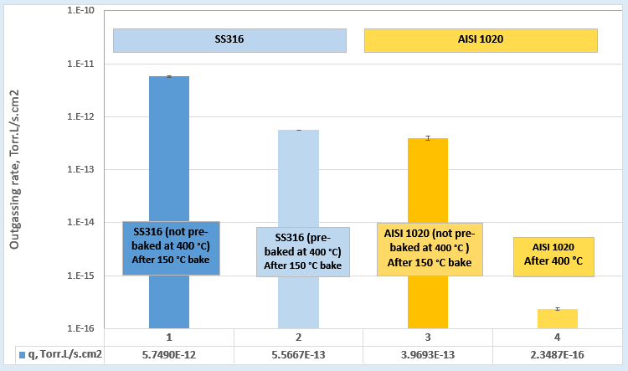
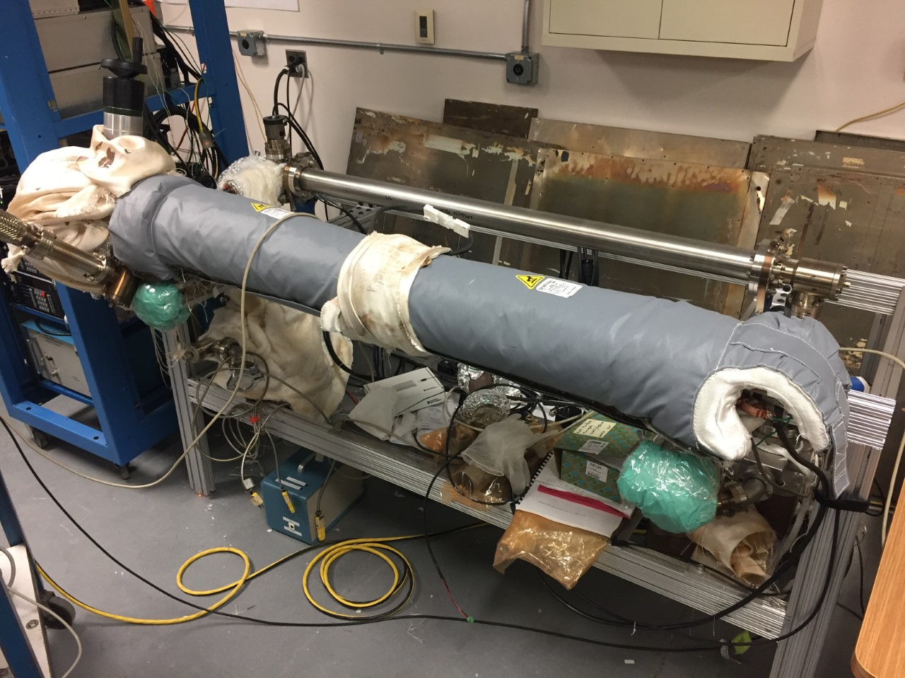
Improving photogun extreme high vacuum conditions
CEBAF photogun
316 stainless steel
R&D
low carbon steel
CEBAF photogun vacuum chamber after 400 C heat treatment
Test stand to measure hydrogen outgassing rate
Pump down “ultimate pressure” setup
Low carbon steel exhibits VERY low hydrogen outgassing rate. JLab measurements are consistent with those of Park et.al.,
Chongdo Park, Taekyun Ha and Boklae Cho, "Thermal outgassing rates of low-carbon steels," J. Vac. Sci. Technol. A 34, 021601 (2016); https://doi.org/10.1116/1.4936840
Slide courtesy M. Poelker

Slide 23
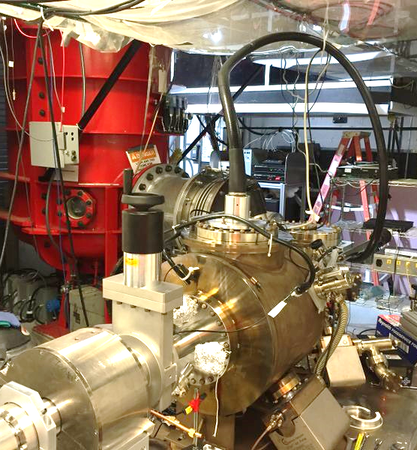
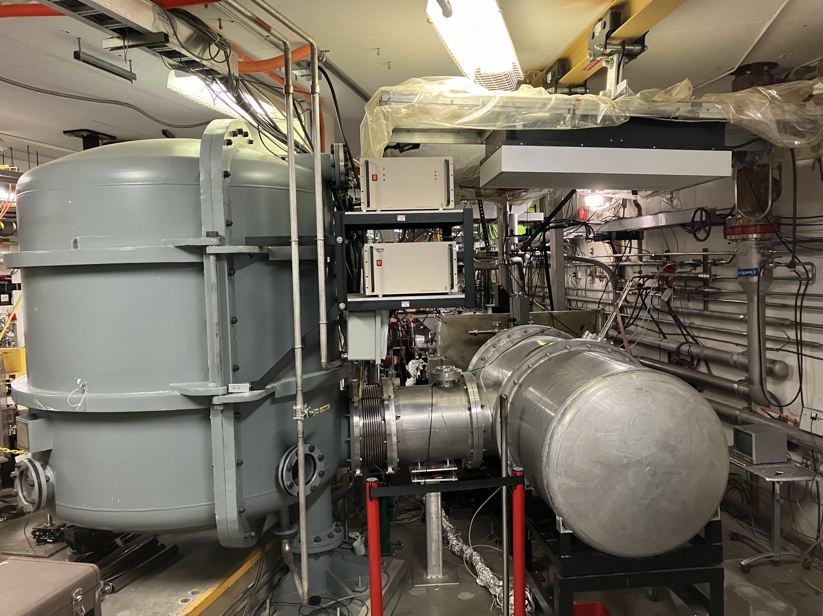
Inverted insulator polarized photogun
The 130 kV spin-polarized inverted-insulator photogun at CEBAF is very compact, provides exceptional vacuum and exhibits NO field emission.
A larger version of this photogun design operates at 300 kV bias voltage
2/3 of SF₆ gets eliminated by using cable
500kV power supply
HV cable
SF₆
500 kV DC power supply
SF₆
photogun
Resistor SF₆
Gun
SF₆

Slide 24
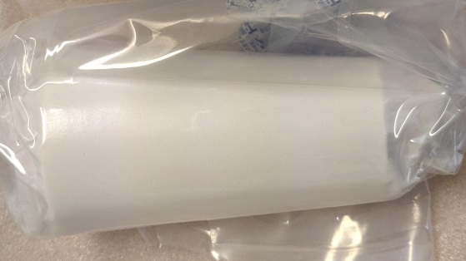
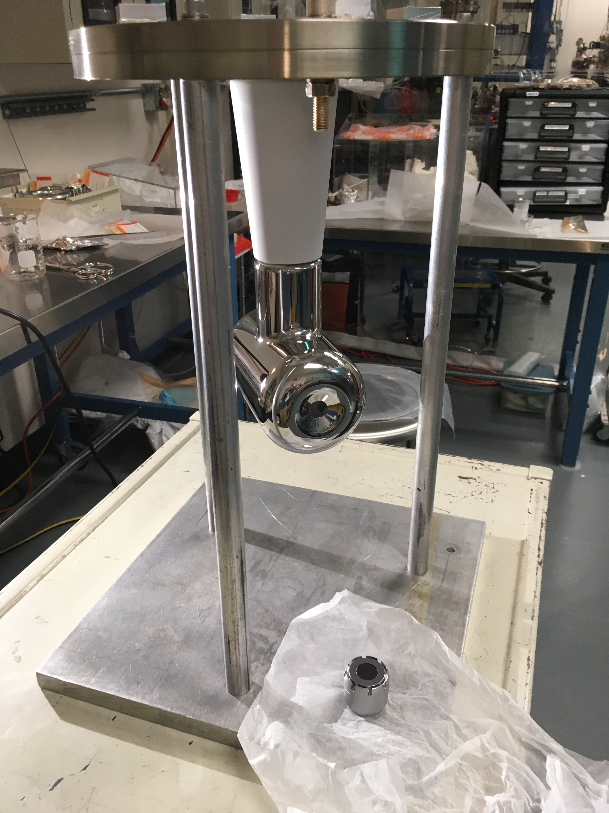
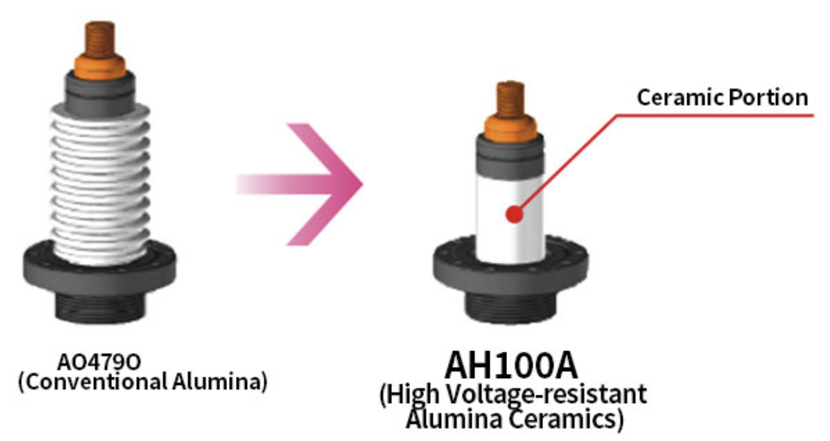
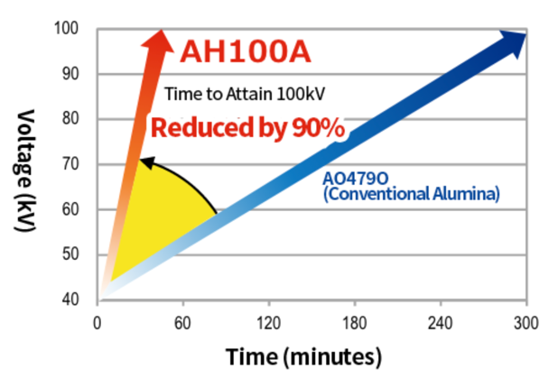
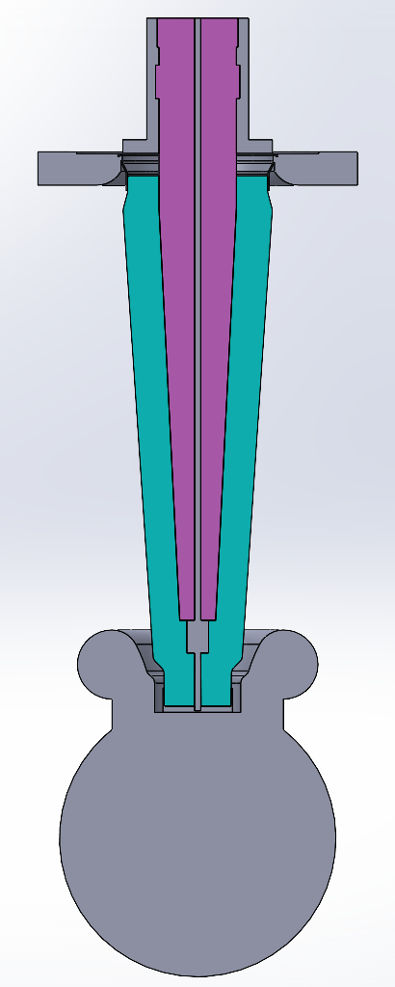
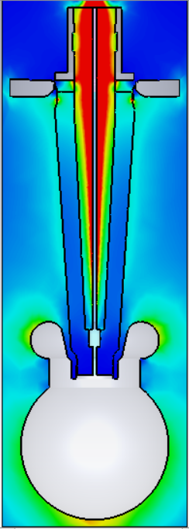

Kyocera high voltage insulator development
Kyocera has manufactured a 200 kV insulator (R28) sample and is in the process of manufacturing two prototypes: one from pure alumina, and one from their novel modified alumina with lower secondary electron yield
JLab will high voltage test the R28 insulator prototype in the Fall 2024.
122 mm
410 mm
JLab has completed the electrostatic design for a 500 kV insulator prototype to fit commercial high voltage cables.
The shielding electrode has been designed to linearize the potential along the insulator and minimize the electric field at the triple point junction (insulator-metal-vacuum).

Slide 25


Ongoing plans at LERF
LERF vent-bake gun
The prototype load-locked mA photogun could replace the LERF vent-bake photogun in the 10 MeV/10 mA injector
The Gun Test Stand gun could be modified as the first prototype mA polarized gun
SRF is preparing to repair the 10 MeV booster

Slide 26


High voltage conditioning with Kr gas serves to eliminate field emission*
The purpose of high voltage conditioning is to achieve vacuum and radiation levels indistinguishable from background at 200 kV DC
Kr gas is injected at ~10⁻⁵ Torr into the gun vacuum chamber during high voltage conditioning.
Kr facilities field emitter ‘burn out’ by ion back bombarding and by increasing stainless steel work function as it is implanted at the gun electrode bias voltage
*M. BastaniNejad, A. A. Elmustafa, E. Forman, J. Clark, S. Covert, J. Grames, J. Hansknecht, C. Hernandez-Garcia, M. Poelker and R. Suleiman, “Improving the performance of stainless-steel DC high voltage photoelectron gun cathode electrodes via gas conditioning with helium or krypton”, Nucl. Instr. and Meth. in Phys. Res. A, Vol. 762, pp. 135–141, 2014

