Slide 1
Precision Test of Mott Polarimetry
in the MeV Energy Range
P.A. Adderley¹, T. Gay², J. Grames¹, J. Hansknecht¹,
C. Horowitz³, M.J. McHugh⁴, A.K. Opper⁴, M. Poelker¹,
X. Roca-Maza⁵, C. Sinclair⁶, M. Stutzman¹, R. Suleiman¹
¹Jefferson Lab, ²University of Nebraska, ³Indiana University,
⁴The George Washington University, ⁵University of Milan, ⁶Cornell University

Slide 2
Outline
Mott scattering polarimetry
MeV-Mott @ CEBAF
Our program to test Mott at ~1% level

Slide 3
Outline
Mott scattering polarimetry
MeV-Mott @ CEBAF
Our program to test Mott at ~1% level

Slide 4
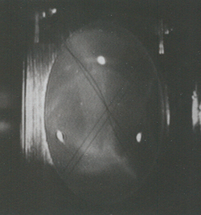
CEBAF Polarized Electron Injector
Polarized Electron Source
(130 keV)
Synchronous Photoinjection
Mott Polarimeter
(5 MeV)
SRF Acceleration
(123 MeV)
Mott
Polarimeter
Synchrotron
Light Monitor
Cryounit
Cryomodules
Apertures
Buncher
Capture
Gun#2
Bunchlength
Injection Chicane
V-Wien Filter
H-Wien Filter
Cavity
Spin Solenoids
Chopper
PreBuncher
Gun#3
Spectrometer Dump
4π Spin Manipulation
Bunching & Acceleration
(500 keV)
SRF Acceleration
(3-8 MeV)

Slide 5
MeV-Energy Mott polarimetery
Desirable qualities
Relatively simple configuration
Very large analyzing power
Statistically efficient figure-of-merit
Straight-forward electron detection
Experiment quality beams suitable for measurement
Challenges for absolute uncertainty < 1%
Theoretical Sherman function (single-atom)
Plural scattering in “thick” targets
Instrumental systematics

Slide 6
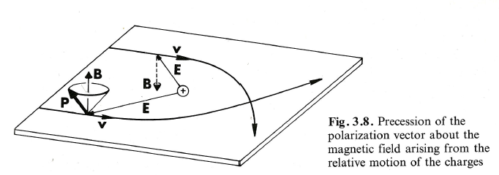
Mott Scattering
J. Kessler, “Polarized Electrons” 2nd Ed. Springer-Verlag
Physical picture and intuition…
Analyzing power in scattering plane (S)
Spin parallel to scattering plane rotates (T,U)
Spin orbit coupling depends strongly on impact parameter
Notes:
Red Interior Page Design 1

Slide 7
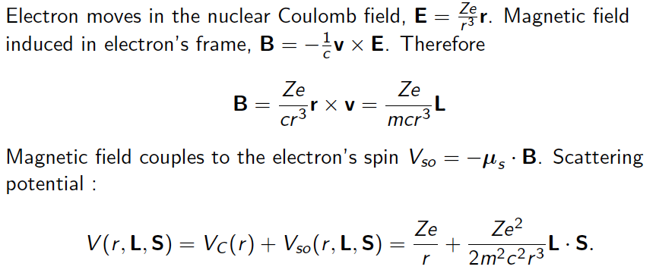
Explicitly
Notes:
Red Interior Page Design 1

Slide 8
Sherman Function & Cross-Section
Notes:
Red Interior Page Design 1

Slide 9
Measuring an Asymmetry
Cross-ratio method cancels false asymmetries from detector efficiency, beam current, target thickness and solid angle.

Slide 10
MeV - Sherman Function & Figure of Merit (FOM)
Analyzing power significant for small impact parameter
Screening is negligible for MeV-energies
Extended nuclear charge distribution (finite size) is relevant for MeV-energies
Cross-section allows for micro-Ampere currents incident on micro-meter thick target foils
Notes:
Red Interior Page Design 1

Slide 11
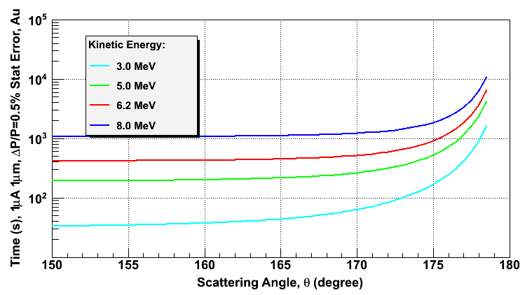
Rate and Run Time
Elastic rate per detector
Run time (2 detectors, 2 helicities)

Slide 12
Outline
Mott scattering polarimetry
MeV-Mott @ CEBAF
Our program to test Mott at ~1% level

Slide 13
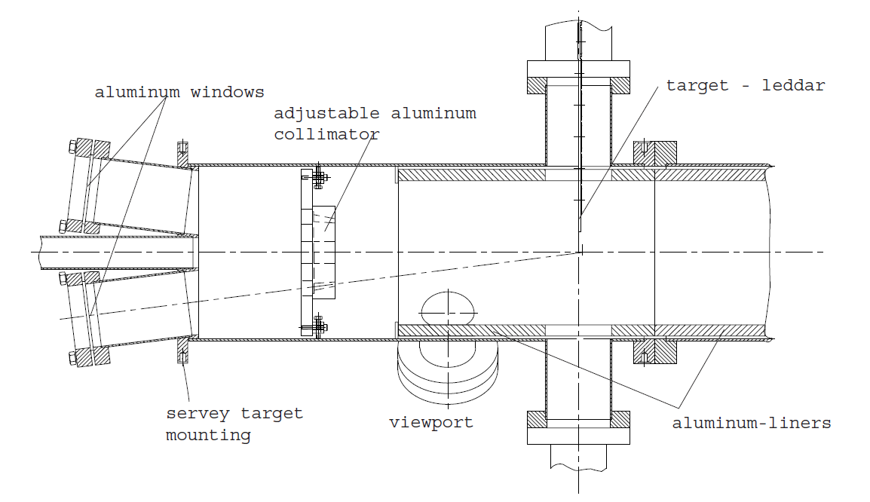
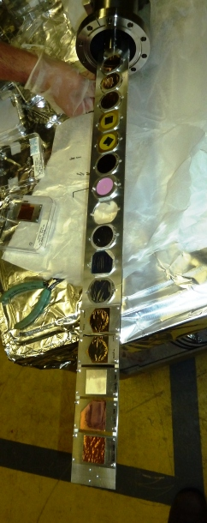
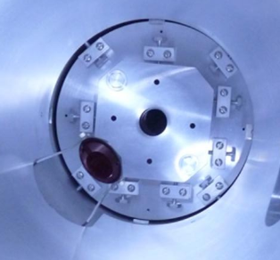
Scattering Chamber
Θ = 172.6°
Ω = 0.18 msr
Foil Targets = 14
Empty = 1
Viewer = 1

Slide 14
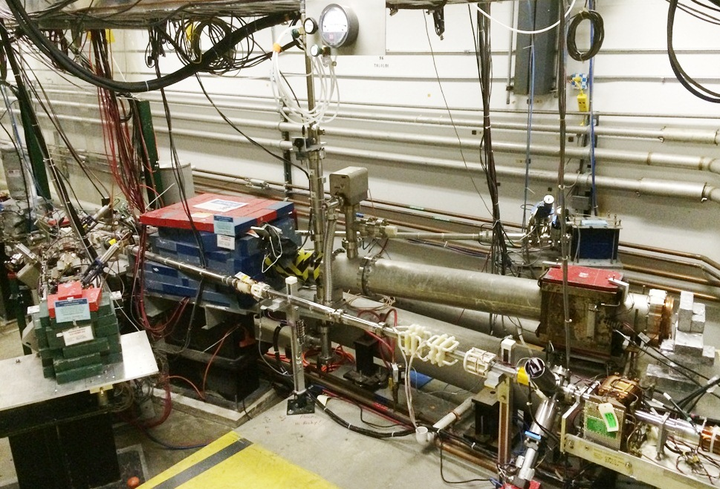
Mott Polarimeter at CEBAF

Slide 15
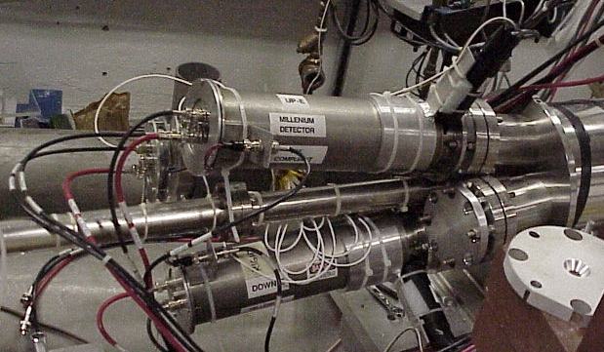
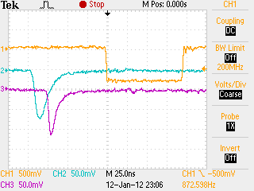
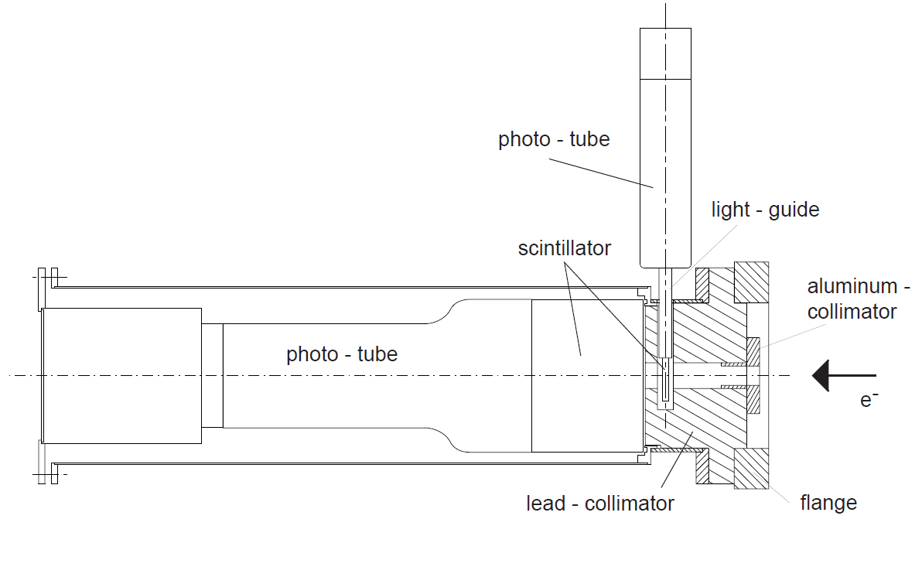
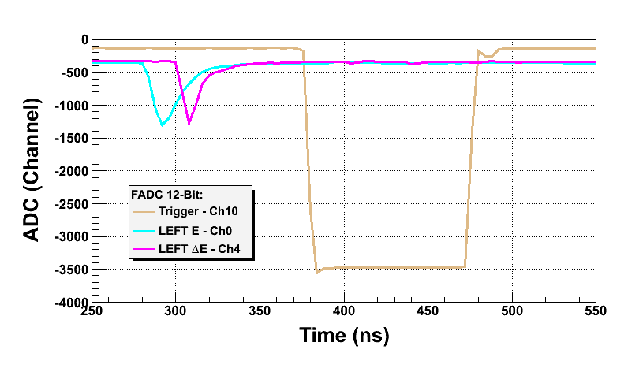
Electron Detection & Photon Suppression
Mott Trigger
Left E
Left ∆E

Slide 16
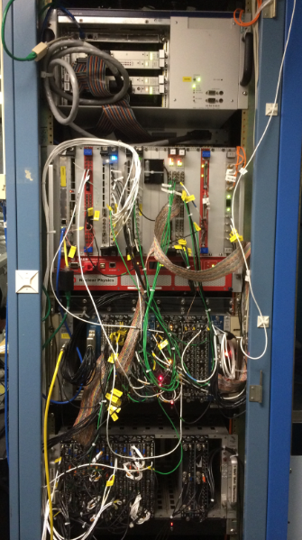
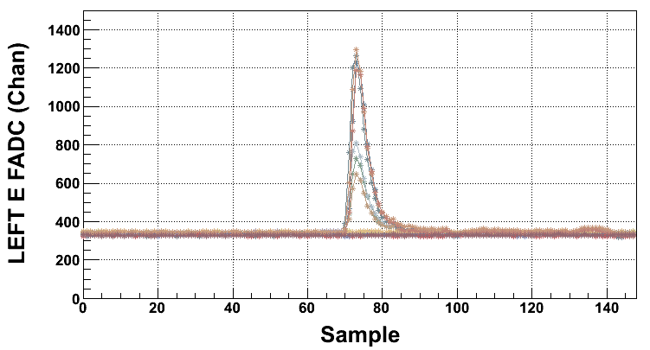
Data Acquisition
CODA (CEBAF Online Data Acquisition)
Motorola MVME6100
JLAB Flash ADC (12 bit, 250 MS/s)
CAEN V775 TDC (34 ps/sample)
SIS 3801 (200 MHz)
Helicity Reversal = 30 to 960 Hz
Fast coincidence (veto) logic
Beam intensity and position
Deadtime <5% at 2kHz (20kHz upgrade)

Slide 17
Time and Energy Spectra (f_{beam} = 499MHz)
δE/E = 2.4%
(after ped. cor.)

Slide 18
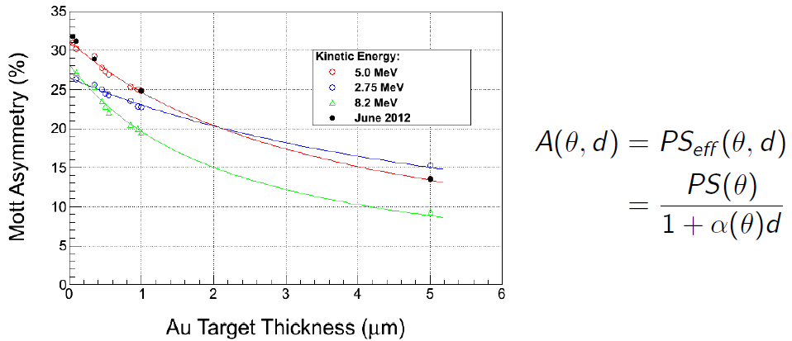
Dependence on foil thickness
M. Steigerwald, “MeV Mott Polarimetry at Jefferson Lab”, SPIN 2000, p.935.

Slide 19
Outline
Mott scattering polarimetry
MeV-Mott @ CEBAF
Our program to test Mott at ~1% level

Slide 20
AccurateTest of MeV Mott (ΔP/P)
Precise single-atom Sherman function (theoretical calculations)
Target thickness dependence (model of plural scattering)
Measure asymmetry with small instrumental uncertainty (beam systematics)
Effective Sherman Function
Expected Range of Uncertainty
Theory | 0.5 – 1.0%
Target Thickness | 0.2 – 0.5%
Instrumental | 0.2 – 0.3%
BUDGET | 0.6 – 1.2%
Target Thickness

Slide 21
Single-Point Sherman Function Calculations
Nuclear recoil – Kinematic and dynamic corrections due to finite mass of target can be accounted for, however, should be negligible if electron beam energy (<10MeV) is negligible compared to the mass of the target (10⁴ MeV) [see F. Gross, Review of Modern Physics 36 (1964) 881]
Coulomb screening – negligible for electrons of energy above few MeV, except for scattering <1° which have negligible Sherman function
Numerical solution of Dirac equation – accuracy of convergence of partial wave solution sufficiently high enough so uncertainty in numerical solution <0.1%
Finite nuclear size – for electrons of energy above few MeV Fermi distribution may be used to compute correction with contributed uncertainty <0.2%

Slide 22
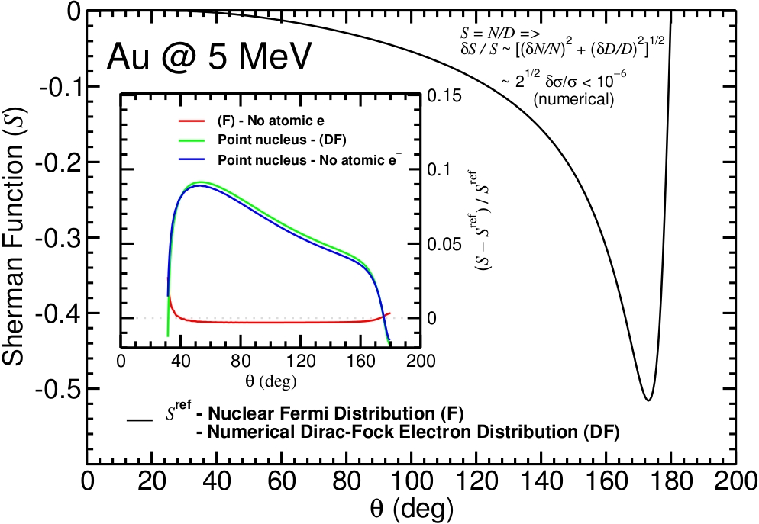
Exploring gold at KE=5.0MeV
X. Roca-Maza

Slide 23
Single-Point Sherman Function Calculations
Nuclear recoil – Kinematic and dynamic corrections due to finite mass of target can be accounted for, however, should be negligible if electron beam energy (<10MeV) is negligible compared to the mass of the target (10⁴ MeV) [see F. Gross, Review of Modern Physics 36 (1964) 881]
Coulomb screening – negligible for electrons of energy above few MeV, except for scattering <1° which have negligible Sherman function
Numerical solution of Dirac equation – accuracy of convergence of partial wave solution sufficiently high enough so uncertainty in numerical solution <0.1%
Finite nuclear size – for electrons of energy above few MeV Fermi distribution may be used to compute correction with contributed uncertainty <0.2%
Radiative Corrections – estimated to be lower than 1%, but remains leading theoretical uncertainty. We aim to test the contributions of the radiative corrections (e.g. Coulomb distortion scale like Zα, dispersion like α) by testing Sherman function over a large range of Z: Au=79, Ag=47, Cu=29, Al=13, C=6.

Slide 24
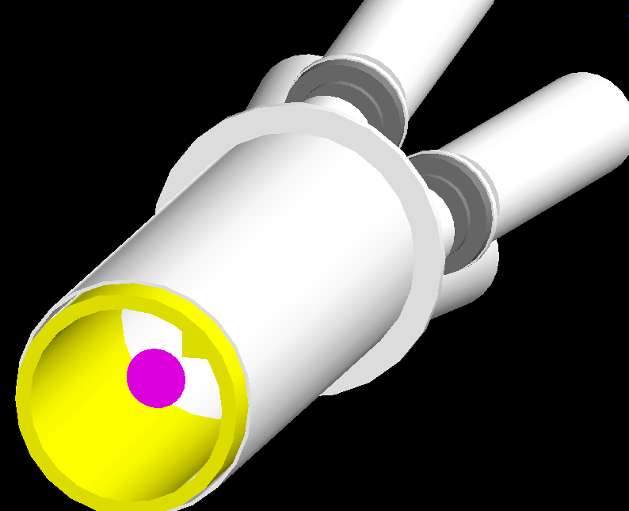
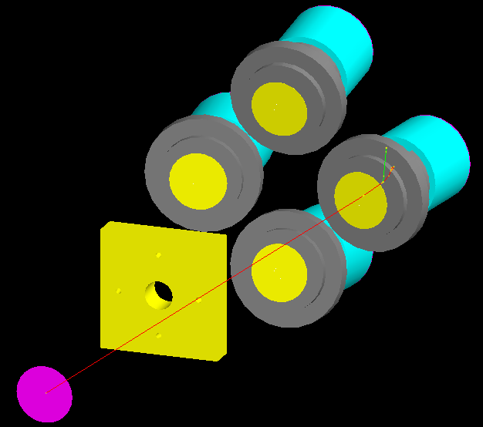
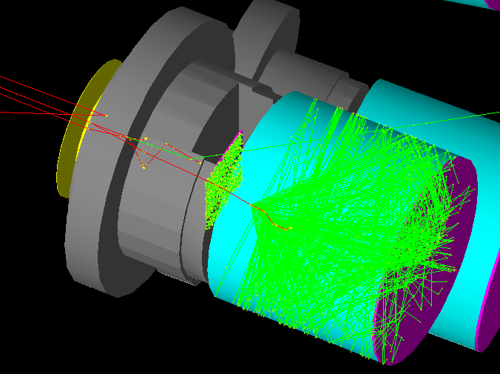
Geant4 Model and Plural Scattering
Geant4 Mott Model V1 (now)
Simple model of target, collimator
Detailed model of detector
Fire electrons at detector
Geant4 Mott Model V2 (next 3 months)
Refine model of entire chamber
Electron generator based on theory
Benchmark against commissioning data

Slide 25
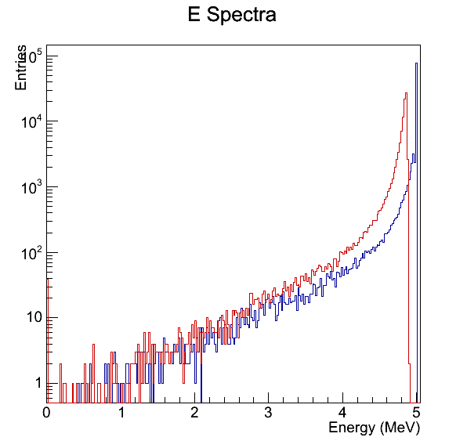
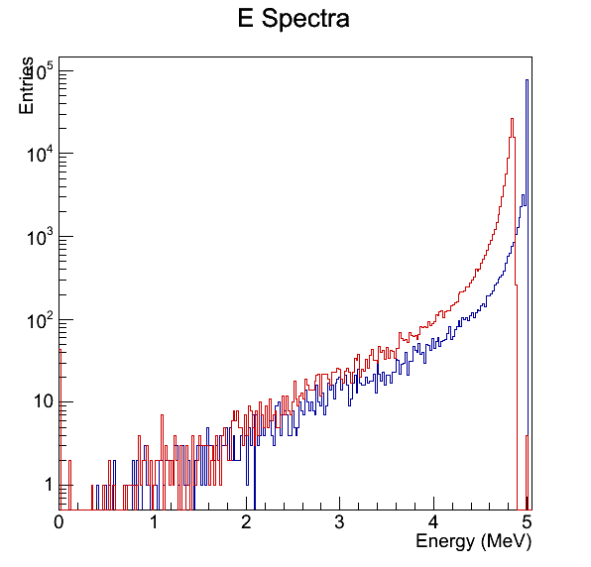
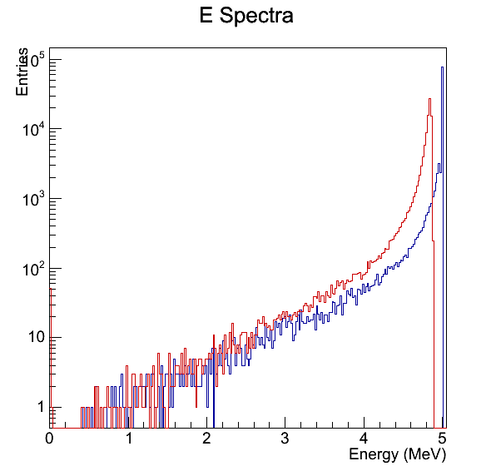
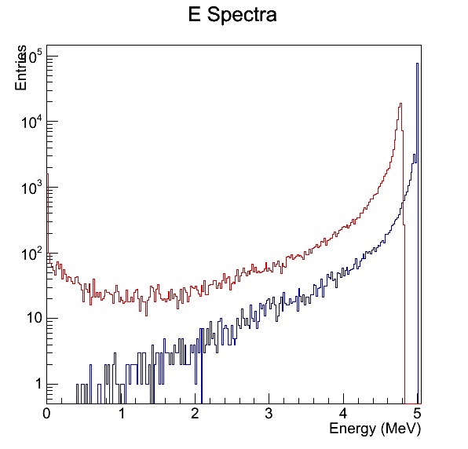
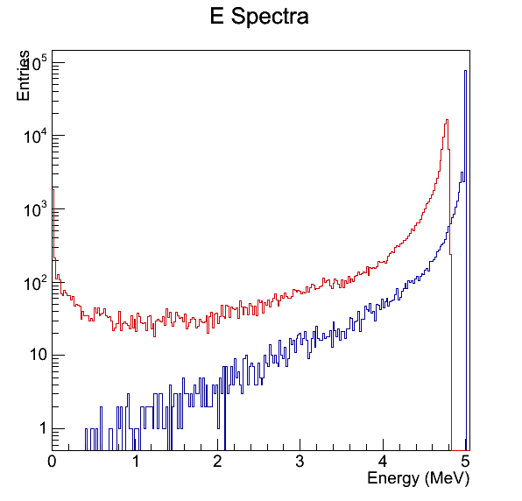
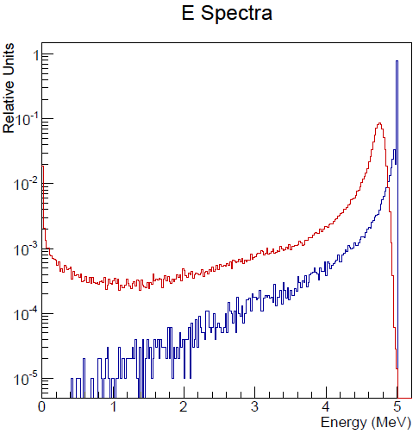
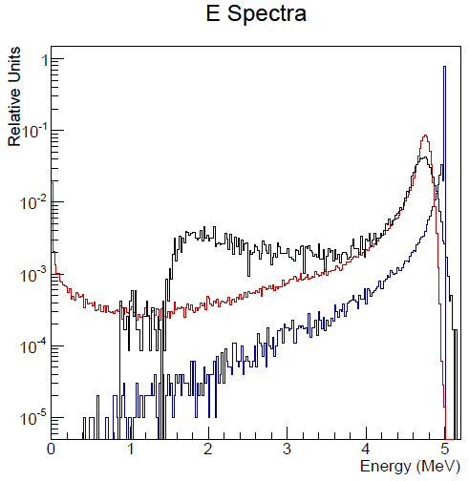
Geant4 detector response
BLUE = Geant4 monoenergetic 5 MeV beam passing to ideal detector
RED = Geant4 adding one degree of reality per panel
BLACK = Experimental data for comparison
ΔE detector
Air
Al + Pb collimator
8mil Al window
Full acceptance
1% energy spread
Compare 1 um Au

Slide 26
Foil Thickness
How do we quote target foil thickness?
Vendor derives by measuring mass with a quartz crystal microbalance
Specification
Absolute uncertainty : ±10%
Variation in a lot of foils produced at same time : ±5%
Variation in a single foil : ±2%
Measurements at JLAB (Courtesy A. Mamun)
Used Scanning Electron Microscopy to measure edge of foil
Plan to measure “sibling” foils from same lot

Slide 27
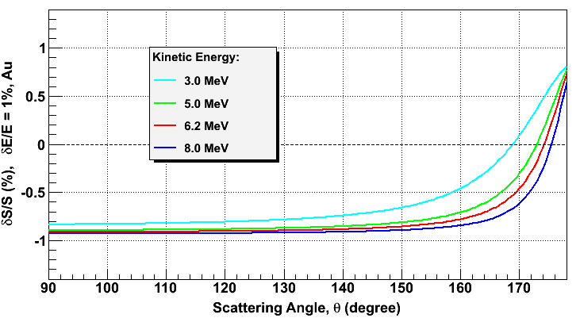
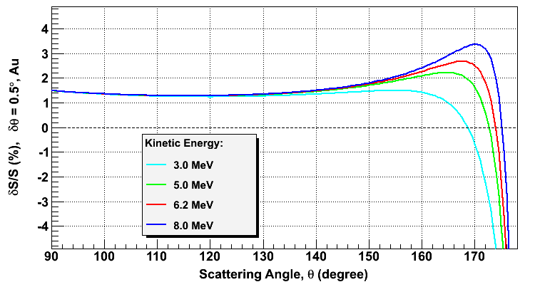
Instrumental Asymmetries
0.5% energy => 0.1% false asymmetry
0.1 deg => 0.1% false asymmetry

Slide 28
Role of Beam Dump Background
12 ns round trip time
499 MHz (2ns)
Gold
0.1 um
Gold
1.0 um
Gold
10 um

Slide 29
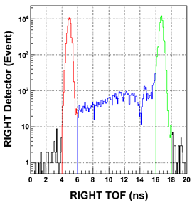
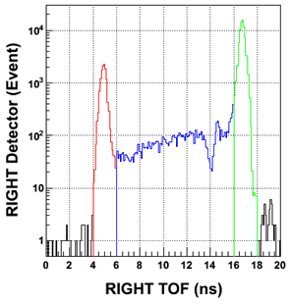
Dipole Suppression
Dipole deflects primary and secondary electrons
OFF
+5 A

Slide 30
Time Of Flight Separation
f_{beam} = 31.1875MHz
16 ns repetition rate > 12 ns “clearing time”
TARGET
STRAGGLERS
DUMP
TARGET
STRAGGLERS
DUMP

Slide 31
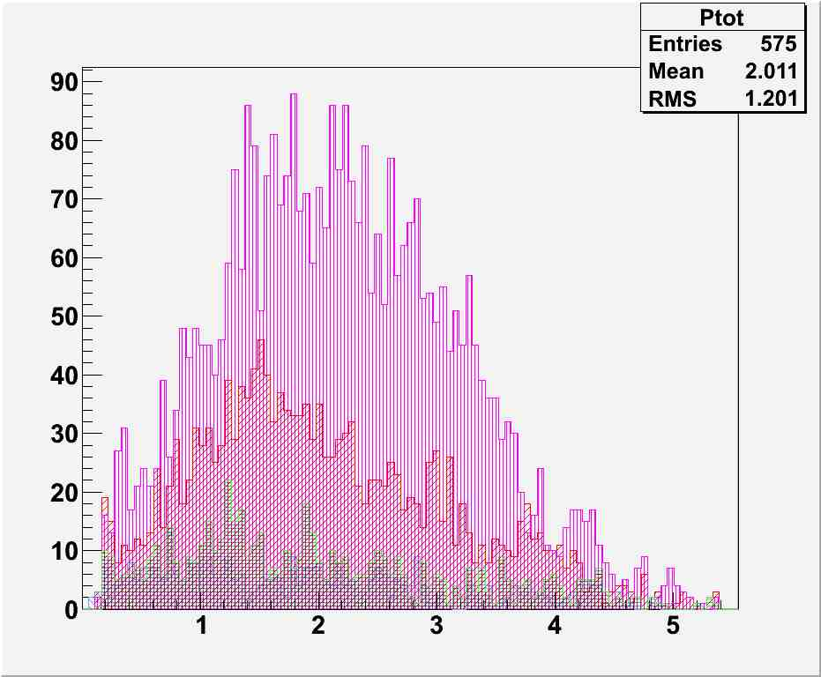
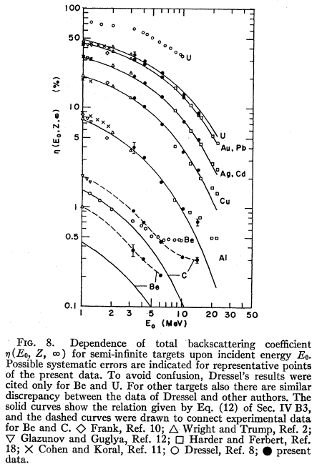
New Beam Dump to Suppress Backscatter
T. Tabata, Phys Rev. 162, 2 (1967)
Number of backscattered electrons
G4Beamline
Cu
Number of Electrons
Al
C
Be
Total Momentum [MeV/c]
Background suppression by factor of four
Photon suppression as well (factor of 2)

Slide 32
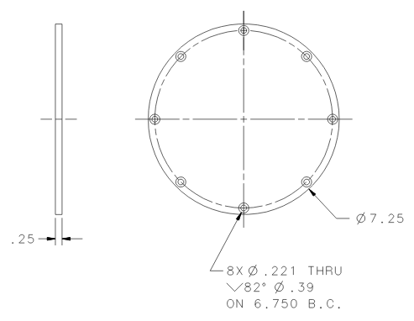
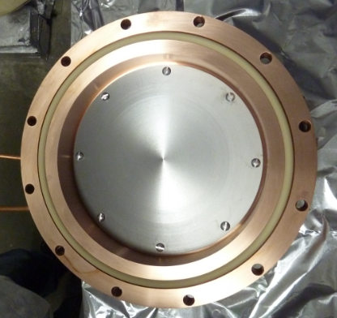
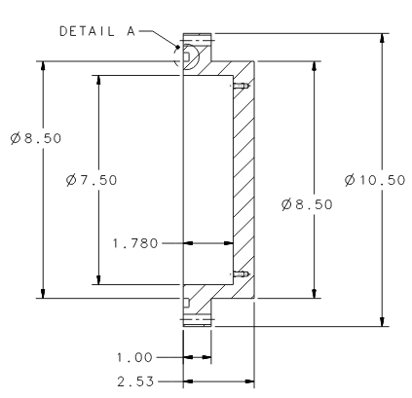
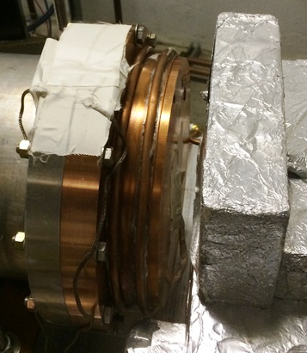
New Dump Design
Kalrez™ high temp (240C) o-ring
Dump should work fine to 1 kW (200uA @ 5MeV) so limitation will be deadtime.

Slide 33
Status
Last 12 months…
Chamber alignments completed
DAQ and detectors commissioned
31MHz operation (RF/2^N) demonstrated
Preliminary instrumental tests consistent w/ zero
Tested of 14 targets (gold, silver and copper)
Began commissioning new Be/Cu dump plate

Slide 34
Plans and Summary
Next 6 months…
Test dump/polarimeter for operating higher currents
DAQ controller/readout upgrade for 20kHz operation
Develop efficient Geant4 model of plural scattering
Measurements vs. energy to test Geant4 model
Measurements vs. target atom (Z) to test theory
Recent effort to upgrade Mott polarimeter and perform precision measurement of absolute analyzing power proceeding per plan with goal to complete work in 2014.

