Slide 1
JLab Positron Coverter Status
5/3/2023
Colwyn Gulliford, Val Kostroun, Christopher Mayes, Bruce Dunham,
Ralf Eichhorn, Karl Smolenski, Nick Taylor, Joe Conway

Slide 2
Status Report
    CFD analysis continues / magnetic field addition
    First Nozzle Manufactured
    First tests with water – looks good
    Velocity sensor on order – arriving soon
    Pumping of liquid metals is next (gear pumps)

Slide 3
Overview of System

Slide 4
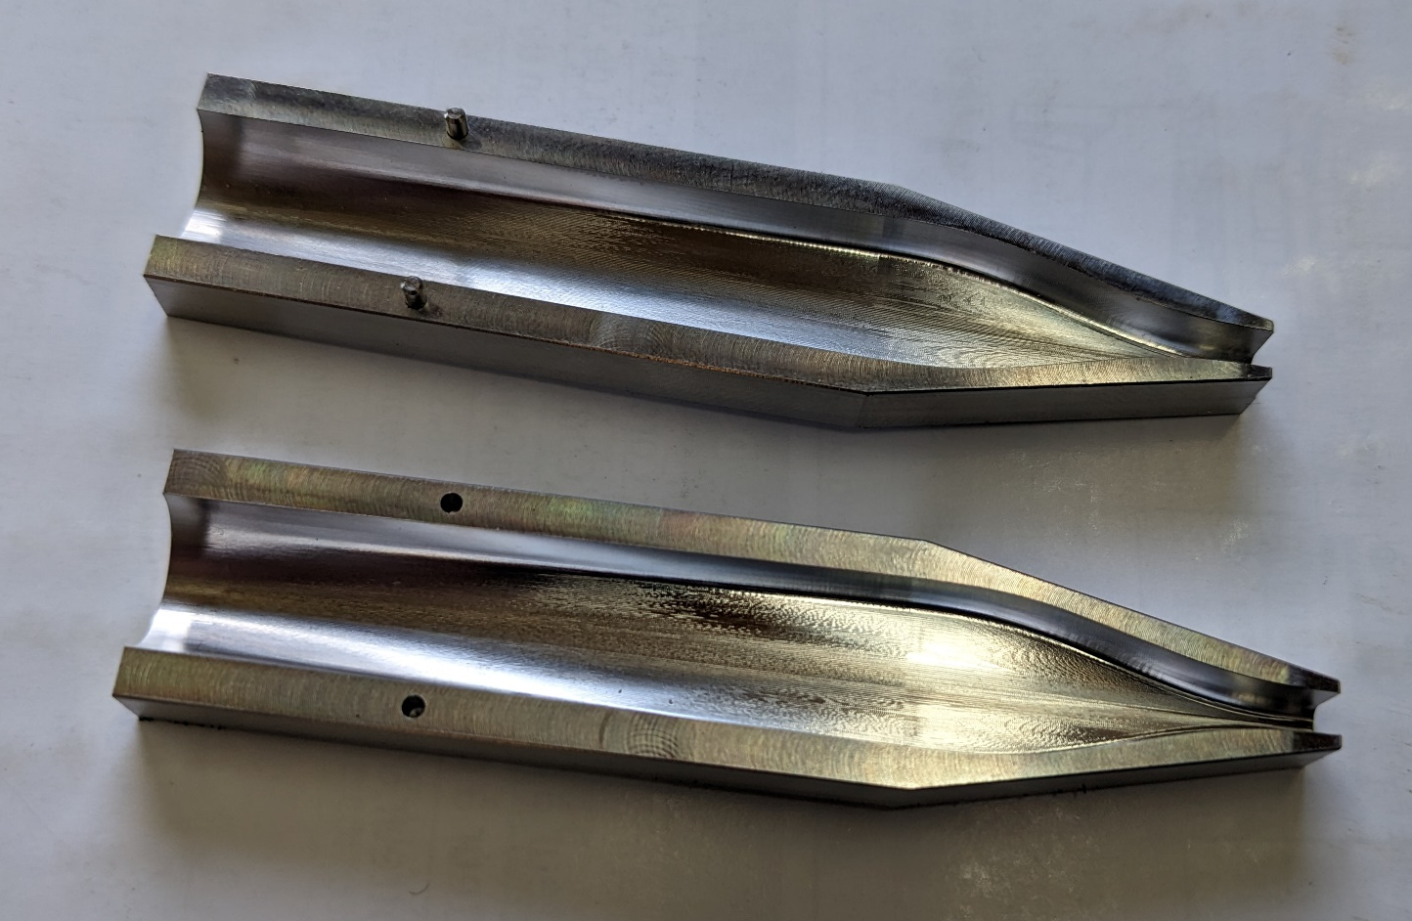
Nozzle Production
    5 axis machining to CFD design
    Finish is quite exceptional
    Seam at centerline may be changed in future designs
Jet of 3mm thickness x 10mm width

Slide 5
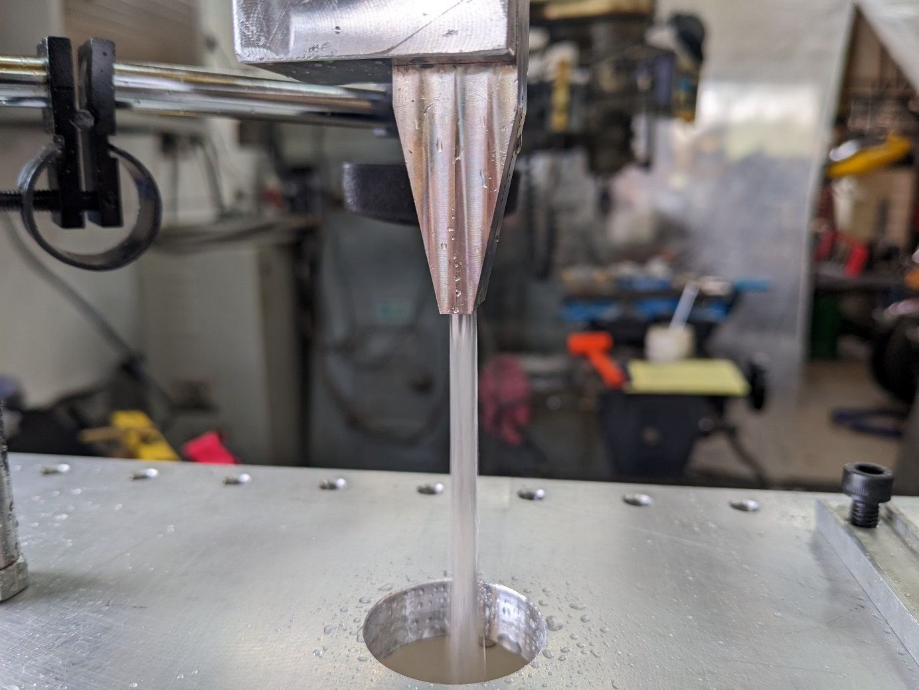
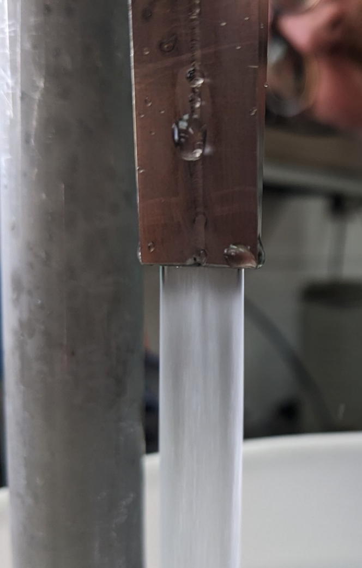
First Jets with Water
Jet of 3mm thickness x 10mm width

Slide 6

Velocity Sensor

Slide 7
Transition to Liquid Metal
    Simple system for water tests can be built from a “Home Depot” trip.
    Work towards a gear pump driven system for Ga-In-Sn next - much of the set up can stay the same
    Minimize liquid volume of the system for cost reasons
    Closed system to avoid oxidation
    Velocity measurements with water to continue
    Second generation nozzle

