Slide 1
ASY-R30-3: Where is the x-deviation coming from?
Gabriel Palacios Serrano
02/24/2021
gabrielp@jlab.org

Slide 2
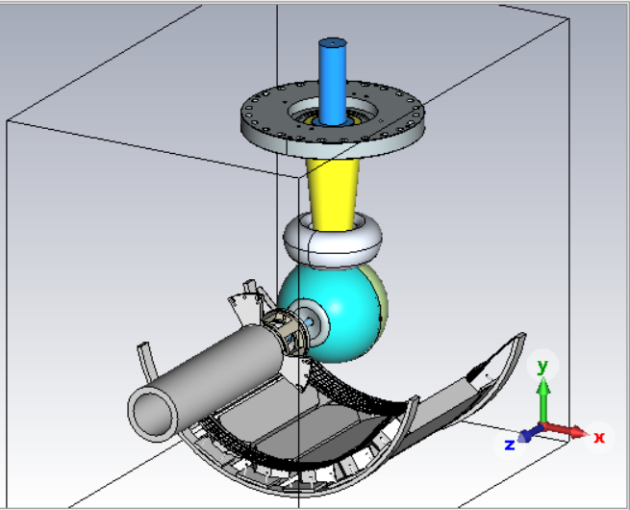
Model
Used Shaun’s latest 02/2022 model and removed the asymmetric mesh on the –x side, and the left and right side bars. I kept my vacuum chamber, even though is not shown here.
Notice that the spider is asymmetric, but it is outside the vac chamber in my model.

Slide 3
Average beam position: -2.5 deg hinge tilt
Trying to explain that x-axis (horizontal) deviation

Slide 4
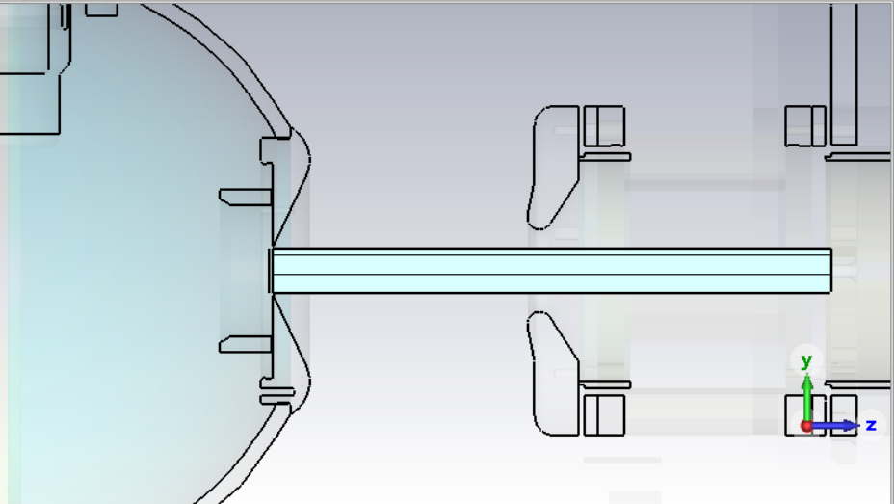
Cylinder to control mesh
CST auto-mesh controls the max step size for the mesh on vacuum regions.
A trick that Fay told me a while ago is to construct a vacuum cylinder (or box) and use it to control the mesh size by imposing a max step size on it.

Slide 5
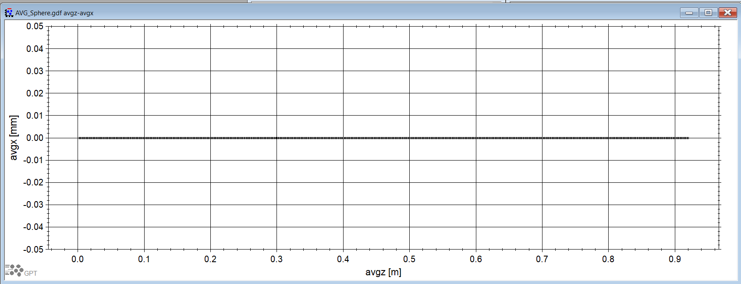
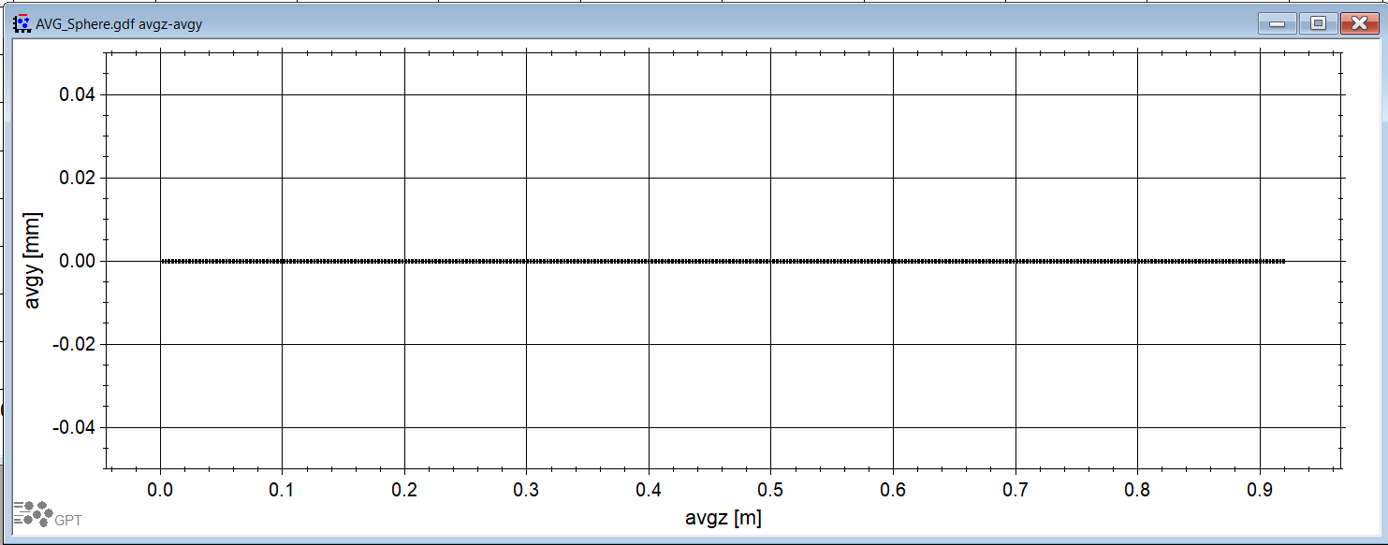
To check if the field map was the problem
Using our GPT deck, remove the beam parameters and just allow a single electron to float from the center of the photocathode towards the anode.
In the absence of any field map or space charge, the single electron should float to the end of the simulation unperturbed

Slide 6
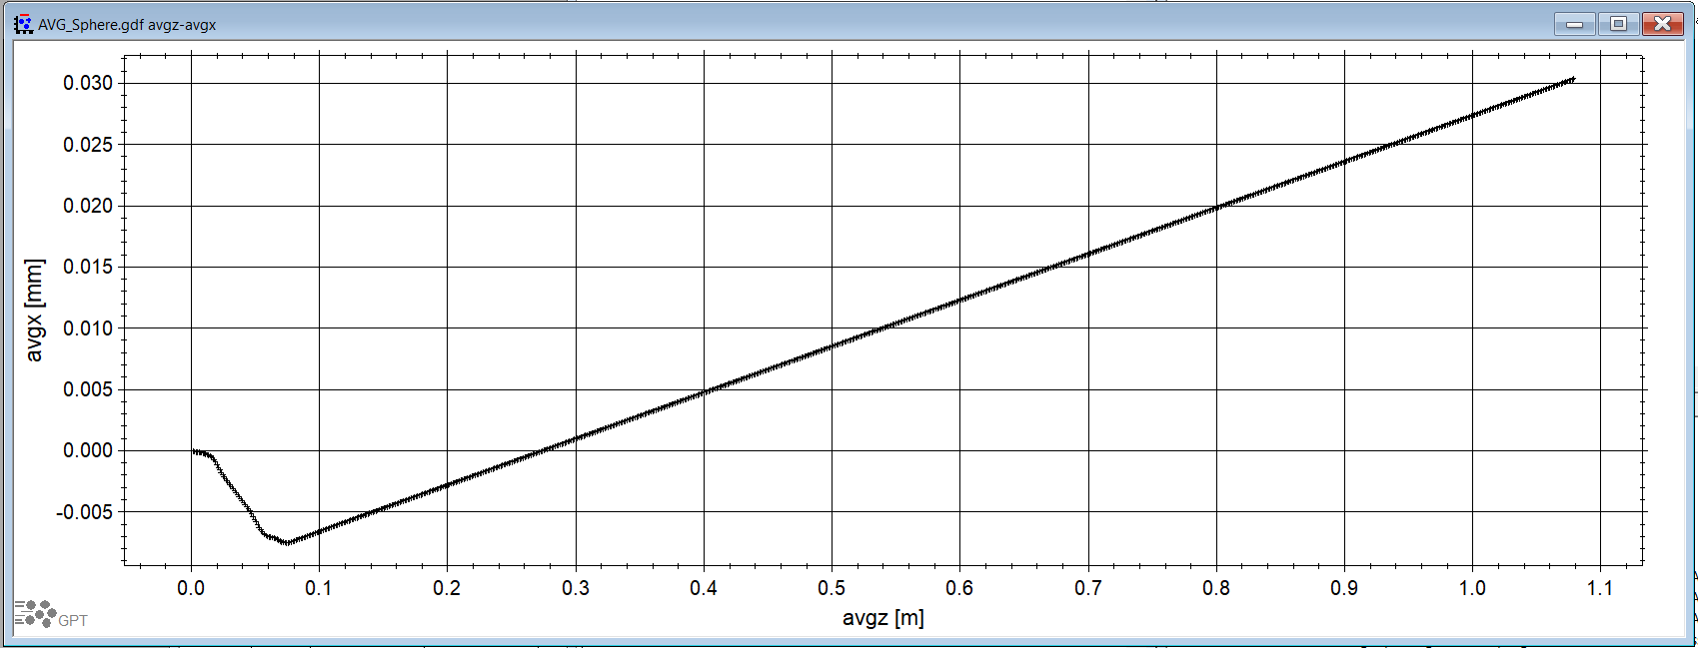
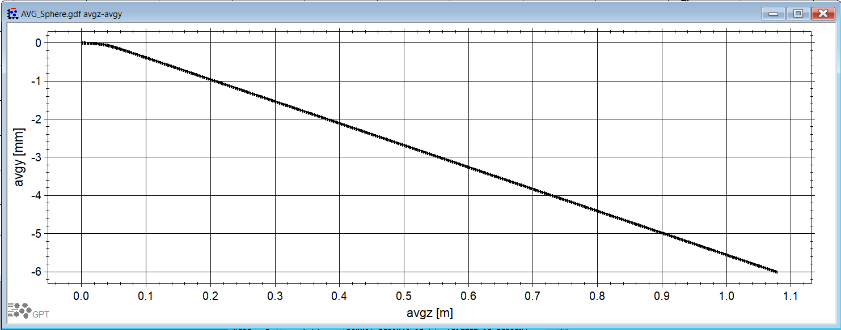
To check if the field map was the problem
Now, activate the 3D field map (created in CST) and re-run the GPT deck. We get that pesky x-deviation.
Notice that the deviation is around 0.017 mm at z=0.75 m. But what is going on in those first 10 cm!?

Slide 7
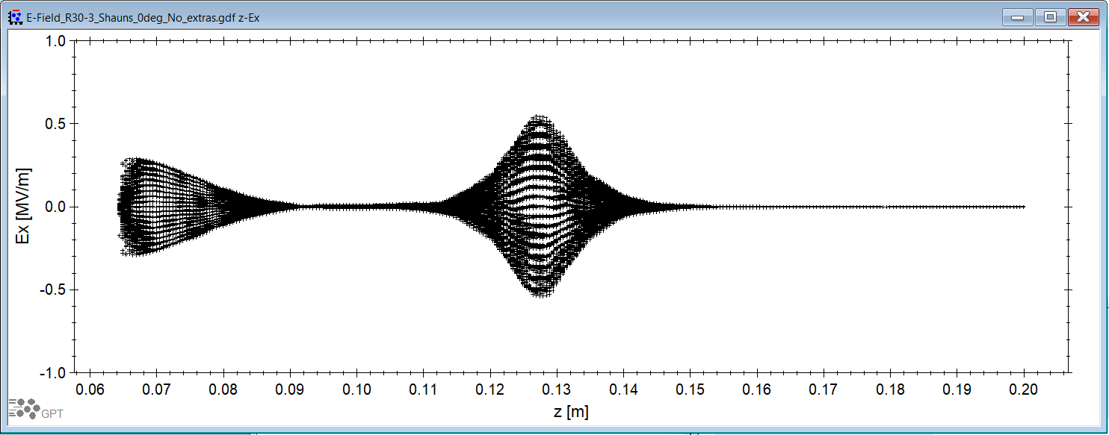
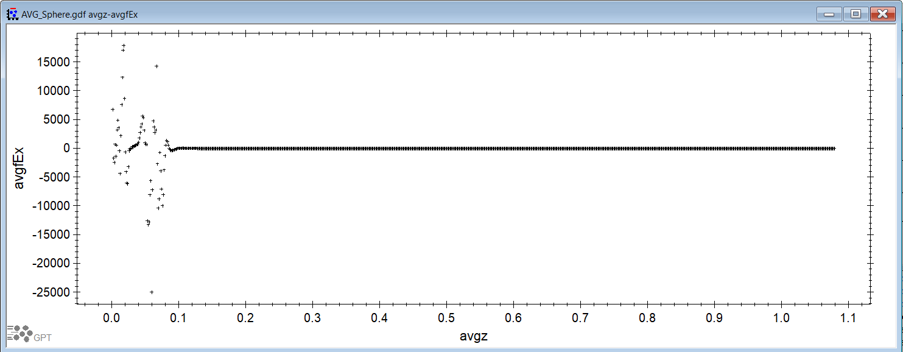
To check if the field map was the problem
It is not suggested to just “look at the field map” to see if it is symmetric. Why? Because the field map is 3D and we care about tiny variations.
But I was still curious to see directly what the beam (in this case the single electron) is experiencing. Use then avgfEx!
Wow, see those field points before the z = 0.1 m mark? That can’t be good. Right at the center, I was expecting Ex=0 across the whole length!

Slide 8
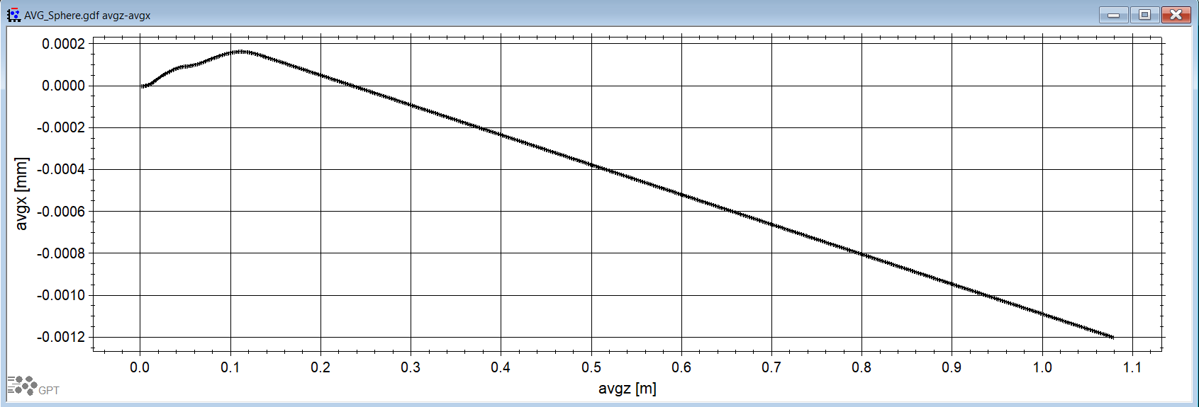
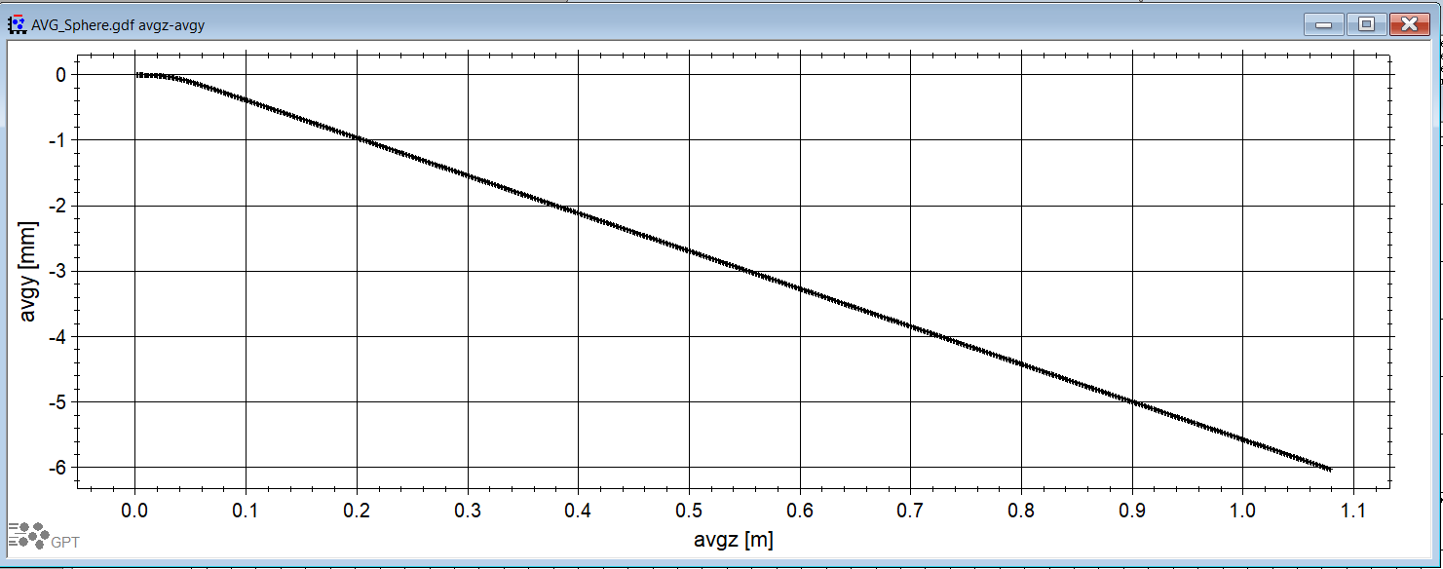
To check if the field map was the problem
I checked the 3D model that Shaun provided an it is symmetric in the pierce geometry and the anode, so where is the Ex field deviation coming from!? My thought was, the mesh! So I went back and noticed the mesh of the cylinder was set in 0 (which means auto mesh), so I switched it to a max step size of 0.001 m, and we get these plots now. See the change in direction from the x-deviation. Like, WTF!?

Slide 9
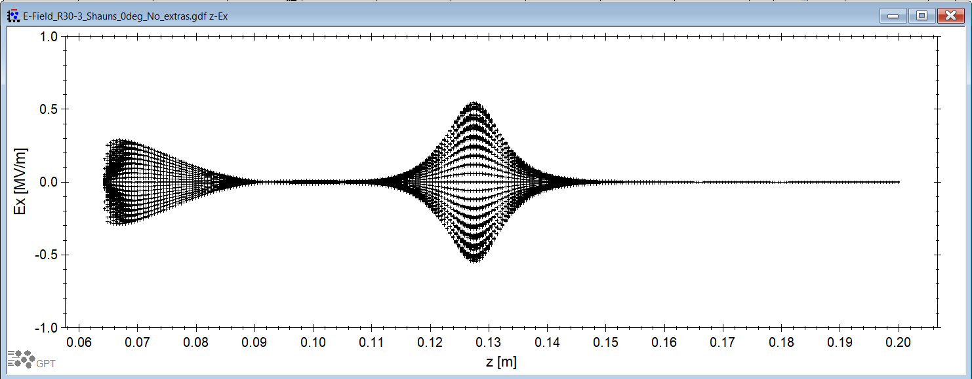
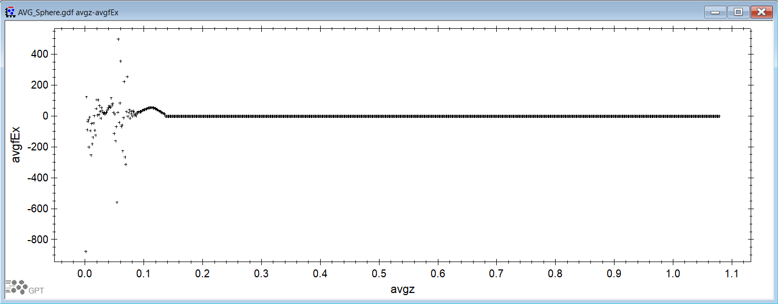
To check if the field map was the problem
And see, just as I mentioned, the field map looks “very similar” at this scale of course.
But is the avgfEx that now looks different. This means, the single-electron is actually experiencing more precise values of the simulated E-field!
So what happens if we go even further into making the max step size in our cylinder even smaller?

Slide 10
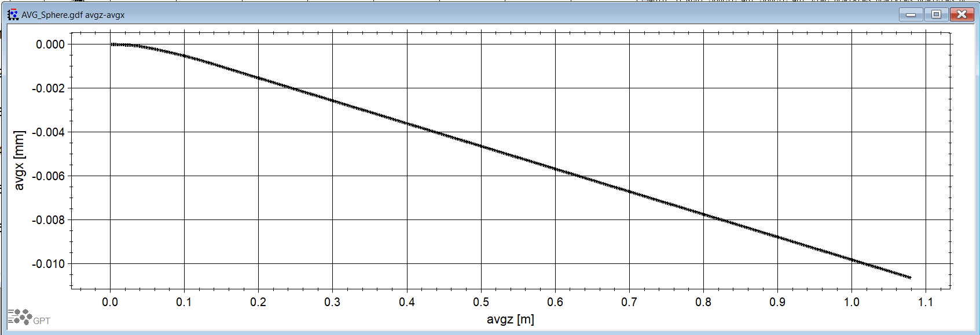
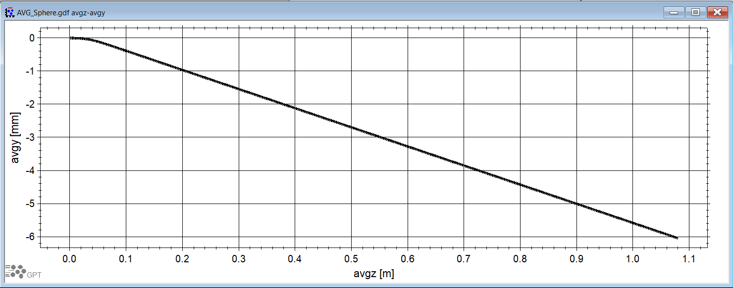
To check if the field map was the problem
Cylinder mesh max step size = 0.0005 m
Which means, better results!

Slide 11
Lessons learned
Remember, the field map file creation goes trough multiple steps that can mess up their fidelity.
Pick a sensible max mesh step size for adjacent geometries that “captures” the details of your simulation
While using the postprocessor in CST to export field maps excel files, use only step sizes that are larger or equal to your max mesh step size.
While reading a field map file, control your GPT accuracy to match the field map file step size. This last one is not a deal breaker, but will allow your GPT deck to interpolate field map values based on more precise values.

Slide 12
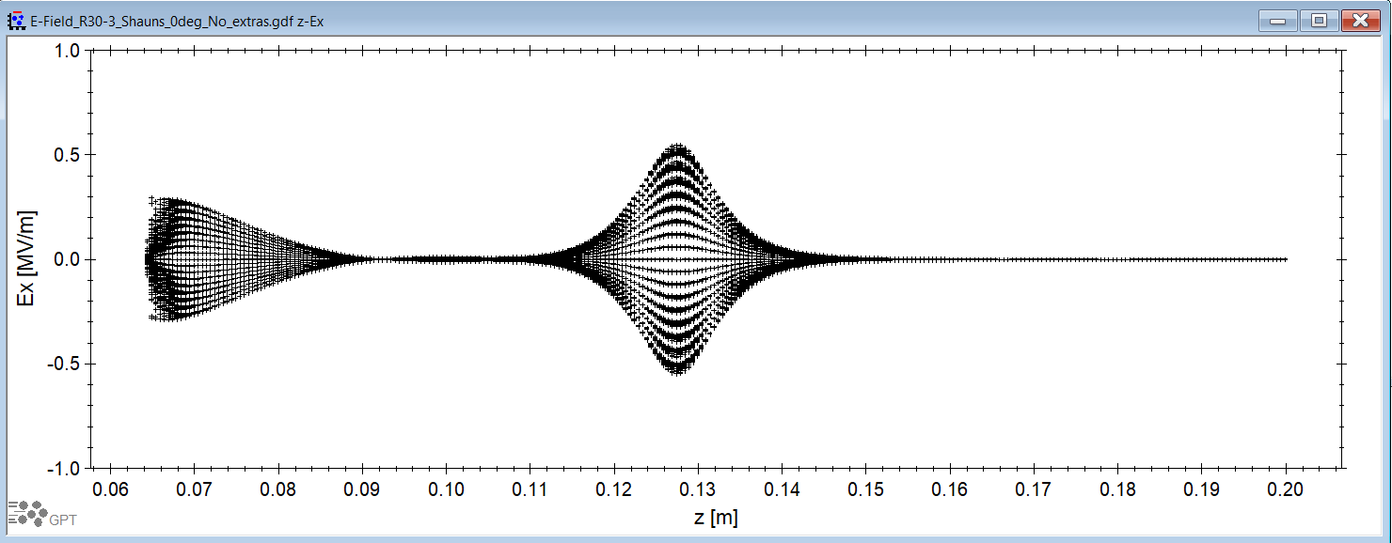
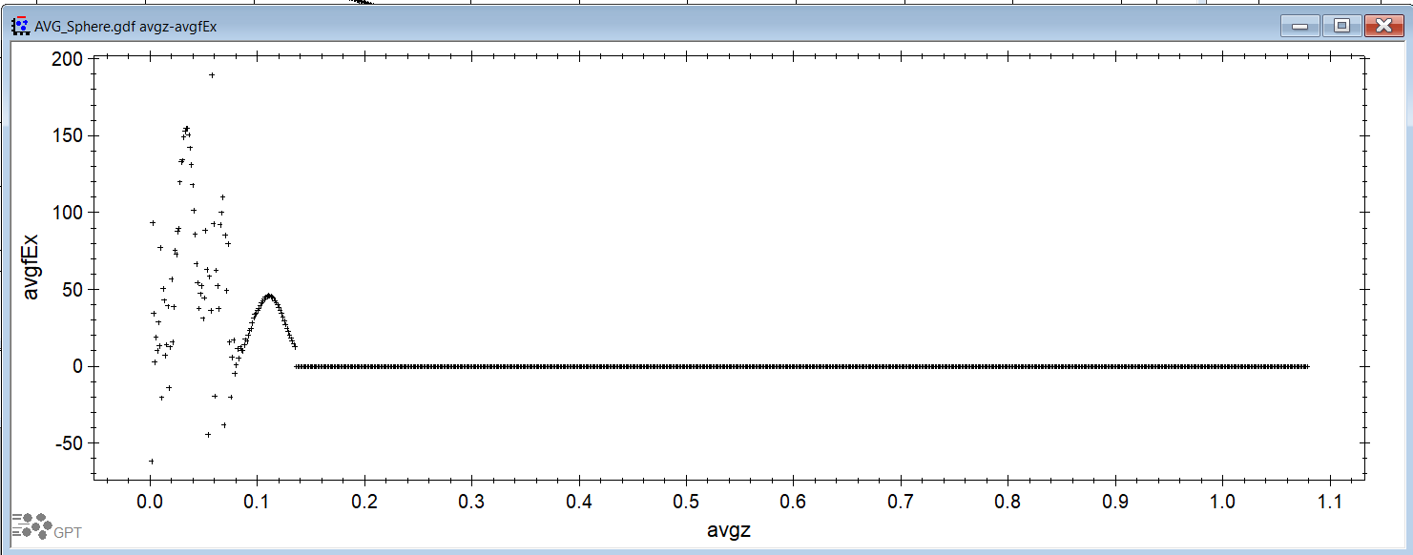
To check if the field map was the problem
Cylinder mesh max step size = 0.0005 m
Which means, better results!

Slide 13
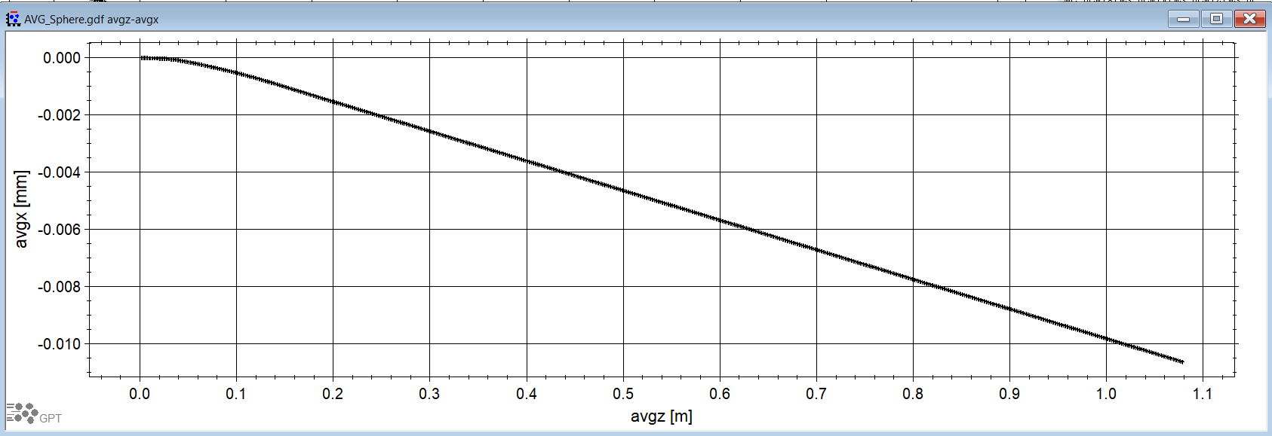
To check if the field map was the problem
And even further! Cylinder mesh max step size = 0.0002 m
Not a lot of change from the previous one! This might mean we are “hitting the spot” on the max step size

Slide 14
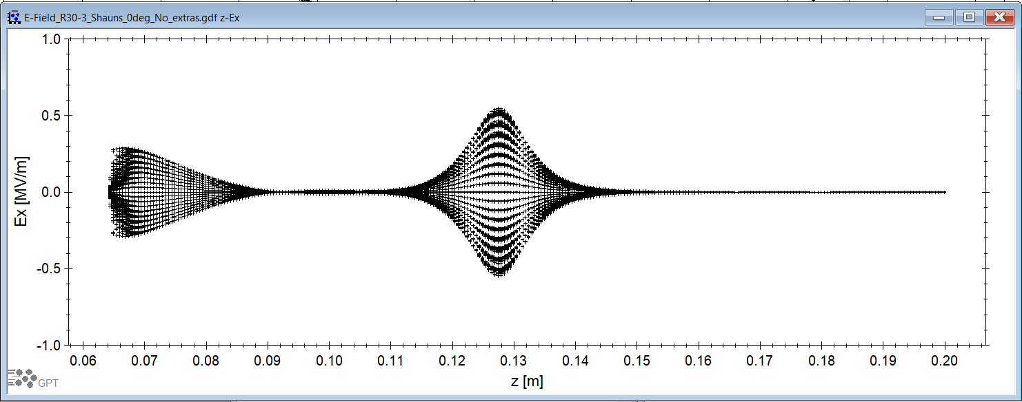
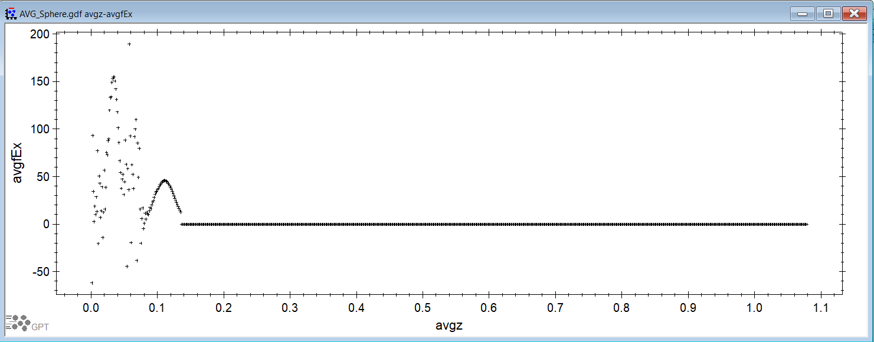
To check if the field map was the problem
Cylinder mesh max step size = 0.0002 m
But I still don’t like how that Ex looks like, it should be zero all the way! But we either spent a lot of time making perfect, or understand where the mismatch comes from and move on. ☺

Slide 15
Lessons learned
Using a single electron, I probed the field that the electron is experiencing in the simulation at every step t=0,1,2…,N
That allowed me to realize that the problem actually was in the field map and using AvgfEx I was able to further inspect the issue.
When the automesh option is selected in a geometry, CST decides the maximum step size base on geometry sizes and boundary characteristics. Allowing CST to automesh these parts was my mistake.
The smaller the max step size is in a geometry, the longer it takes to mesh it. Also, this operation might create issues, such as:
Incompatible mesh sizes, nodes, preventing the mesh to be created. This is solved by matching scales on adjacent geometries
Unmanageable files. This can be managed by using python to manipulate files or by splitting the simulation into sections.

