Slide 1
Spot-Size Reduction
4/5/2017

Slide 2
UVa Results – Reducing Spot-size Helps
Hpol
KD*P
RHWP(808nm)
analyzer
qpd
~800nm
1m lens
IHWP(780nm) + Vpol
-0.75m lens
w_{pc}= 1.35mmX,1.46mmY, w_{qpd}=1.43mmX,1.58mmY
4θ terms ~ 1.3-1.5umX, 0.76-1.1umY
w_{pc}~0.324mmX,0.341mmY,w_{qpd}= 0.886mmX,0.891mmY ~ 7x
4θ terms (NOT realigned) ~ 2.2-3.1umX, 2.5-4.3umY
4θ terms(aligned) ~ 0.29-0.27umX,0.24um-0.09umY ~ 5.2x
w_{pc}= 0.324mmX,0.341mmY,w_{qpd}= 2.06mmX,1.907mmY ~ 3x
4θ terms ~ 0.47-0.54umX,0.33-0.36umY ~ 2.7x
4θ terms ~ wpc * wqpd

Slide 3
3 scenarios (Injector Table)
Now: w_{pc}=1.9mm, w_{c}=1.1mm
Upstream 1m lens (z=-1.29m): w_{pc}=0.53mm, w_{c}=0.85mm
Up+Downstream(z=0.81) 1m lenses: w_{pc}=0.53, w_{c}=1.1mm
A 1m lens 0.2m after the Pockels cell, would keep the wpc the same=1.9mm and enlarge the wc from 1.1mm to 2.05mm (so 4sigma~4mm).
Scenario #2 has a ~20% spot size reduction on the cathode
Scenario #3 goes through a focus after the vacuum window

Slide 4
Layout (Conceptual)
Downstream f=1m lens
window
combiner
~1.29m
0.81m
25.6cm
8.3cm
cathode
2.288m
Upstream f=1m lens
Steering lens
f=2m
Different Halls Beams
May have Upstream Lens before or after combiner (either affecting all Halls or affecting only Hall A)
Upstream lens permanently installed
May keep downstream lens installed or not
(20% spot size difference on cathode)

Slide 5
Predictions (not including vacuum window or 2θ terms)
NOW: model UVa KD*P, Jlab spotsizes
~100nm offsets, 10-40nm 4θ terms
Measure bpm0I01 first after cathode 25-45nm 4θ
1m lens upstream: model UVa KD*P, Jlab predicted spotsizes
20-30nm offsets, <10nm 4θ terms
+Photocathode Rotation
(<5nm offsets & 4θ terms prediction)
Really beneficial for the vacuum window birefringence gradient which is not modeled here…but is important

Slide 6
Resources Needed
2 f=1m lenses (we have 2 at UVa, but for permanent Jlab installation, so maybe order lenses for the week after next)
2 4-axis lens mounts (pitch,yaw, X,Y)
Control over the helicity board
3-5mW of Hall A laser for alignment (CW or pulsed, either is fine)
HallA Electron beam >20uA (70uA is good) going up to at least FC1
(Conditions of injector beamline should be as if accelerator were going to run 70uA of 1GeV beam, or 150uA of 2GeV beam)
Walk-through of injector laser for Amali (M)
Someone in control room who can change beam current, turn on/off autogaining on bpms (M morn., T even., W morn., W even., Th morn., Fri morn.)
Electron beam (M morn, M aft., T even., W, Th 3x, F)
Access to injector laser room (M even., T, W aft.,Th 3x, F morn.)
Someone who can get the laser to give us 3-5mW of Hall A laser beam(M even., T, W aft.,Th 3x, F morn.)
Someone who can help us rotate the photocathode Angle (Th 3x, F morn)

Slide 7
Plan
Day1 - benchmarking, bpm/bcm calibration, RHWP scans (#1), QPD laser setup
Day2 - QPD setup, camera measurements, lens alignment, PC realignment, maybe RHWP scans(#2)
Day3 – bpm/bcm calibration, RHWP scans(#2), downstream lens insertion, camera measurements, bpm/bcm calibration, RHWP scans(#3)
Day4 - Photocathode rotation, bpm/bcm calibration, RHWP scan (repeat 3X)
Day5 – Final photocathode angle selection, bpm/bcm calibration, RHWP scan (final)

Slide 8
Day1
Day1 benchmarking
Morning – bcm/bpm calibration
Need someone in control room who can change beam current, turn on/off autogaining on bpms
HallA Electron beam >20uA (70uA is good) going up to at least FC1
BCM/BPM calibration scan - 5uA steps of current up to max current, auto gaining on injector bpms off
Autogaining of injector bpms back on
Afternoon – RHWP scans
4 RHWP scans (IHWP in/out PITA 0/ PITA non-zero) – 2 hours
Tweak Pockels cell translation – 1 hour
Repeat 4 RHWP scans (IHWP in/out PITA 0/ PITA non-zero) – 2 hours
Evening –laser QPD setup
Need Access to injector laser room
Need someone who can get the laser to give us 3-5mW of Hall A laser beam
Setup pick off to QPD

Slide 9
Day 2
Day 2 upstream lens insertion and PC re-alignment
Morning – QPD setup, camera measurements, lens alignment
Need Access to injector laser room
Need someone who can get the laser to give us 3-5mW of Hall A laser beam
3-5mW Hall A laser (CW or pulsed, either is fine)
Finish Setup of QPD pickoff / calibration
CHECK PC alignment with no analyzer (steering) and Aq in S2 (do PITA scan to make sure in S2)
Get spiricon measure of spot size at cathode
Repeat measure of spot size at pockels cell (will bring our own spiricon for this)
Insert 1m lens upstream of Pockels Cell at predetermined z-position z=…
measure of spot size at pockels cell (will bring our own spiricon for this)
Measure divergence of laser at Pockels cell
Measure spiricon spot size at cathode
Measure spot size at vacuum window(if possible)
Measure spot size at QPD
Afternoon – PC realignment
Calibrate QPD
Check PC alignment starting point– S1, S2, no anal, RHWP scan
Align Pockels cell
Evening – PC realignment (maybe RHWP scans)
PC alignment

Slide 10
Day 3
Day 3 PC -RHWP scans + downstream lens insertion
Morning – RHWP scans
Need someone in control room who can change beam current, turn on/off autogaining on bpms
HallA Electron beam >20uA (70uA is good) going up to at least FC1
BCM/BPM calibration scan - 5uA steps of current up to max current, auto gaining on injector bpms off
Autogaining of injector bpms back on
4 RHWP scans (IHWP in/out PITA 0/ PITA non-zero) – 2-4 hours
Afternoon – downstream lens insertion + camera measurements
Need Access to injector laser room
Need someone who can get the laser to give us 3-5mW of Hall A laser beam
3-5mW Hall A laser (CW or pulsed, either is fine)
Insert 1m lens downstream of Pockels Cell at predetermined z-position z=…
Measure spiricon spot size at cathode
Measure spot size at vacuum window (if possible)
Evening – bpm/bcm calibration + RHWP scans
Need someone in control room who can change beam current, turn on
HallA Electron beam >20uA (70uA is good) going up to at least FC1
4 RHWP scans (IHWP in/out PITA 0/ PITA non-zero) – 2-4 hours
decide to keep downstream lens or remove + RHWP scans
Need Access to injector laser room
Remove 1m lens downstream of PC (if decided)

Slide 11
Day 4
Day 4 Photocathode rotation
Morning
Need Access to injector room
Need someone who can help us rotate the photocathode Angle #2
HallA Electron beam >20uA (70uA is good) going up to at least FC1
Need someone in control room who can change beam current, turn on/off autogaining on bpms
HallA Electron beam >20uA (70uA is good) going up to at least FC1
BCM/BPM calibration scan - 5uA steps of current up to max current, auto gaining on injector bpms off
Autogaining of injector bpms back on
4 RHWP scans (IHWP in/out PITA 0/ PITA non-zero) – 2-4 hours
Afternoon
Need Access to injector room
Need someone who can help us rotate the photocathode Angle #3
HallA Electron beam >20uA (70uA is good) going up to at least FC1
4 RHWP scans (IHWP in/out PITA 0/ PITA non-zero) – 2-4 hours
Evening
Need Access to injector room
Need someone who can help us rotate the photocathode Angle #4
HallA Electron beam >20uA (70uA is good) going up to at least FC1
4 RHWP scans (IHWP in/out PITA 0/ PITA non-zero) – 2-4 hours

Slide 12
Day 5
Day 5 Photocathode rotation final
Morning/Afternoon/Evening
Need Access to injector room
Need someone who can help us rotate the photocathode FINAL ANGLE
HallA Electron beam >20uA (70uA is good) going up to at least FC1
4 RHWP scans (IHWP in/out PITA 0/ PITA non-zero) – 2-4 hours
PC translation to optimize
4 RHWP scans (IHWP in/out PITA 0/ PITA non-zero) – 2-4 hours

Slide 13
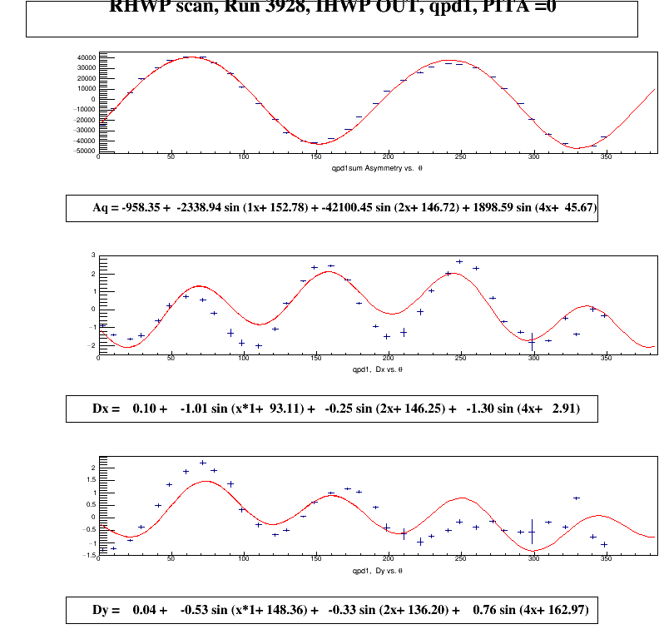
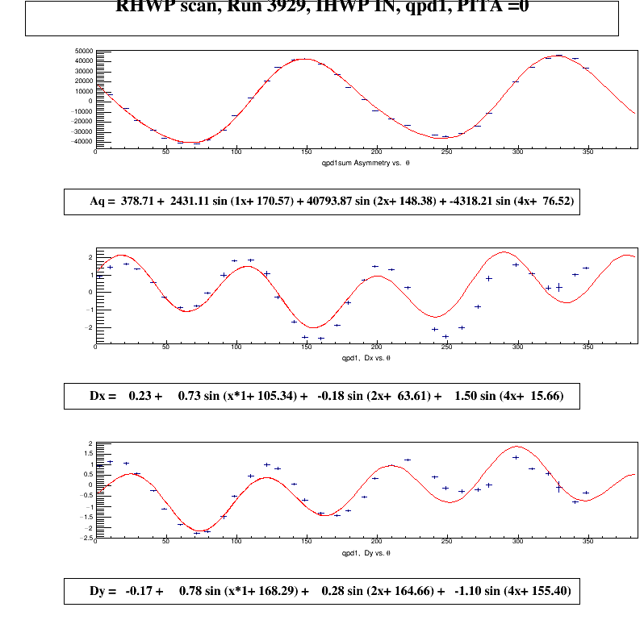
w_{pc}= 1.35mmX,1.46mmY,w_{qpd}=1.43mmX,1.58mmY
UVA data
4θ terms
1.3um(IHWPout)/1.5um(IHWPin)X, 0.76um(IHWPout)/1.1um(IHWPin)Y

Slide 14
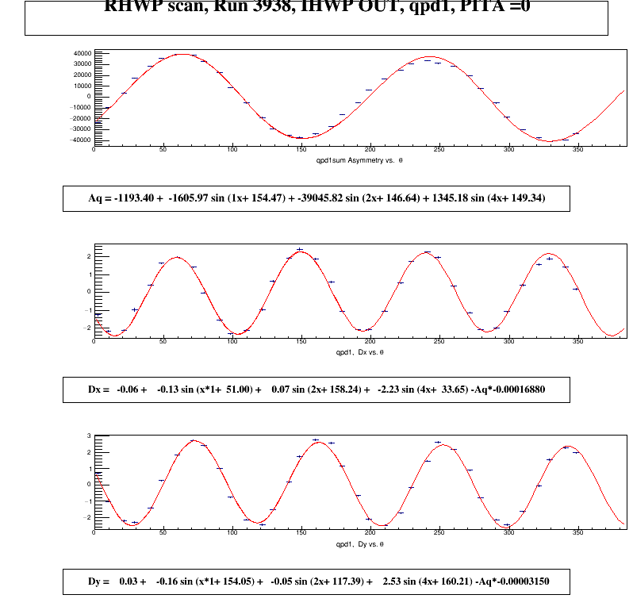
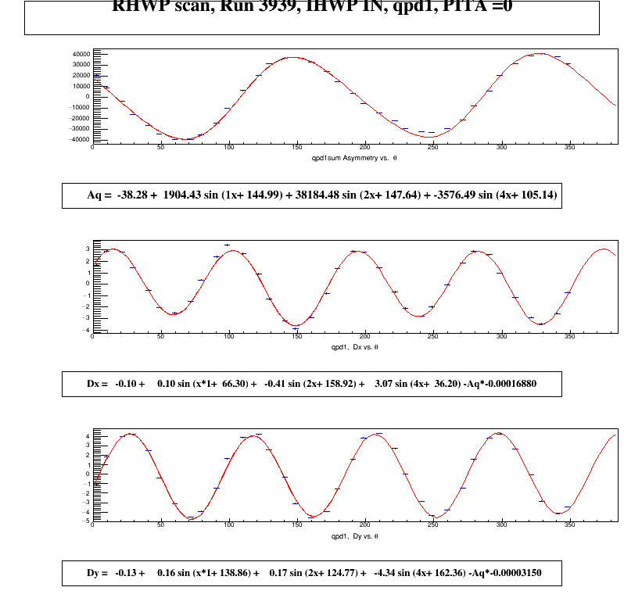
wpcx<=0.324mmX,0.341mmY wqpdx~0.886mmX,~0.891mmY
PC NOT realigned, angle=(1mrad yaw,6mrad pitch)
UVA data
4θ terms
2.2um(IHWPout)/3.1um(IHWPin)X, 2.5um(IHWPout)/4.3um(IHWPin)Y

Slide 15
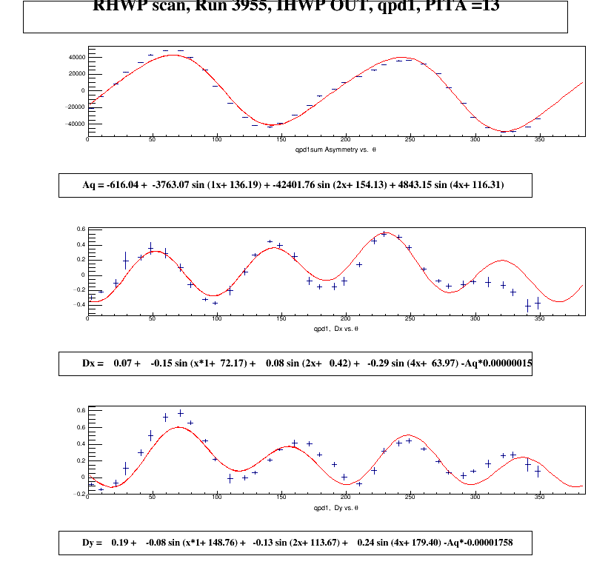
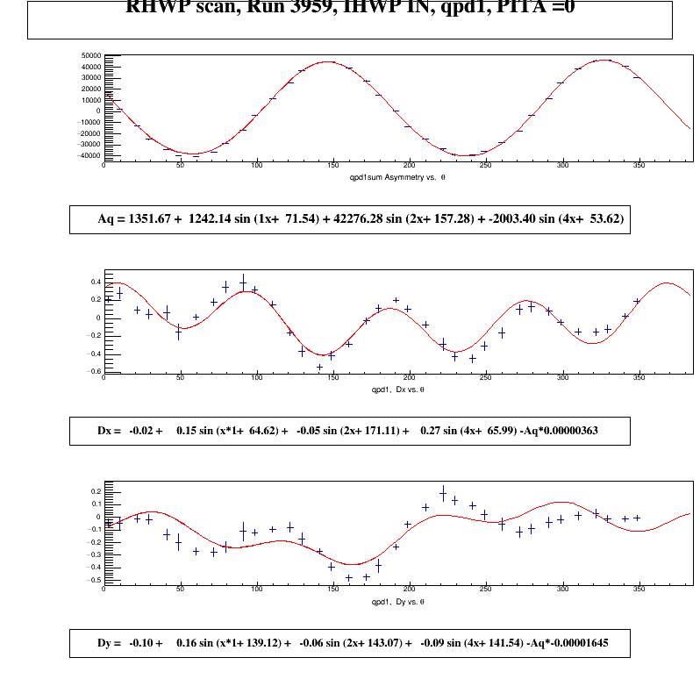
wpcx<=0.324mmX,0.341mmY wqpdx~0.886mmX,~0.891mmY
PC realigned, angle = (-0.3mrad yaw, 5.5mrad pitch)
UVA data
4θ terms
0.29um(IHWPout)/0.27um(IHWPin)X, 0.24um(IHWPout)/0.09um(IHWPin)Y

Slide 16
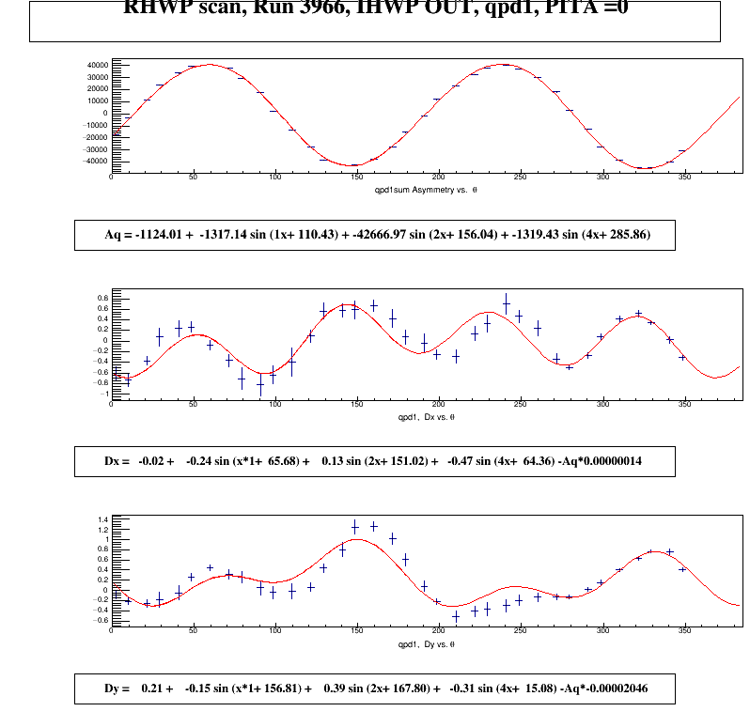
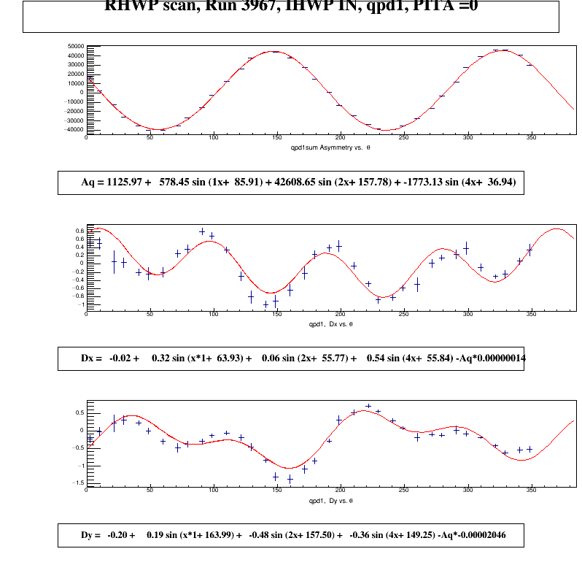
wpcx<=0.324mmX,0.341mmY wqpdx~2.06mmX,~1.907mmY
PC realigned, angle = (-0.3mrad yaw, 5.5mrad pitch)
UVA data
4θ terms
0.47um(IHWPout)/0.54um(IHWPin)X, 0.33um(IHWPout)/0.36um(IHWPin)Y

