Slide 1
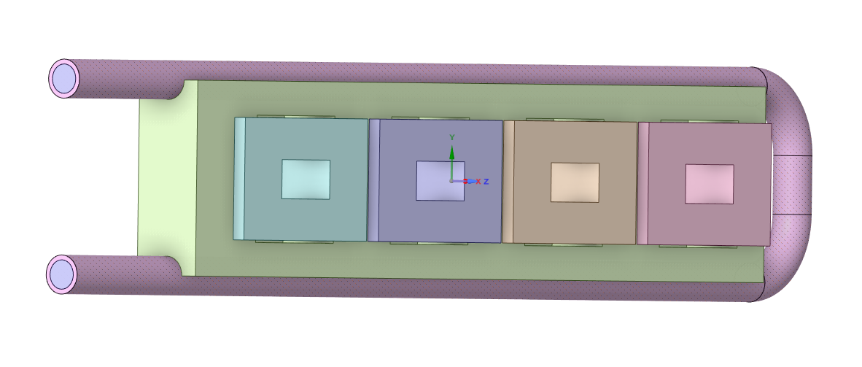
Thermo-Mechanical Sims for Solid e⁺ Target
Sohaib Bhatti

Slide 4
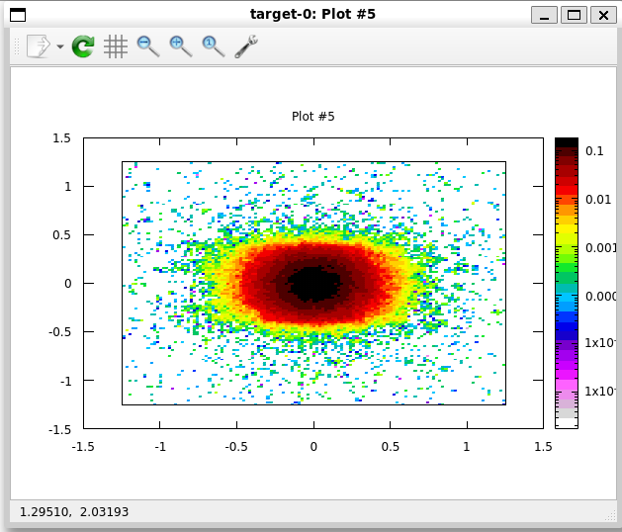
FLUKA
Energy deposition for a 120 MeV electron beam was calculated
Energy deposition was exported to ANSYS

Slide 5
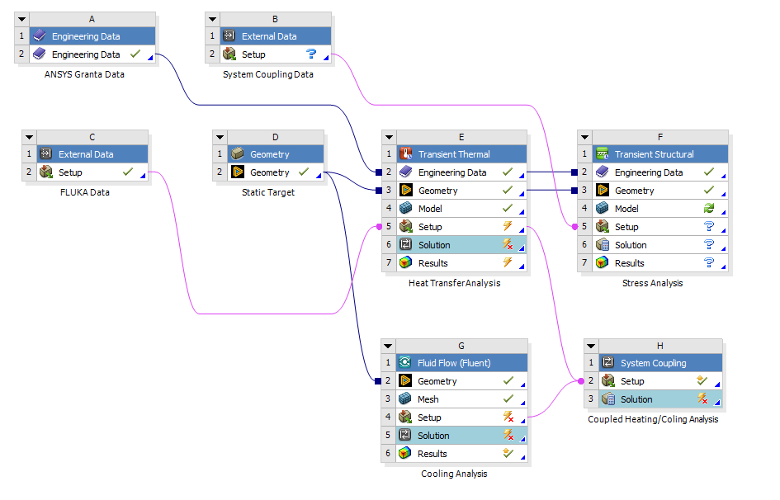
ANSYS Workbench
Transient thermal simulation for energy deposition
CFD simulation to determine the effect of the liquid cooling
2 way coupling to combine effects
Resulting thermal strains are simulated in transient structural simulation

Slide 6
ANSYS Fluent
Cooling effect of pipes was determined
Viscous turbulent k-ω model

Slide 7
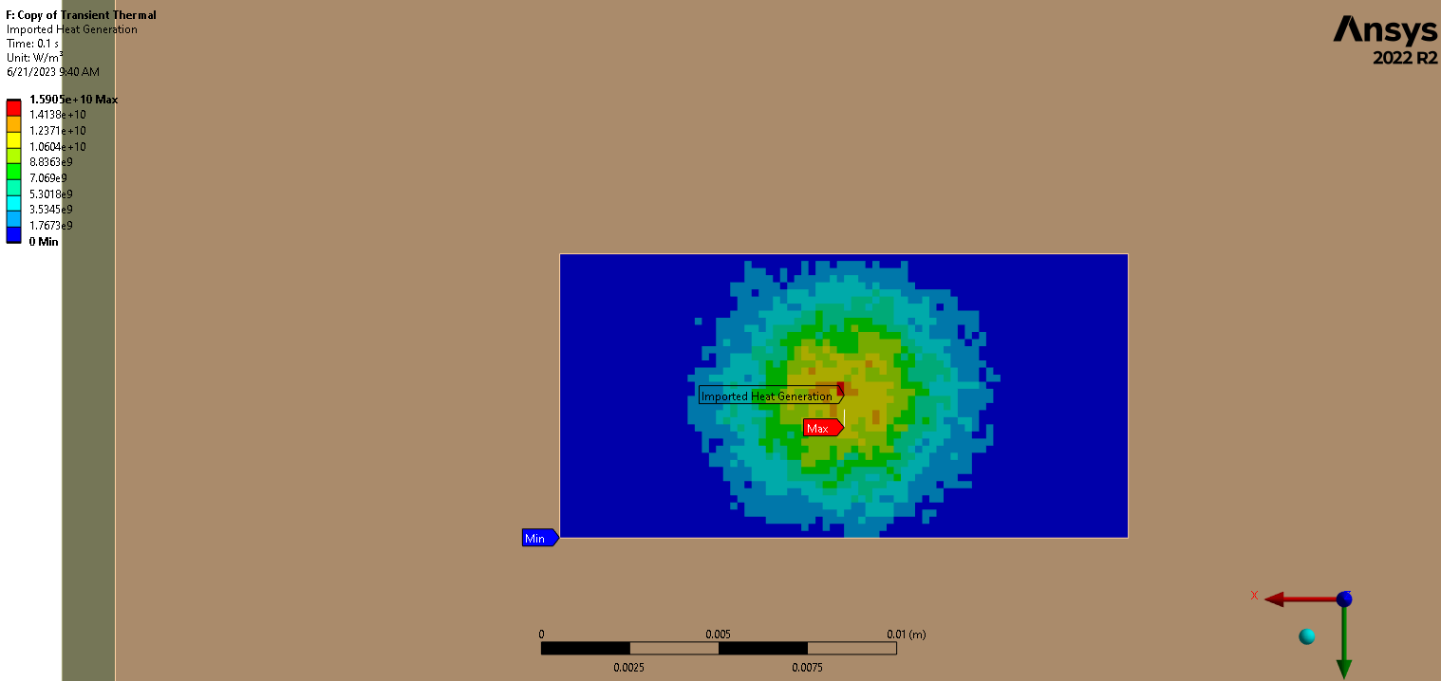
ANSYS Mechanical – Thermal
Transient thermal simulation
Imported FLUKA data
Simulated a pulse length of 10ms for 20 bunches

Slide 8
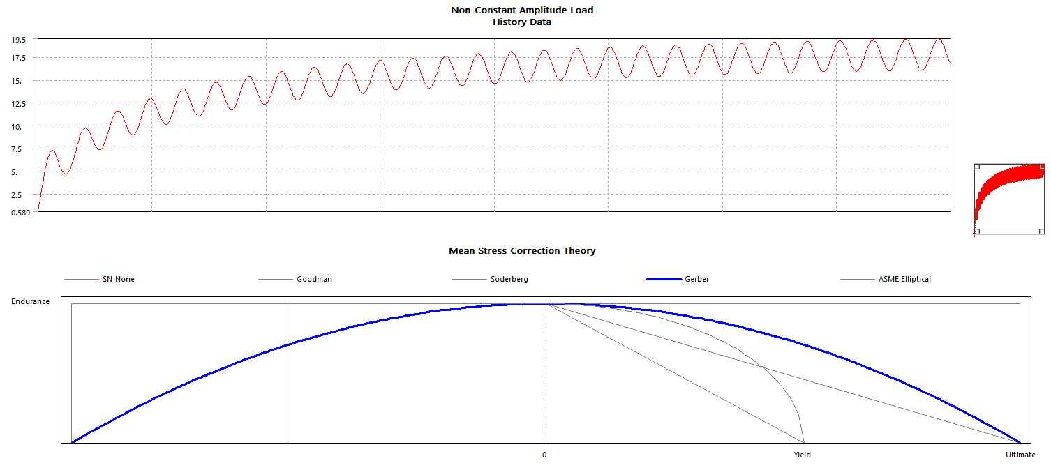
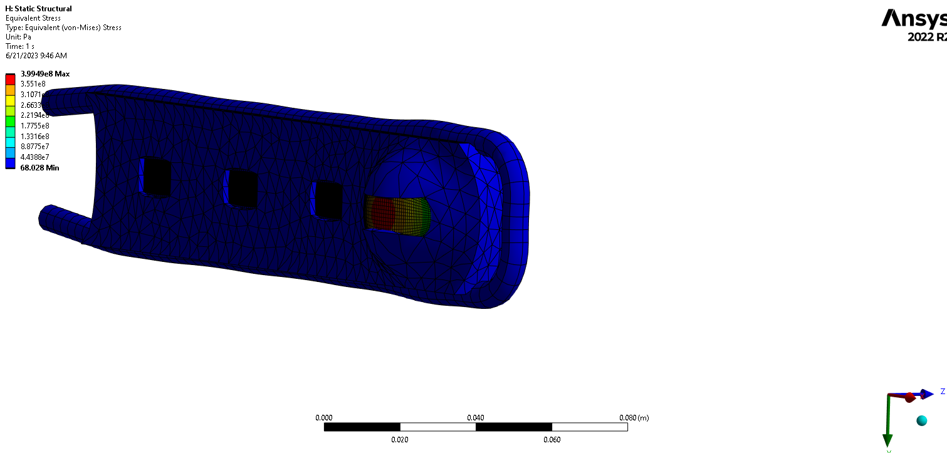
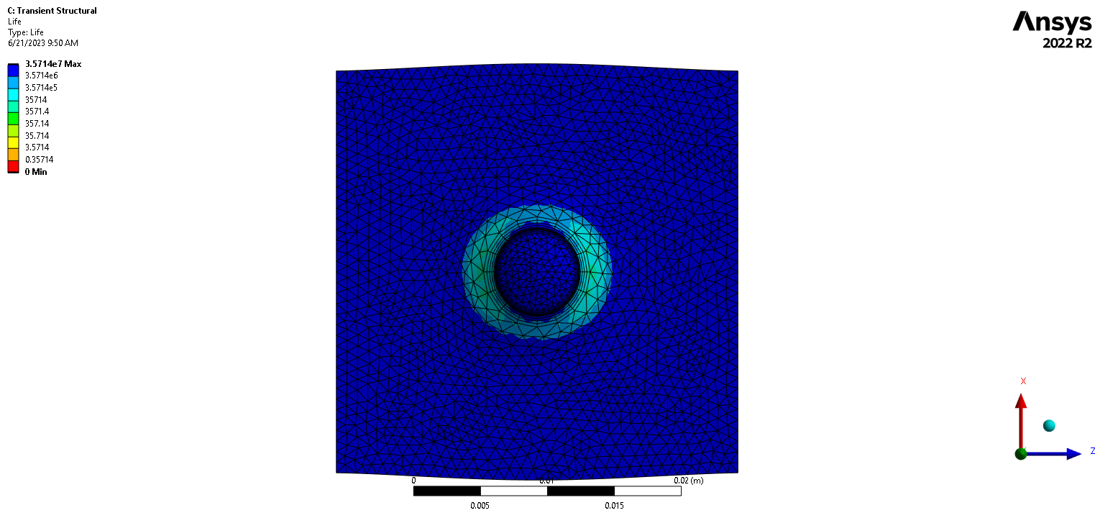
ANSYS Mechanical – Structural
Simulated resulting stresses from thermal strains
Implemented fatigue tool for arbitrary set of data

Slide 9
Next Steps
Finish CFD simulation
Have the workflow in ANSYS validated by an engineer
Test geometry for different pulse lengths
Test different geometries

