Slide 1

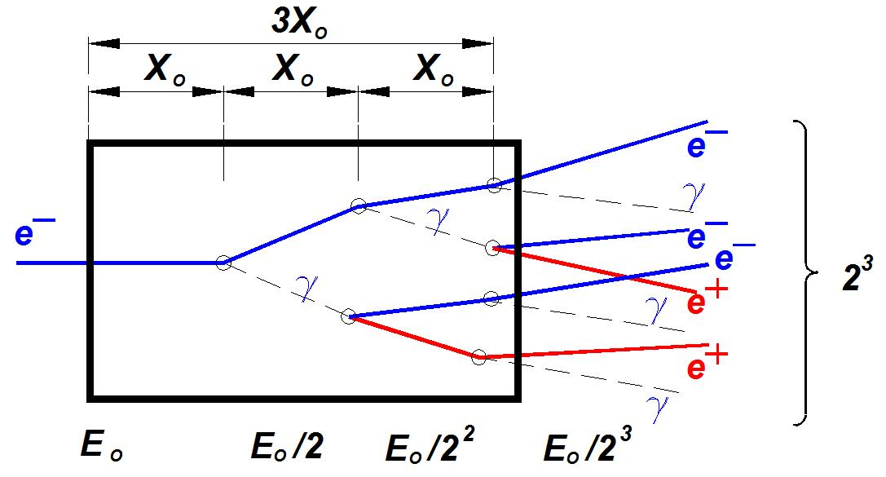
Future CEBAF (polarized positrons at 12 GeV)
Expands the 12 GeV capability with e+
Starts sometime after Moller (2020’s)
Builds new 10 mA polarized e- injector
Builds new e+ injector (100 kW target, 2T magnet, warm RF capture)
Retains present CEBAF e- injector
Multi-hall capability is a high priority
Consequently, a characteristic polarization “map” exists independent of the e⁻ beam energy
Production of Highly Polarized Positrons Using Polarized Electrons at MeV Energies, D. Abbott et al., Phys. Rev. Lett. 116 (2016) 214801

Slide 2

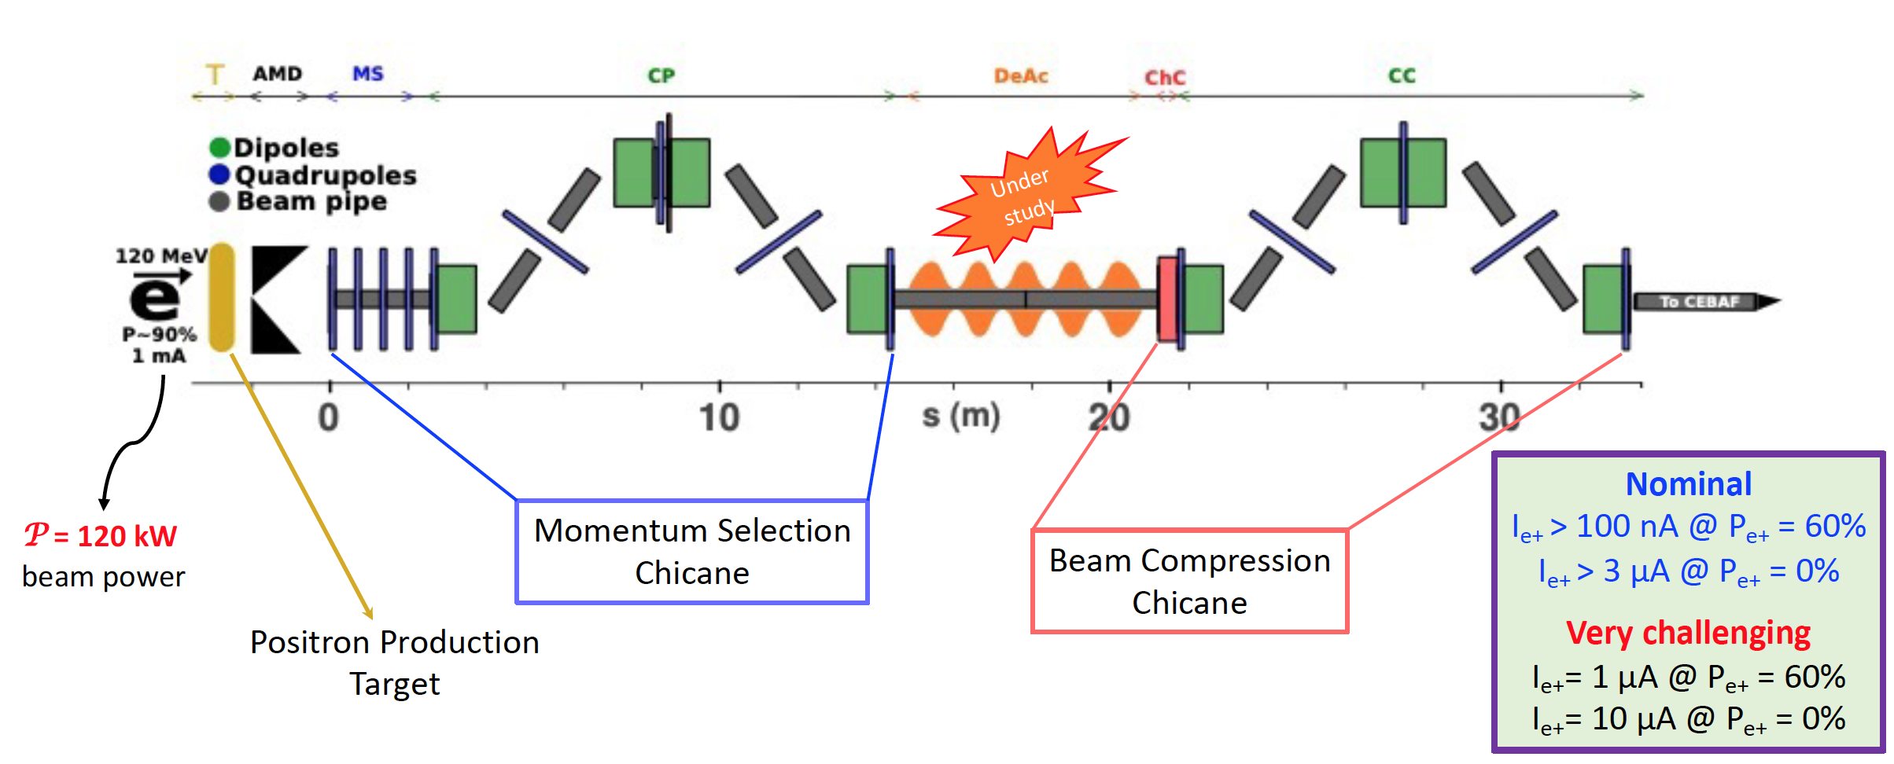
Polarized e+, big picture
Hardware needed:
  High current polarized e- source
  A cryomodule to accelerate e-
  An e+ target-source and collection system
  A cryomodule to accelerate e+
e+ @ 123
e+ source/collection
e-
e+
e-
e-
Collect e+ > 20 MeV
~10 MeV
~75 MeV
~100 MeV
Repaired QCM (1 mA)
Refurbished C75 (1 mA)
Cryomodule C100
Polarized positrons generation
Would like to organize a workshop at Jlab in the Late 2022 or Early 2023 to discuss technical collaboration.

Slide 3
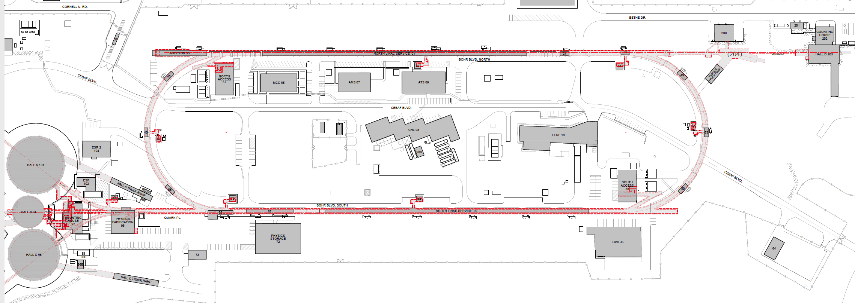
An electron/positron injector vault is required for both upgrades
New underground vault + short beam line
Existing FEL + long beam line
123 MeV e+ for 12 GeV CEBAF
650 MeV e- for Energy Upgrade
Green option is presently more cost effective and provides options for staging positron and energy upgrade

Slide 4
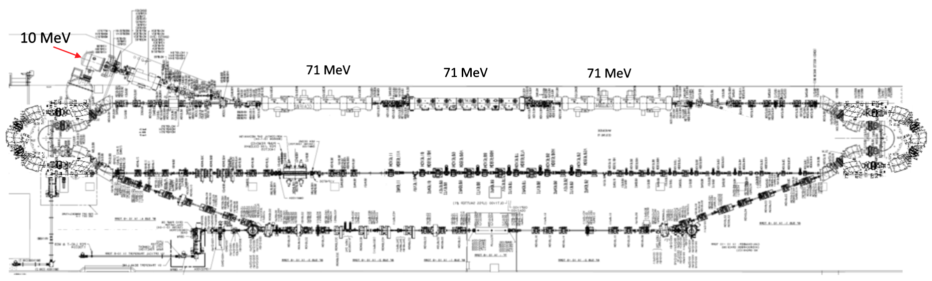
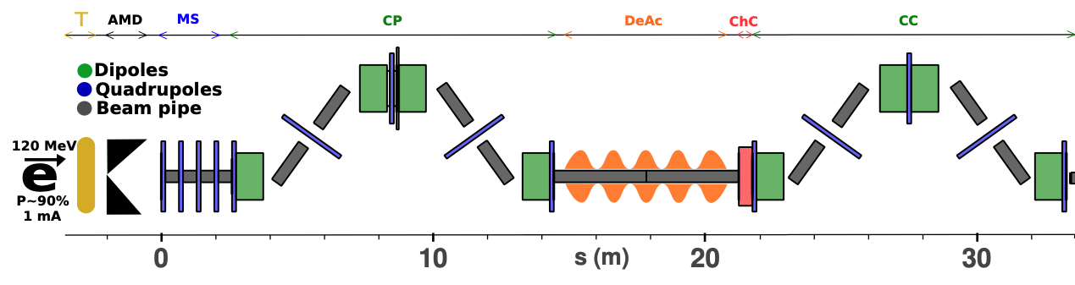
PEPPo II : Polarized e⁺ Prototype Experiment
Next, we want to build a scalable polarized positron injector at LERF to demonstrate beam
  300 kV polarized gun + Wien filter, demonstrate > 1kC lifetime at milliamp current
  Build up the SRF e- injector 50 – 100 MeV
  Ramp up efforts for high power target 50 – 100 kW, e+ collection and compression
  Complete start-to-end concept in FY23
#1 – Compact P-Gun, Wien filter, 10 MeV e- injector
#6 – SRF accelerate e+ to 123 MeV
#2 - SRF accelerate 60-120 MeV
#5 – Injector e+ to linac
#3 – Extract e- to target
#4 - Produce e+ accelerate to 50-70 MeV
#7 – Transport e+ at 123 MeV to exit LERF
4

