Slide 1
Mathematica fits vs. Root
17Jan 2017

Slide 2
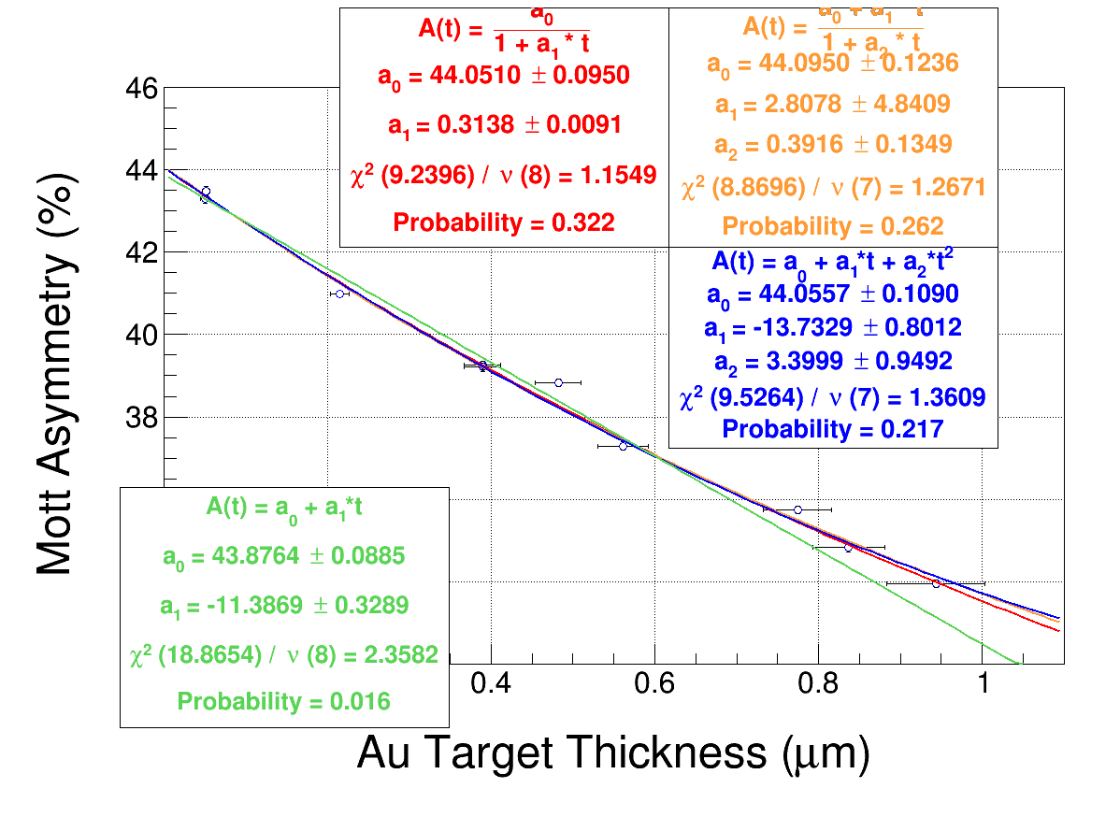
Asym vs. T, Run 1

Slide 3
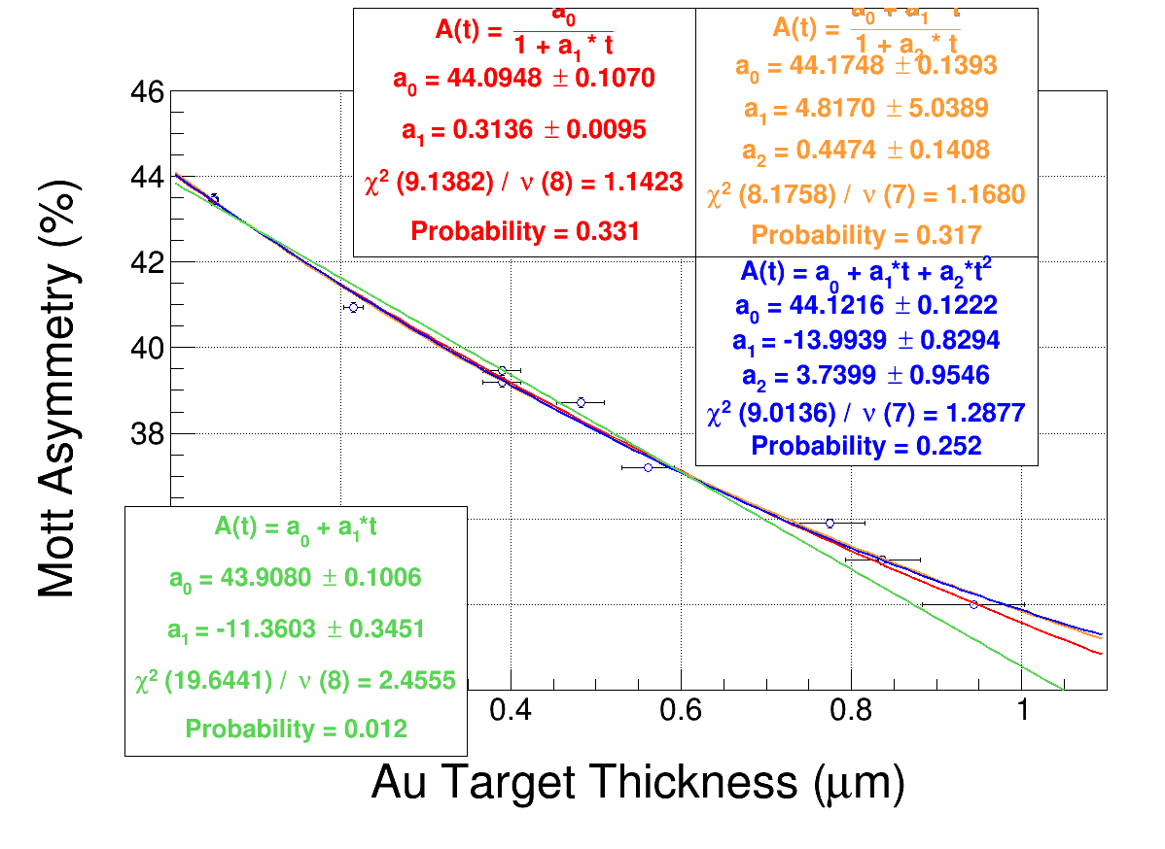
Asym vs. T, Run 2

Slide 4
Root vs. Mathematica
A vs. T | ao | Δao | a1 | a2 | b1 | Chi sq
Pade (2,0) | 44.0557 | .1090 | -13.76 | 3.4 |  | 1.36 | Root
Pade(1,1) | 44.095 | .124 | 2.8 |  | 0.39 | 1.27 | Root
Pade (0,1) | 44.05 | 0.095 |  |  | 0.31 | 1.15 | Root
Pade (2,0) | 44.1216 | .1222 | -13.99 | 3.74 |  | 1.29 | Rt run2
Pade(1,1) | 44.175 | .1393 | 4.8 |  | 0.45 | 1.16 | Rt run2
Pade (0,1) | 44.09 | 0.1006 | -11.36 |  | 0.3136 | 1.14 | Rt run2
A vs. T | ao | Δao | a1 | a2 | b1 | Chi sq
Pade (2,0) | 44.0492 | 0.129 | -0.0137 | 3.45e-6 |  | 1.37 | MM run 1
Pade(1,1) | 44.0928 | 0.139 | 0.00336 |  | 0.0002747 | 1.27408 | MM run 1
Pade (0,1) | 44.0395 | 0.1012 |  |  | 0.0003122 | 1.16 | MM run 1
Pade (2,0) | 44.1172 | 0.1413 | -0.014 | 3.85e-6 |  | 1.29 | MM run 2
Pade(1,1) | 44.1759 | 0.152 | 0.00564 |  | 0.000469 | 1.18 | MM run 2
Pade (0,1) | 44.0809 | 0.1131 |  |  | 0.000312 | 1.15 | MM run 2

Slide 7
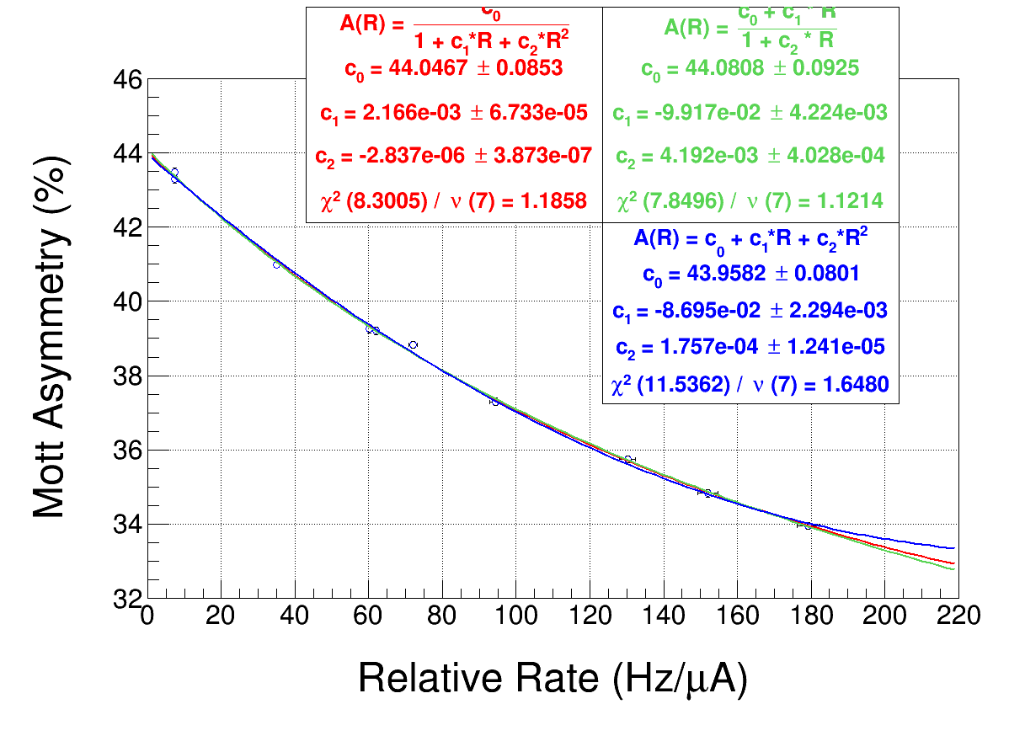
Asym vs. Rate run 1

Slide 8
Asym. vs rate run 2

Slide 9
A vs. R | Ao | dAo | Chi squared | Run
Pade (2,0) | 43.96 | 0.08 | 1.65 | Root, 1
Pade (1,1) | 44.08 | 0.09 | 1.12 | Root, 1
Pade (0,2) | 44.05 | 0.09 | 1.19 | Root, 1
Pade (2,0) | 43.99 | 0.093 | 3.00 | Root, 2
Pade (1,1) | 44.18 | 0.11 | 1.71 | Root, 2
Pade (0,2) | 44.11 | 0.100 | 2.00 | Root, 2
A vs. R | Ao | dAo | Chi squared | Run
Pade (2,0) | 43.913 | 0.125 | 2.68 | MM, 1
Pade (1,1) | 44.0829 | 0.105 | 1.38 | MM, 1
Pade (0,2) | 44.0279 | 0.105 | 1.63 | MM, 1
Pade (2,0) | 43.959 | 0.187 | 4.28 | MM, 2
Pade (1,1) | 44.1744 | 0.170 | 2.54 | MM, 2
Pade (0,2) | 44.0948 | 0.167 | 2.95 | MM, 2

Slide 12
Summary
Extrapolated Ao in agreement with two methods (mathematica and root analysis of same data set)
Some differences in the Chi squared values may come from slightly different methods for calculation, x-error bar handling
Pick one, pick thickness units, proceed.

Slide 13
Math in mathematica
Get y(x+dx), y(x-dx) for fitting function, add this dy due to x error bar in quadrature
Use weighting function: w=(1/dy)^2 at each pt
Use the mathematica “NonlinearModelFit” function – least squares, using weighted data points, standard error on Ao term
Define χ2 (sum over all data pts)
SUM{[(data pt – fit(xi))/Δyi]^2}
Reduced χ2 :
χ2 /(# data points - fit parameters)

