Slide 1
18” CEBAF gun: NEG screen
Front Views
Gabriel Palacios Serrano
gabrielp@jlab.org
11/02/2021

Slide 2
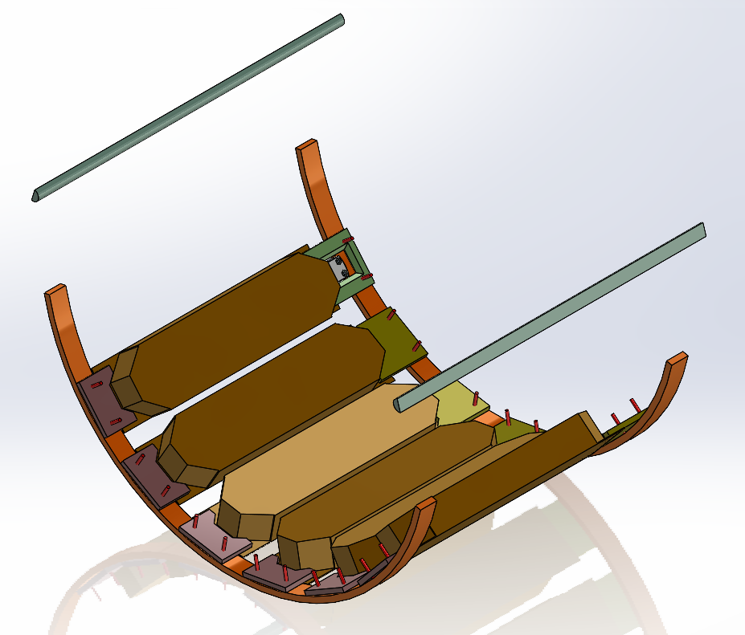
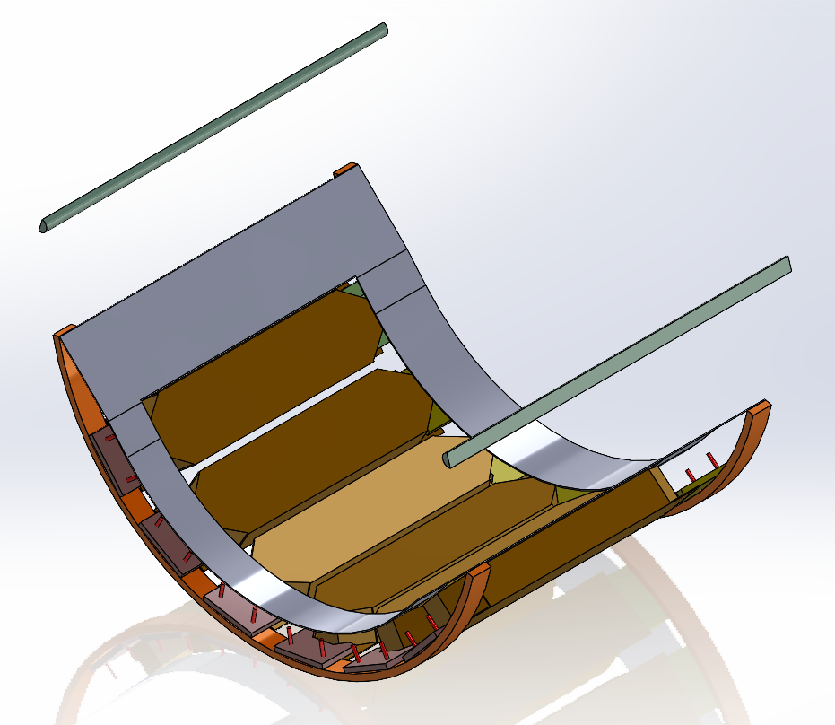
Shaun’s NEG model
Shaun’s model w/o screen
Shaun’s model w Gab’s screen

Slide 3
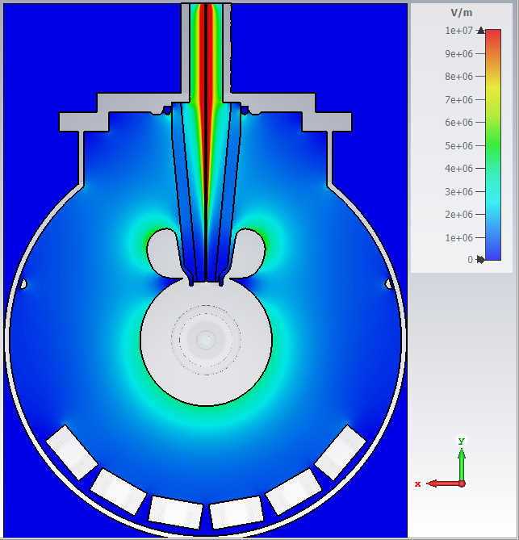
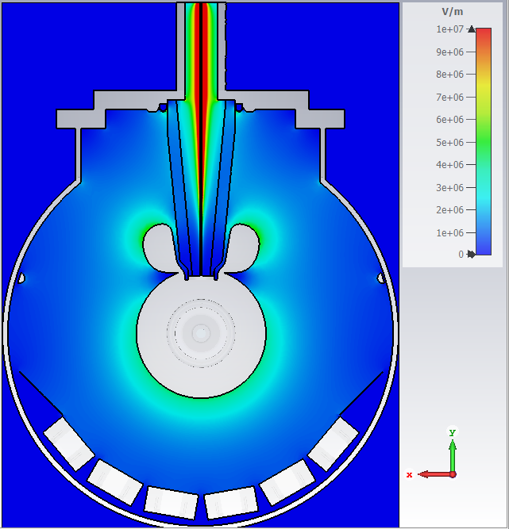
Electrostatics simulation:
Plot max at 10 MV/m
Shaun’s model w/o screen
Shaun’s model w Gab’s screen
Bottom: 4.2 MV/m
Bottom: 4.2 MV/m
Gun at -200 kV in all plots

Slide 4
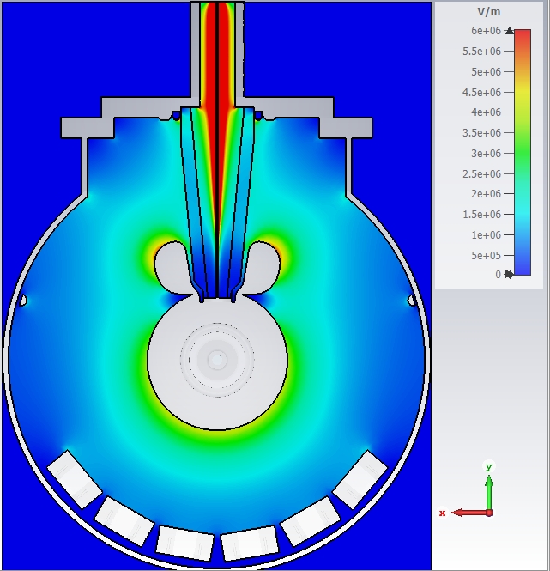

Electrostatics simulation: Plot max at 6 MV/m
Shaun’s model w/o screen
Shaun’s model w Gab’s screen
Bottom: 4.2 MV/m
Bottom: 4.2 MV/m
Gun at -200 kV in all plots

Slide 5
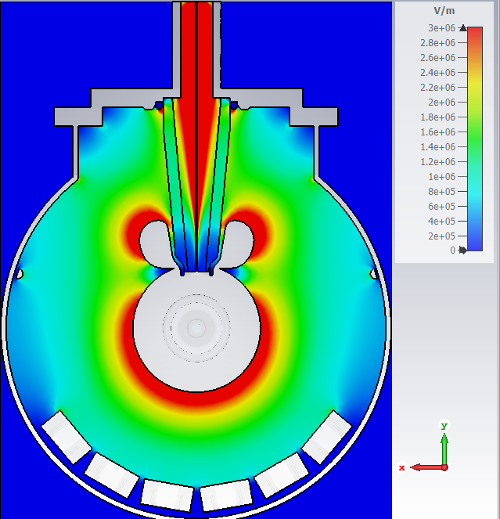
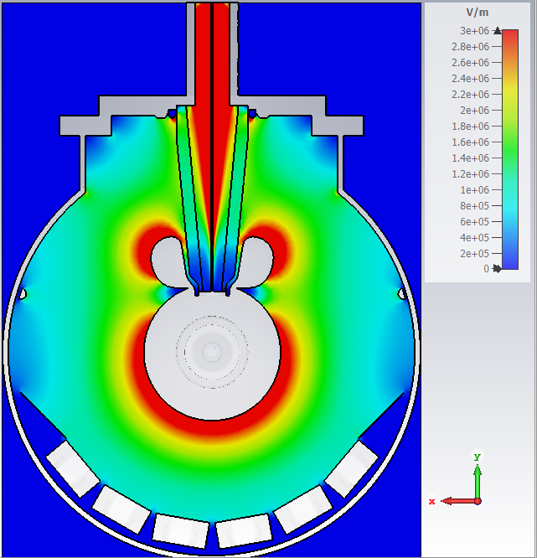
Electrostatics simulation: Plot max at 3 MV/m
Shaun’s model w/o screen
Shaun’s model w Gab’s screen
Bottom: 4.2 MV/m
Bottom: 4.2 MV/m
Gun at -200 kV in all plots

Slide 6
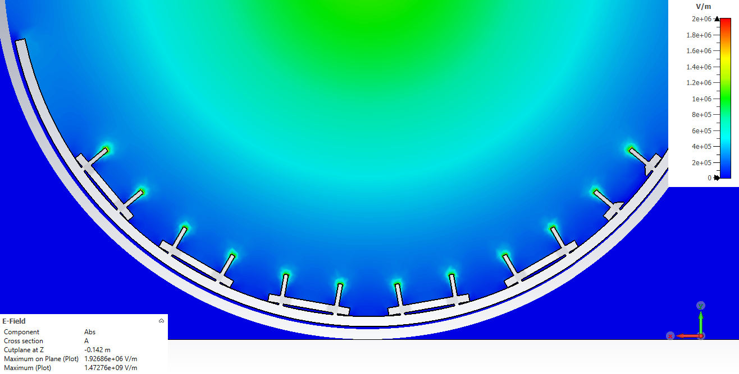
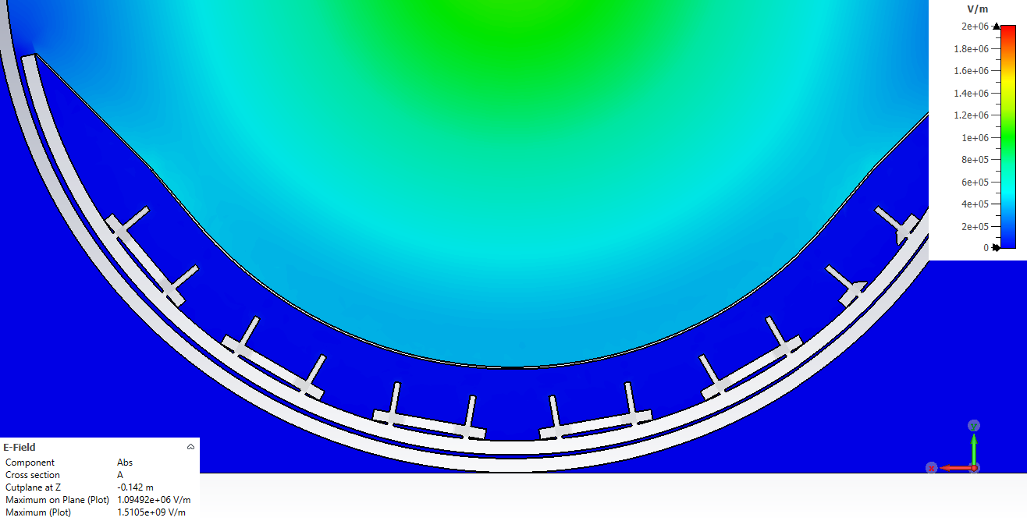
Electrostatics simulation: Bolt cross-section
Plot max at 1.5 MV/m
Shaun’s model w/o screen
Shaun’s model w Gab’s screen
2.0 MV/m
Right on edge
0.1 MV/m
Bottom: 4.2 MV/m
Gun at -200 kV in all plots

