Slide 1
ASY-R30-3: Surveyed check
Gabriel Palacios Serrano
09/01/2022
gabrielp@jlab.org

Slide 2
Notes
S&A found an anode horizontal displacement of 0.5 mm
In this document I compare the GPT results for two models
Per design
As built
Cathode at -200kV, 12-slot anode at +2kV, tube grounded.
The model is Gabriels’ best, used to design the 2 degree “skewed anode”
The GPT deck is found in:

Slide 3
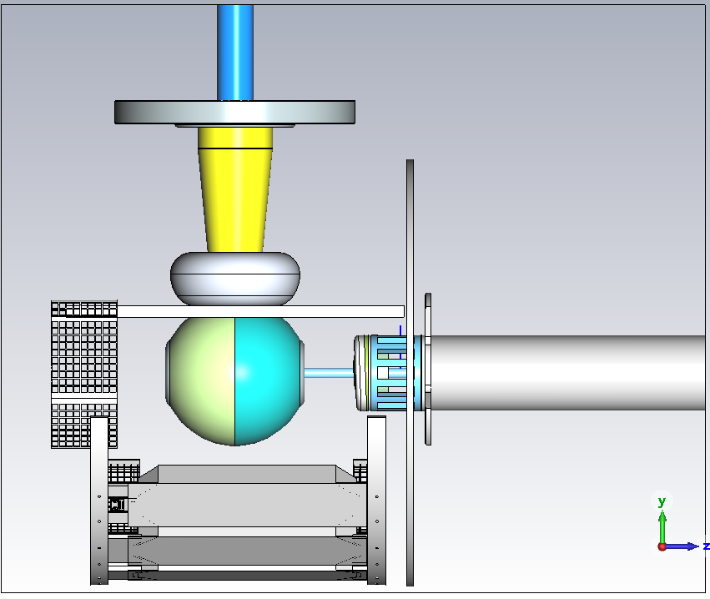
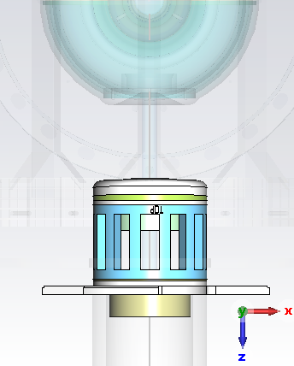
3D model
Skewed anode (2 deg), Shaun’s model with Gabs’ chamber
Anode displaced +0.5 mm on x-axis
0.5 mm

Slide 4
Average horizontal position

Slide 5
Average vertical position

Slide 6
Horizontal angle

Slide 7
Vertical angle

Slide 8
Extras

Slide 9
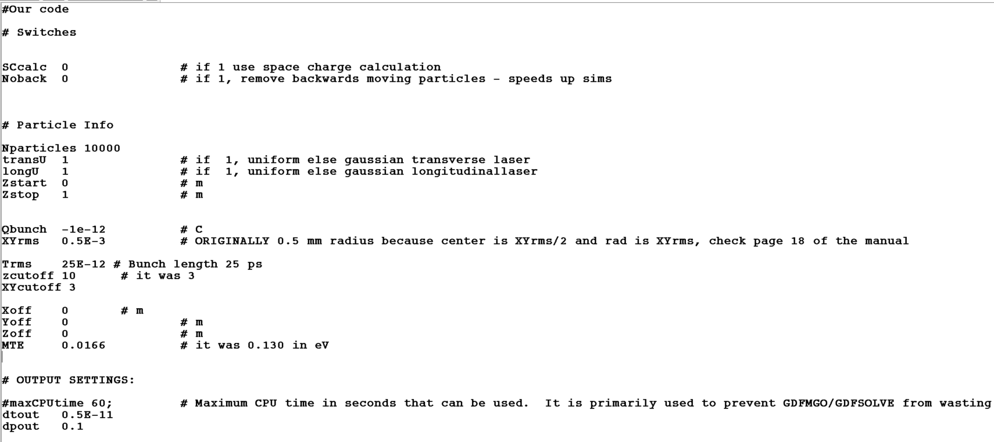
GPT settings
Field maps:
E-Field_R30-3_SKEWED_-2deg_12_SLOTS_2kVAnode.gdf

Slide 10
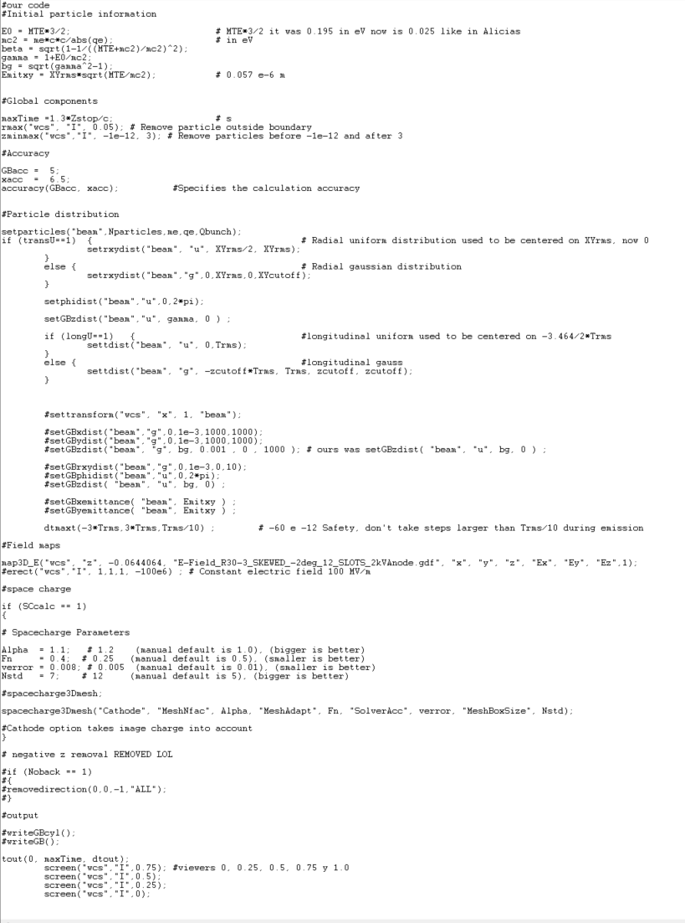
GPT settings
Field maps:
E-Field_R30-3_SKEWED_-2deg_12_SLOTS_2kVAnode.gdf

