Slide 1
Foil thickness measurements
5June2015

Slide 2
FE-SEM images

Slide 3
Measure using ImageJ
measurement | Angle | Length
1 | 94.988 | 0.546
2 | 95.232 | 0.543
3 | 95.648 | 0.543
4 | 96.108 | 0.54
5 | 95.69 | 0.539
6 | 95.711 | 0.537
7 | 95.877 | 0.541
8 | 96.34 | 0.538
9 | 95.583 | 0.529
10 | 95.369 | 0.529
11 | 95.46 | 0.539
12 | 95.251 | 0.541
13 | 95.44 | 0.543
14 | 95.232 | 0.543
15 | 95.382 | 0.549
16 | 95.176 | 0.548
17 | 93.705 | 0.551
18 | 93.474 | 0.555
19 | 94.899 | 0.556
20 | 94.574 | 0.546
21 | 94.145 | 0.548
22 | 94.145 | 0.548
23 | 94.383 | 0.544
24 | 94.493 | 0.556
25 | 94.493 | 0.556
26 | 94.042 | 0.561
27 | 95.102 | 0.556
28 | 94.847 | 0.562
29 | 93.45 | 0.559
30 | 93.414 | 0.565
31 | 92.612 | 0.564
32 | 93.191 | 0.569
33 | 92.37 | 0.574
34 | 91.968 | 0.576
35 | 92.532 | 0.582
36 | 92.135 | 0.584
37 | 92.218 | 0.562
38 | 91.206 | 0.564
39 | 91.608 | 0.564
40 | 94.295 | 0.552
42 | 91.206 | 0.529
43 | 96.34 | 0.584
 | AVERAGE | 0.552738
 | STDEV | 0.014422
 | MIN | 0.529
 | MAX | 0.584

Slide 4
Measured vs. Lebow thicknesses
Foil | Lebow (nm)
5385B | 1000
3057C | 870
5134B | 750
7028B | 625
5275C | 500
5613A | 350
7029B | 225
6809B | 50

Slide 5
Weighted means of data

Slide 6
Systematic errors
Foil tilt
0.2% of measurement at tilts up to 2.5 degrees
Pixel resolution of image
assume within 4 pixels of actual edge
Film uniformity
quoted 1%/cm by Lebow
Judgement on edges
repeat measurements

Slide 7
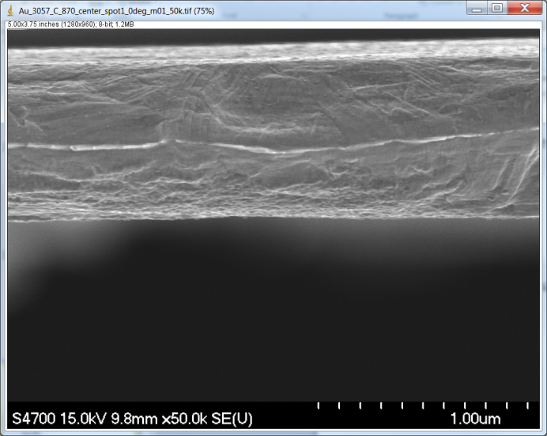
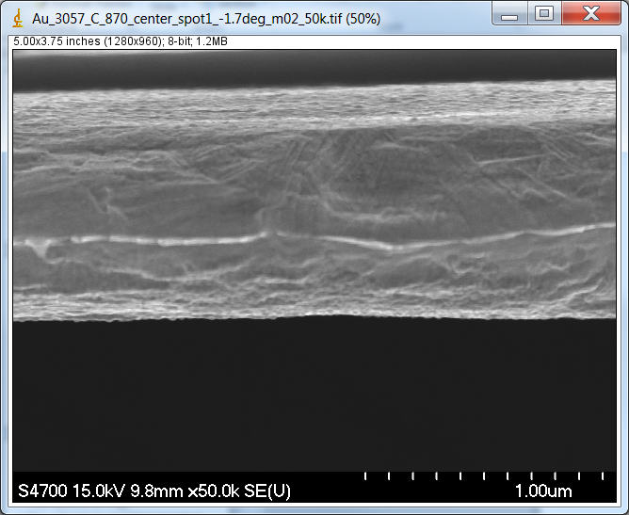
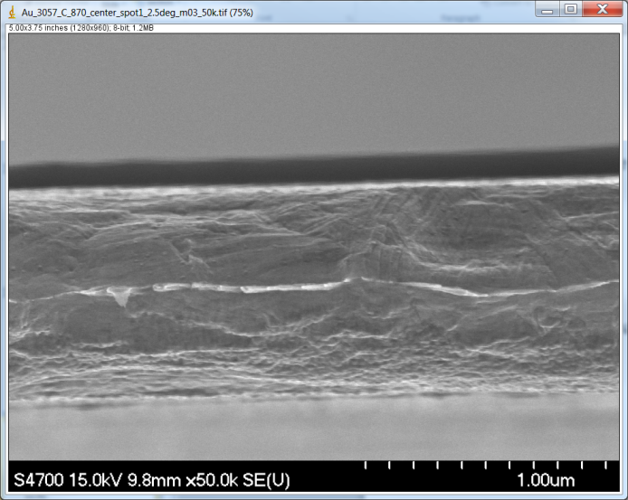
Foil tilt analysis
First foils measured were not carefully controlled
Roll
Pitch
Later measurements
Roll set to ~zero
Pitch varied intentionally to study effect
3057C, ~870 nm
0 deg pitch | -1.7 deg pitch | +2.5 deg pitch
749 nm | 808 nm | 861 nm

Slide 9
Zero suppressed for detailed look
Tilts of 1.7-2.5 degrees should reduce measured thickness ~0.2%
about 1.5 nm at 870 nm
tilted foils measure thicker?
Differences larger than the expected tilt error
focus/magnification issues with tilt
Image measurement issue only?

Slide 10
Position dependence: 3 spots along same foil
All consistent with an average of 835 nm within error bars – no strong position dependence
Lebow uniformity quote 1%/cm implies 1x10⁻⁴%/ µm
Foil thickness measurements here not sensitive enough to test uniformity

Slide 11
Asymmetry analyzed with timing cuts only, measured foil thicknesses
$$y= \frac{44.0335}{1+0.31886 x}$$

