Slide 1
GTS GUN
Yan
9/1

Slide 2
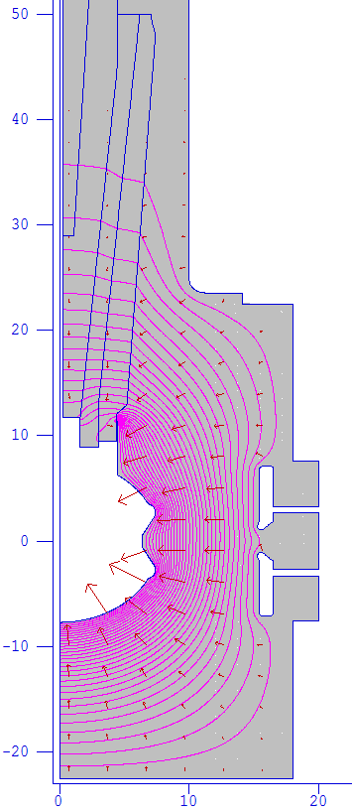
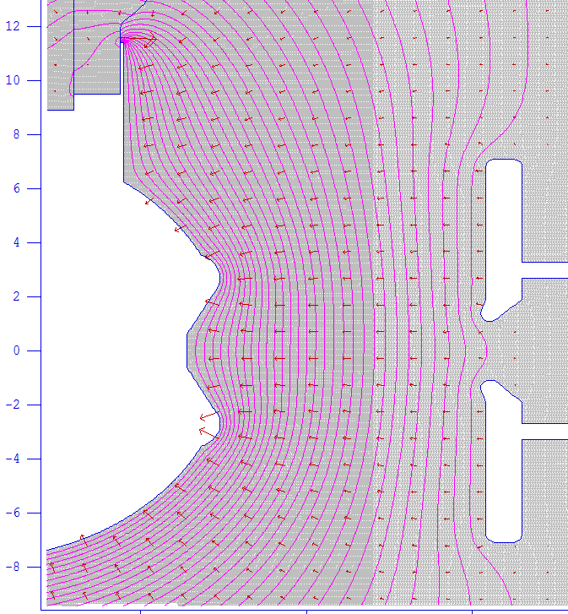
Updated Gun
E > 50 MV/m
E = 10.07 MV/m
E = 12 MeV/m

Slide 3
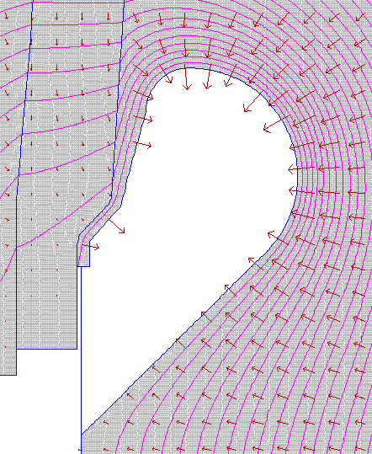
A Good Shed
r1 = 1 cm
r2 = 2.5 cm
r3 = 9.5 cm
9.5 MV/m
r1
r2
Gap
r3
E = 8 MV/m
10.5 MV/m

Slide 4
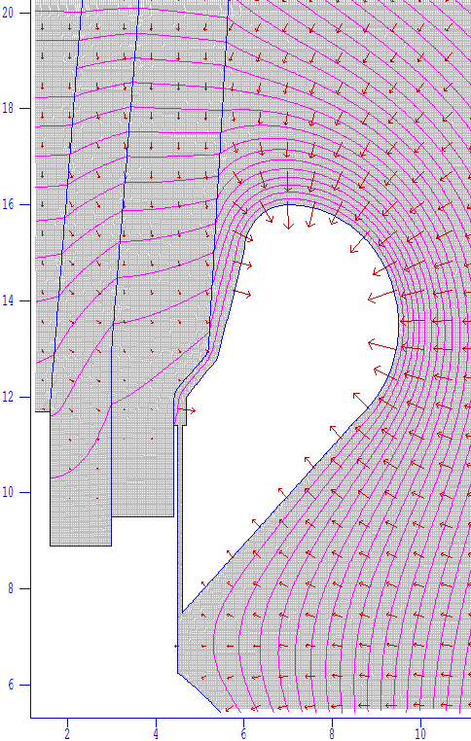
1 mm gap between shed and brazing
It works

Slide 5
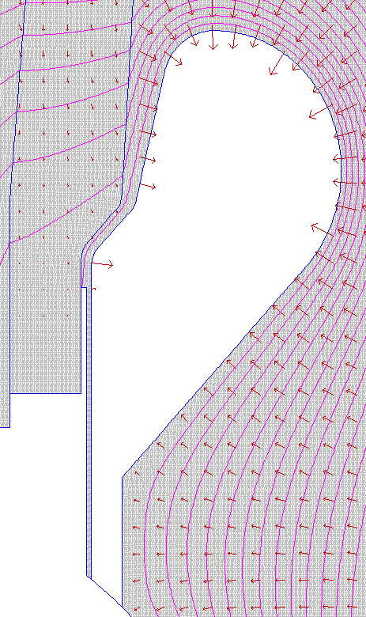
Shed
7 MV/m
9.5 MV/m
10 MV/m
10.8 MV/m
8 MV/m
9.5 MV/m
7 MV/m
8 MV/m
Gap = 1 mm

Slide 6
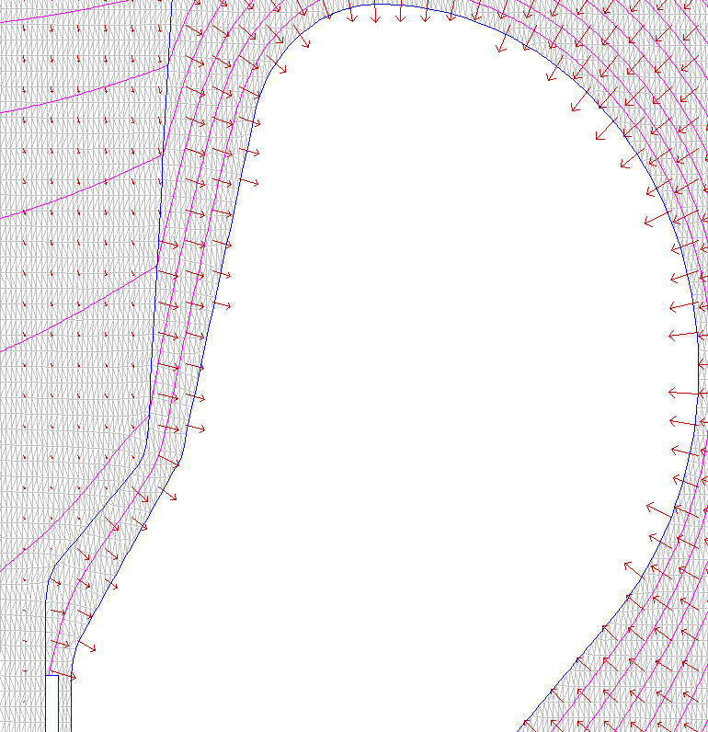
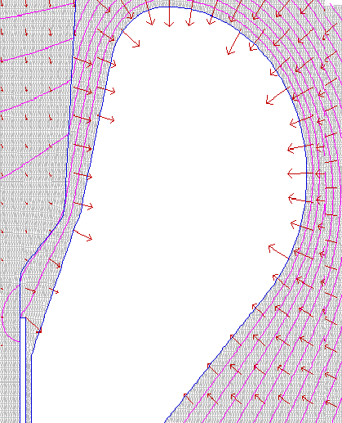
Shed
a
9.5 MV/m
9.3 MV/m

Slide 7
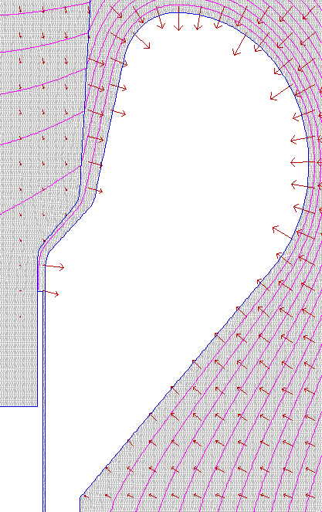
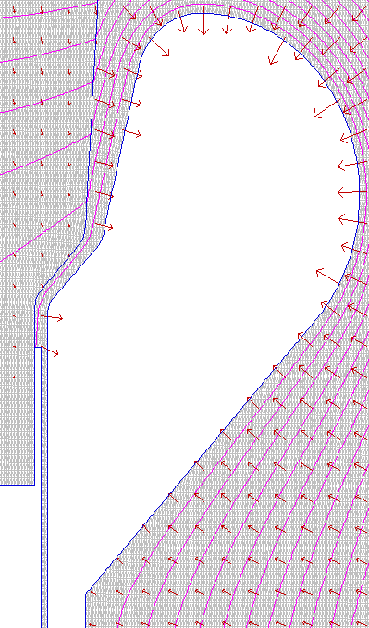
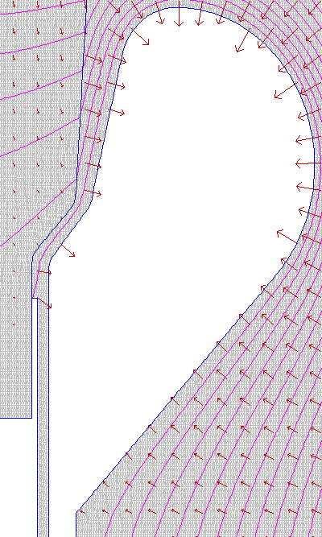
Sheds with different gaps
z
8.6 MV/m
9.0 MV/m
9.4 MV/m
10.6 MV/m
8.0 MV/m
7.99 MV/m
Gap = 0.5 mm
Gap = 1.0 mm
Gap = 2.0 mm

Slide 8
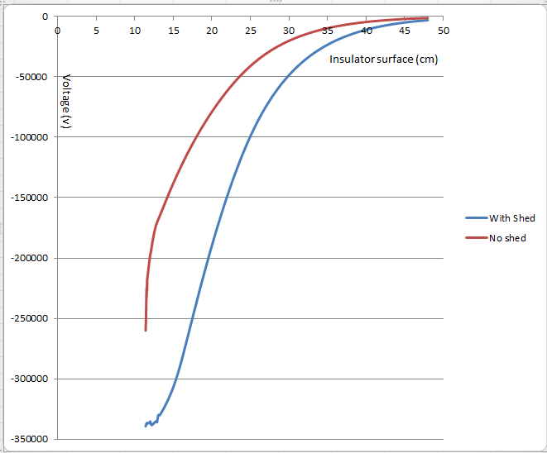
Potential along the insulator surface
2

Slide 9
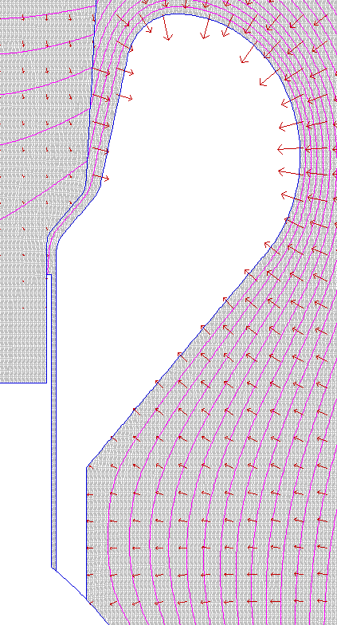
Shed dimensions (cm)
Po1: x=4.6, y=11.8
Po2: r=0.5, theta=150, x0=5.1, y0=11.8
Po3: x=5.4, y=12.8
Po4: r=0.5 , theta=-5, x0=5, y0=13.1
Po5: x=6.043, y=15.293
Po6: r=1, theta=90, x0=7, y0=15
Po7: r=2.5 , theta=-45, x0=7, y0=13.5
Po8: x=5.2, y=8.0
Po9: x=5.2, y=5.68
Po10: r=7.70128, theta=53.323
Gap = 0.1
6
5
4
3
2
1
7
8
Gap
9
10

