Slide 1

CEBAF Injector Update
Moller Mtg
April 21, 2017
Matt Poelker, Joe Grames
Center for Injectors and Sources

Slide 2
Outline
Operation
  Recent Source Performance
  Delivering Spin in the 12 GeV era
  Simultaneous 4-Hall Operation
Injector Upgrade
  Overview of planned work
  Status updates
  Near term plans 2017-2018
Parity Quality Beam Readiness

Slide 3
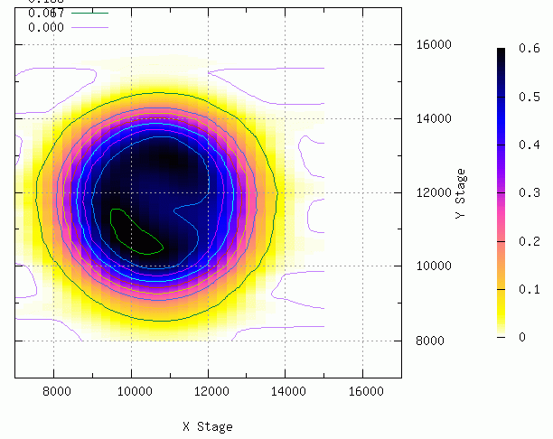
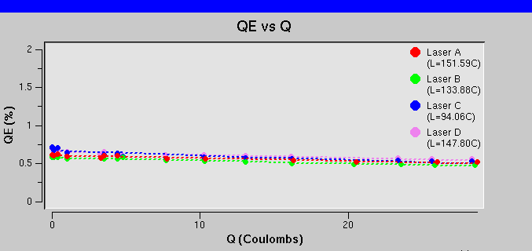
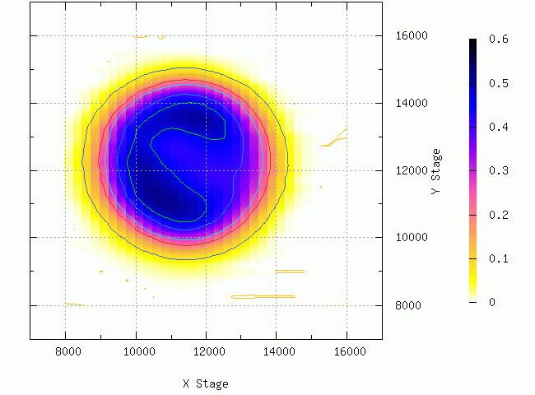
Source Operation
Spring/Fall 2016
  SSL GaAs/GaAsP SVT #5756-4 (Polarization ~ 87%)
  No heat/activation over Summer 2016 / Winter 2017 SADs
Fall 2016
Gun2 operating at -130 kV without problems
Charge lifetime > 100 C with average current 70-80 μA
Spring 2017
Delivering up to 3 halls at a time (either 249.5 or 499 MHz)
Hall A (Physics), Hall B (KPP), Hall C (KPP), Hall D (Physics)
Jun 2016
Sep 2016
3

Slide 4
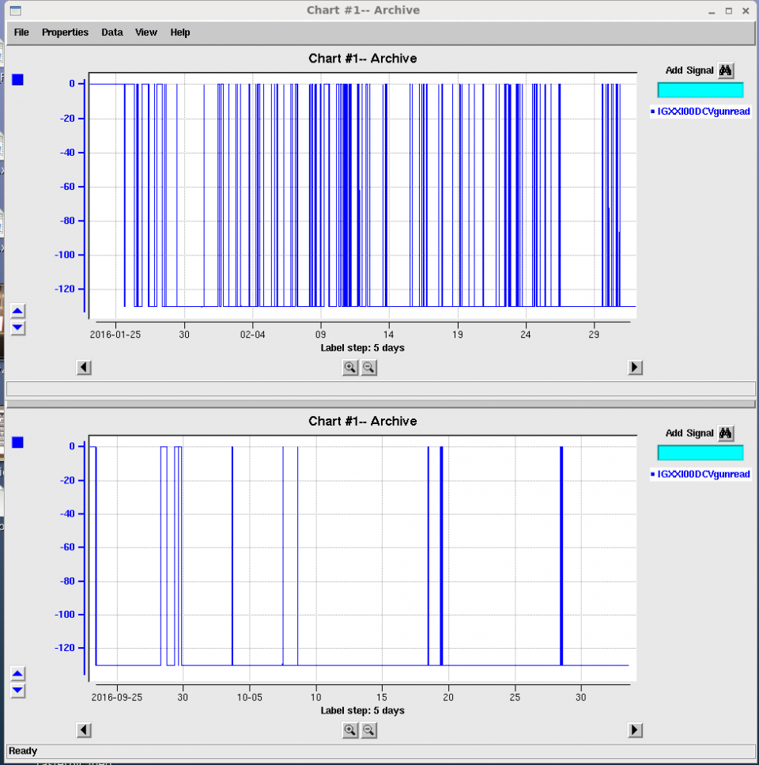
PSS High Voltage Interface Upgrade
Fall 2016
Historically Gun HV tied to PSS Beam Permit state => Frequent trips Off!
Gun HV power supply now remains ON when PSS = Power Permit
Anticipate improved injector reliability and possibly increased charge lifetime
First 5 weeks of
Spring 2016 Run
(before upgrade)
First 5 weeks of
Fall 2016 Run
(after upgrade)

Slide 5
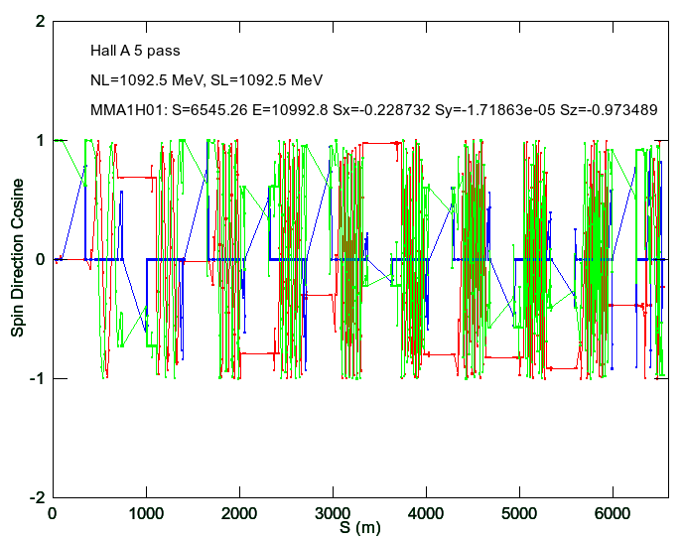
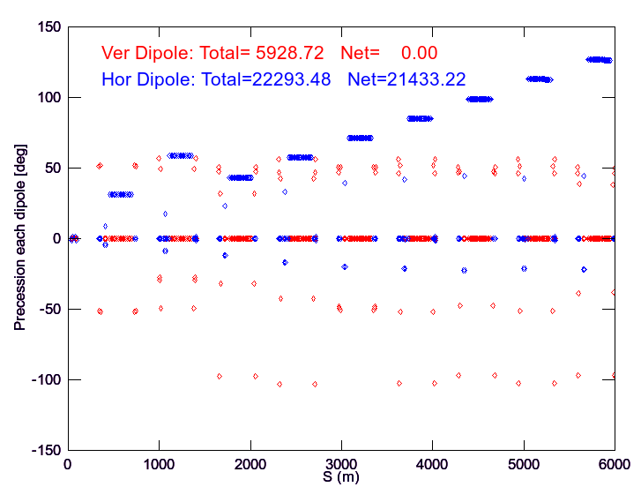
Delivering Spin in 12 GeV era
Spring 2016
Synchrotron radiation energy losses become important for spin precession > 3rd pass
We use Elegant to calculate evolving energy and post-processing spin calculation
Model vs. measured with Hall A @ 11 GeV agrees within couple degrees (<10⁻⁴ level)
No significant polarization reduction observed, but need 11 GeV Spin Dance….

Slide 6
  CEBAF 4-Hall Operations Begins Fall 2017
4 Hall Operations (also called D+3) begins this Fall
4 Hall Preparations Completed ….so far
  Backed out of tune mode generator “improvement” that resulted in damaged RTP cells
  Rebuilt laser table w/ 4th laser and 4-beam combination
  Two beams @ 249.5 MHz share one 499 MHz “RF Chopping Bucket”
  750 MHz separators for 5th pass ABC / D separation, fully functional
Condition | (D+2) | (D+3)
Maximum number of halls receiving beam | 3 halls | 4 halls
ABC Beam @ 5th pass (Hall D on) | 499 MHz | 249.5 MHz
ABC Beam @ 5th pass (Hall D off) | 499 MHz | 499 MHz
ABC Beam @ lower passes | 499 MHz | 499 MHz

Slide 7
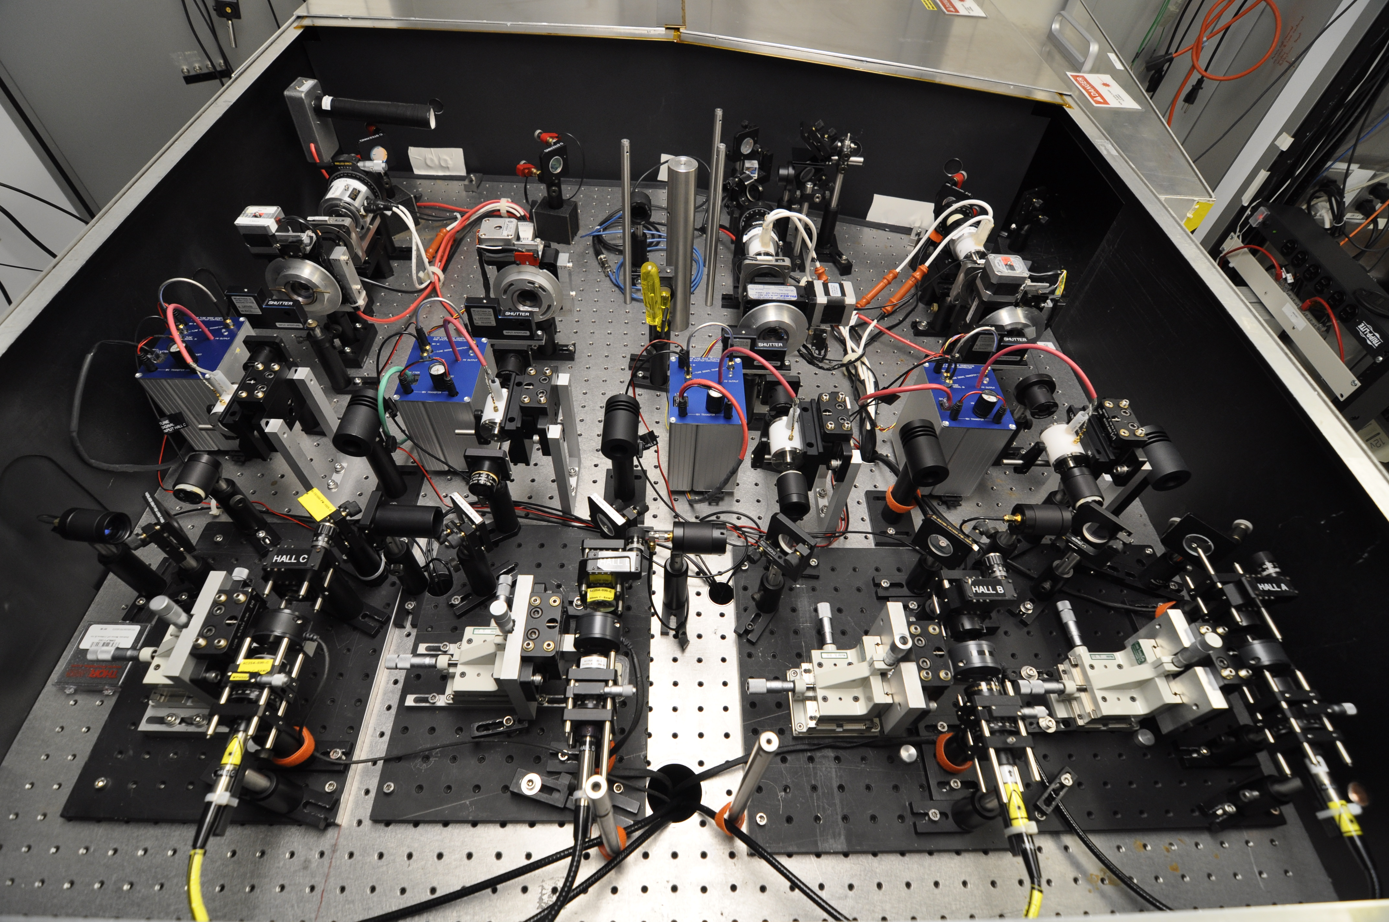
4-Hall Polarized Source Laser Table Rebuild
Summer 2017

Slide 8
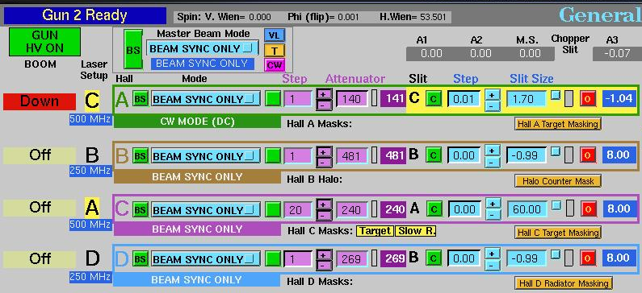
4-Beam Operations Punch list
Summer 2017 Shutdown
  New LLRF system to support 4 lasers and 499/249.5 MHz
  Improve => define, communicate, manage, archive 4-Hall Ops
      (4 lasers, 2 rep rates, 6 unique RF buckets, 5.5 passes, 4 halls)

Slide 9
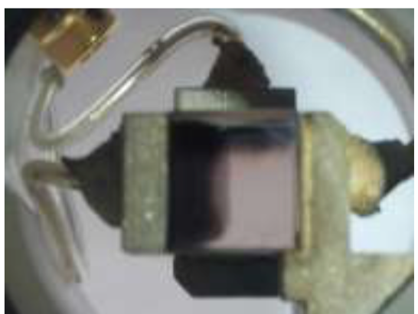
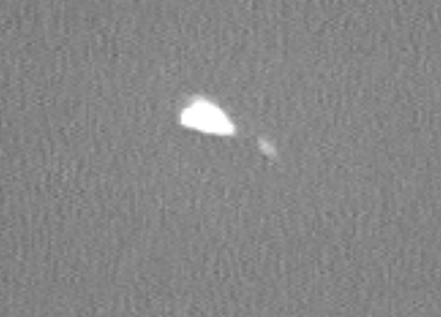
Tune Mode Generators
Fast RTP electro-optic crystals used to shutter beam (Pulsed Mode)
A simpler design implemented Summer 2016 => dc voltage applied all the time:
  Contrary to vendor claim RTP suffered ion migration from electrode to RTP
  Backout to conventional configuration Summer 2017
Cells are mainly >10 years old, signs of degradation from long term use
  Asked management for ~$24k to replace damaged cells, request denied
Poor Extinction
(dc HV)
Afterpulse
(old cell)

Slide 10
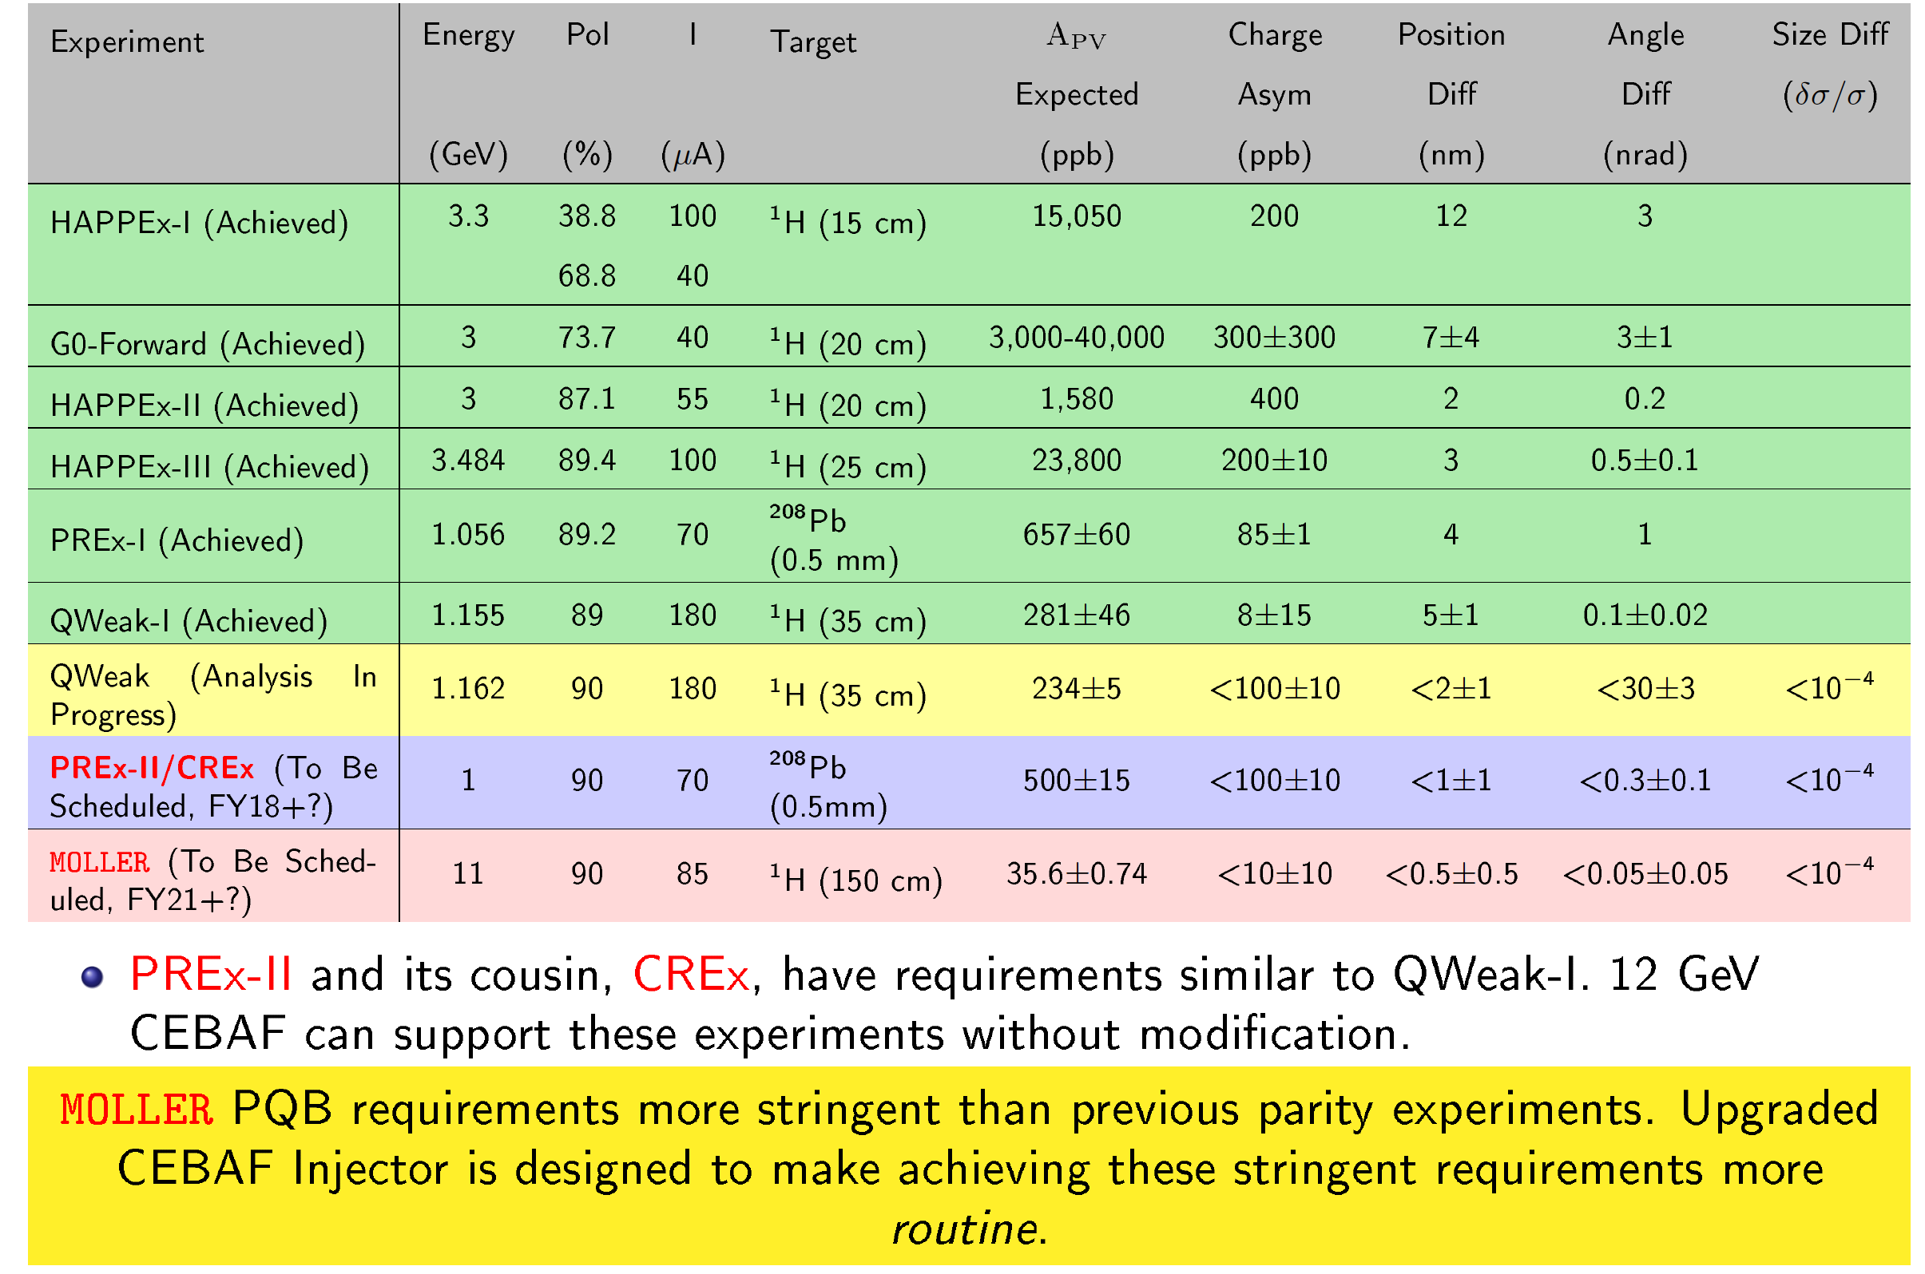
    AIP Injector Upgrade Project
(A. Freyberg Aug 2016 ECT’16)

Slide 11
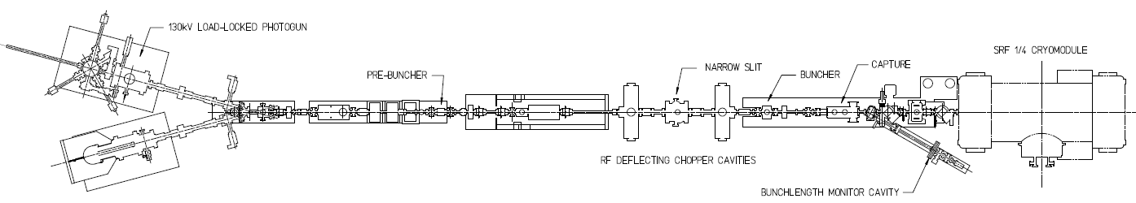
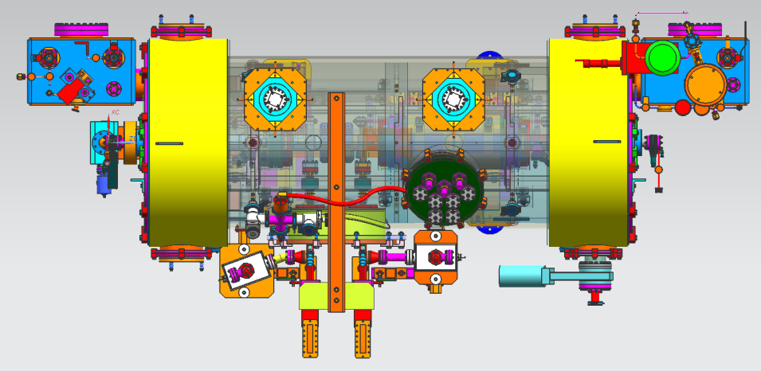
Injector Upgrade (what remains after R100)
200 kV
Increase gun voltage, modify Wien filters for 200kV operation
Improve baked beam line vacuum so gun does not pump on beam line
Locate H-Wien (energy filter) upstream of pre-buncher cavity
New SRF booster eliminates warm capture, RF deflection and x/y coupling
Our new “1/4 cryomodule”:
2 cell capture section + 7 cell cavity,
should provide 10 MeV beam and introduce no x/y coupling, allow better matching, more adiabatic damping

Slide 12
Why a higher voltage gun?
Parity Quality Beam improves with better transmission
  Space charge repulsion drops as beam becomes more relativistic
Measured
Modeled
Parity Quality Beam improves with more uniform Quantum Efficiency
  No beam loss on apertures, smaller HC asymmetries, no wasted electrons
  Electron impact ionization cross-section falls with increasing beam energy, should see improved photogun lifetime

Slide 13
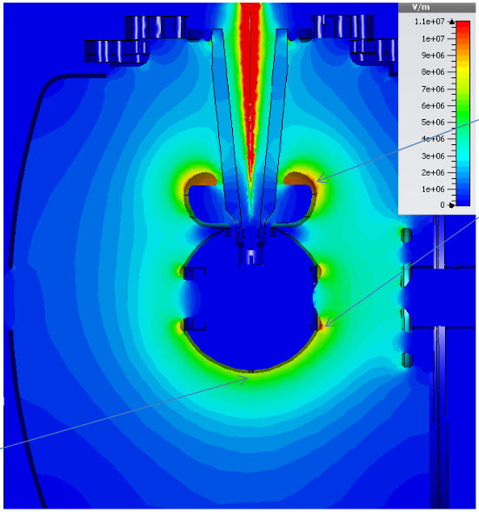
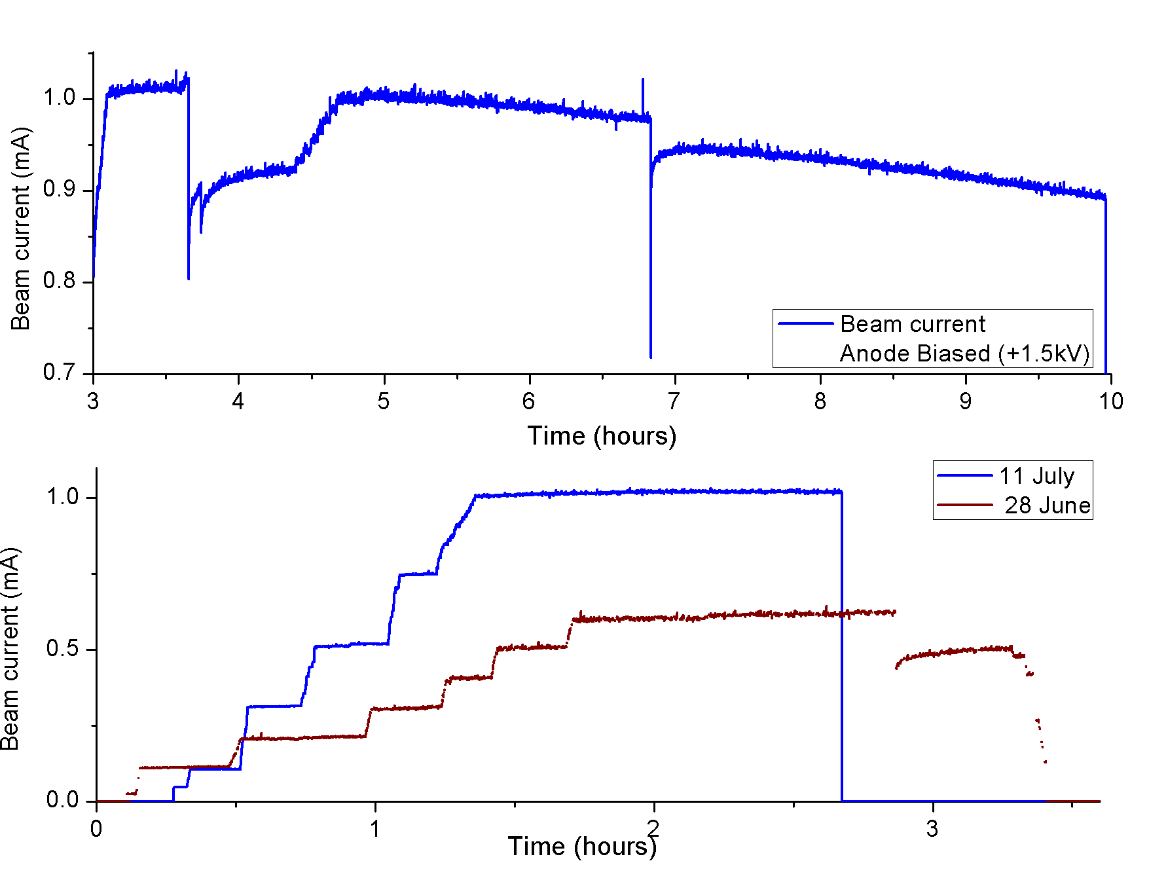
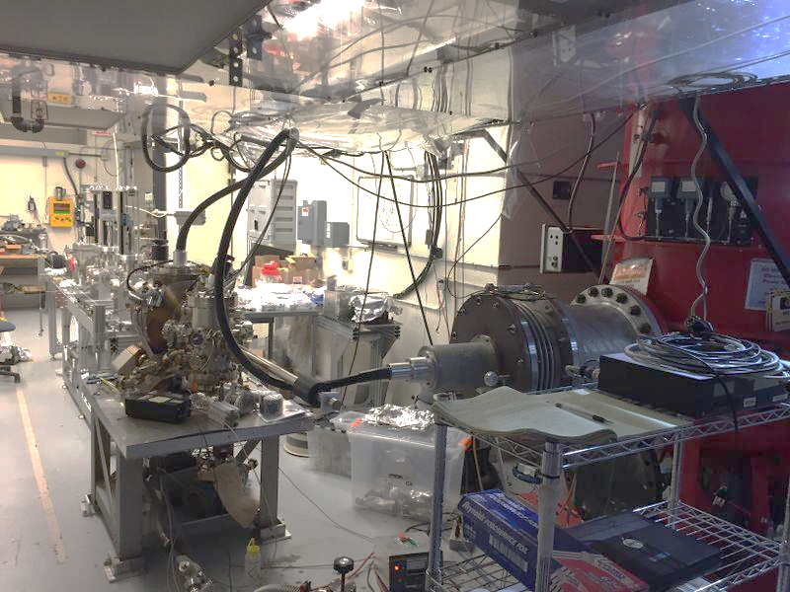
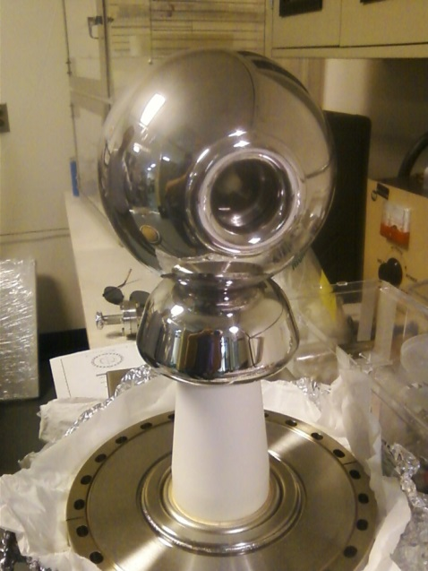
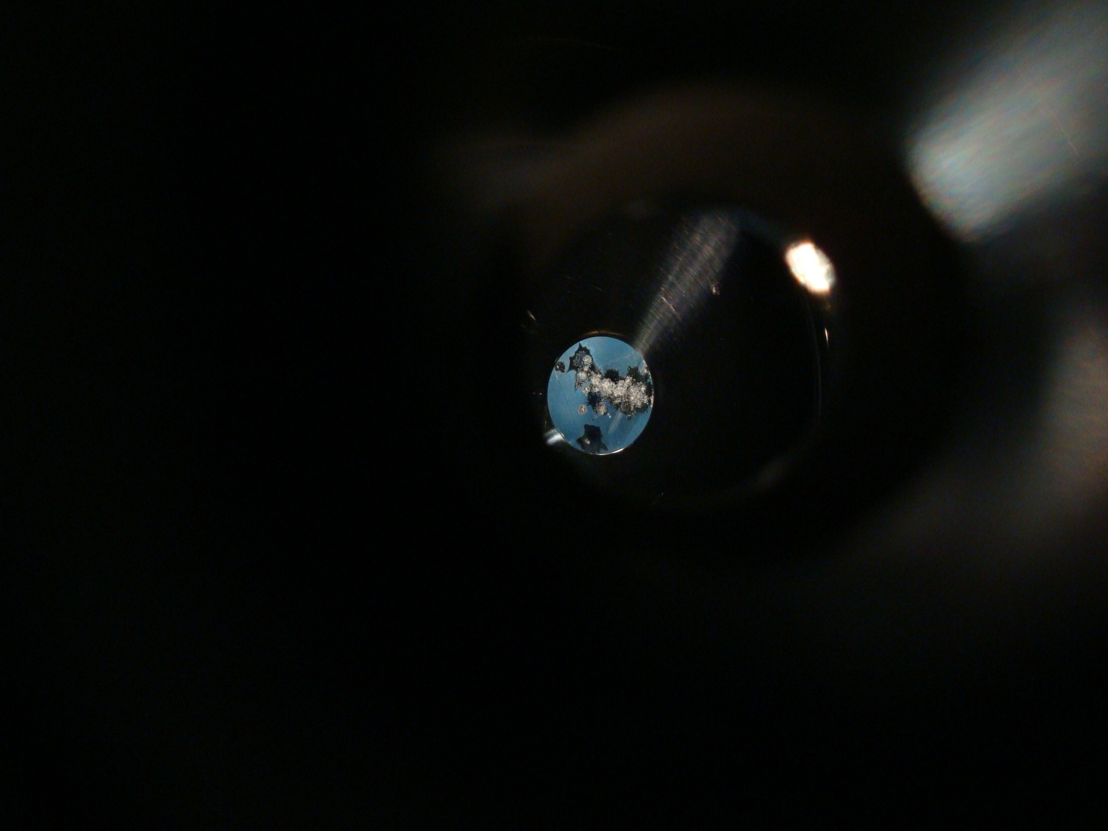
350 kV Inverted Gun and CsK₂Sb Photocathode
11 MV/m
1mA
Need mask and precipitator
8 MV/m
Learning how to use the new photocathode
First insulator conditioned to 325 kV
New insulator, installed now, supports higher voltage operation
Notes:
Interior Page Design 2

Slide 14
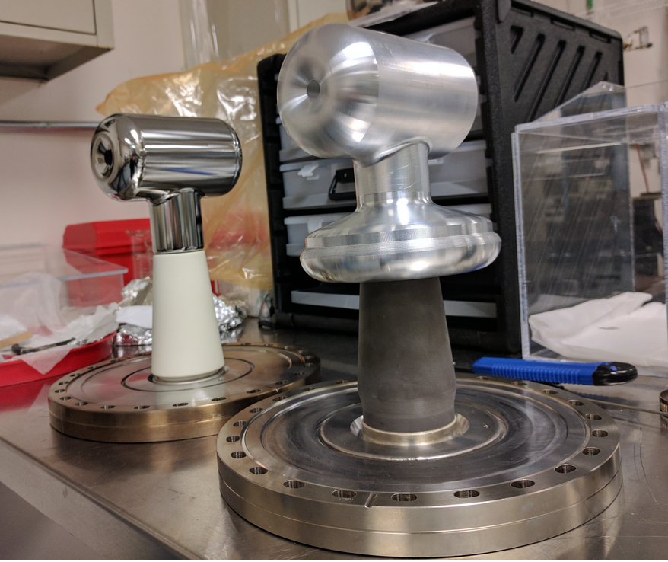

CEBAF 200kV Photogun
Replace white insulator and tee-shaped electrode with mildly conductive insulator, electrode with “shed” at triple-point
Apply voltage at UITF before installation at CEBAF
Add two BPMs on NEG tube downstream of gun
Notes:
Interior Page Design 2

Slide 15
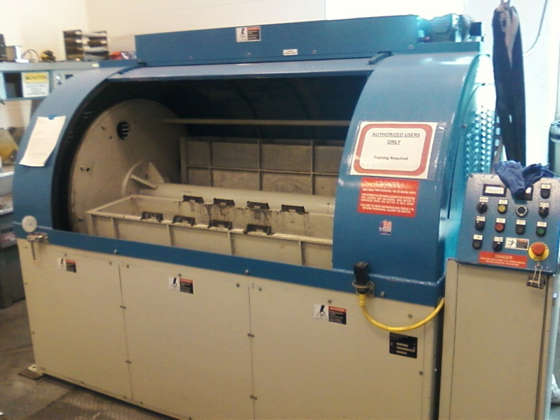
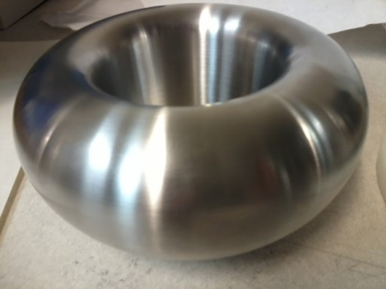
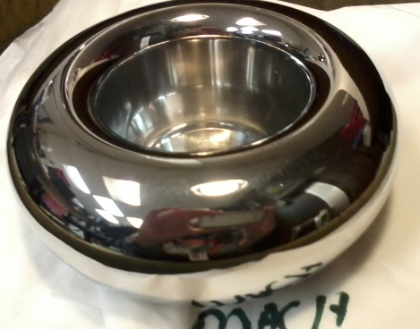
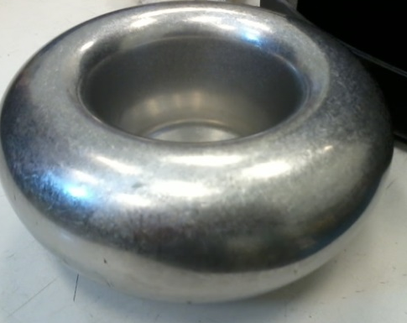
Barrel-Polished Electrodes
Gun electrodes traditionally polished using sand paper and diamond paste
Tedious process, takes about 30 days to complete
Now performed in 1 day using SRF barrel polishing machine
  From machine shop
30 minutes with corncob
Work by Don Bullard
30 minutes with plastic cones
Notes:
Interior Page Design 2

Slide 16
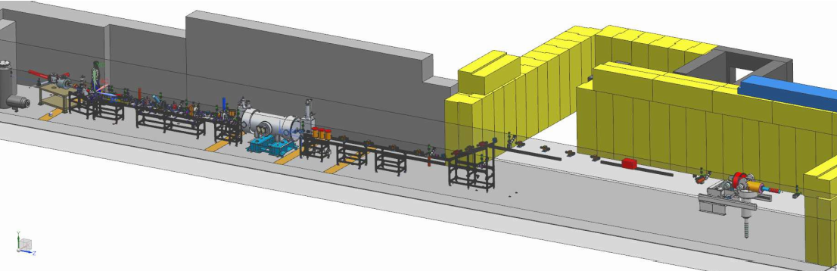
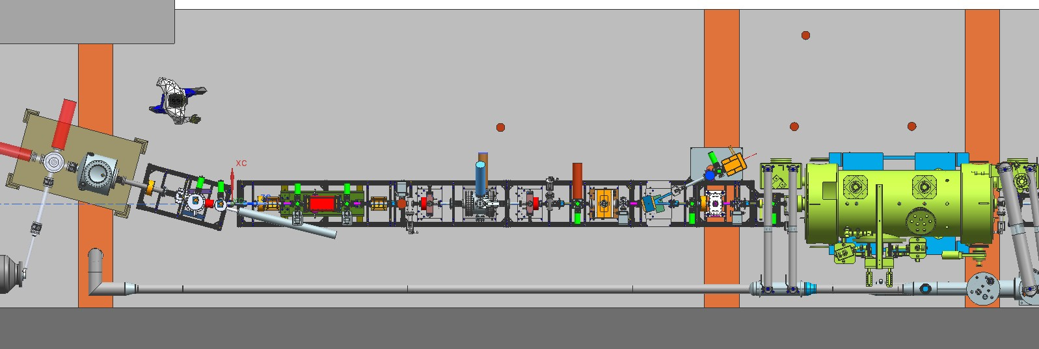
CEBAF Upgrade Activities at the UITF
TEST MORE ROBUST (>300kV) INVERTED GUN
TEST 200 kV WIEN FILTER
COMMISSION 2/7 CELL CRYOUNIT
UITF beamline has BPMs, pockel cell tests can happen here…..

Slide 17
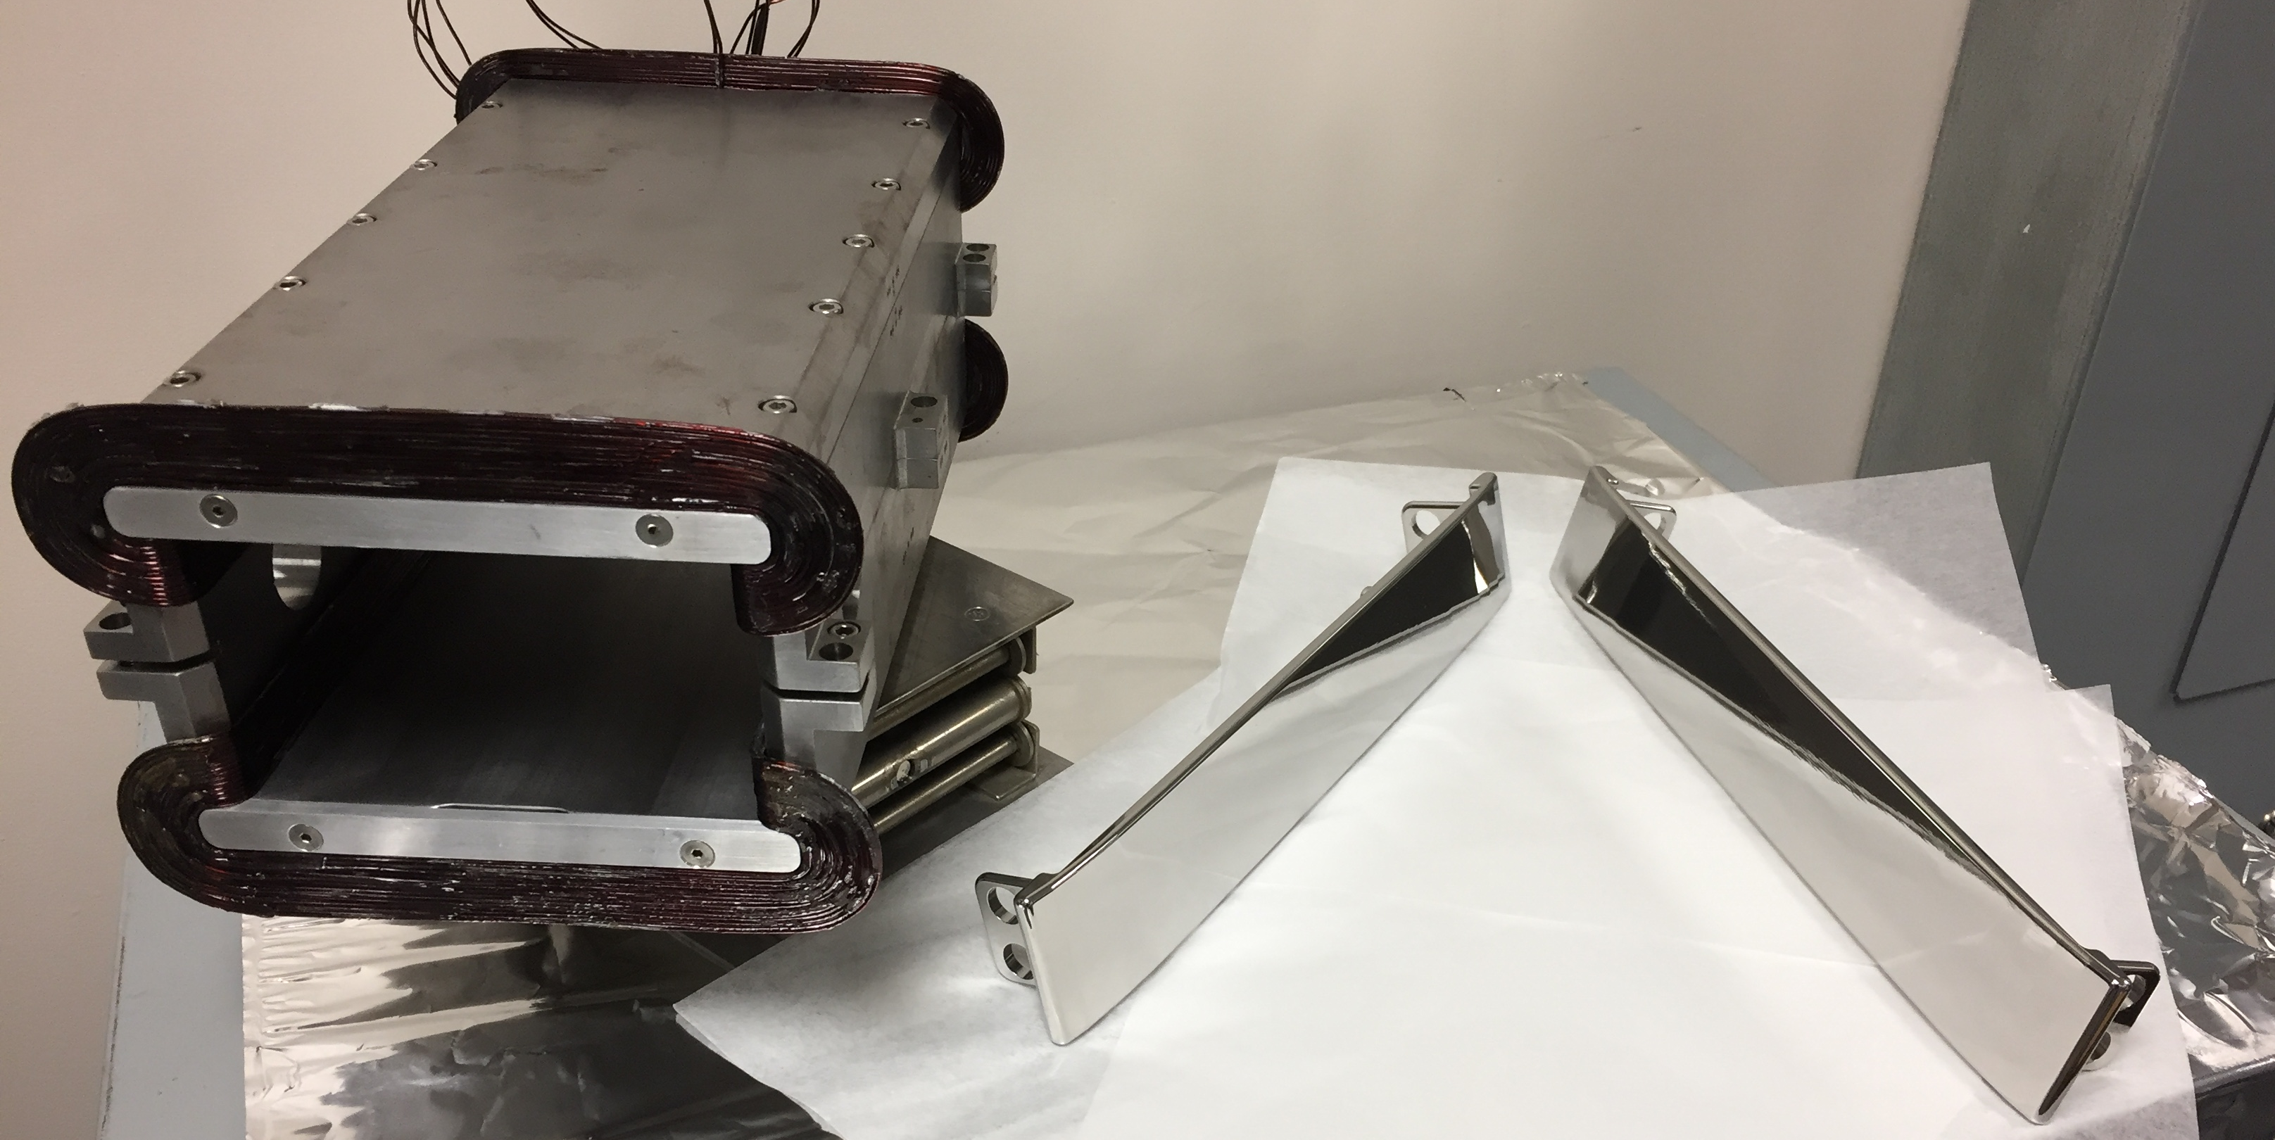
Testing 200 kV Wien filter at UITF
Will test the 200 kV Wien characterization
  Existing Wien filters limited to about 150 keV beam
  Believe we can modify for 200 keV beam
  Barrel polished electrodes, successfully tested HV feed thru to 20kV
  Shop is fabricating new 20A coils Jay proposed (JLAB-TN-15-032)
  Small modification to magnet completed to accept new coils
Wien Upgrade for 100 deg precession
Beam Voltage | keV | 200.00 | 350.00
Integrated BL | G-cm | 3993.86 | 6788.51
Magnet Current | A | 15.36 | 26.11
Electric Field | MV/m | 2.67 | 5.27
Electrode High Voltage | kV | 20.05 | 39.56

Slide 18
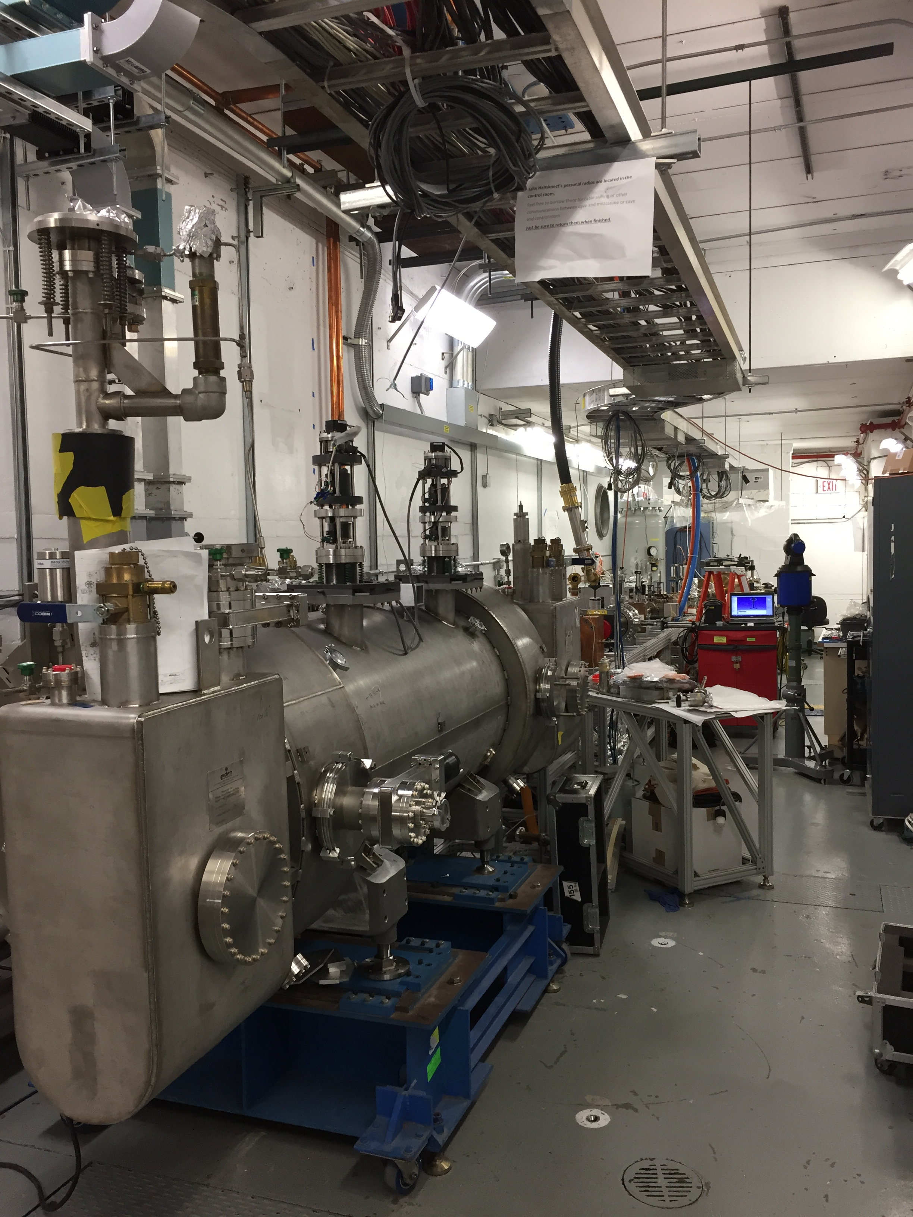
UITF Today
Just one more meter of keV beamline remaining
Two more bakeouts
Still lots of epics controls work but…
expect keV beam operations this summer
UITF beamline has BPMs, pockel cell tests can happen here…..

Slide 19
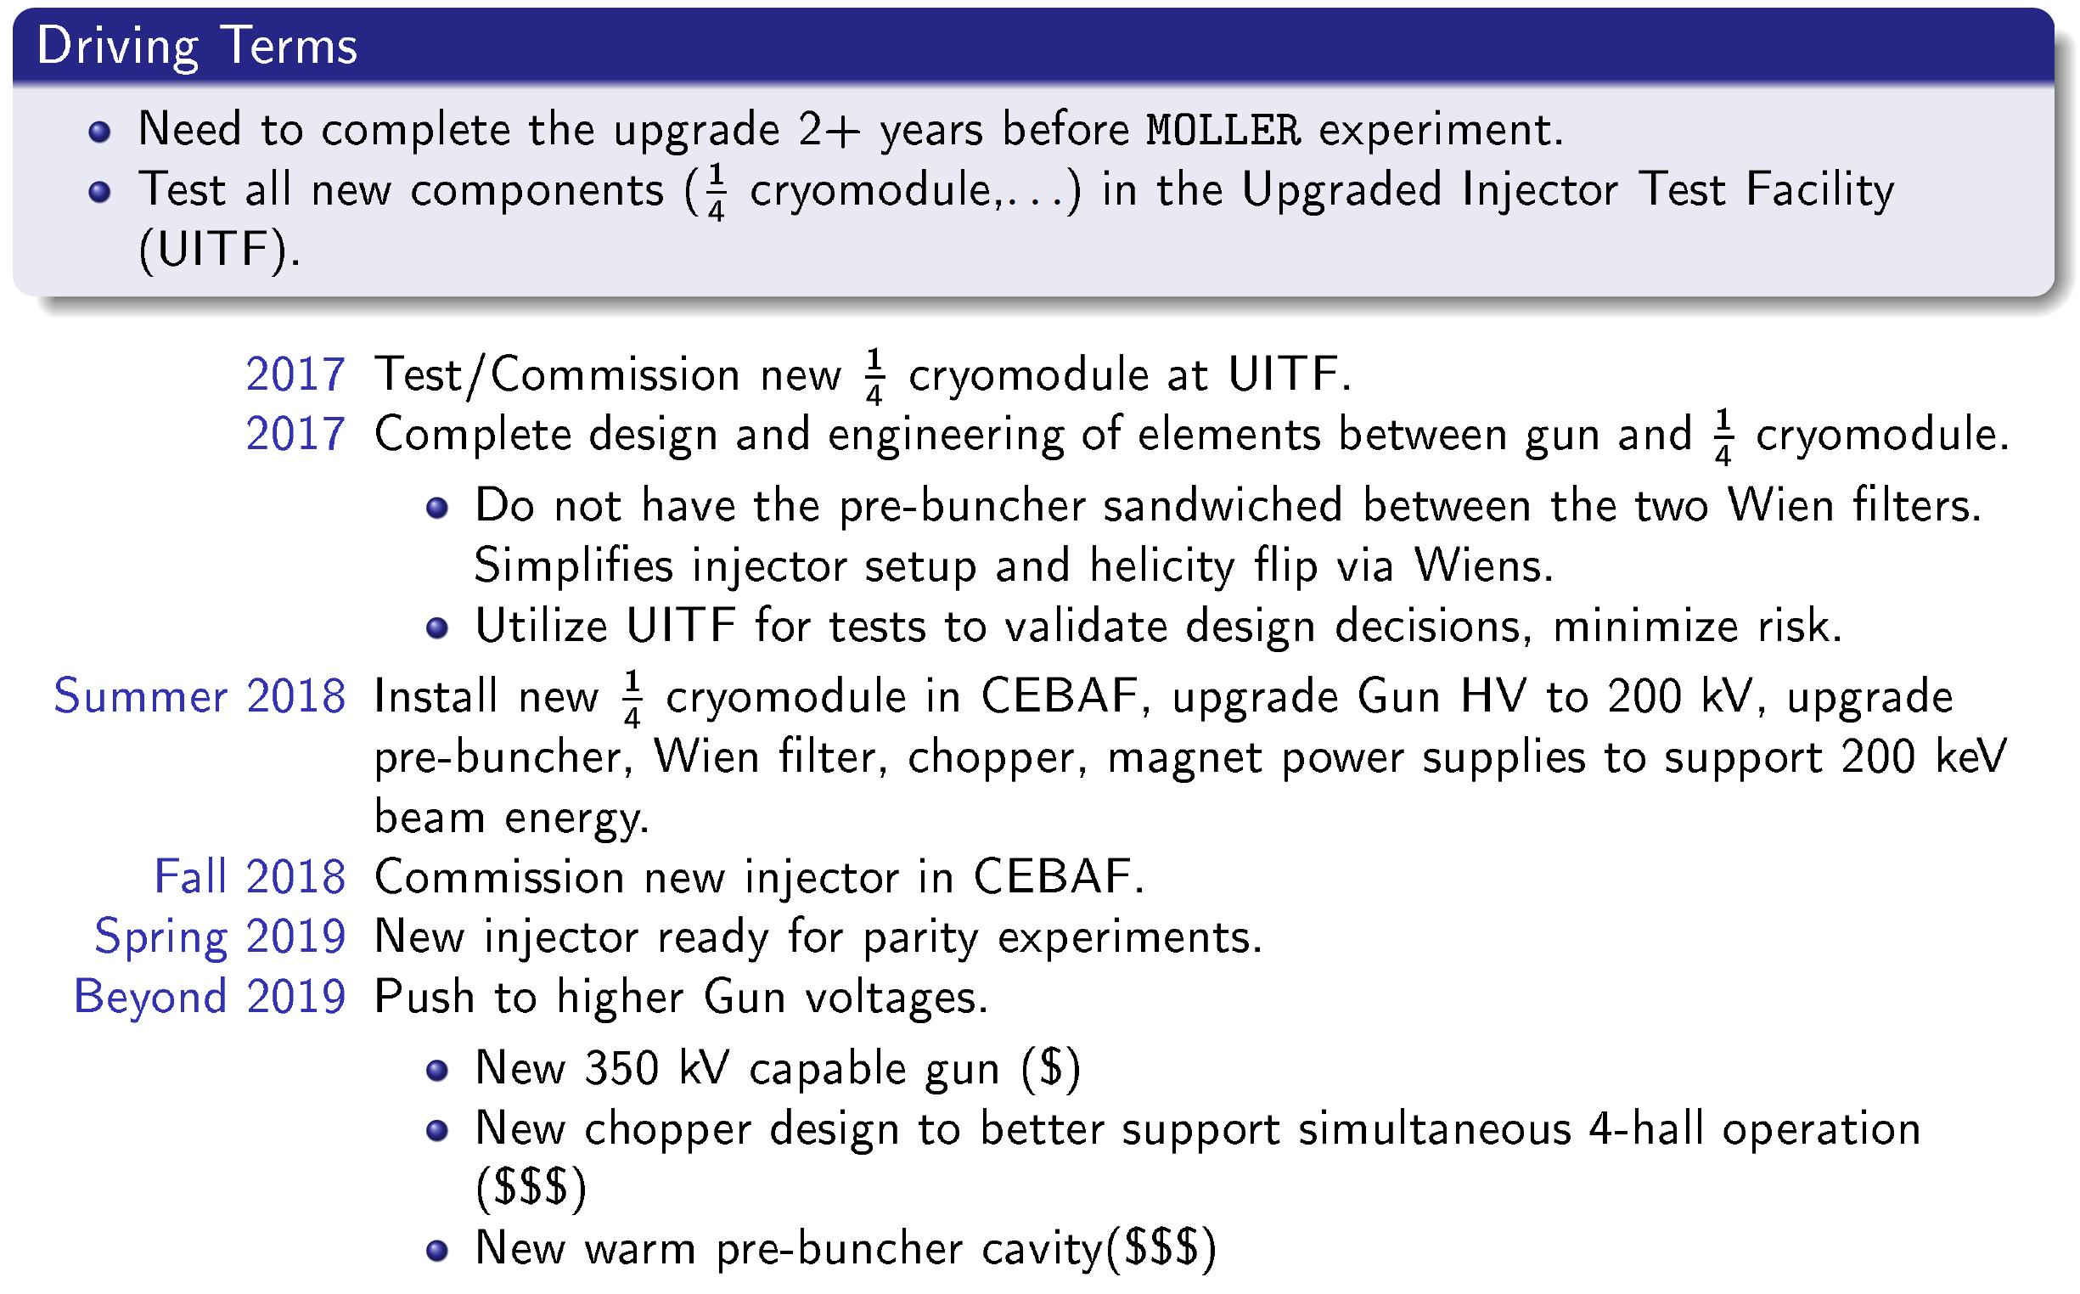
A. Freyberg Aug 2016 ECT’16 =>
PREX/CREX
timescale
Not likely if we test at UITF first

Slide 20
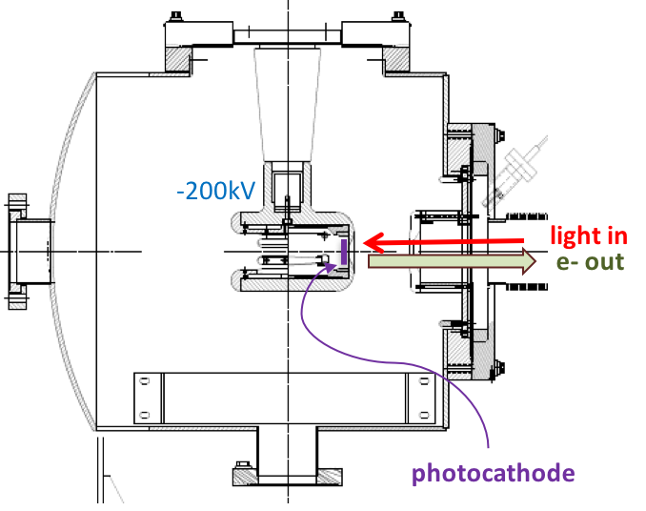
Upgrading Polarized Source / Beamline
Summer 2017 – Install/Test 200kV gun @ CEBAF
  Modify existing CEBAF/ILC 200 kV gun design
  Install 200 kV HV chamber and operate with higher voltage PS
  Run 200 keV beam and test functionality of existing beam line
Spare CEBAF/ILC Gun:
Operated at 200kV and up to 4mA at Test Cave
Summer 2018 – Rebuild Two Wien Beam line
  Install 225 kV HVPS for routine operation (will run -130kV until new QCM)
  Modify INJTWF beam line layout and w/ 200kV Wien filters

Slide 21
Scheduled Accelerator Down : Summer 2017

Slide 22
Parity Quality Beam Readiness
PQB specs for PREX/CREX have been demonstrated
  QWeak achieved these with higher current for longer duration
  Recall we are now operating with essentially the QWeak injector today
Resume the same successful mindset from the 6 GeV era
  Careful control of source systematics (Pockels cell, laser spot size, QE)
  Optimizing injector transmission to minimize intensity asymmetry
  Matching across the cryo-unit to benefit from setup at the source
  Careful separation of the beam
On-going Injector upgrade activities benefit PREX/CREX
  Motivated to improved parity quality beam
  Improved two-Wien spin flipper will be ready for Fall 2018

Slide 23
Summary
CEBAF Operations
  Source is operating well, providing high polarization at 11 GeV
  On track for 4-Beam operations in Fall 2017, time will tell how easy this is.
Injector Upgrade
  Deliver and test 200 kV beam at CEBAF injector Summer 2017 SAD
  Test of 200 kV Wien filter, new QCM and higher voltage polarized gun at UITF
  Rebuild baked beamline with 2-Wien spin flipper Summer 2018 SAD
Parity Quality Beam Readiness
  We are ready to return to setting up and delivering PQB beams

Slide 24
Want to help?
Spin Dance (low and high energy beam at halls, Injector and Hall A, or wait till B and C are running?)
5 MeV Mott (different energies and Zs, to improve theory)
Complete remote control capability of PC alignment
Optimize the design of the Pockels cell
Evaluate HC beam size variation using new NEG-tube BPMs

Slide 25
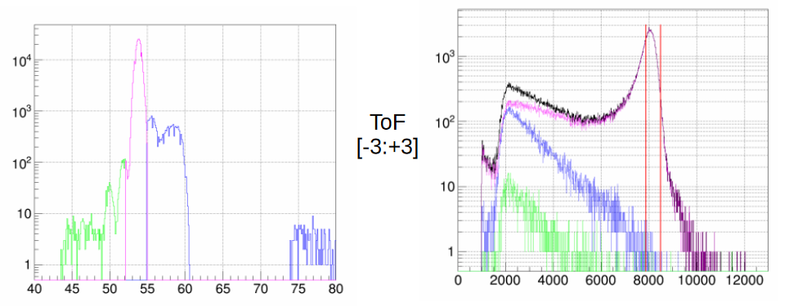
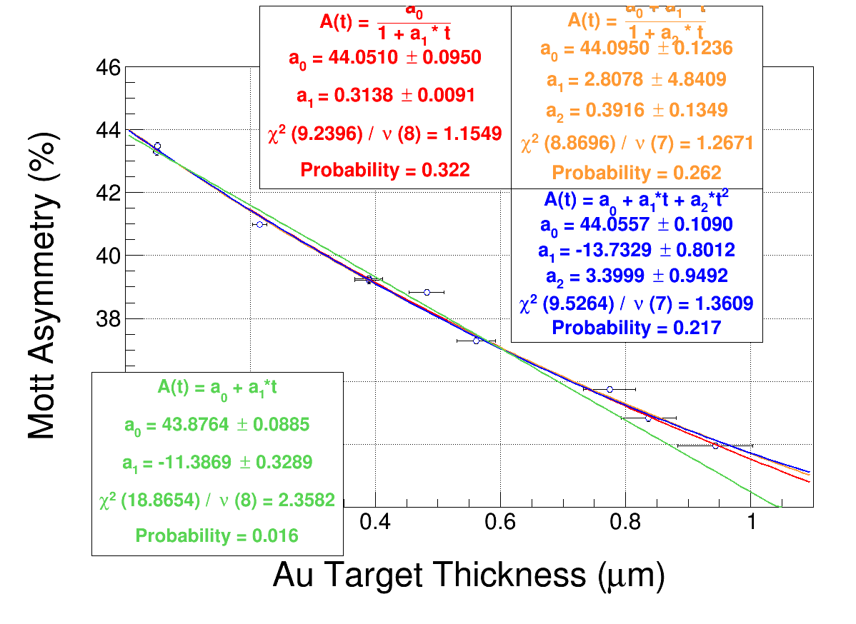
5 MeV Mott Polarimeter
Sub percent accuracy? Future tests: different beam energies and Zs to improve theory

Slide 26
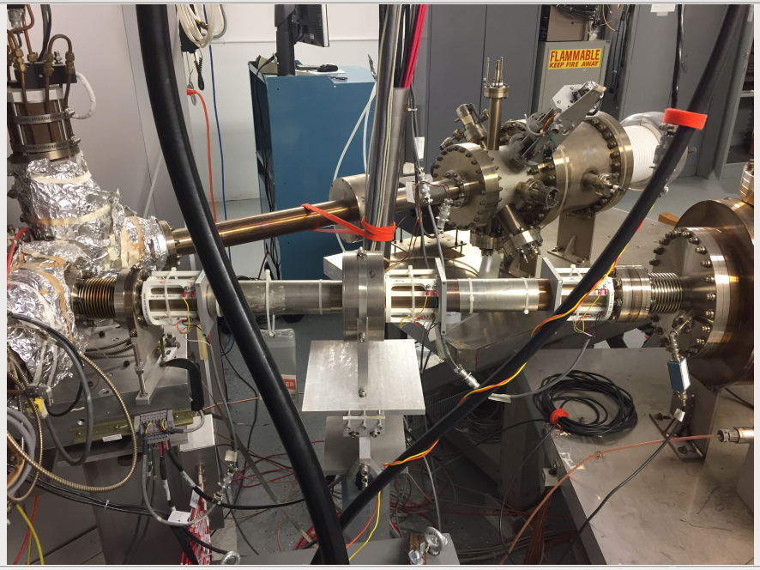
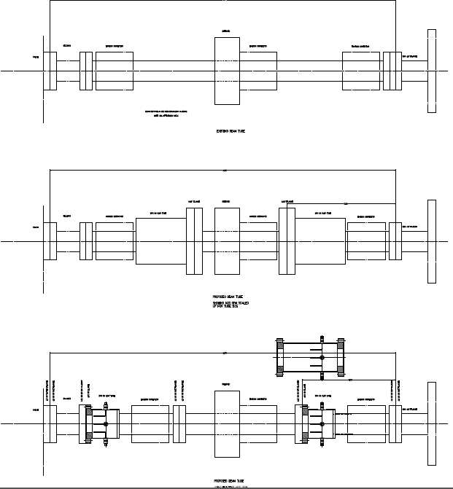
BPMs downstream of Gun:
HC beam size monitor?

