Slide 1
Jefferson Lab – Compton Transmission Polarimeter
Riad, Joe, Eric, and Matt

Slide 2
Achievements, Milestones and Timeline
FY22 Q2:
Bismuth Germanate (Bi₄Ge₃O₁₂) (BGO) crystals are ready to order – three crystals from Alpha Spectra, Inc, each: 76.2 mm diameter x 200 mm long
Design of magnet with iron core is underway
Collecting/precuring parts of the portable DAQ
Build a second radiator
FY22 Q3-Q4:
Install old polarimeter at UITF
Portable DAQ is ready
Test portable DAQ with old magnet and detector
FY23 Q1:
Install new magnet and new detector at UITF
Calibrate polarimeter

Slide 3
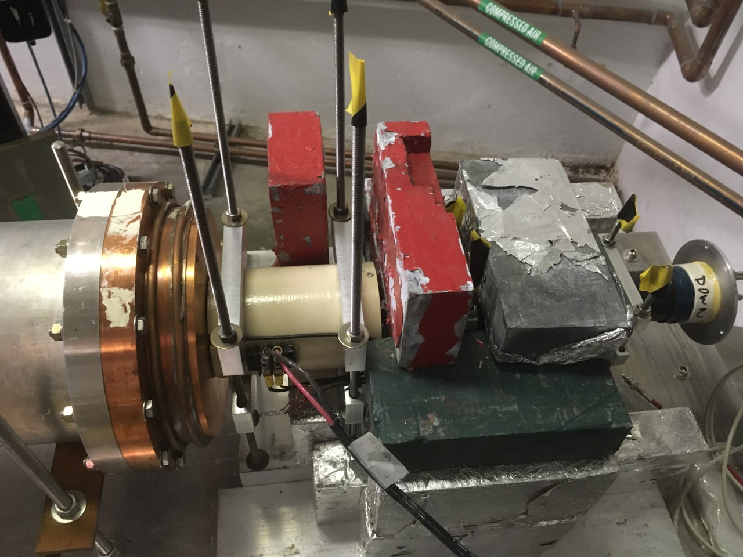
Polarimeter at CEBAF – Summer 2018

Slide 4
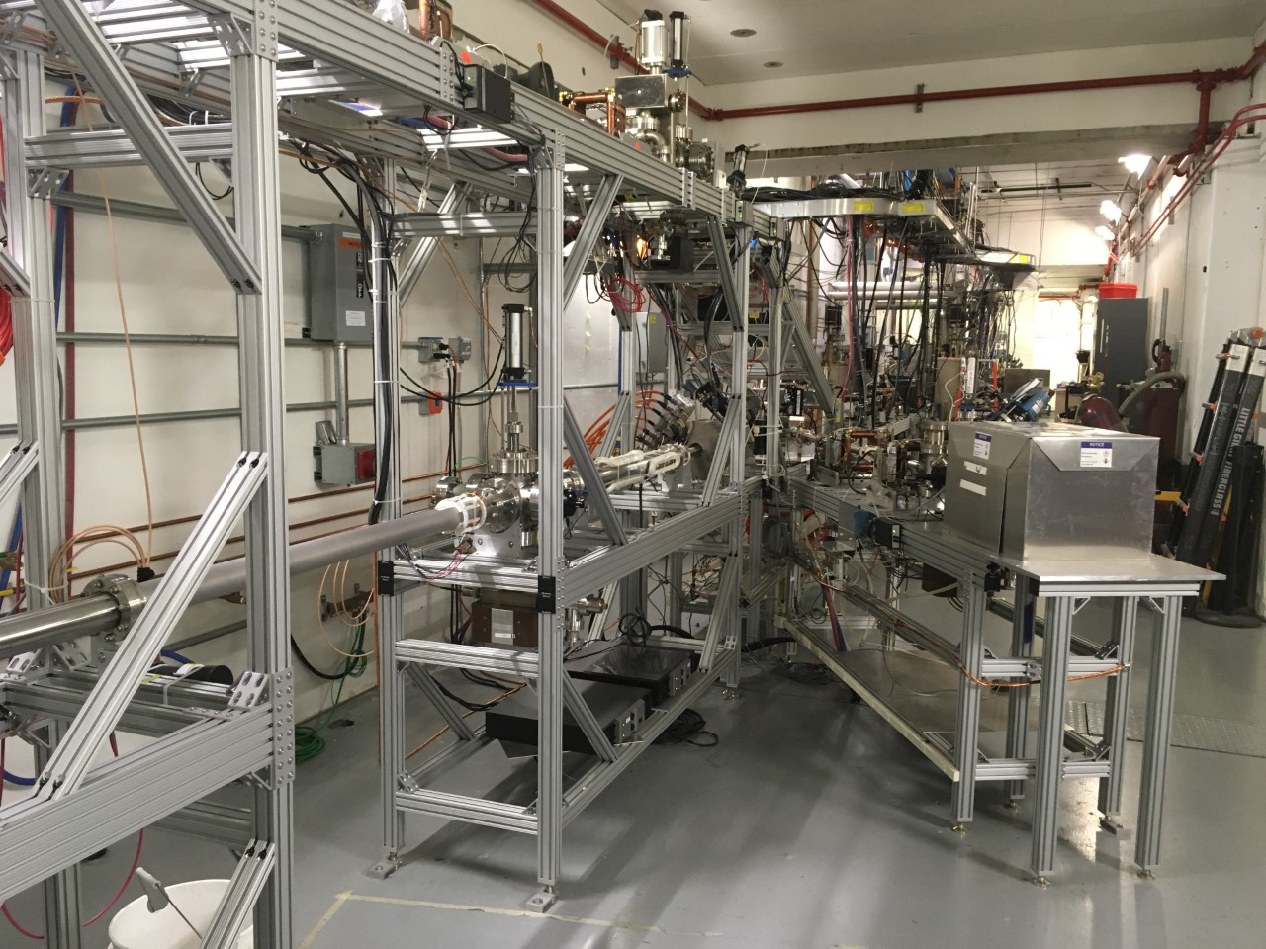
Planned Test at UITF
Here

Slide 5
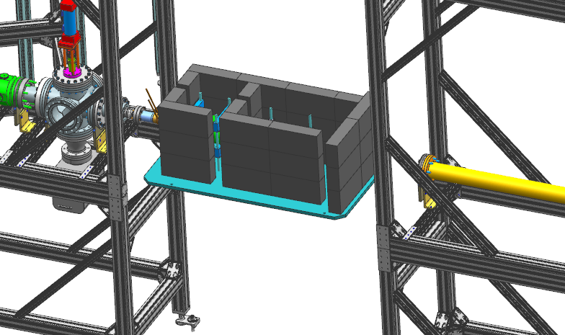
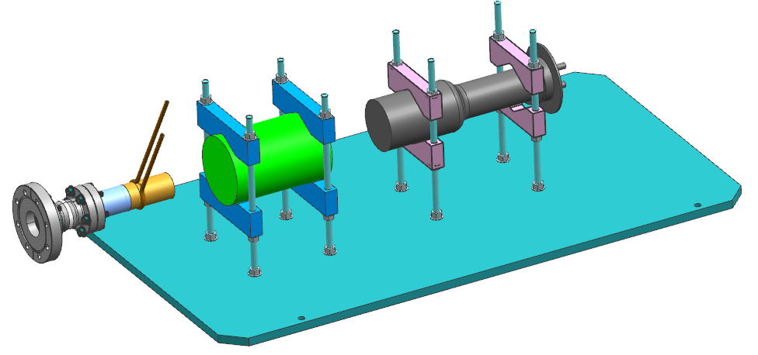
Planned Test in UITF

Slide 6
New Portable Data Acquisition System (DAQ)
DAQ Readout:
Delayed Helicity, T_Settle and Pattern Sync
PMT, BCM
Battery
Remote controllable IHWP
Two systems: one for BNL and one for JLab
Portable Rack
HV Power Supply, -5kV
Magnet Power Supply, ±10 Amps
PMT
Magnet
DAC
Computer
DAC
PMT Signal
Mini VME Crate
Beam Current Monitor (1 V)
Delayed
Helicity Fiber
T-Settle Fiber
Battery (1 V)
Pattern Sync
FADC
Helicity
Generator
Helicity TTL 5V Signal to
Pockels Cell

Slide 7
DAQ List
 | PORTABLE DAQ
ID# | Item | Description | Needed Quantity | On-site | To Order | Model# | Cost | Software | Ordered?
1 | Portable Rack | Equipment rack | 2 |  | 2 | ? |  |  | ?
2 | 5kV Power Supply | CAEN VME HV | 2 |  | ? | V6533P | $0.00 |  | On Site
3 | Magnet Power Supply | 1.5kW, 20A, 75V programmable, bipolar | 2 | 2 |  | ? | ? | Used at CEBAF | YES
4 | Mini VME Crate | WEINER 7 slot '64x crate | 2 | 2 |  | 195-X-64X | $0.00 |  | On Site
5 | VME Controller | VME Single Board Computer | 2 |  | 2 | VP E2x/msd | $3,000.00 |  | YES
6 | VME Digital-Analog-Converter | DAC module | 2 |  | ? | ? | ? |  | NO
7 | VME NIM-ECL level translator | CAEN 6U single slot | 2 |  | 2 | V538AB | $2,700.00 |  | YES
8 | Helicity Decoder Module | New module | 2 |  | 2 | HD-FEDAQ | $2,200.00 |  | YES
9 | Helicity Generator | EES designed and built | 2 | 2 |  | EES | $1,000.00 | Used at CEBAF | On Site
10 | Ethernet Flash ADC-250MHz | 16 channel ADC | 2 | 2 |  | FEDAQ-EFADC | $3,500.00 |  | YES
11 | EFADC250 Power supply | Power supply and cable | 2 | 2 |  | FEDAQ-EFADC | $1,800.00 |  | YES
12 | Computer | DELL/LinuX | 2 |  | 2 | ? | $2,500.00 |  | NO
13 | Fluxmeter | Integrating Flux Meter | 1 |  | 1 | Hirst IFM03 | $5,000.00 |  | NO
14 | Cable Patch Panel |  | 2 |  | 2
15 | Signal cable + terminators
16 | HV cable + terminators
17 | Magnet cable + terminal block

