Slide 1
DAQ Speed and Run2 Estimates
April 3, 2015

Slide 2
Summary of FADC Development for Faster Performance
Name | Readout | Trigger
Scalers | Scaler S1 (helicity gated), S2 (un-gated) | Delayed nT_Settle
Mott_Sample | Mott FADC (Mode=1), S1, S2, TDC | Mott Detector
Mott_SemiInt | Mott FADC (Mode=7), S1, S2, TDC | Mott Detector
PEPPo_Int | INT FADC, S1, S2 | nT_Settle
SemiIntFast | Mott FADC (Mode=7), BlockLevel=1 | Mott Detector
SemiIntBlock | Mott FADC (Mode=7), BlockLevel=50 | Mott Detector
SampleBlock | Mott FADC (Mode=1), BlockLevel=50 | Mott Detector
For DAQ to be faster:
No Readout of CAEN V775 TDC or SIS3801 Scalers; only FADC readout
Use block readout

Slide 3
Beam Test (Goal: Can we use FADC timing)
February 9, 2015:
Run 8225: Mott_SemiInt, deadtime = 28% at 5.1 kHz
Run 8227: SemiIntFast, deadtime = 17% at 5.1 kHz
Run 8228: SemiIntBlock, deadtime = 1% at 5.1 kHz
March 17, 2015:
Mott Run 8312: Mott_SemiInt, FADC Delay: Ch8=0,CH9=0,Ch11=4
Mott Run 8313: Mott_SemiInt, FADC Delay: Ch8=0,CH9=2,Ch11=4
Mott Run 8315: Mott_Sample, deadtime = 32% at 5.5 kHz
Mott Run 8316: SampleBlock, deadtime = 4% at 5.5 kHz
Problem handling periodic signals
JLab expert changed FADC firmware
Still analyzing but problem may not be solved yet
The other option is to readout the raw data and calculate timing in analysis (raw data files will be larger)

Slide 4
Remaining Challenges and Plans
Show that we can use FADC timing, either:
Timing is done in firmware, or
Timing is done in analysis
Otherwise: Keep using TDC but figure out a way to run faster or upgrade to new TDC
For scalers: we can upgrade to new JLab scalers we have
Change decoder to be able to decode Block data

Slide 5
Au Estimates

Slide 6
Estimates Assumptions
DAQ rate limit = 2 kHz, deadtime = 15%. Note that any systematic errors due to deadtime cancel to all orders in cross-ratio method – Measured in Run1
Current limit of 5 µA
Dump rate = 100 Hz/µA per detector:
Measured during Run1 5 MeV data at
Discriminator threshold was 25 mV (or energy of about 1.25 MeV, 2000 FADC channels)
Dump dipole magnet was at +5A

Slide 7
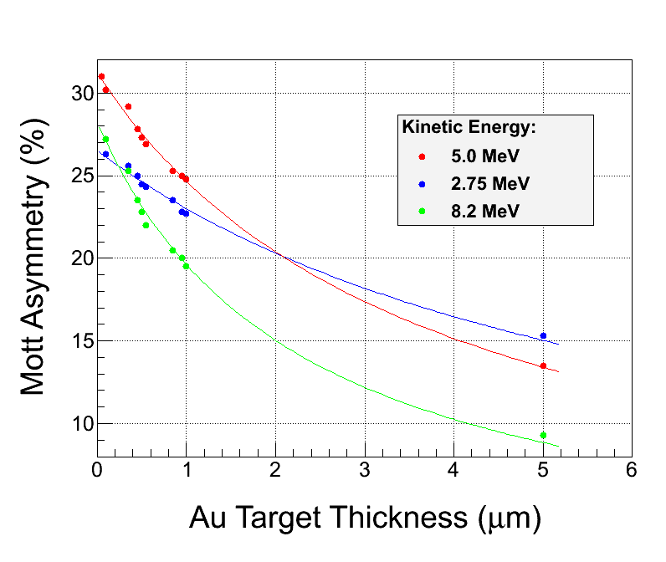
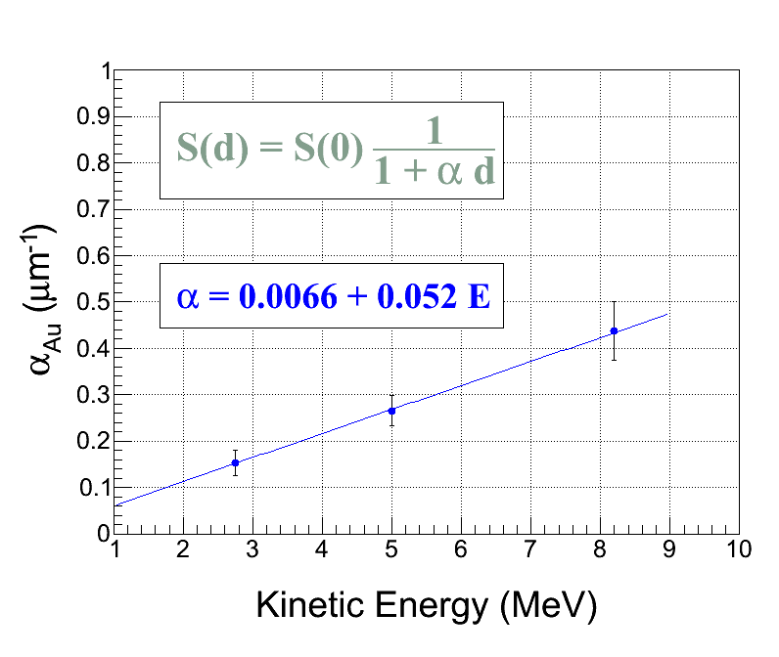
Target Thickness Extrapolation

Slide 8
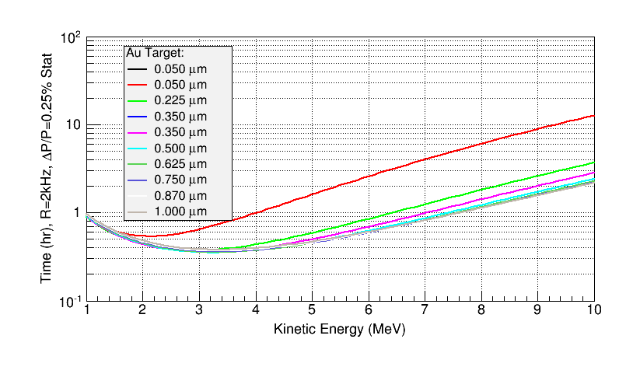

Slide 9
3 MeV
5 MeV
8 MeV

Slide 10
Dump Event Suppression
Increase discriminator threshold – Tested in Run1
Study dump dipole (+5A, 0A, -5A) – Tested in Run1 (for thinner foils, 0A or -5A may yield lower dump rate)
Laser timing veto – Tested on February 9, 2015
Note: Dump rate depends on electron energy ( ̴1/E)

Slide 11
Run2 Strategy
At 3 MeV:
Dump events will be higher due to energy
Increase discriminator threshold
Thick foils will benefit from faster DAQ but very little reduction in overall time required for Run2. Here DAQ speed will help with systematic studies, e.g., many short runs with very high statistics for stability study.
At 8 MeV:
Dump events will be lower due to energy
Elastic rate is too low to benefit from faster DAQ
Suppress dump events will reduce deadtime
Will run at about 5 µA (31 MHz) for all foils (current limited)
What is a reasonable current limit? Run1 was 5 µA

Slide 12
Al Estimates

Slide 13
Al Estimates Assumptions
DAQ rate limit = 10 kHz
Current limit = 40 µA
Dump rate (with suppression) = 10 Hz/µA per detector
Target thickness extrapolation: α_{Al} = 0
We have to suppress dump events for Al

Slide 14
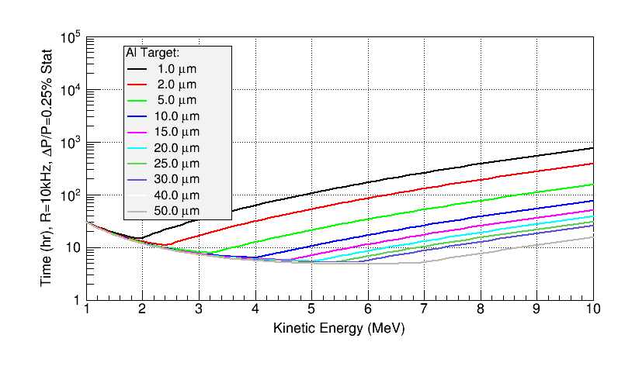

Slide 15
