Slide 1
Resistor tank designed by J. Hansknecht using R28 connectors
Design dates from 2012
R28 cable plug arcs over consistently at 250kV
Tanks are filled up to 15 psig with relief valve

Slide 2
These are the drawings John made to fabricate the tanks (2)

Slide 4
And this is the R28 resistor adapter (aluminum)

Slide 5
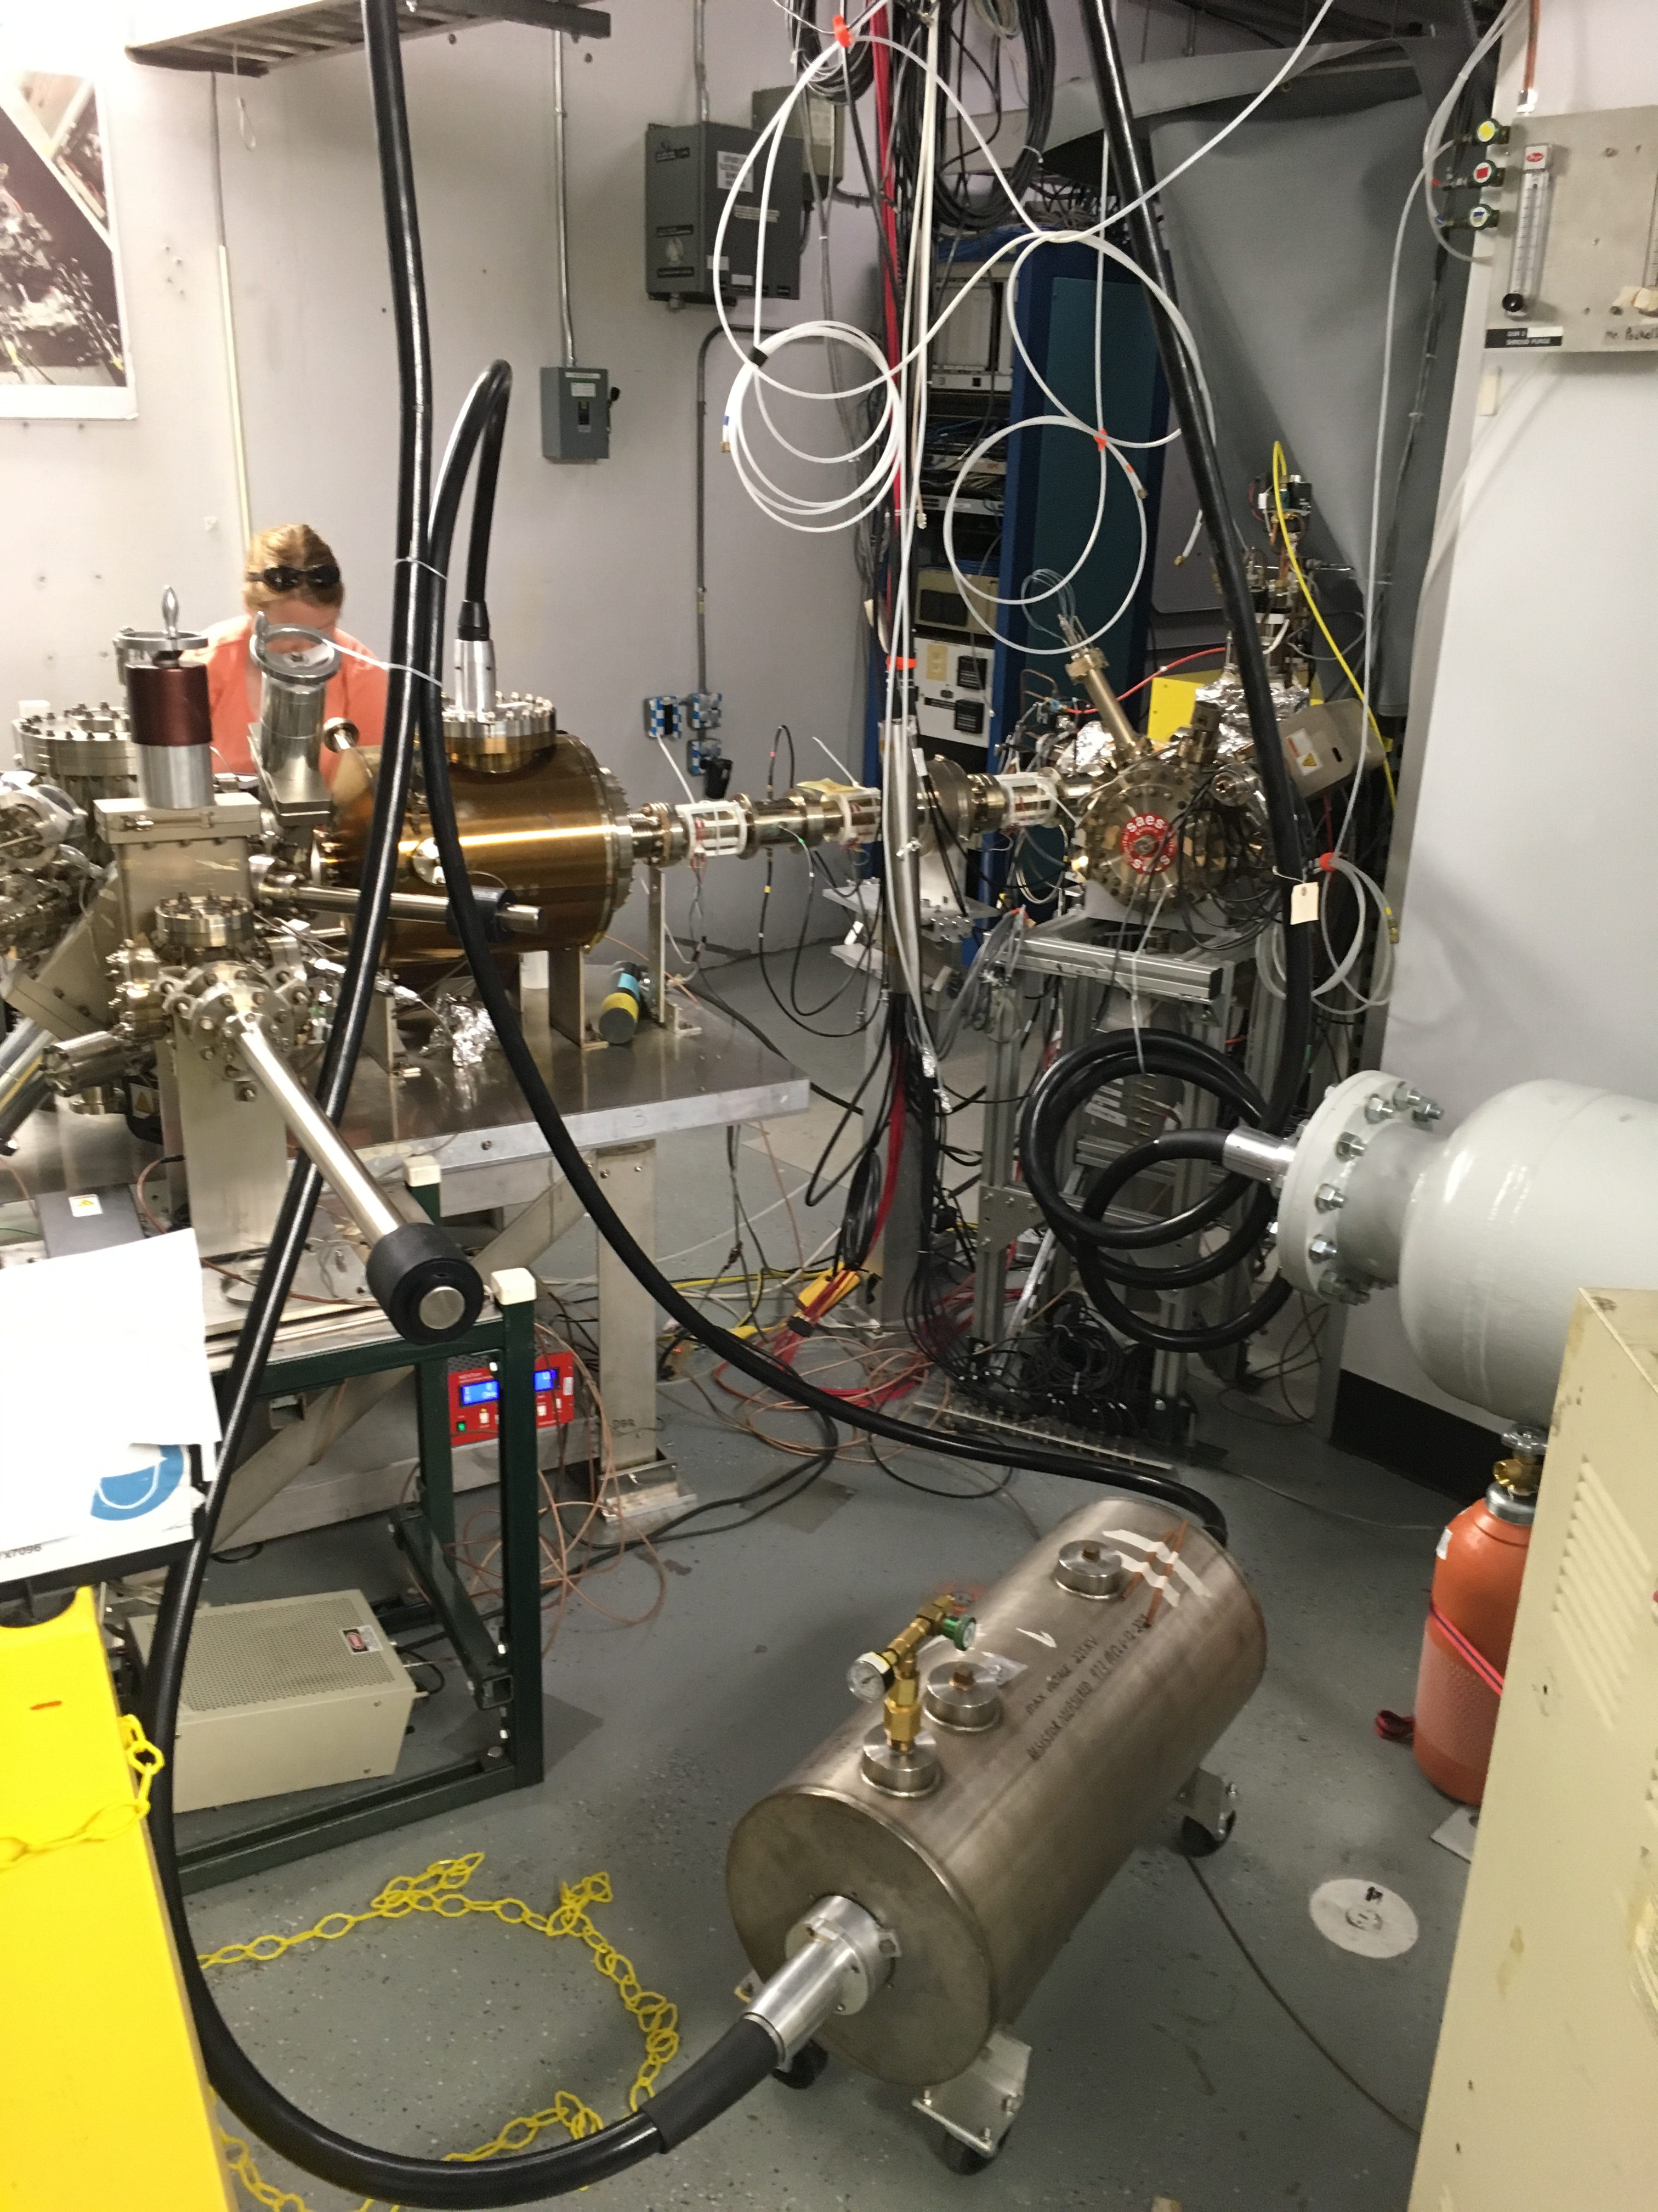
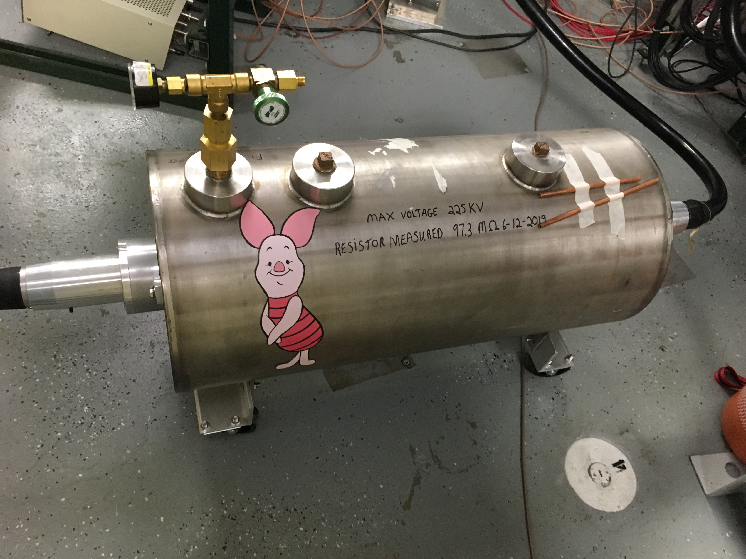
Two tanks were made, both arced over along the plug at 250kV. This was used in CEBAF, the other one is in the GTS

