Slide 1
UITF Project Status Meeting
Matt Poelker
July 31, 2015

Slide 2
Outline
Purpose: to inform Lab Leadership of the UITF status
Action Items (from previous meetings)
Project Update
Progress Update
Milestones Update
Budget Update
Highlights & Concerns
Next meeting agenda
Notes:
RW=Roy Whitney

Slide 3
Action Items – From May 13, 2015 Minutes
R. Sprouse: confirm the UITF enclosure finish date – Nov 2015 or Feb 2016
M. Logue: consult with Vashek on the shape of the labrynth (U-shape vs 2 hall). It is felt that 2 bounces are achieved through the current configuration. Done
M. Poelker/W. Oren: determine if the 18 FTEs requested to complete the work are prioritized correctly – is a squeeze play possible? What does “squeeze play” mean?
M. Poelker: provide a summarized level spreadsheet comparing Areti’s original estimate with the current estimate, noting the differences. Done
M. Poelker: request B. May confirm safety tasks associated with the Aug 2016 finish date. We have a list, Hari to work on it
M. Poelker/W. Akers: create a detailed schedule with milestones that can be updated during each meeting Pass 1 complete, Detailed schedule In progress
M. Poelker: get Vashek’s approval of > 100 nA now. Yes, good plan for 100uA
M. Poelker/R. Sprouse: determine disposition of the concrete walls being removed Done
L. Wells: setup regular meetings for updates on the project progress – monthly or every 6 weeks
All: provide names to attend the update meetings briefing the UITF progress
Accelerator: TBD, Engineering: TBD, Physics: TBD, Facilities: R. Yasky, EHS&Q: TBD
Notes:
RW=Roy Whitney

Slide 4
Highlights
Major components
Facilities
Engineering
Mech Design
Cryo
Safety Systems
I&C
DC Power
Low Level RF systems
High Power RF
Survey & Alignment
SRF
Commission with RF
Operations
Network and communications

Slide 5
Highlights
Major components
Source Group
Reliable 350kV ops
Beam to cup in front of ¼ cm
Beam to cup in front of HDIce
EHSQ
Shielding approval
Global hazard review
FSAD
Accel Readiness Review
Commissioning Plan
HDIce
Installation at Cave
Beam on HDIce

Slide 6
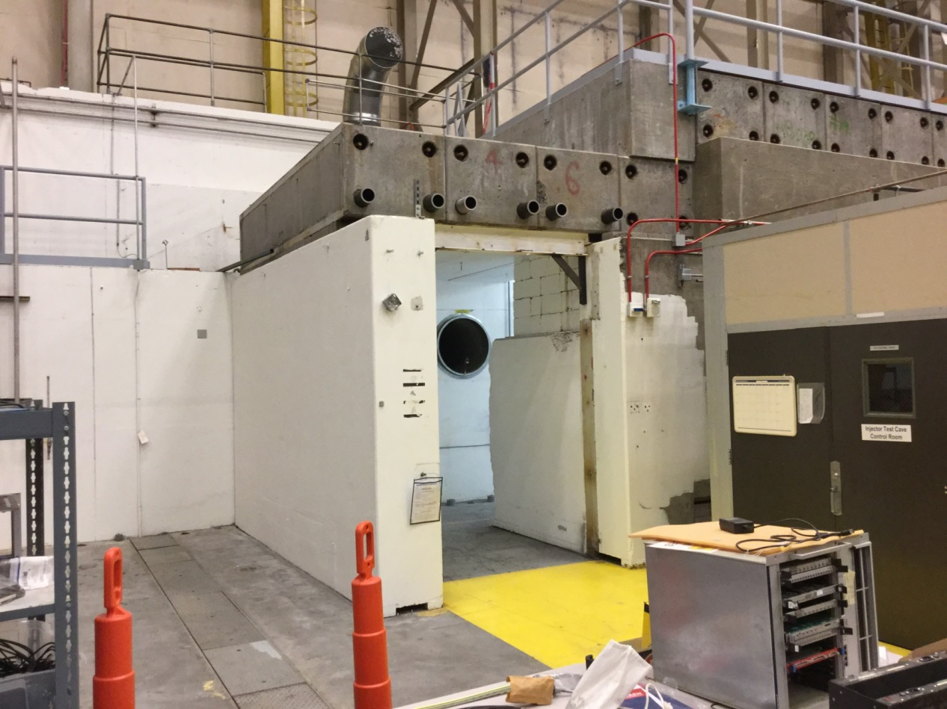
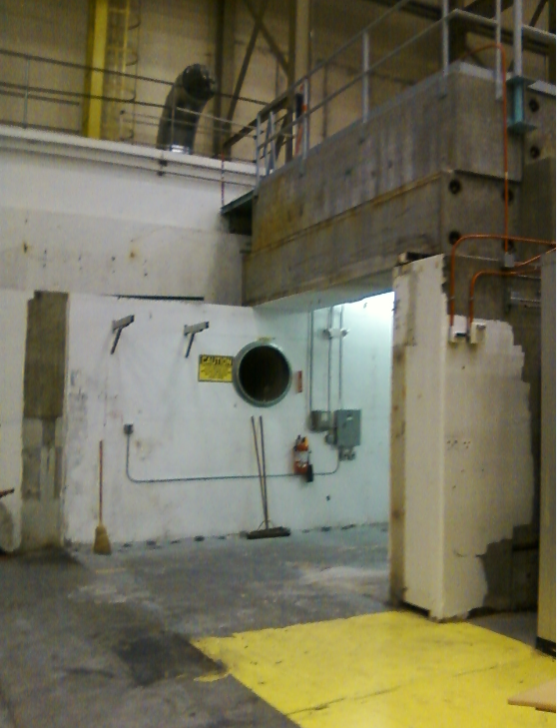
Concrete demolition complete
Stairs are next (complete in FY15)
Bi-weekly meetings scheduled

Slide 7
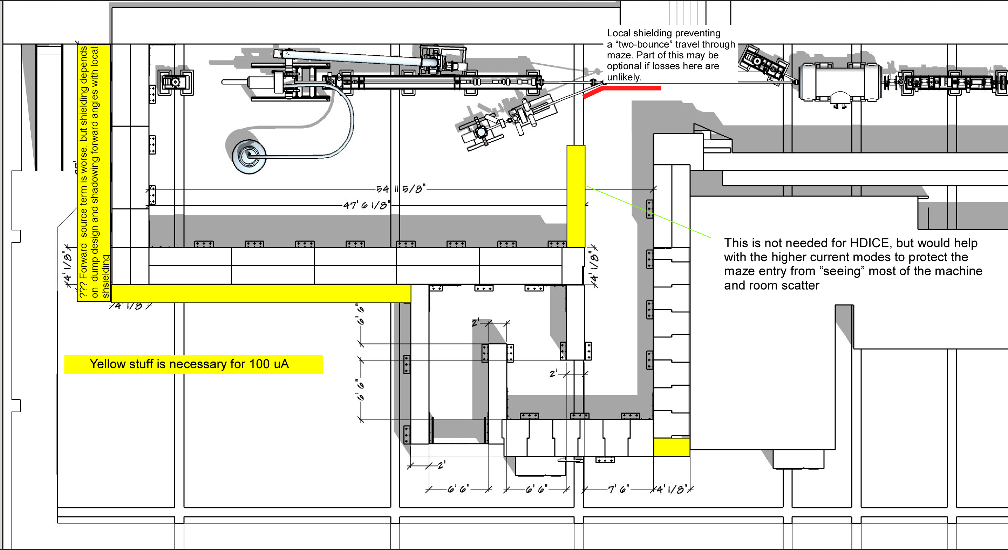
Approved Labyrinth and plan for 100uA
Plus: augment ceiling shielding, and be generous with local shielding of dumps

Slide 8
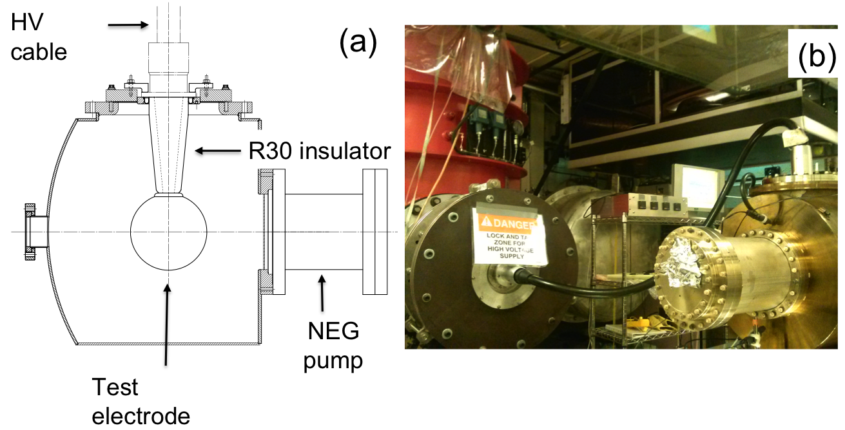
Building the 350 kV Gun
Start with “dummy” electrodes and test different insulators and cathode screening electrode
Notes:
Interior Page Design 2

Slide 9
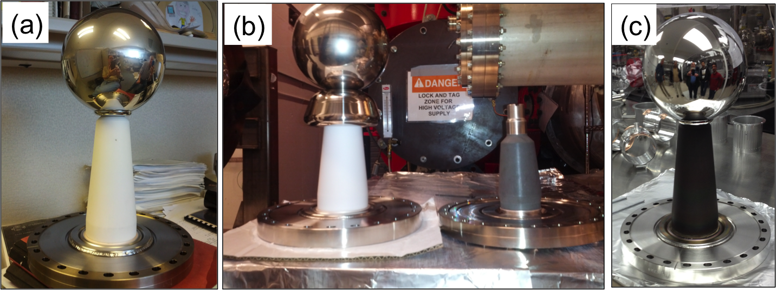
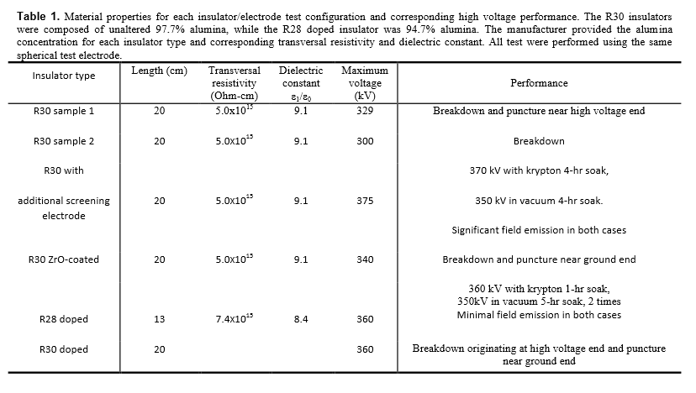
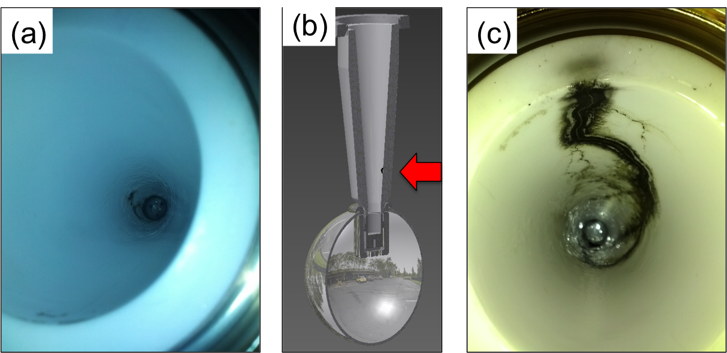
Notes:
Interior Page Design 2

Slide 11
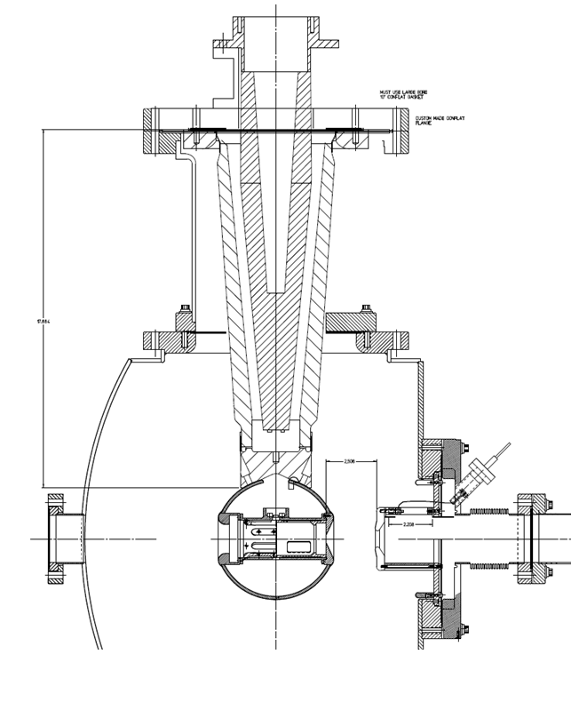
Danny Machie helping with design modifications
Combination of doped insulator and shed, SF6 and epoxy receptacle, and added length
Carlos is back, will model the “shed” , specify the cathode electrode shape
The large doped insulators are “free”, purchased by FEL but never used
Bigger gun than expected, but still relatively compact

Slide 12
Today’s layout, ready to cut metal…..
Design by Shaun Gregory
Cryo lines hug the wall, waveguides on same side as cryo lines
Heat exchanger added to the mix, Rao says this will make things more efficient and stable

Slide 13
Cryo lines compatible with old and new ¼ CM…
Looks similar to our “upgrade injector” front end

Slide 14
EHS&Q related tasks (from Bob May)
Global hazard review (can be documented in FSAD)
Radiation source term, shielding design, assessment, approval, installation
Final ODH assessment, with Cryo?
Standard industrial hazards (electrical, fall protection, emergency egress, magnetic and RF field exposure, etc.)
FSAD update (Rev 8) incorporating hazards assessment and mitigations
ASE development and submittal (Rev 8) for TJSO approval
Commissioning Plan Development
(Internal or External?) Review of Commissioning Plan (CP)
Operations plan/procedure development (related to Accelerator Operations Directives? Borrow from and scale down LERF procedures?)
Decision about type of ARR and who participates – external/internal/combo
Accelerator Readiness Review Plan Review (can be done with CP Review)
Work with SSG to implement PSS, RCD to implement CARMS
Conduct Hot Checkout (test all installed systems – ready for safe/effective ops)
Conduct ARR
Obtain TJSO permission to commission UITF (must include shileding effectiveness check, verification of safety device performance
Commissioning results report
Obtain TJSO permission to operate UITF

Slide 15
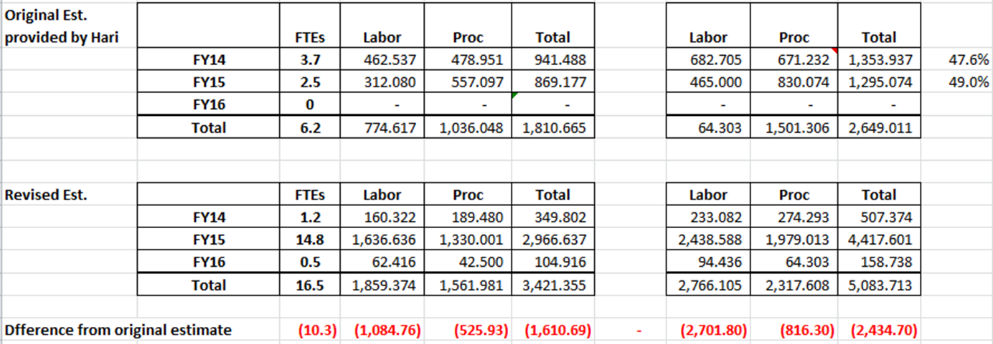
Original vs Current Estimate
Presented at UITF meeting May 13, 2015:
Direct $
Loaded $
Don’t know where we came up with FY14 numbers. I see only 126.4k$ procurement, Matt to meet with Kelly to decipher

Slide 16
Revised Estimates Breakdown
Original request to DOE: $2.6M (loaded)
Current estimate for completion: $5.2 M (loaded)
Delta increase of $2.6M (loaded)
Labor estimates
Underestimated effort by 10.3 FTEs
Increased labor by $1.6M (loaded)
Procurements
Underestimated by ~$1.0 (loaded)
Several sub-system components were not included in the original estimate and later determined were necessary to complete the scope

Slide 17
Comparison Procurement Estimates (Direct $)
System | Prev | Now | Delta | Comment
Facilities | 305 | 300 | -5 | (numbers are Proc and Labor)
Safety System | 59 | 46 | -13
RF Systems | 125 | 253 | +128 | rf control boards, klystron PS
Cryogenics | 40 | 91 | +51 | Pipe, heat exchanger
Polarized Source | 255 | 262 | +7 | Gun insulators, beamline parts
I&C | 131 | 220 | +89 | BPMs, viewers, picoammeters
DC Power | 0 | 145 | +145 | Trim cards and parts
Magnets | 58 | 120 | +120 | Additl quads, correctors, dipoles
SRF | 50 | 0 | -50
HDIce | 5 | 0 | -5
Network, IOCs | 0 | 58 | +58
CIS | 0 | 189 | +189 | FY14 actuals (need to check)
Labor | 775 | 1,859 | 1,084 | Revised estimate to the scope
Total | 1,803 | 3,541 | +1,738

Slide 18
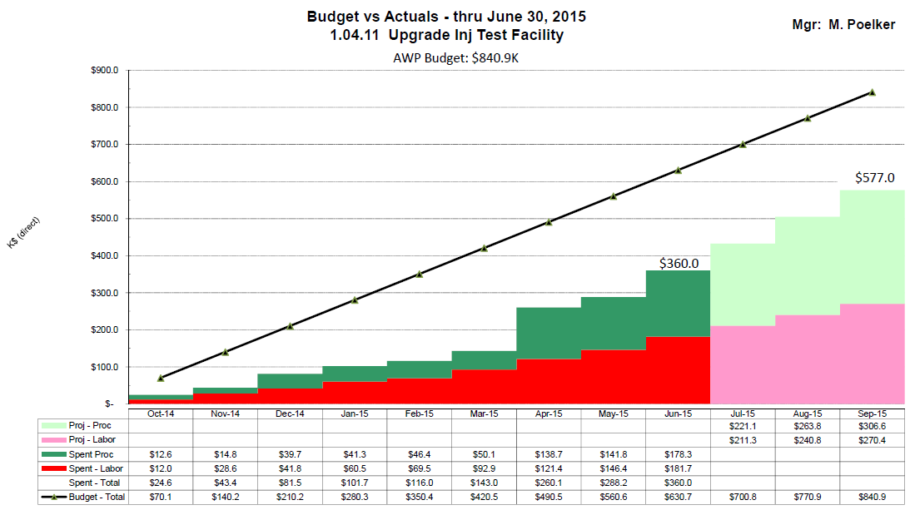
k$ direct

Slide 19
UITF Procurements
UITF Procurements
FY14 |  |  | FY15 |  |  | Addl. expected FY15 procurements
Solid Workds CAD program | 2.2 |  | Insulator flange | 1 |  | contract labor for Mech Designer | ~ 30
450kV HV power supply | 31.1 |  | bpm components | 7.6 |  | stairs | ~ 20
semiconducting R30 insulators | 52.6 |  | semiconducting R30 insulators_v2 | 22.3 |  | trim cards | ~100
gun HV chamber | 7.8 |  | Klystron HV power supply | 55.5 |  | quadrupole magnets (machine shop) | 70 to 130
ion pumps | 15.1 |  | concrete wall removal | 32 |  | rf amplifiers (x2) for chopper | 44
beamline Y chamber | 5 |  | LLRF parts | 15.1 |  | water skid for chopper | 3
photocathode prep chamer | 4.5 |  | steering magnets | 19.3 |  | keV beamline support structure | 6.5
drill penetrations in concrete | 4.2 |  | SF6 tank | 11.3 |  | Addl. FY15 procurement total | 303.5
assorted | 3.9 |  | waveguide | 3.8
total | 126.4 |  | SSG sensor | 1
 |  |  | assorted | 0.8
I need help determining total FY 14 spent
 |  |  | total | 168.7
Kelly says:
160 labor |  |  | (total labor plus procurements spent so far in FY15 ~ 360k$)
189 procurement
350 total spent FY14, ?

Slide 20
FY16 Procurements?
What remains to buy in FY16
 | ~ required | spent in FY15 | To purchase in FY16
Facilities: | 300 | 56.2 | 243.8 | (this includes labor, I don’t have break down of labor and proc.)
Cryo | 90.8 |  |  | waiting for update
RF | 252.5 | 121.4 | 131.1
Gun | 192.1 | 41.1 | 151
I&C | 219.5 | 7.6 | 211.9 | Kevin Jordan has idea to save money…use FEL technology
SSG | 45.7 | 1 | 44.7
DC power | 144.5 |  |  | pushing for them to buy trim cards, ~ 100k$
Magnets | 120 | 119.3 | 0.7 | shop to make quads, assumed 100k$, but don't know final cost
 |  |  |  | And still need three dipoles
Network | 58 | 0 | 58
Total |  |  | 841.2

Slide 21
Milestones Update
WBS | Item | Milestone Description | Start Date | Projected Finish | % Complete | Days Float? | Change (%) | Change (Days)
1.04.xxx | Facilities | Civil work complete | 6-4-15 | Feb 2016 | 10%
 | Gun | Demonstrate gun ok at 350 kW at FEL GTS |  | Dec 2015 | 80%
 | CM | Commission cold ¼ CM, no beam |  | Jan 2016 | 10%
 |  | Beam from Gun to Cup in front of ¼ CM |  | Mar 2016 | 10%
 |  | Beam thru ¼ @ MeV energy delivered to cup in front of HDIce |  | Jun 2016 | 0
 |  | Beam to HDIce |  | Aug 2016 | 0

Slide 22
Schedule Ramifications
Current status:
Close to having working 350kV gun
Nice progress on “stretch” goals: RF, magnets, bpms
keV beamline design GOOD, start building it
Next month activities
Stairs, work with FM on next set of projects (HVAC, LCW, new concrete walls Cave2 and braces)
Electronics racks, populate them
Order keV beamline girder
Finish Plan Z gun design, make parts
Fan and feed: ODH system, cryo lines, trim cards, network and software
Dissatisfaction with my “schedule”, improve it, resource-loaded?

Slide 23
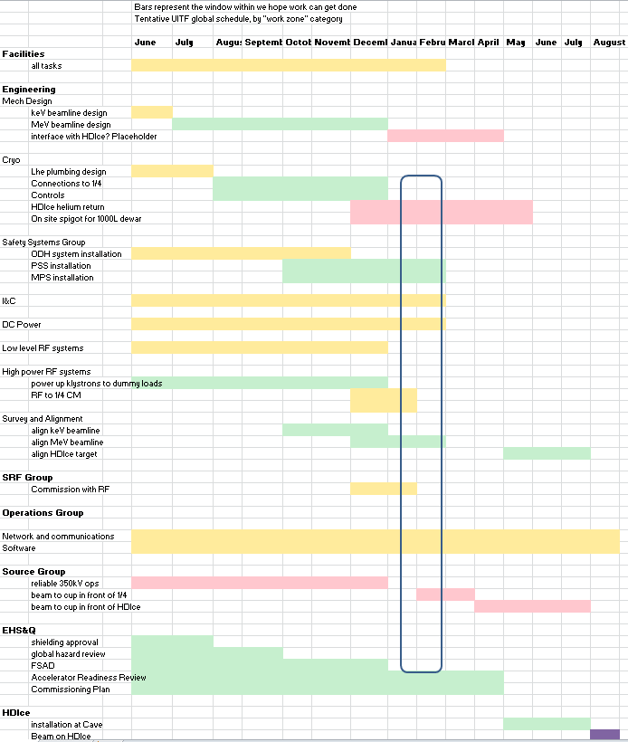

Slide 24
Issues & Concerns
CTF is not big enough to support three LHe Users. How to “park” the ¼ cryomodule?
UITF (4 to 6 wks, 3 times per year)
CMTF and LCLS II
VTA
How long will it take to design MeV beamline?
Do 5 -10 MeV electrons represent authentic beam conditions for HDIce testing? Heat transfer, YES, but what about scattered electrons?
Groups are busy but I continue to be optimistic that work can get done opportunistically within project timeline. Most reservations for Mech Design, Cryo, SSG, and Ops software

Slide 25
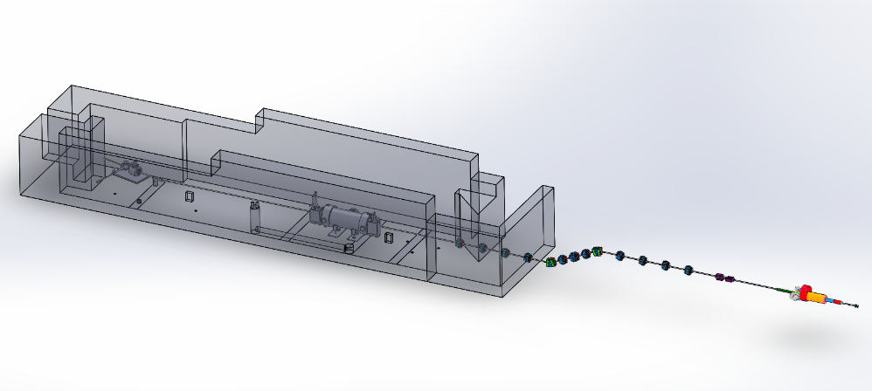
Haven’t started designing the MeV beamline yet…

Slide 26
5 MeV electrons on thin gold foil
12 ns round trip time
499 MHz (2ns)
Gold
0.1 um
Won’t things be worse for HDIce?
Gold
1.0 um
Gold
10 um

Slide 27
Summary
There is progress, we are moving forward
Progress will become more obvious soon. By October, expect to see some beamline, with ¼ CM inside the cave, electronics racks above the cave….
Hope the Lab can continue funding at ~ FY15 level
We are being responsible with money and we are respectful of other JLab work priorities…

