Slide 1
Upgraded Injector Test Facility
The recent highlights:
Working a solution for North Wall Shielding and other shielding deficiencies
The warm RF group finished the high power RF system! Very nice
Commissioned the buncher and solid state amp, nice!
HV conditioning the photogun, in progress
Finished the MeV beamline songsheet, good progress building MeV beamline
Have a reasonable draft of the AOD, which is big part of the COO….
Cooled the QCM to 2K but missed the window of opportunity to commission with RF
The HDIce target solenoid quenched, need to pull out IBC for repairs
Submitted draft report to Stuart summarizing “Uses of UITF” meeting from 12 Dec., 2018

Slide 2
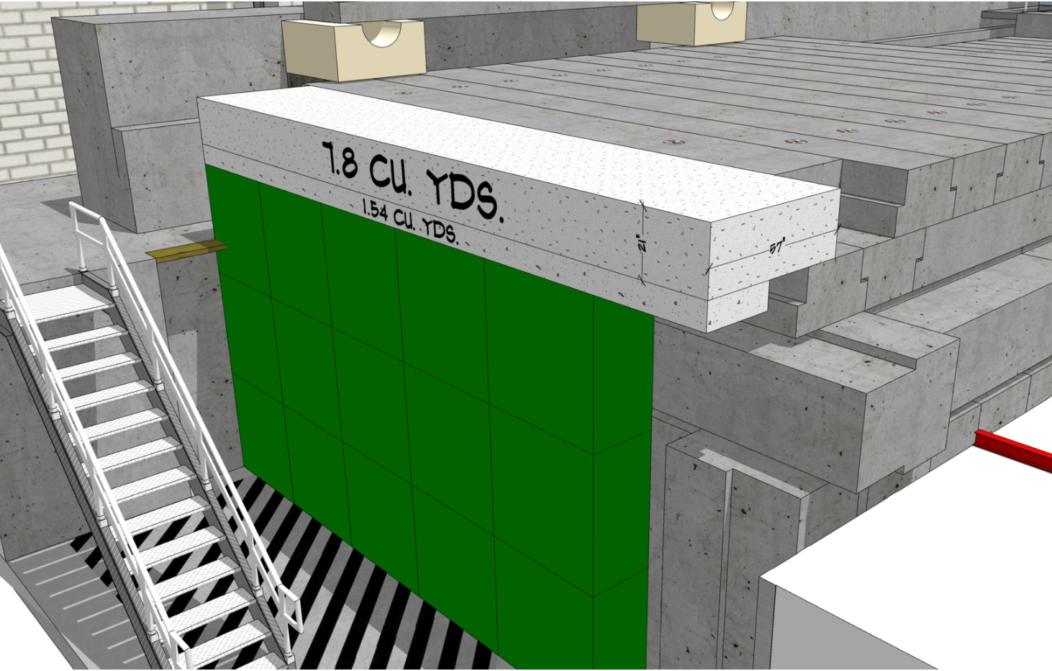
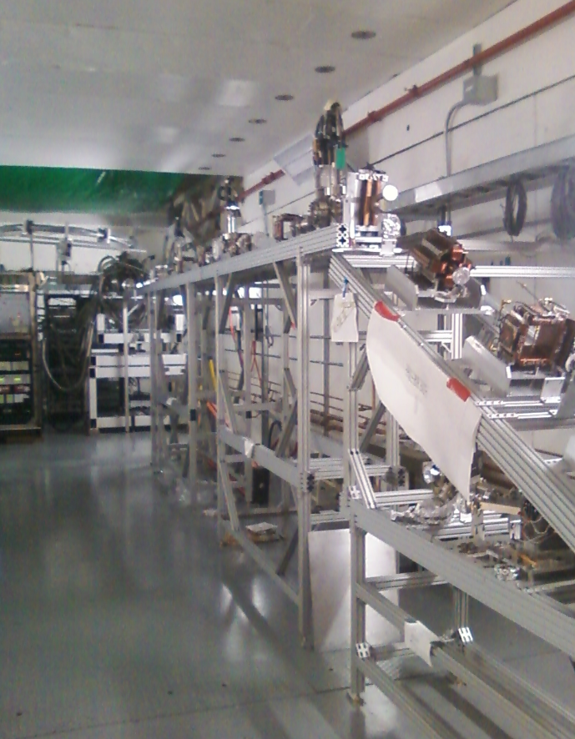
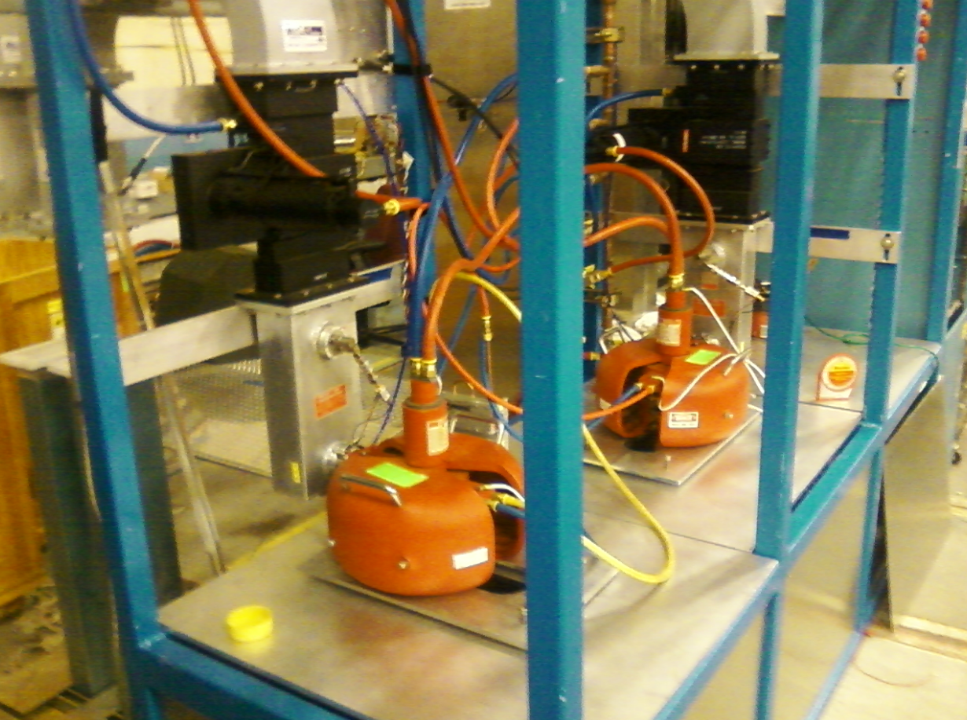
Upgraded Injector Test Facility
thanks Walt Akers

Slide 3
UITF Meeting with Patrizia R., June 15, 2018
Tasks before running beam to HDIce for target commissioning
Mechanical design, full time for next ~ 2 months, then intermittently (i.e., Shaun Gregory and company)
Installation group to help secure HDIce target support structure
Suggest we use the Vacuum Group to build the MeV beamline (my group can help)
Cryo: install the helium return line, or be content to vent the helium to the test lab
SRF, need a point of contact for all things related to QCM operation
Electrical engineering and SSG: design and build the PSS BCM, our "credited control" to limit beam current/loss and prevent accidental exposure to x-rays
Electrical engineering: stripline BPMs, get them to work
Magnet group: build a third trim-card rack
Cable-up the MeV beamline: valves, viewers, magnets, BPMs, harps, water flow meters, current monitors, ….
RF group: commission the buncher with solid state amp, finish klystrons and high power amplifier, water skids
SSG needs to incorporate high power RF interlocks into PSS, recertify. BLMs. Add PSS BCM to circuitry
Vashek: finish specifying the shielding requirements, then we start moving lead and sand (open CATS item)
RCG to install all CARMs and electronics
R&D related to low current BPMs, suggest Andy take this on, with help from Engineering
Operations Group should augment Joe's modeling, using a particle tracking code (to support commissioning of QCM)
Safety and Approvals: OSP for buncher, OSP for MeV beam, PSS BCM credited control documentation, UITF Accelerator Operations Directive, Conduct of Operations, Accelerator Readiness review (i.e., lots of documents, lots of reviews)
Gun group needs to build a new photogun, improve the Wien filter, test polarimeters
Need to operate the UITF on a daily basis.....students, Operators, Staff Scientist1 (critical hire list)
Need access to liquid helium for weeks-long periods of time (i.e., competition with LCLS)
This list is getting shorter!

Slide 4
Tasks before running beam to HDIce for target commissioning
Mechanical design (Shaun Gregory and Keith Harding), assist with MeV beamline construction, design HDIce related components (dump, catwalk)
Installation group: LCW and compressed air, ceiling tile removal/installation
Electrical engineering and SSG: design and build the PSS BCM, our "credited control" to limit beam current/loss and prevent accidental exposure to x-rays
Magnet group: build a third trim-card rack
Cable-up the MeV beamline: valves, interlocks, viewers, magnets, BPMs, harps, water flow meters, current monitors, ….
SSG needs to incorporate high power RF interlocks into PSS, recertify. BLMs. Add PSS BCM to circuitry
Operations Software group: more screens, MPS system, UED, etc.,
RadConGroup: finish specifying the shielding requirements, install all CARMs and electronics
Facilities to help implement shielding solutions: purchase concrete, steel support structure, re-route electrical conduit
Safety and Approvals: OSP for MeV beam, PSS BCM credited control documentation, SCMB review, UITF Accelerator Operations Directive/Conduct of Operations, Accelerator Readiness review
Poelker meeting with SCMB on Wednesday January 16, 2019
Gun Group: finish the MeV beamline, vacuum from gun to HDIce target
Gun group: make beam from photogun at 200kV
Need to operate the UITF on a daily basis.....students, gun group and injector group
Work with SRF and Cryo to schedule helium delivery to UITF
Install, operate the raster magnets (C. Cuevas)
Engineering

