Slide 1





Test of Target Materials
Irradiated by 180 MeV Electron Beam at MAMI
Andriy Ushakov^{1,2}, C. Le Galliard¹, Eric Voutier¹,
Joe Grames², Silviu Covrig Dusa², Shukui Zhang²
¹Université Paris-Saclay, CNRS/IN2P3, IJCLab, Orsay;
²Jefferson Lab
December 1, 2022
This project has received funding from the European Union’s Horizon 2020 research and innovation program under grant agreement No 824093; the U.S. Department of Energy, Office of Science, Office of Nuclear Physics under contract DE-AC05-06OR23177; UT-Battelle, LLC, under contract DE-AC05-00OR22725 with the US Department of Energy (DOE).

Slide 2
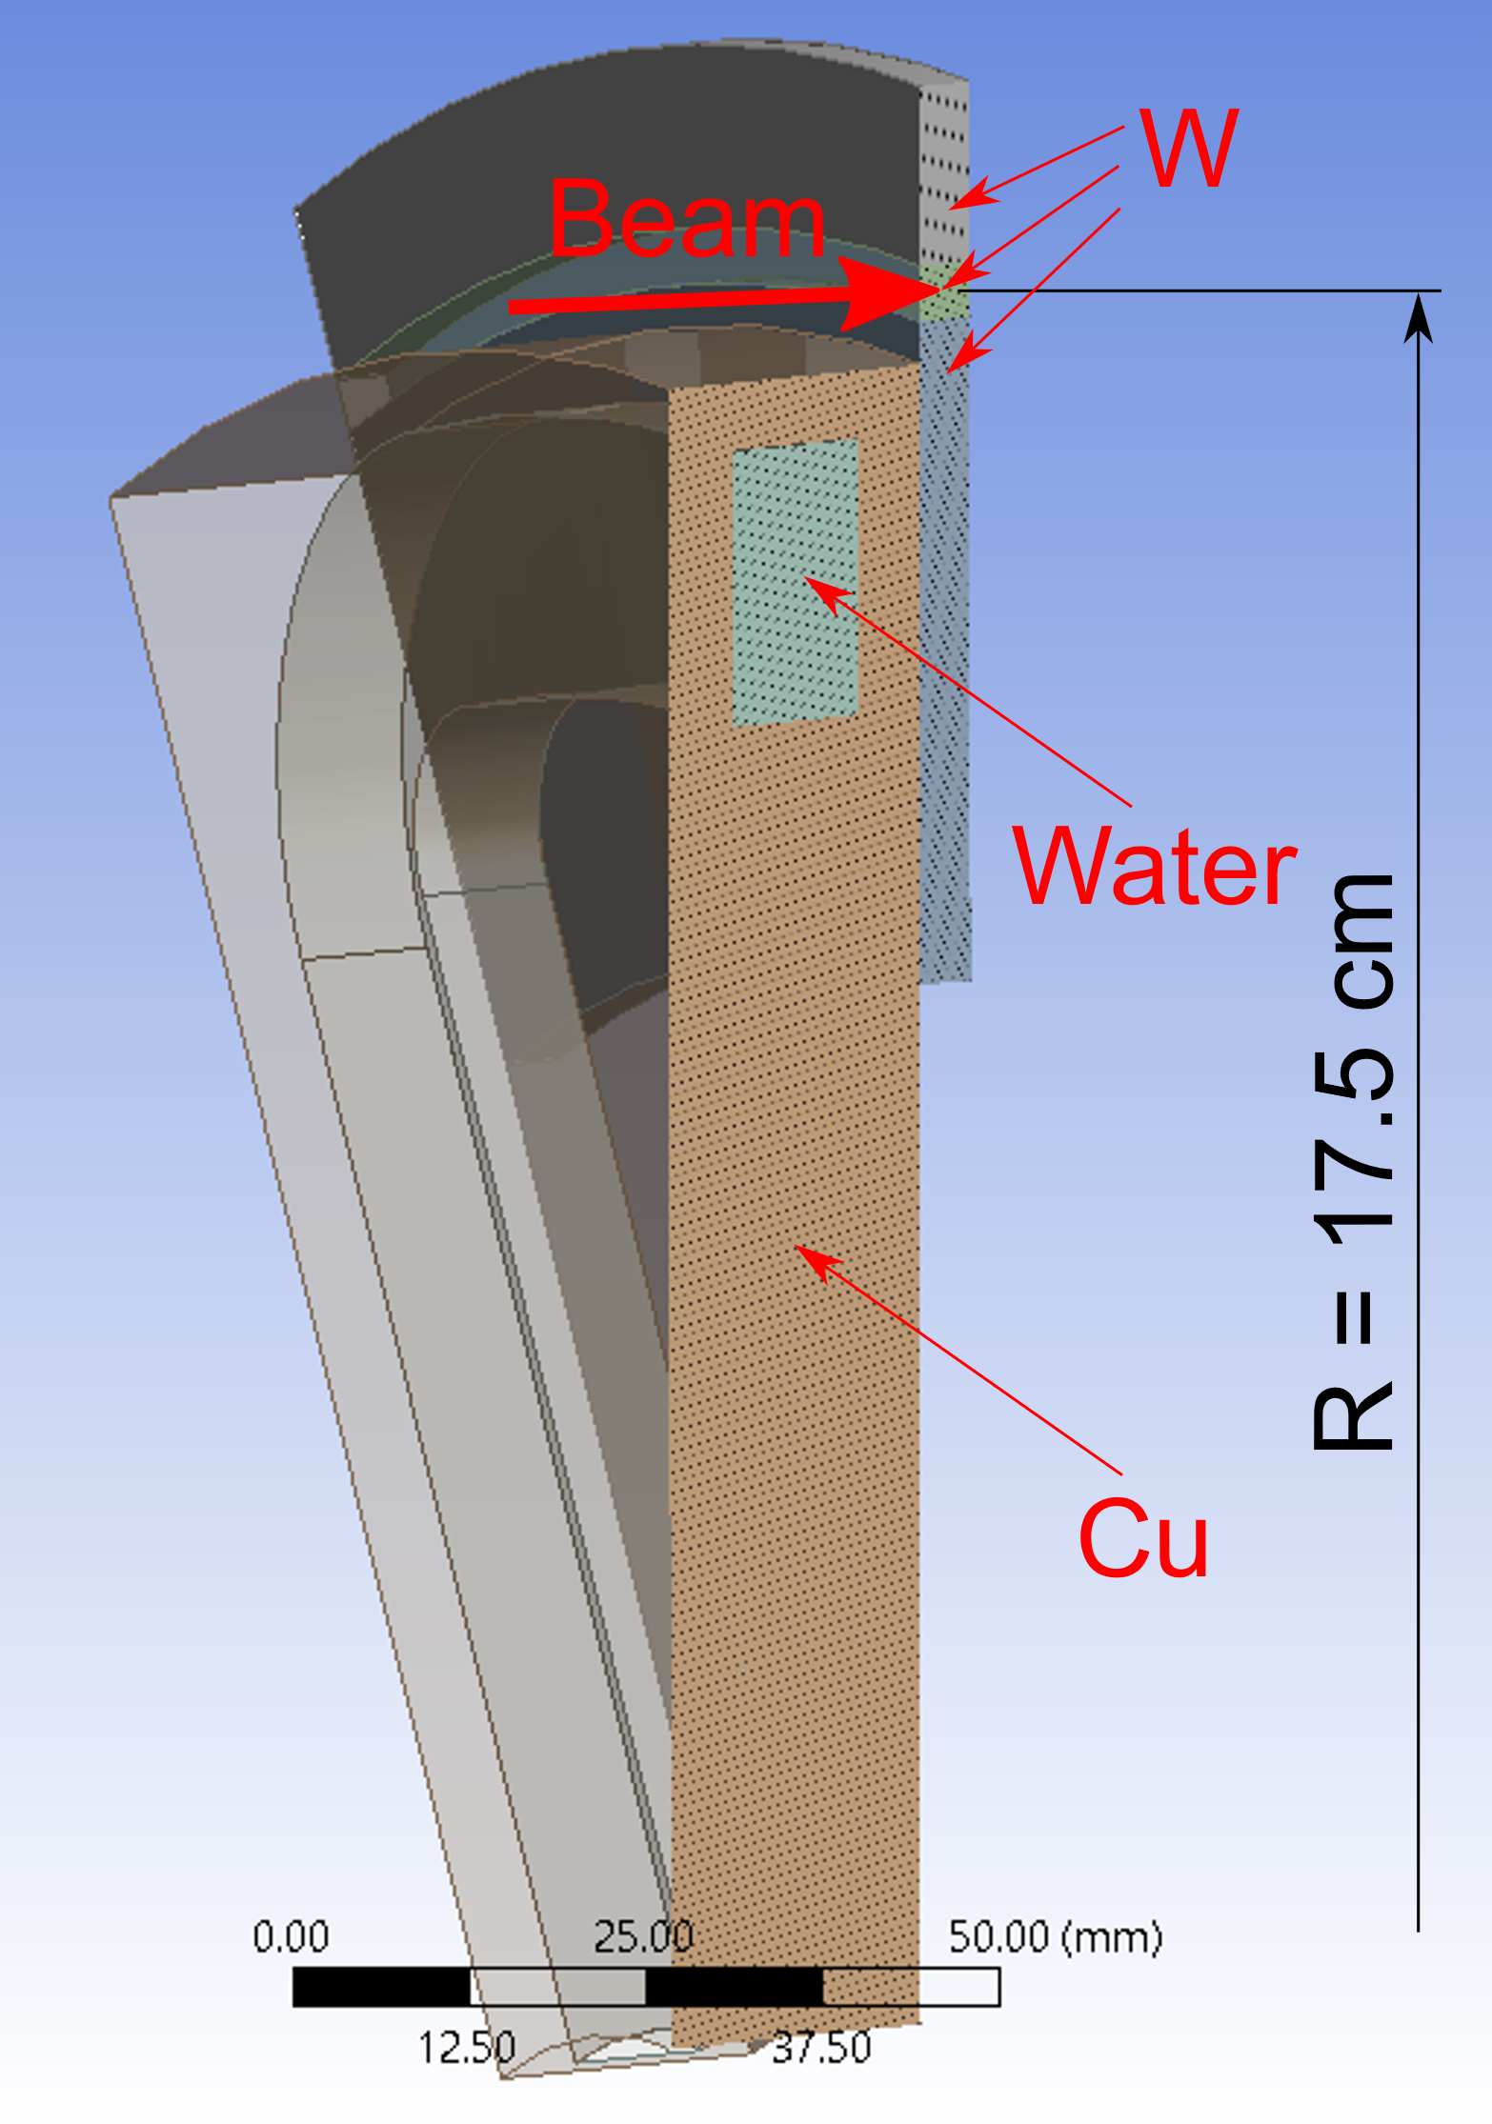
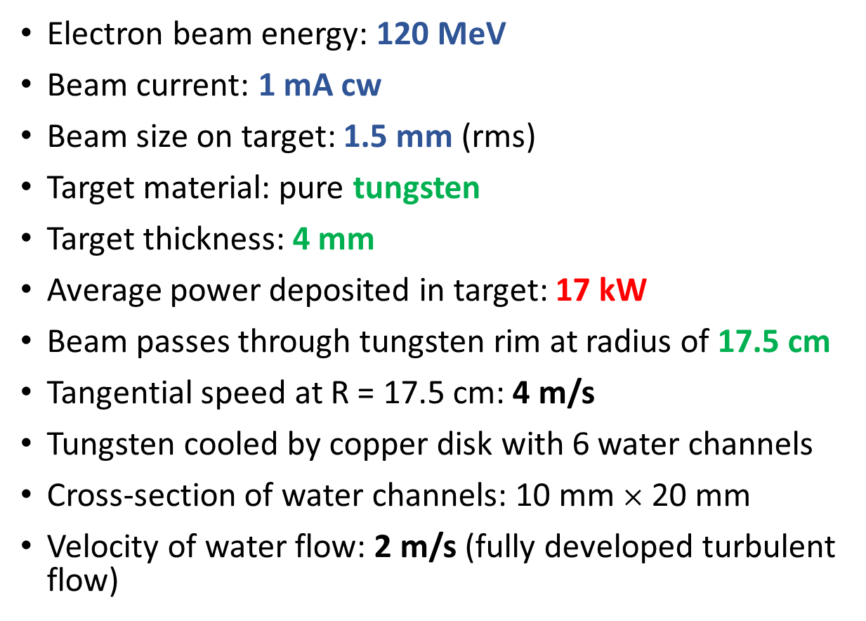
JLab e⁺ Source: e‒ Beam and e⁺ Target
3D View of 60° Target Sector
Cut in the Middle
Electron beam energy: 120 MeV
Beam current: 1 mA cw
Beam size on target: 1.5 mm (rms)
Target material: pure tungsten
Target thickness: 4 mm
Average power deposited in target: 17 kW
Beam passes through tungsten rim at radius of 17.5 cm
Tangential speed at R = 17.5 cm: 4 m/s
Tungsten cooled by copper disk with 6 water channels
Cross-section of water channels: 10 mm $×$ 20 mm
Velocity of water flow: 2 m/s (fully developed turbulent flow)

Slide 3
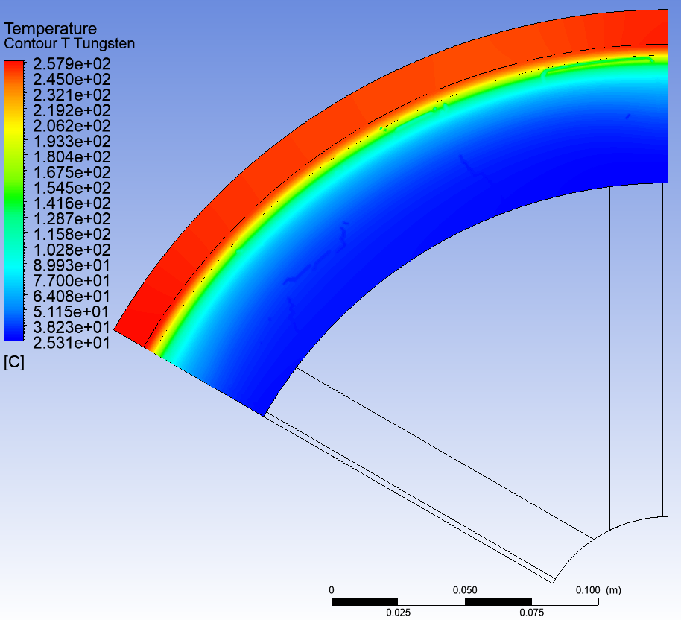
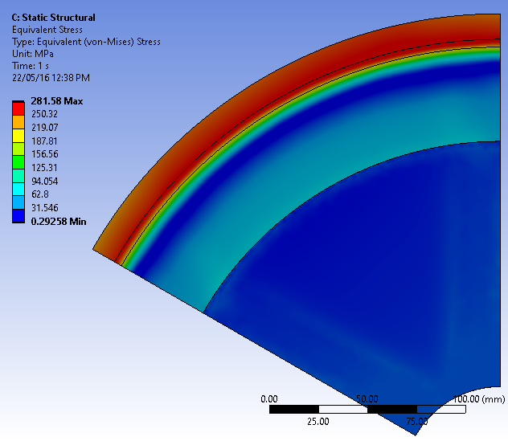
JLab e⁺ Source: Average Temperature and Thermal Stress
Average Temperature of Tungsten
Equivalent von Mises Stress
T_{max} = 258 °C
σ_{vM max} = 282 MPa

Slide 4
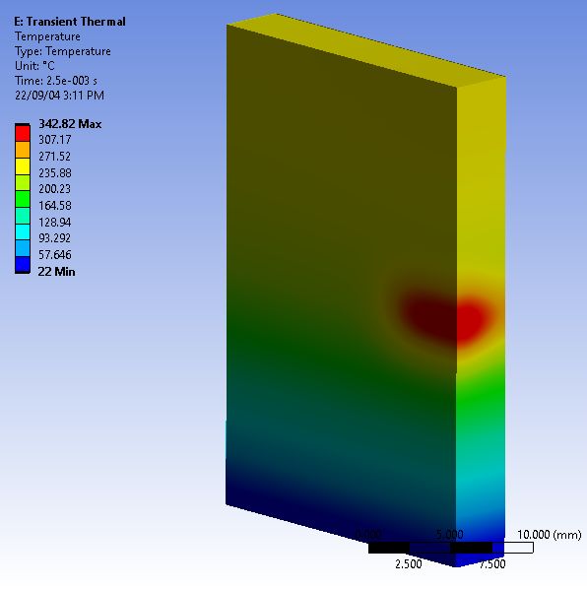
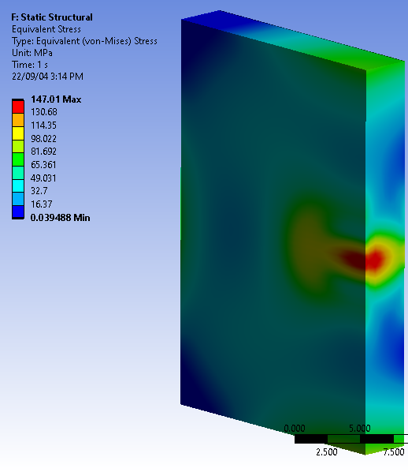
JLab e⁺ Source: Thermal Cycling of a Spinning Target
Thermal Cycle
Temperature and Stress at the End of Heating Phase
Heating Phase
T_{max} ≈ 340°C
σ_{vM max} ≈ 150 MPa
+ 280 MPa due to T_{ave} = 258°C
ΔT_{max} ≈ 120°C
Duration of Heating ≈
2.5 ms
Period of Cycles =
275 ms

Slide 5
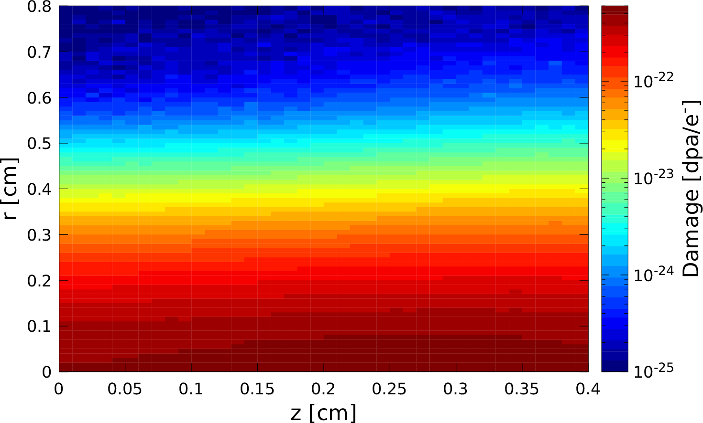
JLab e⁺ Source: Radiation Damage of Tungsten
Radiation Damage per e‒ in Stationary Target
Damage of Rotated Target vs z
Max Damage per e‒ = 5.7· 10 ^{‒22} dpa/e‒
Max Damage per 5000 h = 0.215 dpa

Slide 6
What We Would Like to Test at MAMI
MAMI Beam and Target
Rad. Damage of Tungsten ≈ 0.215 dpa
Tungsten at cycling temperatures expected at JLab e⁺ source:
  Average T ≈ 300 °C
  ΔT_{pulse} ≈ 120 °C
Electron beam energy: 180 MeV
Beam current: 22 μA
Beam size on target: 250 μm (RMS)
Target material: pure Tungsten
Target thickness: 100 μm

Slide 7
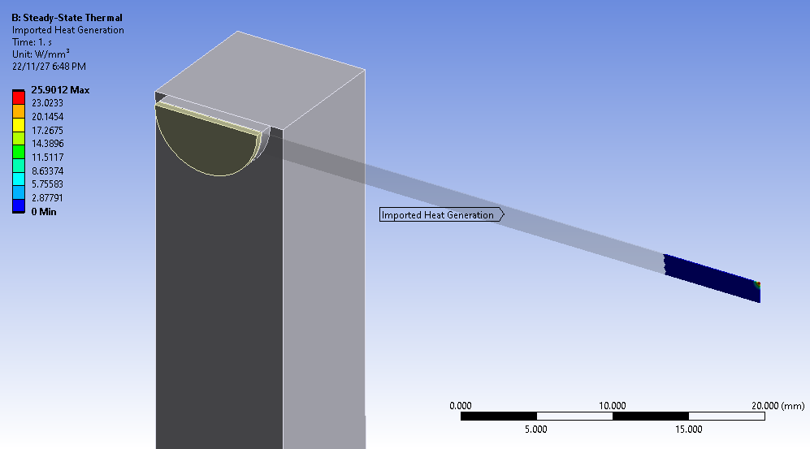
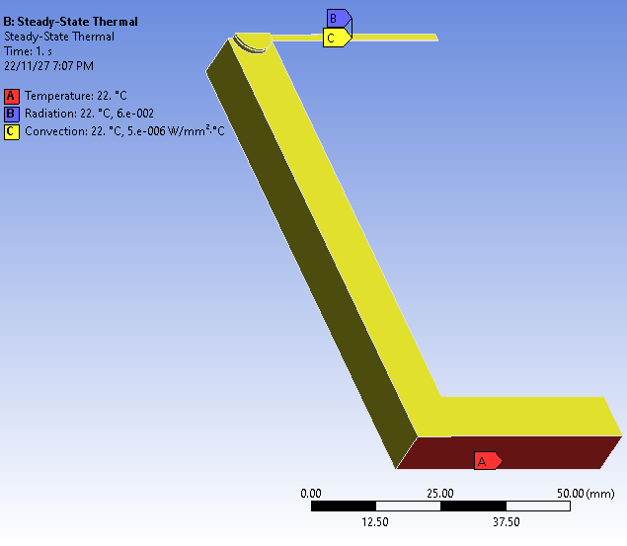
Geometry of W Target and Al Holder
Al₂O₃
3D View of ¼ of Target
Thickness of W target: 100 μm
Length of W target: 80 mm
Width of W target: 3 mm
Thickness of Al₂O₃ ceramic: 1 mm
W
Beam
Al
Temperature,
Radiation and
Convection

Slide 8
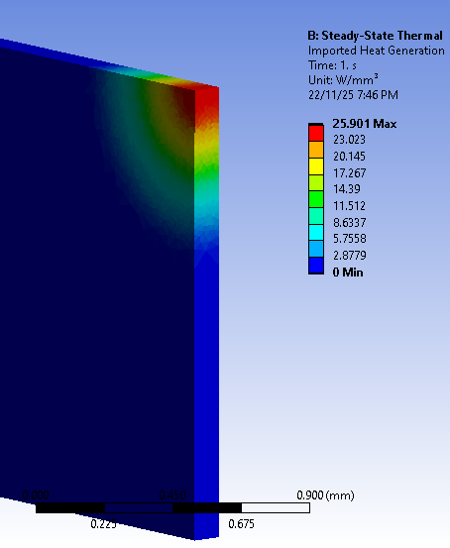
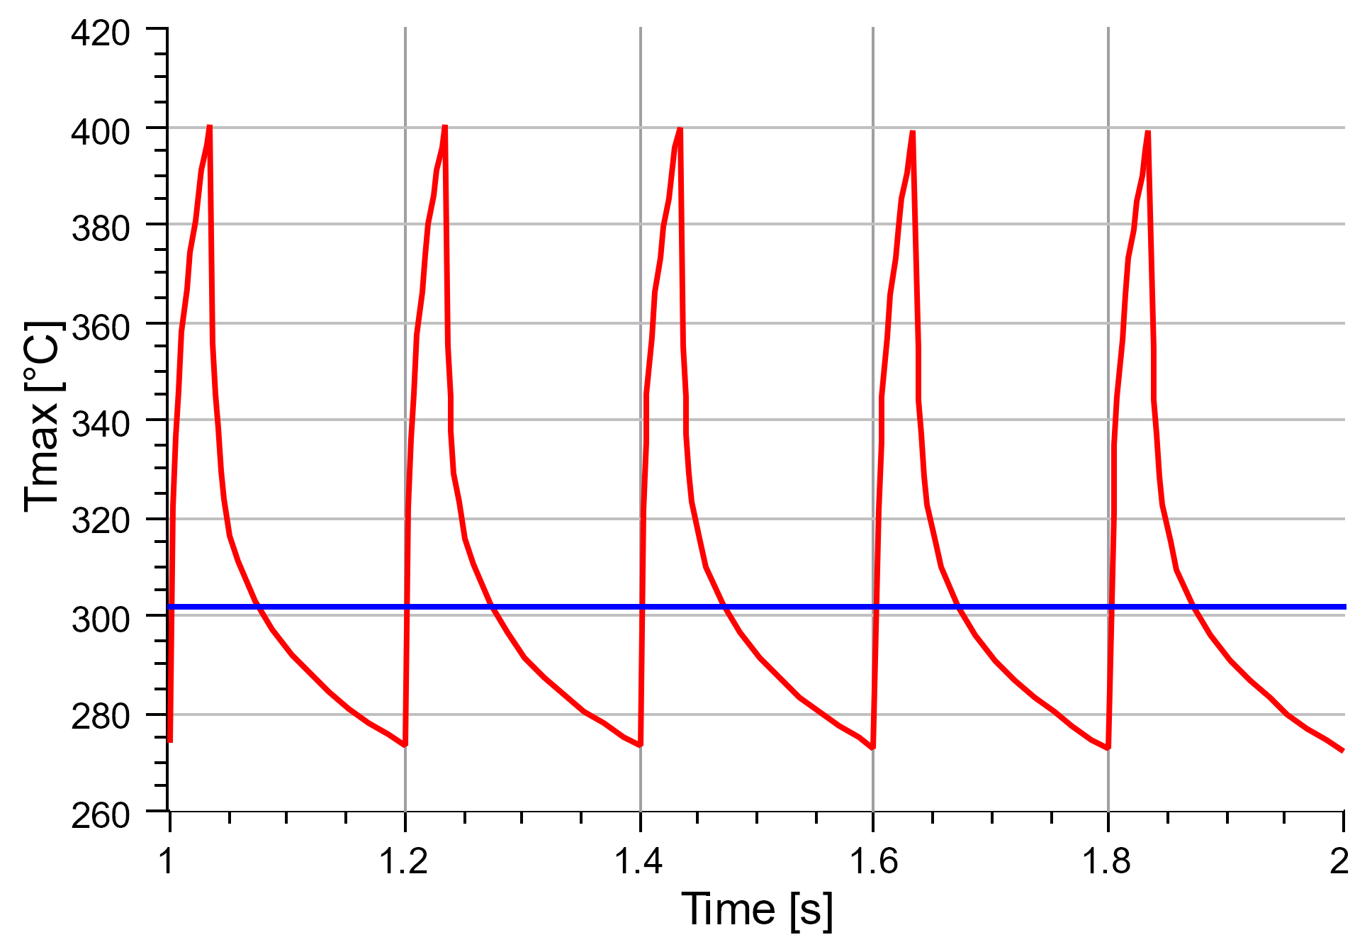
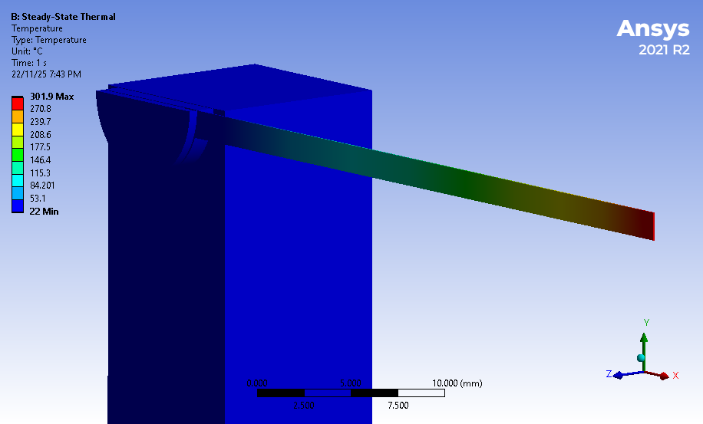
Power and Temperature for Duty Cycles of 0.17
Average P = 25.9 W/mm³
Cycling Temperature for
Pulse length = 34 ms, Pulse Period = 200 ms
Average Temperature
P_{pulse} = 152 W/mm³
T_{ave} = 302 °C
ΔT = 125 °C

Slide 9
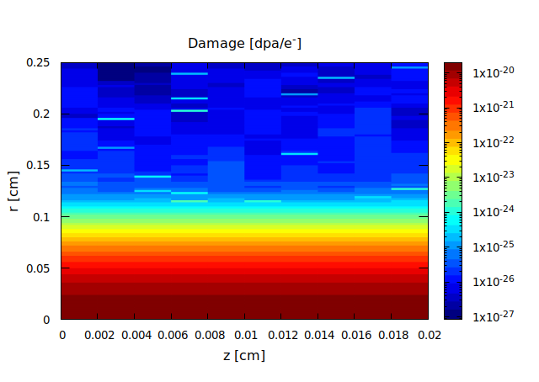
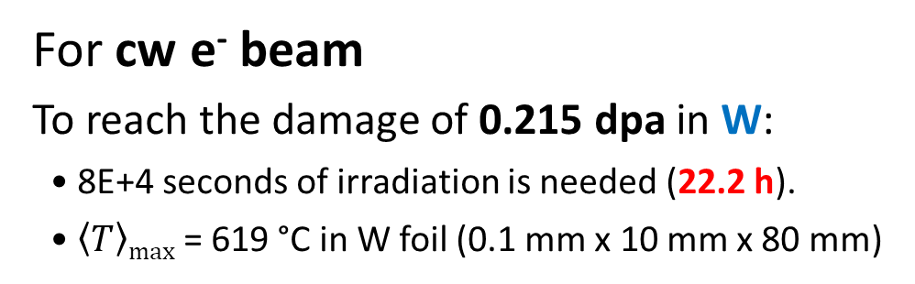
Radiation Damage by 22 μA @ 180 MeV e- beam with 250 μm RMS spot size
22 μA → 1.375E+14 e⁻/s
Tungsten
For cw e⁻ beam
To reach the damage of 0.215 dpa in W:
• 8E+4 seconds of irradiation is needed (22.2 h).
• $\left\langle T\right\rangle max$ = 619 °C in W foil (0.1 mm x 10 mm x 80 mm)
Material | Displacement Threshold Energy [eV] | Rad. Damage [dpa/e⁻]
Ta | 90 | 1.94E-20
W | 90 | 1.96E-20
Re | 60 | 3.37E-20
Cu | 30
W40Cu |  | 5.27E-20
Rad. Damage of W per e⁻ = 1.96E-20 dpa/e⁻

Slide 10
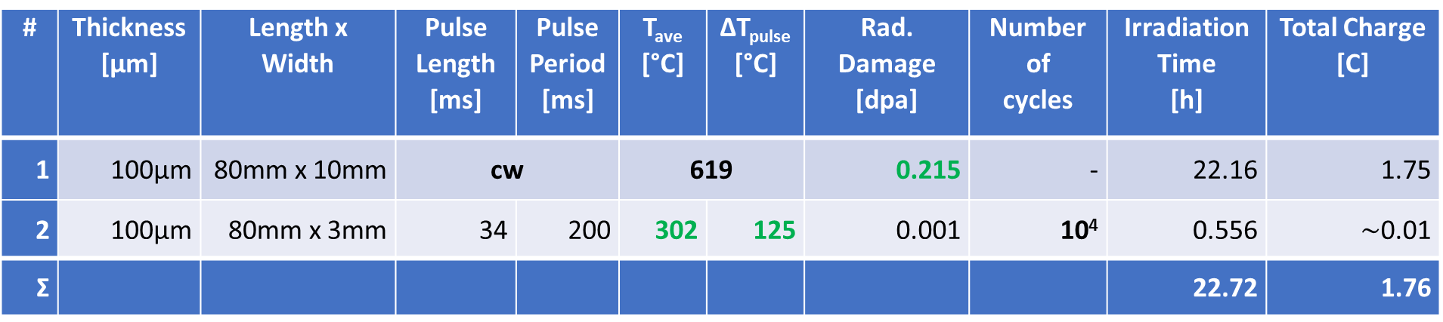
Plan of Irradiation Test of W Targets
# | Thickness [μm] | Length x Width | Pulse Length [ms] | Pulse Period [ms] | T_{ave} [°C] | ΔT_{pulse} [°C] | Rad. Damage [dpa] | Number of cycles | Irradiation Time [h] | Total Charge [C]
1 | 100μm | 80mm x 10mm | cw |  | 619 |  | 0.215 | - | 22.16 | 1.75
2 | 100μm | 80mm x 3mm | 34 | 200 | 302 | 125 | 0.001 | 10⁴ | 0.556 | $\sim$0.01
Ʃ |  |  |  |  |  |  |  |  | 22.72 | 1.76
Target #1: test of radiation damage
Target #2: test 10k thermal cycles with expected temperatures at JLab e⁺ target

Slide 11
Test at MAMI (180 MeV e-)
Test at JLab (Laser)
To test the radiation damage of target materials at moderate elevated average temperatures (0.215 dpa at 300 °C for W)
(If possible) Short tests of cycling temperature expected at JLab e⁺ injector
To test high peak heat load (PEDD) in a wide temperature range (up to 1000 °C)
To test fatigues limits at different T
Tasks
Define target geometry (thickness and other dimensions), target holder, and required beam time structure.
Simulate radiation damage and calculate target temperatures of different materials (W, Ta, WRe- and WCu- alloys,).
Prepare/buy materials and equipment for the experiments and measure material properties before irradiation
Post-analysis of irradiated materials:
  Surface analysis (cracks) using microscopes
  Changes in a bulk material (crystal structure), thermal and mechanical properties
  Measure radiation damage using X-rays (PETRA, DESY, Hamburg)

Slide 12
Backup Slides

Slide 13
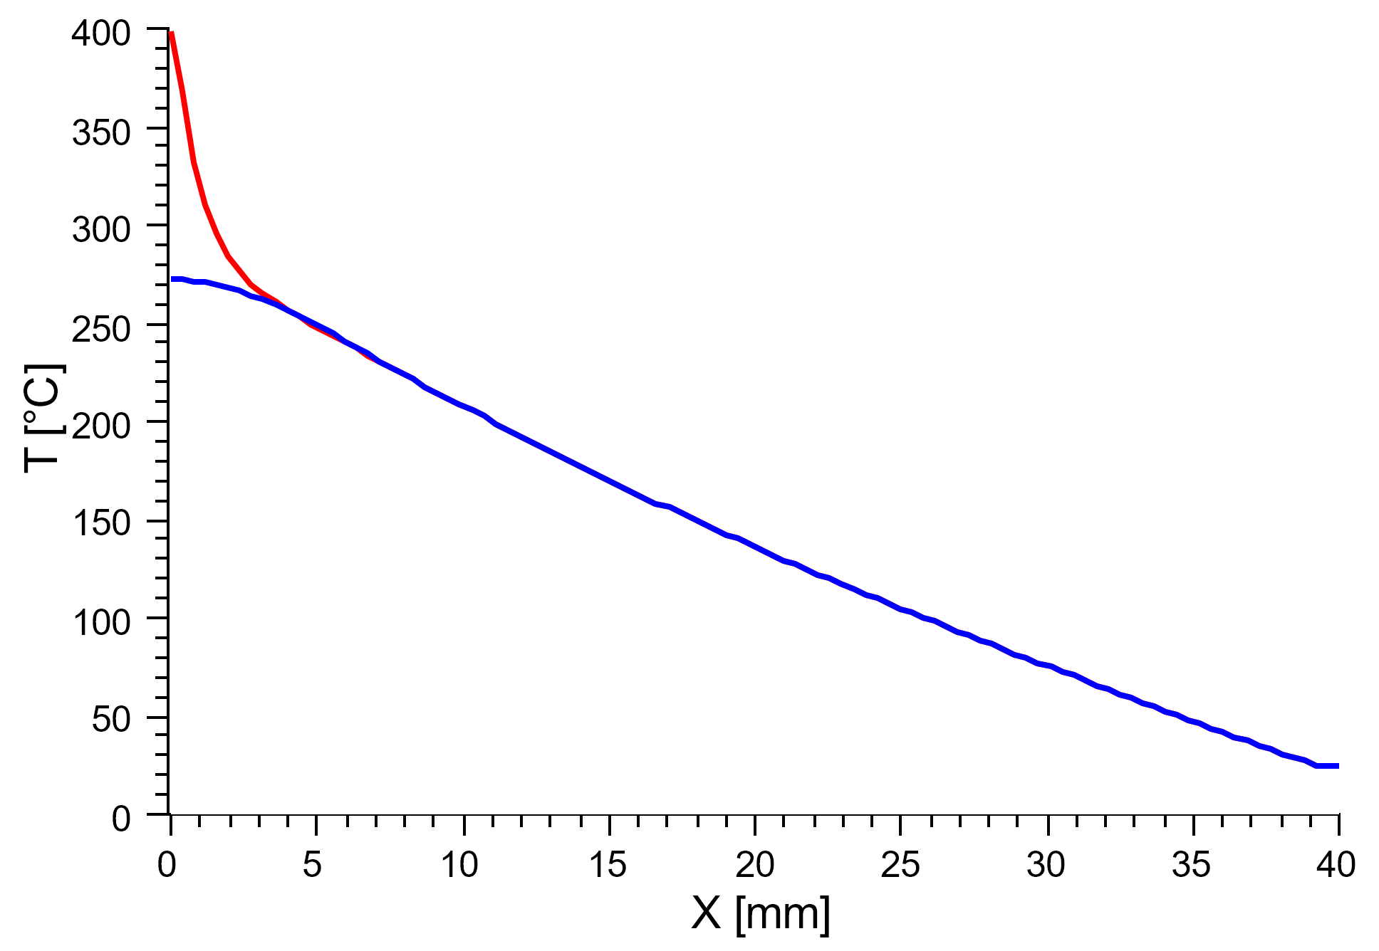
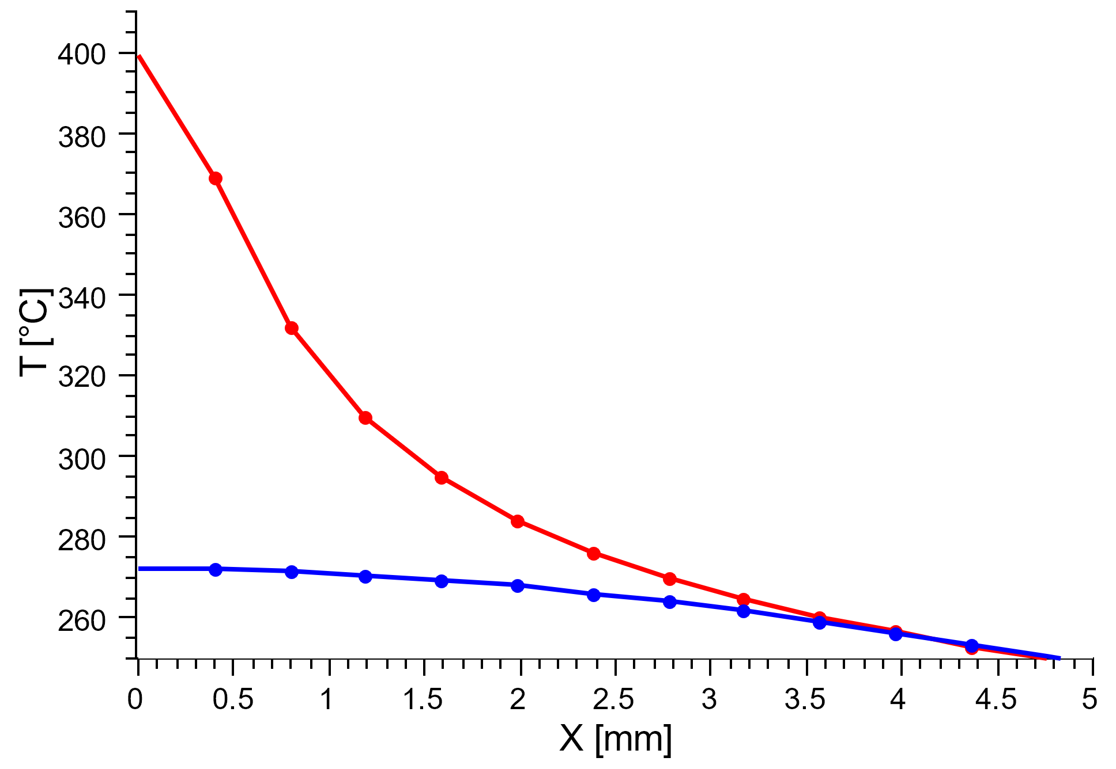
Pulsed MAMI Beam: Temperatures of W foil (0.1mm x 3mm x 80mm)
Pulse Length = 34 ms and Pulse Period = 200 ms
Red profile: T at the end of heating (t = 34 ms)
Blue profile: T at the end of thermal cycle (t = 200 ms)

Slide 14
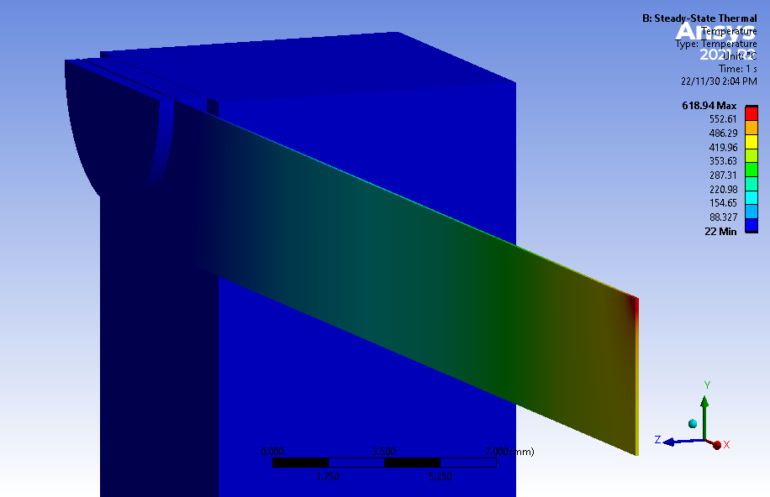
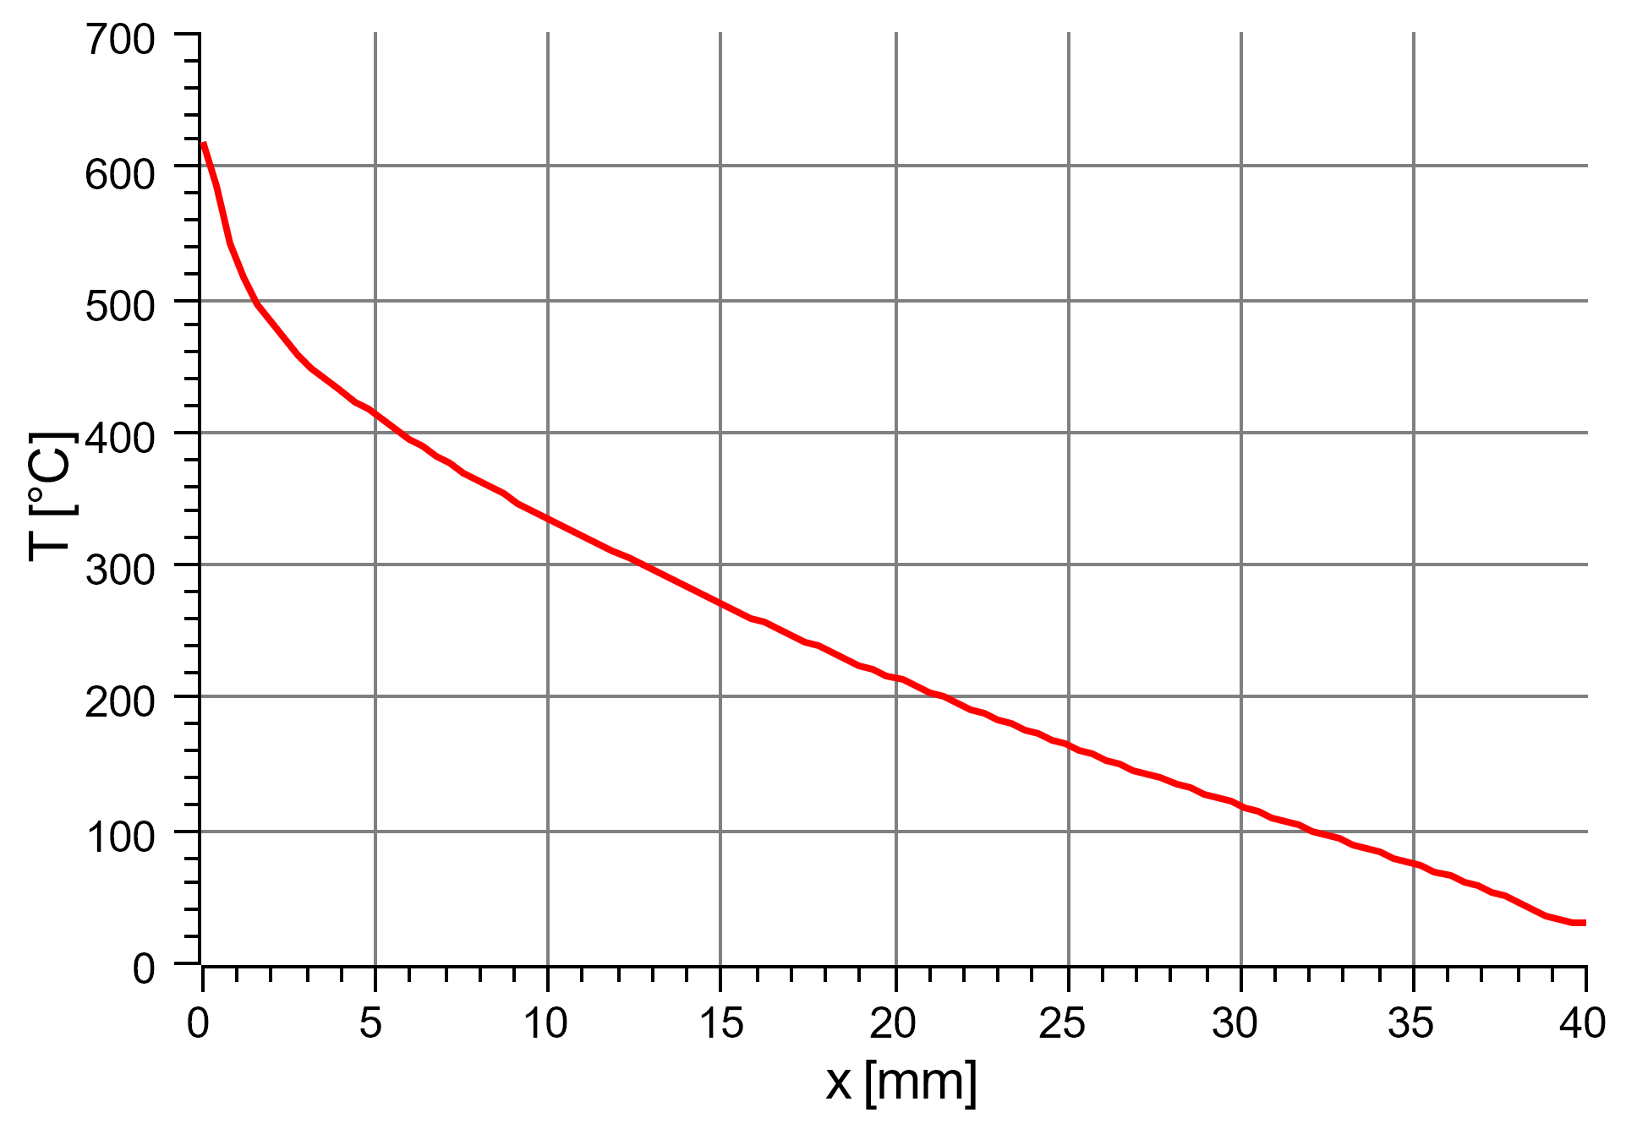
CW MAMI Beam: Temperature of W foil (0.1mm x 10mm x 80mm)

Slide 15
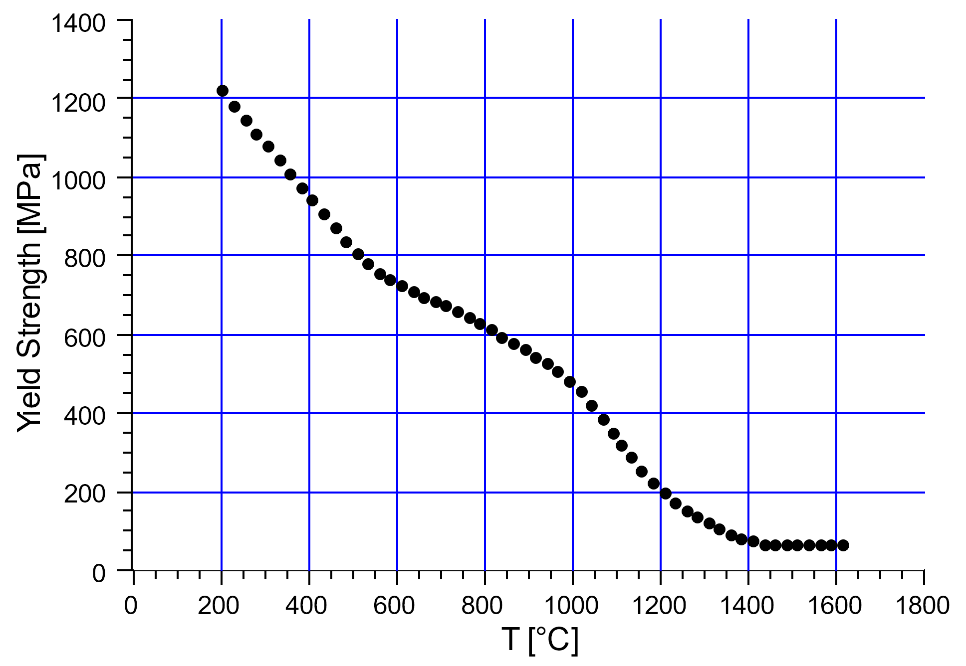
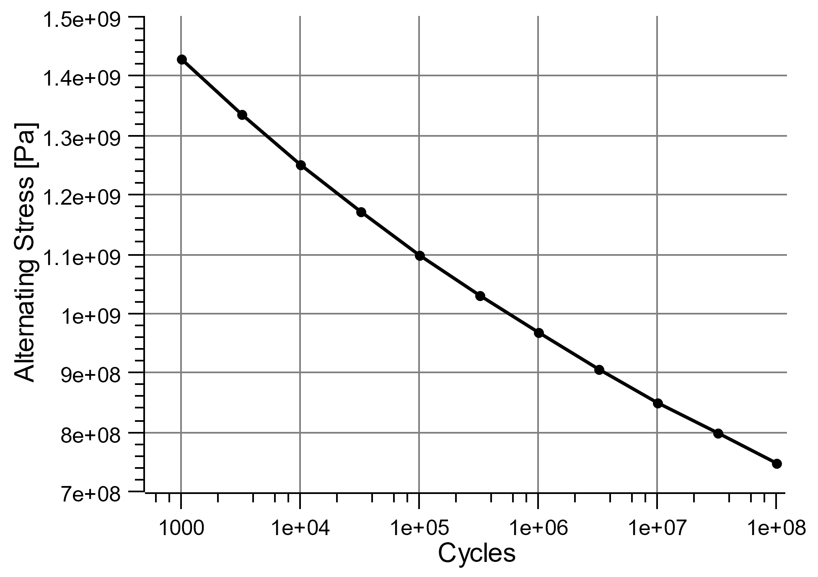
Tungsten: Temperature Dependence of Yield Strength and Fatigue Limit vs Number of Cycles
Yield Strength vs Temperature
(taken from Plansee website)
Fatigue Limit vs Number of Cycles
(taken from ANSYS Granta)
T = 22 °C
Plansee: Yield Strength (T = 420 °C) ≈ 923 MPa
Fatigue Limit (N_{cycles} = 6.55e+7*) = 774 MPa
ANSYS Granta: Yield Strength (T = 22 °C) = 1506 MPa
* For Ø35 cm target spinning with 4 m/s after 5000h

