Slide 1
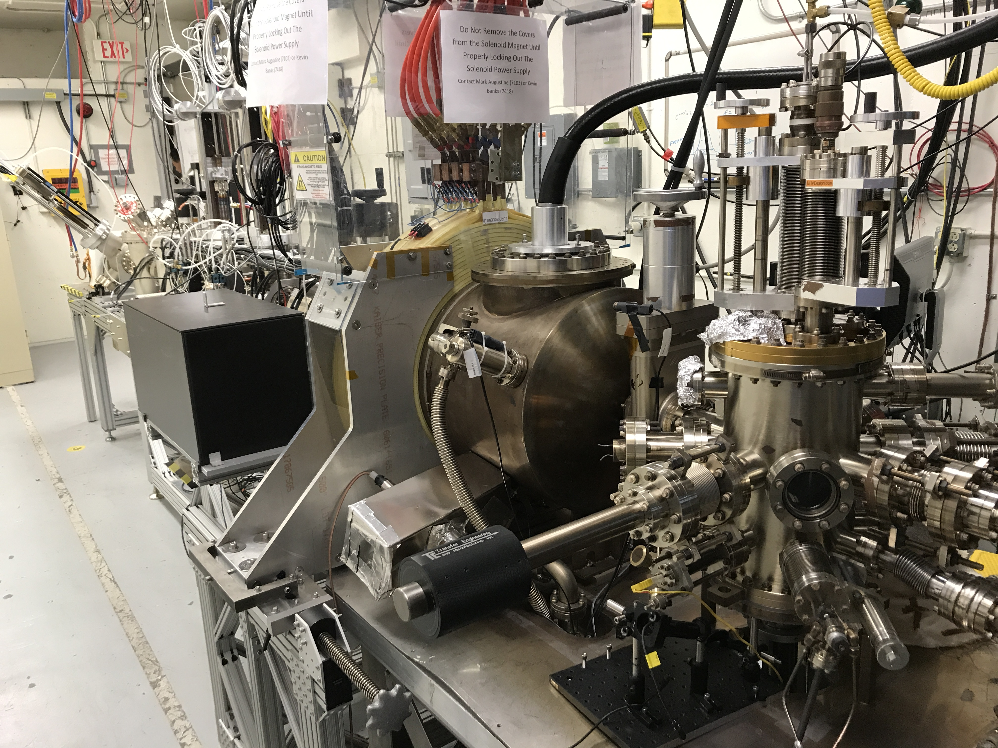
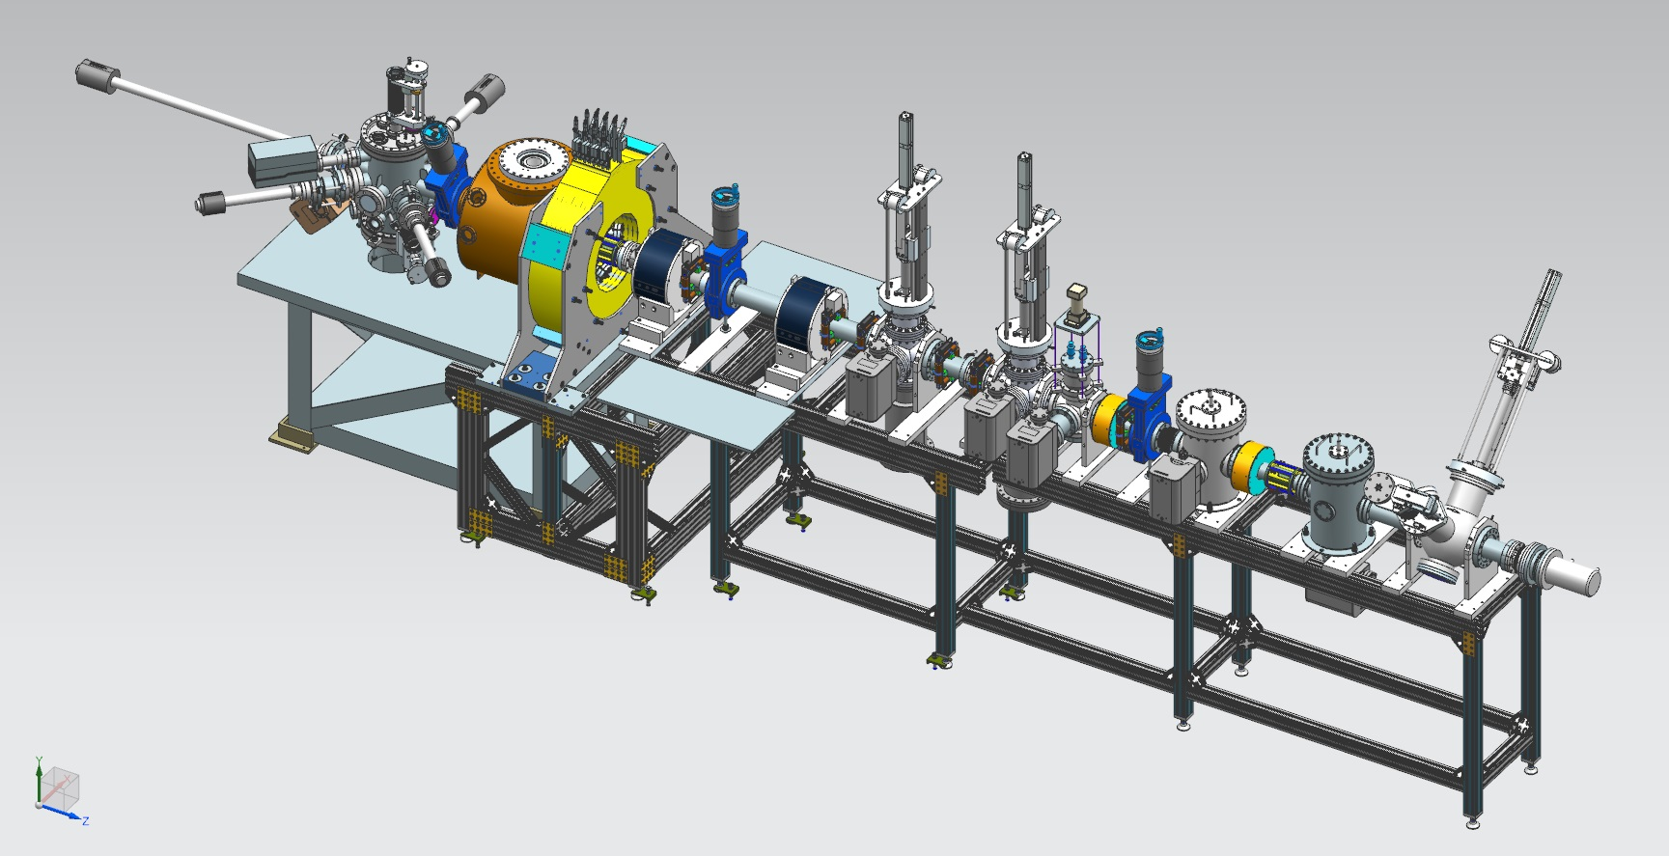
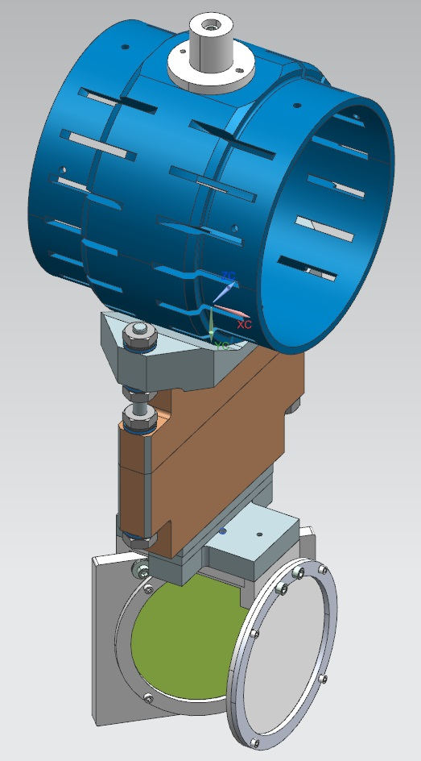
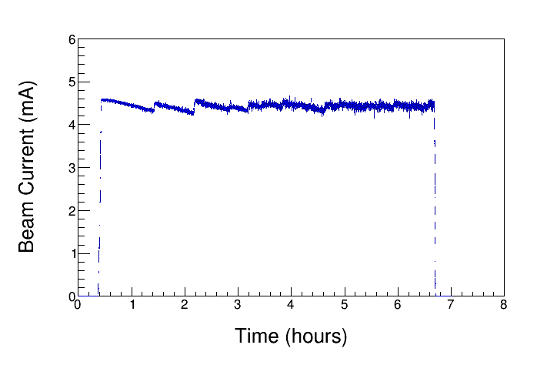
Magnetized Beam
Gun HV Chamber
Gun Solenoid
Beamline
Photocathode
Preparation
Chamber
Measuring beam mechanical angular momentum (beam magnetization) using slit and viewer screen method with 1511 G at photocathode
0 G
Shield Tube
1511 G
1511 G
Slit
Viewer Screen

