Slide 1
Polarized Positron Source
Logo Idea
New goal parameters
2+3 cavity
Plan A B & C in Simulations
Mark Stefani

Slide 2
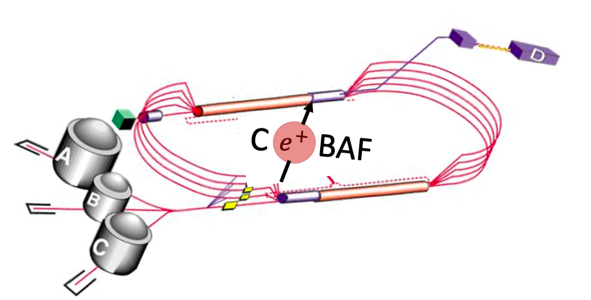
Logo ideas? Project name?

Slide 3
New parameters for optimization

Slide 4
New parameters for optimization
Polarized:
Reduce range of energy selected and increase mean energy.
Efficiency of 1e-4, emittance <40 mm-mrad, and Polarization >70%.
Unpolarized:
Reduce range of energy selected and decrease mean energy.
Efficiency of > 1e-3 and emittance of <40 mm-mrad.

Slide 5
Cavity used in simulation
2+3 cell cavity
Allows for different phase and field amplitude to see if initial deceleration is beneficial
Still allows multiple cells of acceleration.
Allows for a flat 5 cell field if optimal.
Length and bore is dependent on frequency.

Slide 6
Three layouts will be optimized and compared
1.
Legend
Target
AMD
Solenoid
Quadrupole
Dipole
Collimator/dump
RF Cavity
2.
3.

Slide 7
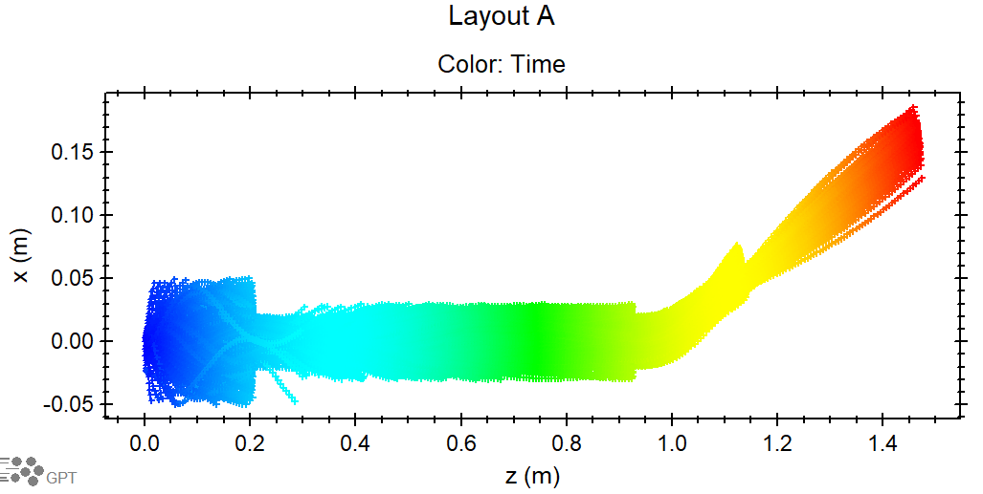
A

Slide 8
B

Slide 9
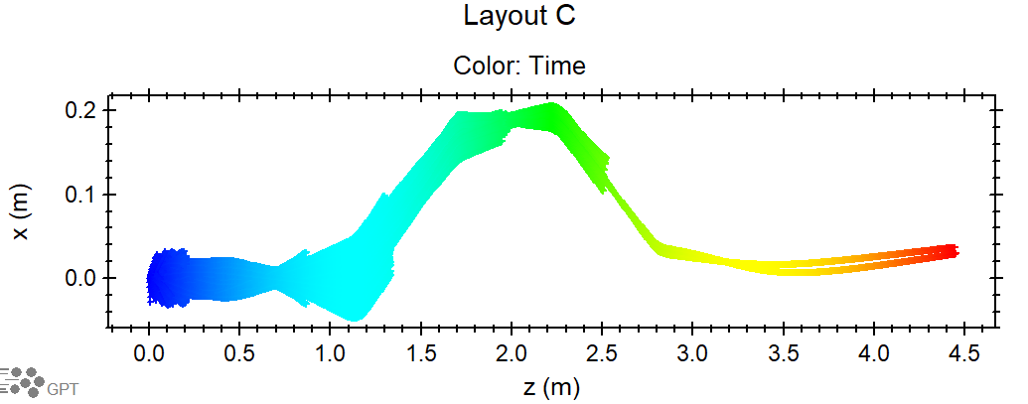
C

