Slide 1
T-Cathode CST E-Field Map and Specs
Josh Yoskowitz

Slide 2
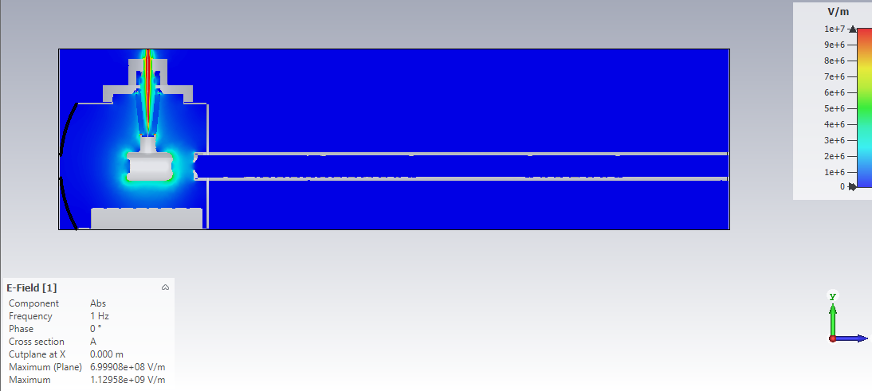
HV Cable
Gun Chamber Body
Z=0m
Z=0.935m
Cathode
E-Field Map Region
Field Map Diameter=0.06m
Anode
Beampipe
NEGs

