Slide 1
GPT Simulations for Jay’s Solenoids
Alicia Hofler, Jay Benesch, Reza Kazimi, and Joe Grames

Slide 2
Outline
Jay’s solenoid models vs. beam measurements
Single solenoid behavior comparison
Solenoid behavior in chopper system
Conclusion

Slide 3
Fopt: Poisson vs. Opera3d Models of Installed Solenoids: FD, FA, FG, FL

Slide 4
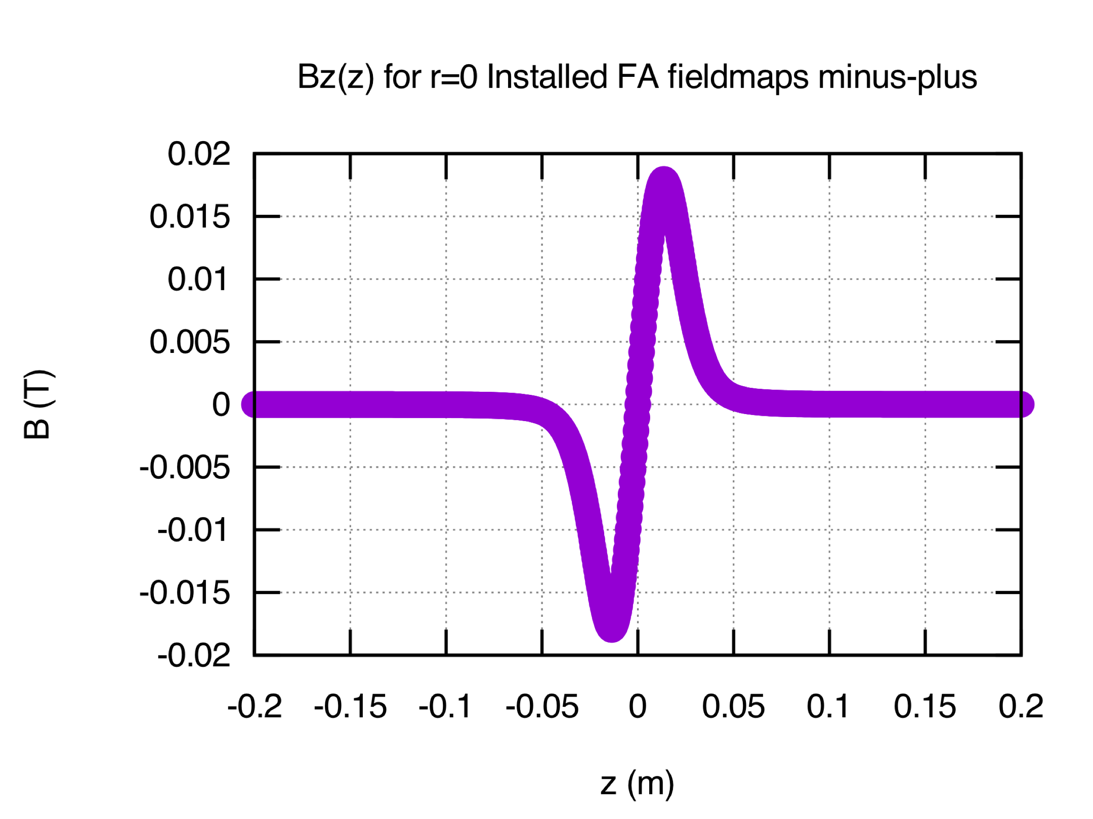
Jay’s New Design as FD and FA: Stand Alone Assessment
Jay’s Design (57 mm bore)
Installed FD
Installed FA

Slide 5
FD: Focal Length vs. Vertical Beam Displacement (y=15 mm)
Vertical Displacement: -20 mm to +20 mm
Zoom to +12 mm to +18 mm

Slide 6
FA: Focal Length vs. Vertical Beam Displacement (Solenoid Center)

Slide 7
FD and FA: Residual Horizontal Displacement

Slide 8
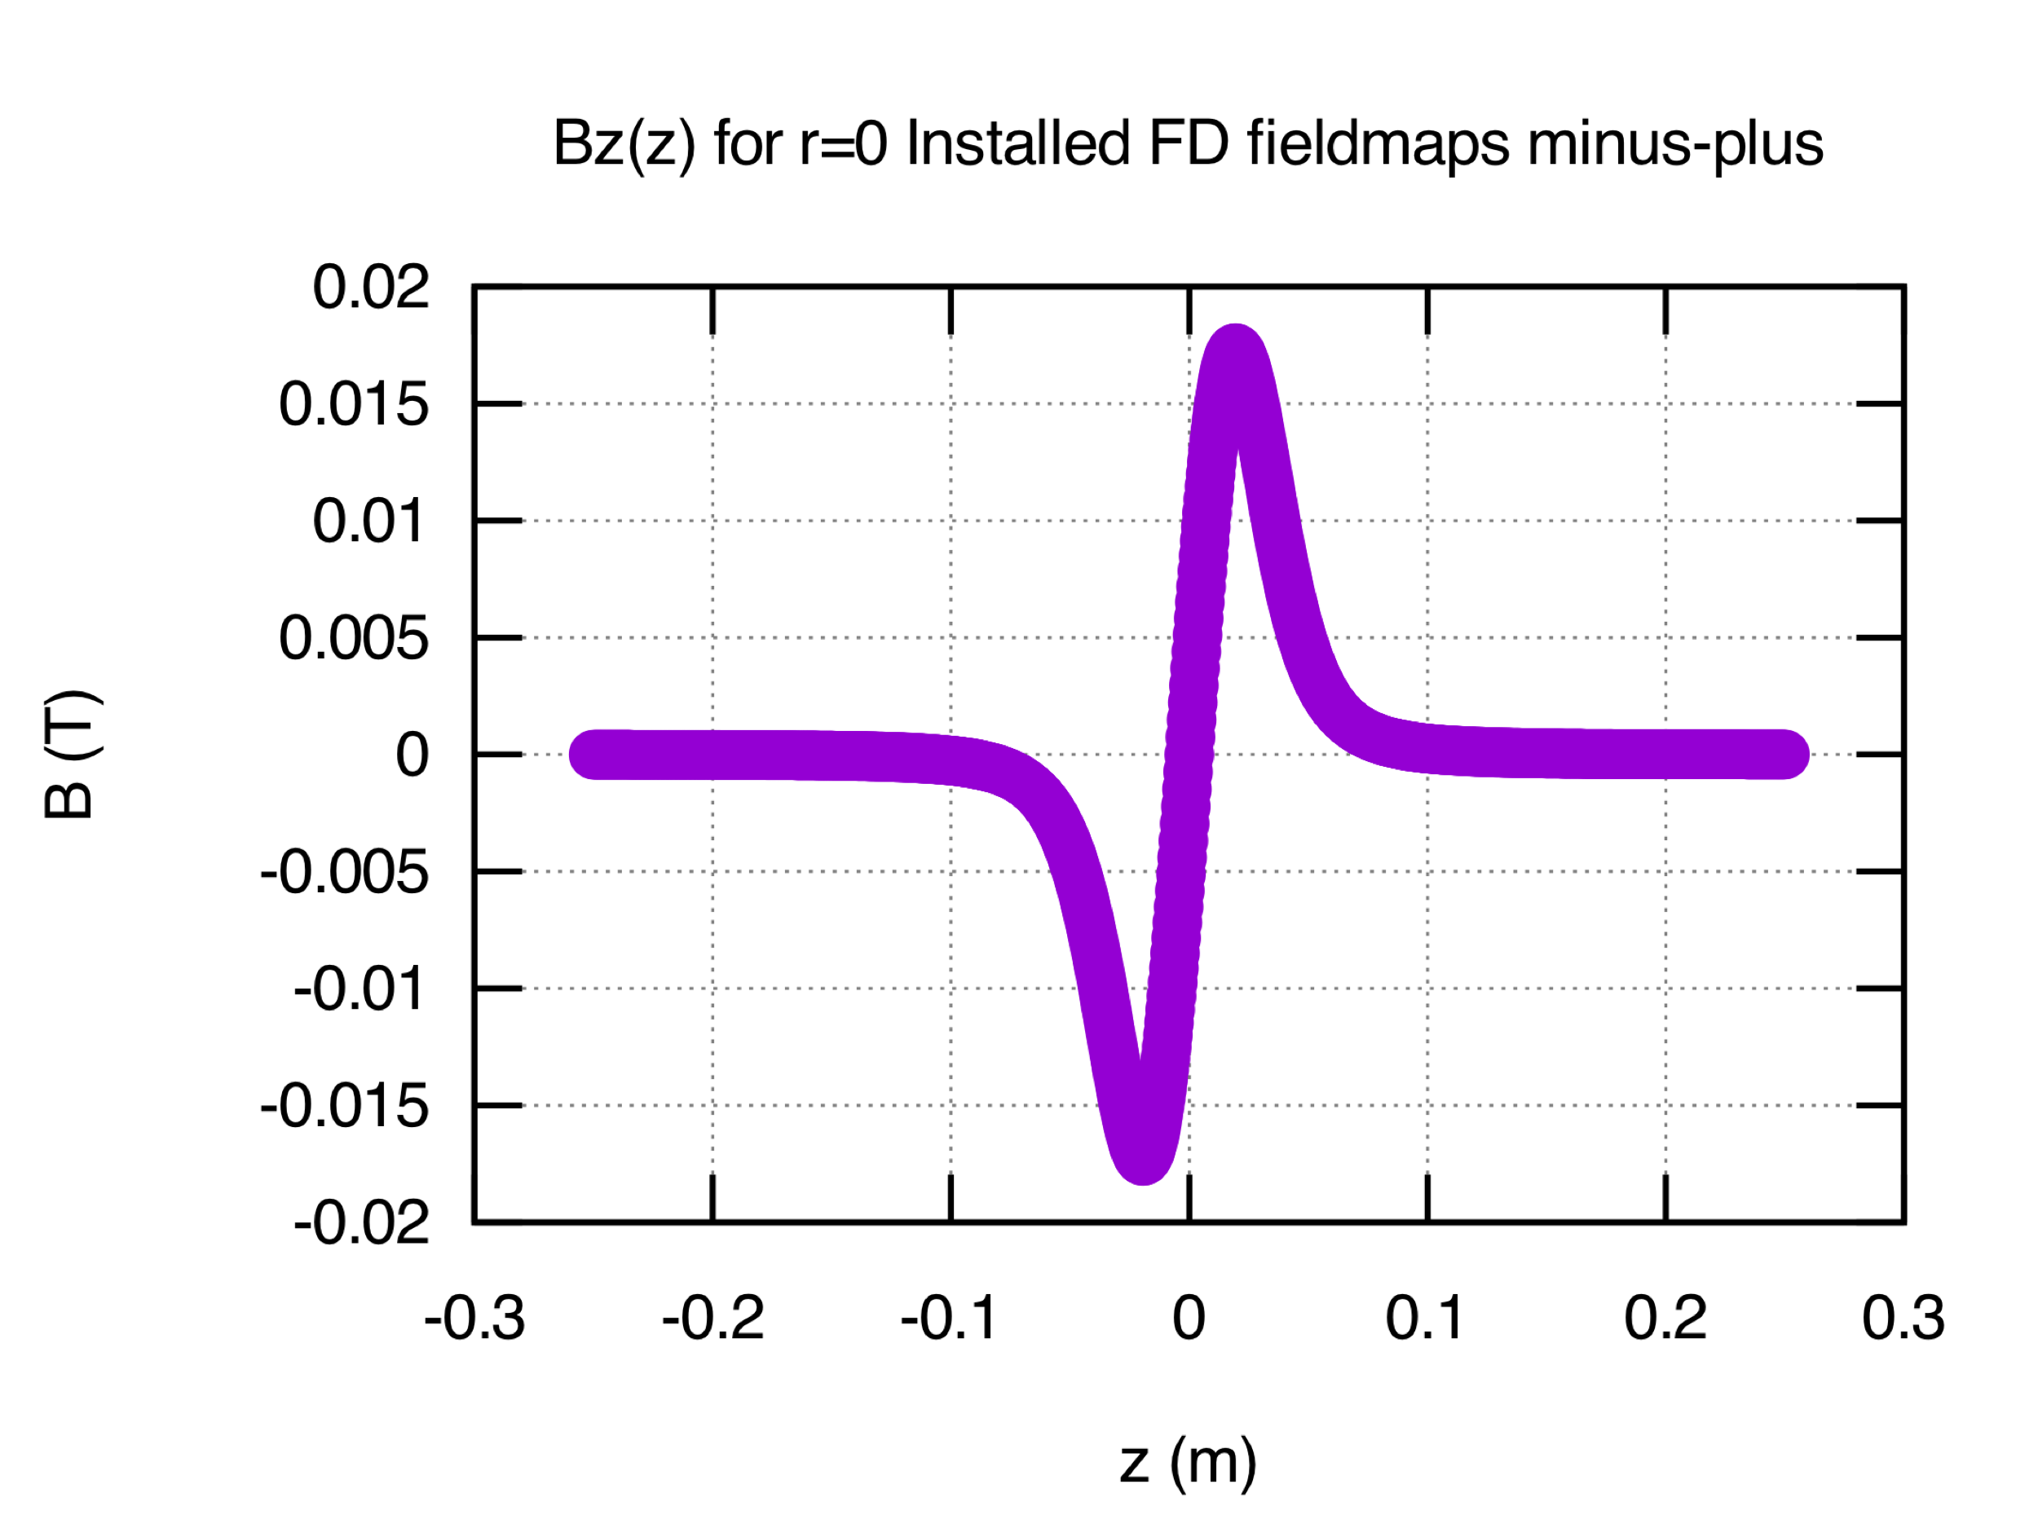
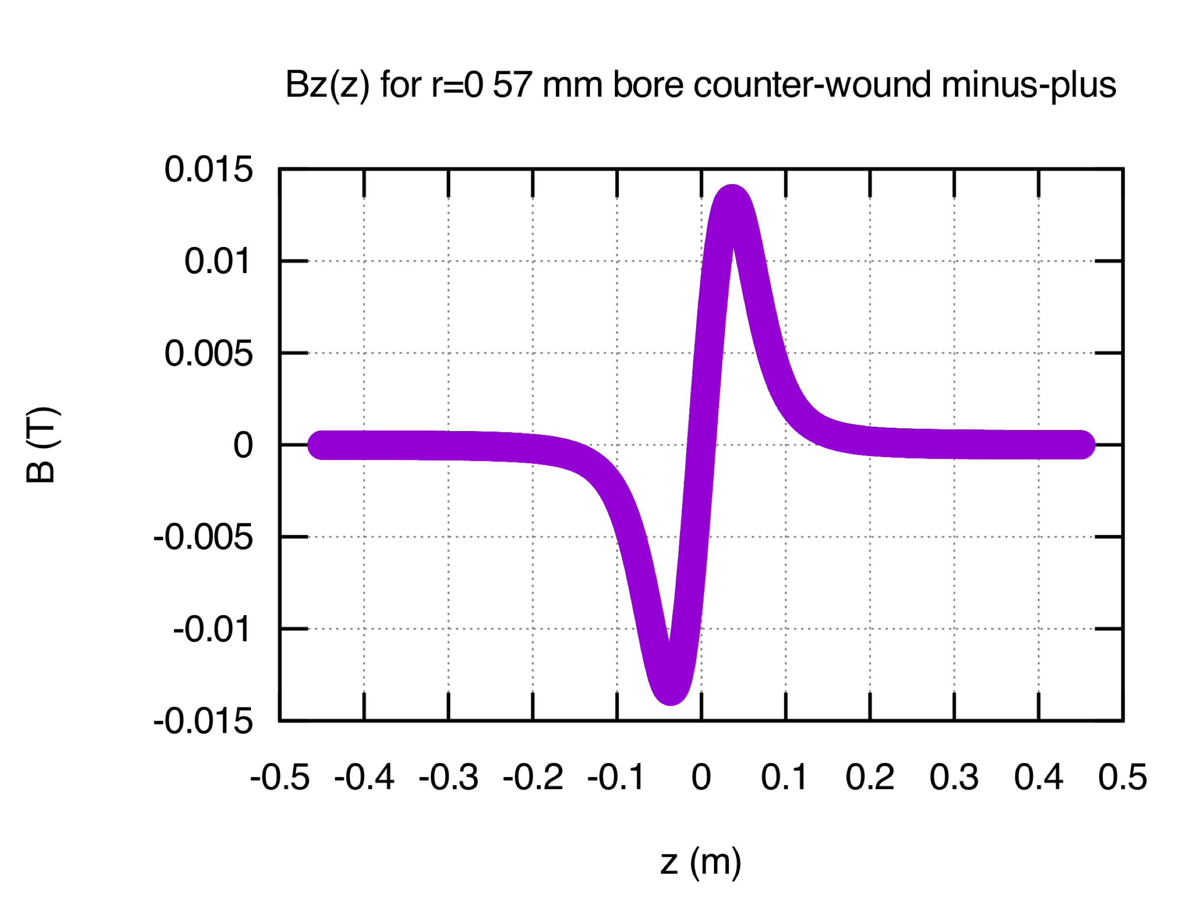
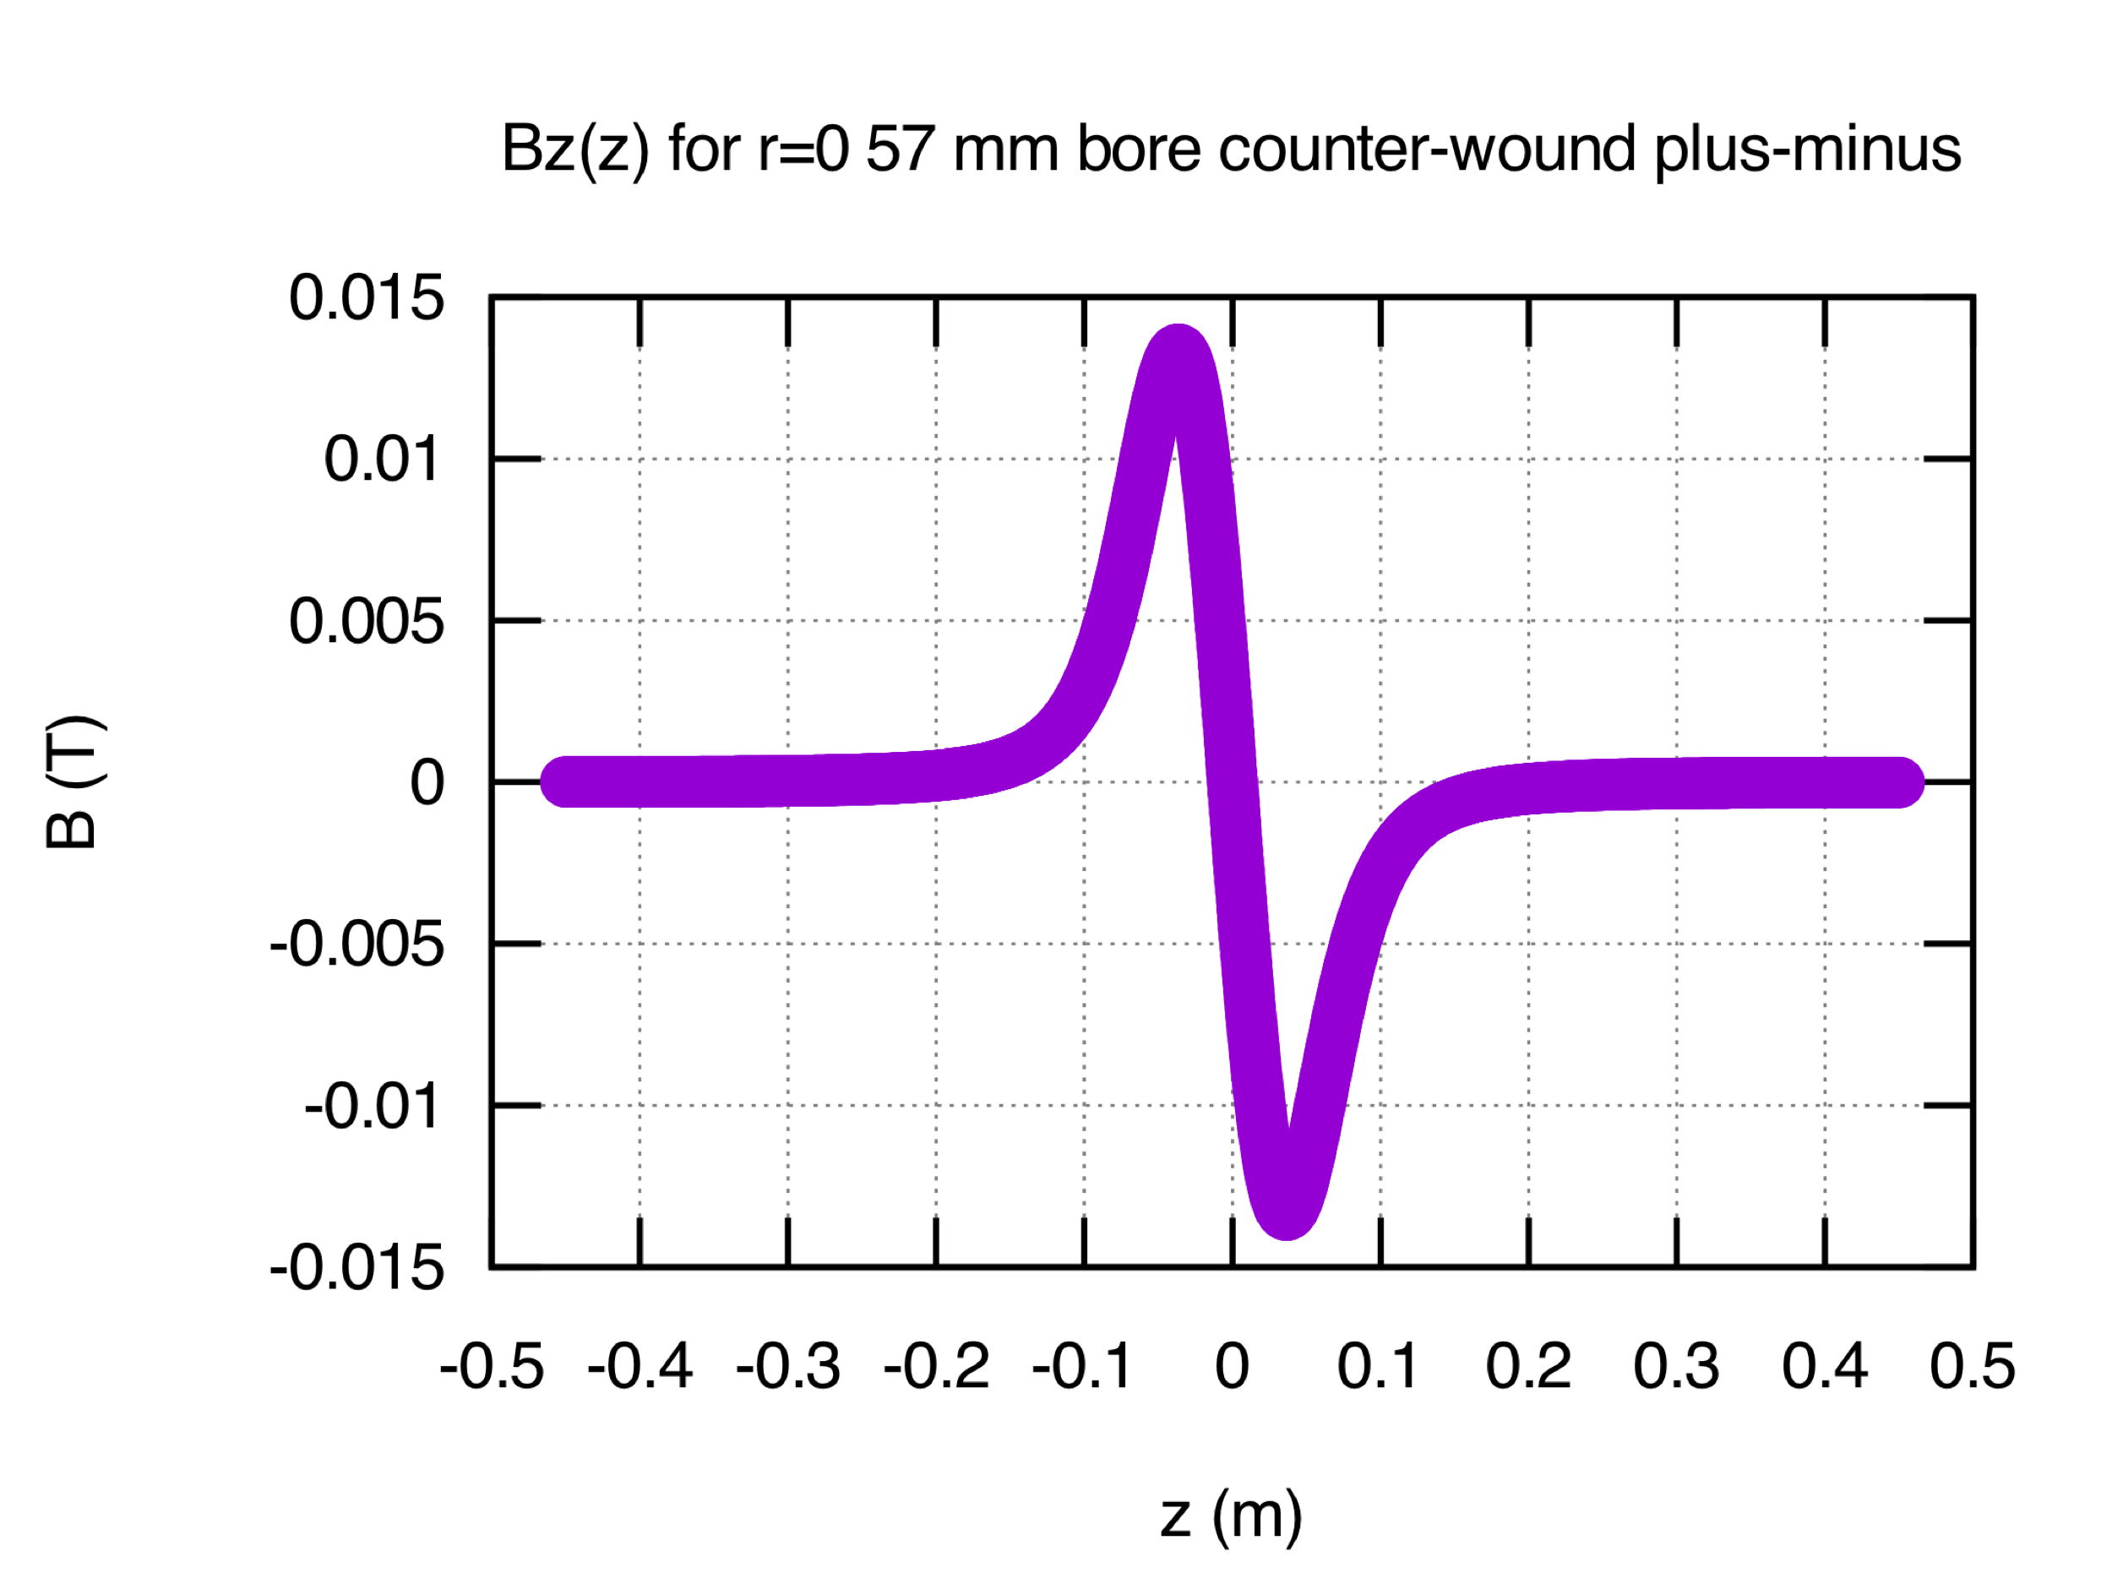
Jay’s New Design as an FD in Chopper System
Installed FD field sense (a.k.a. mpmp)
FD1: -Bz +Bz
FD2: -Bz +Bz
Compare new design
Following installed FDs
Alternate FD2: +Bz –Bz (a.k.a. mppm)
FD1
FD2
Jay Design1
Jay Design2

Slide 9
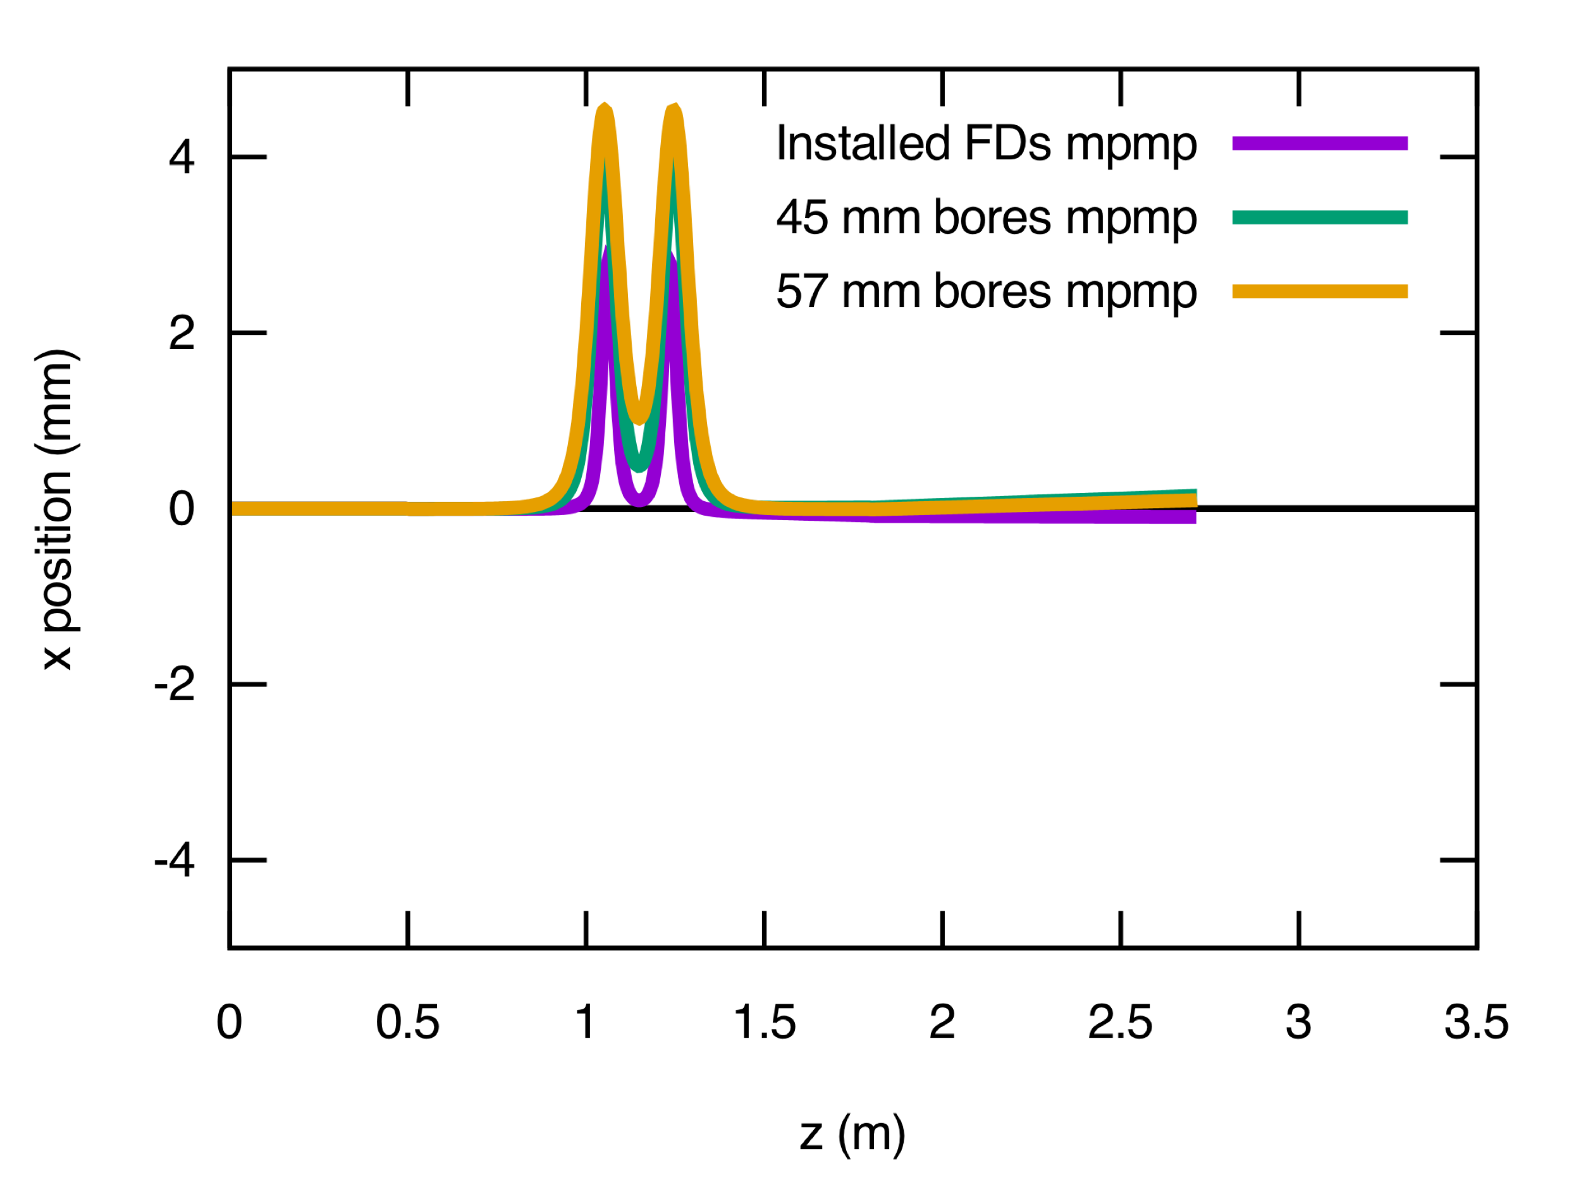
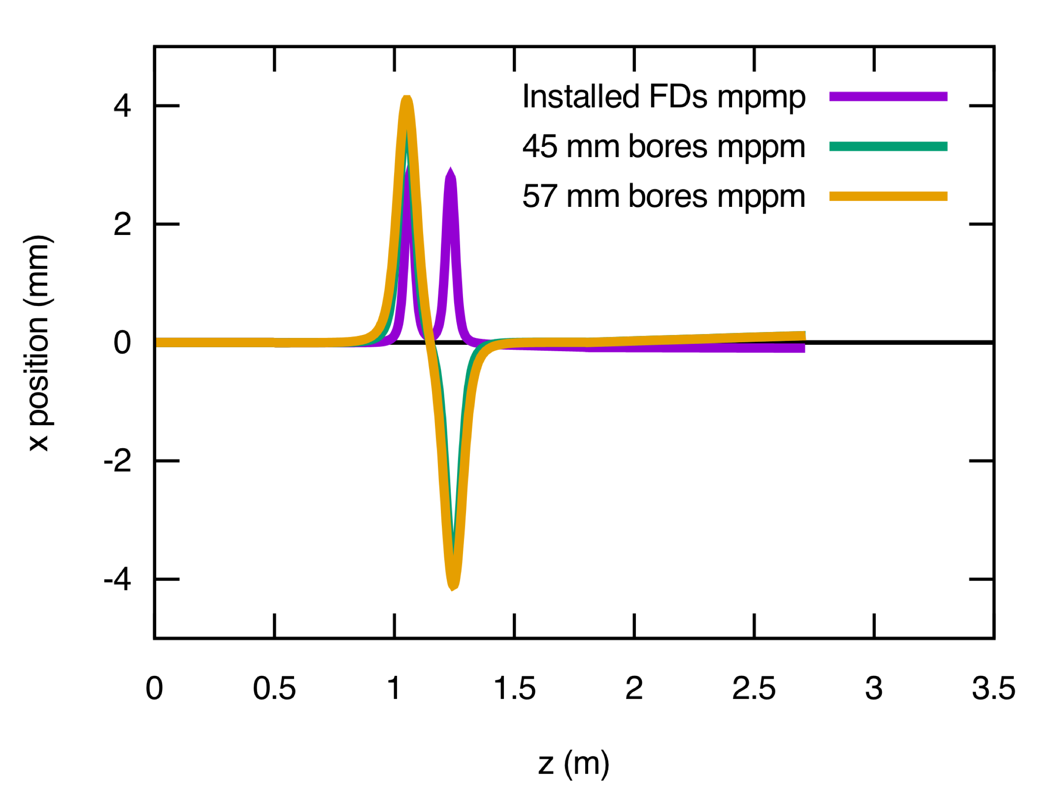
FD Relative Field Orientations: Optimal RF and Solenoids B Slit
Vertical orbit
Jay Bz: -+ -+
Vertical orbit
Jay Bz: -+ +-
Horizontal orbit
Horizontal orbit
Jay Bz: -+ -+
Jay Bz: -+ +-

Slide 10
Chopper 1 and 2 X/Y ON Optimal RF and Solenoids – Master Slit
Line of charge at r=0: 360º train 10º intervals

Slide 11
Chopper 1 and 2 X/Y ON Lower RF Amplitude – Master Slit
Line of charge at r=0: 360º train 10º intervals

Slide 12
Chopper 1 and 2 X/Y ON Higher RF Amplitude – Master Slit
Line of charge at r=0: 360º train 10º intervals

Slide 13
Chopper 1 and 2 X/Y ON Optimal RF and Solenoids – Downstream CH2
Line of charge at r=0: 360º train 10º intervals

Slide 14
Chopper 1 and 2 X/Y ON Lower RF Amplitude – Downstream CH2
Line of charge at r=0: 360º train 10º intervals

Slide 15
Chopper 1 and 2 X/Y ON Higher RF Amplitude – Downstream CH2
Line of charge at r=0: 360º train 10º intervals

Slide 16
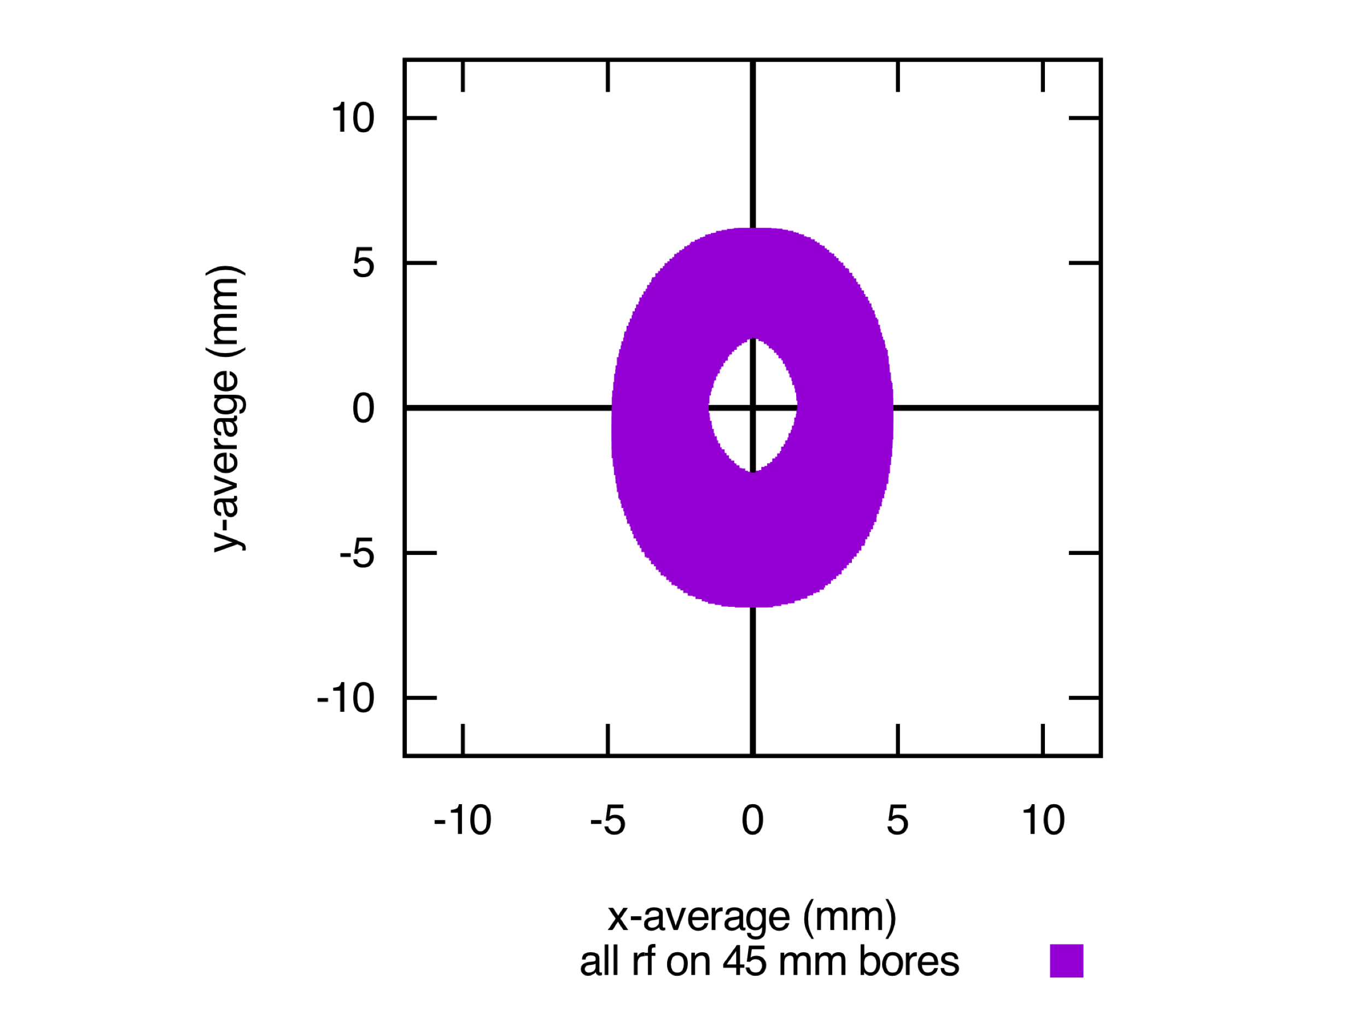
Chopper 1 and 2 X/Y ON Optimal RF and Solenoids – Downstream CH2
Installed FD
45 mm bore
57 mm bore
Vertical Ring Beam (OD 8mm, ID 4mm, delta z=0)

Slide 17
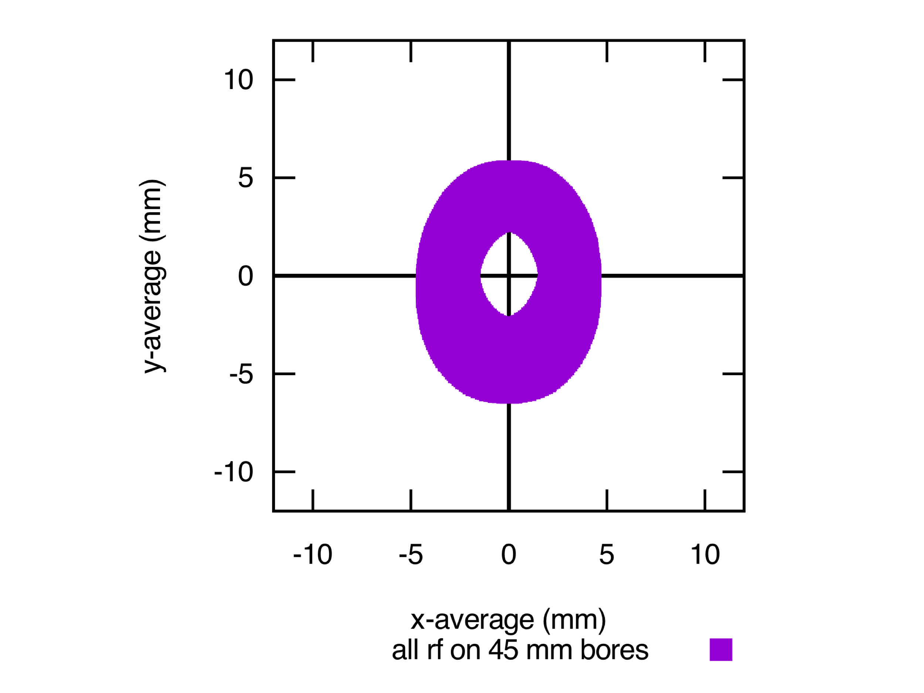
Chopper 1 and 2 X/Y ON Lower RF Amplitude – Downstream CH2
Installed FD
45 mm bore
57 mm bore
Vertical Ring Beam (OD 8mm, ID 4mm, delta z=0)

Slide 18
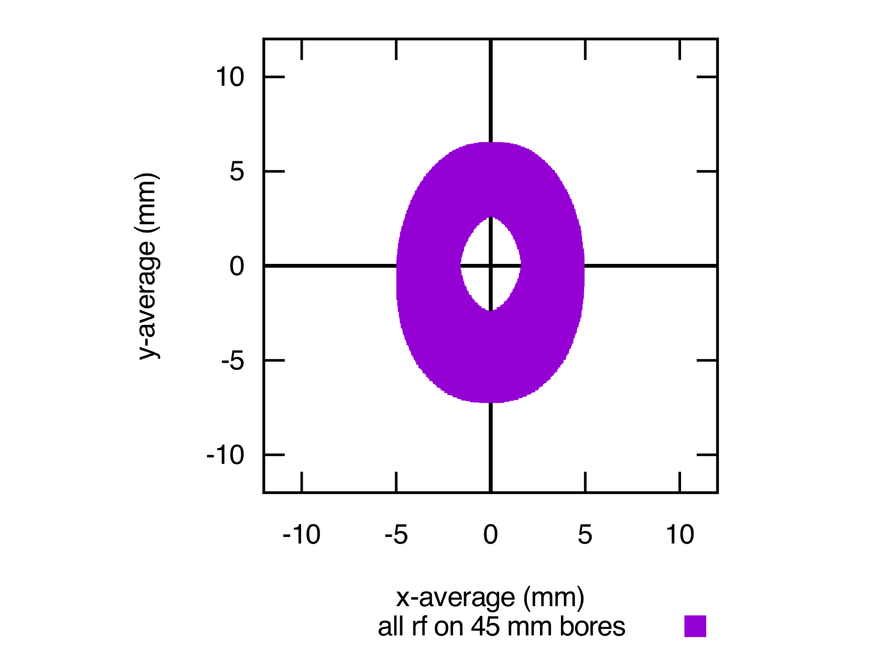
Chopper 1 and 2 X/Y ON Higher RF Amplitude – Downstream CH2
Installed FD
45 mm bore
57 mm bore
Vertical Ring Beam (OD 8mm, ID 4mm, delta z=0)

Slide 19
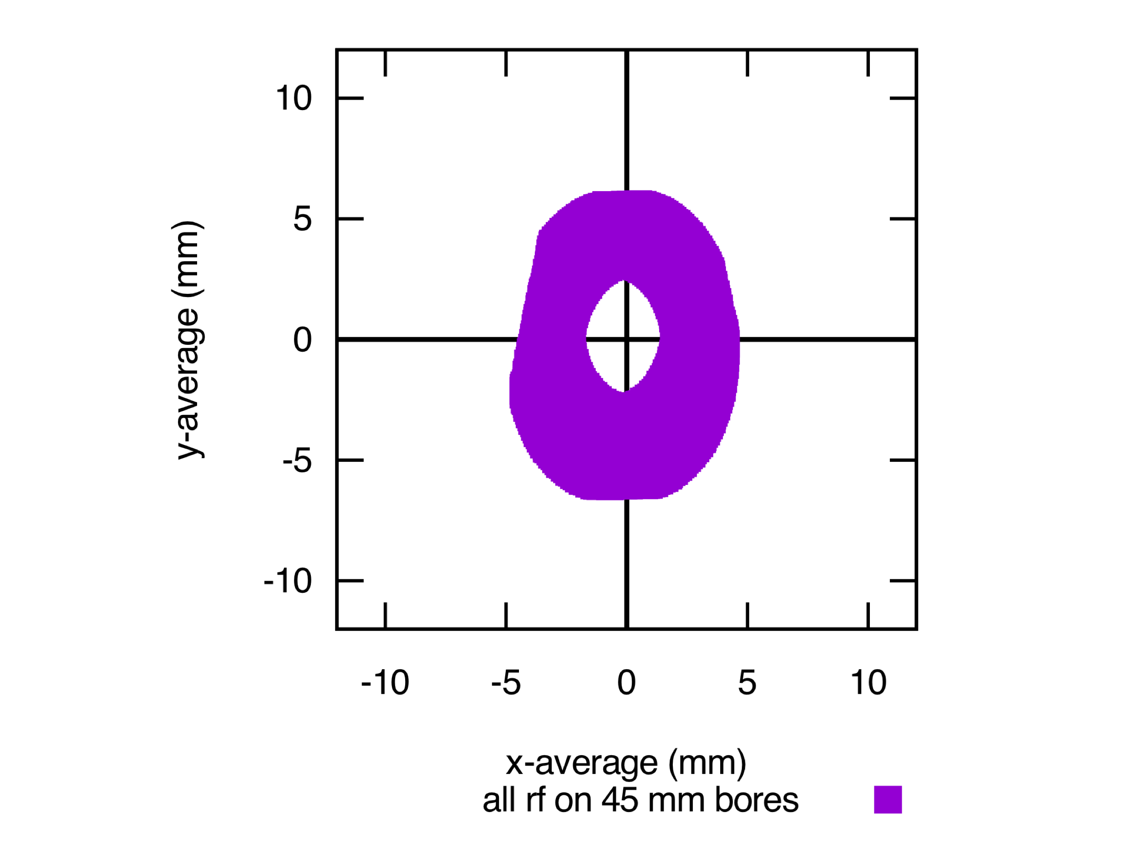
Chopper 1 and 2 X/Y ON Optimal RF and Solenoids – Downstream CH2
Installed FD
45 mm bore
57 mm bore
Vertical Ring Beam (OD 8mm, ID 4mm, delta z=0)
Master Slit IN

Slide 20
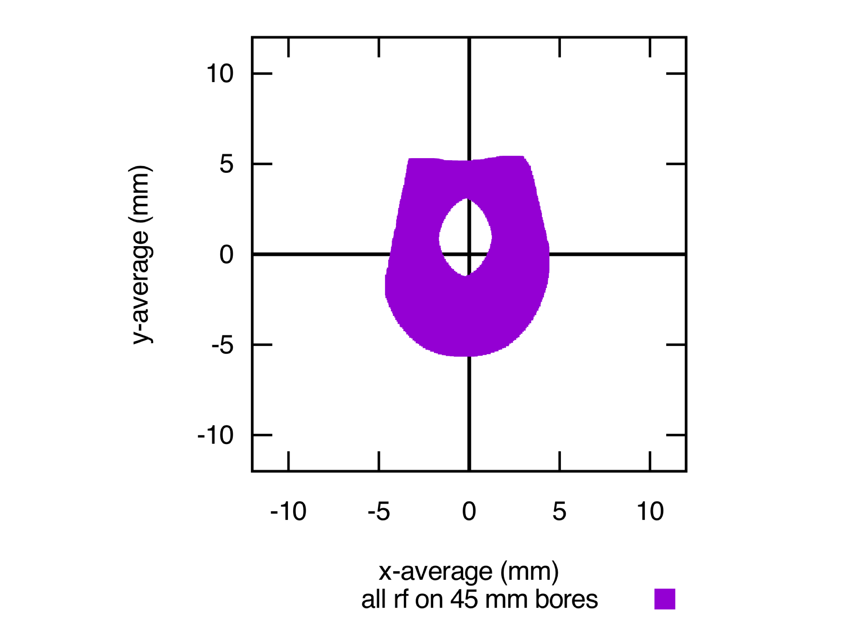
Chopper 1 and 2 X/Y ON Lower RF Amplitude – Downstream CH2
Installed FD
45 mm bore
57 mm bore
Vertical Ring Beam (OD 8mm, ID 4mm, delta z=0)
Master Slit IN

Slide 21
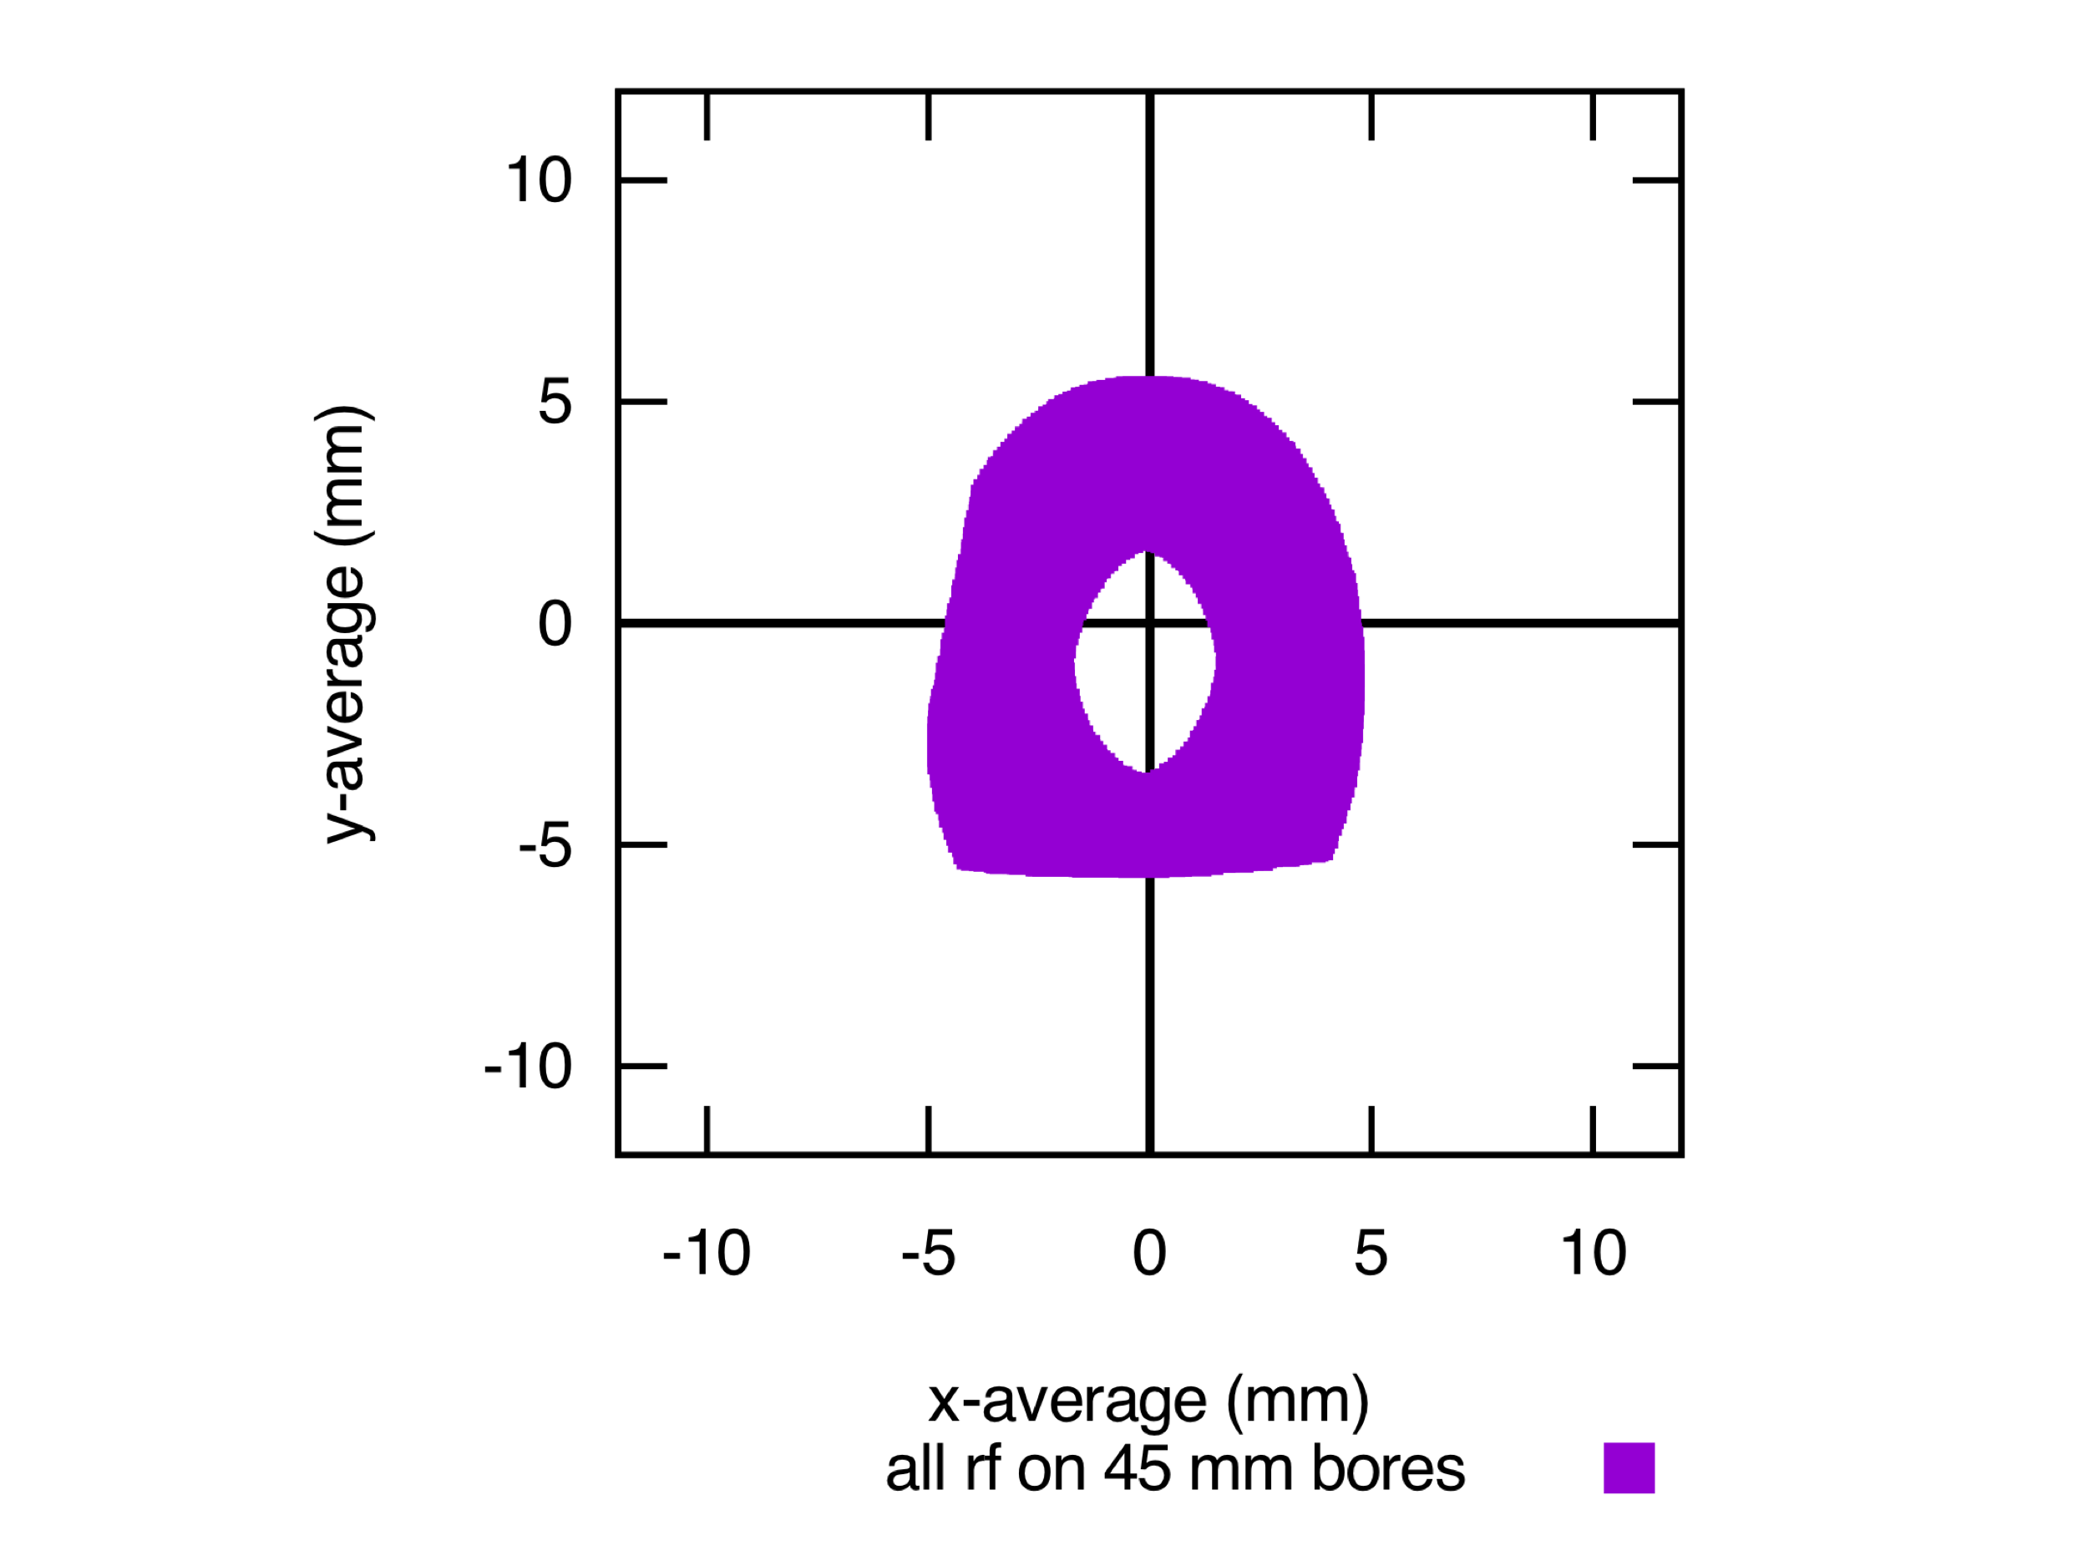
Chopper 1 and 2 X/Y ON Lower RF Amplitude – Downstream CH2
Installed FD
45 mm bore
57 mm bore
Vertical Ring Beam (OD 8mm, ID 4mm, delta z=0)
Master Slit IN

Slide 22
Chopper 1 and 2 Y ON Optimal RF and Solenoids – Master Slit
Line of charge at r=0: 360º train 10º intervals

Slide 23
Chopper 1 and 2 Y ON Lower RF Amplitude – Master Slit
Line of charge at r=0: 360º train 10º intervals

Slide 24
Chopper 1 and 2 Y ON Higher RF Amplitude – Master Slit
Line of charge at r=0: 360º train 10º intervals

Slide 25
Conclusion
Jay’s new design is a viable replacement for all injector solenoids
The change from mpmp to mppm for the two chopper solenoids is necessitated by the longer Bz field inherent in flatter focusing vs. radius and the z displacement of hall slits.
Sign can be flipped on second FD for a feasibility check with beam in present injector
not a full test since FD was designed to have no Bz a cm beyond the magnet.
An alternative which would eliminate this risk (and lower RF drive on chopper cavities for 200 kV or 275 kV KE beam) would be to increase the chopper cavities separation by perhaps 50 cm, allowing the FD replacements to be moved 10 cm farther from the slits and each other.

