Slide 1

CEBAF Source/Injector Update
PREX/CREX Collaboration Meeting
October 2, 2017
Joe Grames
Center for Injectors and Sources

Slide 2
Outline
Polarized Source
  Recent performance
  Preparing for simultaneous 4-Hall operation
  High polarization photocathode studies
Injector Upgrade
  Status of the 200 keV upgrade
  Plans for next SAD
Some “Plan B” Options to Consider

Slide 3

CEBAF Injector Gun2 @ 130 keV
CEBAF Polarized Inverted Load Lock Gun (Spring 2017)

Slide 4
Polarized Source Operation
Photocathode
  Strained Superlattice GaAs/GaAsP #5756-4
  Good Polarization 85-87% (measured at Mott)
  Good QE > 1% after activation
Last Spring 2017
  Delivered 20-40 uA to 3 halls at a time (249.5 & 499 MHz)
  Hall A (Physics), Hall B (KPP), Hall C (KPP), Hall D (Physics)
This Fall 2017 – Winter 2018
  CEBAF restoration starts late November
  12 weeks of running scheduled
  Start simultaneous 4-Hall Operation
4

Slide 5
  Simultaneous CEBAF 4-Hall Operations
4 Hall Delivery Conditions (called D+3)
4 Hall Setup Considerations
  Two 249.5 MHz beams share a 499 MHz “Chopper Bucket”
  750 MHz separators used for the 5th pass ABC + D separation
  Pairs of lasers have opposite helicity (A/B opposite of C/D)
Condition | (D+2) | (D+3)
Maximum number of halls receiving beam | 3 halls | 4 halls
ABC Beam @ 5th pass (Hall D on) | 499 MHz | 249.5 MHz
ABC Beam @ 5th pass (Hall D off) | 499 MHz | 499 MHz
ABC Beam @ lower passes | 499 MHz | 499 MHz

Slide 6
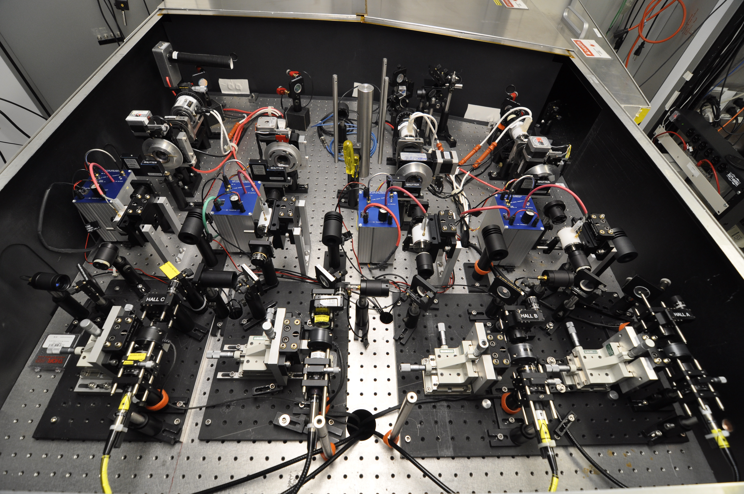
4-Hall Source Laser System – Spring 2016

Slide 7
4-Hall Source Laser System Update
Summer 2017 Shutdown
  Replaced damaged or aging RTP cells, exhibiting poor extinction or optical after-pulse. We backed out of applying DC high voltage to RTP crystals, which DO suffer ion migration from electrode.
  Improved independent management of laser size/divergence
    Added stages to readily vary laser size
    Modified lens for PPLN doubling and improved performance
    Added splitters/targets to improve combining lasers
  Completed installation of production LLRF (replaced proto-type)
  Identified a vendor in China providing less costly bare RTP crystal

Slide 8


Improving Lifetime with Larger Laser Size
J. Grames, et al, Phys. Rev. ST Accel. Beams 14 043501 (2011)
GaAs @ 532nm

Slide 9

Improving charge lifetime with GaAs/GaAsP
Indeed, we enhanced the Charge Lifetime for Qweak by a factor of four when doubling the laser spot size from 0.5mm to 1.0 mm (diameter)

Slide 10

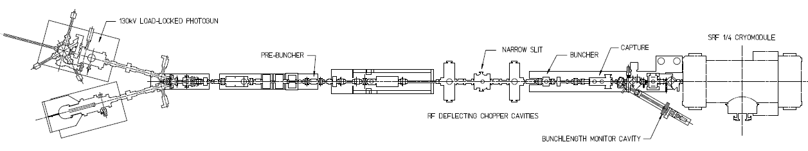
Lifetime Studies at mA Beam Current
CEBAF 130kV polarized “inverted gun” with load lock
Note:
1 mA 86 C/day
5 mA 432 C/day
10 mA 860 C/day
50 mA 4320 C/day
Polarized positrons for CEBAF, and on-going discussions with BNL related to high current eRHIC EIC, prompted experiments at CEBAF to characterize lifetime vs. laser spot size using high-polarization photocathodes
Required laser power, slope proportional to QE decay
Make beam here
Increasing laser size reduces QE decay proportionally
Deliver it here
Monitor vacuum and radiation
1mA
Vary the laser beam size

Slide 11

First Results: GaAs/GaAsP at mA Current
We operate left of this line
  CEBAF charge lifetime improves with spot size, as expected, but eventually beam size becomes “too large”
  Laser diameters greater than ~4 mm (4 sigma) will require properly designed cathode/anode electrodes, to ensure 100% transmission, to maintain excellent vacuum, to minimize ion bombardment
Although PREX/CREX doesn’t need milliAmp’s, by performing these studies we aim to improve Lifetime and QE Uniformity

Slide 12

Polarization Studies at mA Beam Current
First measurement of polarization from superlattice photocathode at milliampere current
CEBAF 5 MeV Mott polarimeter: on-going effort to ascribe sub-percent accuracy (collaborators D. Moser, X. Roca-Maza, Charles Sinclair, M.J. McHugh, and Tim Gay)
CEBAF 5 MeV Mott Polarimeter

Slide 13
High Polarization Photocathodes
Strained Superlattice GaAs/GaAsP
Bulk GaAs
Strained GaAs
with DBR
100 nm
100 nm
14 Layers
30 mA/W
1 mA/W
6 mA/W
30 mA/W
Testing at
CEBAF now
P_{e-} 35% 35% 75% 75% 85% 89%
I_{e-} 30μA 100μA 50μA 100μA 150μA 200μA
1995 1998 1999 2000 2004 2017
Photocathode capability (polarization and QE) has grown significantly.

Slide 14
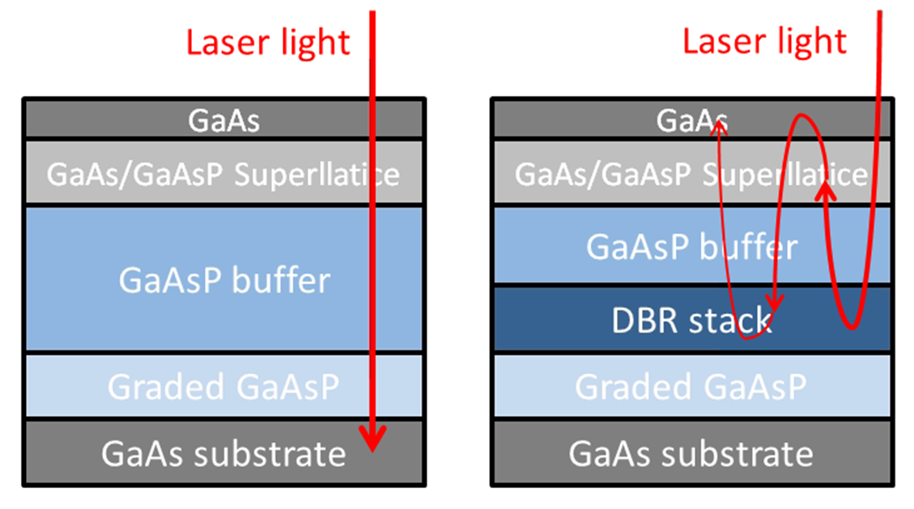
Benefits of Distributed Bragg Reflector
non-DBR Photocathode : absorption in the GaAs/GaAsP superlattice < 5%
DBR photocathode : absorption in the GaAs/GaAsP superlattice > 20%
Enhanced absorption occurs only at specific laser wavelengths
Non-DBR photocathode
DBR photocathode

Slide 15
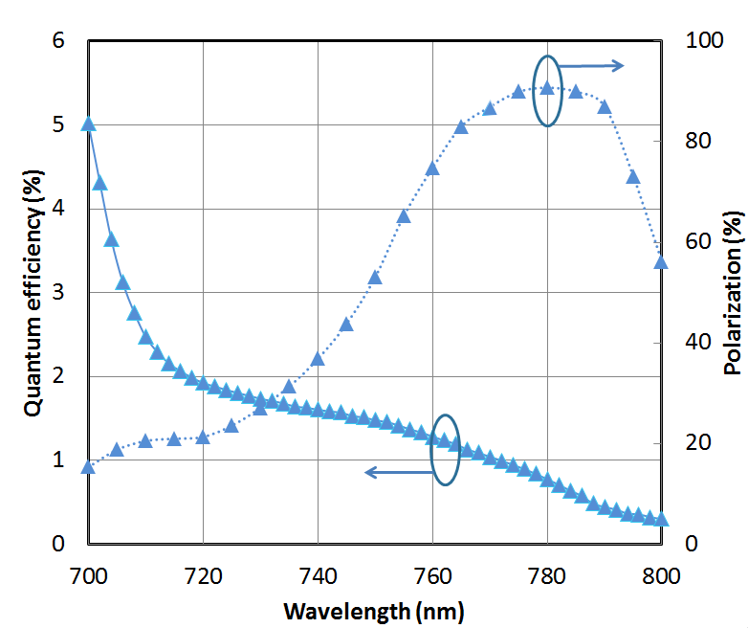
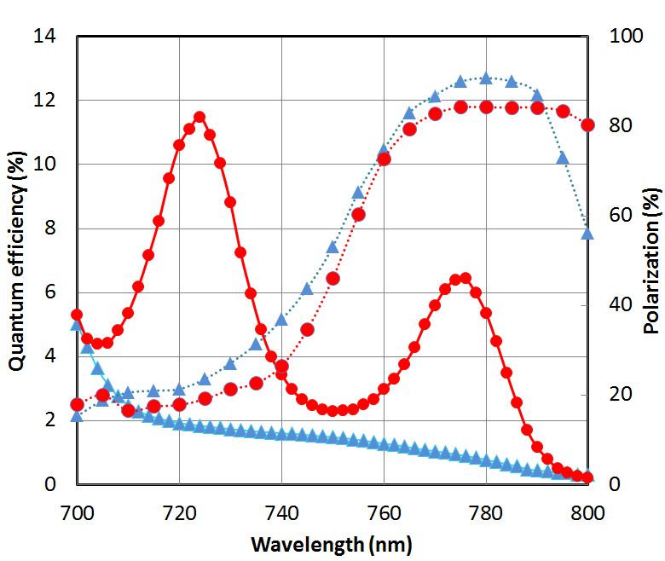
World Record QE from High Polarization Photocathode
Others have tried…but very difficult to obtain QE enhancement at the laser wavelength that also provides high polarization, CEBAF lasers operate at ~ 776 nm (doubled-telecom lasers)
Standard strained-superlattice
  QE = 0.89%
  Polarization = 92%
DBR
  QE = 6.4%
  Polarization = 84%
The highest reported QE of any high polarization photocathode
Excellent candidate for mA operations, will test at CEBAF this shutdown
SBIR partnership
W. Liu, S. Zhang, M. Stutzman, M. Poelker, Y. Chen, W. Lu, and A. Moy, Appl. Phys. Lett. 109, 252104 (2016)

Slide 16
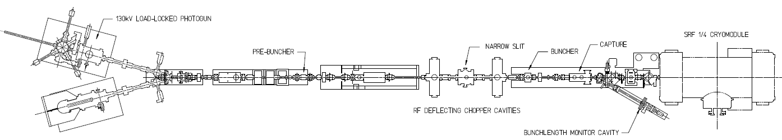
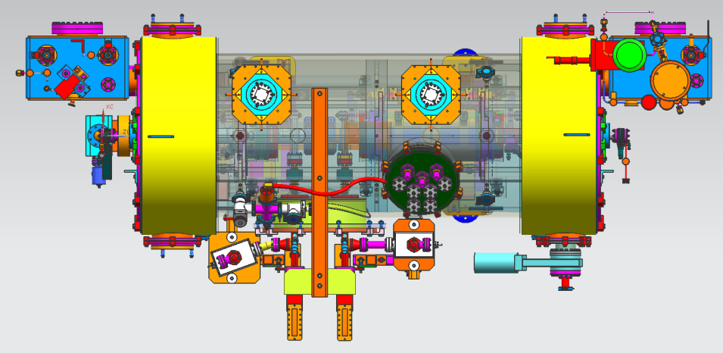
Injector Upgrade (what remains after R100)
200 kV
Increase gun voltage and Wien filters for 200kV operation
Improve baked beam line vacuum so gun does not pump on beam line
Locate Wien filters (energy filter) upstream of pre-buncher cavity
New SRF booster eliminates warm capture, RF deflection and x/y coupling
Our new “1/4 cryomodule”:
2 cell capture section + 7 cell cavity,
should provide 10 MeV beam and introduce no x/y coupling, allow better matching, more adiabatic damping

Slide 17
Reminder: Our summer 2017 “early start” goal
1. Build and install a HV chamber that can produce 200keV beam to explore operation.
2. Replace “NEG tube” with one that also includes two BPM’s.
3. Remove Gun3.

Slide 18
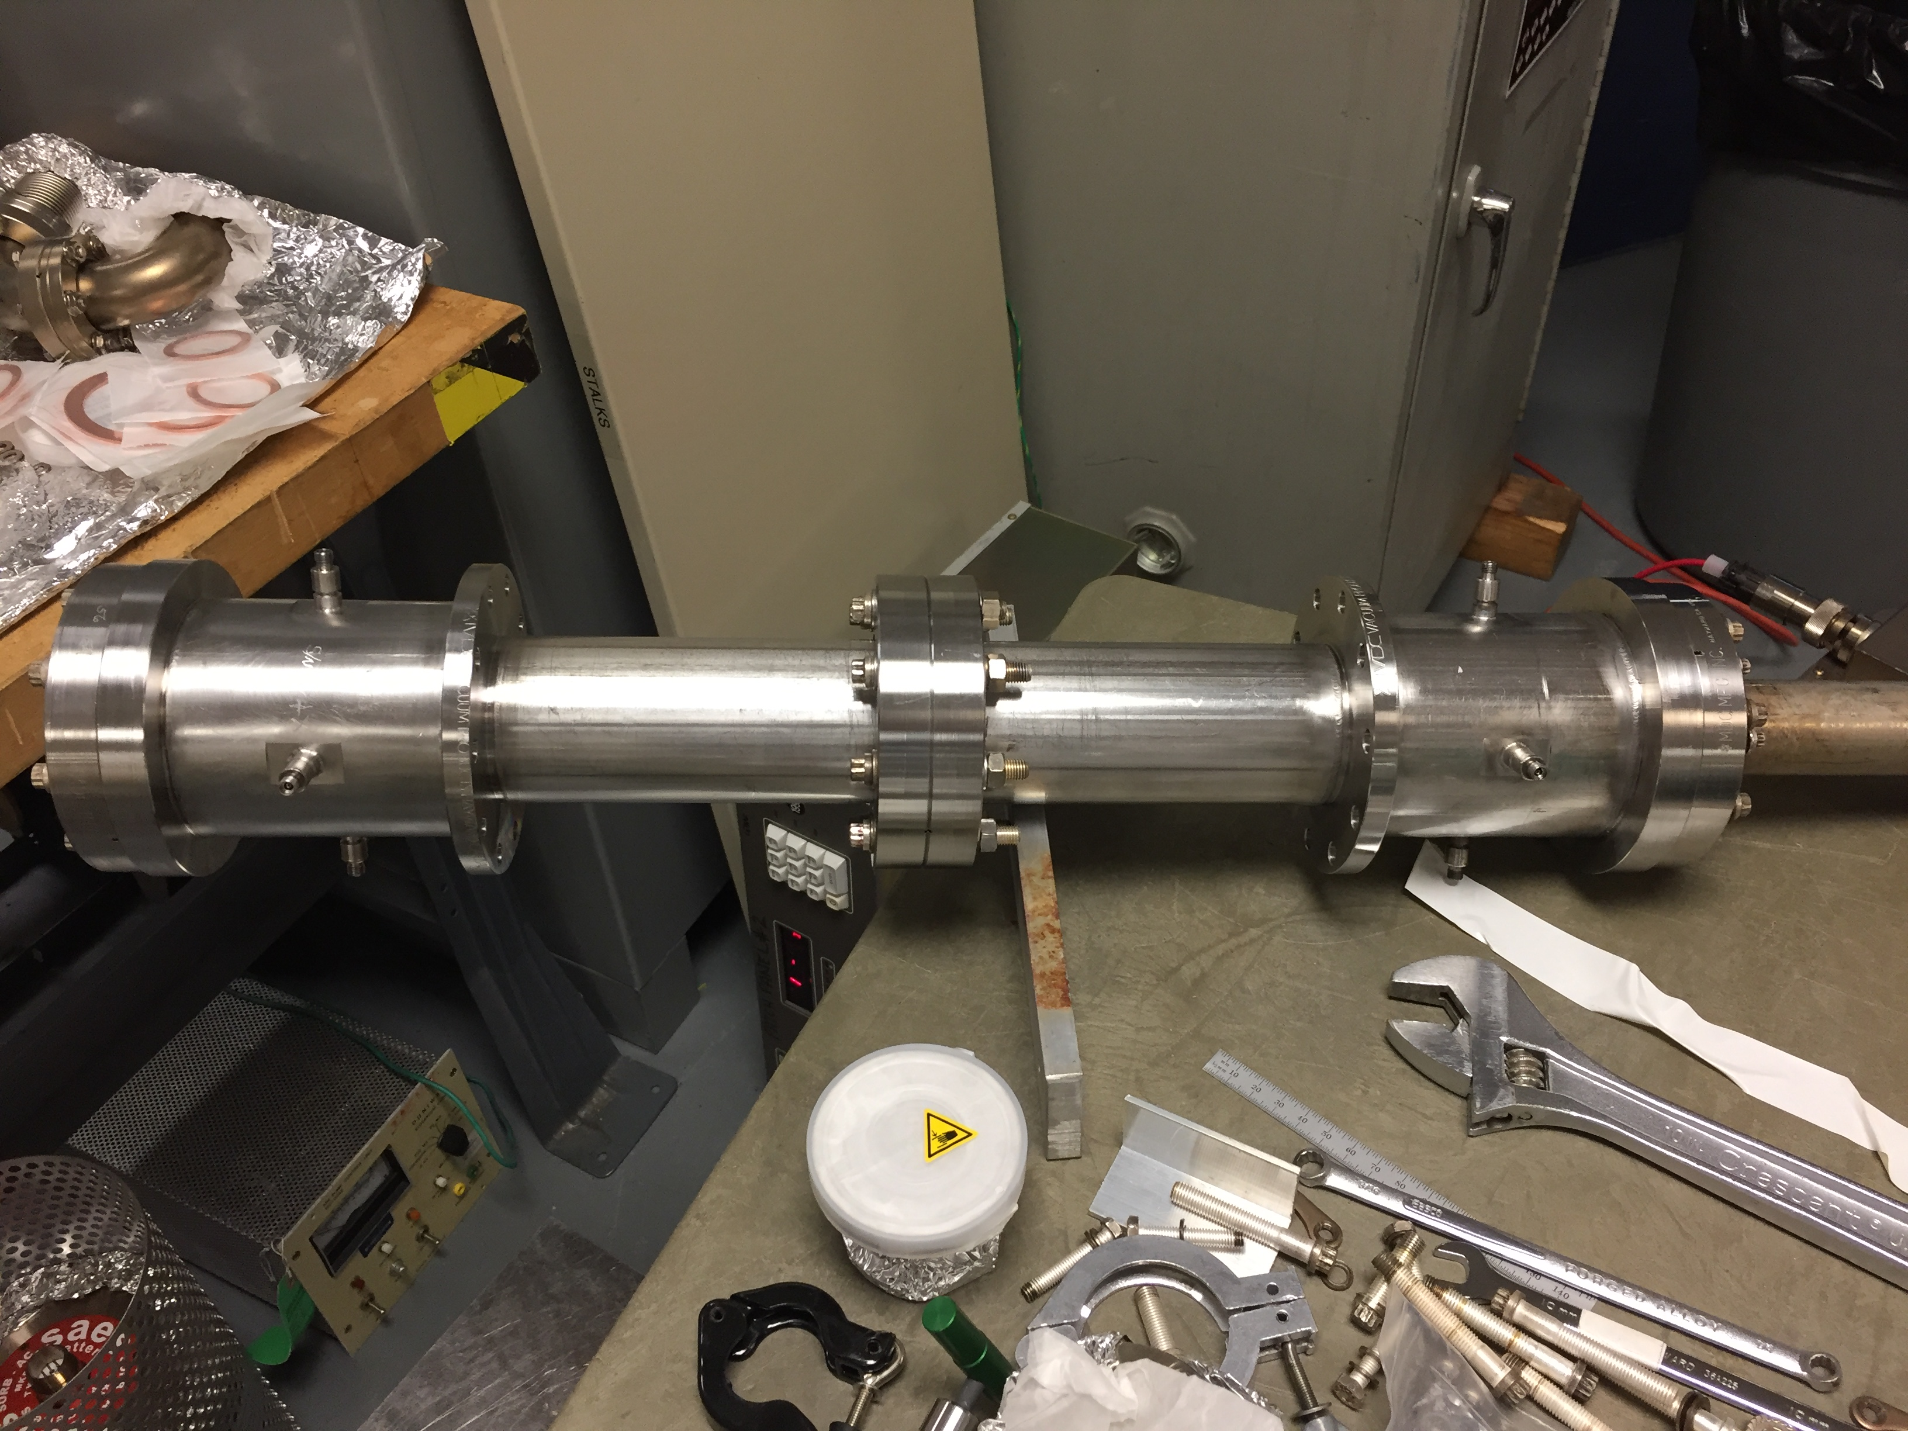
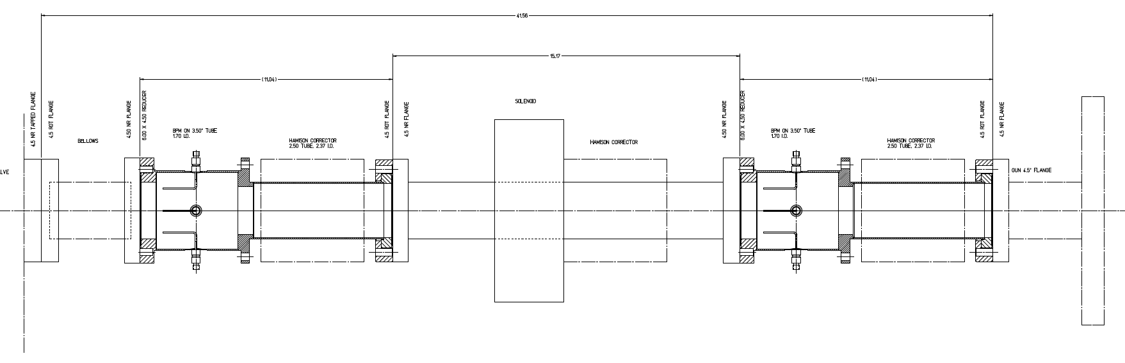
New NEG tube w/ two BPM’s
We will take advantage of replacing the gun high voltage chamber to replace the NEG coated beam pipe with one that has two BPM’s
Modified M20
BPM’s will have S/H cards for parity DAQ
With solenoid off measure position/angle
Test resolution to measure 2nd moment

Slide 19
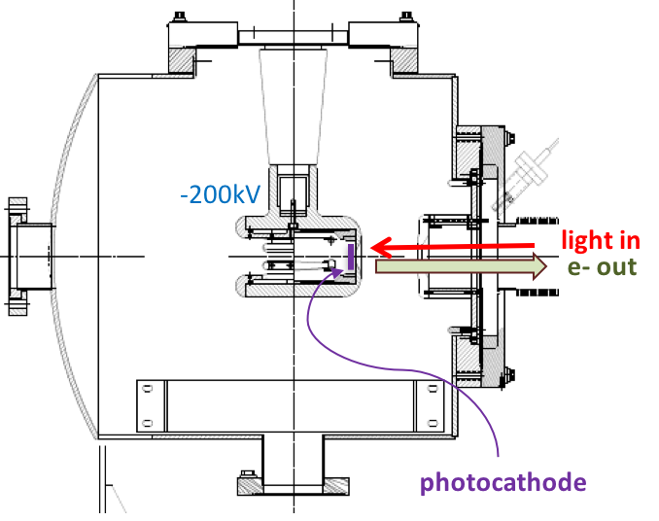

200 kV Gun
Modify spare CEBAF/ILC gun for reliable 200 kV operation
  One must is very high vacuum ~1E-12 Torr
  Another is no field emission; a “shed” protects the ceramic-vacuum-metal triple point, mitigates unwanted field emission
Work of G. Palacios, C.H. Garcia

Slide 20
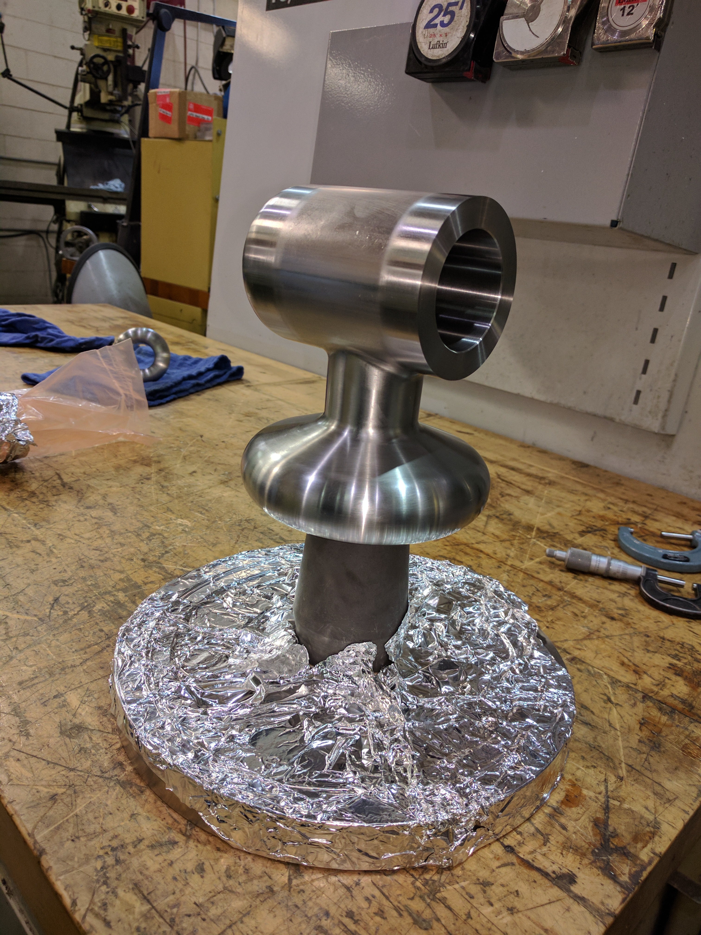
Hand-Polishing Nightmare!
New CEBAF 200 kV Gun
Work of G. Palacios, C.H. Garcia

Slide 21
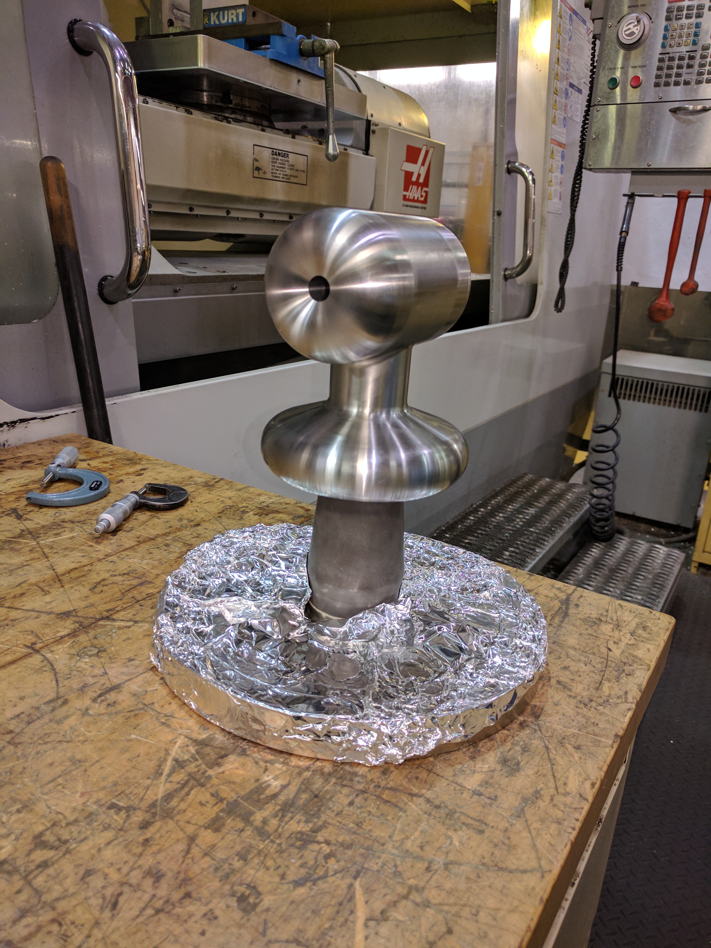
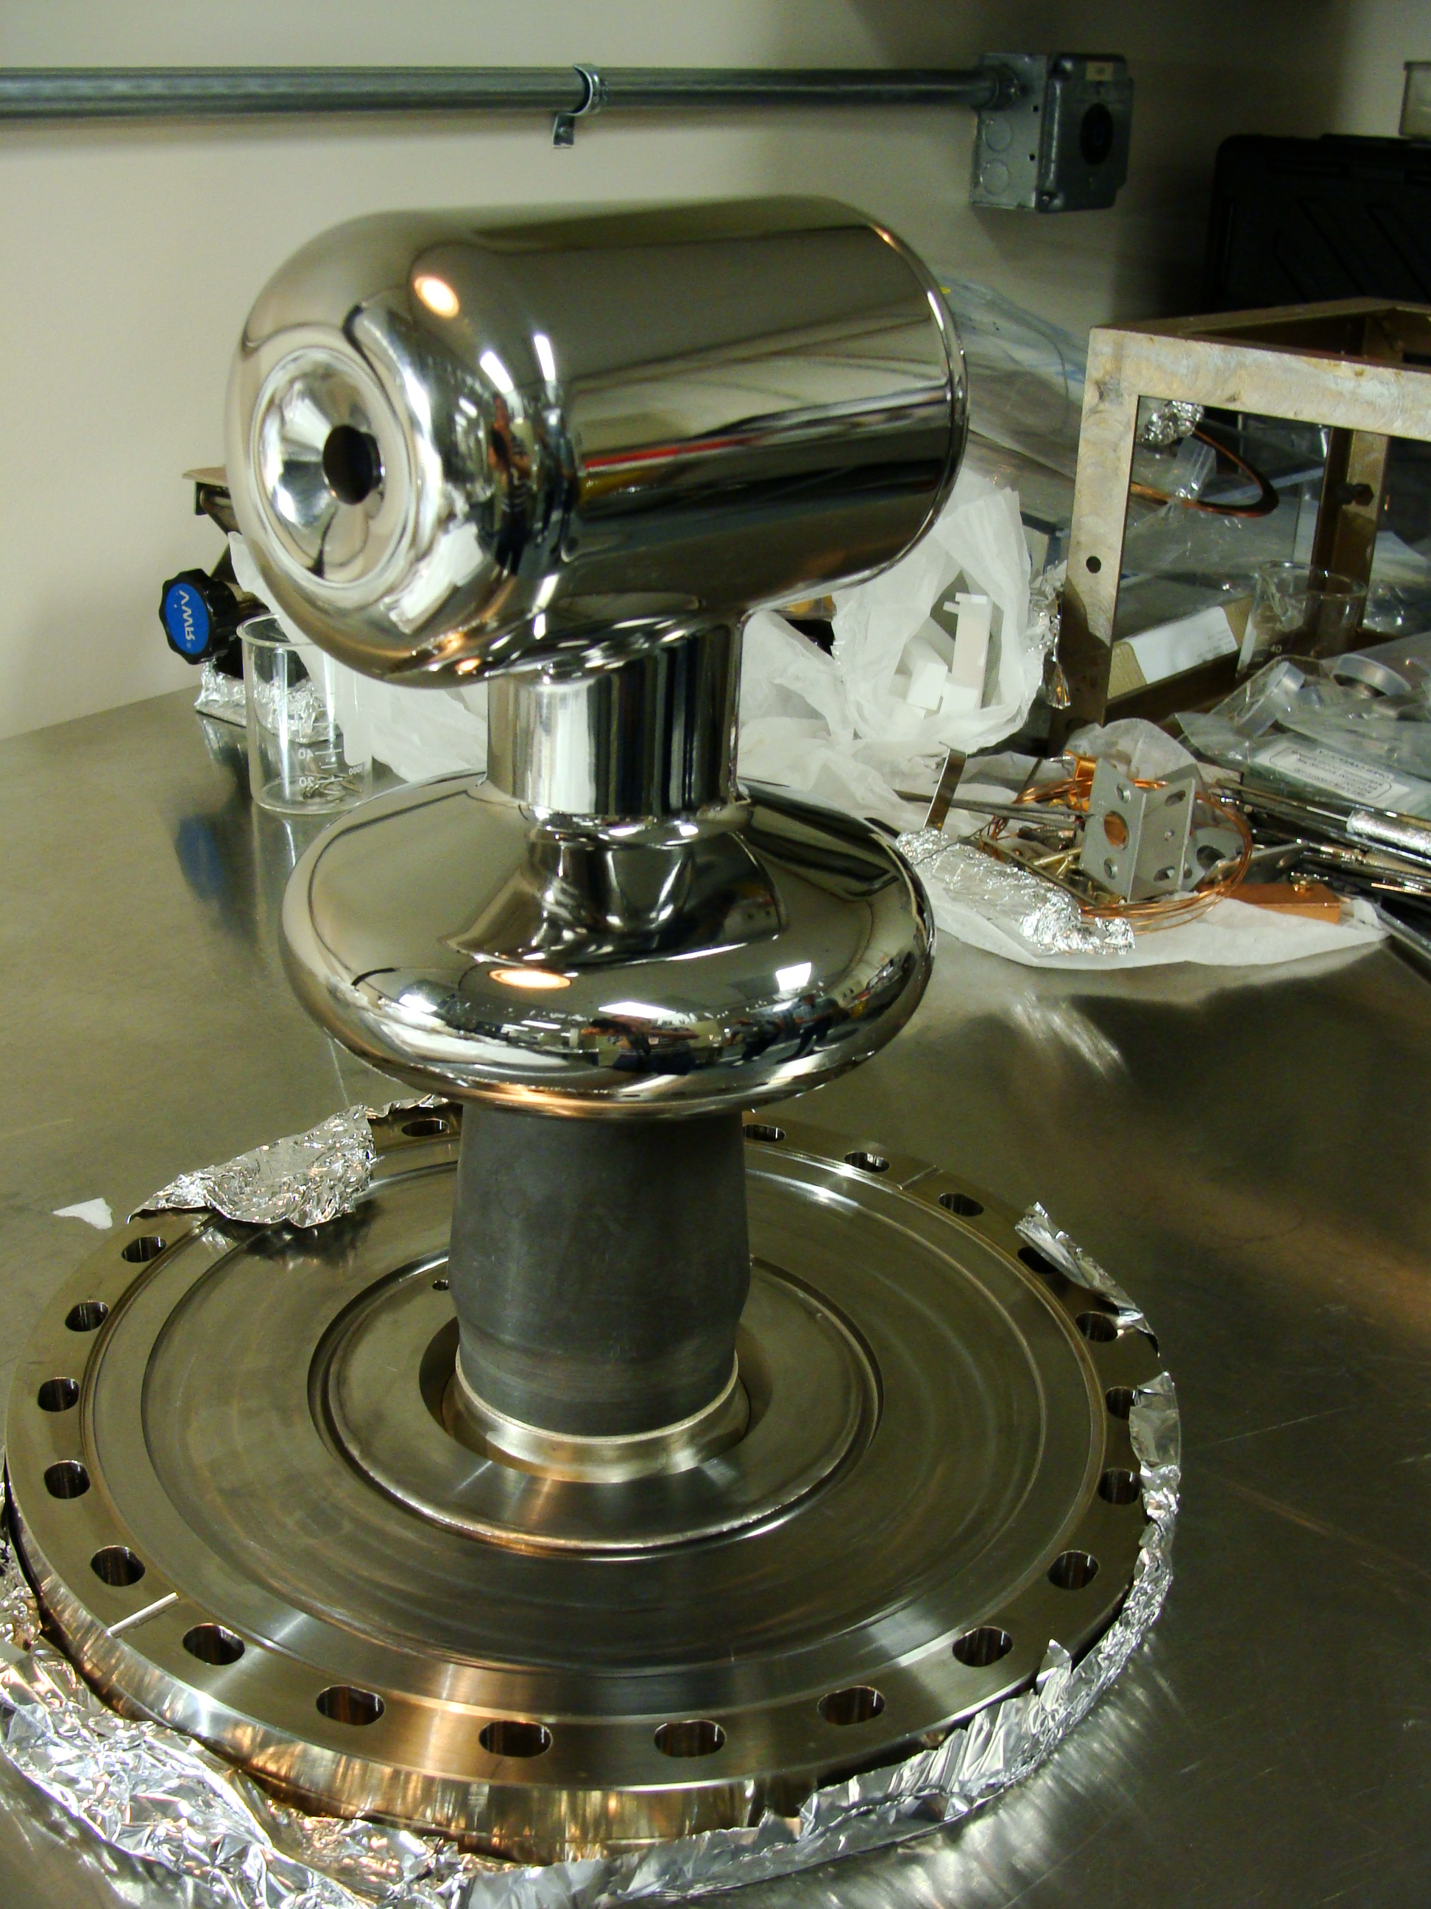
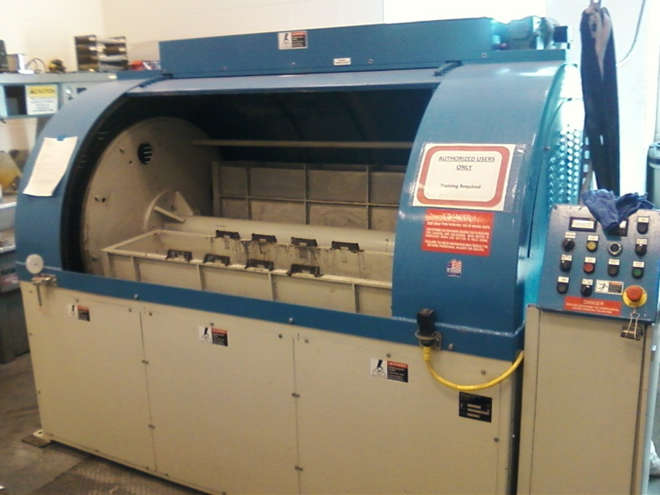
Centrifugal Barrel Polishing to Rescue
Reduced polishing time from Months to hours !!!
30 min. plastic cones
30 min. crushed corncob
  From machine shop
  Barrel polishing machine at JLab SRF
C. Hernandez-Garcia, D. Bullard, F. Hannon, Y. Wang, and M. Poelker, “High voltage performance of a dc photoemission electron gun with centrifugal barrel-polished electrodes,” accepted Rev. Sci. Instrum, 22 August 2017

Slide 22
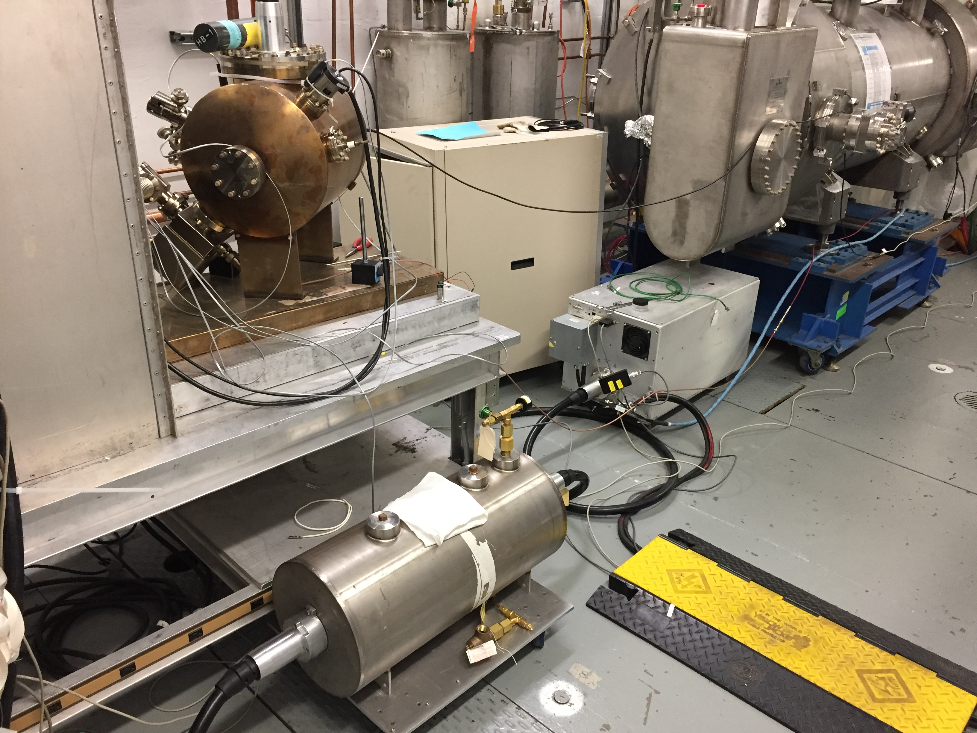
Conditioning the 200 kV gun at UITF (June 2017)
Gun assembled and baked successfully.
HV conditioned at the UITF using available with 225kV HVPS (Spellman) and SF6
Small, yet measurable on-set of field emission above 200kV – requires conditioning > 225kV to process

Slide 23
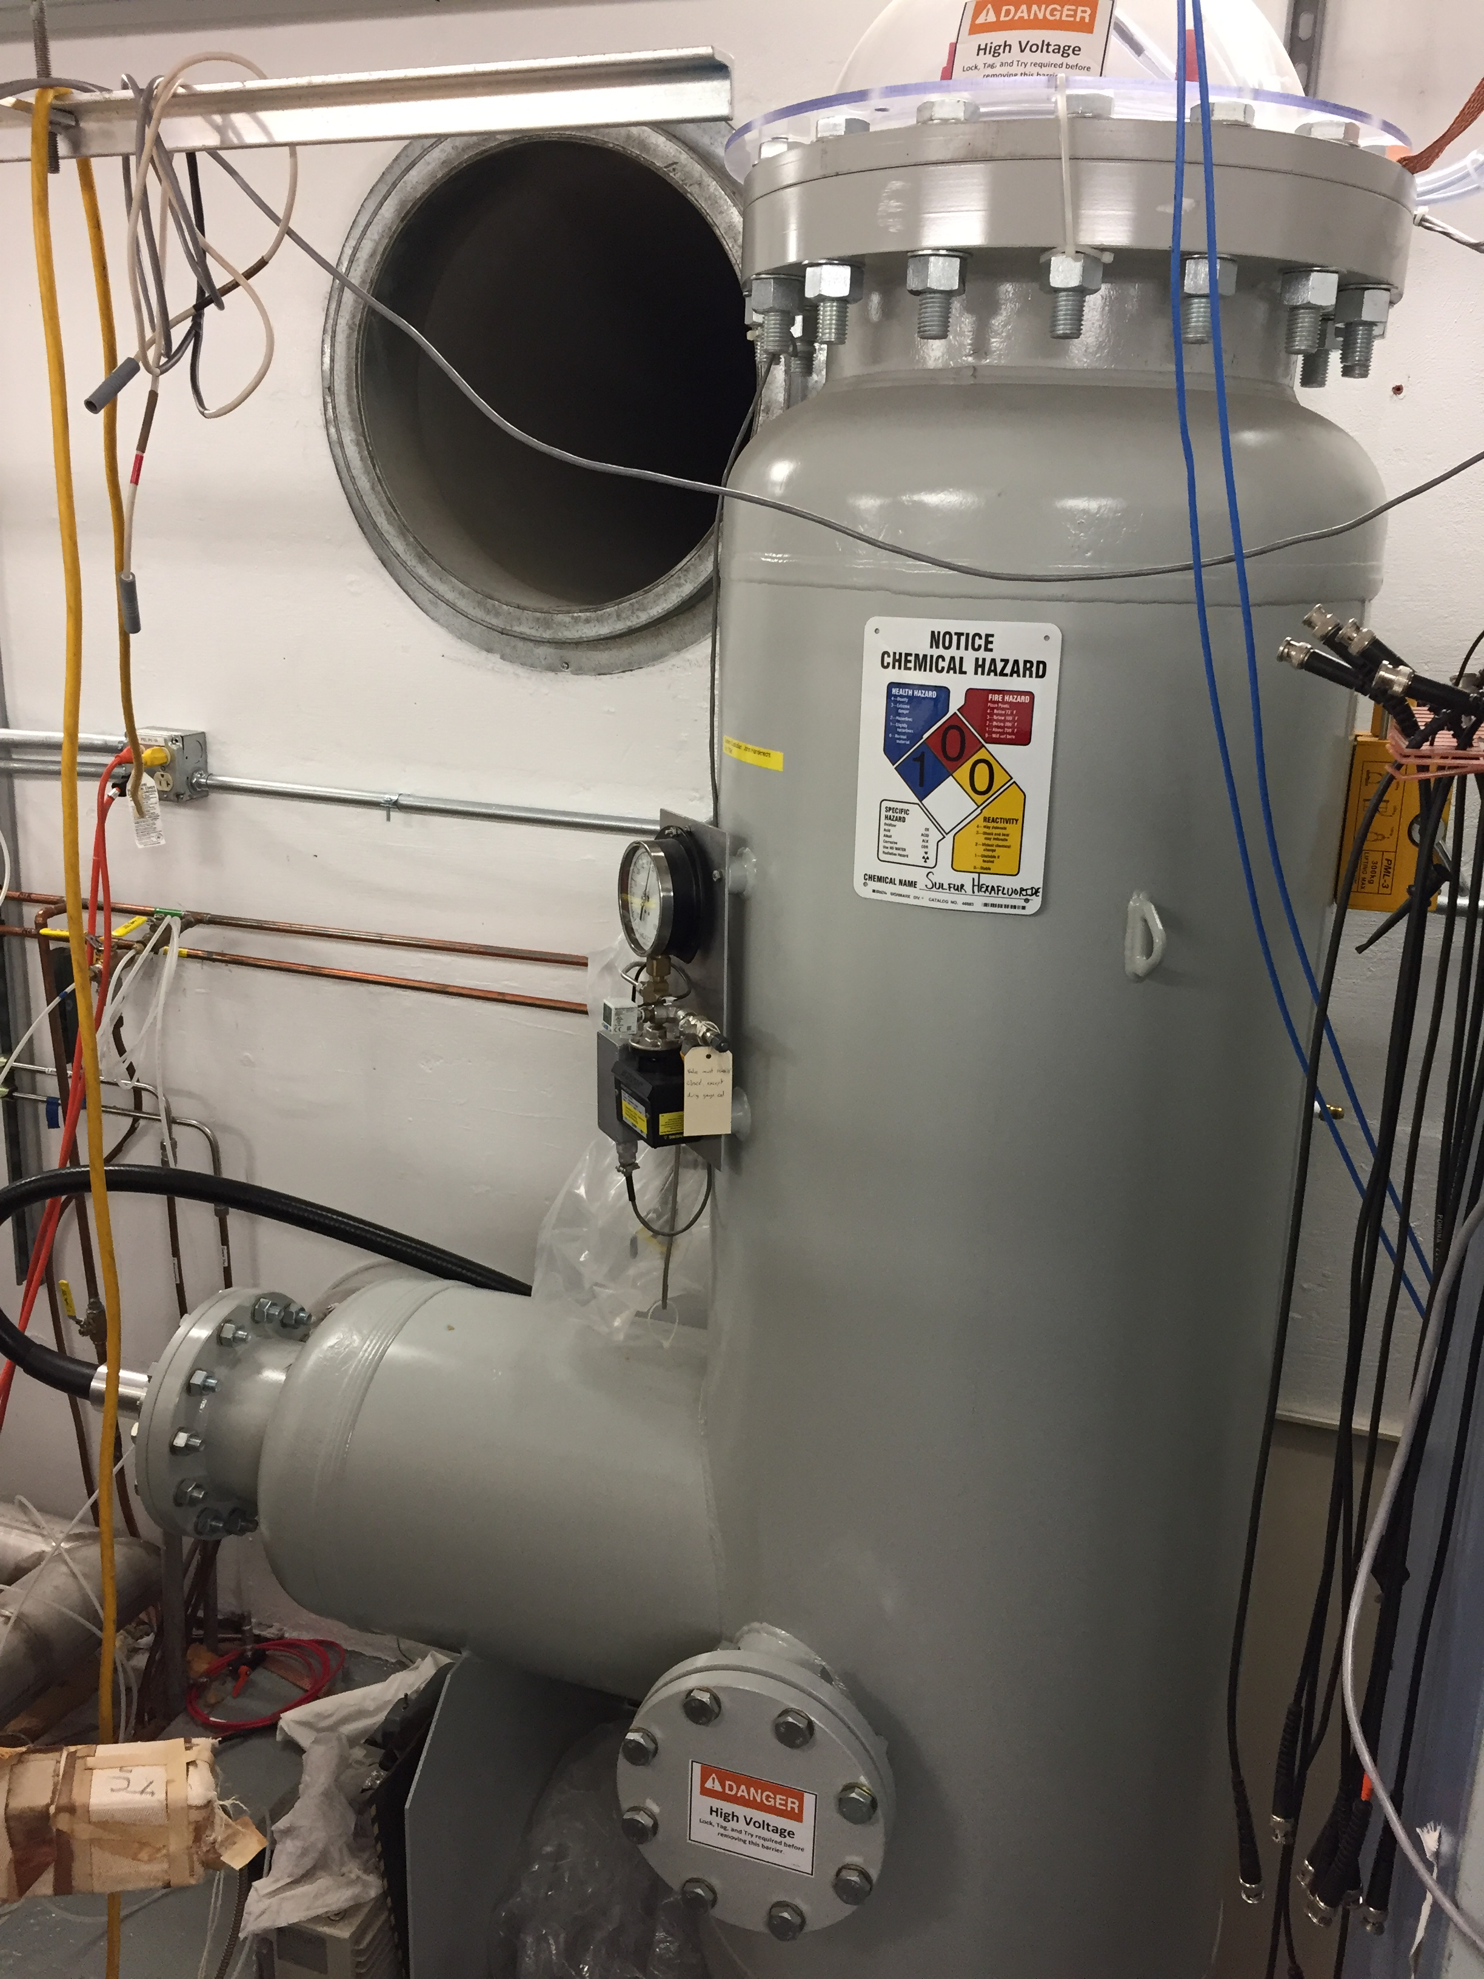
Steps moving forward…
Spellman HVPS supply inadequate for CEBAF operations
  Require higher voltage > 225 kV to process field emission
  PR’s for Glassman 350kV/4.5mA HVPS and SF6 tank submitted
  System identical to UITF (spare)
Fall/Winter
  Process 200kV gun w/ UITF spare
  Build 350kV HVPS for CEBAF
  Re-design of beam line started already
Spring 2018 SAD Goals
  350kV HVPS + 200kV Gun + NEG tube
  Commission 200 keV beam operation
  Time/$ permitting, rebuild the beam line

Slide 24
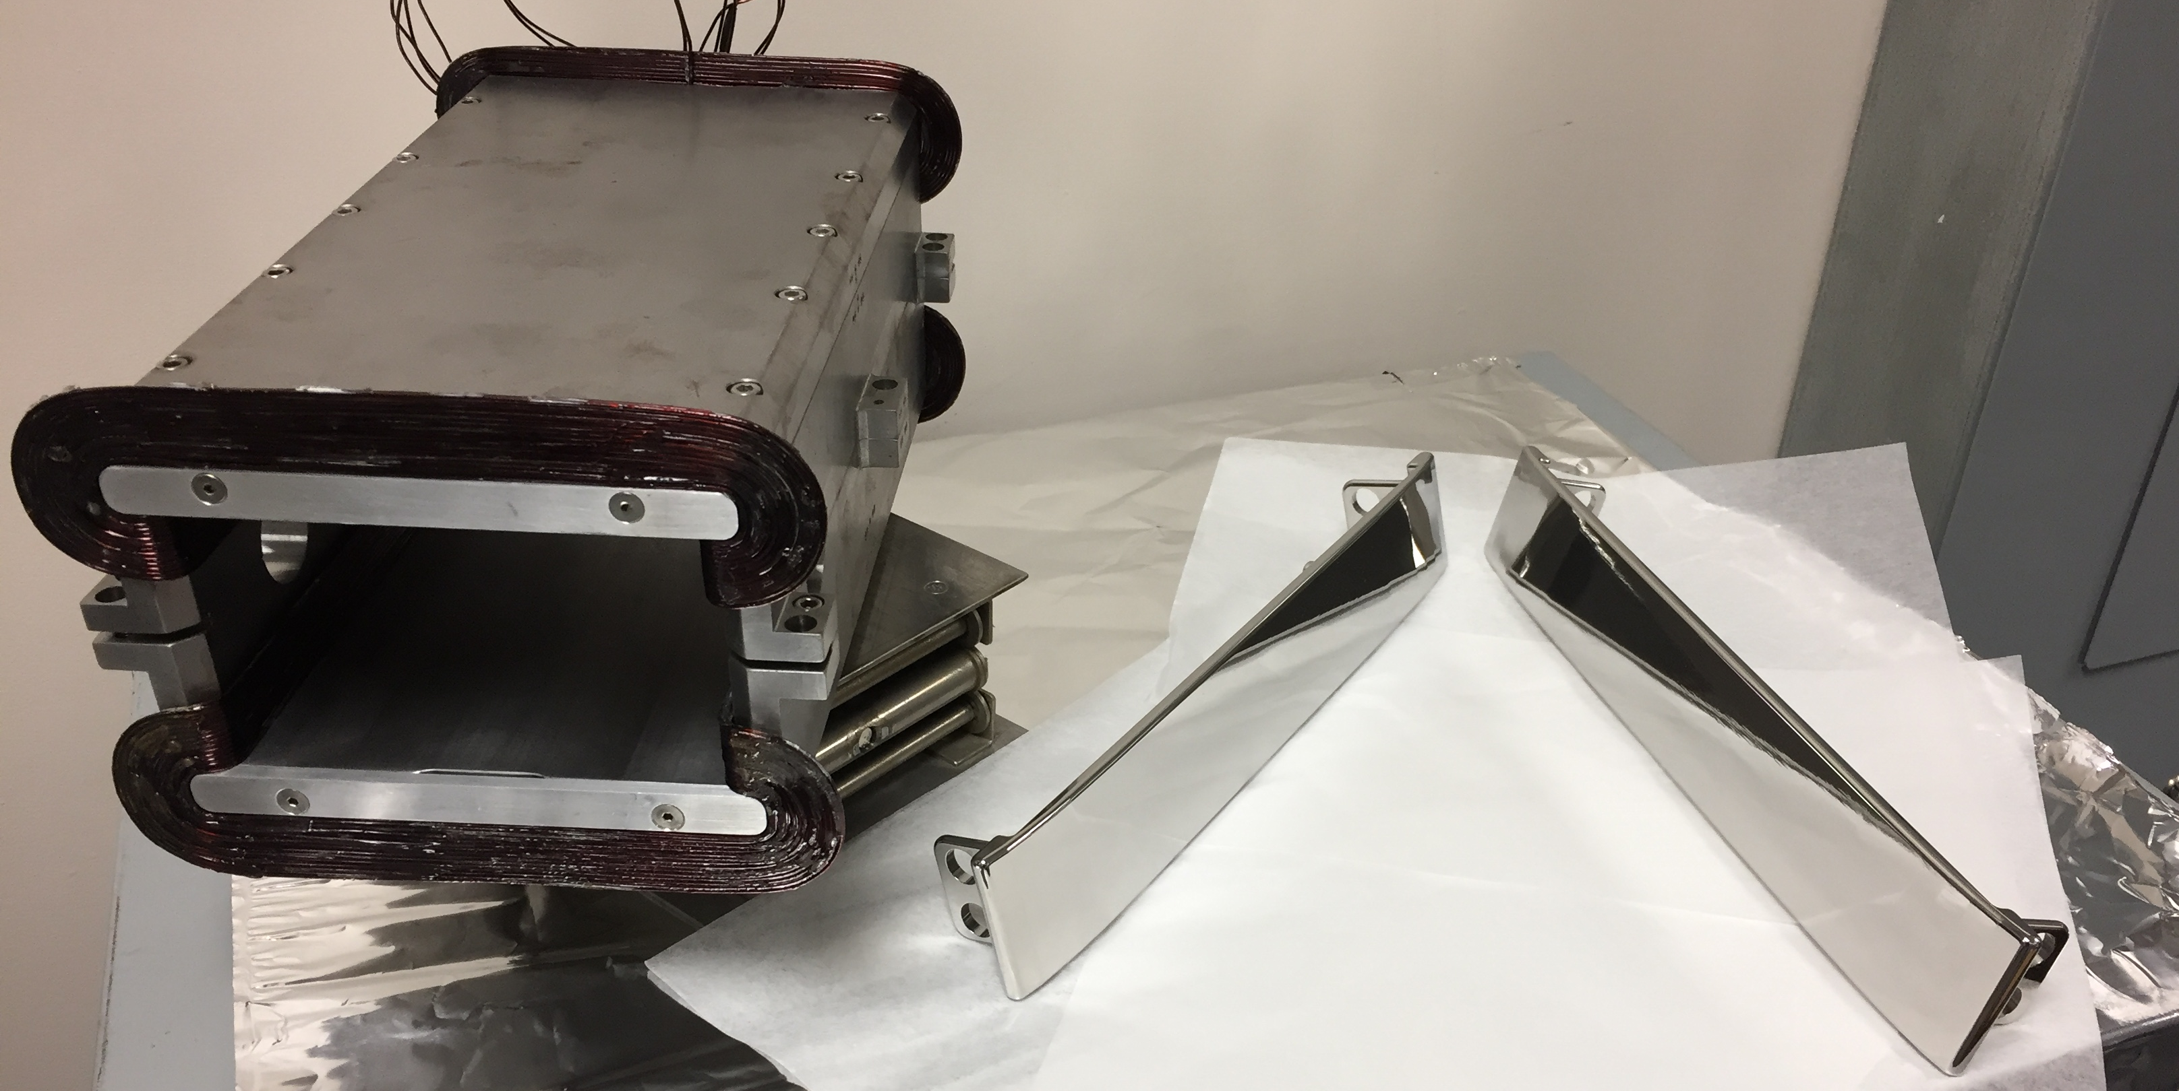
200 kV Wien filter
Upgrade the actual 130 keV Wien filters for 200 keV operation
Barrel polished electrodes and successfully tested to 20kV
Replace 14 kV supplies with 30 kV power supplies
Replace 10 A coils with 20 A coils (J. Benesch, JLAB-TN-15-032)
First upgrade prototype to be tested at the UITF this Fall
Wien Upgrade for 100 deg precession
Beam Voltage | keV | 200.00
Integrated BL | G-cm | 3993.86
Magnet Current | A | 15.36
Electric Field | MV/m | 2.67
Electrode High Voltage | kV | 20.05

Slide 25
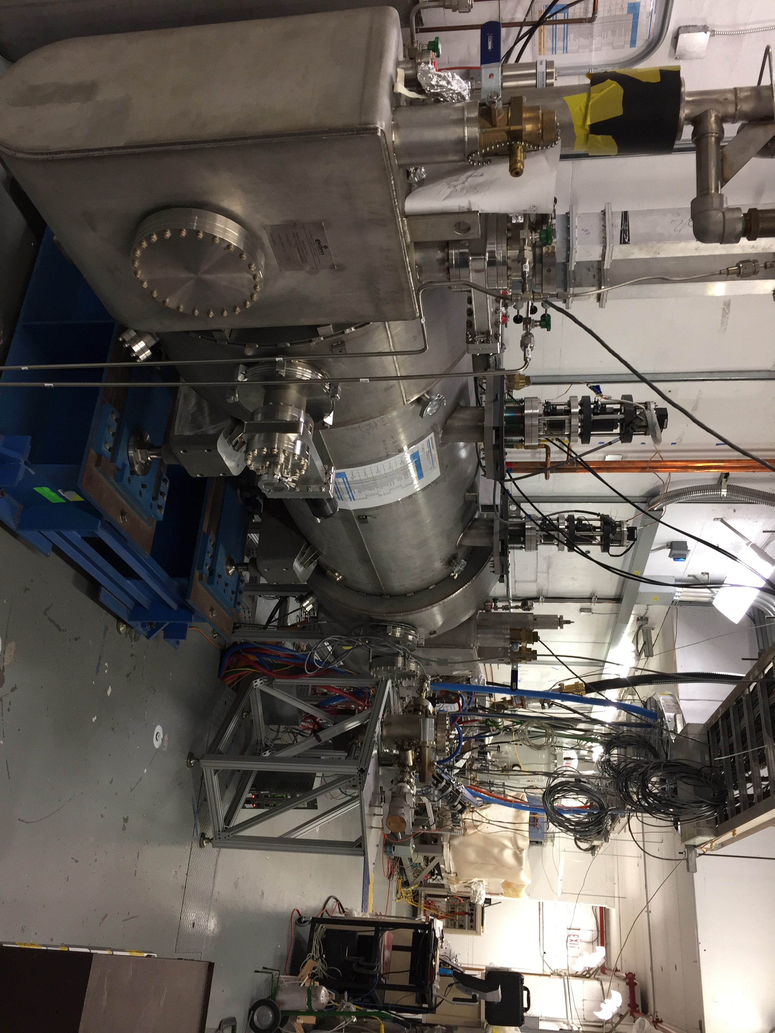
Testing CEBAF Upgrade Cryounit at UITF
Upgrade Cryounit Commissioning at Test Lab
  Spring 2017 – cryostat positioned at UITF
  Summer 2017 – keV vacuum beam line connected
  Winter 2018 – application of klystron power

Slide 26
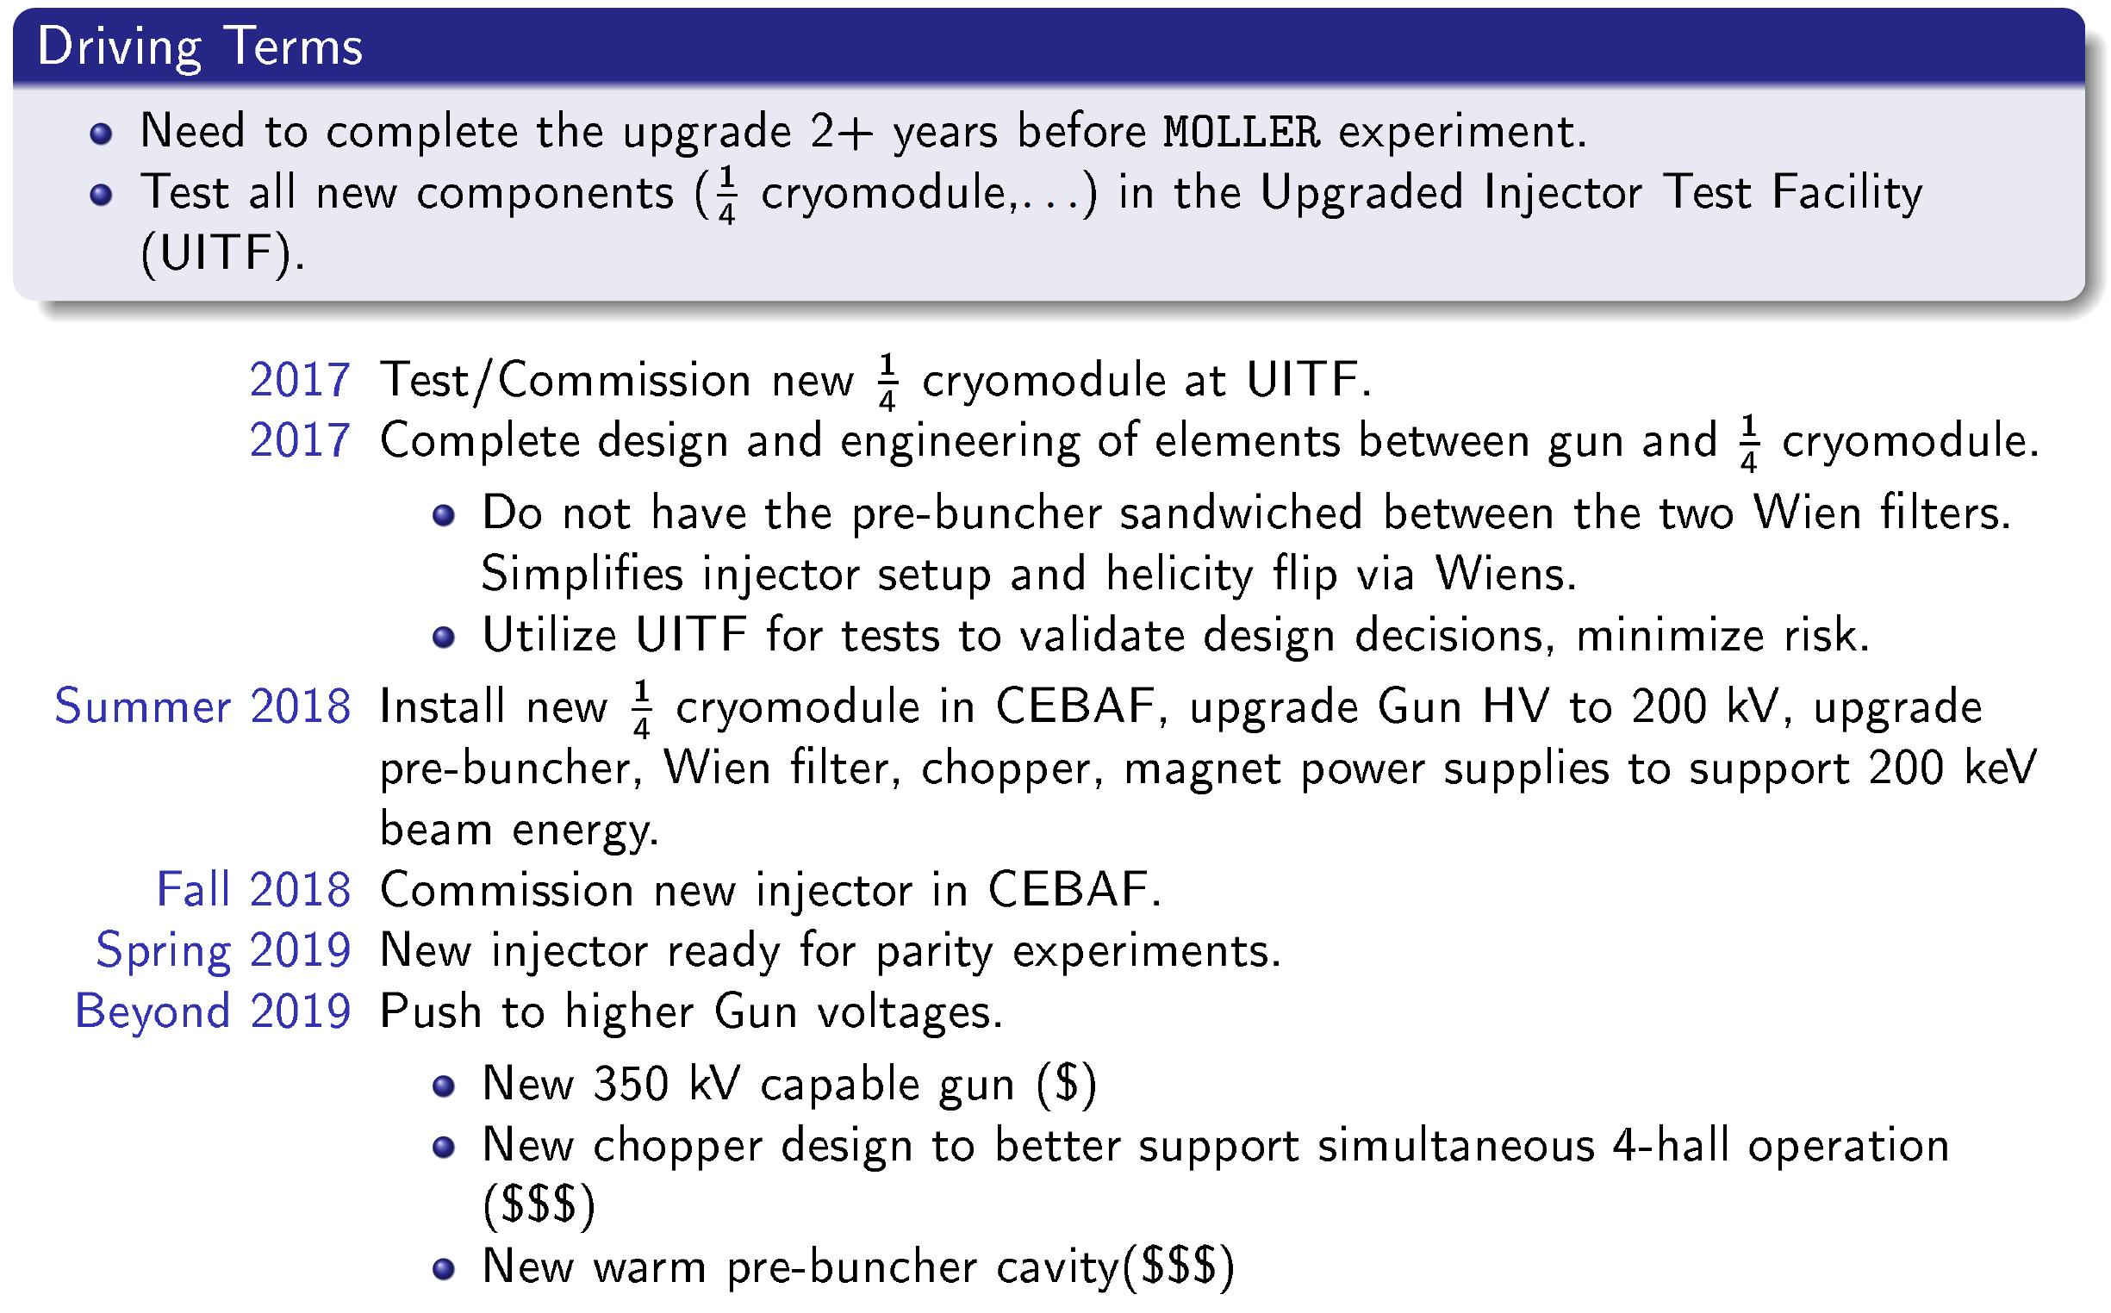
A. Freyberg Aug 2016 ECT’16 =>
PREX/CREX
timescale
Not likely if we test at UITF first

Slide 27
Summary - Running PREX/CREX
The >130keV Gun
We plan to install a gun capable of 200 keV operation by Fall 2018
Until remaining beamline fully upgrade (chopper/cryounit) we may still find a higher voltage operating point that benefits gun operation
Parity Quality Beam
Laser table setup for QWeak successfully meet the PREX/CREX requirements
Large laser size of about 1 mm consistent KD*P benefit photocathode lifetime
Helicity magnets downstream of all apertures are ready for position feedback
SRF Operation at 4K
We have demonstrated capability to operate C20/C50 5-cell modules at 4K
At the injector produced indistinguishable beam up to about 15 MeV
Tested the NL @ 4K to 130 MeV suggesting 1 GeV; maybe 2 GeV possible?
Propose to invite Grigory Eremeev to give a talk to PREX/CREX.

