Slide 1
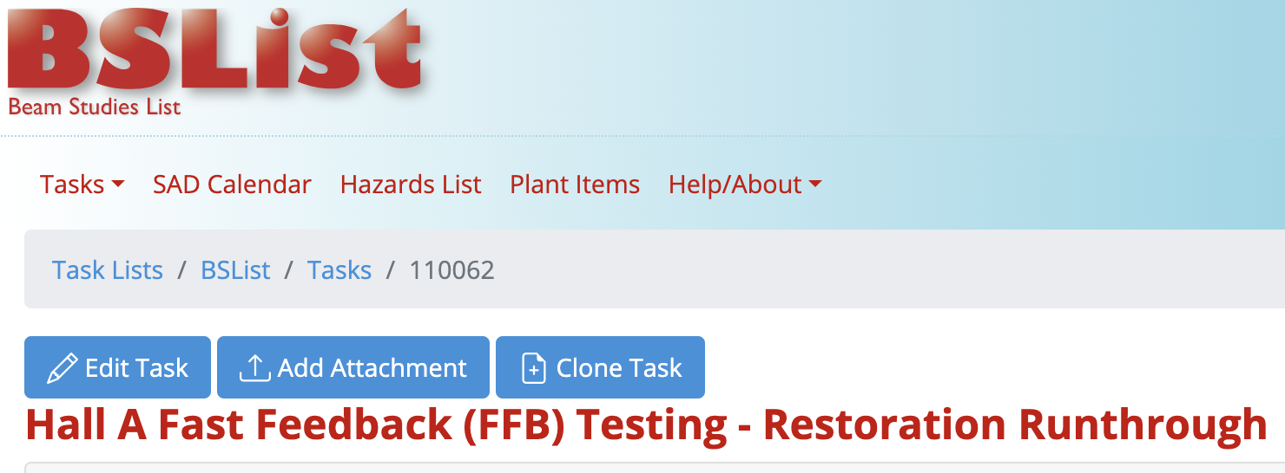
Fast Feedback Resurrection – Current Status
Performed Beam Study in December to go through start up procedure
  Performed in Hall C instead of Hall A due to availability
  Test was successful, and feedback was used to update the control screens and documentation
  No analysis was performed at this test – it was only to see if the system worked as described
Agreed to keep FFB running into Hall C (unless it interferes)
  Has *mostly* been running
    Some small hiccups as we (re)learn to use the system
    Gain switching can sometimes cause hiccups

Slide 2
Fast Feedback Resurrection – FFTs
3C07H
3C16H
3C12H

Slide 3
Fast Feedback Resurrection – FFTs (Zooming In)
3C07H
3C12H
Took data with multiple FFB states to check 60 Hz suppression
  Clear suppression, but not exactly at 60 Hz
  Making new test plan to “calibrate” via data – will use 30 Hz switch to drive modulations and look at FFTs from FFB system (AtLIS being written now)
Following up with small errors encountered during operations
Will perform power spectral density on FFT data

