Slide 1

Milliampere beam studies using high polarization photocathodes
J. Grames
JLAAC Review September 13-15, 2017

Slide 2
Outline
Ion back-bombardment of photocathodes
PEPPo – an application requiring a milliampere polarized electron beam
R&D efforts to extend the charge lifetime of polarized electron sources

Slide 3

Ion Bombardment

Slide 4


PEPPo
(PEPPo Collaboration) D. Abbott et al., Phys. Rev. Lett. 116 (2016) 214801
electron beam polarization
85.2 ± 0.6 ± 0.7 %
PEPPo apparatus at the CEBAF Injector
Demonstrated the feasibility to use the bremsstrahlung of polarized electrons for the efficient production of polarized positrons.
Using a 100 MeV energy electron beam requires milliampere current to produce useful 100’s nA polarized positrons for CEBAF

Slide 5
High Polarization Photocathodes
Bulk GaAs
Strained GaAsP
Superlattice GaAs/GaAsP
100 nm
1 Layer
100 nm
14 Layers
30 mA/W
1 mA/W
6 mA/W
P_{e-} 35% 35% 75% 75% 85% 89%
I_{e-} 30μA 100μA 50μA 100μA 150μA 200μA
1995 1998 1999 2000 2004 2017
Photocathode capability (polarization and QE) has grown significantly.

Slide 6

Improving Lifetime with Larger Laser Size
J. Grames, et al, Phys. Rev. ST Accel. Beams 14 043501 (2011)
GaAs @ 532nm

Slide 7

Improving charge lifetime with GaAs/GaAsP
Indeed we enhanced the Charge Lifetime for Qweak by a factor of four when doubling the laser spot size from 0.5mm to 1.0 mm (diameter).
We must extend the operational lifetime of milliampere sources producing 36 C/mA-hr well beyond hundred’s of Coulombs.

Slide 8


Lifetime Studies at mA Beam Current
High current (1-10 mA) studies with low-P photocathodes demonstrated that charge lifetime is improved by increasing laser spot size (spreading out ion damage).
Measurements are underway using the CEBAF polarized source to characterize lifetime vs. spot size with high-P (>85%) photocathodes.
Phys. Rev. ST Accel. Beams 14, 043501 (2011)
CEBAF Polarized Inverted Load Lock Gun
Slope is proportional to QE Decay
Increasing laser size reduces QE decay proportionally
1mA

Slide 9
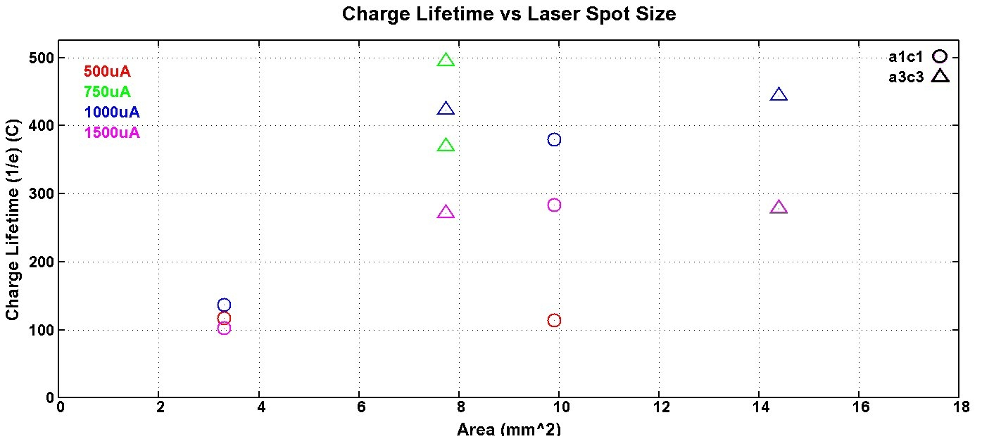
First CEBAF GaAs/GaAsP milli-ampere Results
  CEBAF charge lifetime expectedly improves with spot size, but eventually gains lessen as beam size becomes “too large”.
  A photo-gun with cathode/anode optics that manages a larger laser/beam offers a pathway towards milli-ampere operation.

Slide 10

Polarization Studies at mA Beam Current
First measurement of polarization from superlattice photocathode at milliampere current
CEBAF 5 MeV Mott polarimeter: on-going effort to ascribe sub-percent accuracy (collaborators D. Moser, X. Roca-Maza, Charles Sinclair, M.J. McHugh, A.K. Opper, and Tim Gay)
CEBAF 5 MeV Mott Polarimeter

Slide 11
Summary
Extending the charge lifetime of today’s spin polarized GaAs photoelectron guns from tens to thousands of Coulombs is a requirement for uninterrupted operation at milliampere beam current.
New experimental results demonstrate high polarization and improved lifetime with laser spot size using GaAs/GaAsP photocathodes.
Managing all of the beam remains essential, and suggests photo-guns with larger acceptance an important path for sustainable milliampere operation.
New DBR photocathode is an excellent candidate for high current (mA) polarized electron beam initiatives. Lifetime tests at CEBAF to happen soon.

