Slide 1
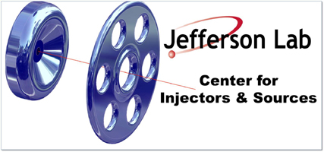
Polarized Injector & Upgrade Schedule
P. Adderley, J. Clark, J. Grames, J. Hansknecht, M. Poelker,
M. Stutzman, R. Suleiman, K. Surles-Law
QWeak Collaboration Meeting
November 06, 2009

Slide 2
Outline
Inverted Gun & Higher Voltage
Electron Polarization Reversal
Fast Helicity Reversal & New Helicity Board
New QWeak IA Electronics
Injector Commissioning & Optimization for QWeak

Slide 3
Parity Experiments Requirements
Experiment | Hall | Start | Energy (GeV) | Current (µA) | Target | A_{pv} (ppm) | Maximum Charge Asym (ppm) | Maximum Position Diff (nm)
HAPPEx-III (Achieved) | A | Aug 09 | 3.484 | 100 | ¹H (25 cm) | 16.9±0.4 | 0.2±0.1 | 3±3
PVDIS | A | Oct 09 | 6.068 | 100 | ²H (25 cm) | 63±3 | 1±1 | 10±10
PREx | A | March 10 | 1.056 | 100 | ²⁰⁸Pb (0.5 mm) | 0.500±0.015 | 0.100±0.010 | 2±1
QWeak | C | May 10 | 1.162 | 180 | ¹H (35 cm) | 0.234±0.005 | 0.100±0.010 | 2±1

Slide 4
Inverted Gun at CEBAF
First Inverted Gun (with Stainless Steel electrode) installed at CEBAF, operational since July 23, 2009
Running at 100 kV. Conditioned to 110 kV
Lifetime about 75 C at 130 µA average current
2 weeks between spot moves, 2-3 months between heat/activations
HAPPEx-III, PVDIS, and PREx: 100 kV. QWeak: >100 kV
Maximum possible Gun Voltage is 150 kV (limited by Safety System and HV Power Supply)

Slide 6
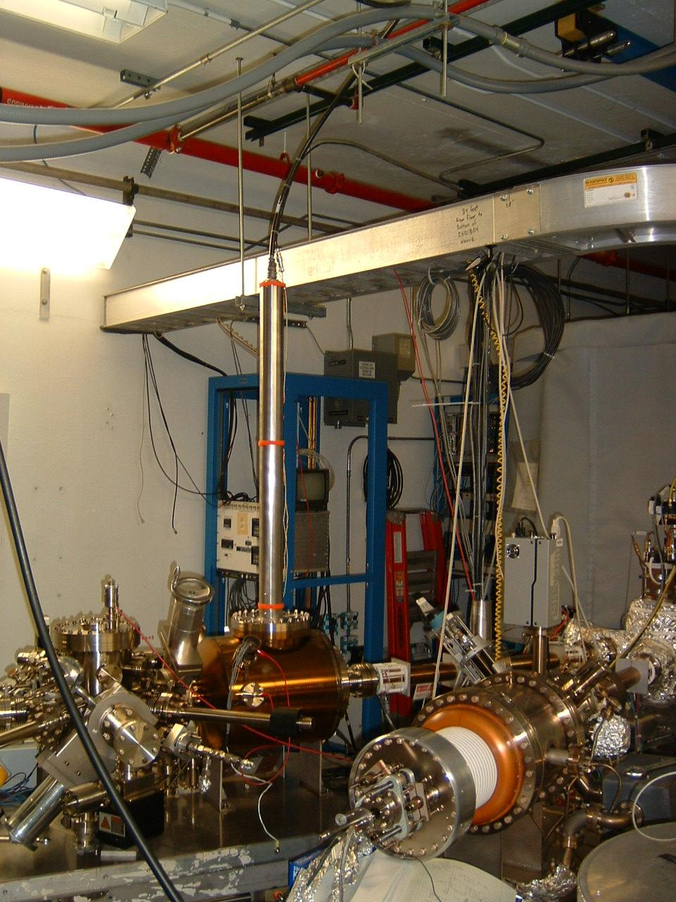
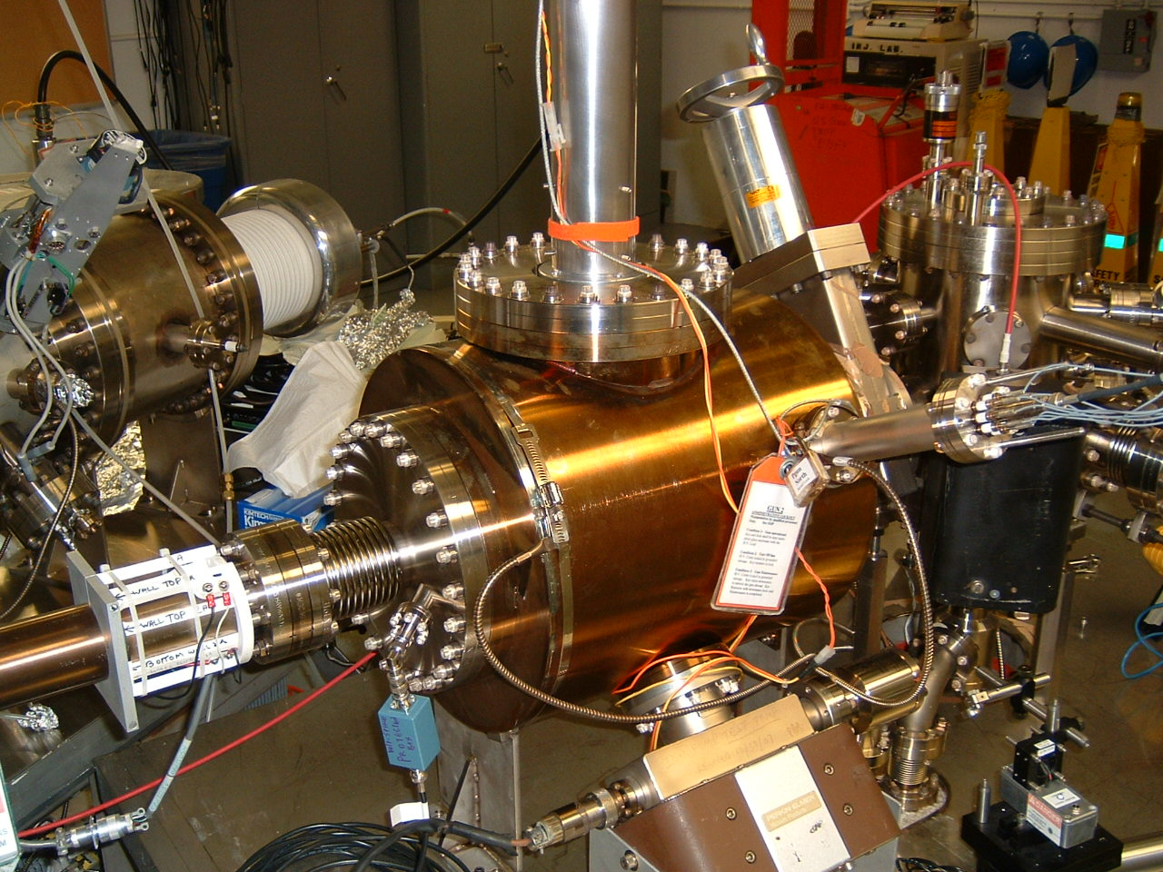

Slide 7
Inverted Gun at Test Cave & Higher Voltage
Second Inverted Gun (with Nb electrode) will be installed at Test Cave by mid November
Condition to 150 kV by end of November
Run beam and measure lifetime at >100 kV by Christmas
Reminder: still need to test the CEBAF injector up to 150 keV for compatibility with higher voltage gun, mainly warm RF: PreBuncher, Chopper, Buncher, Capture.

Slide 8
Injector Test Cave

Slide 9
Electron Polarization Reversal
“Long. Pol. for Halls”
Horizontal Wien = -90° → +90°
+ Solenoid Current
- Solenoid Current
“Spin Flipper”
Vertical Wien = 90°
Two Solenoids 2(+/- 45) = ± 90°

Slide 10
Helicity reversal using one Wien Filter and Two Solenoids:
New optics design with new quadrupoles to maintain constant Injector configuration
Cancels all helicity-correlated beam asymmetries from laser and photocathode
Can be used up to maximum Gun Voltage of 140 kV
Install in Jan 2010. Commission basic beamline in Feb 2010. Commission reversal at 100 kV at start of PREx
More diagnostic to commission and operate the beamline: 1 new harp, 1 new viewer, new vacuum gauges, new UHV ion supplies and two new BPMs with LINAC IF and S/H cards (Need to add to QWeak DAQ)

Slide 11
Fast Helicity Reversal
Summary of Fast Helicity Reversal Studies:
Reduces noise on beam current by factor of 4
Reasonable reduction in beam position noise
Achieved Pockels Cell T_Settle of 60 µs
Will reduce noise from QWeak target density fluctuations
Requirements:
Experiment | Rate | Clock | Pattern
HAPPEx III & PVDIS | 30 Hz | Free | Quartet
PREx | 240 Hz | Line-Locked | Octet
QWeak (Preliminary) | 1 kHz | Free | Quartet

Slide 12
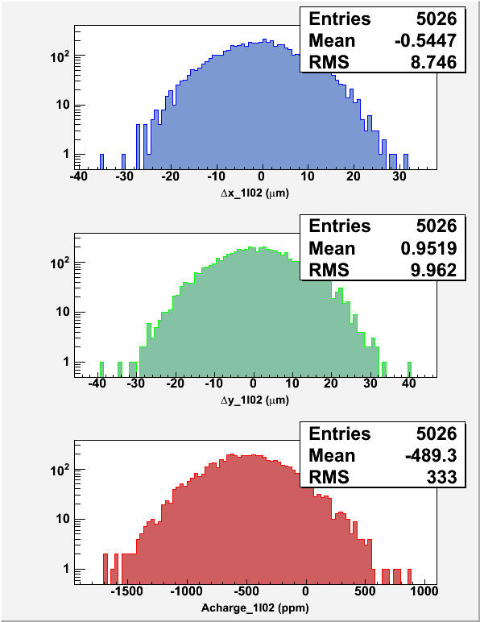
30 Hz, T_Stable = 33.333 ms, T_Settle = 500 µs
1 kHz, T_Stable = 0.980 ms, T_Settle = 60 µs

Slide 13
New Helicity Board
New Helicity Board installed on Nov 2, 2009
Features:
Transition to T-Settle will start 1 µs before all other signals
30-bit Pseudo-random Shift Register
Patterns: Toggle, Pair, Quartet, Octet
T-Settle: 10 µs – 1,000 µs
Clock:
Line-Locked: Helicity Reversal of 30 Hz, 120 Hz, or 240 Hz
Free: T-Stable of 400 µs – 1,000,000 µs
More Fiber Outputs:
Real Time Helicity:
Standard: Pockels Cell & IAs
Complementary: Helicity Magnets
20 MHz board internal clock
Two outputs indicate current and previous helicity patterns to QWeak IA

Slide 14
QWeak New IA Electronics
Charge Feedback using Intensity Attenuator (IA) with the option to correct for Pockels Cell hysteresis
Use Fast EPICS to communicate with the IA
Use 16-bit ADC and 16-bit DAC
Hardware to be installed in Jan 2010
Commission during QWeak in May 2010

Slide 15
Injector Commissioning & Optimization
Coordinator: Suleiman
Members: Poelker, Grames, Hansknecht, King, Carlini, Paschke, Ramsay
Plan:
Higher Voltage:
Gun: Dec 2009, Test Cave
CEBAF Beamline: May 2010
Electron Polarization Reversal: Commission at 100 kV during PREx, >100 kV in May 2010
New Helicity Board: Commission during PREx
QWeak Pattern: May 2010
QWeak Reversal Rate: May 2010
New IA (Charge Feedback): May 2010 (need analysis support)

