Slide 1
4.5 mA , 32 mA
Sajini Wijethunga

Slide 2
4.5 mA
Bunch charge - 12 pC
Gun voltage - 300 kV
Laser 50 ps (Gaussian)
Solenoid current - 400 A
Laser size- 0.32 mm rms
Xoff =0 , Yoff =0
Emittance 0.56 mm mrad/mm
Space charge on
Other solenoids off
v1 (mm) |  | v2 (mm) |  | v3 (mm)
x | y | x | y | x | y
7.1229 | 7.1243 | 9.3523 | 9.3528 | 16.872 | 16.8695

Slide 3
v1
v2
v3

Slide 4
Viewer 1
50000 particles in distribution
-12.00 pC total charge
Position 1.47
2.99890e-01 MeV, beta*gamma 1.2, beta 0.7765
5.15990e-01 keV sig energy spread
43.98180 ps, sig time at cathode
sigx = 7.1229 mm, sigy = 7.1243 mm
sigxp = 6.6066 mrad, sigyp = 6.6040 mrad
sigz = 10.9451 mmnEnz = 2.1604 keV mm = 9.2744 keV ps
Enxps = 39.4646 um, Enyps = 39.4553 um
Enxtr = 39.4702 um, Enytr = 39.4603 um
Exge = 32.0295 um, Eyge = 32.0219 um

Slide 5
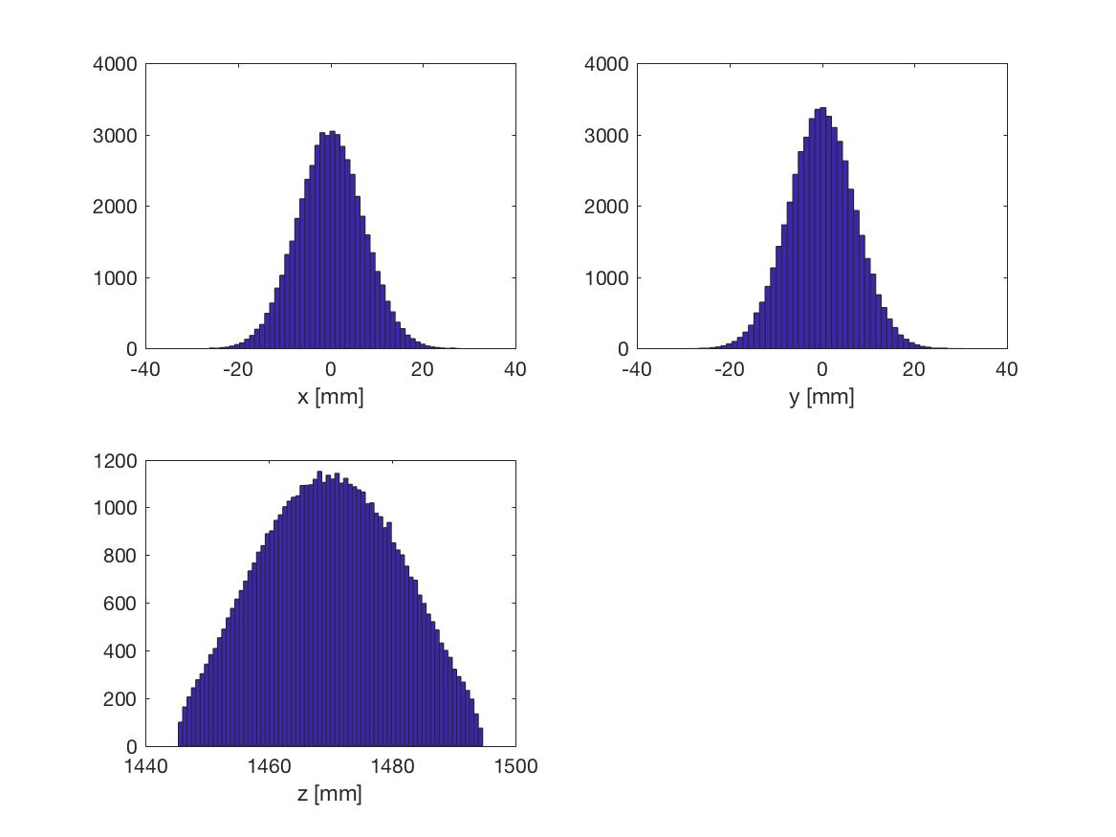
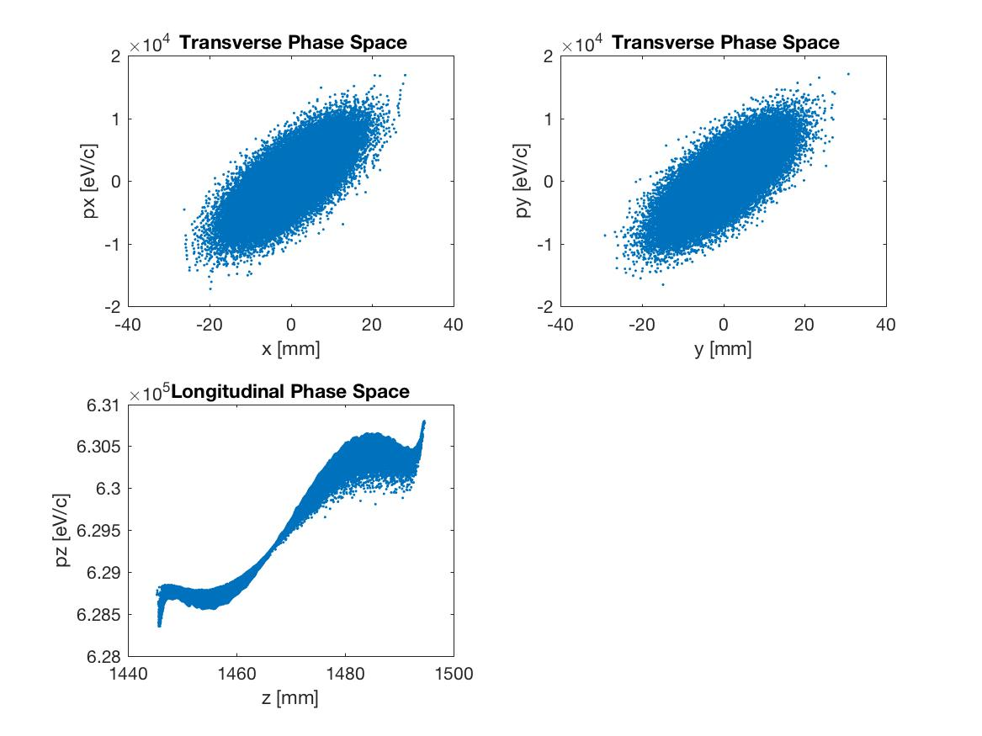
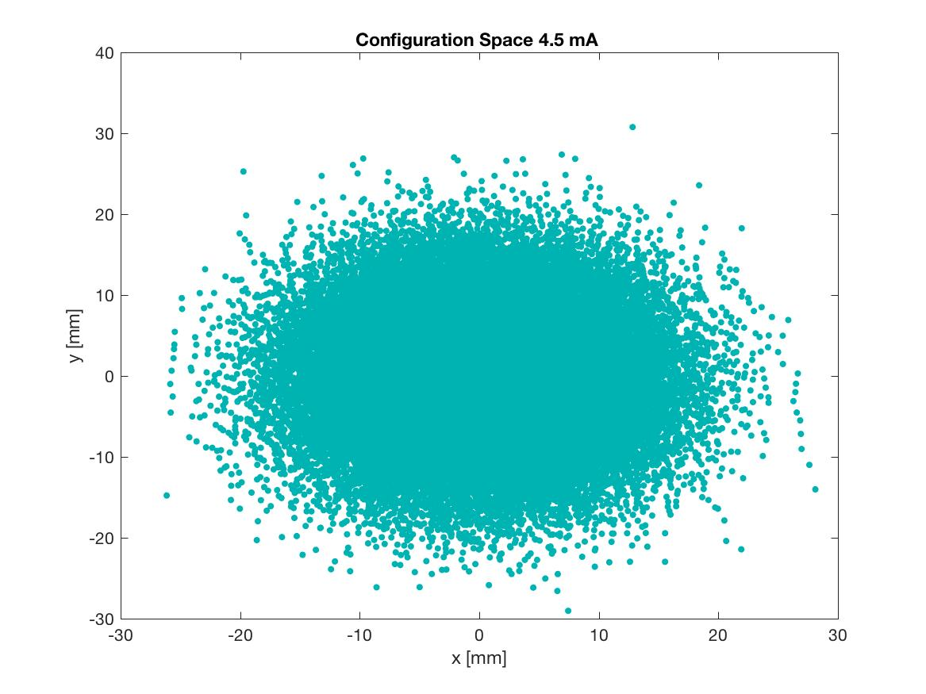
Viewer 1

Slide 6
Viewer 2
50000 particles in distribution
-12.00 pC total charge
Position 1.98
2.99890e-01 MeV, beta*gamma 1.2, beta 0.7765
5.54400e-01 keV sig energy spread
43.98180 ps, sig time at cathode
sigx = 9.3523 mm, sigy = 9.3528 mm
sigxp = 4.1830 mrad, sigyp = 4.1810 mrad
sigz = 11.1574 mmnEnz = 2.2881 keV mm = 9.8227 keV ps
Enxps = 5.6409 um, Enyps = 5.6618 um
Enxtr = 5.6411 um, Enytr = 5.6611 um
Exge = 4.5781 um, Eyge = 4.5951 um

Slide 7
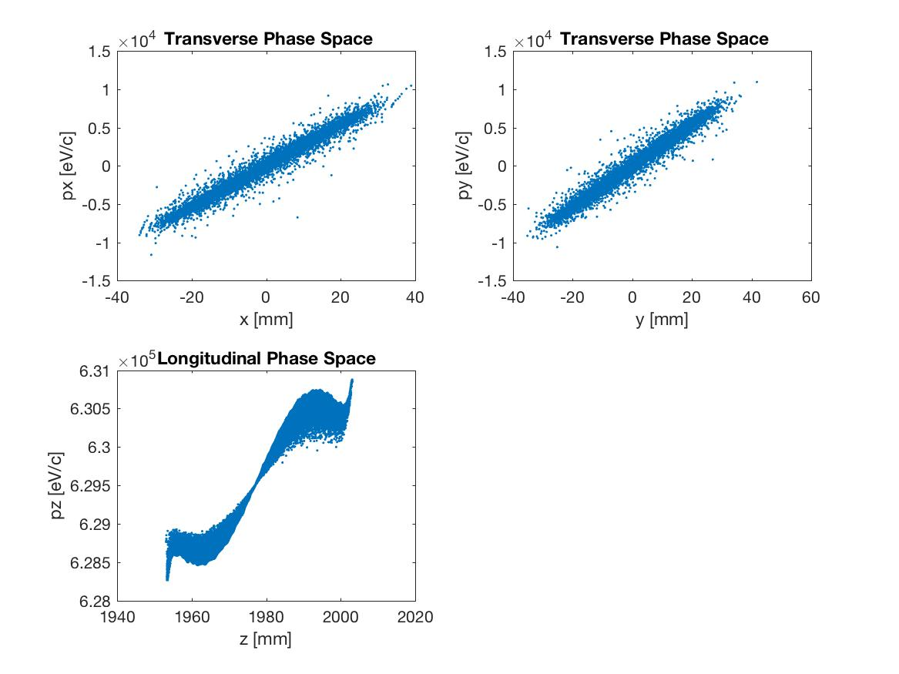
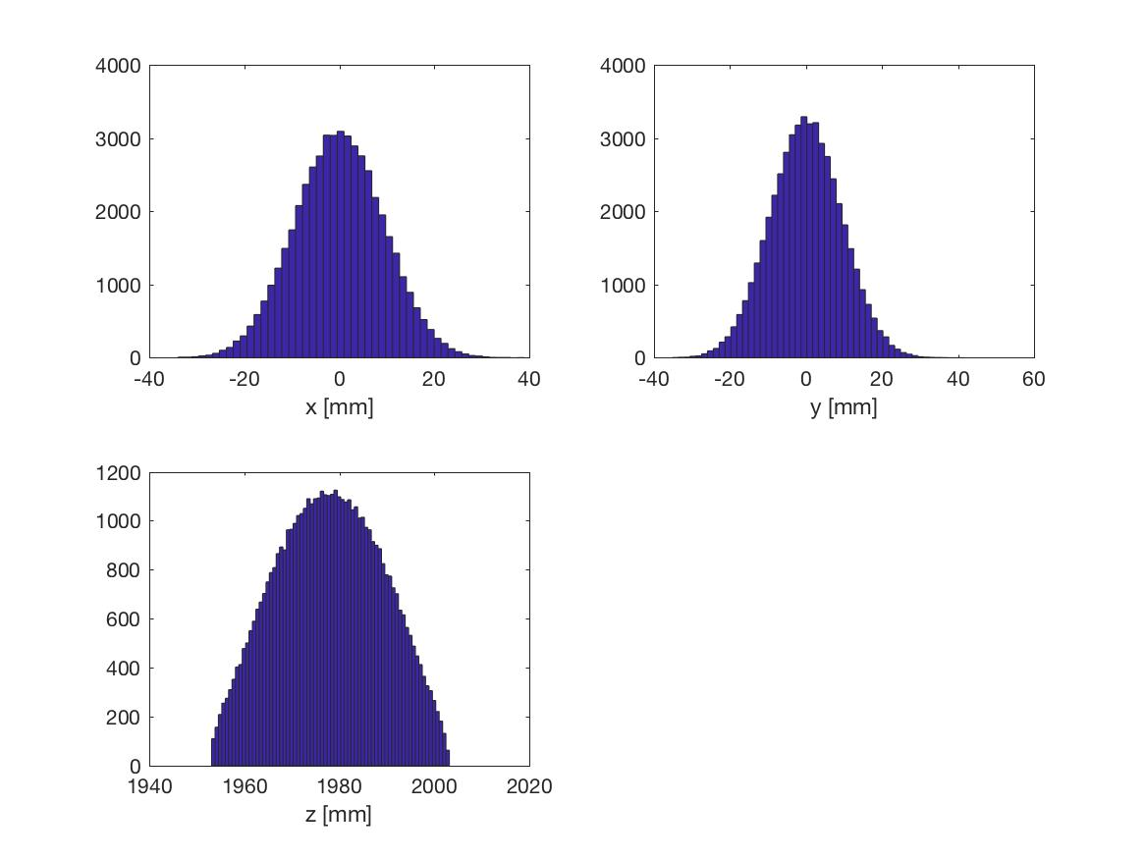
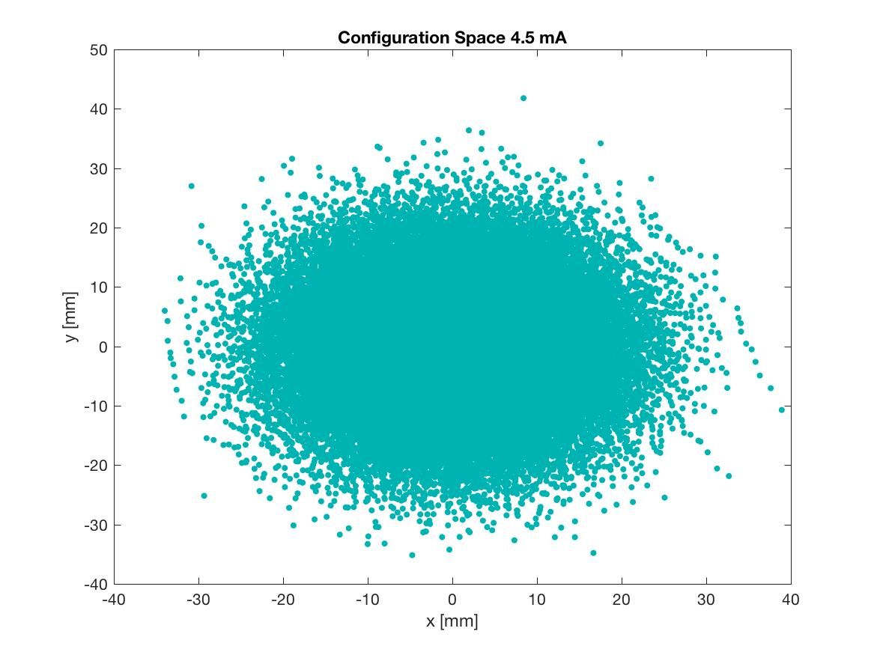
Viewer 2

Slide 8
Viewer 3
50000 particles in distribution
-12.00 pC total charge
Position 3.76
2.99898e-01 MeV, beta*gamma 1.2, beta 0.7765
6.37596e-01 keV sig energy spread
43.98180 ps, sig time at cathode
sigx = 16.8728 mm, sigy = 16.8695 mm
sigxp = 4.2942 mrad, sigyp = 4.2922 mrad
sigz = 11.9927 mmnEnz = 2.5856 keV mm = 11.0998 keV ps
Enxps = 5.9055 um, Enyps = 5.9333 um
Enxtr = 5.9050 um, Enytr = 5.9310 um
Exge = 4.7928 um, Eyge = 4.8154 um

Slide 9
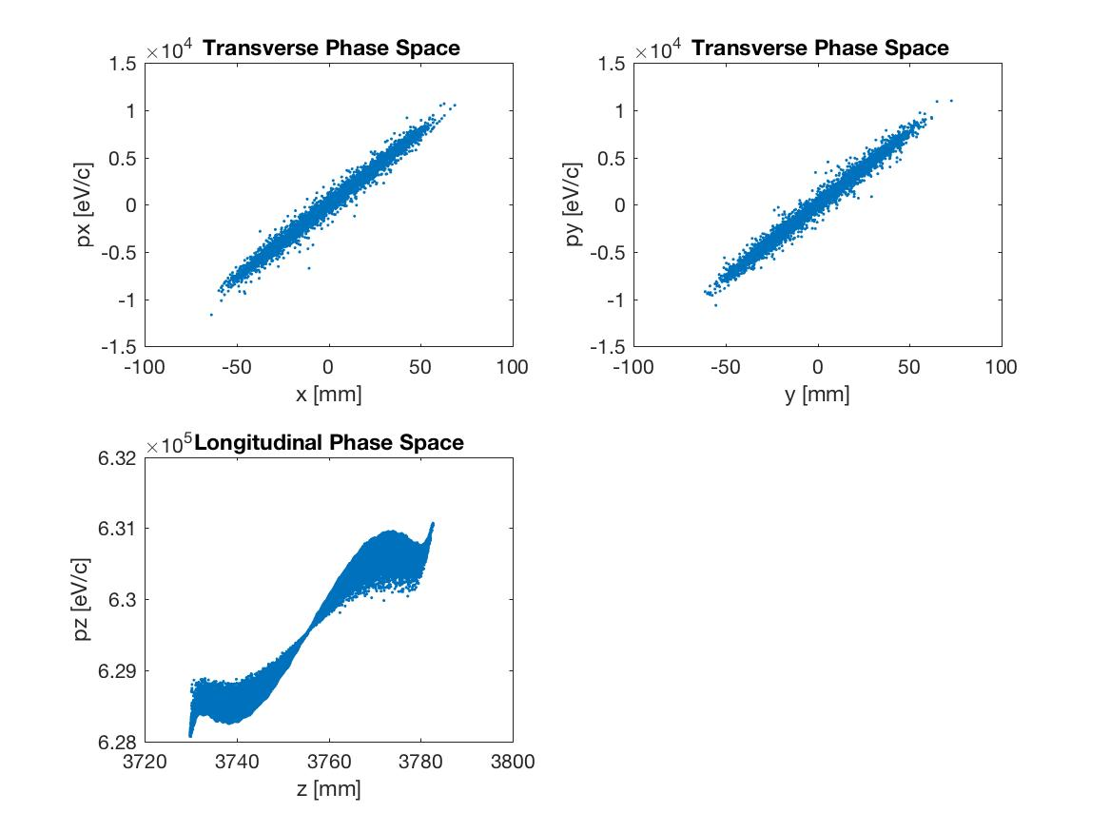
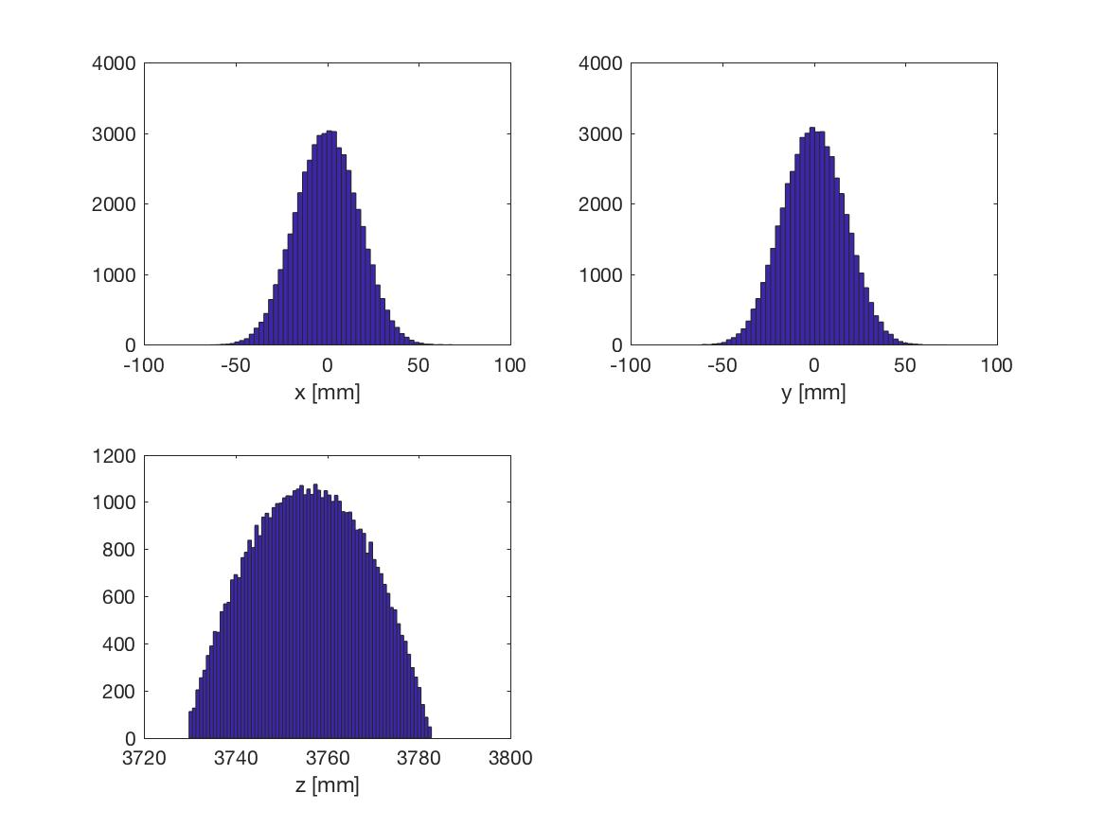
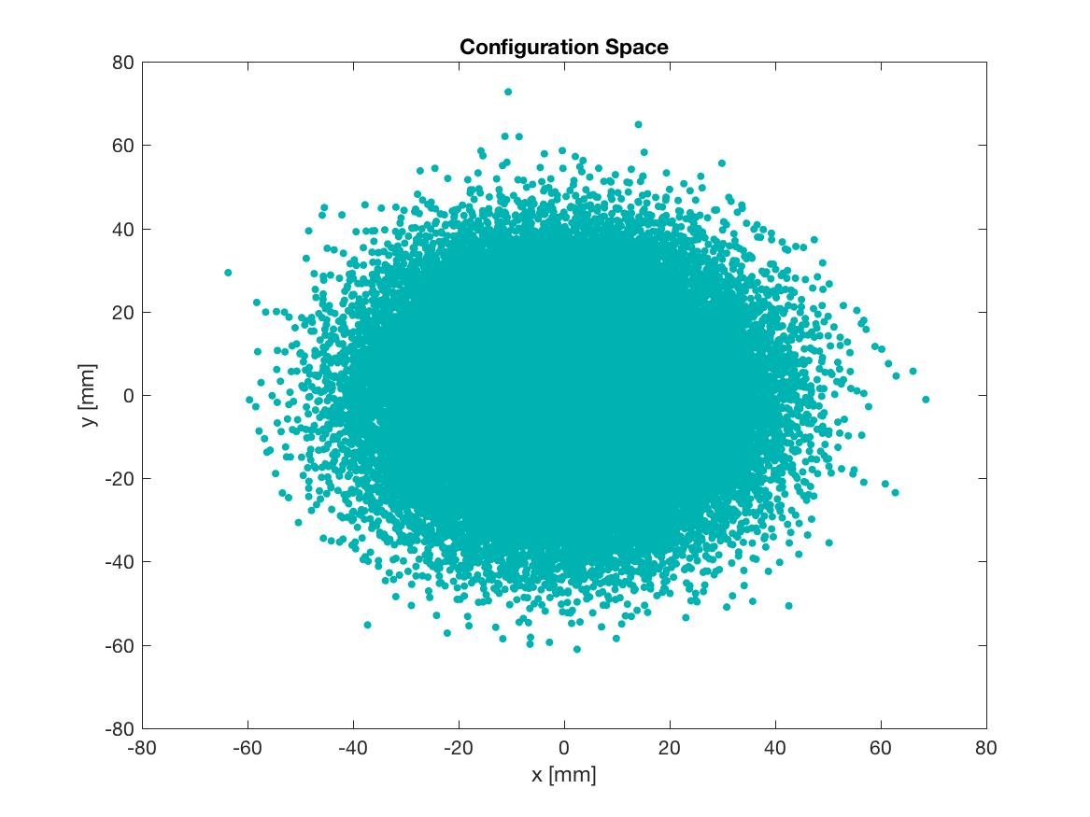
Viewer 3

Slide 10
32 mA
Bunch charge - 85 pC
Gun voltage - 300 kV
Laser 50 ps (Gaussian)
Solenoid current - 400 A
Laser size- 0.32 mm rms
Xoff =0 , Yoff =0
Emittance 0.56 mm mrad/mm
Space charge on
Other solenoids off
v1 (mm) |  | v2 (mm) |  | v3 (mm)
x | y | x | y | x | y
6.4063 | 6.4116 | 8.9053 | 8.9090 | 18.1620 | 18.1672

Slide 11
v1
v2
v3

Slide 12
Viewer 1
50000 particles in distribution
-85.00 pC total charge
Position 1.47
3.00923e-01 MeV, beta*gamma 1.2, beta 0.7771
2.75019e+00 keV sig energy spread
43.98180 ps, sig time at cathode
sigx = 6.4063 mm, sigy = 6.4116 mm
sigxp = 6.5251 mrad, sigyp = 6.5206 mrad
sigz = 14.3087 mmnEnz = 6.8933 keV mm = 29.5684 keV ps
Enxps = 31.4516 um, Enyps = 31.4762 um
Enxtr = 31.4892 um, Enytr = 31.5125 um
Exge = 25.4723 um, Eyge = 25.4922 um

Slide 13
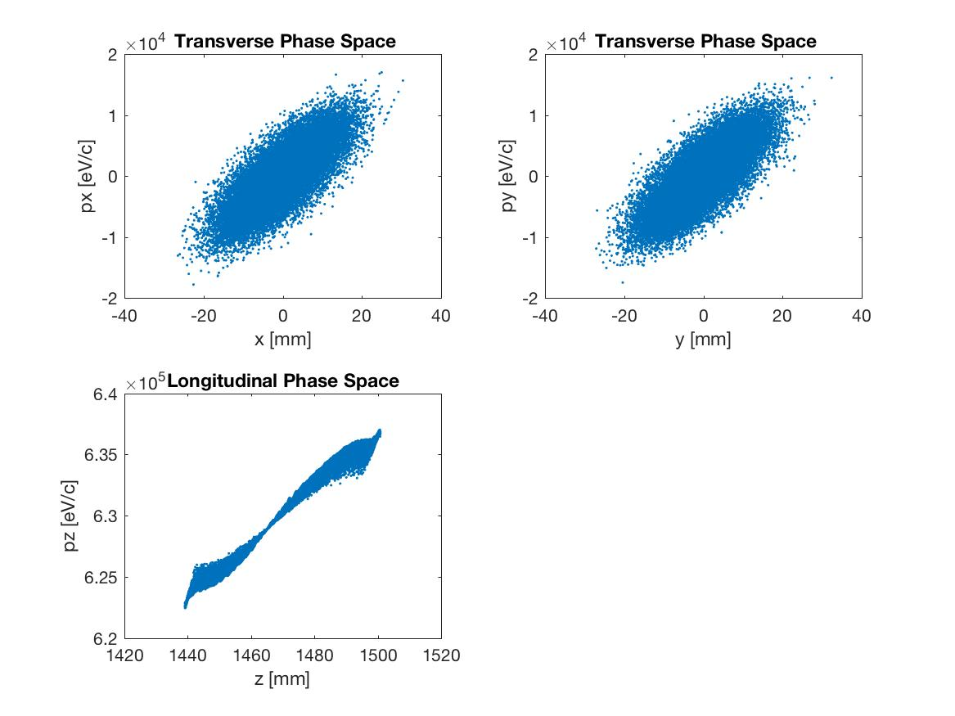
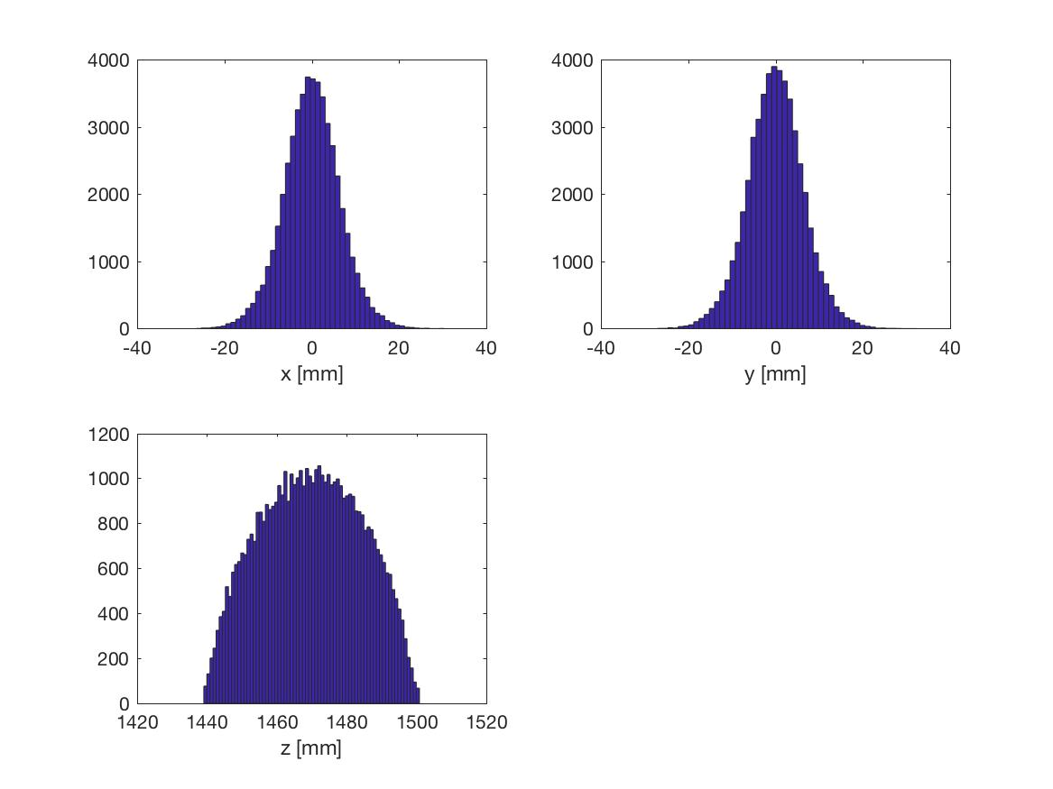
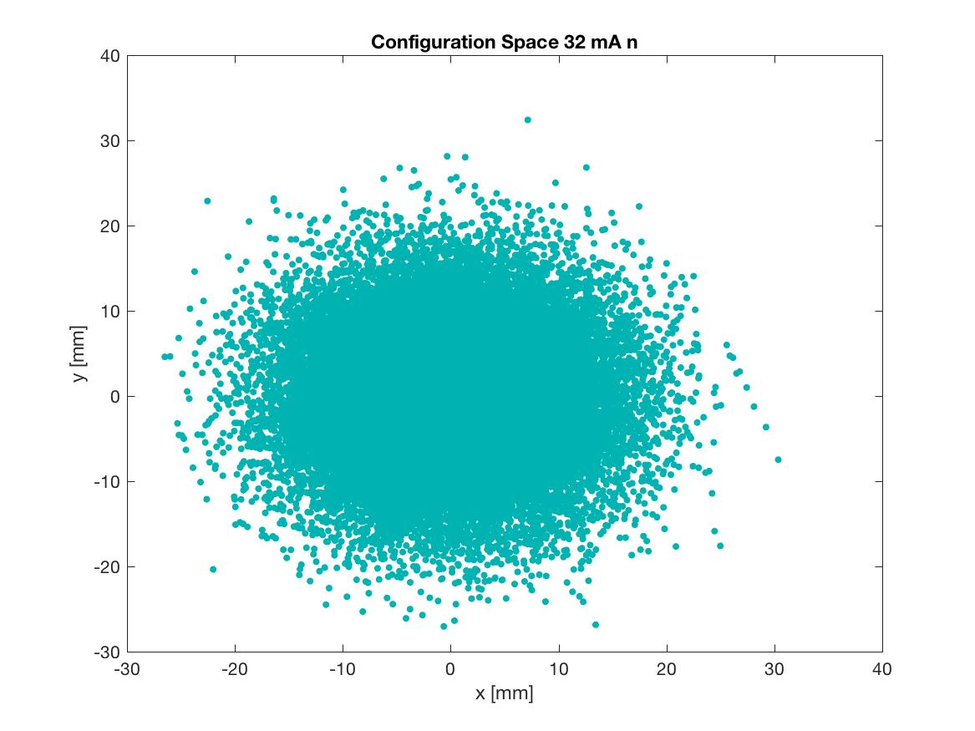
Viewer 1

Slide 14
Viewer 2
50000 particles in distribution
-85.00 pC total charge
Position 1.98
3.00977e-01 MeV, beta*gamma 1.2, beta 0.7771
2.95342e+00 keV sig energy spread
43.98180 ps, sig time at cathode
sigx = 8.9053 mm, sigy = 8.9090 mm
sigxp = 4.9001 mrad, sigyp = 4.9011 mrad
sigz = 15.4768 mmnEnz = 7.6606 keV mm = 32.8582 keV ps
Enxps = 8.1752 um, Enyps = 8.2393 um
Enxtr = 8.1844 um, Enytr = 8.2483 um
Exge = 6.6202 um, Eyge = 6.6722 um

Slide 15
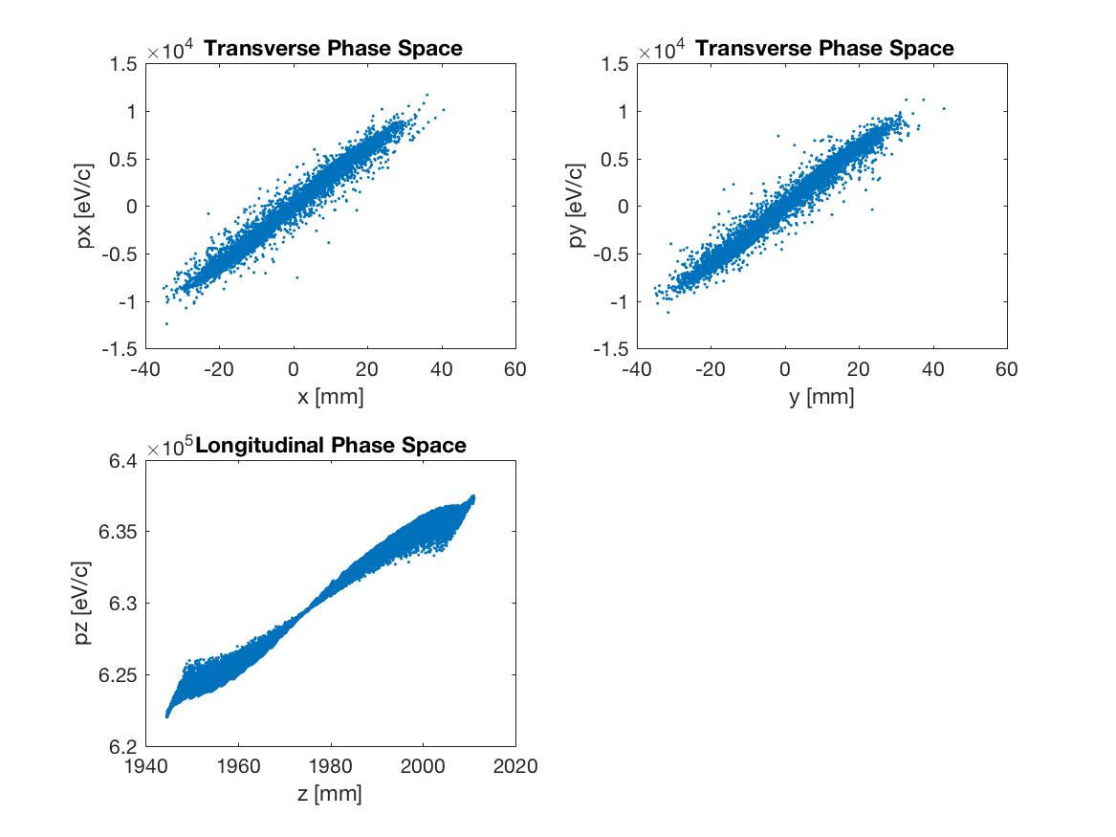
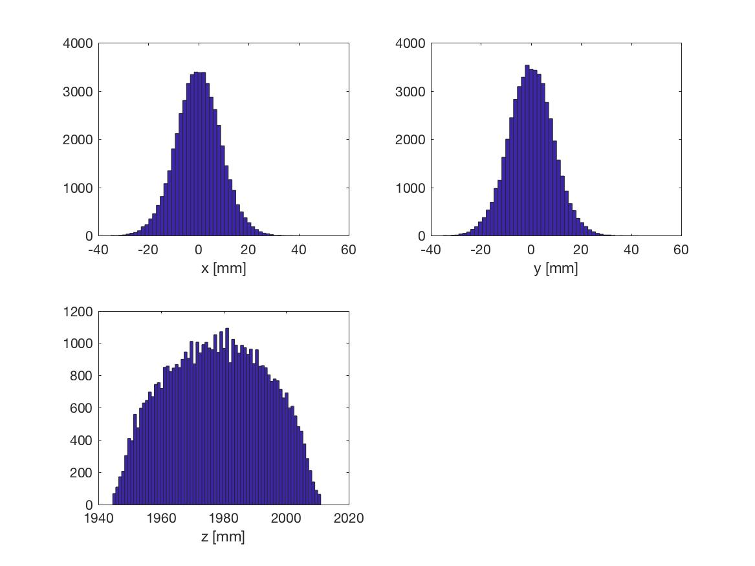
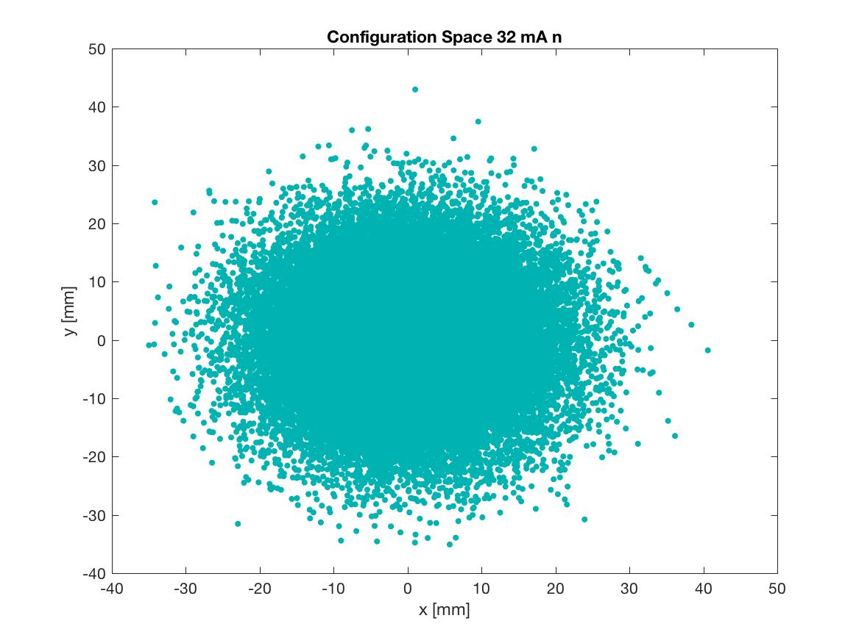
Viewer 2

Slide 16
Viewer 3
50000 particles in distribution
-85.00 pC total charge
Position 3.76
3.01001e-01 MeV, beta*gamma 1.2, beta 0.7772
3.32532e+00 keV sig energy spread
43.98180 ps, sig time at cathode
sigx = 18.1620 mm, sigy = 18.1672 mm
sigxp = 5.4822 mrad, sigyp = 5.4836 mrad
sigz = 20.0151 mmnEnz = 8.9197 keV mm = 38.2579 keV ps
Enxps = 11.2724 um, Enyps = 11.3256 um
Enxtr = 11.2502 um, Enytr = 11.3056 um
Exge = 9.1280 um, Eyge = 9.1710 um

Slide 17
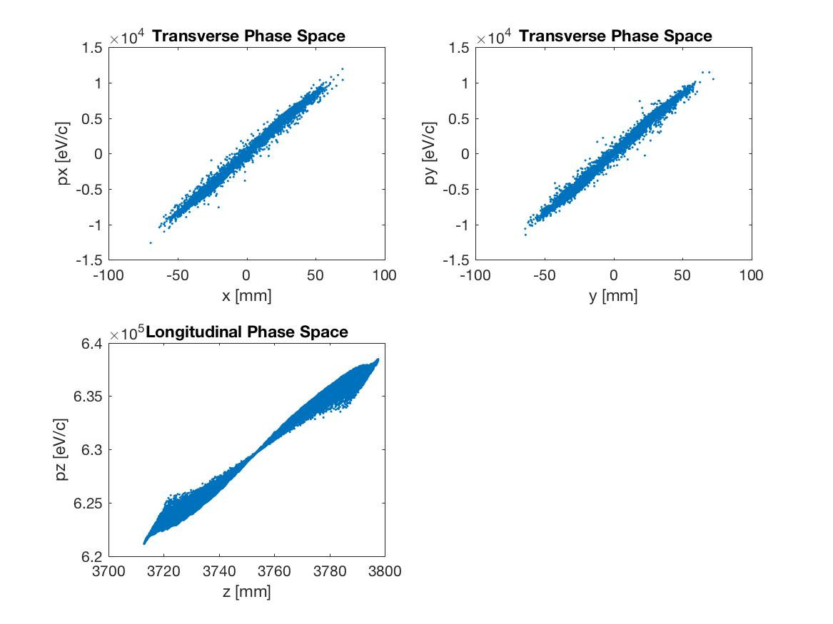
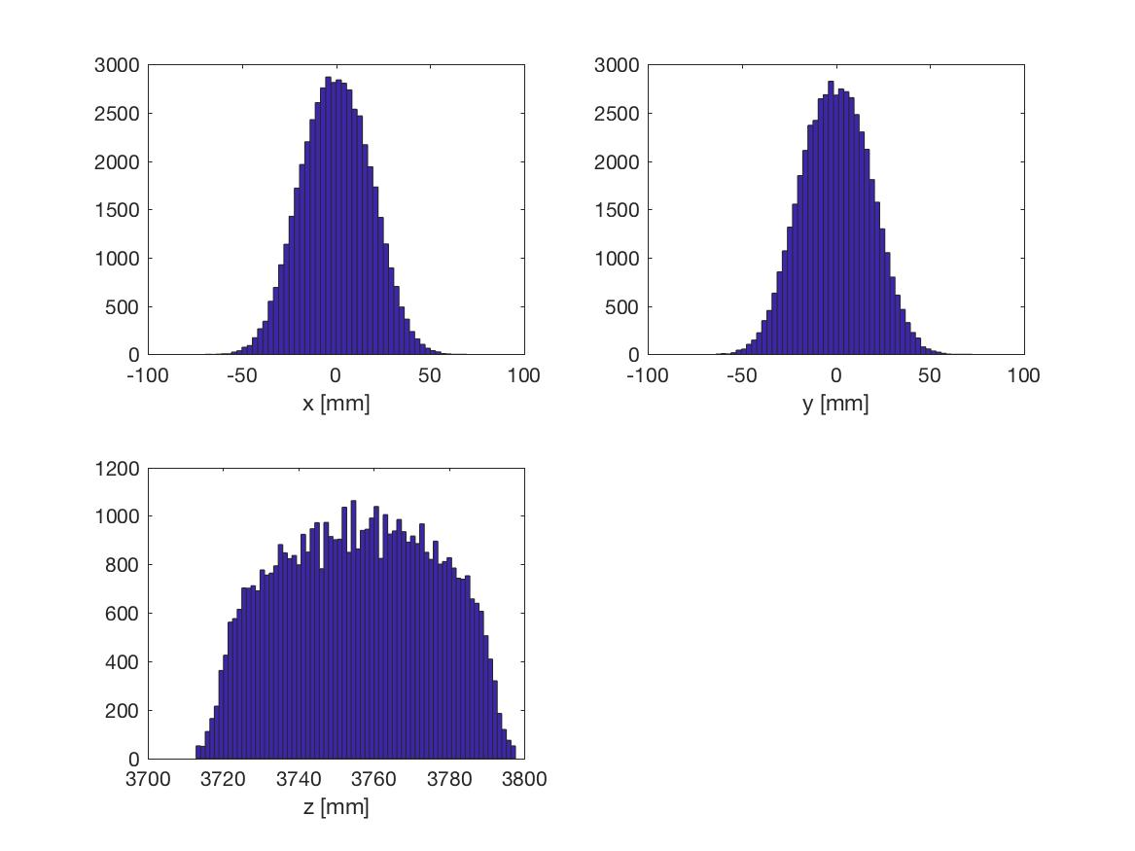
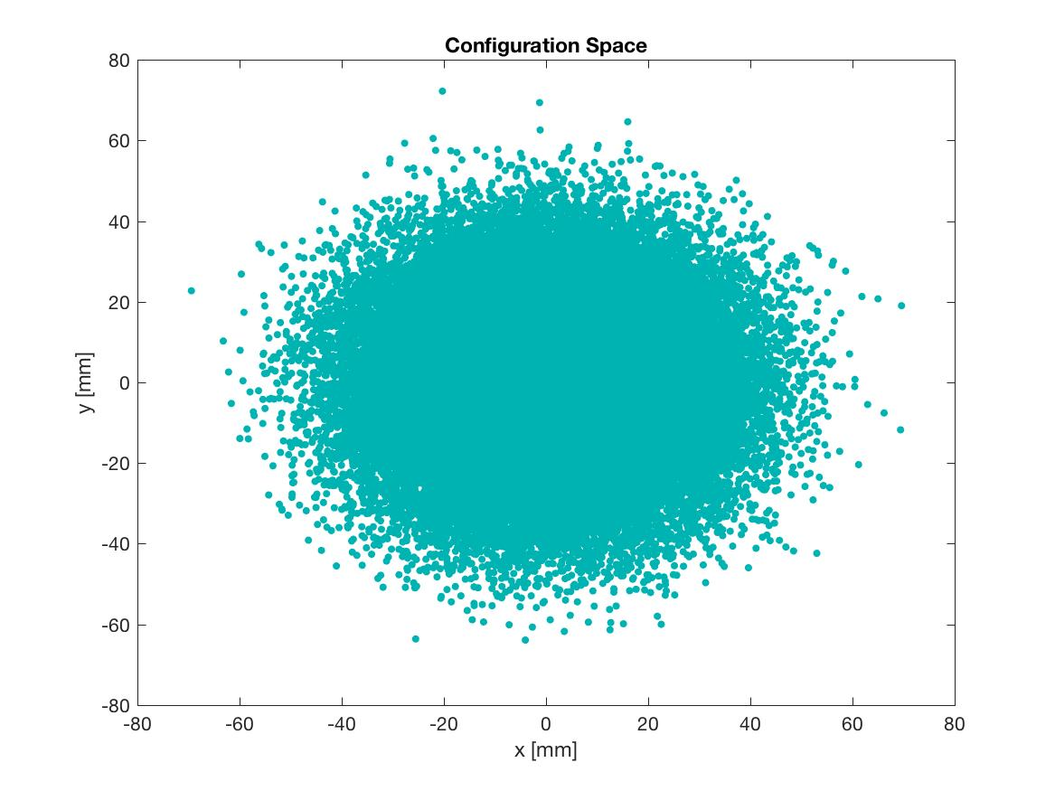
Viewer 3

