Slide 1
Momentum Measurement Analysis
A. Hofler

Slide 2
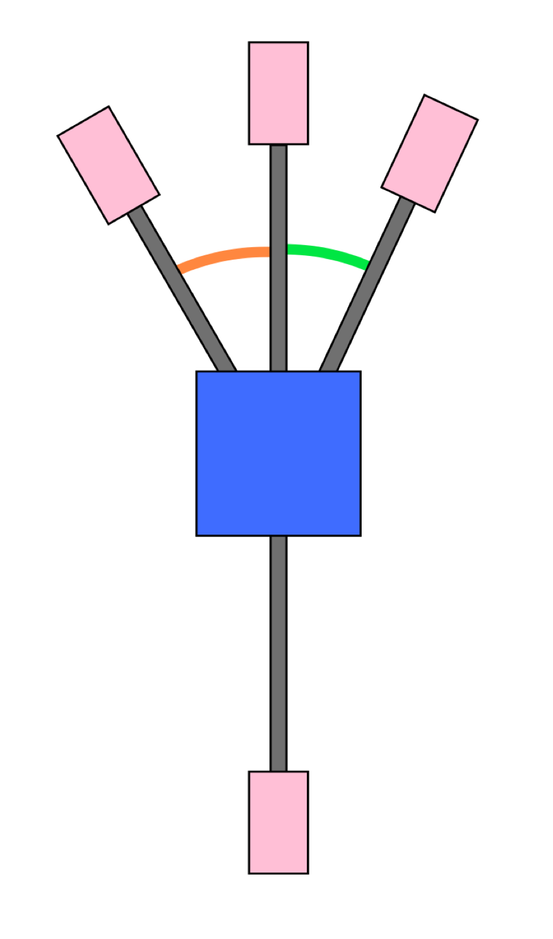
Measurement
BPM
Design p (MeV/c) | Design K.E. (MeV) | 2D line dipole setting (G cm) | 5D (Bubble) line dipole setting (G cm)
5.84 | 5.35 | -9937.637 | 8168.800
5.74 | 5.25 | -9865.500 | 8099.000
5.64 | 5.15 | -9632.300 | 7909.200
5.54 | 5.05 | -9468.500 | 7771.400
5.44 | 4.95 | -9320.700 | 7646.800
5.34 | 4.85 | -9135.993 | 7490.000
5.24 | 4.75 | -8957.675 | 7338.900
BPM
2D
-30º
5D
25º
BPM
Dipole
BPM=Beam Position Monitor
BPM
Procedure:
A priori, center beam in quadrupole closest to BPM and note positions (except 2D).
Turn OFF and cycle all unnecessary magnets around hysteresis loop.
Degauss dipole.
Establish straight ahead orbit with restricted corrector magnet set.
Adjust dipole setting (and cycle) for zero orbit in each dump BPM.

Slide 3
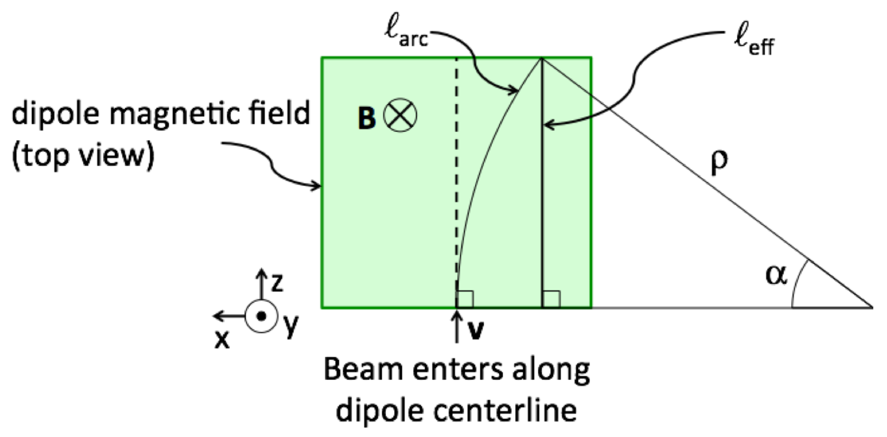
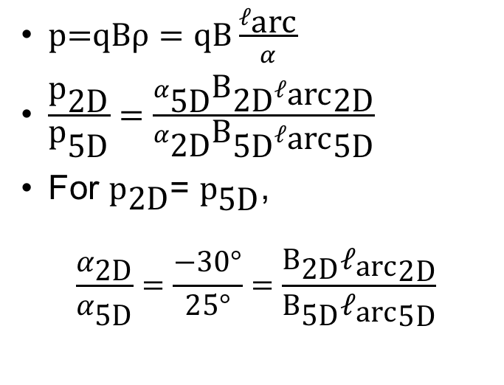
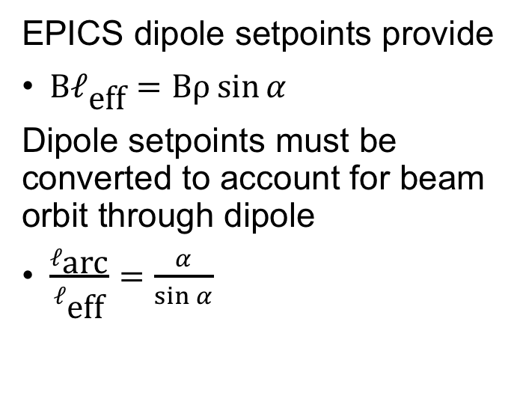
Analysis
Accelerator coordinate system is LH
-
$p\text{=}\text{qB}ρ=\text{qB}\frac{ℓ_{\text{arc}}}{α}$
$\frac{{\text{p}}_{\text{2}\text{D}}}{{\text{p}}_{\text{5}\text{D}}}=\frac{α_{\text{5}\text{D}}{\text{B}}_{\text{2}\text{D}}{ℓ_{\text{arc}}}_{\text{2}\text{D}}}{α_{\text{2}\text{D}}{\text{B}}_{\text{5}\text{D}}{ℓ_{\text{arc}}}_{\text{5}\text{D}}}$
For ${\text{p}}_{\text{2}\text{D}}$= ${\text{p}}_{\text{5}\text{D}}$,
  $$\frac{α_{\text{2}\text{D}}}{α_{\text{5}\text{D}}}=\frac{−30°}{25°}=\frac{{\text{B}}_{\text{2}\text{D}}{ℓ_{\text{arc}}}_{\text{2}\text{D}}}{{\text{B}}_{\text{5}\text{D}}{ℓ_{\text{arc}}}_{\text{5}\text{D}}}$$
EPICS dipole setpoints provide
$\text{B}ℓ_{\text{eff}}=\text{B}ρ\sin{α}$
Dipole setpoints must be converted to account for beam orbit through dipole
$\frac{ℓ_{\text{arc}}}{ℓ_{\text{eff}}}=\frac{α}{\sin{α}}$

Slide 4
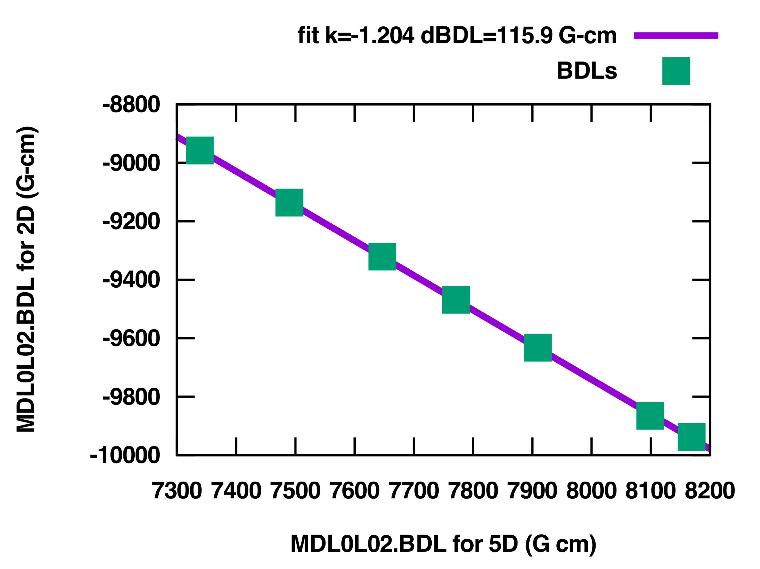
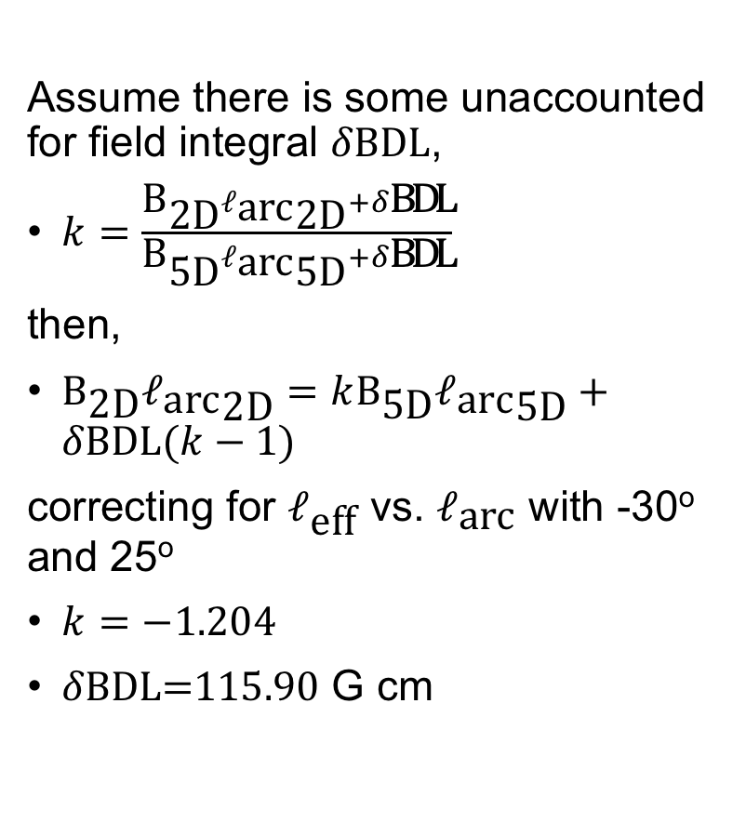
Fit 2D vs. 5D dipole settings for each set up
Assume there is some unaccounted for field integral $δ\text{BDL}$,
$k=\frac{{\text{B}}_{\text{2}\text{D}}{ℓ_{\text{arc}}}_{\text{2}\text{D}}+δ\text{BDL}}{{\text{B}}_{\text{5}\text{D}}{ℓ_{\text{arc}}}_{\text{5}\text{D}}+δ\text{BDL}}$
then,
${\text{B}}_{\text{2}\text{D}}{ℓ_{\text{arc}}}_{\text{2}\text{D}}=k{\text{B}}_{\text{5}\text{D}}{ℓ_{\text{arc}}}_{\text{5}\text{D}}+δ\text{BDL}(k−1)$
correcting for $ℓ_{\text{eff}}$ vs. $ℓ_{\text{arc}}$ with -30º and 25º
$k=−1.204$
$δ\text{BDL}\text{=115.90}$ G cm

Slide 5
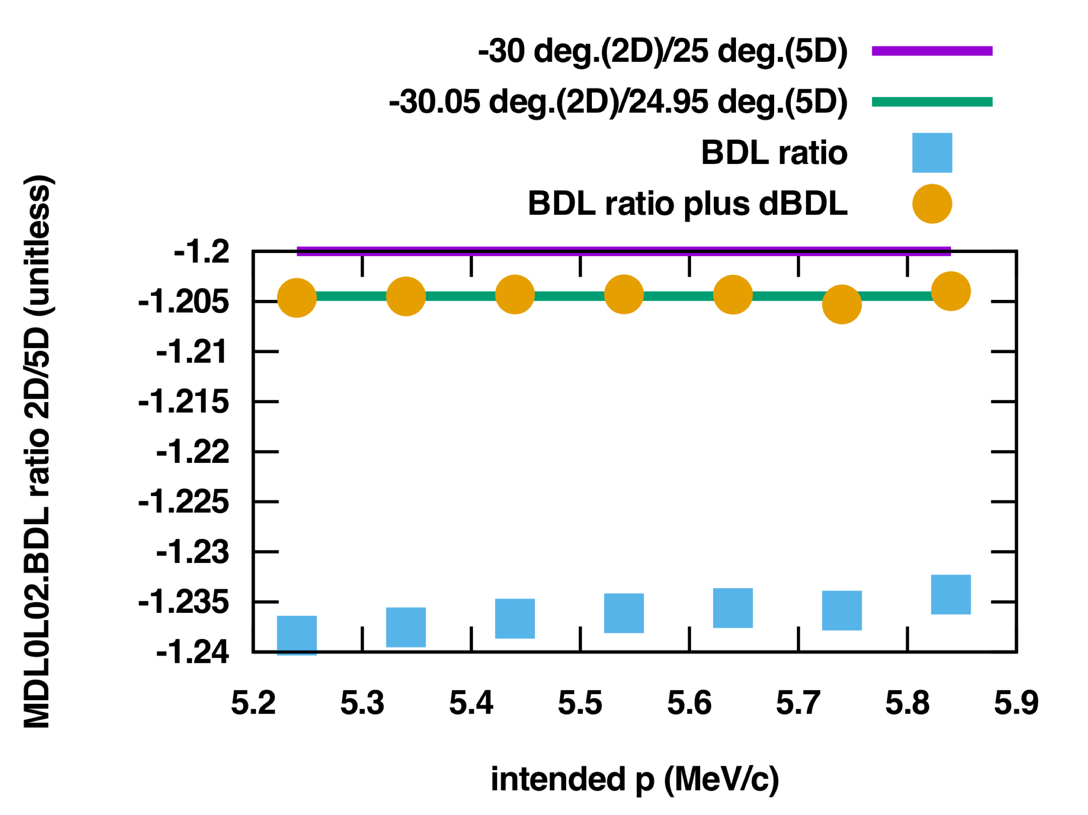
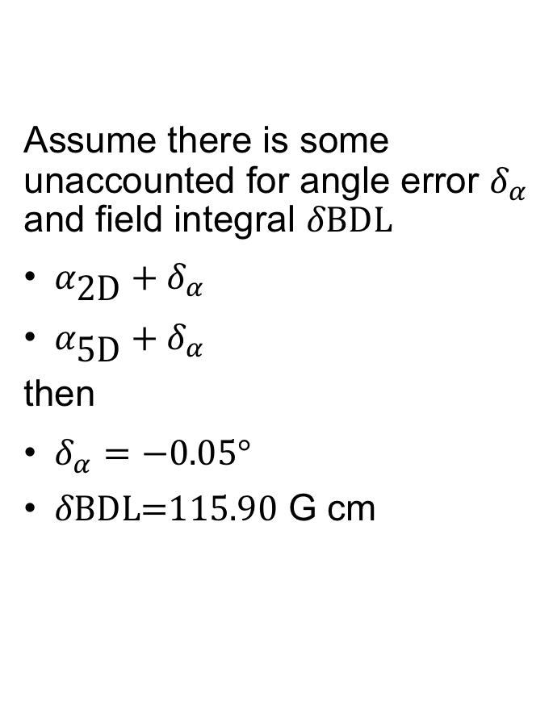
Refit accounting for angle error
Assume there is some unaccounted for angle error $δ_{α}$ and field integral $δ\text{BDL}$
$α_{\text{2}\text{D}}+δ_{α}$
$α_{\text{5}\text{D}}+δ_{α}$
then
$δ_{α}=−0.05°$
$δ\text{BDL}\text{=115.90}$ G cm

Slide 6
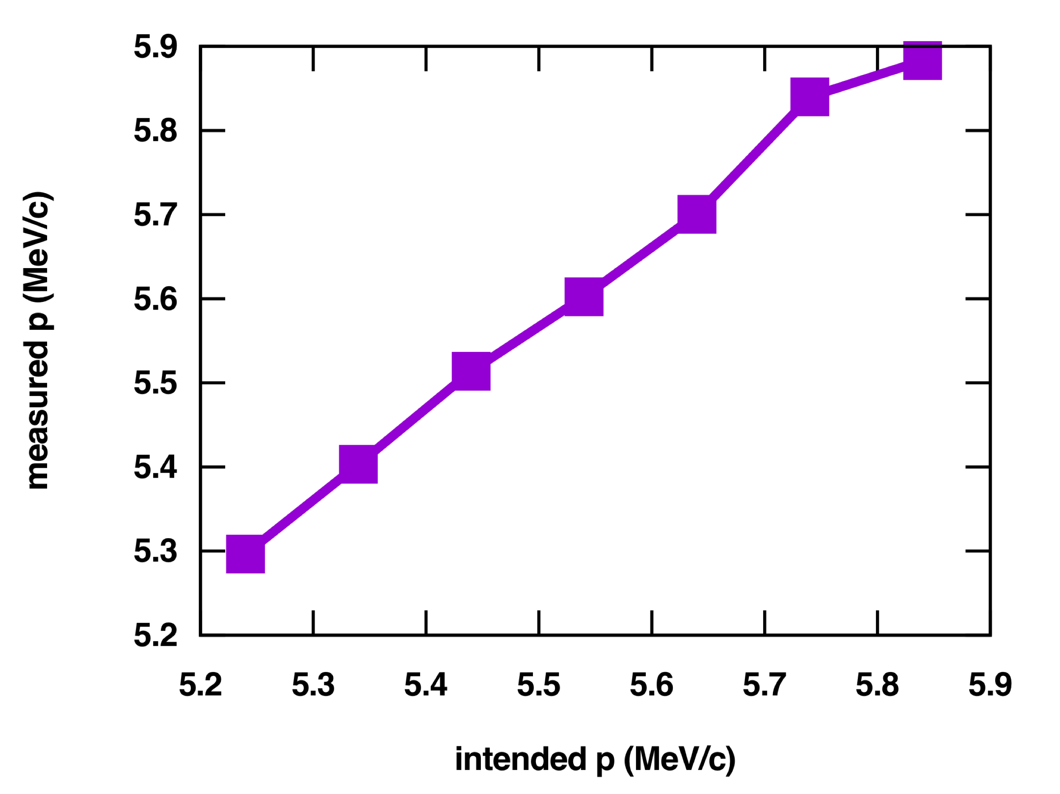
Measured momenta
Design p (MeV/c) | Design K.E. (MeV) | Measured p (MeV/c)
5.84 | 5.35 | 5.88
5.74 | 5.25 | 5.84
5.64 | 5.15 | 5.70
5.54 | 5.05 | 5.60
5.44 | 4.95 | 5.51
5.34 | 4.85 | 5.40
5.24 | 4.75 | 5.30

Slide 7
Questions?
A. Hofler
Thank you.
Thanks to
  J. Grames
  R. Kazimi
  D. Moser

