Slide 1
UITF Project Status Meeting
Matt Poelker
August 31, 2015

Slide 2
Outline
Purpose: to inform Lab Leadership of the UITF status
Action Items (from previous meetings)
Project Update
Progress Update
Milestones Update
Budget Update
Highlights & Concerns
Next meeting agenda
Notes:
RW=Roy Whitney

Slide 3
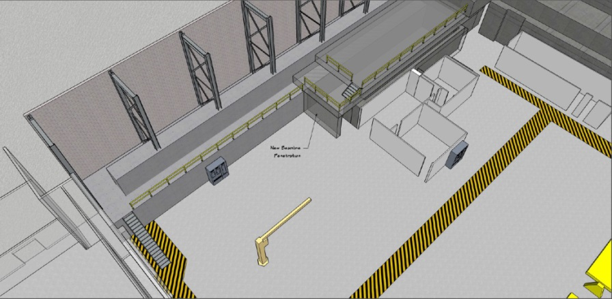
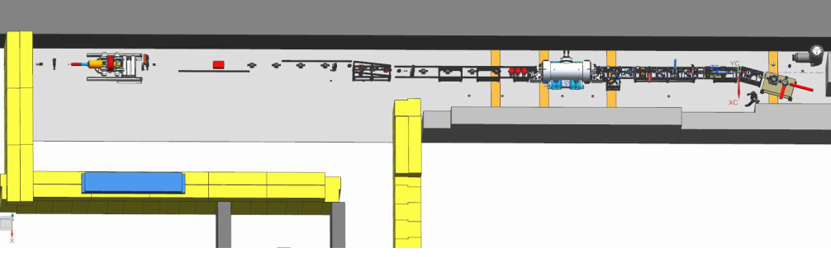
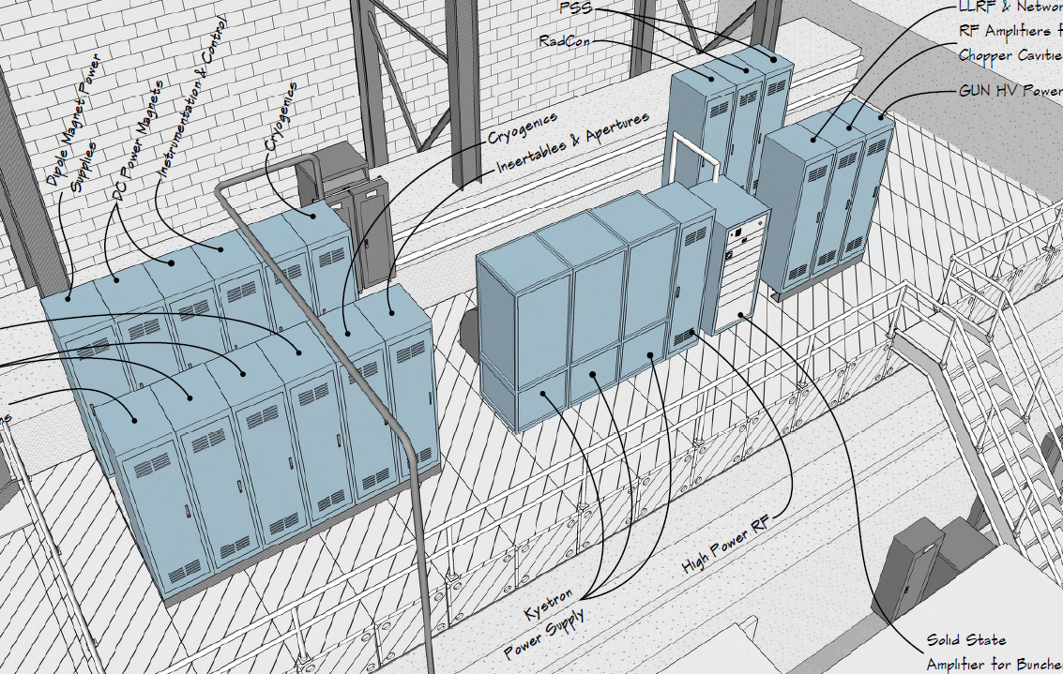
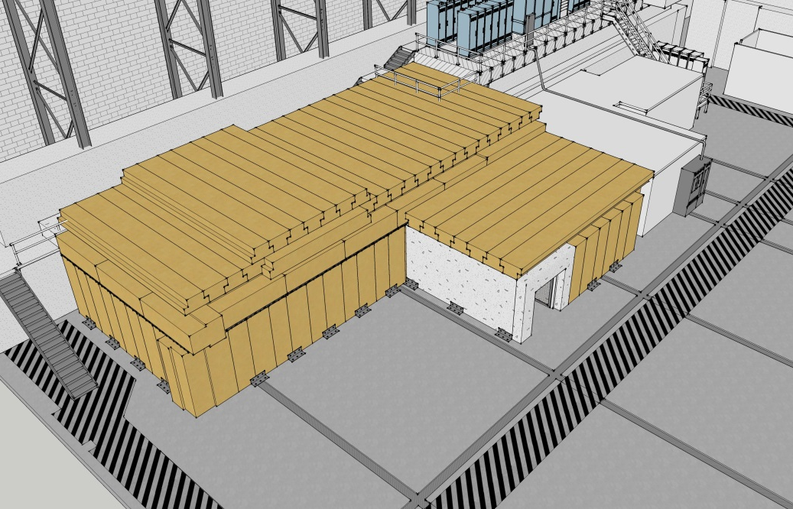
To refresh your memory…
What we started with…
UITF as imagined

Slide 4
Action Items – From July 31, 2015 Minutes
Discussion Notes:
Emphasis was made to ensure the UITF area ODH analysis includes a Cryo assessment. Dick Owen, EHS&Q, will contact Mat Wright, Cryo to go over the layout and address ventilation concerns. Worst case scenario of ~1,500 liters from HDIce plus 400 liters from ¼ CM. But Will O. points out that the cryo lines will drive the capacity for defining a worst case scenario (i.e., the CTF represents a bigger helium supply).
Milestones Update slide. Mont would like Andy to schedule out what Physics needs to complete prior to going into the UITF. Andy mentioned 1 of 3 sets of targets would be ready. He needs about 3 months of work in the cave before the August 2016 beam to HDice. Matt describes their group’s plan to operate the ITF at ~33% in support of HDIce in the early days, but then hopes that Accel Ops would take over. Andy indicates that further discussion is needed on the ops plans.
Schedule Ramifications slide: Plan work towards the Jan 2016 milestone of ¼ CM commissioning (no beam).
Notes:
RW=Roy Whitney

Slide 5
Action Items – From July 31, 2015 Minutes
Issues & Concerns:
CTF capacity to run 3 LHe Users: meetings being held to evaluate path forward. J. Preble has the lead and action item from the P&C meeting.
Andrew wondered if the UITF should get all the new parts. Perhaps the new parts could be installed in the machine and the older parts be used in the UITF.
New Action Items:
M. Poelker/W. Akers: create a detailed schedule with milestones that can be updated during each meeting. Work in progress. Goal is to show progress during each update meeting. A simple gantt chart would work.
M. Poelker: Add an Estimate to Complete (ETC) slide to the monthly briefing. Develop a “Spend Profile”, particularly for procurements, to understand when funds are needed.
A. Sandorfi/W. Akers: prepare a schedule of activities for HDIce to complete before the Aug 2016 beam to HDIce.
Notes:
RW=Roy Whitney

Slide 6
Highlights
Major components
Facilities
Engineering
Mech Design
Cryo
Safety Systems
I&C
DC Power
Low Level RF systems
High Power RF
Survey & Alignment
SRF
Commission with RF
Operations
Network and communications
Green means we can see progress

Slide 7
Highlights
Major components
Source Group
Reliable 350kV ops
Beam to cup in front of ¼ cm
Beam to cup in front of HDIce
EHSQ
Shielding approval
Global hazard review
FSAD
Accel Readiness Review
Commissioning Plan
HDIce
Installation at Cave
Beam on HDIce
Green means we can see progress

Slide 8
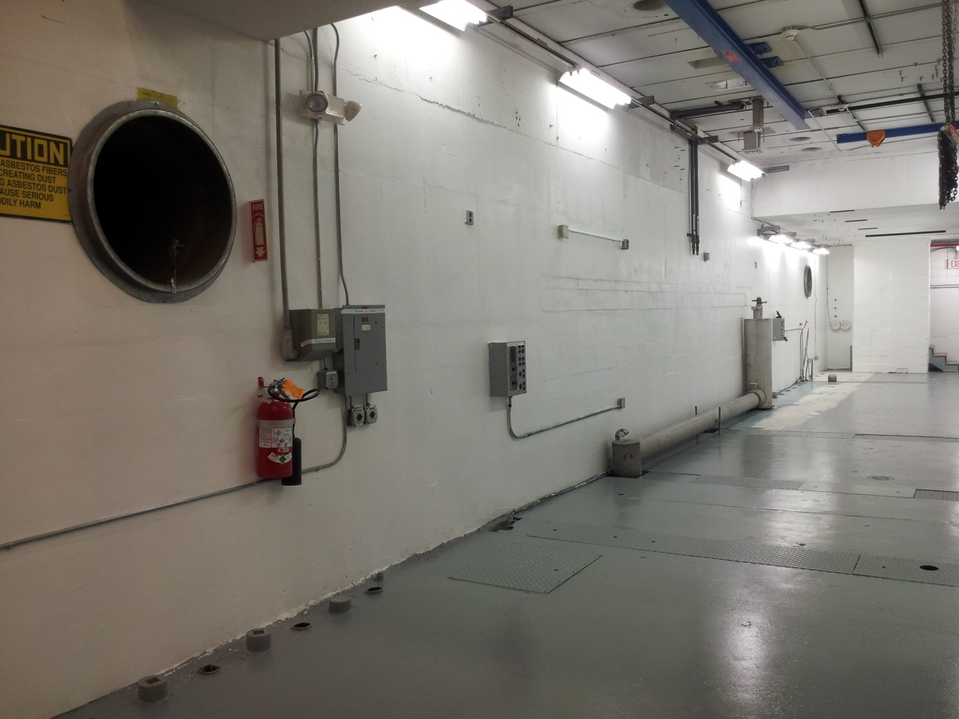
Cave 1 cleared out

Slide 9
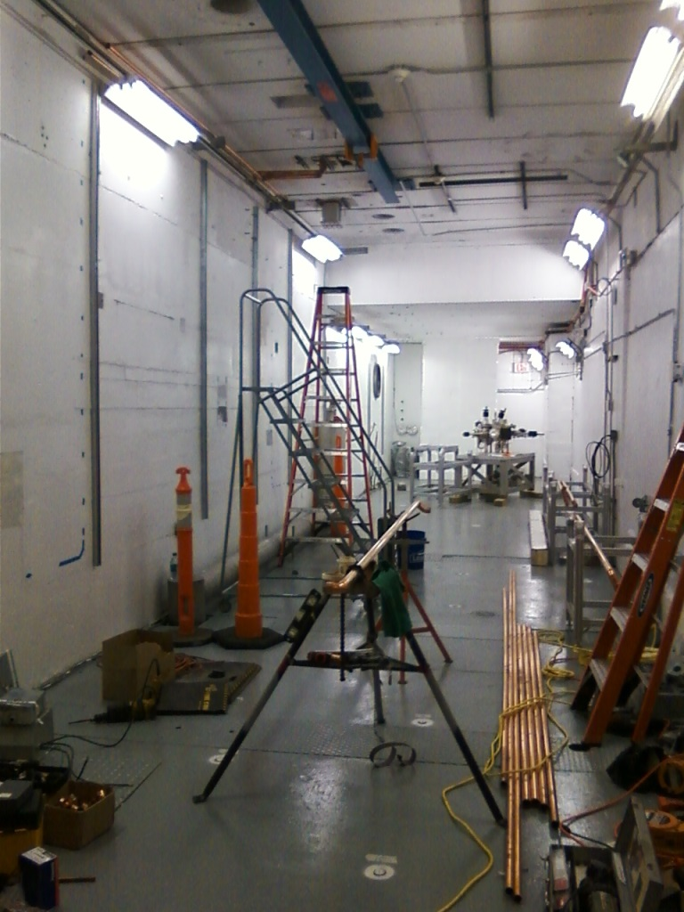
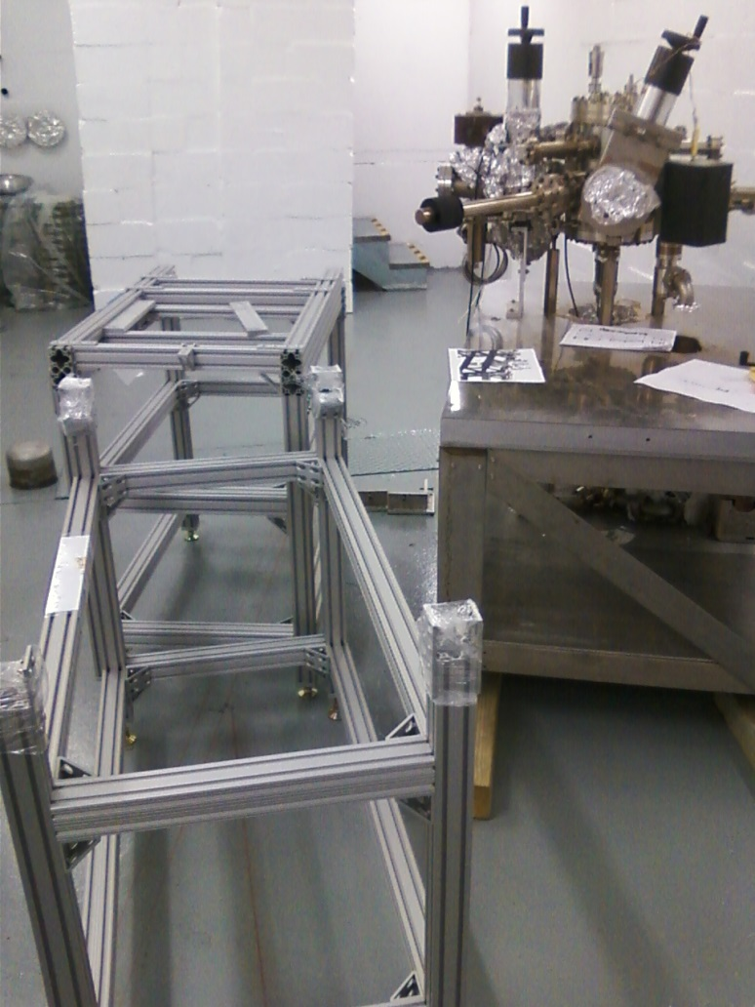
…and then filled back up
Unistrut added to walls for utilities, LCW piping being installed
keV beamline girders in house
S&A checked monuments, identified gun and girder locations

Slide 10
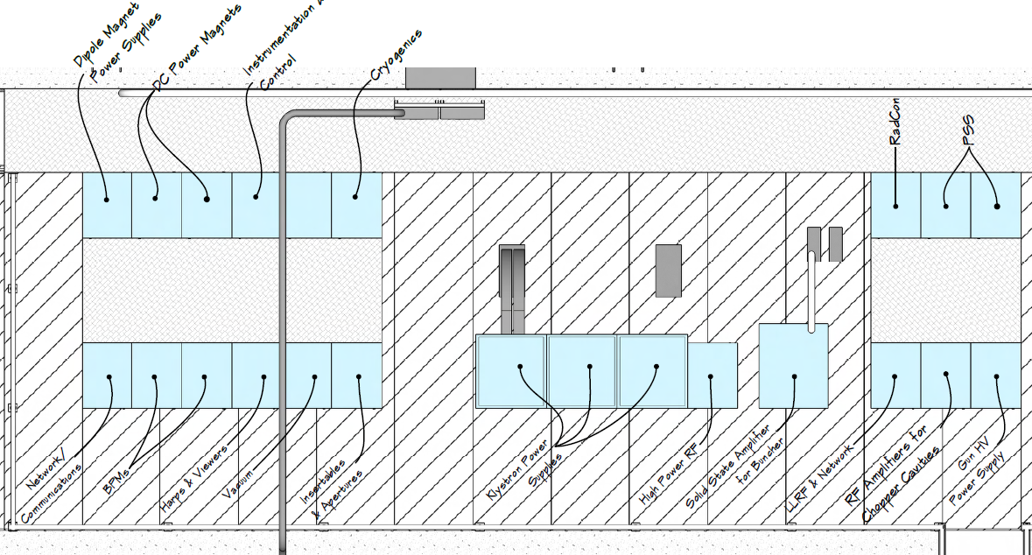
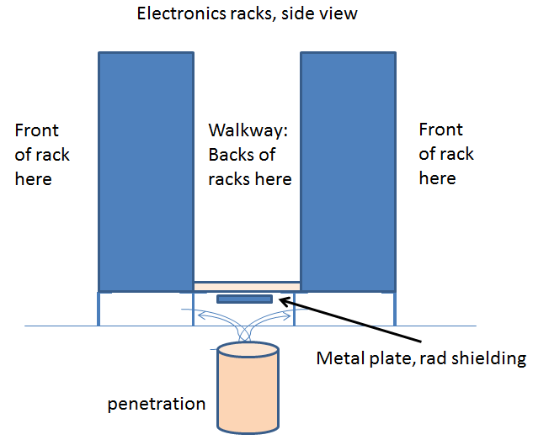
Rack layout now more clearly defined
Consensus on layout
Working with system owners to finalize electrical requirements
Build it, populate the racks

Slide 11
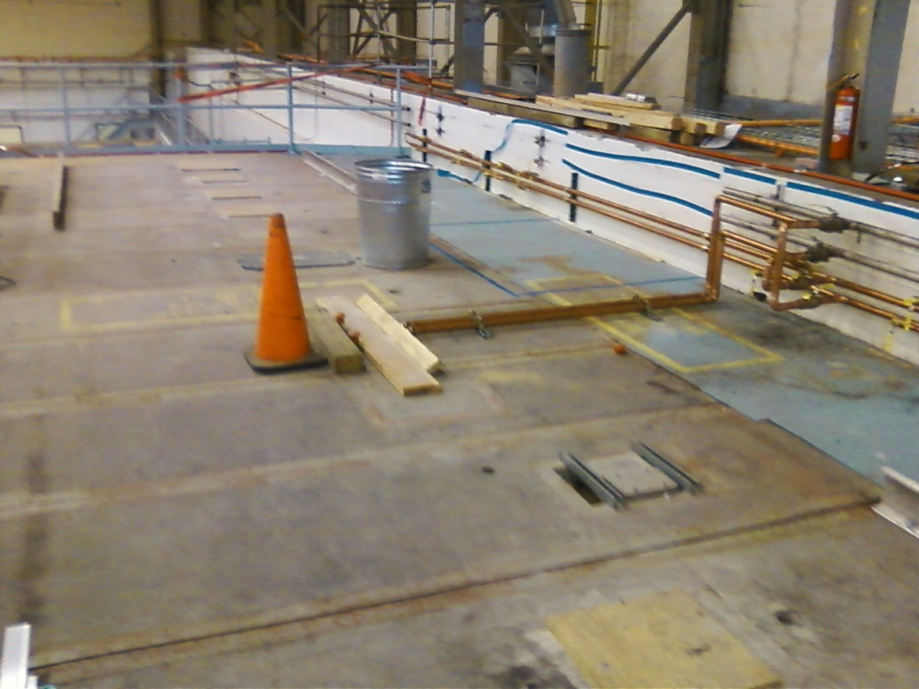
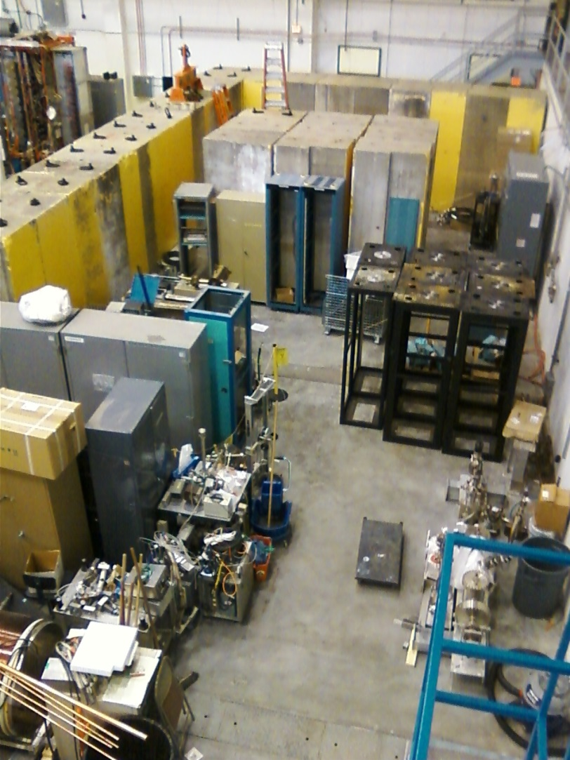
Move these racks here
Top of cave cleared out
Installed LCW lines
Building rack platform

Slide 12
Status Facilities Tasks
Jib crane removal was completed on 8/25/15.
Access Stair purchase order issued 8/18/15. Preconstruction meeting held 8/20/15. Shop drawings due 9/4/15, with installation scheduled for completion by 9/25/15.
Control Room carpet, Dennis met with Tuskegee Contracting on 8/26/15 to review job. They will provide the labor, we provide materials. Will have labor quote by 8/28/15. Estimate completion date of 9/9/15.
Leo Meire working with installation Group, LCW piping complete 9/15/15.
For Cave 1 electrical work, schedule as follows: Electrical drawings in progress and should be complete 9/4/15. Complete technical and ESH reviews, send purchase req to procurement 9/18/15. Contractor site visit 9/25/15 with bids due 10/2/15. Award first week of October, completion date will depend on panel lead time, but tentative date is 11/6/15.
Facilities updated cost estimates: $307k direct procurement, plus 43 PW labor. Original estimate $300k total, procurement + labor.

Slide 13
Status Cryo
Related to ¼ Cryomodule
Drawings complete within 6 weeks (October 8, 2015)
Plumbing installed by Feb 1, 2016
They prefer we provide a keep-out space during installation, but we would like to start building beamline…
Cryo didn’t considered computer controls…resources are available, but added cost
Related to HDIce
Must get to know HDIce, to design warm return
Related to ODH assessment
LERF building 18 vault assigned OHD0 because of two 12” diameter vent pipes to outside. UITF is more “holy”

Slide 14
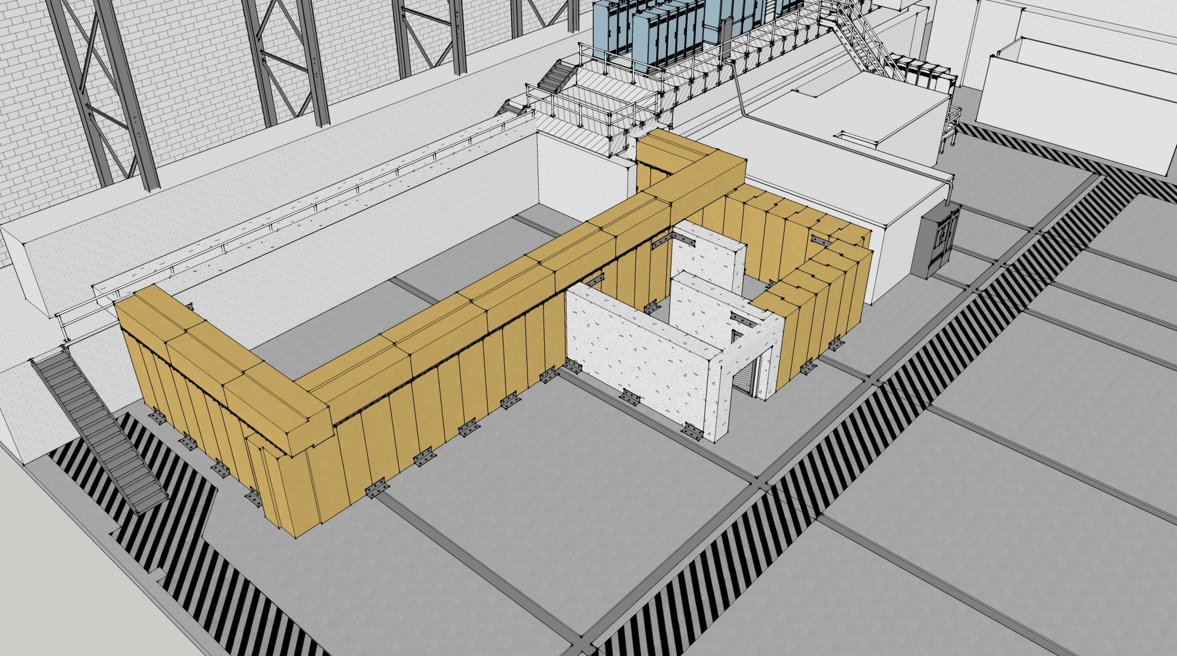
Simple ODH solution? vent pipes
Two 30” vent pipes in Cave1
Six 10” dia. cable penetrations
Large entry/exit with chain-link gate
Install elbow-shaped vent pipes inside pre-cast concrete
Can Cryo/EHS&Q specify vent dimensions? How many?
Radcon must approve from shielding perspective

Slide 15
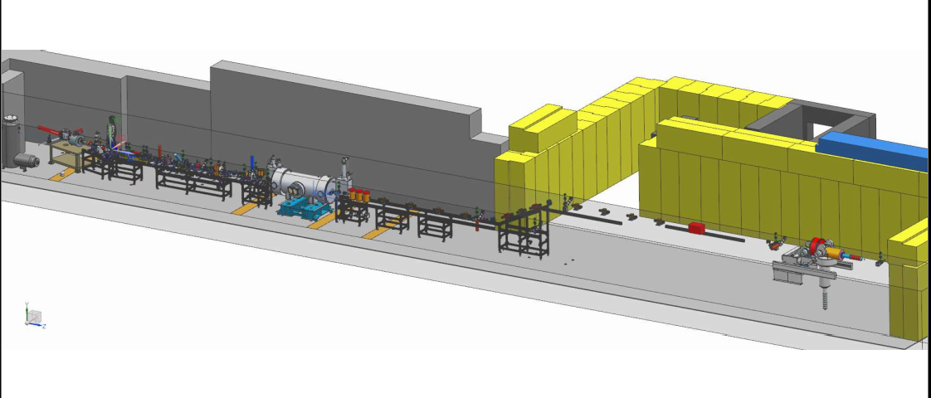
Shaun Gregory has started the MeV beamline design
Contractor Forrest Ellingsworth wrapping up details of keV beamline

Slide 16
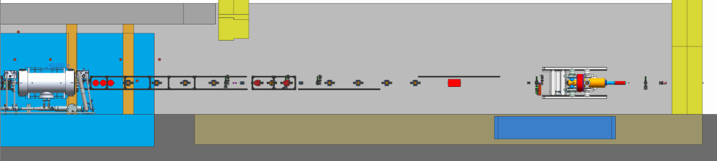
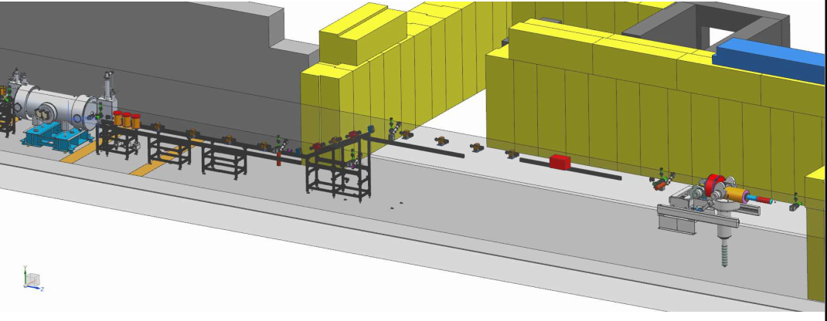
Enough Space?
The chicane dictates 11 quads to provide a tight and round beam at HDIce, does this leave enough space for HDIce? Consider raster and beam dump requirements
Physics Division should provide accurate HDIce model, Shaun needs a Physics Designer POC
Enough Space?

Slide 17
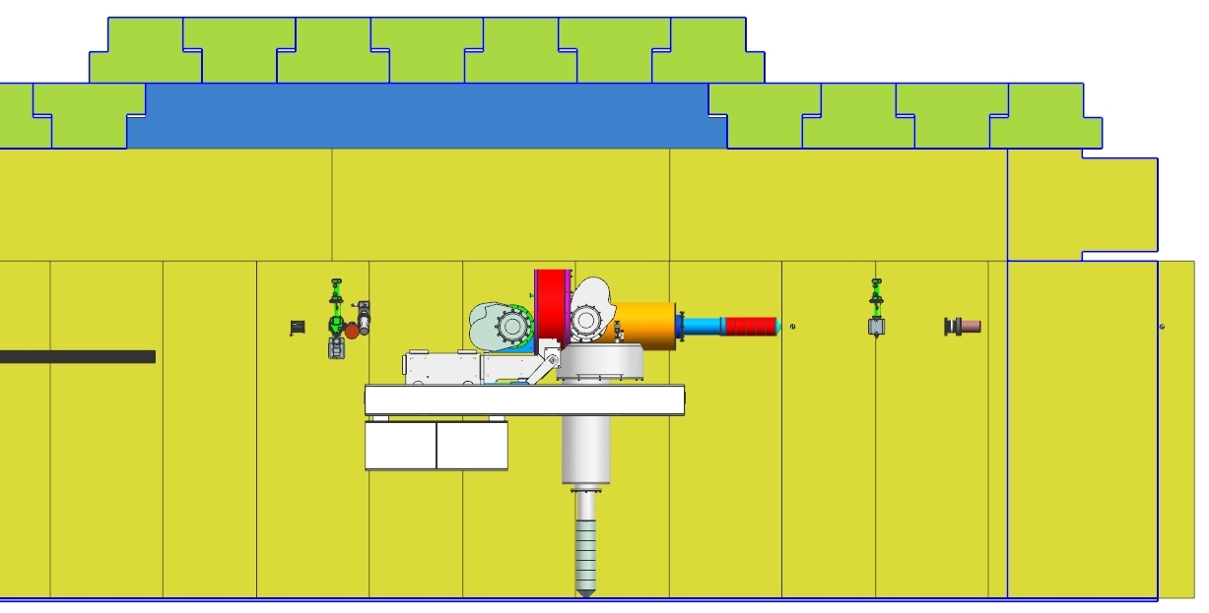
The chicane dictates 10 quads to provide a tight round beam at HDIce, does this leave enough space for HDIce? raster and beam dump
Physics Division to provide accurate HDIce model, Shaun needs a Physics Designer POC
87”
Need to agree on height soon, as this affects many things

Slide 18
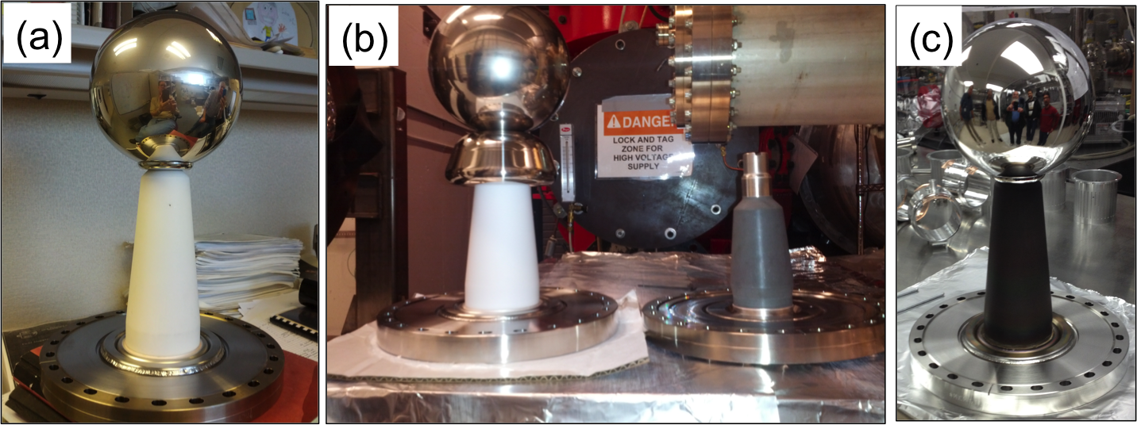
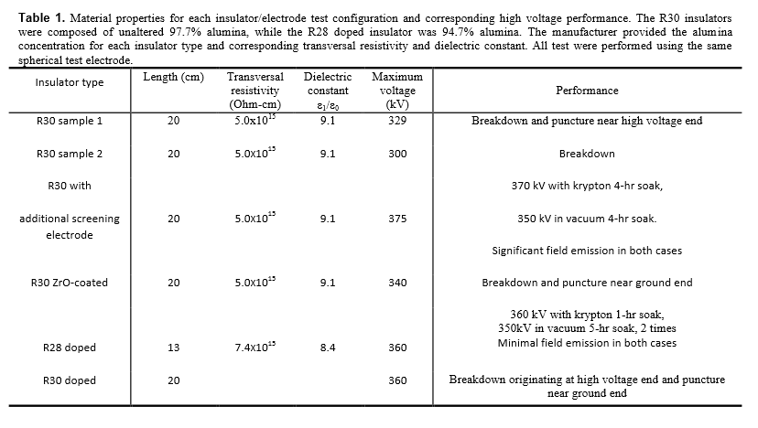
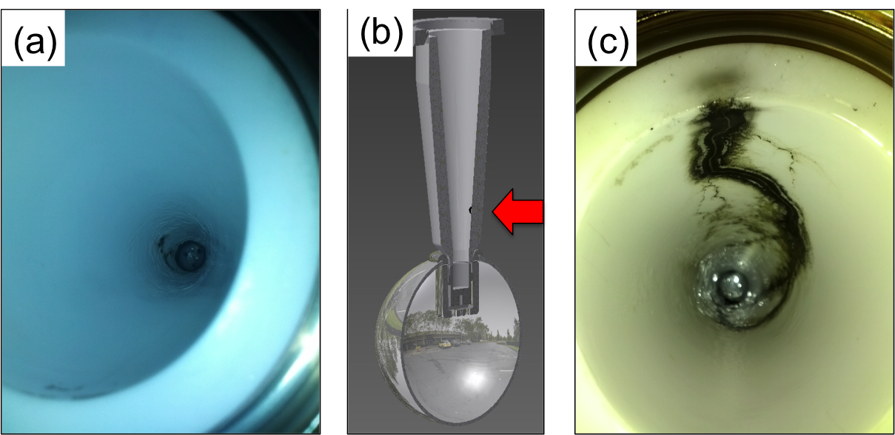
Notes:
Interior Page Design 2

Slide 19
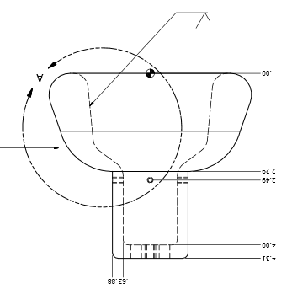
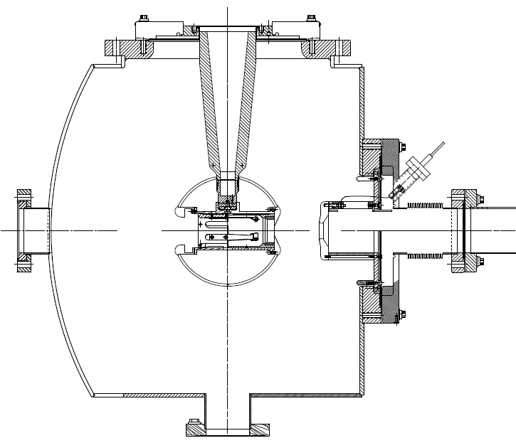
Next test late September
Combine the two features that provided incremental success: shed and doped insulator

Slide 20
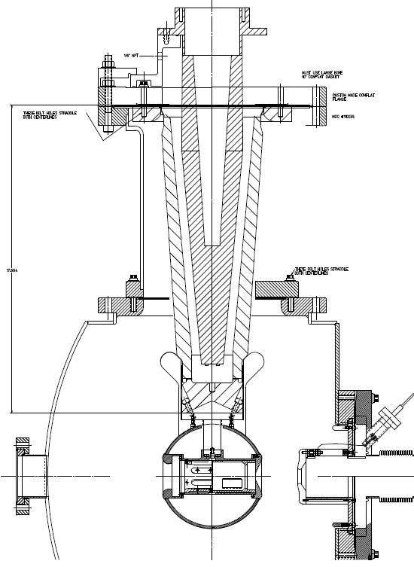
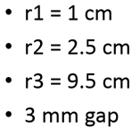
R350 epoxy receptacle
…then in October
Combination of doped insulator and shed, SF6 and epoxy receptacle, plus added length
Yan Wang has modeled the shed, a good design…
SF6
Doped insulator
“Shed” triple-point protection

Slide 21
Milestones Update
WBS | Item | Milestone Description | Start Date | Projected Finish | % Complete | Days Float? | Change (%) | Change (Days)
1.04.xxx | Facilities | Civil work complete | 6-4-15 | Feb 2016 | 10%
 | Gun | Demonstrate gun ok at 350 kW at FEL GTS |  | Dec 2015 | 80%
 | CM | Commission cold ¼ CM, no beam |  | Jan 2016 | 10%
 |  | Beam from Gun to Cup in front of ¼ CM |  | Mar 2016 | 10%
 |  | Beam thru ¼ @ MeV energy delivered to cup in front of HDIce |  | Jun 2016 | 0
 |  | Beam to HDIce |  | Aug 2016 | 0

Slide 22
Schedule Ramifications
Current status:
Utility work is key focus now, particularly electricity to racks
Source group starting to put keV beamline together
ODH assessment must be completed soon, for Tom Renzo to make progress on Cave2 structural design
Next month activities (September)
LCW complete
Compressed air and GN₂ complete
Electrical requirements delivered to Jason/Facilities
Stairway to top of Cave1 installed
ODH assessment complete, ideally with ODH0 assignment
Voltage applied to gun at GTS, plan Y
MeV beamline design complete to 80%, done with contractor

Slide 23
Schedule Ramifications
In two months (October):
Facilities working on electricity to racks
Klystron rack finished, Seidman building control panel
Apply high voltage to new gun design at GTS, plan Z
Renzo working on Cave2, precast and bracing
Move more shield blocks into place. Build as much of Cave2 perimeter as possible
Recall, next big milestone…commission ¼ CM (no beam), scheduled for Jan. 2016 (cryo, ODH, LL and HP RF, software, adequate shielding, EHS&Q approvals)

Slide 24
Schedule Ramifications
Commission ¼ CM (no beam), scheduled for Jan 2016
Facilities – electricity to racks by Nov 2015
Control room – complete by Nov 2015, with computer terminals
SRF checkout of ¼ CM present condition – complete Nov 2015
Low Level RF – Hovater and Seidman have provided MO and LL RF control boards by Dec 2015
High Power RF – klystron chassis and controls complete by Dec 2015
Network controls (IOCs) – complete by Dec 2015
Software control of RF – complete by Jan 2016
Facilities - adequate shielding (Cave2 with a roof) – Feb 2016
Cryo - plumbing to ¼ CM and controls complete Feb 2016
ODH - SSG installed permanent system by Feb 2016, or we are using portable system from CEBAF
EHS&Q approvals…

Slide 25
Schedule Ramifications
Commission ¼ CM (no beam), scheduled for Feb 2016
Electric/FM – 150 k$
Control room – -
SRF checkout of ¼ CM present condition – -
Low Level RF – 25 k$
High Power RF – 56 k$
Network controls – -
Software control of RF – -
adequate shielding (Cave2 with a roof) – 95 k$
Cryo – 90 k$
ODH - SSG 6 k$
EHS&Q approvals…
Total 422 k$

Slide 26
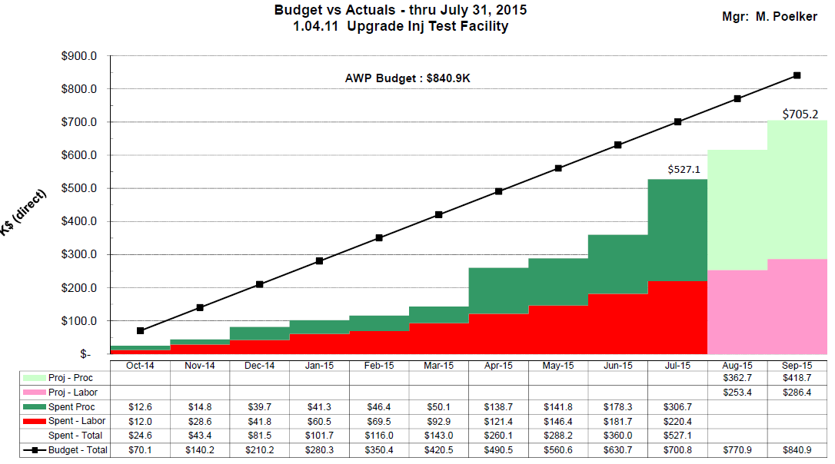

Slide 27
FY16 Procurements?
 | ~ required | spent in FY14 FY15 | To purchase in FY16
Facilities: | 300 | 56.2 | 245
Cryo | 90.8 | 0 | 90.8 | waiting for update
RF | 252.5 | 121.4 | 131.1
Gun | 451.2 | 265.5 | 130 | includes beamline components + contract designer
I&C | 219.5 | 7.6 | 211.9 | Hope to reduce this number using PLC technology
SSG | 45.7 | 1 | 44.7
DC power | 144.5 | 100 | 8 | Trim cards…
Magnets | 120 | 119.3 | 0 | shop to make quads, assumed 100k but could be less Still need three dipoles
Network | 58 | 58 | 0
Total | 1682 | 671 | 862 | Of course, hope the number comes in lower: 750 k$

Slide 28
Issues & Concerns
Schedule slip one month…
If it slips more, perhaps consider installing the new ¼ CM first (ready June, 2016). Commission HDIce and the new ¼ CM at same time (kill two birds with one stone)
CTF is not big enough to support three LHe Users. How to “park” the ¼ cryomodule?
UITF (4 to 6 wks, 3 times per year)
CMTF and LCLS II
VTA
Groups are busy but I continue to be optimistic that work can get done opportunistically within project timeline. Facilities, Mech Design, Cryo, SSG, and Ops software have expressed most reservations

Slide 29
Summary
Progress now becoming more obvious. By October, expect to see some beamline, with ¼ CM inside the cave, electronics racks above the cave….
Hope the Lab can continue funding at ~ FY15 level
We are being responsible with money and we are respectful of other JLab work priorities…

Slide 30
Backup Slides
Backup slides from past meetings, P&C meetings

Slide 31
Original vs Current Cost Estimate
Presented at UITF meeting May 13, 2015:
Direct $
Loaded $
Original Est. by Hari Areti |  | FTEs | Labor | Proc | Total |  | Labor | Proc | Total
on 2-7-2014 | FY14 | 3.7 | 462.54 | 478.95 | 941.49 |  | 682.70 | 671.23 | 1,353.94
 | FY15 | 2.5 | 312.08 | 557.10 | 869.18 |  | 465.00 | 830.07 | 1,295.07
 | FY16 | 0 | - | - | - |  | - | - | -
 | Total | 6.2 | 774.62 | 1,036.05 | 1,810.66 |  | 1,333.458 | 1,501.306 | 2,649.011
Revised Est. |  | FTEs | Labor | Proc | Total |  | Labor | Proc | Total
by Matt Poelker | FY14 | 1.2 | 160.32 | 189.48 | 349.80 |  | 233.08 | 274.29 | 507.37 | 47.6%
on 5-13-2015 | FY15 | 8.6 | 937.36 | 611.17 | 1,548.53 |  | 1,396.67 | 907.95 | 2,304.62 | 49.0%
 | FY16 | 7.9 | 940.39 | 881.33 | 1,821.72 |  | 1,422.80 | 1,333.46 | 2,756.26 | 51.3%
 | Total | 17.7 | 2,038.07 | 1,681.98 | 3,720.05 |  | 3,052.56 | 2,515.70 | 5,568.26
Dfference from original estimate |  | (11.5) | (1,263.46) | (645.93) | (1,909.39) |  | (1,719.10) | (1,014.40) | (2,919.25)
Total cost estimate. The specific allocations for FY15 and 16 are not correct

Slide 32
Revised Estimates Breakdown
Original request to DOE: $2.6M (loaded)
Current estimate for completion: $5.6 M (loaded)
Delta increase of $2.9M (loaded)
Labor estimates
Underestimated effort by 11.5 FTEs
Increased labor by $1.7M (loaded)
Procurements
Underestimated by ~$1M (loaded)
Several sub-system components were not included in the original estimate and later determined were necessary to complete the scope

Slide 33
Comparison Procurement Estimates (Direct $)
System | Prev | Now | Delta | Comment
Facilities | 305 | 300 | -5 | (numbers are Proc and Labor)
Safety System | 59 | 46 | -13
RF Systems | 125 | 253 | +128 | rf control boards, klystron PS
Cryogenics | 40 | 91 | +51 | Pipe, heat exchanger
Polarized Source | 255 | 262 | +7 | Gun insulators, beamline parts
I&C | 131 | 220 | +89 | BPMs, viewers, picoammeters
DC Power | 0 | 145 | +145 | Trim cards and parts
Magnets | 58 | 120 | +62 | Addl. quads, correctors, dipoles
SRF | 50 | 0 | -50
HDIce | 5 | 0 | -5
Network, IOCs | 0 | 58 | +58
CIS FY14 Actuals | 0 | 189 | +189 | FY14 actuals
Total | 1,028 | 1,684 | +656

Slide 34
FY14 and FY15 UITF Procurements
FY14 |  |  |  | FY15 |  |  | Addl. expected FY15 procurements
Solid Works CAD |  | 2.2 |  | Insulator flange | 1 |  | Contract Mech Designer | ~ 30
450kV HV power supply |  | 31.1 |  | bpm components | 7.6 |  | stairs | ~ 20
semiconducting R30 insulators |  | 52.6 |  | semiconducting R30 insulators_v2 | 22.3 |  | trim cards | ~100
gun HV chamber |  | 7.8 |  | Klystron HV power supply | 55.5 |  | quad magnets (machine shop) | 70 to 130
ion pumps |  | 15.1 |  | concrete wall removal | 32 |  | Chopper rf amplifiers (x2) | 44
beamline Y chamber |  | 5 |  | LLRF parts | 15.1 |  | water skid for chopper | 3
photocathode prep chamber |  | 4.5 |  | steering magnets | 19.3 |  | keV beamline support structure | 6.5
drill penetrations in concrete |  | 4.2 |  | SF6 tank | 11.3 |  | Addl. FY15 procurement total | 303.5
assorted |  | 3.9 |  | waveguide | 3.8
Credit card |  | 21.8 |  | SSG sensor | 1
Machine shop |  | 40.8 |  | assorted | 9.4
total | 189 |  |  | total | 178.3
FY14 + FY15 Procurements: 670.8
UITF Total Procurements 1682

Slide 35
UITF – Upgrade Injector Test Facility
Deliverables/Milestones
Beam on HDIce by August 2016 (nA current level at ~ 10 MeV)
Staffing
Critical Skills needed NOW: Facilities, Cryo including ODH assessment, Mechanical Design, Safety System Group for ODH, Ops Software
Update since last meeting
Monthly meetings with Mont, on-going
Cave1 north concrete wall demolition complete
Accelerator design sufficiently complete to start building the keV beamline
Shaun Gregory has started the MeV beamline design
Cave1 cleared out, ready for Survey and Alignment
Consensus achieved on entry/exit labyrinth from shielding point of view
We realized we might have unwanted ODH2 conditions. Mat Wright now performing formal ODH assessment, which will include recommendations (?). Suspect we must revisit Cave2 ceiling design, to provide a passive escape path for helium gas
Stairway to top of Cave1 – PR has been awarded
Carlos and Don Bullard are back – they can focus on 350kV gun
Continued progress on “stretch goals”: RF control modules, trim cards, quad magnets, BPMs (and staying within FY15 budget)

Slide 36
UITF – Upgrade Injector Test Facility
To-do list for next 30 days
Setup the electronics racks above Cave1
Agree on layout, RadCon to approve it
Installation Group (Neal Wilson and company) to build it
Need a temporary stairway to access the top of Cave
Provide electrical requirements to Facilities/Jason Willoughby
Obtain the formal ODH assessment, use it to provide Tom Renzo information relevant to Cave2 ceiling design. Modifications to Cave1 ceiling required?
Facilities should remove utilities on Control Room exterior wall (window air conditioner, fire, electric), so that Walter Kehlner can move more concrete block into position to erect the perimeter of Cave2
Installation Group to install unistrut along east wall, for attaching utilities. Installation Group and Facilities to begin attaching utilities to this wall: LCW, GN2, compressed air, electric, lighting, fire suppression
Move the ¼ CM into Cave1 or Cave2
Apply high voltage to gun with shed electrode at FEL Gun Test Stand
Need to make some headway on Bob May’s EHS&Q task list

Slide 37
UITF – Upgrade Injector Test Facility
Issues/Concerns that could affect on-time delivery
Can Cryo provide plumbing soon? Begin work on He recovery system for HDIce? Want to leave space for them to do their work but also want to start “filling up the cave” now
Designers in short supply
Can SSG provide the ODH and PSS systems on schedule?
Facilities end-date February 2016 could delay ¼ CM commissioning, gun HV conditioning, and intentional beam generation
Impact on CTF, a new LHe User
Recommended Mitigation
Purchase contract designer
We can use portable ODH monitoring system for ¼ CM commissioning
Temporary shield wall and OSP could provide a means to commission ¼ CM, condition gun and perhaps make 350kV beam without a completed UITF concrete enclosure and PSS?
Preble, K. Davis, Cryo Group have started conversation related to oversubscribed CTF. However, near term solution is likely a scheduling solution.
Timing is good for Ops Software, provided we (mostly) duplicate existing CEBAF software controls

Slide 38
EHS&Q related tasks (from Bob May)
Global hazard review (can be documented in FSAD)
Radiation source term, shielding design, assessment, approval, installation
Final ODH assessment, with Cryo?
Standard industrial hazards (electrical, fall protection, emergency egress, magnetic and RF field exposure, etc.)
FSAD update (Rev 8) incorporating hazards assessment and mitigations
ASE development and submittal (Rev 8) for TJSO approval
Commissioning Plan Development
(Internal or External?) Review of Commissioning Plan (CP)
Operations plan/procedure development (related to Accelerator Operations Directives? Borrow from and scale down LERF procedures?)
Decision about type of ARR and who participates – external/internal/combo
Accelerator Readiness Review Plan Review (can be done with CP Review)
Work with SSG to implement PSS, RCD to implement CARMS
Conduct Hot Checkout (test all installed systems – ready for safe/effective ops)
Conduct ARR
Obtain TJSO permission to commission UITF (must include shileding effectiveness check, verification of safety device performance
Commissioning results report
Obtain TJSO permission to operate UITF
Hari has agreed to work on this

Slide 39
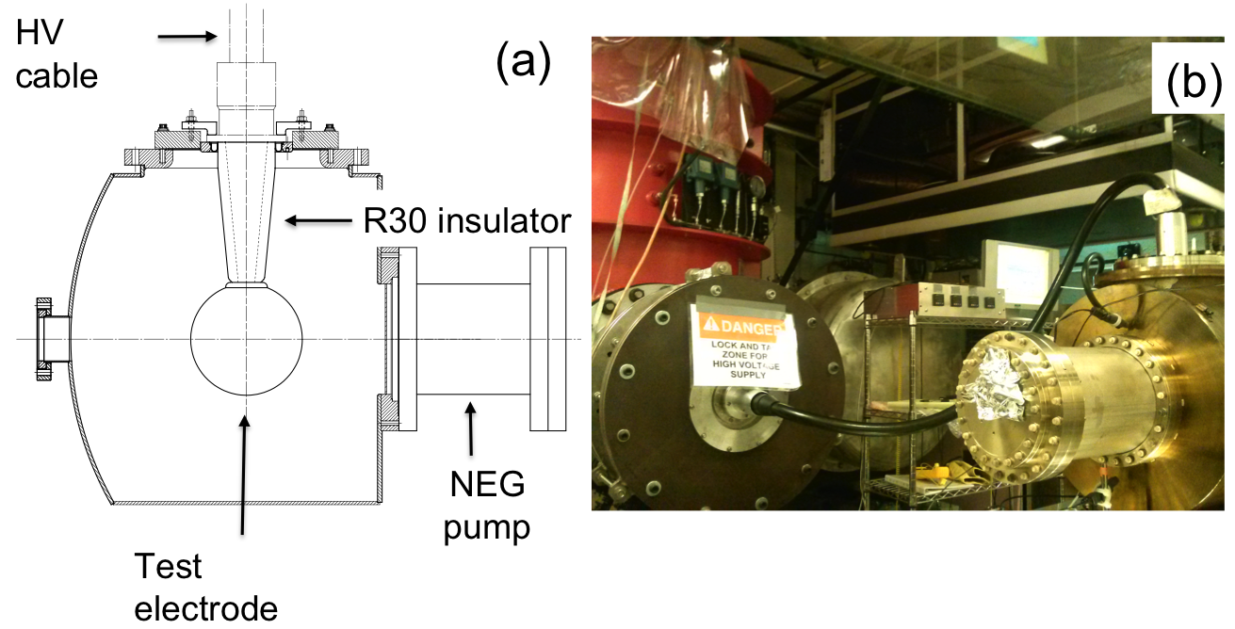
Building the 350 kV Gun
Start with “dummy” electrodes and test different insulators and cathode screening electrode
Notes:
Interior Page Design 2

Slide 40
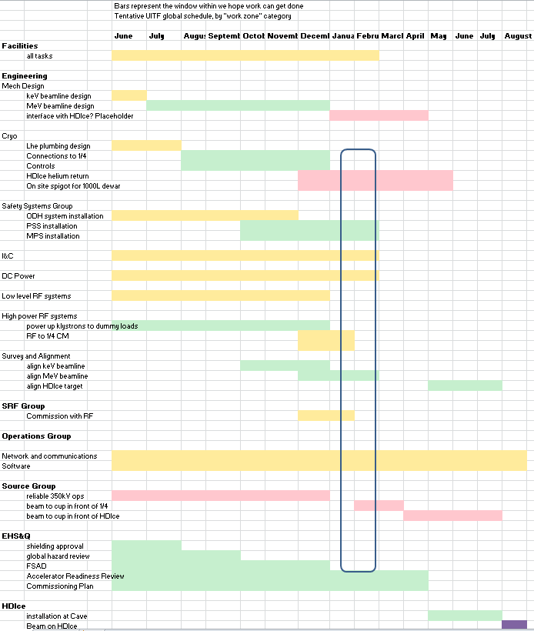

Slide 41
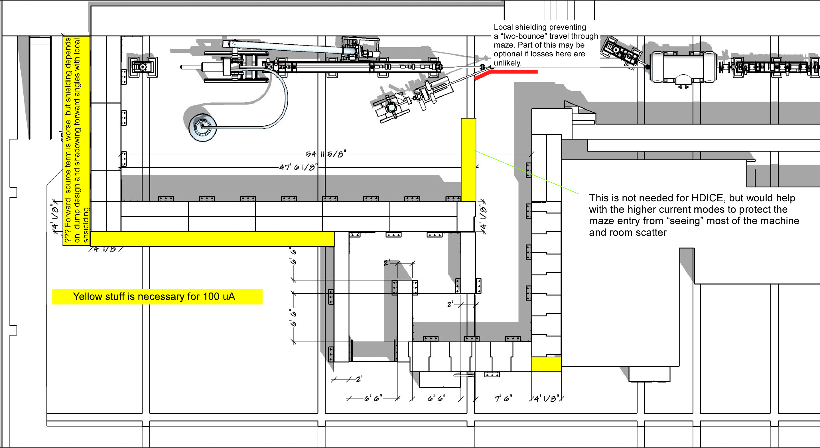
Approved Labyrinth and a plan for 100uA
Plus: augment ceiling shielding, maybe some restricted areas, and be generous with local shielding of dumps

Slide 42
Today’s layout, ready to cut metal…..
Design by Shaun Gregory
Cryo lines hug the wall, waveguides on same side as cryo lines
Heat exchanger added to the mix, Rao says this will make things more efficient and stable

Slide 43
Cryo lines compatible with old and new ¼ CM…
Looks similar to our “upgrade injector” front end

