Slide 1
Center for Injectors and Sources
Scientists: M. Poelker, J. Grames, C. Hernandez-Garcia, R. Suleiman, M. Stutzman, and S. Zhang
Postdoc: M. A. Mamun
Technical Staff: P. Adderley, B. Bullard, J. Hansknecht,
Graduate Students: Gabriel Palacios, Y. Wang, S. Wijiethunga, J. Yoskovitz, M. Stefani
Frequently work with others: F. Hannon, R. Kazimi, A. Hofler

Slide 2
CIS Responsibilities
CEBAF polarized electron source and injector upgrade
LERF photogun and drive laser
Gun Test Stand: magnetized beam for JLIEC (pgun and tgun)
UITF: a compact 10 MeV accelerator at bldg 58

Slide 3
Skill Set
Photocathode
High Polarization
High QE (photoemission yield)
Long Lifetime
Vacuum
Static Vacuum
Dynamic Vacuum
High Voltage
Eliminating field emission
Drive Laser
Reliable, phase locked to machine
Adequate Power
Wavelength Tunable
Notes:
Interior Page Design 2

Slide 4
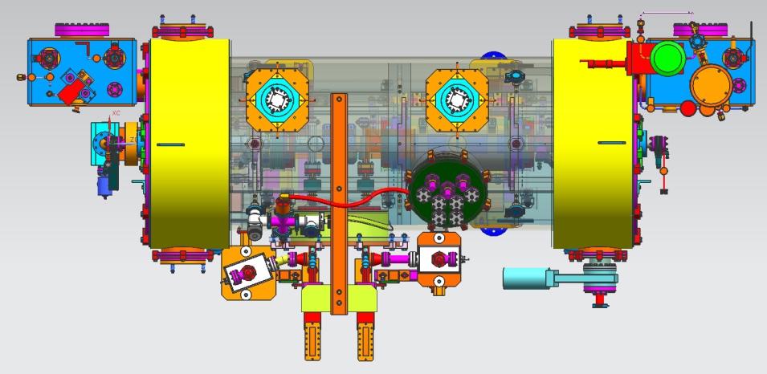
Injector Upgrade
200 kV
Increase gun voltage, modify Wien filters for 200kV operation
Improve baked beam line vacuum so gun does not pump on beam line
Locate H-Wien (energy filter) upstream of pre-buncher cavity
New SRF booster eliminates warm capture, RF deflection and x/y coupling
Our new “1/4 cryomodule”, or QCM:
2 cell capture section + 7 cell cavity,
should provide 10 MeV beam and introduce no x/y coupling, allow better matching, more adiabatic damping
Accelerator Division All Hands Meeting
4

Slide 5
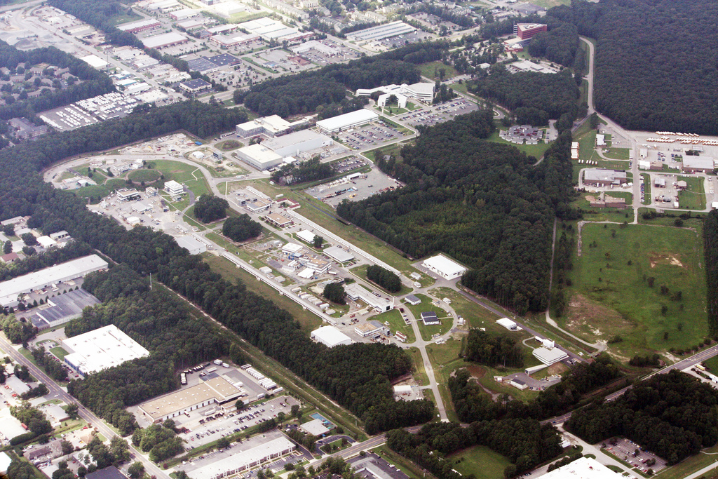
JLab Energy Recovery Linac
Beam accelerated from 5 to 100 MeV and then decelerated back to 5 MeV, to recover the energy
Powerful light source
IR and UV FEL
THz light
Search for Dark Matter
Fixed Target Options
Notes:
Interior Page Design 2

Slide 6
The injection line - DC photogun NCRF buncher + SRF booster and dog-leg merger
0.35 MeV
DC photogun
10 MeV
SRF booster
Dog-leg
Solenoid
NCRF buncher
Beam to linac
Solenoid
Quadrupoles
2.5 m

Slide 7
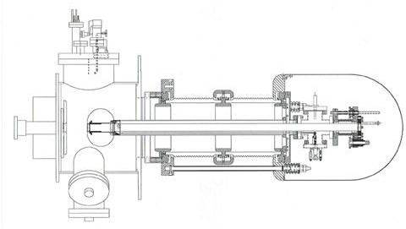
Vent-Bake FEL gun
RGA, extractor gauge
and leak valve
Electrodes
Vacuum chamber
Ceramic stand-offs
Corona shield
End flange
Photocathode retractor mechanism
Anode
Photocathode
End flange
High voltage feed
(3) 1000 l/s NEG pumps
80 cm

Slide 8
JLEIC High Energy Electron Cooler
High Energy Electron Cooler
ion beam
Magnetization flip
ion beam
cooling solenoid (B<0)
cooling solenoid (B>0)
beam dump
linac
injector
fast extraction kicker
circulating bunches
fast injection kicker
Circulator Cooler Ring
ERL Ring
injected bunches
exchange
septum
extracted bunches
dechirper
vertical
bend
to CCR
vertical
bend
into ERL
rechirper

Slide 9
JLEIC Magnetized Source Requirements
Bunch length | 60 ps (2 cm)
Repetition rate | 43.3 MHz
Bunch charge | 3.2 nC
Peak current | 33.3 A
Average current | 120 mA
Transverse normalized emittance | <19 microns
Cathode spot radius – Flat-top ($a_{0}$) | 3.14 mm
Solenoid field at cathode (B_{z}) | 0.5 kG
Cornell University demonstrated 65 mA and 2 nC, but not at same time, and non-magnetized
Fermilab Magnetized Photoinjector Laboratory:
Pulsed NCRF gun with Cs₂Te photocathode and UV laser (λ=263 nm)
Bunch charge: 0.5 nC and bunch length: 3 ps
0.5% duty factor (average current: 7.5 μA)
Bunch frequency: 3 MHz
Macropulse duration: 1 ms
Number of bunches per macropulse: 3000
Macropulse frequency: 5 Hz

Slide 10
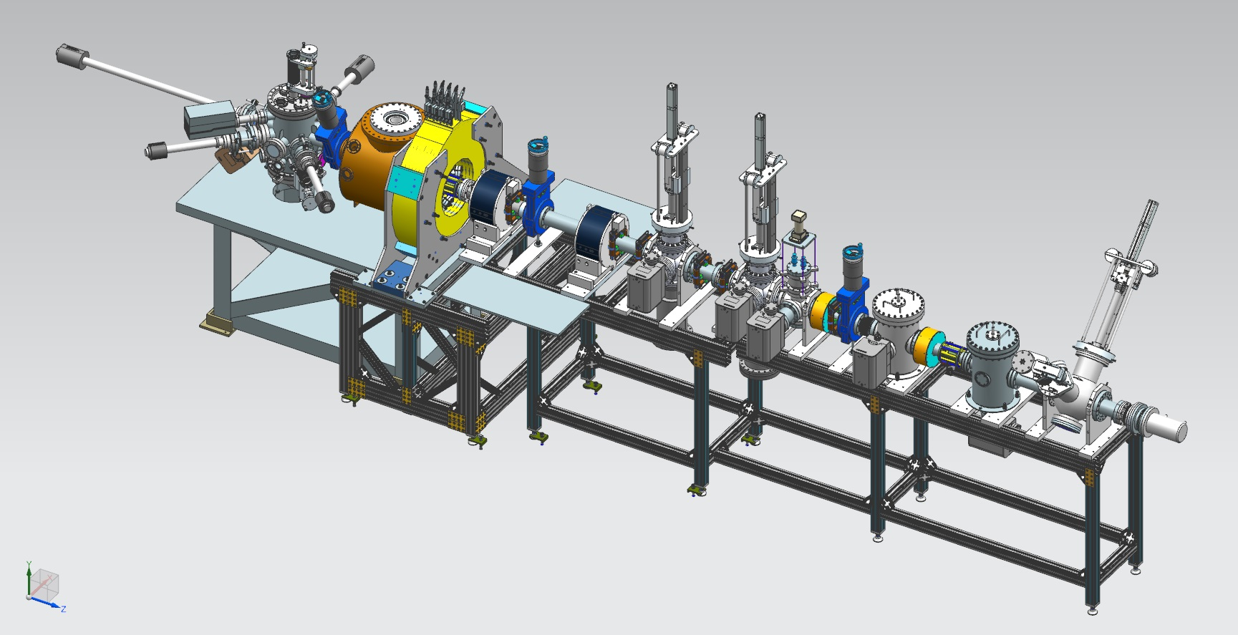
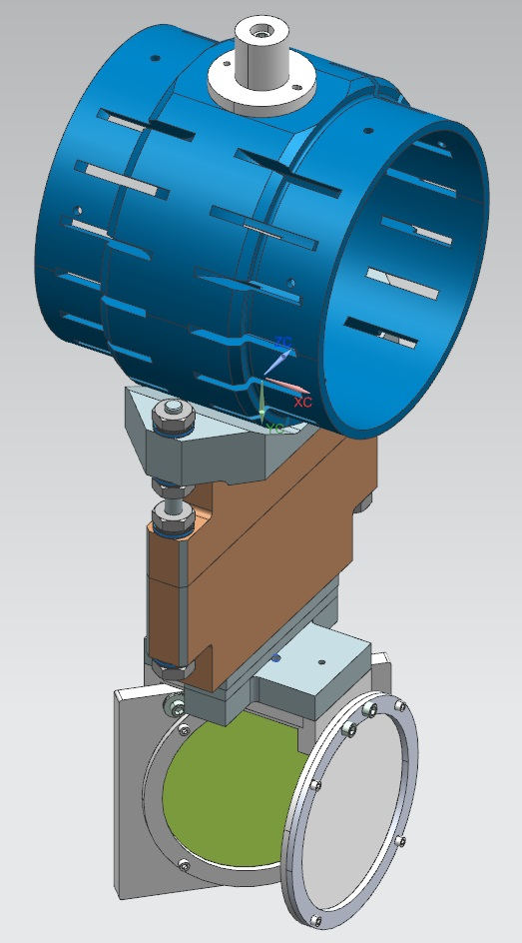
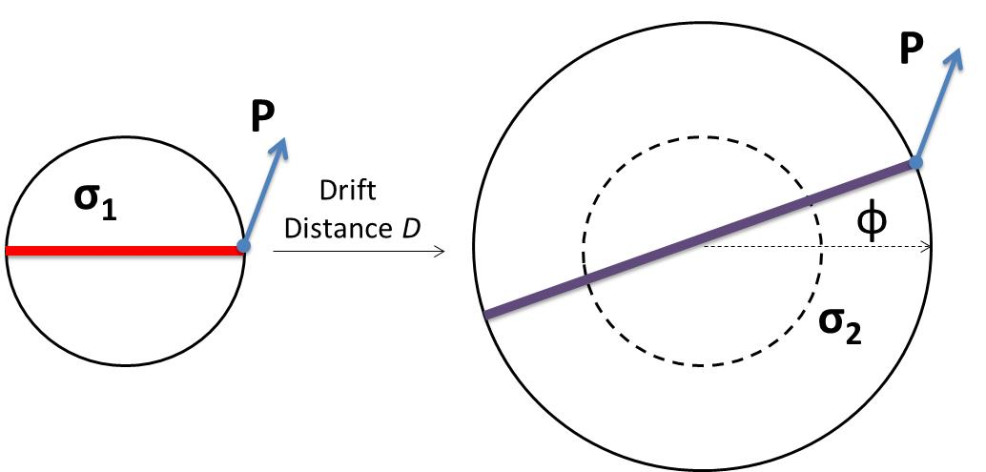
Magnetized Source Schematics
Gun HV Chamber
Photocathode
Preparation
Chamber
Beamline
Gun Solenoid
Shield Tube
Viewer 3 Screen
Beam Dump
Use slit and viewscreens to measure mechanical angular momentum:
Slit
$B_{z}$: solenoid field at photocathode
$a_{0}$: laser rms size
φ: rotation (sheering) angle
Viewer Screen

Slide 11
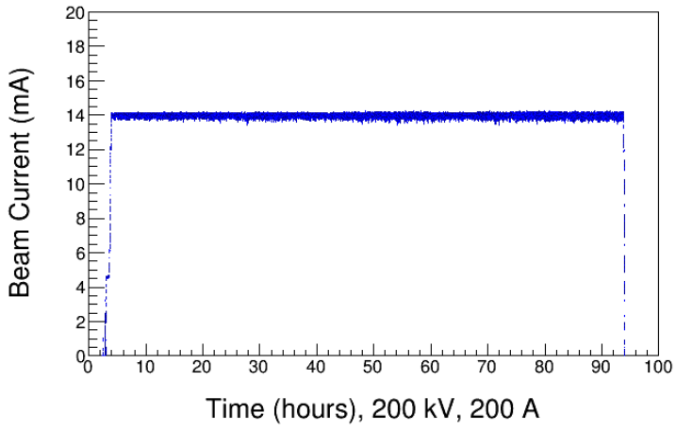
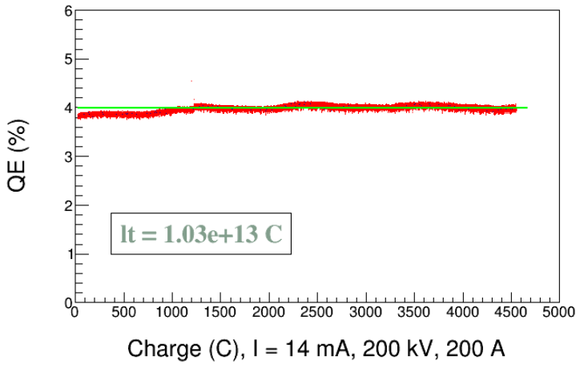
300 kV Inverted Gun and CsK₂Sb Photocathode

Slide 12
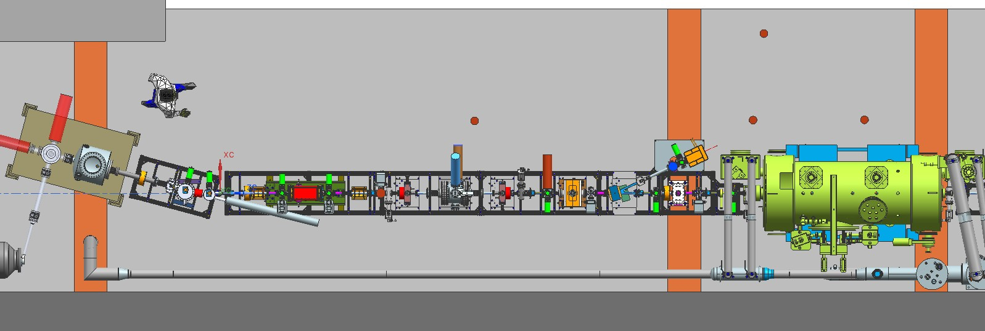
Upgraded Injector Test Facility - UITF
New equipment for CEBAF: photoguns, Wien filter, QCM
mA polarized beam R&D
NbSn-coated cavities
Polarimetry (SBIR-sponsored)
Fast Kicking (SBIR-sponsored)
TEST HDIce
TEST NEW PHOTOGUNS
TEST 200 kV WIEN FILTER
COMMISSION NEW QUARTER CRYOMODULE
12

Slide 13
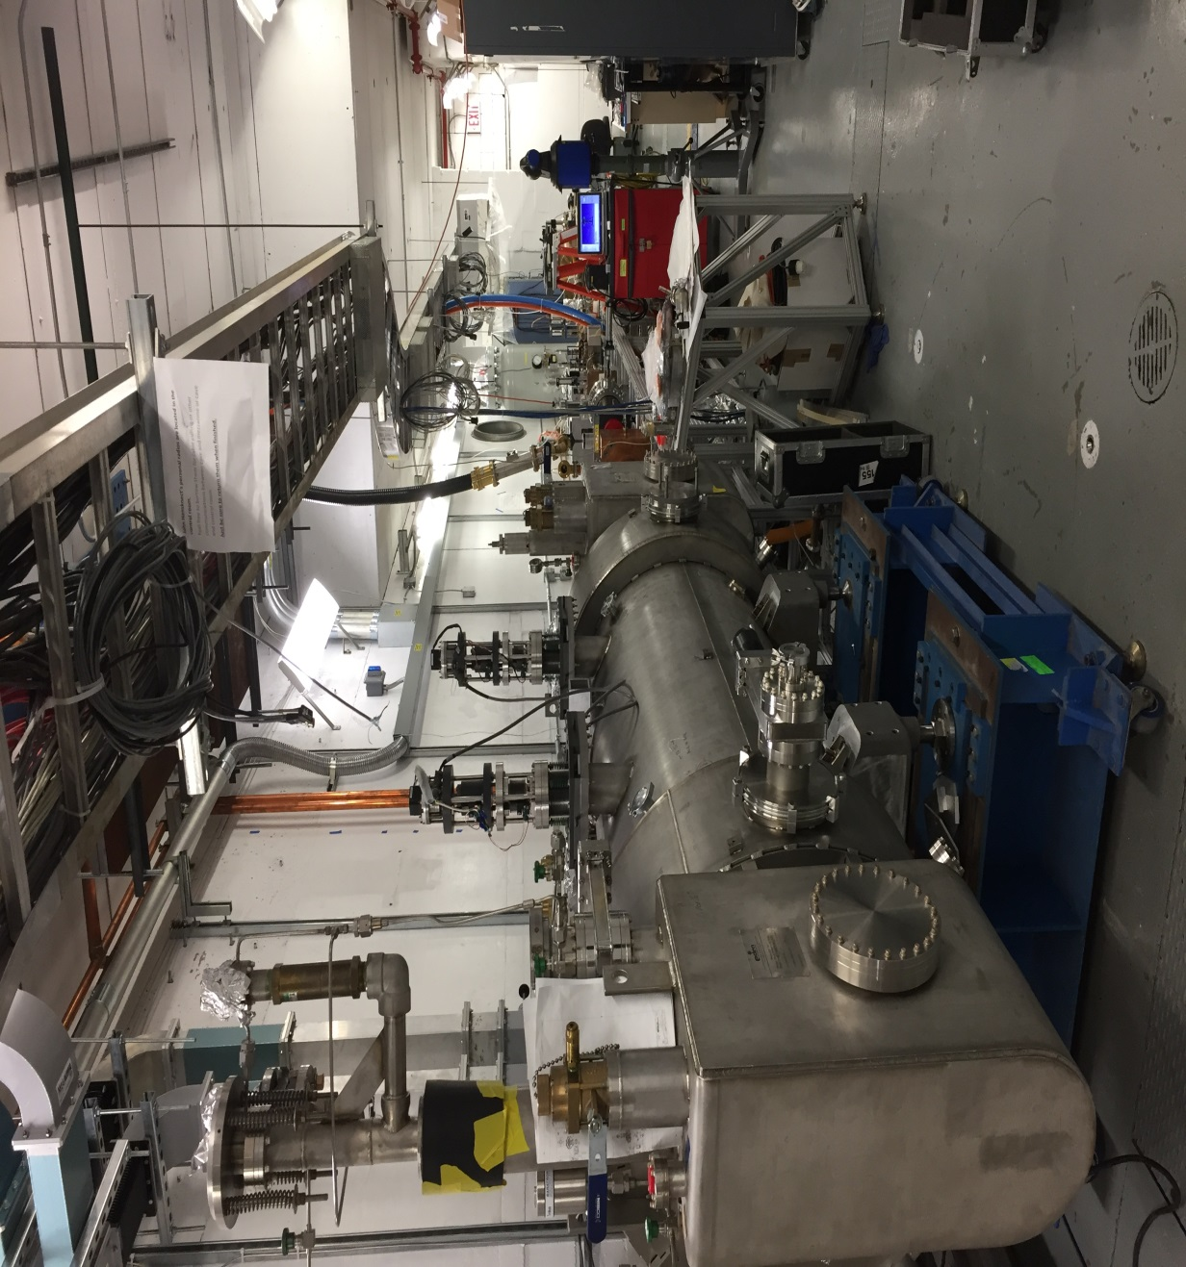
Upgraded Injector Test Facility
Demonstrated 200 keV beam delivery
QCM cooled to 2K
HDIce cryostat to be installed soon
Need to build MeV beamline
Need klystrons
Need to design/build current-limiting safety device

