Slide 1
DOE-NP Accelerator R&D
PI Meeting
P. Adderley, D. Bullard, J. Grames, J. Hansknecht,
C. Hernandez-Garcia, Md. Abdullah Mamun, M. Poelker,
M. Stutzman, R. Suleiman, S. Zhang
Students: W. Liu, Y. Wang
DOE Headquarters, Germantown 11/14/2016
Matt Poelker, Jefferson Lab
Notes:
Interior Page Design 2

Slide 2
Recently Funded Projects
500kV DC High Voltage Inverted Gun with Load-locked CsK₂Sb Deposition Chamber - Research and Development for Next Generation Nuclear Physics Accelerator Facilities (LAB 12-632) and (LAB 14-1082)
New Photocathode Materials for Electron Ion Colliders - Research and Development for Next Generation Nuclear Physics Accelerator Facilities (LAB 12-632) and (LAB 14-1082)
Cryo-Pumped DC High Voltage Polarized Electron Source - Small Project, DOE Office of Nuclear Physics, (LAB 10-339)
Matt Poelker, Jefferson Lab
Notes:
Interior Page Design 2

Slide 3
Recently Funded Projects
500kV DC High Voltage Inverted Gun with Load-locked CsK₂Sb Deposition Chamber - Research and Development for Next Generation Nuclear Physics Accelerator Facilities (LAB 12-632) and (LAB 14-1082)
New Photocathode Materials for Electron Ion Colliders - Research and Development for Next Generation Nuclear Physics Accelerator Facilities (LAB 12-632) and (LAB 14-1082)
Cryo-Pumped DC High Voltage Polarized Electron Source - Small Project, DOE Office of Nuclear Physics, (LAB 10-339)
Matt Poelker, Jefferson Lab
Notes:
Interior Page Design 2

Slide 4
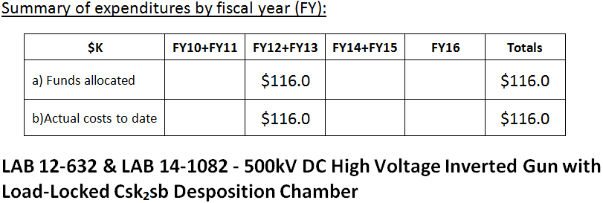
Recently Funded Projects
To extend the “inverted gun” geometry design, to operate at higher voltage, for high bunch charge and high average current EIC cooling applications
To design a photocathode test stand to measure QE and polarization of new photocathode materials that might help EIC
To improve photogun vacuum and thereby improve lifetime of polarized electron sources, particularly at mA current, i.e., eRHIC
Matt Poelker, Jefferson Lab
Notes:
Interior Page Design 2

Slide 5
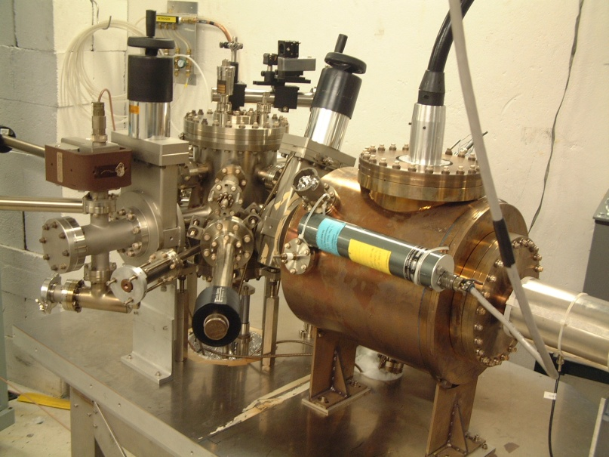
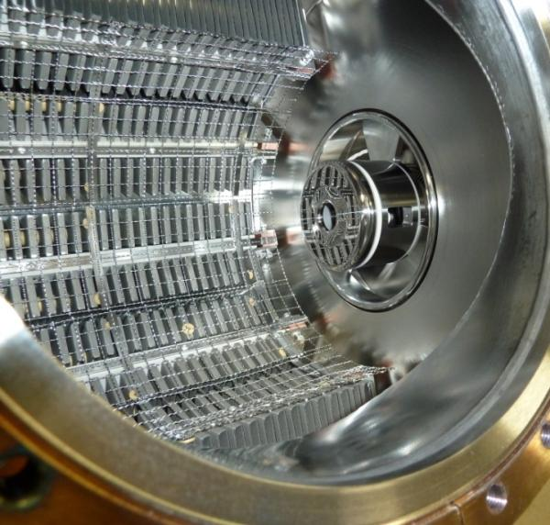
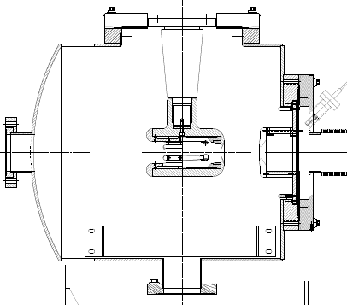
The CEBAF - ILC Inverted Gun
NEG pumps
New design
Load-locked GaAs polarized photogun
130 kV at CEBAF, 200 kV at Injector Test Stand
Gun Vacuum ~ low 10⁻¹² Torr
Matt Poelker, Jefferson Lab
Notes:
Interior Page Design 2

Slide 6
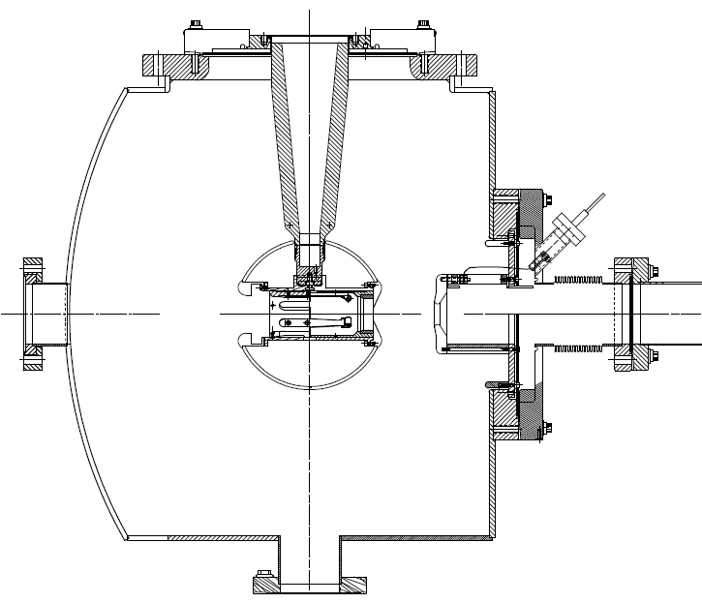
500 kV Photogun?
CEBAF 130 kV Inverted Gun
“R28” insulator
Longer “R30” insulator
Spherical electrode
Matt Poelker, Jefferson Lab
Notes:
Interior Page Design 2

Slide 7
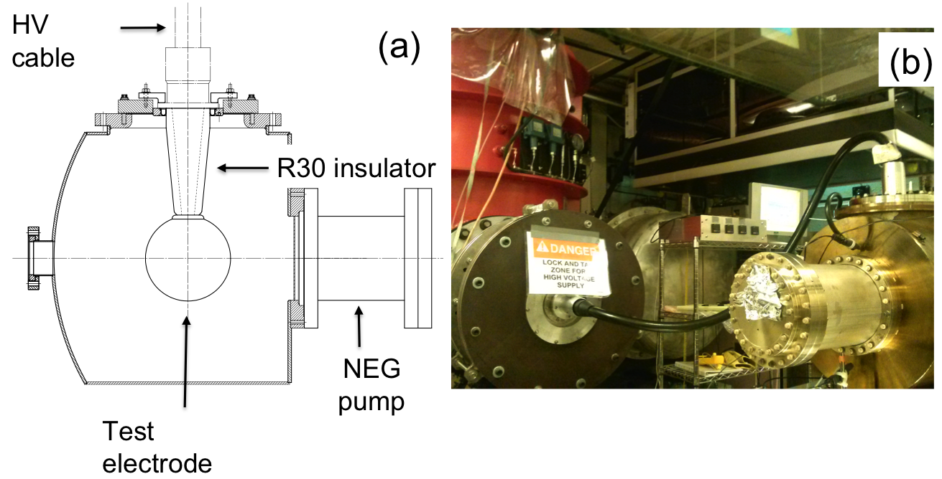
Building the 500 kV Gun
Start with “dummy” electrodes and test different insulators and cathode screening electrode
Notes:
Interior Page Design 2

Slide 8
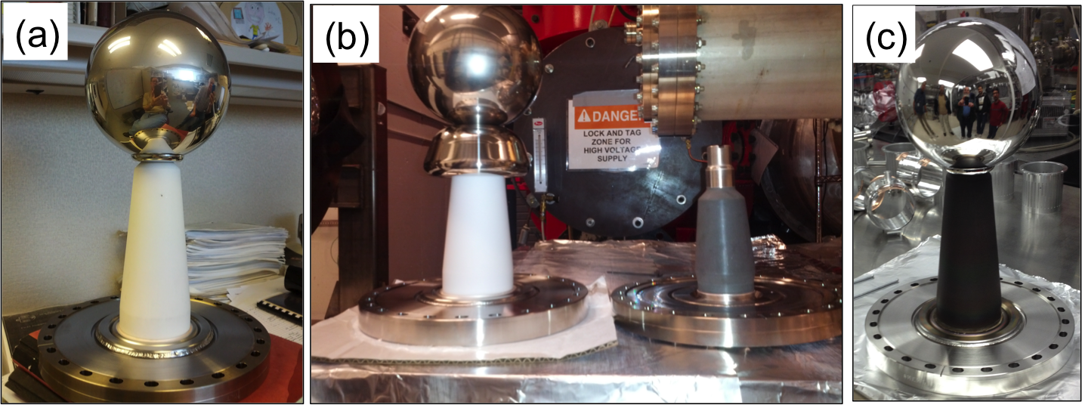
Insulators and Screening electrode
Longer R30 insulators, conventional alumina
Short R28 insulator, bulk resistivity, mildly conductive
Longer R30 insulator, bulk resistivity, mildly conductive
ZrO-coated R30 insulator, also mildly conductive
dummy electrode with a screening electrode (shed)
Notes:
Interior Page Design 2

Slide 9
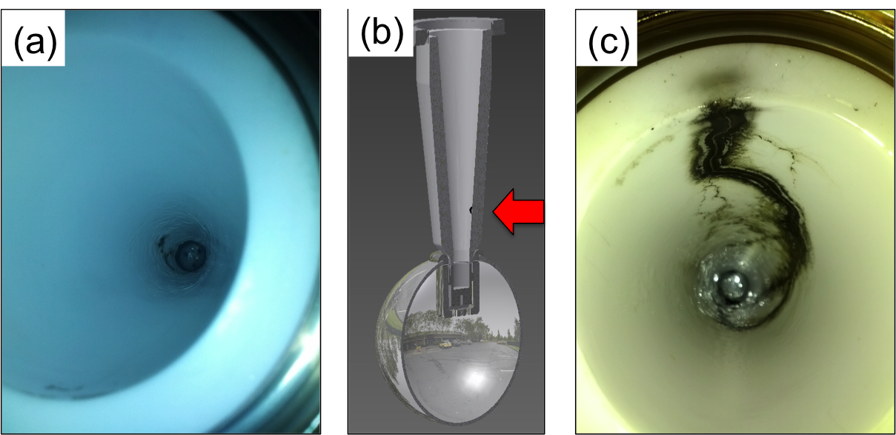
Breakdown at Cable/Insulator Interface
Problems at the cable junction, atmosphere side
Note: Field emission was managed via krypton-processing. i.e., voltage first applied with ~10⁻⁵ Torr krypton added to gun chamber
Notes:
Interior Page Design 2

Slide 10
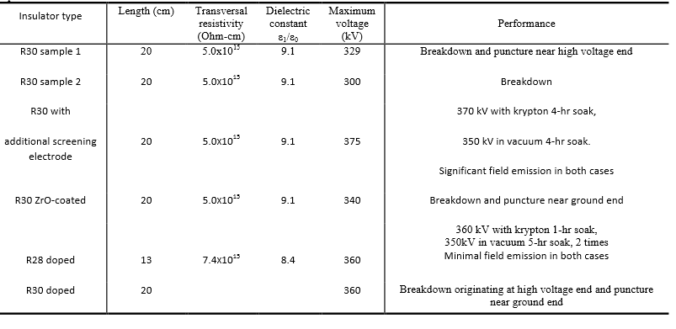
Summary of Tests
Two and 1/2 configurations reached our voltage goal
Notes:
Interior Page Design 2

Slide 11
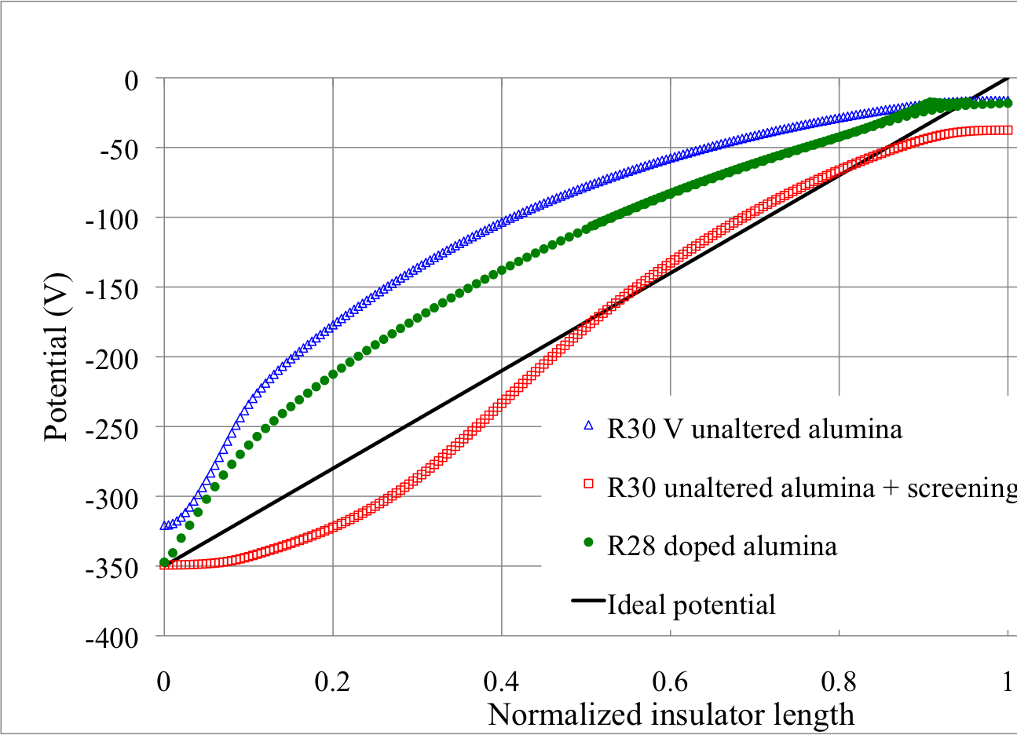
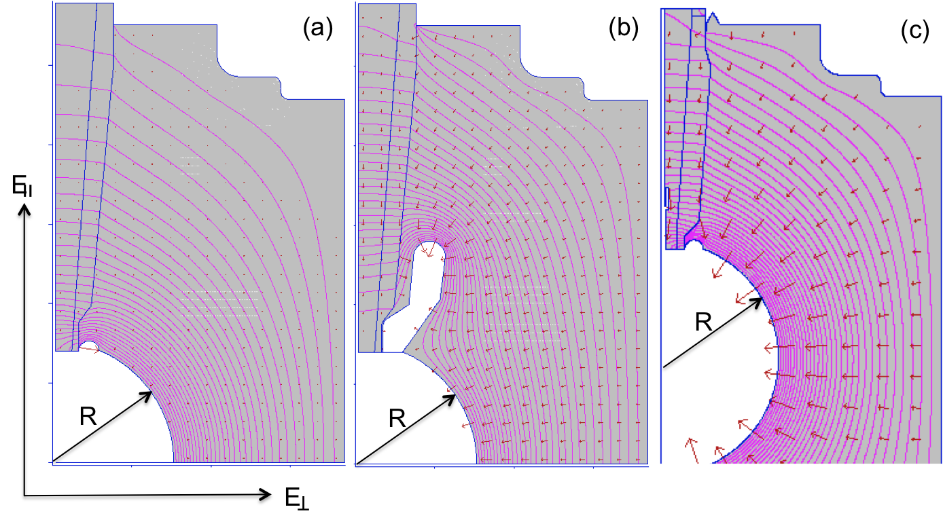
Linear Potential Drop
Want a linear potential gradient along length of the insulator
Note - POISSON does not accurately model the mildly-conductive feature of the black insulator
Notes:
Interior Page Design 2

Slide 12
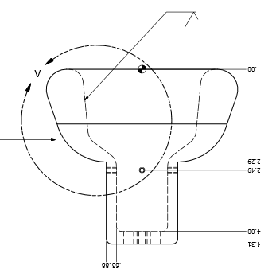
Combine the two features that provided incremental success: screening electrode and doped black R30 insulator
Replaced dummy ball with electrode that can hold photocathode
Matt Poelker, Jefferson Lab
Notes:
Interior Page Design 2

Slide 13
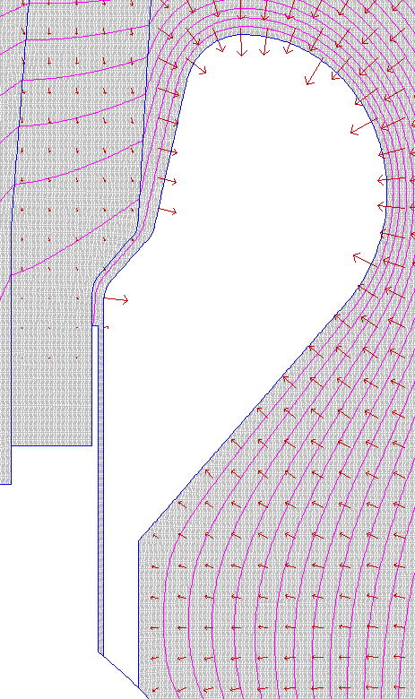
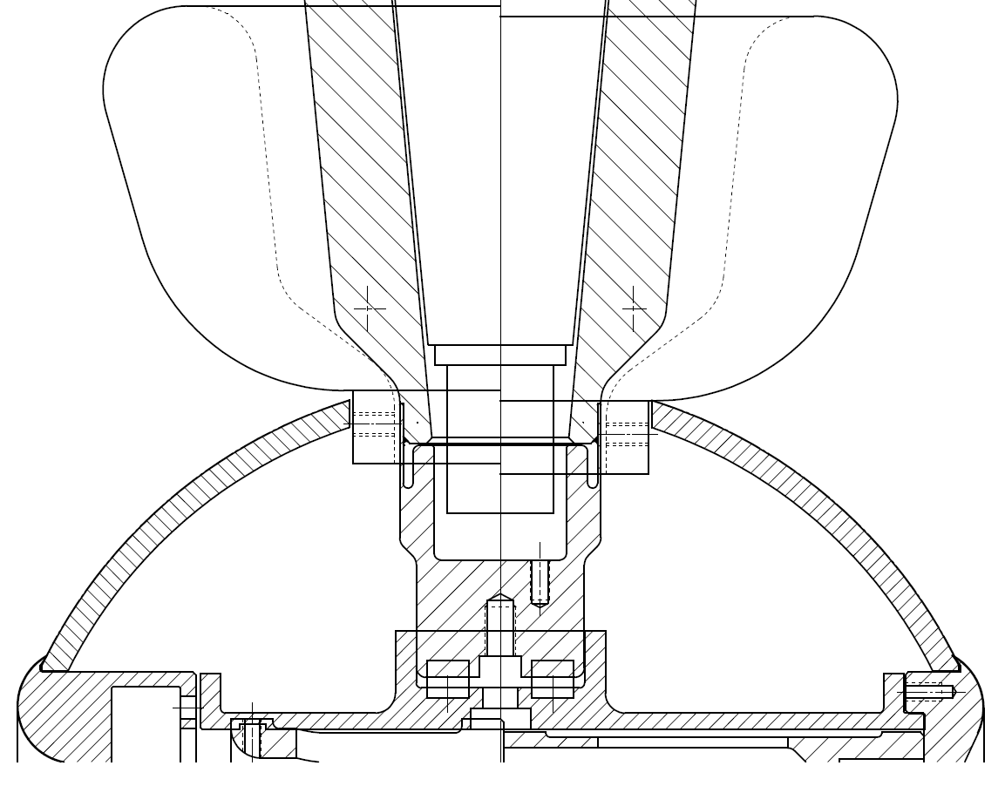
The gap between shed and insulator
reduce
7 MV/m
9.5 MV/m
10 MV/m
10.8 MV/m
Keep field strength low at triple point (metal, insulator, vacuum)
8 MV/m
9.5 MV/m
7 MV/m
8 MV/m
Gap = 1 mm

Slide 14
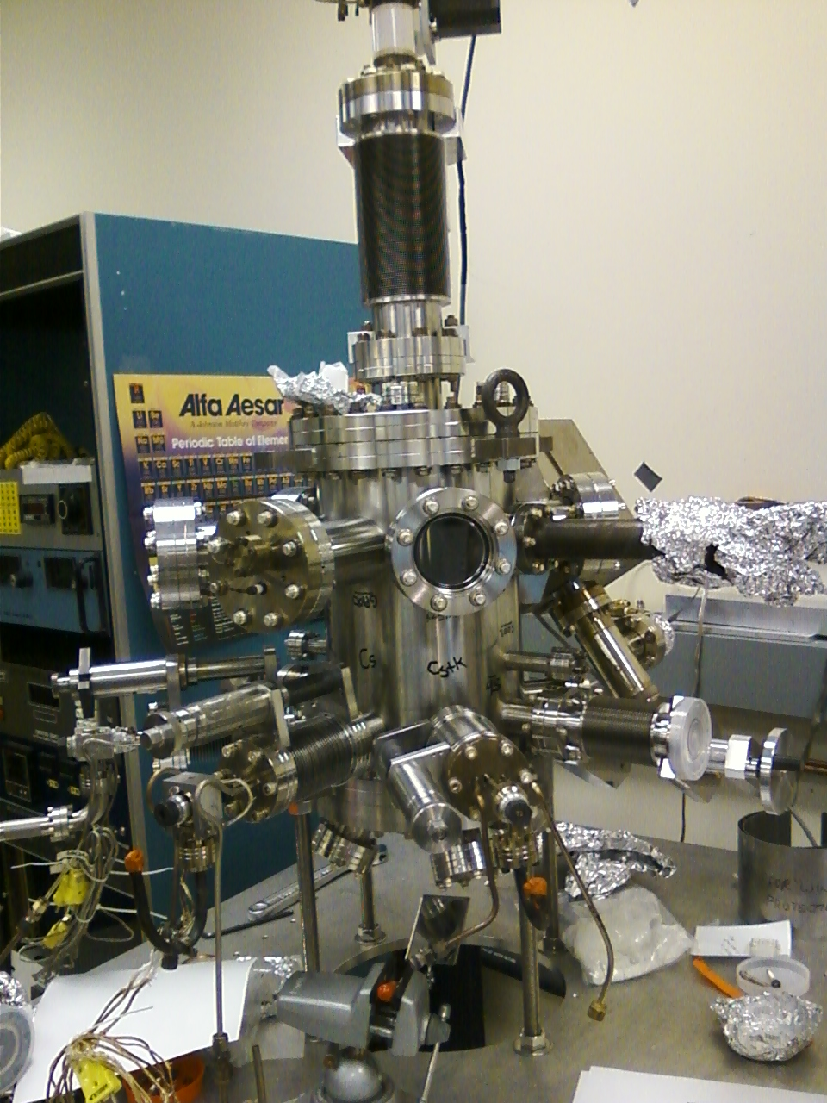
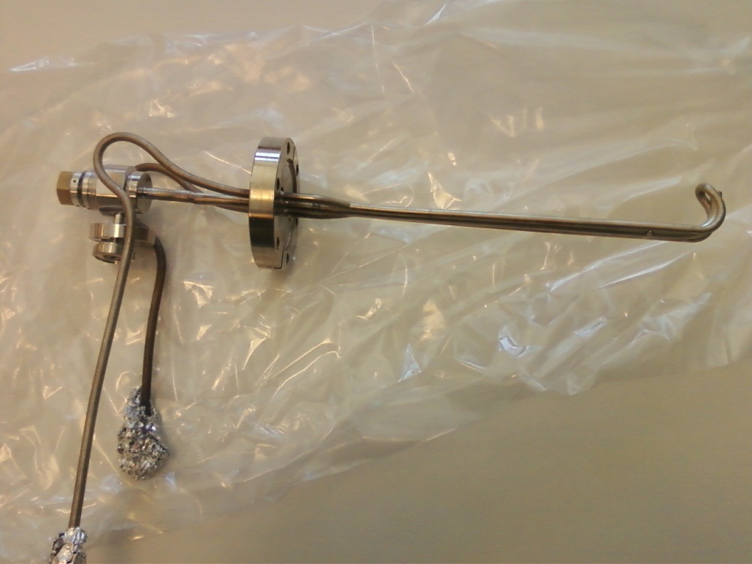
CsK₂Sb deposition Chamber
Effusion source, compact, high capacity
Contains both Cs and K species, co-deposition
Photocathodes grown on stalks
Matt Poelker, Jefferson Lab
Notes:
Interior Page Design 2

Slide 15
Distinguishing QE Drop due to Contamination
Work of M.A. Mamun
Pre-bake vacuum ~10⁻⁸ Pa
Brief heating 170 - 200 °C,
H₂O 34%
QE Recovery
Brief heating 170 - 200 °C,
H₂O 26%
QE Recovery
Brief heating 170 - 200 °C,
H₂O 37%
QE Recovery
RT
LN₂
RT (Post Heating)
Systematic decrease in QE at RT in repeated cooling events
Considerable increase in water partial pressure during brief heating was observed
Rejuvenation of QE by brief heating at 170-200 °C was consistently observed in the non-baked system which can be considered as a signature of water adsorption
Notes:
Interior Page Design 2

Slide 16
Reproducible QE - Cryocooled Photocathode
baked vacuum ~10⁻⁹ Pa
Work of M.A. Mamun
RT
LN₂
RT (Post Heating)
The QE at RT did not show any decrease between repeated cooling events
QE at Liquid N₂ temperature (77 K) showed similar QE every time it was cooled
Initial QE rise due to stoichiometric optimization
We did our spectral response and temperature analysis from this phocathode.
Notes:
Interior Page Design 2

Slide 17
Depo Chamber at Gun Test Stand
Always something to fix: Valve between gun and depo chamber leaked, working distance between puck and chemical sources too large, no mask to limit active area
Notes:
Interior Page Design 2

Slide 18
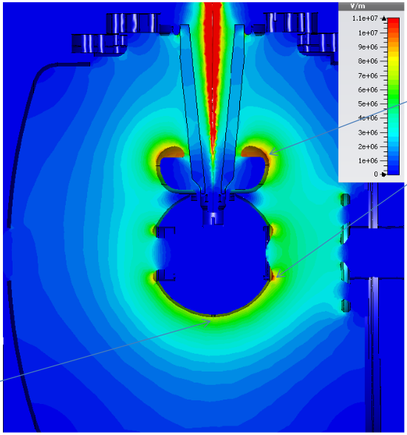
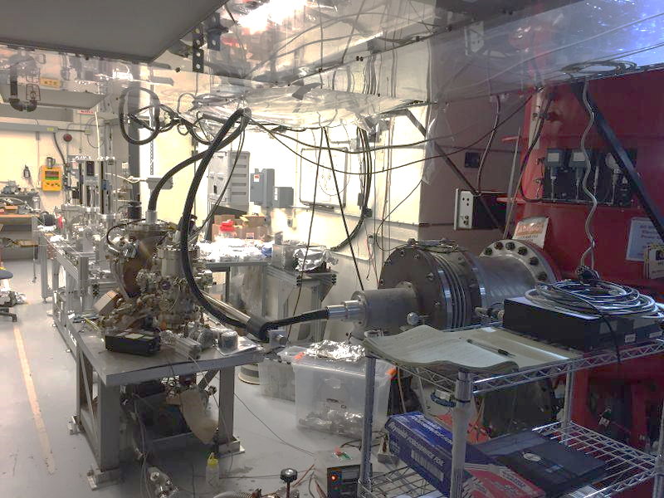
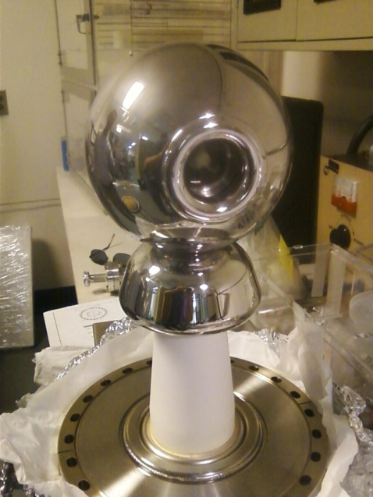
300 kV Inverted Gun and CsK₂Sb Photocathode
11 MV/m
1mA
Need mask and precipitator
8 MV/m
Learning how to use the new photocathode
First insulator conditioned to 325 kV
New insulator, installed now, supports higher voltage operation
Notes:
Interior Page Design 2

Slide 19
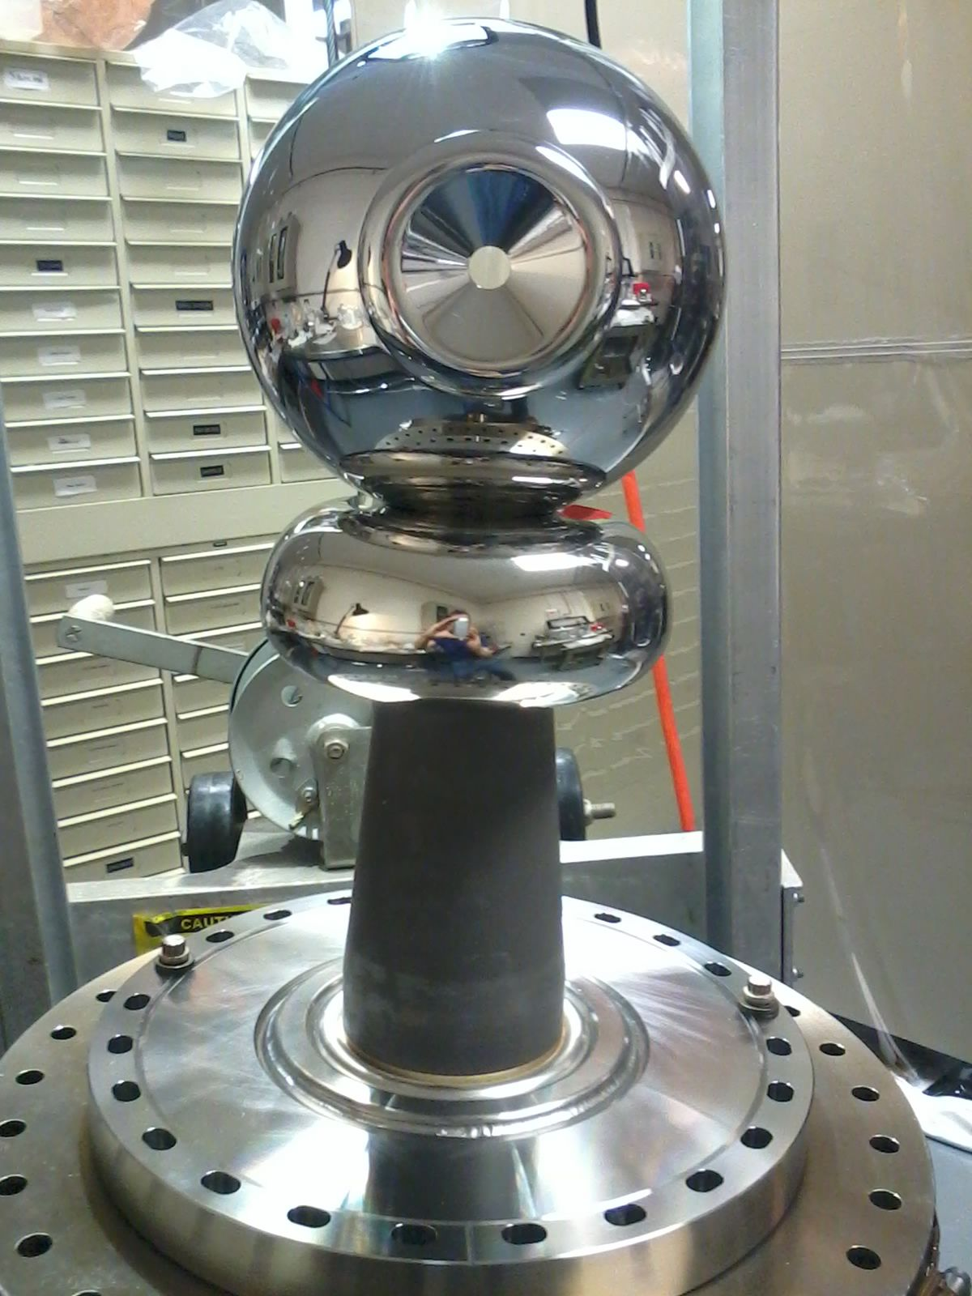
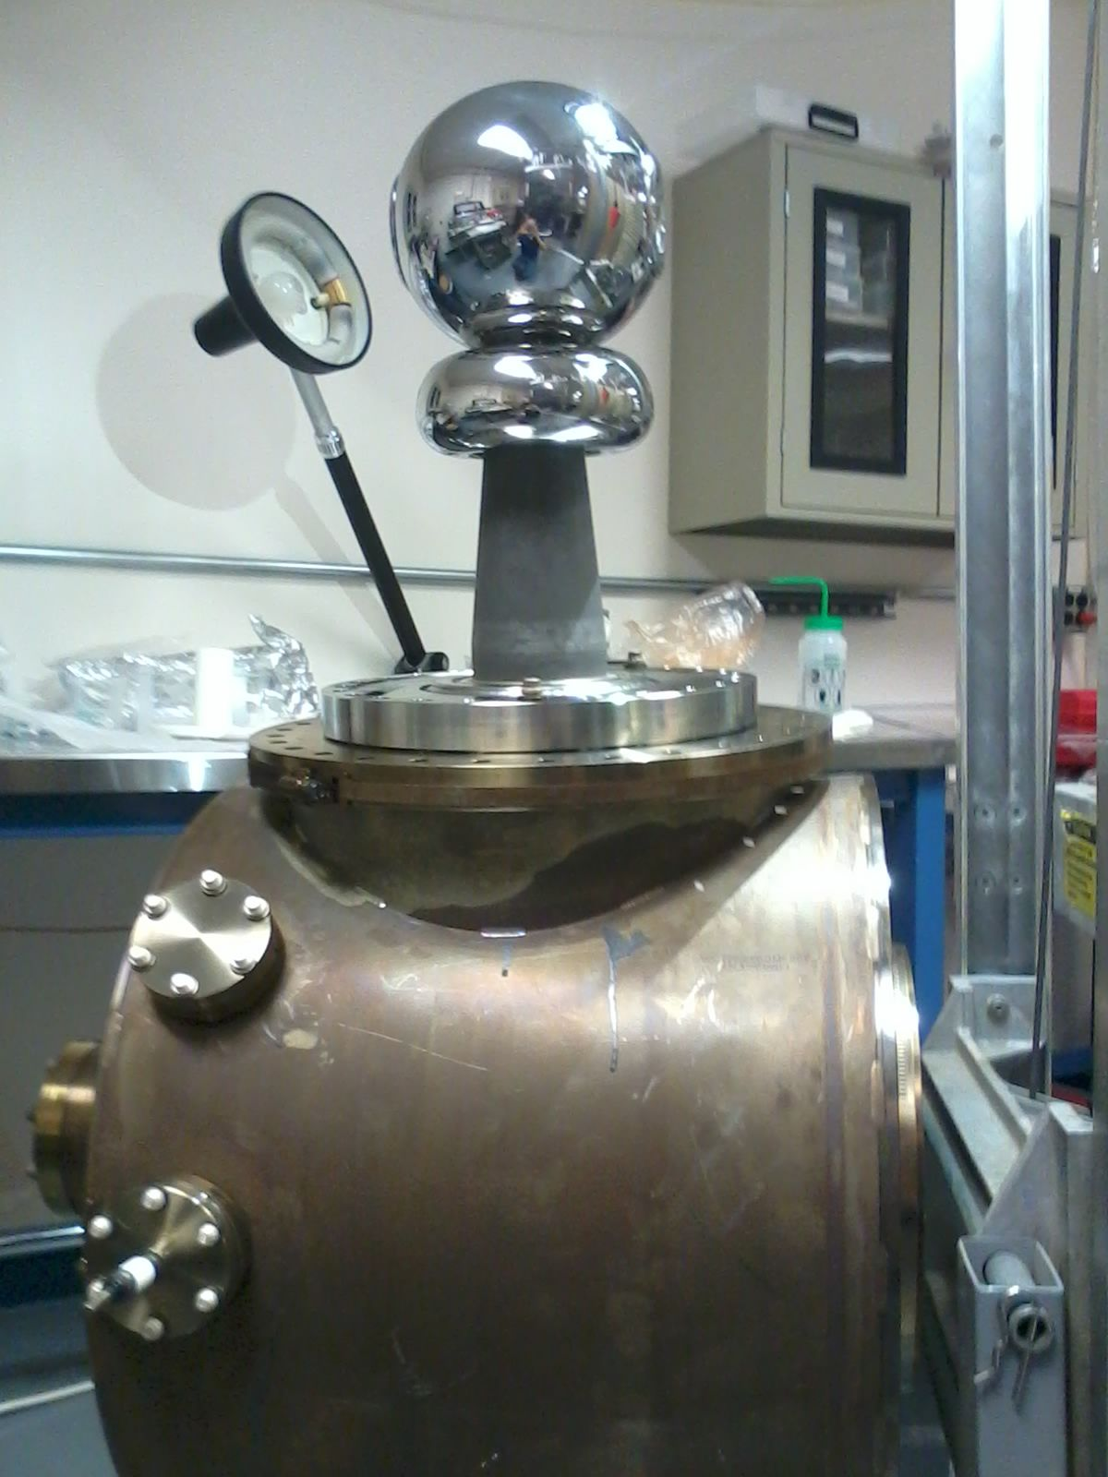
500 kV Gun
Notes:
Interior Page Design 2

Slide 20
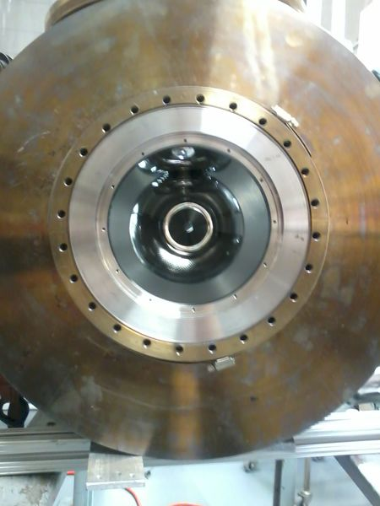
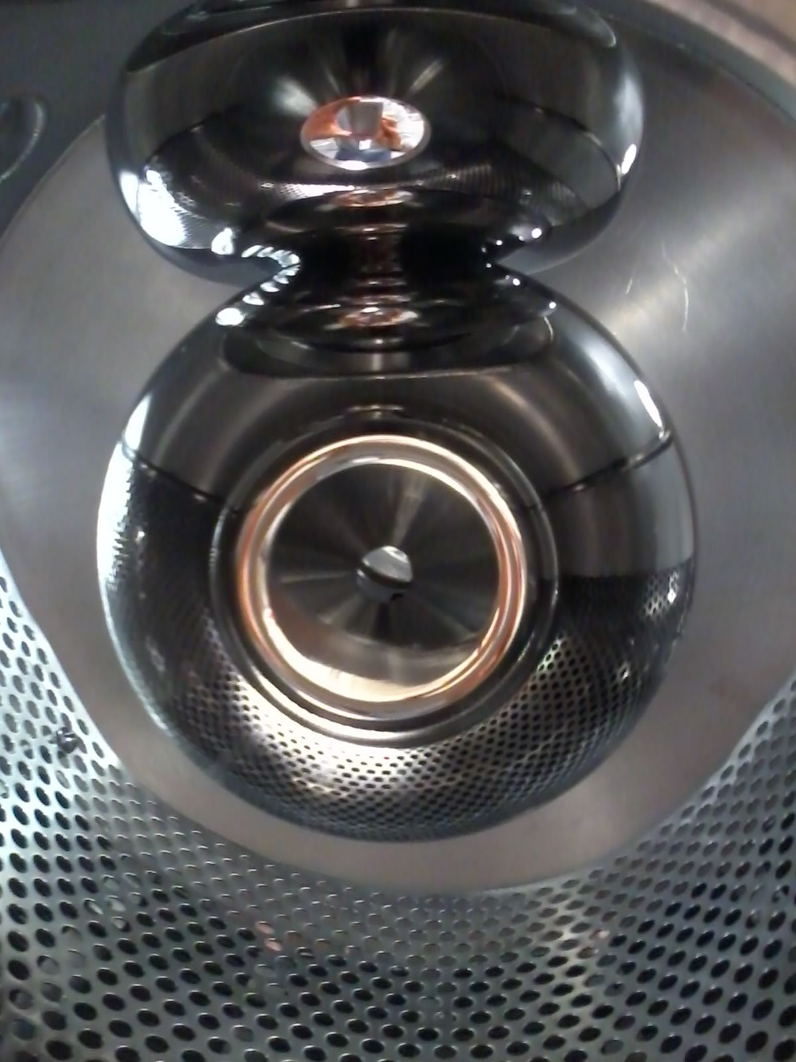
500 kV Gun
Notes:
Interior Page Design 2

Slide 21
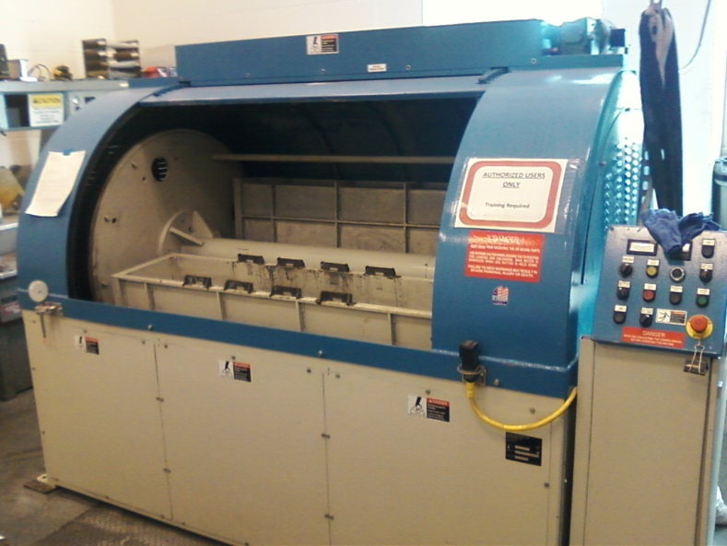
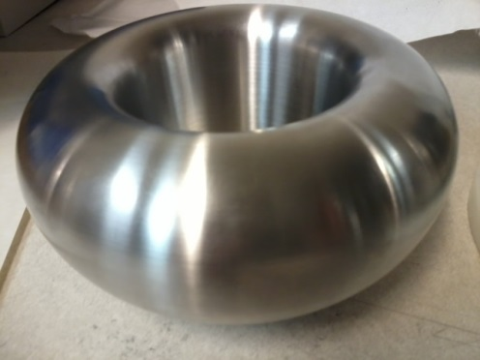
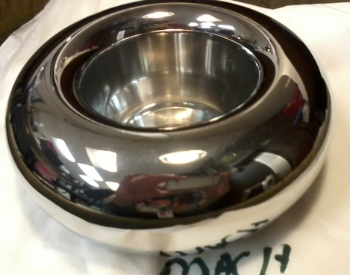
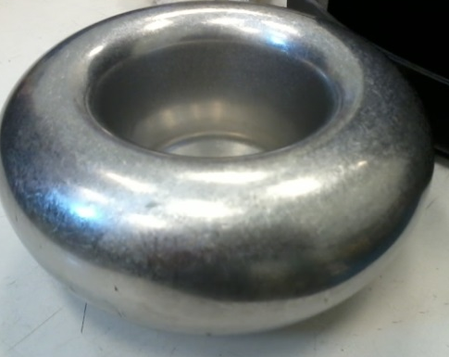
Barrel-Polished Electrodes
Gun electrodes traditionally polished using sand paper and diamond paste
Tedious process, takes about 30 days to complete
Now performed in 1 day using SRF barrel polishing machine
From machine shop
30 minutes with corncob
Work by Don Bullard
30 minutes with plastic cones
Notes:
Interior Page Design 2

Slide 22
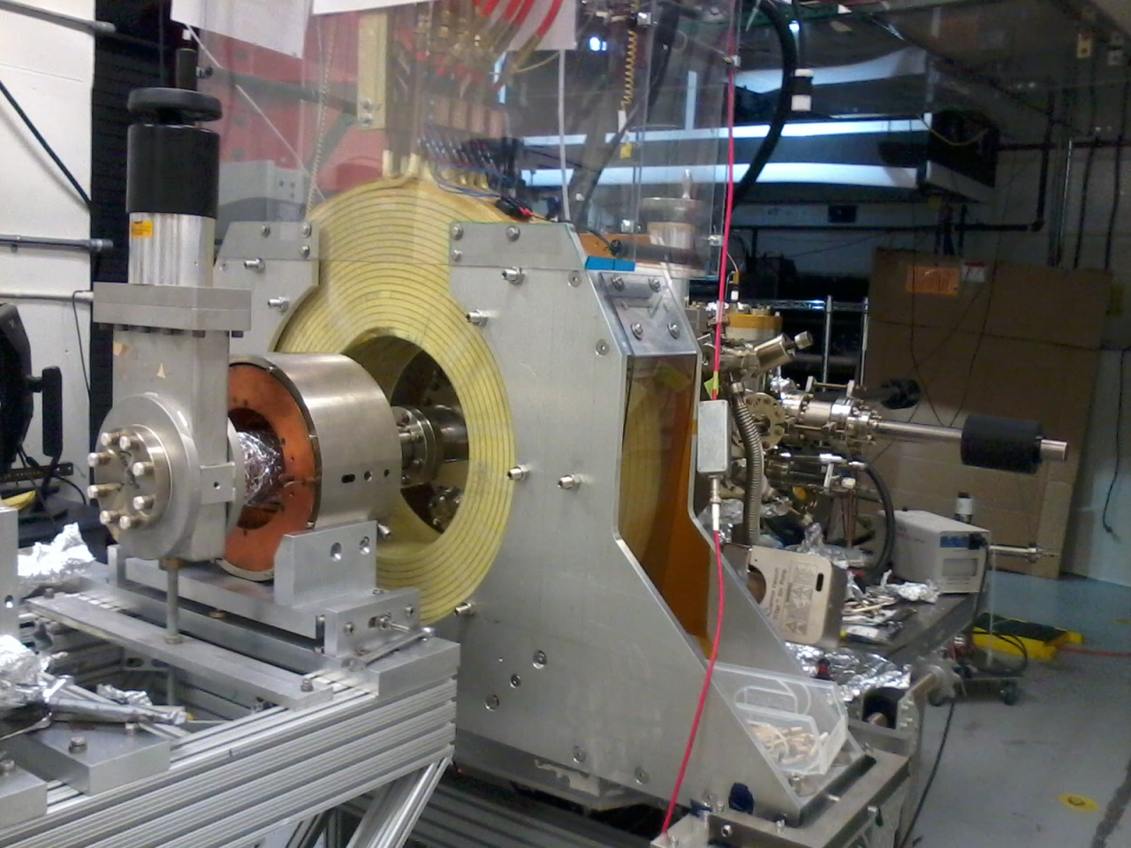
Magnetized Beam Tests
Fixed the gun and deposition chamber, added solenoid
Notes:
Interior Page Design 2

Slide 23
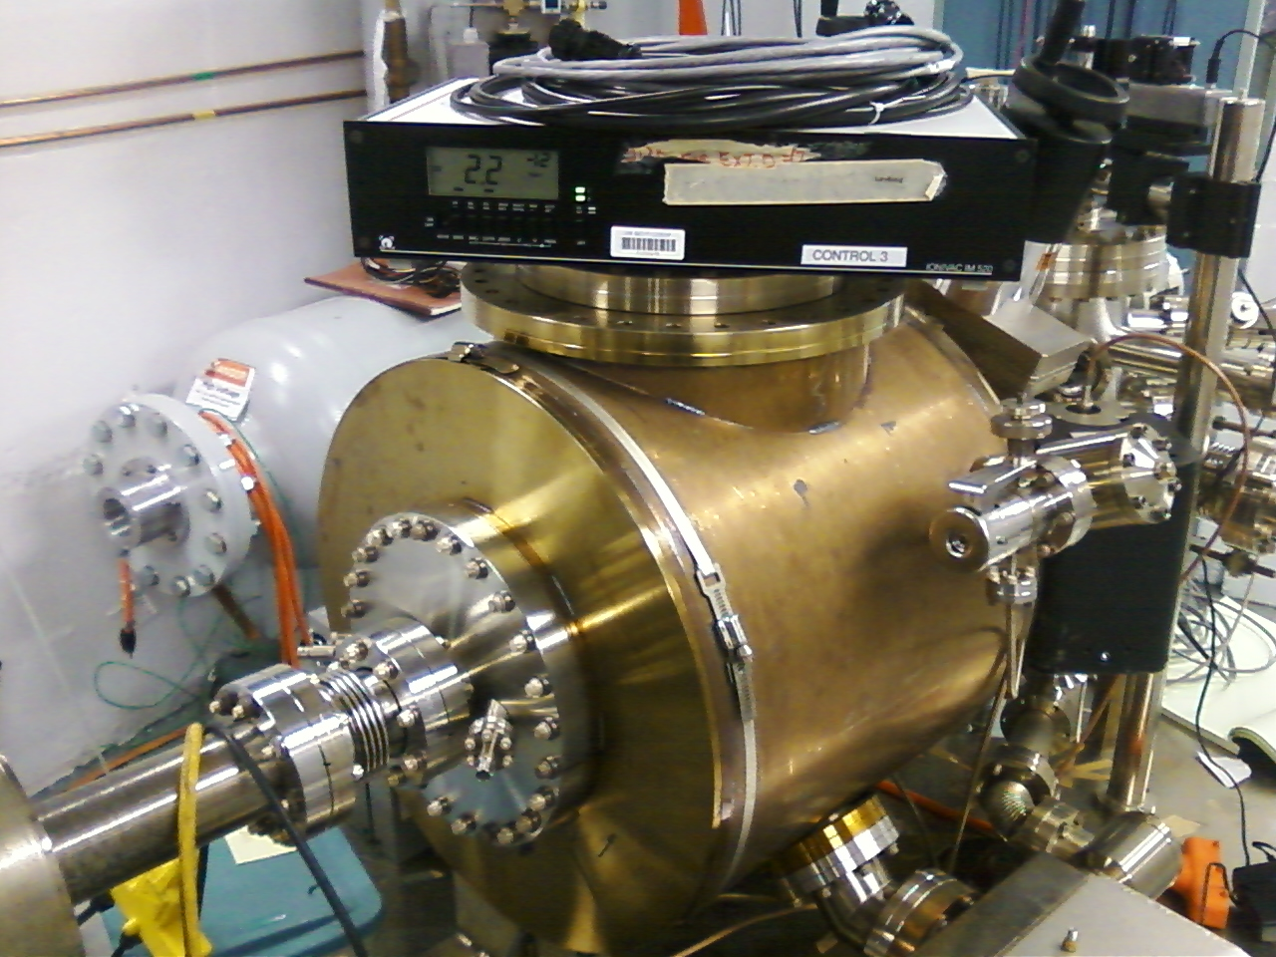
350 kV Gun at Injector Test Facility
450 kV 3mA supply
Old and New inverted guns
Vacuum low 10⁻¹² Torr
Working on the beamline now
Notes:
Interior Page Design 2

Slide 24
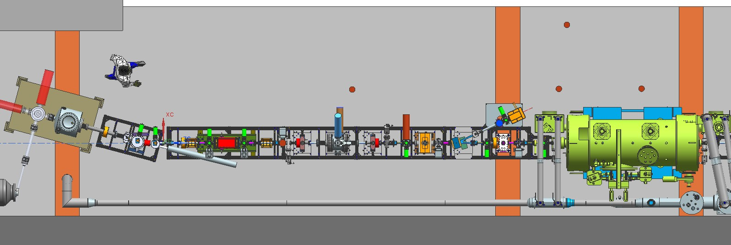
kV beamline at Injector Test Facility
Dif pump
RF deflector cavities
200 kV Wien
2.5 kW dump
Buncher
Notes:
Interior Page Design 2

Slide 25
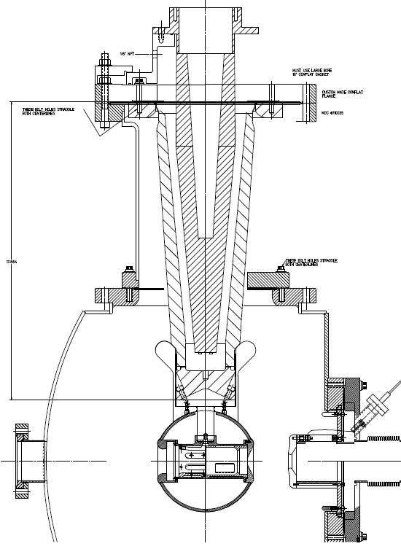
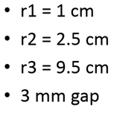
R350 epoxy receptacle
Plan Z
Our plan to reach 500 kV
Combination of long doped insulator and shed, SF6 and epoxy receptacle
And likely a different vacuum chamber
SF6
Doped insulator
Screening electrode
Work of Yan Wang
Matt Poelker, Jefferson Lab
Notes:
Interior Page Design 2

Slide 26
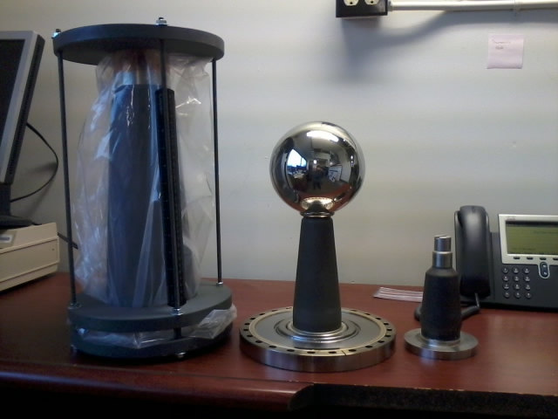
R350 epoxy receptacle
Plan Z
We have the big insulators
Cables in Receptacles: very reliable
Receptacles in SF6: very reliable
Use cold SF6 to remove heat from photocathode
SF6
Doped insulator
Screening electrode
Matt Poelker, Jefferson Lab
Notes:
Interior Page Design 2

Slide 27
Thank You
Will continue to work on 500 kV inverted gun, CsK₂Sb deposition chamber (and Cryopumped gun)
Magnetized beam tests
We can revisit high current (mA) lifetime tests with polarized beam but need support
Matt Poelker, Jefferson Lab
Notes:
Interior Page Design 2

