Slide 1
Summary Extrapolation
31May2017

Slide 2
Method of Pade’ Approximants for A(t), A(R), R(t)
A(t),Run1 Pade(n,m) | (0,m) | (1,m) | (2,m) | (3,m)
(n,0) |  | 43.82(14),n/a, 2.6, 0.009 | 44.05(13),7.7, 1.4, 0.204 | 44.25(17),2.8, 1.1, 0.36
(n,1) | 44.04(10),8.2, 1.3, 0.224 | 44.09(14),6.3, 1.8, 0.173 | 44.35(38),‑2.2, 5.4, 6.6e-4
(n,2) | 44.09(14),0.3, 1.5, 0.171 | 43.98(33),‑0.41, 2.5, 0.074
Format:
the intercept(with uncertainty), F-test,
reduced χ2 value, p-value
red are excluded by the F-test,
blue are excluded using the reduced χ2 value

Slide 3
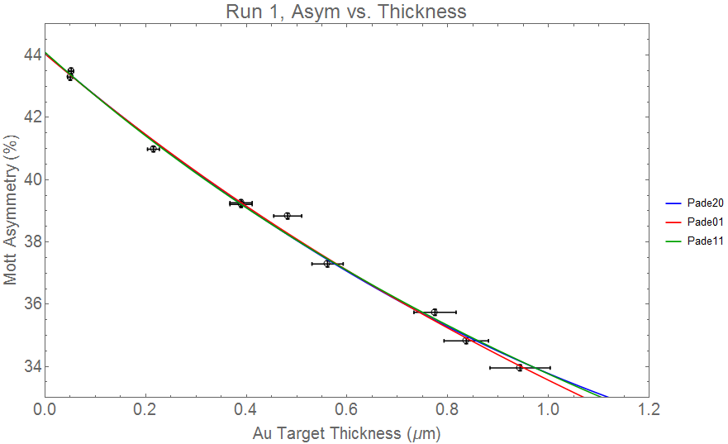
A(t) graph

Slide 4
A(t), Runs 1&2

Slide 5
Pade Analysis for Run1, A(R)
Format:
the intercept(with uncertainty), F-test,
reduced χ2 value, p-value
red are excluded by the F-test,
blue are excluded using the reduced χ2 value

Slide 6
A(R) results

Slide 7
PA for R(t)
Format:
F-test,reduced χ2 value, p-value
red are excluded by the F-test,
blue are excluded using the reduced χ2 value

