Slide 1
Pade order investigation Re-run of functional forms
11Jan2017
All data

Slide 2
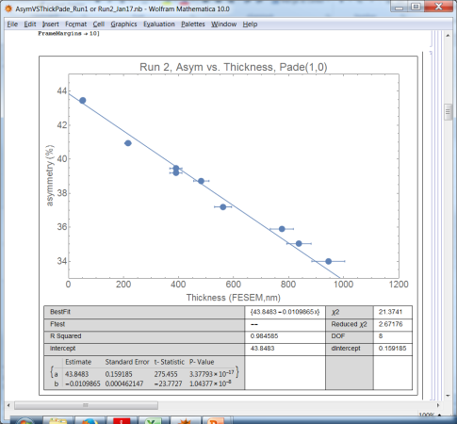
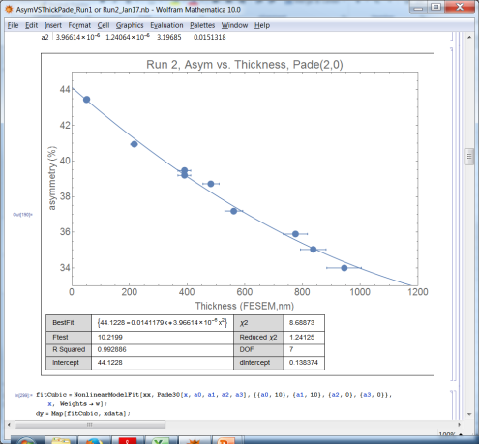
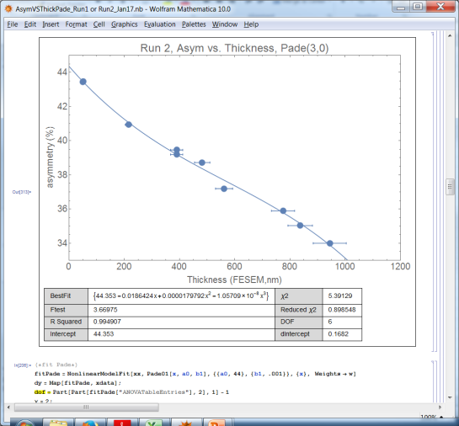
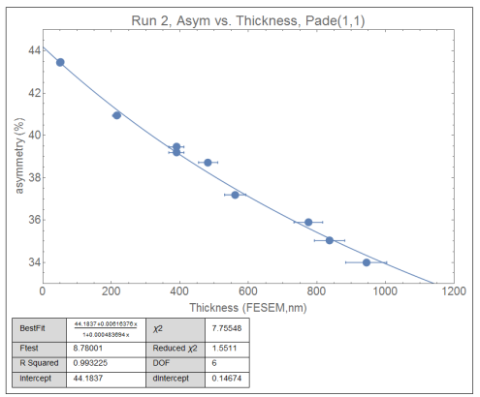
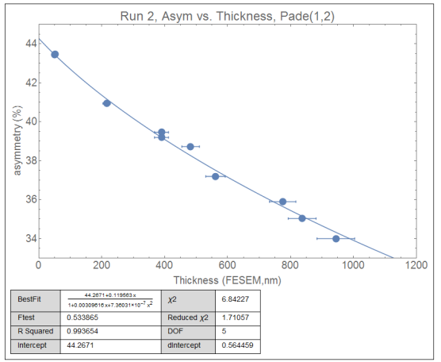
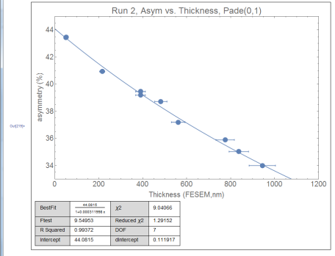
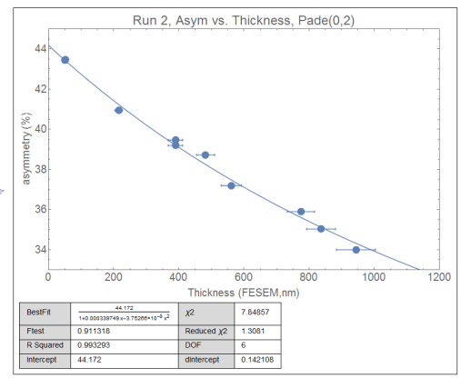
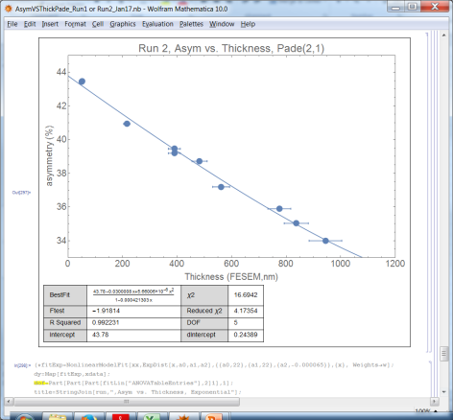
Asymmetry vs. Thickness Run 2 2017

Slide 3
Pade(n,m) orders: Asy vs. Thick, Run2 2017
Pade(n,m) | intercept | dA | R² | red. χ² | D.O.Free. | Ftest
(1,0) | 43.8483 | 0.1592 | .984 | 2.67 | 8 | -- worst red. χ²
(2,0) | 44.1228 | 0.1384 | .993 | 1.24 | 7 | 10.22
(3,0) | 44.353 | .168 | 0.995 | 0.899 | 6 | 3.67 (rej F test)
(0,1) | 44.0815 | 0.1119 | 0.994 | 1.292 | 7 | 9.55
(0,2) | 44.172 | 0.1421 | 0.9933 | 1.3081 | 6 | 0.9113 (rej F. Test)
(1,1) | 44.1837 | 0.1467 | 0.9932 | 1.5511 | 6 | 8.78
(1,2) | 44.2671 | 0.5644 | 0.994 | 1.710 | 5 | 0.534 (rej F test)
(2,1) | 43.78 | 0.244 | 0.992 | 4.17 | 5 | -1.918 (reject F test)

Slide 4
Pade(n,m) orders: Asy vs. Thick, Run1 2017
Pade(n,m) | intercept | dA | R² | red. χ² | D.O.Free. | Ftest
(1,0) | 43.8274 | 0.1370 | 0.987 | 2.50 | 8 | n/a
(2,0) | 44.052 | 0.128 | 0.994 | 1.338 | 7 | 7.93
(3,0) | 44.259 | 0.164 | 0.995 | 1.037 | 6 | 3.02 rej Ftest
(0,1) | 44.041 | 0.0999 | 0.9944 | 1.304 | 7 | 8.32
(0,2) | 44.0921 | 0.1334 | 0.994 | 1.4429 | 6 | 0.327 rej Ftest
(1,1) | 44.0976 | 0.1364 | 0.998 | 1.7244 | 6 | 6.587
(1,2) | 45.0844 | 23 | 0.994 | 1.82 | 5 | 0.74 rej Ftest
(2,1) | 43.78 | 0.211 | 0.994 | 3.82 | 5 | -1.54 rej F Test

Slide 5
Pade orders, run 1: Asym vs. Rate
Again, rate uncertainty extrapolated to asym uncertainty for fitting. Rate uncertainties much smaller percentage than thickness uncertainties

Slide 6
Pade(n,m) orders, run 1: A vs rate
Pade(n,m) | intercept | dA | R² | red. χ² | Ftest
(1,0) | 43.0651 | 0.308 | 0.974 | 33.01 | -- | Reject chi
(2,0) | 43.935 | 0.113 | 0.998 | 2.16 | 115
(3,0) | 44.04 | 0.127 | 0.999 | 1.86 | 2.12 | Reject F
(1,1) | 44.0747 | 0.1086 | 0.999 | 2.09 | 121
(2,1) | 44.078 | 0.143 | 0.999 | 2.62 | -0.004 | Reject F
(1,2) | 44.0577 | 0.139 | 0.999 | 2.65 | -0.058 | Reject F
(0,1) | 43.56 | 0.196 | 0.99 | 11 | 15.194 | Reject chi
(0,2) | 44.0364 | 0.1037 | 0.999 | 1.82 | 29.69
(0,3) | 43.939 | 0.119 | 0.999 | 2.92 | -1.28 | Reject F
(2,2) | 43.9554 | 0.3903 | 0.998 | 5.68 | -2.15 | Reject F

Slide 7
Allowed Pade fits A vs. R, Run 1

Slide 8
Pade(n,m) orders, run 2: A vs rate
Pade(n,m) | intercept | dA | R² | red. χ² | Ftest
(1,0) | 42.884 | 0.3747 | 0.964 | 36.88 | -- | Reject chi
(2,0) | 43.9593 | 0.1866 | 0.996 | 4.266 | 62.158
(3,0) | 44.159 | 0.1776 | 0.998 | 2.607 | 5.45 | Reject F
(1,1) | 44.10746 | 0.1695 | 0.998 | 3.55 | 78.043
(2,1) | 44.043 | 0.227 | 0.997 | 5.47 | -0.756 | Reject F
(1,2) | 44.2403 | 0.2462 | 0.998 | 4.18 | 0.2467 | Reject F
(0,1) | 43.4299 | 0.2726 | 0.986 | 17.23 | 10.123 | Reject chi
(0,2) | 44.0951 | 0.1673 | 0.997 | 3.44 | 29.1323
(0,3) | 43.9577 | 0.199 | 0.997 | 5.90 | -1.51 | Reject F
(2,2) | 43.9555 | 1.106 | 0.993 | 15.21 | -2.56 | Reject F

Slide 9
Pade(n,m) orders, run 1: Rate vs. Thickness
Pade(n,m) | function | dA | DOF | red. χ² | Ftest
(1,0)* | {0.164479 x} | 0.0046 | 8 | 2.73 | n/a | Not reject
(2,0) | {0.111449 + 0.141093 x + 0.0000436137 x^2} | 0.7601 | 7 | 0.895 | 17.39 | Not reject
(2,0)* | {0.142228 x + 0.0000422168 x^2} | 0.0056 | 8 | 0.898 | 17.31 | Not reject
(3,0) | {0.151723 x - 6.89155*10^-6 x^2 + 4.70547*10^-8 x^3} | 0.0088 | 6 | 0.711 | 1.81 | Reject F
(0,1) | 15.6383/(1 - 0.000982543 x) | 4.81 | 7 | 159 | -6.86 | Reject F
(0,2) | 11.7609/(1 - 0.00244356 x + 1.6083*10^-6 x^2) | 2.86 | 6 | 68 | 10.267 | Reject chi
(1,1) | (0.143629 x)/(1 - 0.000232145 x) | 0.0046 | 6 | 1.14 | 14.098 | Not reject
(1,2) | (0.837584 + 1.0258 x)/(1 + 0.0470451 x - 0.0000460074 x^2) | 1095 | 5 | 200 | -3.97 | Reject F
(2,1) | (0.748261 + 0.14042 x - 0.0000438248 x^2)/(1 - 0.000497014 x) | 1.09 | 5 | 1.66 | -0.548 | Reject F
Frederick James,
Statistical methods in experimental physics 2nd ed.

Slide 10
Allowed orders, RvsT

Slide 11
Pade(n,m) orders, run 2: Rate vs. Thickness
Pade(n,m) | function | dA | DOF | red. χ² | Ftest
(1,0)* | {0.153224 x} | 0.0049 | 8 | 2.96 | n/a | Bad chi sq
(2,0) | {0.404822 + 0.125329 x + 0.0000501778 x^2} | 0.723 | 7 | 22.26 | 0.81 | Bad chi sq
(2,0)* | {0.12945 x + 0.0000451039 x^2} | 0.0054 | 8 | 0.845 | 21 | Not reject
(3,0) |  |  |  |  |  | Reject F
(0,1) |  |  |  |  |  | Reject F
(0,2) |  |  |  |  |  | Reject chi
(1,1)* | (0.131145 x)/(1 - 0.000262462 x) | 0.0042 | 7 | 1.027 | 18.04 | Not reject
(1,2) |  |  |  |  |  | Reject F
(2,1) |  |  |  |  |  | Reject F
Frederick James,
Statistical methods in experimental physics 2nd ed.

Slide 12
Summary: Allowed Pade orders
For Asy. vs. Thickness
(1,0), (2,0), (0,1), (1,1)
For Asy. vs. Rate
(2,0), (1,1), (0,2)
For Rate vs. Thickness
(1,0),(2,0)*, (1,1)* (*=forced zero)
Theory suggested fits: in red
Italics: doesn’t look good, but should still be looked at

