Slide 1
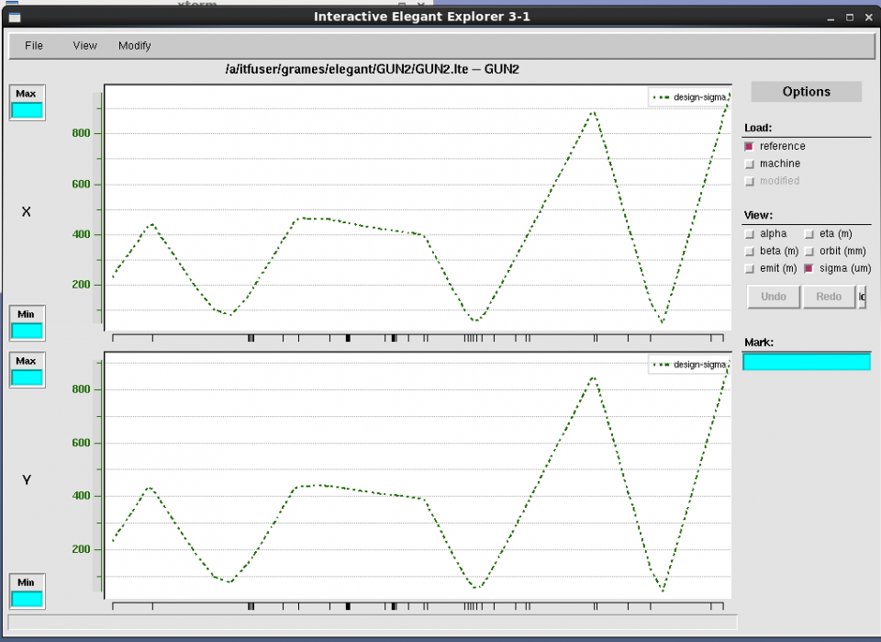
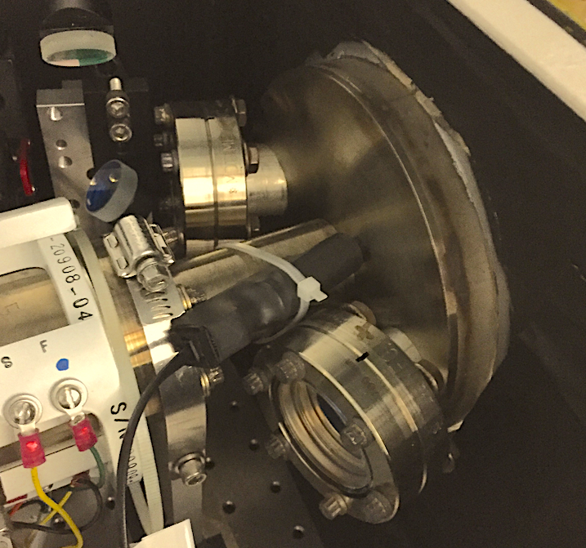
Lifetime Studies at mA Beam Current
X-ray detectors were distributed along beam line at locations of likely beam loss, e.g. apertures (where beam pipe size changes or intentional apertures).
Beam Size

Slide 2
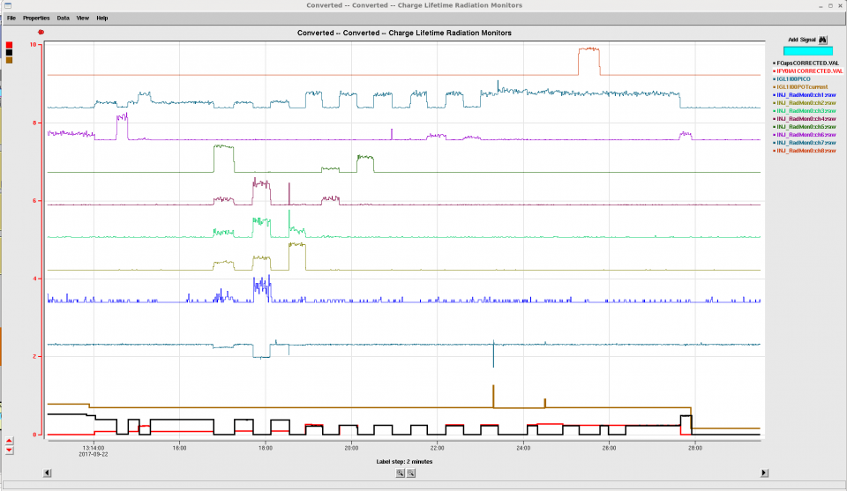
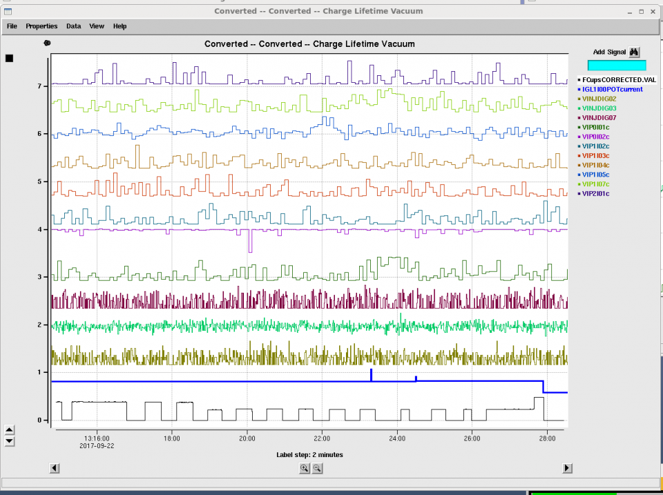
Sensitivity of x-ray detectors for beam loss
In this study x-ray monitors demonstrate good sensitivity and localization for beam intentionally lost (500nA).
x-ray
loss
While increased vacuum levels are a good indicator of decreased photocathode lifetime, in this study we observe little indication of beam loss.
vacuum
loss

Slide 3
Location | EPICS Name | s (cm)
HV Electrode | n/a | -2.5
Phocathode face | n/a | 0
Gun exit flange | INJ_RadMon0:ch1:raw | 15-20
Entrance Y-chamber | INJ_RadMon0:ch2:raw | 140-150
Exit- Y-chamber | INJ_RadMon0:ch3:raw | 155-165
Exit laser chamber | INJ_RadMon0:ch4:raw | 170-190
Entrance Vwien | INJ_RadMon0:ch5:raw | 240-250
Exit Prebuncher cavity | INJ_RadMon0:ch6:raw | Didn't measure
Above A1 aperture | INJ_RadMon0:ch7:raw | Didn't measure
Above A2 aperture | INJ_RadMon0:ch8:raw | Didn't measure

Slide 4
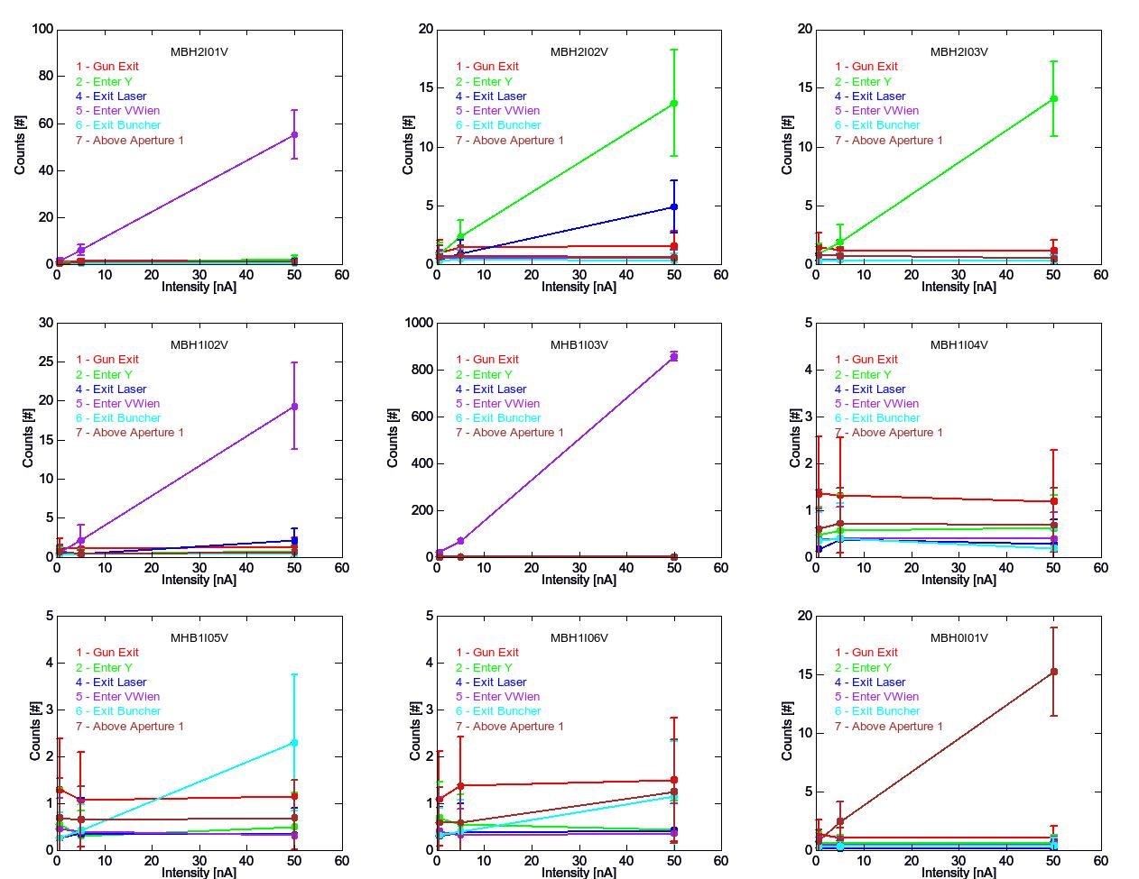
For each of 9 steering coils:
Dumped beam (within 10 cm)
Varied e-beam : 0.5, 5.0, 50 nA
Recorded RadMon (1,2,4,5,6,7)
Fit RadMon vs.e- beam intensity

Slide 5
Summary…
I need to look up & summarize positions of steering coils (beam loss)
I need to compute and summarize loss slopes (counts/nA)
Note….relative slope between radiation monitors is not very meaningful, i.e. depends on location of radiation monitor, geometry and type of materials in between beam and monitor

