Slide 1


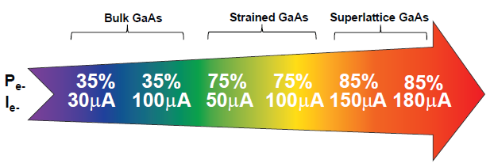
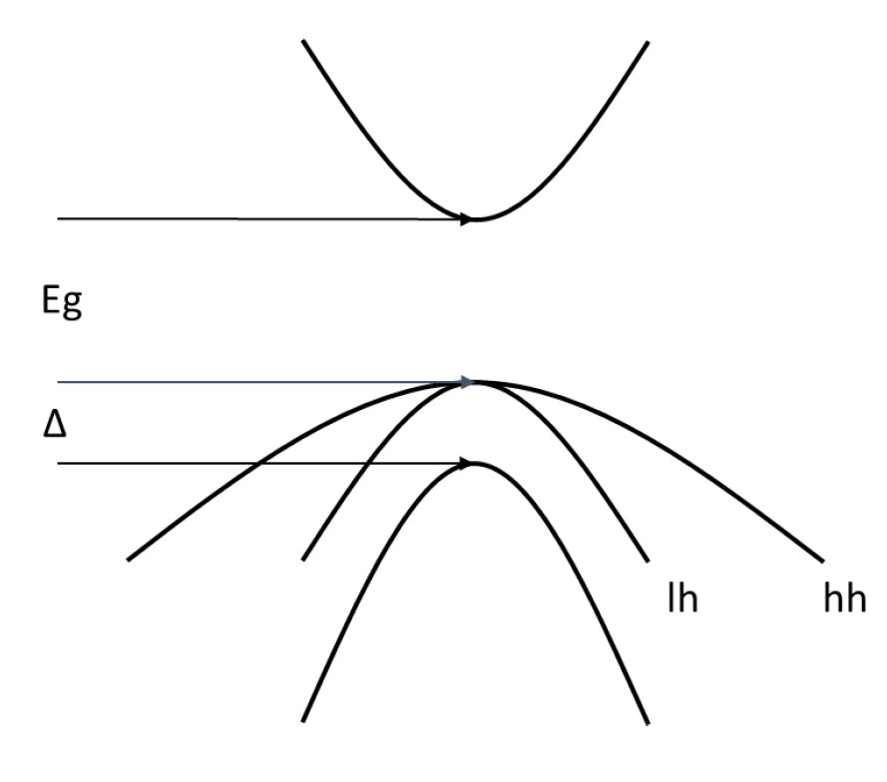
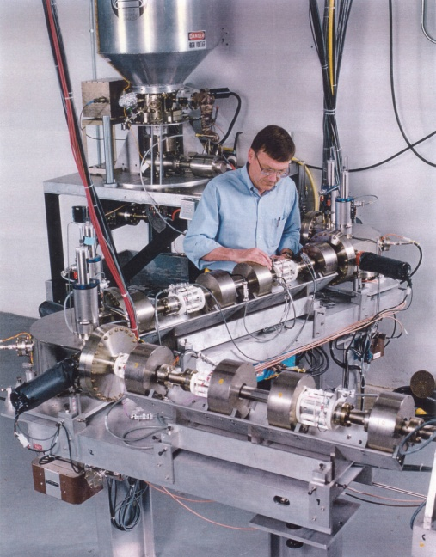
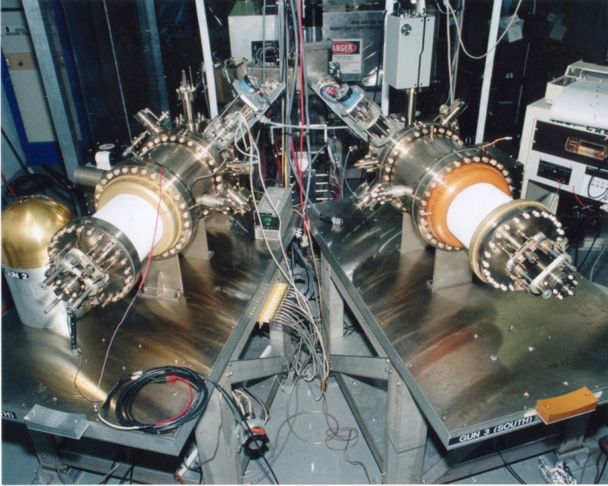
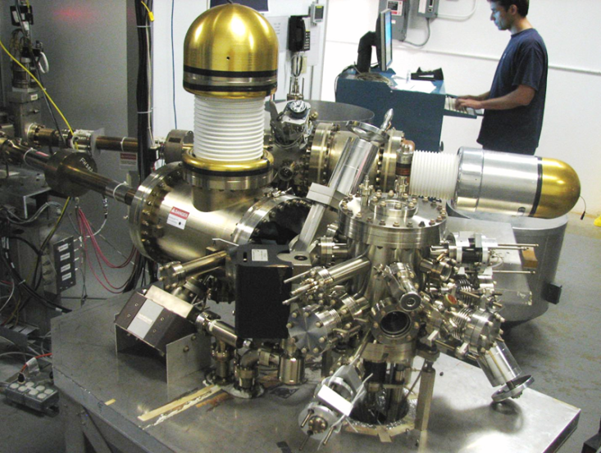
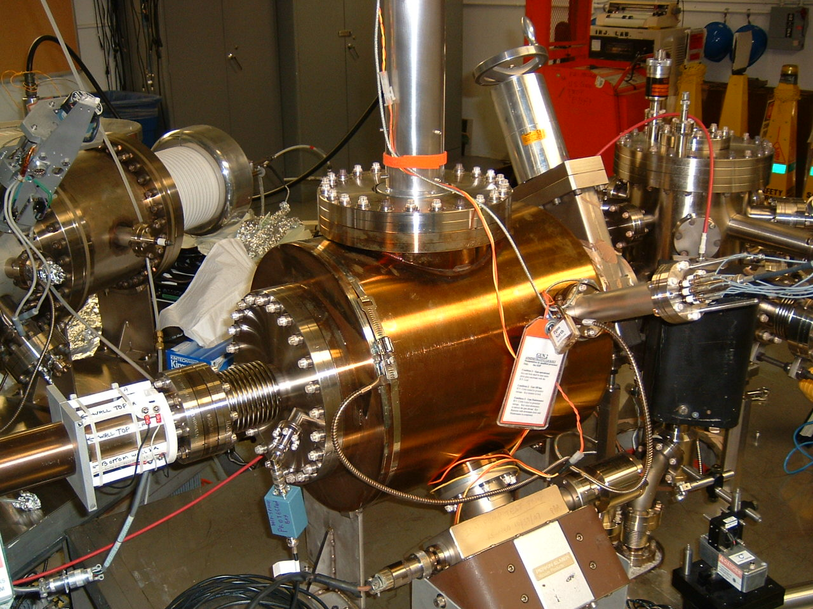
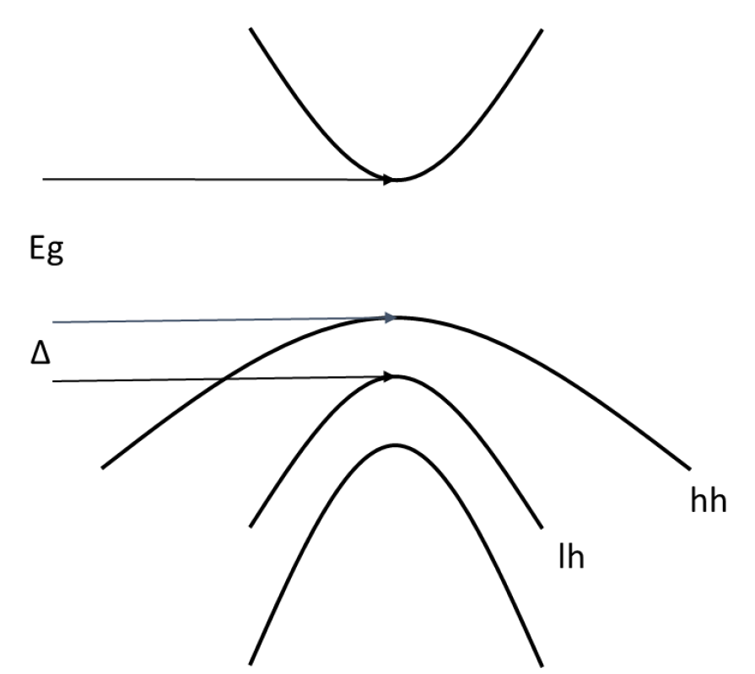
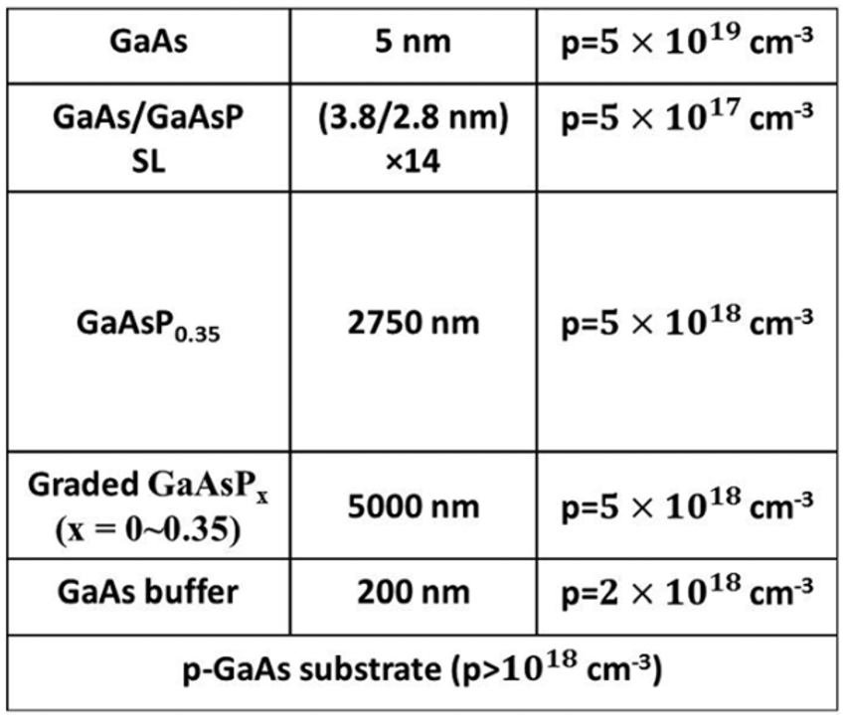
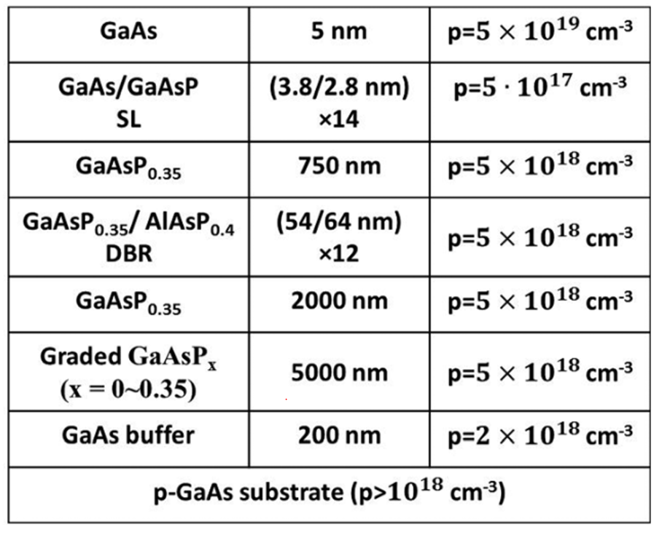
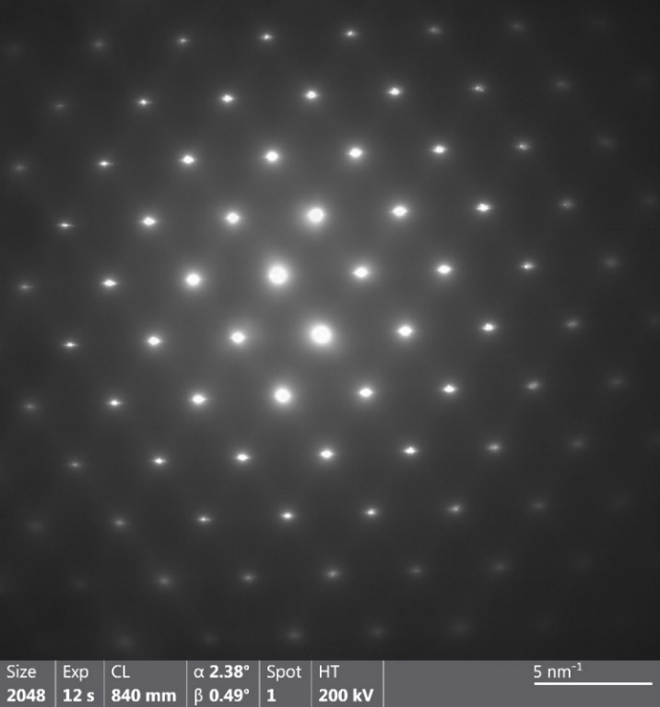
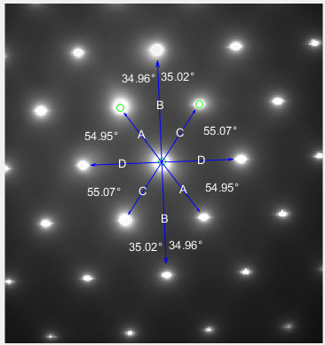
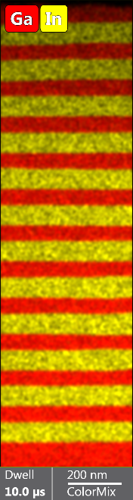
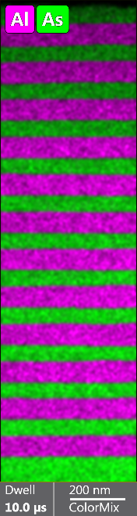
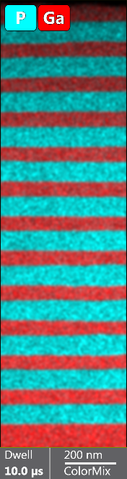
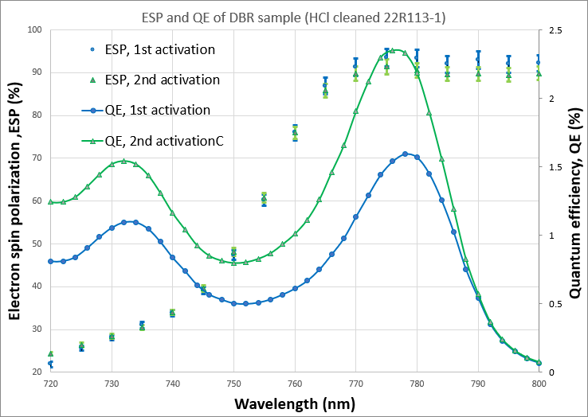
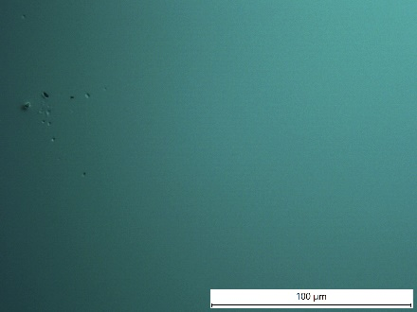
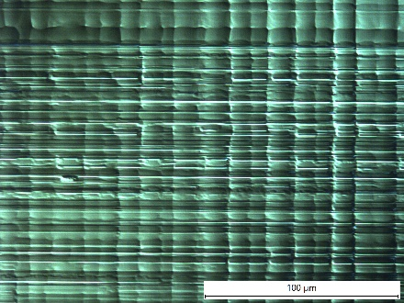
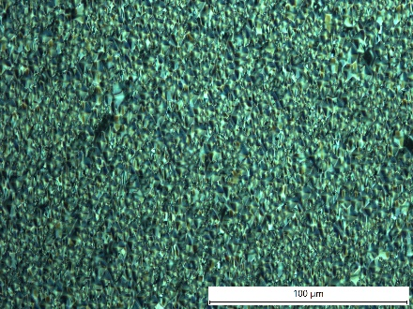
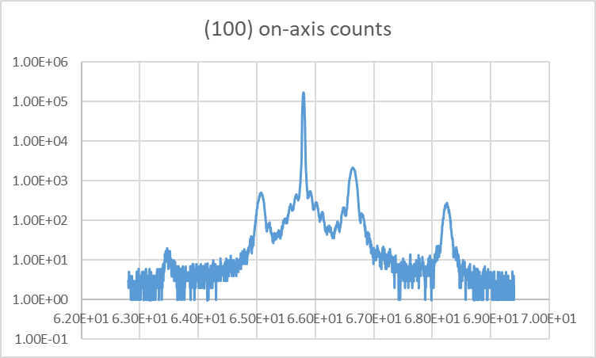
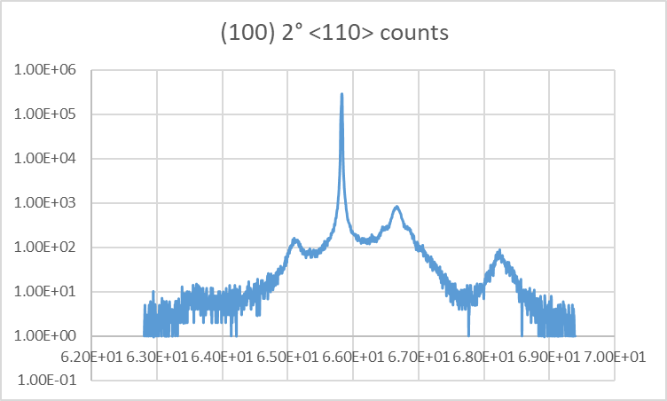
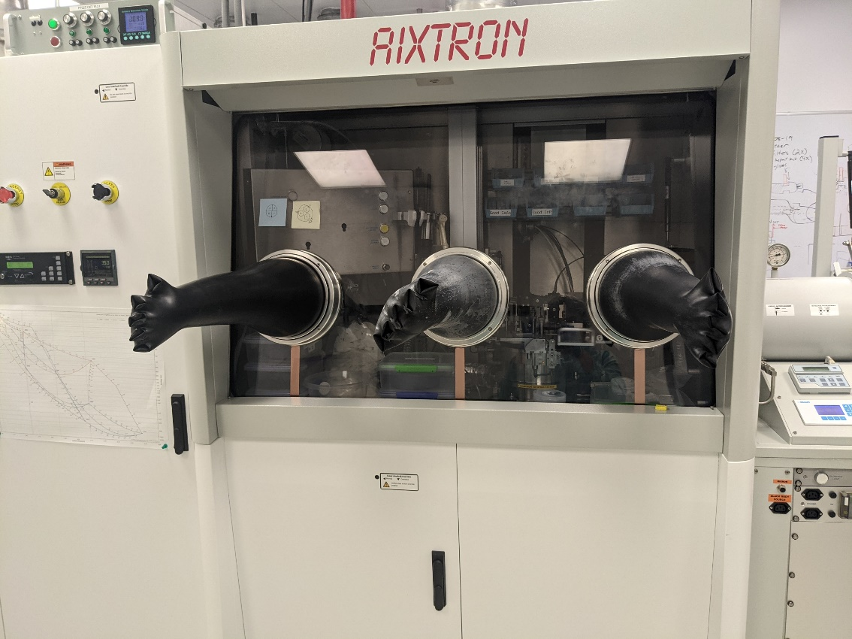
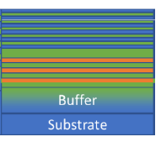
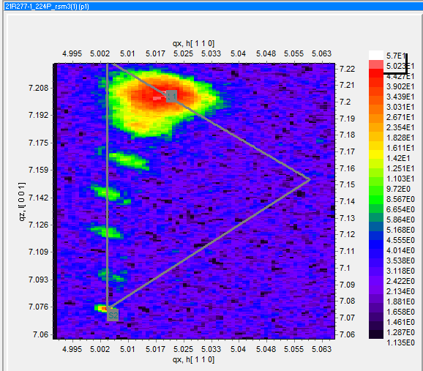
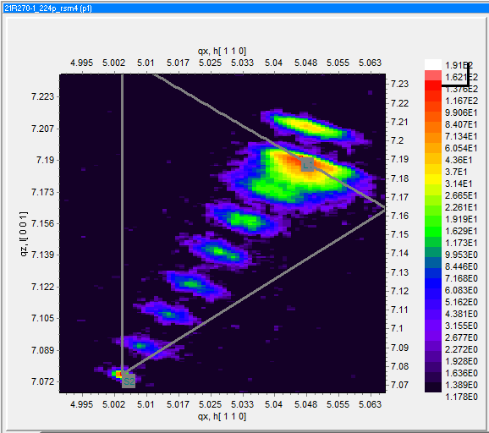


GaAs-based superlattice photocathodes manufactured using MOCVD provide spin polarization > 90% and quantum efficiency > 1%
M. Poelker¹, B. Belfore³, A. Masters³, W. Liu², M. Stutzman¹, E. Wang², M. Grau³, S. Marsillac³
¹Thomas Jefferson National Accelerator Facility, Newport News, Virginia 23606, USA
²Brookhaven National Laboratory, 2 Center Street, Upton NY, 11973, USA
³Old Dominion University, 5115 Hampton Blvd, Norfolk Virginia 23529, USA
2023
Introduction and Motivation
How to make polarized electron beams
Spin-polarized electron beams are important for nuclear physics research performed at electron accelerators. Over many years, beam polarization has increased significantly, from 35% provided by unstrained bulk GaAs, to ~ 75% using single strained-layer GaAs, to ~ 90% using strained-superlattice GaAs photocathodes grown using molecular beam epitaxy (MBE).
Commercial vendors once provided high-polarization photocathodes but today there is little interest in supporting this small market. Here, we report successful results fabricating high polarization GaAs/GaAsP superlattice photocathodes using metal organic chemical vapor deposition (MOCVD), a method dismissed by some as not providing sufficient control of layer thickness and uniformity.
The best samples provide spin polarization greater than 90% and quantum efficiency (QE) exceeding 2%, with QE enhanced using a distributed Bragg reflector (DBR) incorporated into the structure. Together, these quantities represent some of the best results ever reported for high polarization photocathodes.
Enhanced QE via DRB is very important for future work at CEBAF/Jefferson Lab because it will simplify the production of polarized electron beams at milliampere current needed for a polarized positron source.
Bulk GaAs – no strain
m _{j} = -1/2
+1/2
3
σ⁺
σ⁻
3
1
1
m _{j} = -3/2
-1/2
+1/2
+3/2
1
m _{j} = -1/2
+1/2
2
3
4
Maximum Polarization 50%
Strained GaAs
m _{j} = -1/2
+1/2
3
σ⁺
σ⁻
3
m _{j} = -3/2
-1/2
+1/2
+3/2
electrons
positrons
m _{j} = -1/2
+1/2
10 mA e-
100 nA e+
Maximum Polarization 100%
Strained Superlattice
Strained Superlattice with Distributed Bragg Reflector
adiabatic focusing
Characterization Tools
PEPPo technique: see Phys. Rev. Lett. 116 (2016) 214801
Light stored here
Transmission Electron Microscopy
Results
Nomarski Microscopy
SVT Associates, 7620 Executive Dr., Eden Prairie, MN 55344 - pioneered these designs, grown via MBE
GaAs_{0.95}P_{0.05}
minimal strain - minimal surface features
GaAs_{0.65}P_{0.35}
Textured photocathode, uniform strain
poorly relaxed growth
MBE
Gas Source Molecular Beam Epitaxy
elemental As, P, Ga
Pressure ~10⁻⁸ mbar
Growth rates ~ 1 µm/hr
Very precise control
GSMBE
Gas Source Molecular Beam Epitaxy
AsH₃, PH₃
elemental Ga
CBE
Chemical Beam Epitaxy
AsH₃, PH₃, triethyl gallium (TEGa) or elemental Gallium
Pressure <10⁻⁴ mbar
Growth rates 0.5-1 µm/hr
MOCVD
Metal organic chemical vapor deposition (metal organic vapor phase epitaxy)
AsH₃, PH₃, trimethylgallium (TMGa)
Pressures >100 mbar during growth
Growth Rates 10 µm/hr
Some claim difficult to get sharp interfaces
X-ray Diffraction
measurements by Wei Liu
Pol ~ 92%, QE ~ 2.3%, λ_{peak} ~ 785 nm
Higher QE following HCl rinse hints at surface contamination
Future Work:
Higher QE: arsenic cap layer, hydrogen cleaning
Improve the DBR: AlAsP was used as the high index material, however, AlAsP is highly air unstable. Grow DBR using InAlP instead. Much more stable and allows for much easier tuning of the composition. Group III precursors easier to incorporate than group V precursors.
Modify doping of the top layer to ensure appropriate level of dopant (high concentration) and limited diffusion. Candidates include zinc and carbon. This can reduce surface charge limitation.
Molecular
beams
(100) substrate, on-axis
(100) substrate, 2 degree offcut in the (110) direction
X-ray Diffraction : Reciprocal phase space mapping
Molecular
and gas sources
Gas sources
MOCVD system at Rochester Institute of Technology
> 50 distinct layers
3μm/hr 730ºC growth temperature Close to vertical line: more strain
10μm/hr 730ºC growth temperature
Close to diagonal line: less strain
Acknowledgement: This work is supported by the U.S. Department of Energy, Office of Science, Office of Nuclear Physics under contract DE-AC05-06OR23177

