Slide 1
UITF Project Status Meeting
Matt Poelker
February 23, 2016

Slide 2
Outline
Purpose: to inform Lab Leadership of the UITF status
Action Items (from previous meetings)
Project Update
Progress Update
Milestones Update
Budget Update
Highlights & Concerns
Next meeting agenda
Notes:
RW=Roy Whitney

Slide 3
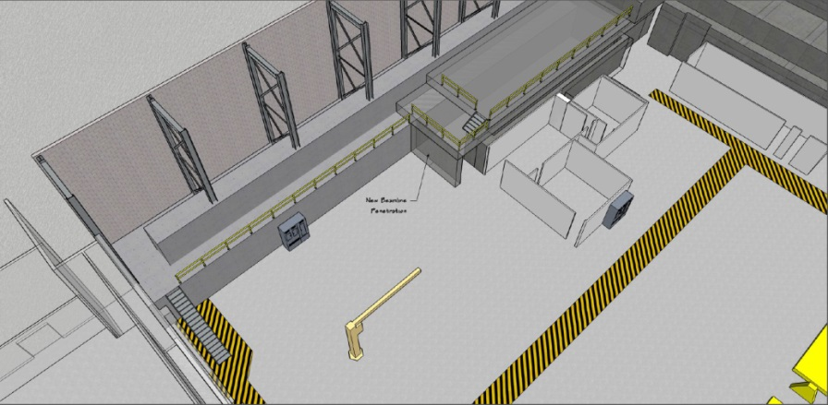
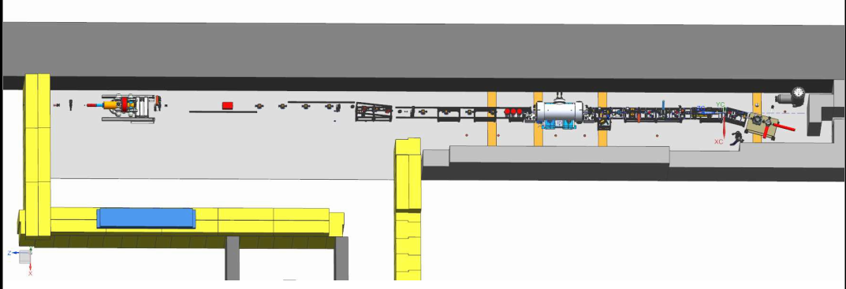
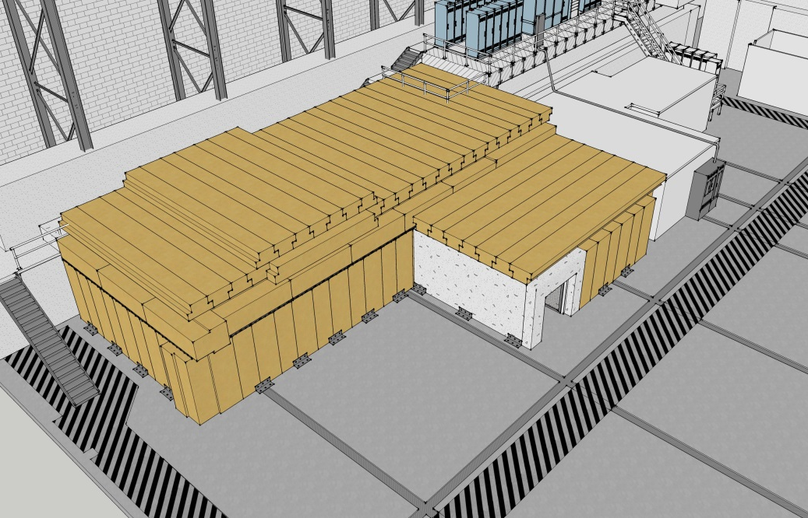
Proposed re-scoping
ITFCRY
ITFPTB
UITFBL
Facilities
Cryo Infrastructure including some RF
Polarized Target Beamline
UITF
Facilities

Slide 4
Action Items – November 23, 2015 Minutes
New Action Items:
Recall new dates: Facilities work complete August 2016, Poelker suggests we install new ¼ CM July 2016. MeV beam milestone pushed to September/October 2016. Is this OK with Team HDIce? Yes Can we wrap up UITF capital equipment project in FY16? Yes
Downselect our means to cool HDIce: purchase dewars or connect to CTF
Firm up the CTF shutdown schedule
Poelker/Areti need to focus more attention on review processes and approvals: Operations and Safety
Budget: ~ $55k capital equipment shortfall UITF and ~ $833k labor shortfall ITFCRY, ITFPTB and RSR
Notes:
RW=Roy Whitney

Slide 5
Progress Update
Major components
Facilities
Engineering
Mech Design
Installation
Cryo
Safety Systems
I&C
DC Power
Low Level RF systems
High Power RF
Survey & Alignment
SRF
Build new ¼ CM
Commission with RF
Operations
Network and communications
Green means we can see progress

Slide 6
Progress Update
Major components
Source Group
Reliable 350kV ops
Beam to cup in front of ¼ CM
Beam to cup in front of HDIce
EHSQ
Shielding approval, ODH assessment
Global hazard review
FSAD
Accel Readiness Review
Commissioning Plan
HDIce
Installation at Cave
Beam on HDIce
Green means we can see progress

Slide 7
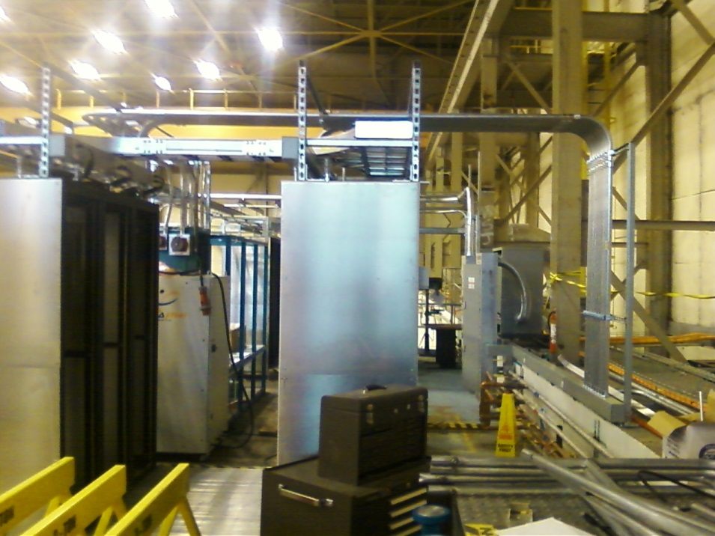
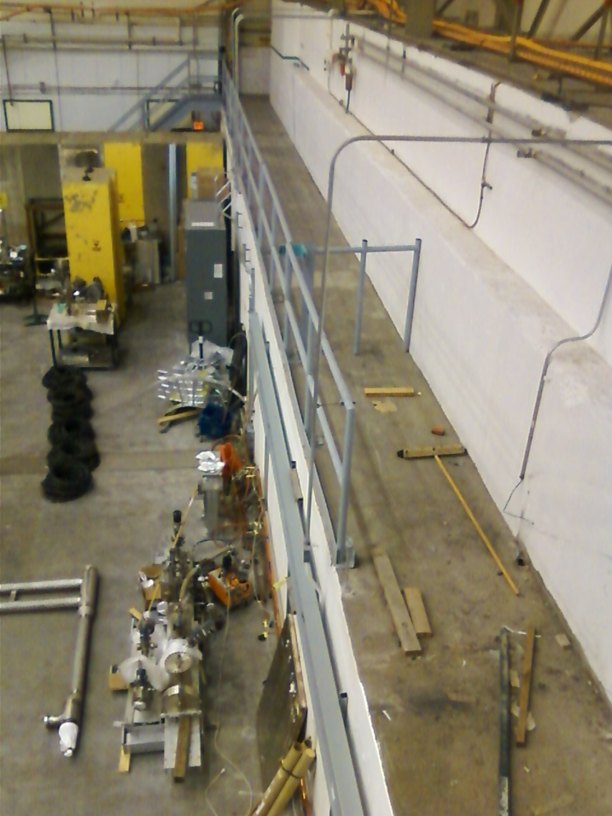
Status Facilities
Cave 1 electric and network complete
NEXT: Clean off ledge and move IPC

Slide 8
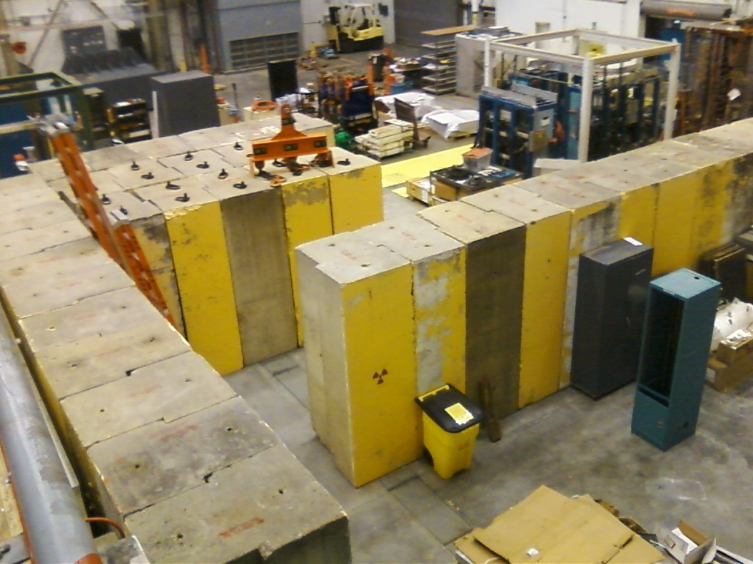
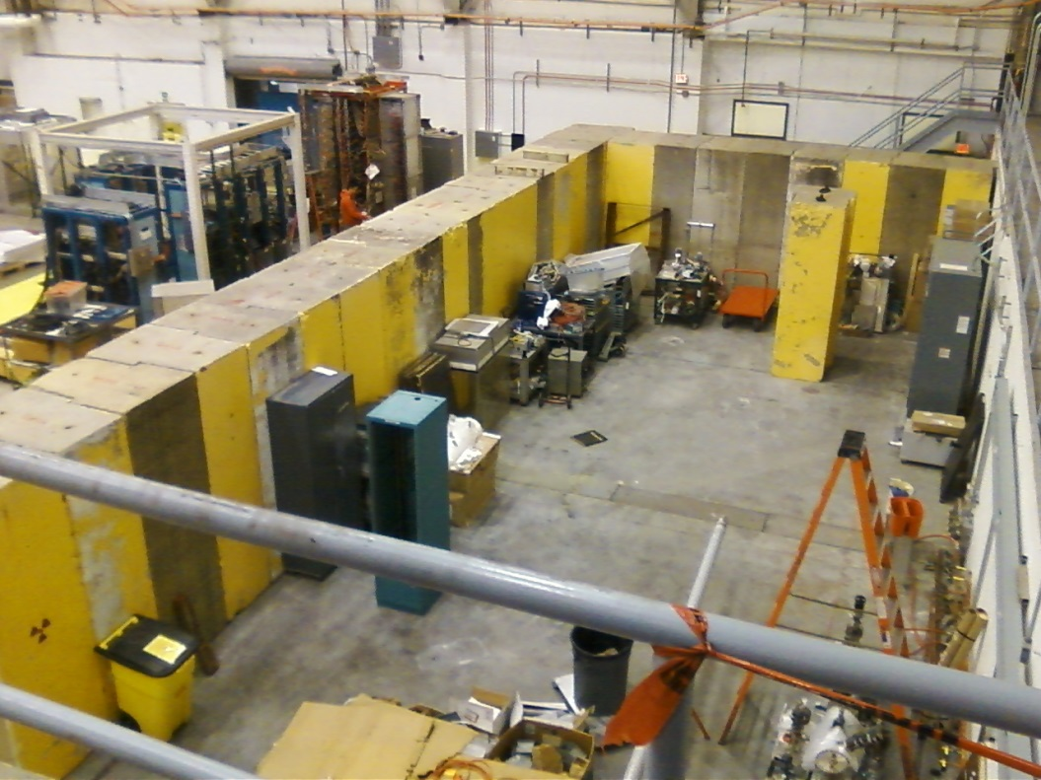
Status Facilities
Precast concrete bids to arrive soon – this package includes bracing and means to secure 2nd layer

Slide 9
Facilities Tasks and Timeline
February 2016
Cave1 electrical work complete
Facilities has issued PR for Cave2 concrete and bracing, out for bids
March
Installation Group willing to secure Cave2 structure, install other utilities
April
Facilities moves IPC outside Cave2
Concrete for Cave2 arriving on site, installing it
Physics installs 2nd layer of concrete, adds bracing
May
Cave2 including labyrinth complete, roof not yet installed
June
Facilities focus shifts to utilities inside Cave2: electricity, lights, fire suppression, gate
July
Facilities continues to work on utilities inside Cave2: electricity, lights, fire suppression, gate
August
Facilities completes utilities inside Cave2: electricity, lights, fire suppression, gate, entire Cave2 roof installed. All bracing complete
Facilities provides power to big Bertha from diesel generator (this could happen later, since no Beam to HDIce until Jan 2017)

Slide 10
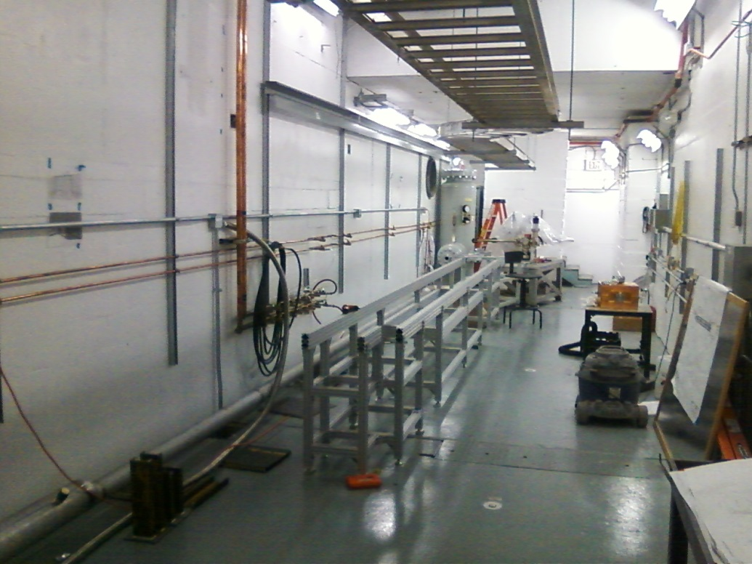
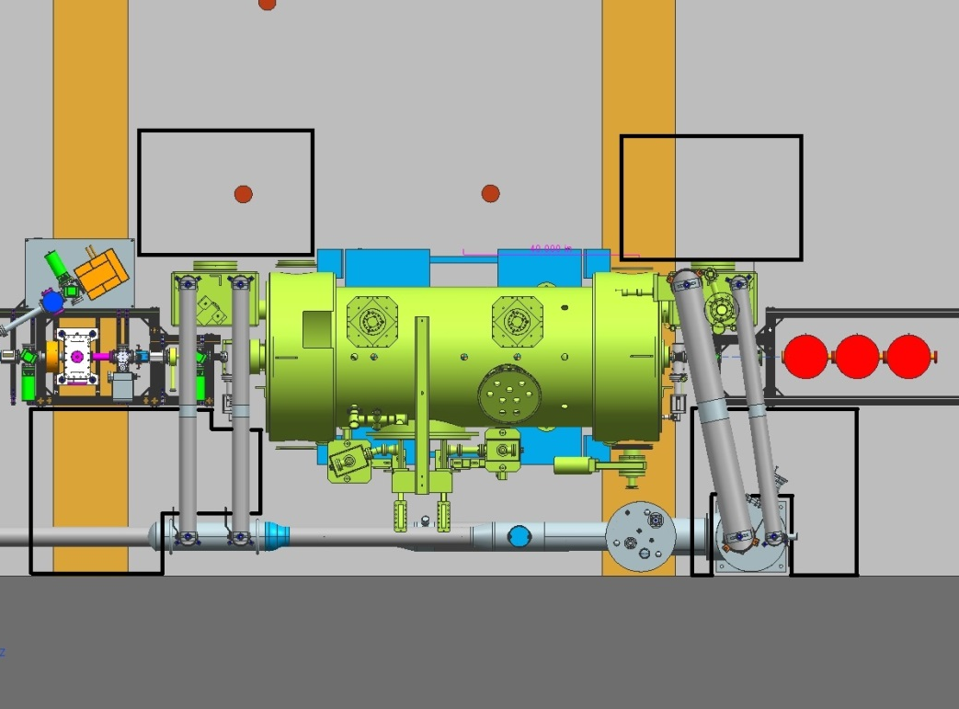
Status Cryo Group
Installed transfer line, leak checked OK
Purchased a turbo pump for leaky shield line
Building the heat exchanger
Controls getting worked

Slide 11
Status Engineering
I&C building stripline bpm electronics
DC power prep-ing magnet racks
RF control boards in fab
RF group building second water skid
RF group building the klystron control panel
Safety System Group on track, ODH and PSS
Installation Group done with Cave1, can help with Cave2 when it makes sense

Slide 12
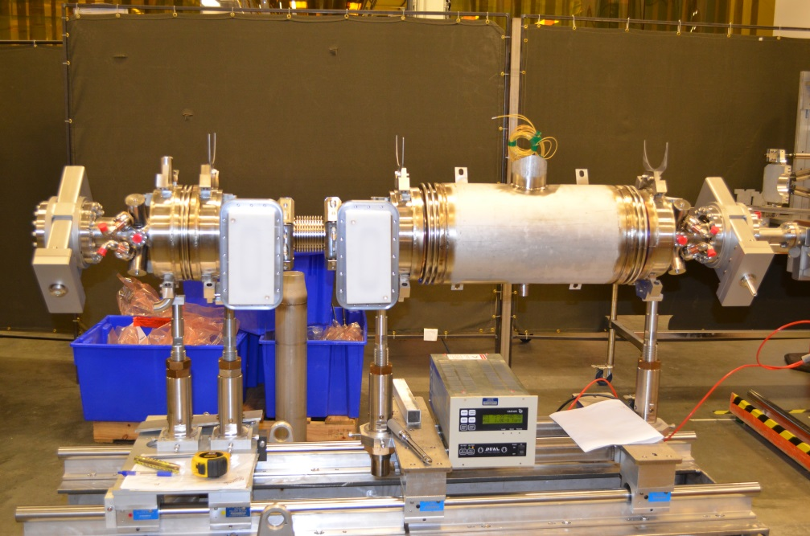
Status New ¼ CM
Test at CMTF June
Install at UITF July
Met with Cryo, SRF, RF, and Kazimi of Ops
Discussing relief valves from ODH point of view
Who does what? e.g. Cryo makes u-tubes and SRF stabs them, Cryo pulls cables, SRF provides connectors
Expect 8 MeV beam with available klystrons

Slide 13
Cryo, SRF, RF and new 1/4 CM
Recall, we agreed on means to “park” the ¼ CM when not accelerating beam: circulate 80K LN2 through 35K shield line. UITF should not be a burden on CTF 34 wks per year
LN2 temp could fluctuate 80 to 100 K, no problem for parking but….
How to cool HDIce? I think we are leaning toward CTF connection…
Nagging ODH assessment is “nagging” because some issues were ill-defined: parking strategy and relief valves
New ¼ CM requires waveguide tuners
Chad Seaton building the high power rf control board
Next biggest issue: designing the waveguide layout

Slide 14
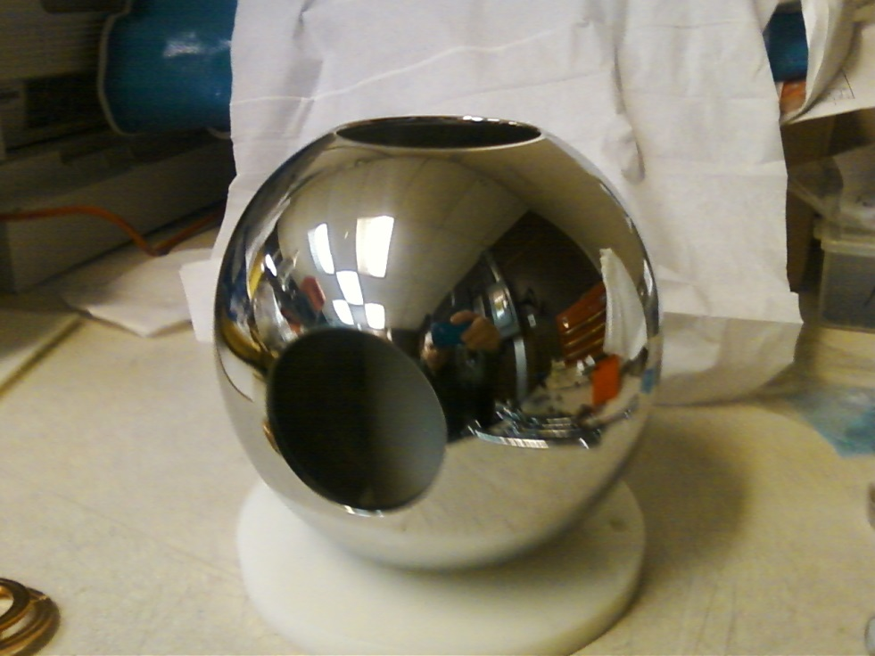
Status Gun Group
Barrel polished in 2 days
HV power supply
buncher
Gun HV power supply installed inside SF6 tank, very little corona at 60 psi
Gun table and 80/20 keV beamline structure moved into place
NEXT: add gun HV chamber, install big beamline elements, buy stuff….

Slide 15
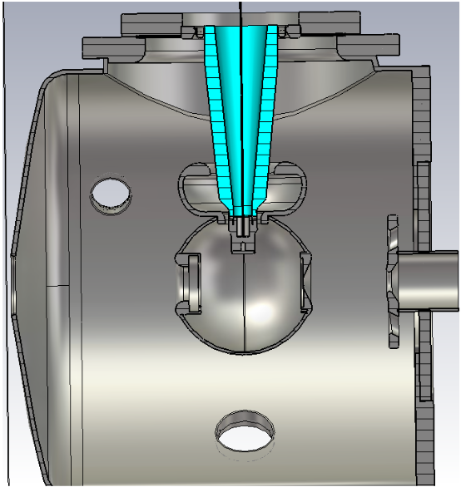
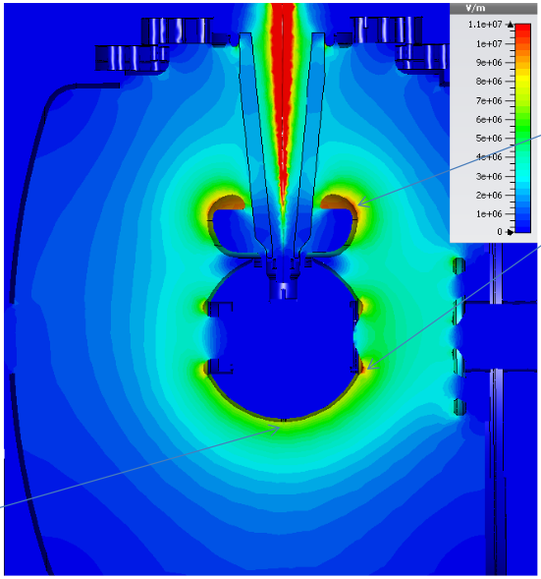
Status Gun Group
11 MV/m
8 MV/m
Yan Wang’s POISSON simulations validated by Fay Hannon using CST 3D field mapper

Slide 16
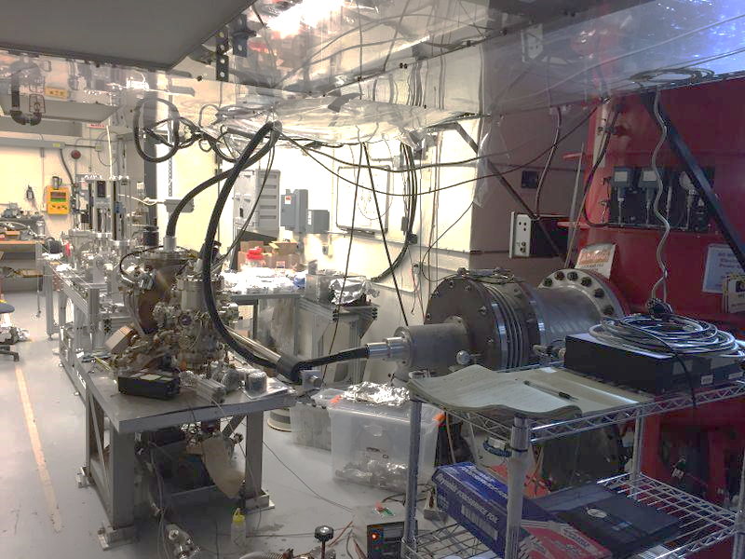
Gun and Beamline at GTS

Slide 17
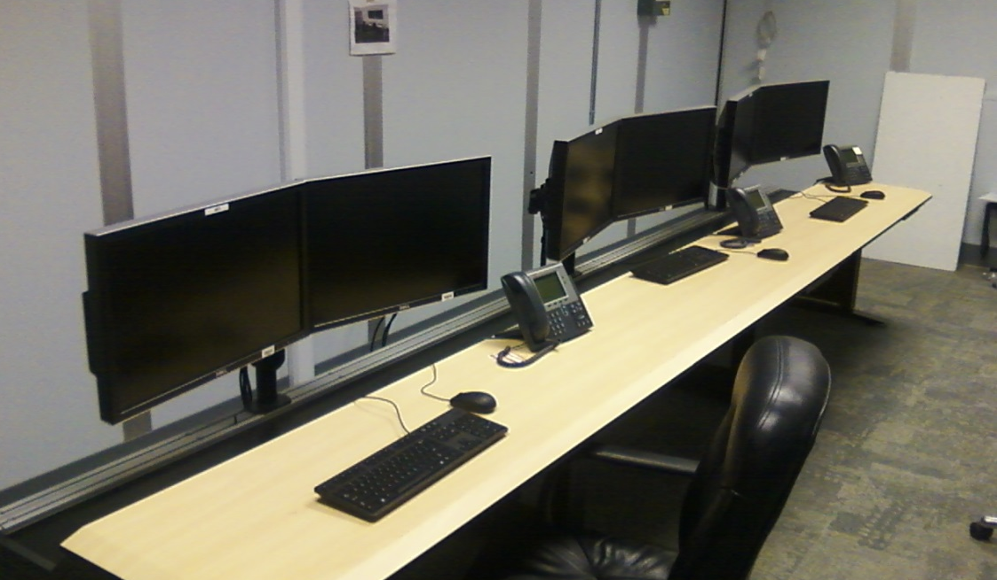
Status Operations
Network switcher hardware installed
Computer terminals installed in control room
6100 IOCs ordered, but we can use older IOCs if needed sooner
Groups are installing hardware in racks, and conversations have started with Software (Scott Higgins our POC)

Slide 18
Status Reviews
UITF Accelerator Review: where beamline design is reviewed by Ops/CASA/SRF, March 15, 2016
Geoff Krafft, Mike Spata, Reza Kazimi, Arne Freyberger, Todd Satogata, Bob Rimmer
Need to send out pre-review material soon: beamline design, optics envelope, machine protection
Safety Systems Review, May 2016
Machine and Personnel, including radiation protection
SCMB?
UITF Readiness Review, August 2016
Commissioning and Operations plans
Experimental Readiness Review, December 2016
Focused on HDIce
Documents: FSAD, mini-AOD, ESAD

Slide 19
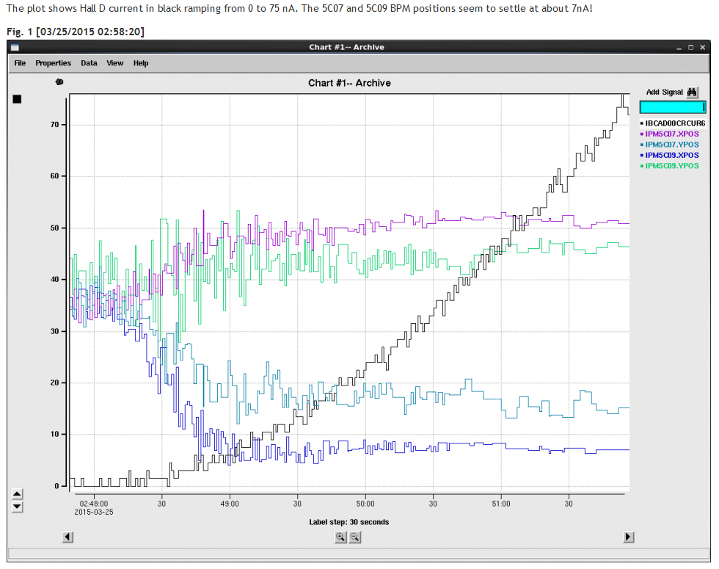
Status HDIce
Stripline BPMs see 7nA beam with 1 Hz integration time. But we want to see 1nA beam, or even less at UITF. Don’t want to fly blind

Slide 20
Status HDIce
$$1nA=DutyFactor Ipeak+Ibaseline$$
$\frac{0.1msec}{16.7msec}$ x 10 nA = 0.06 nA ; I_{baseline} = 0.94nA
I_{peak}
Acceptable duration of high peak current: long enough to see but not long enough to depolarize
I_{baseline}
Need to work out details with HDIce and T. Allison, J. Musson

Slide 21
Milestones Update
WBS | Item | Milestone Description | Start Date | Projected Finish | % Complete | Days Float? | Change (%) | Change (Days)
1.04.xxx | Facilities | Civil work complete | 6-4-15 | August 2016 | 50%
 | Gun | Demonstrate gun ok at 200 kW at FEL GTS |  | December 2015 | 100% |  | done
 | CM | Commission cold ¼ CM, no beam |  | July 2016 | 20% |  | 10 to 20%
 |  | Beam from Gun to Cup in front of ¼ CM |  | September 2016 | 20% |  | 10 to 20%
 |  | Beam thru ¼ @ MeV energy delivered to cup in front of HDIce |  | October 2016 | 0
 |  | Beam to HDIce |  | April 2017 | 0
Facilities work complete by August
RF applied to new ¼ CM July
Beam at MeV during Fall 2016
Physics preparing for installation of HDIce November, 2016

Slide 22
Budget Update: Getting into Target
$55k UITF capital equipment shortfall, $833k labor shortfall ITFCRY, ITFPTB and RSR
Engineering will donate money from one of their accounts to solve the UITF capital equipment shortfall of ~ 50k$. I believe this money will come from an account managed by Anthony Dipette. CEBAF won't suffer because we don't believe the work assigned to this account needs to get done this year. To help address the 833k$ labor shortfall in Accelerator NP accounts ITFCRY and ITFPTB, there are three possible paths forward: 1) Engineering will take a look at their ENGINF accounts to see if they can reduce scope and donate funds to Accelerator 2) Engineering staff who would normally charge RSR will work opportunistically on ITFCRY and ITFPTB when CEBAF does not require assistance. 3) Arne can reduce all RSR accounts by ~ 7% and we can assign this labor to ITFCRY and ITFPTB

Slide 23
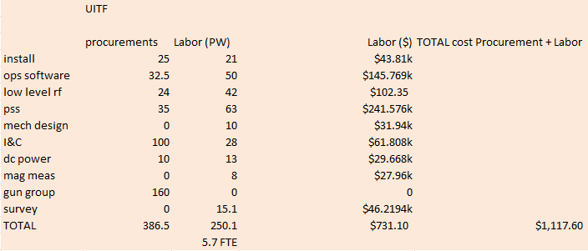
Budget
Gun Group procurements reduced by $55k to get capital into target, money moved to ITFPTB in defensible manner

Slide 24
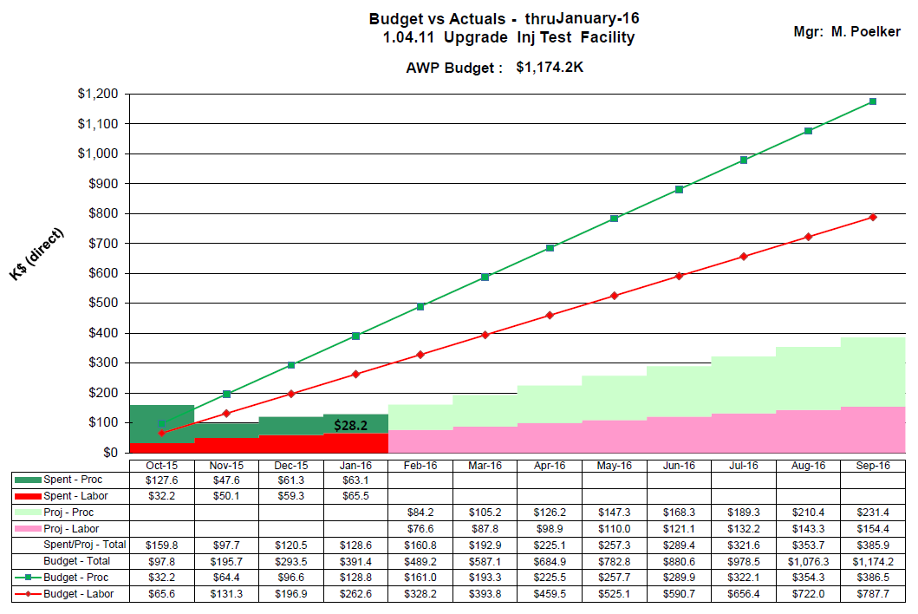
Budget UITFBL

Slide 25
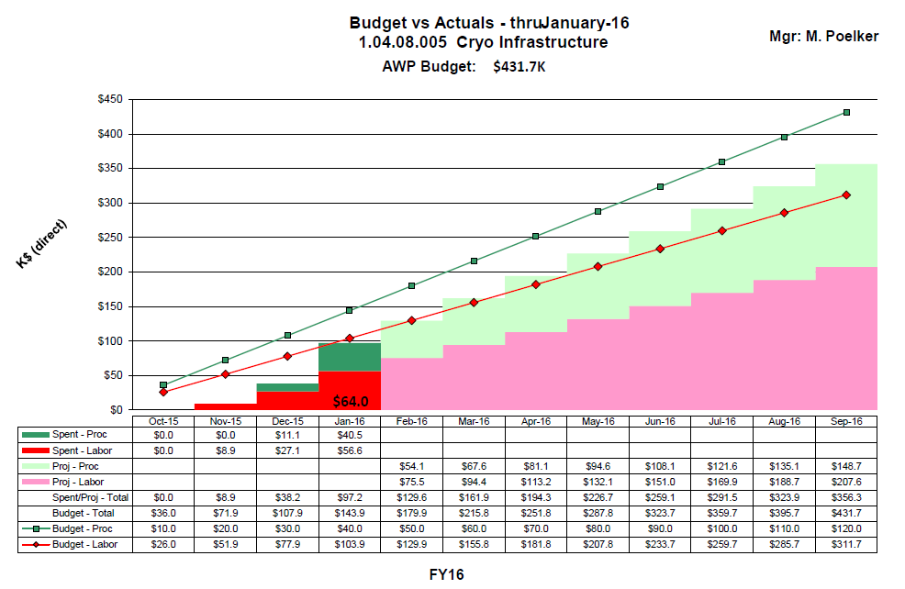
Budget ITFCRY

Slide 26
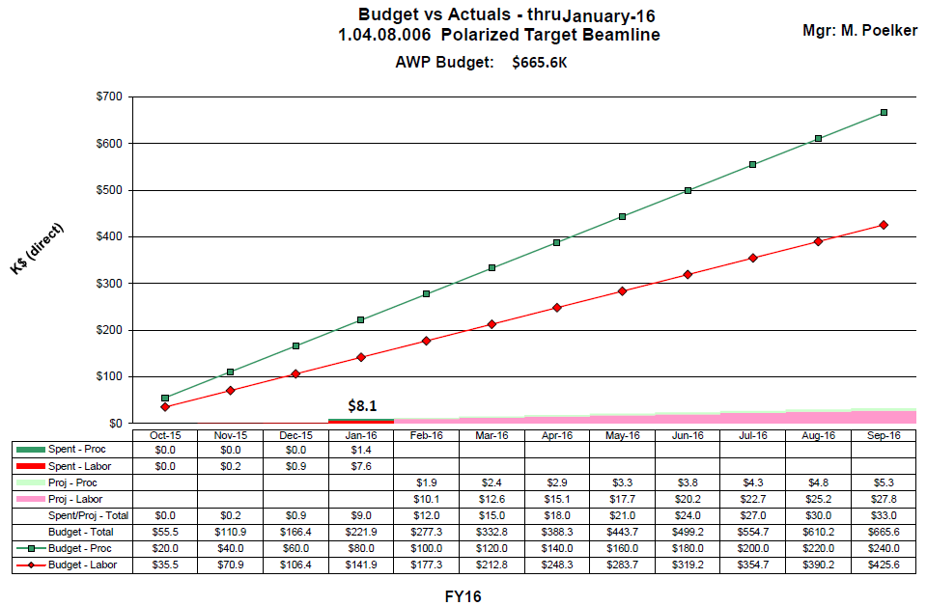
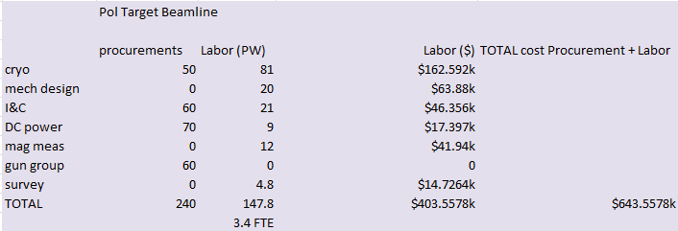
Budget ITFPTB

Slide 27
Schedule Ramifications
Current status:
Need to revisit Cryo costs, and especially costs related to connecting HDIce to CTF
Fill the racks and start loading software – success will depend on groups working opportunistically on UITF
¼ CM – where the work of many groups converge….
Designer Shaun Gregory oversubscribed: moveable supports for “big” beamline items, waveguides, “songsheets”, stripline BPM can, chopper chamber, MeV beamline and 80/20 girder structure
Gun Group tech support occupied at LERF GTS right now
Have to get SCMB to weigh in on UITF shielding and means by which we limit beam current (e.g., PSS BCM(s))
RadCon: installing CARMS, is that a big job?

Slide 28
Summary
There’s continued progress….

Slide 29
Backup Slides
Backup slides from past meetings, P&C meetings

Slide 30
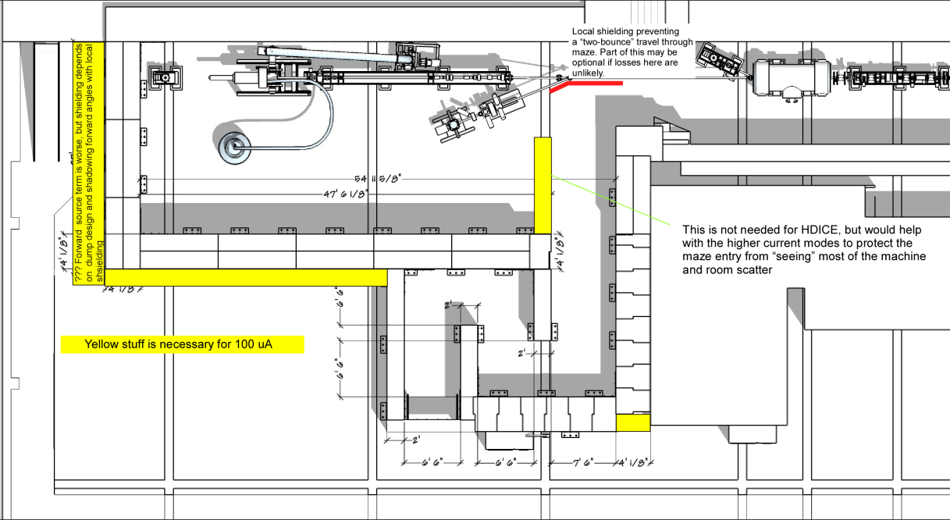
To refresh your memory…
What we started with…
UITF as imagined

Slide 31
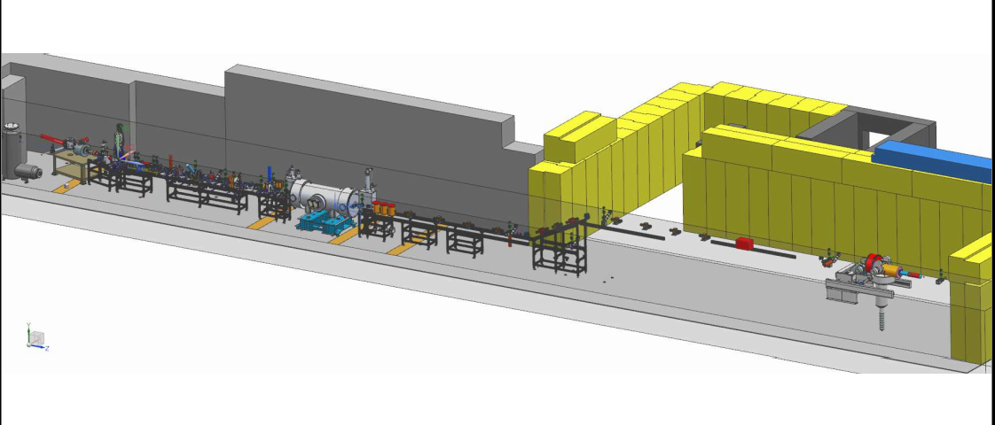
Design work was stopped…would like it to continue

Slide 32
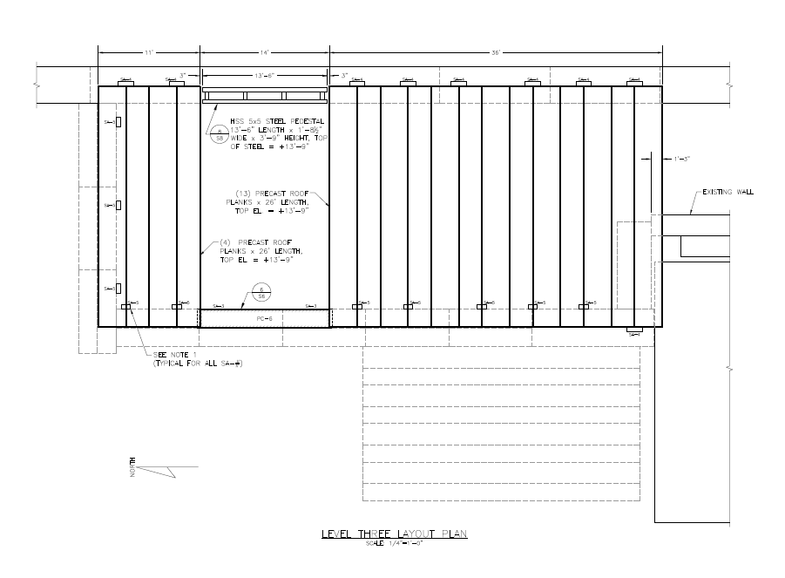
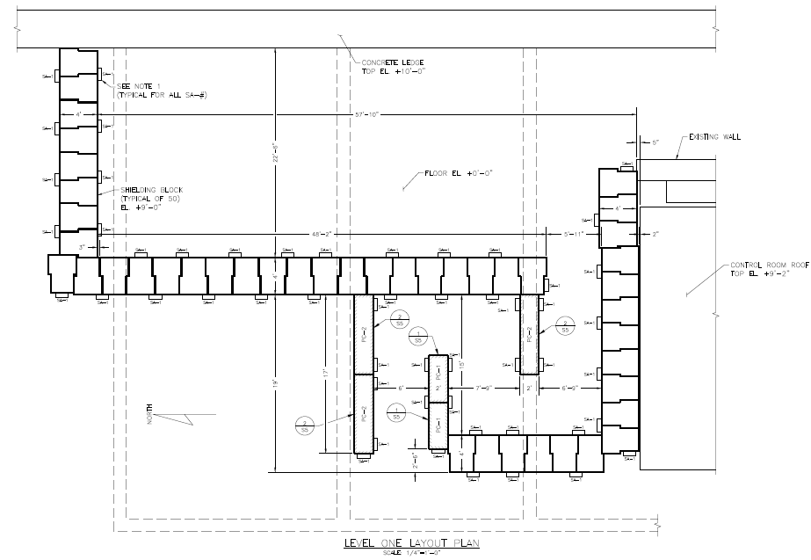
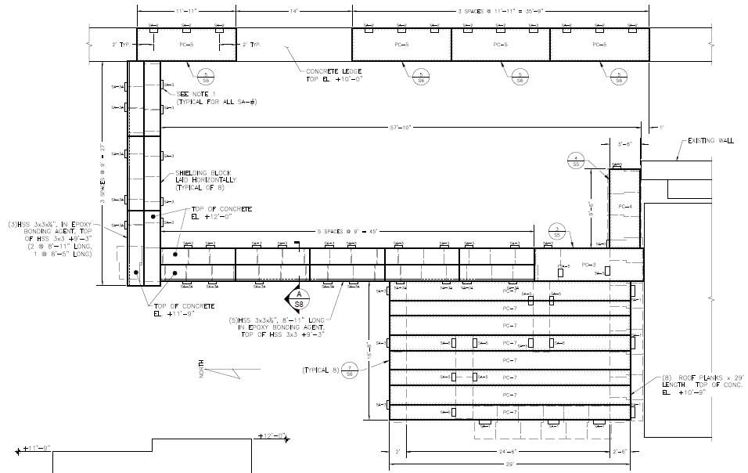
Facilities (T. Renzo)

Slide 33
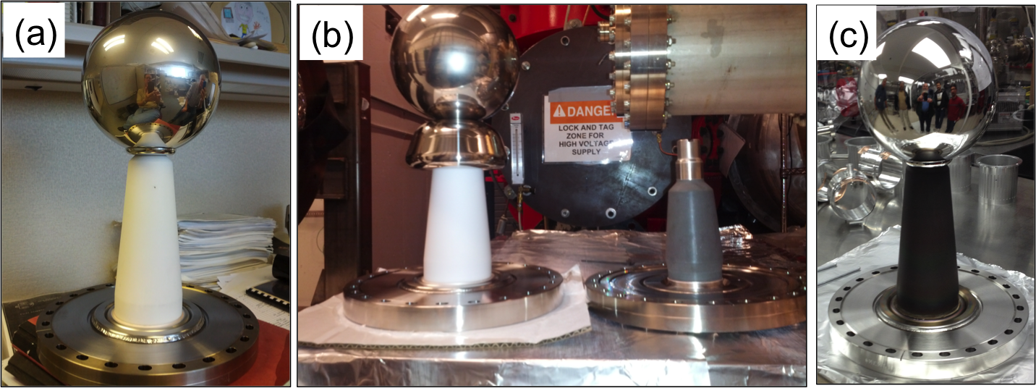
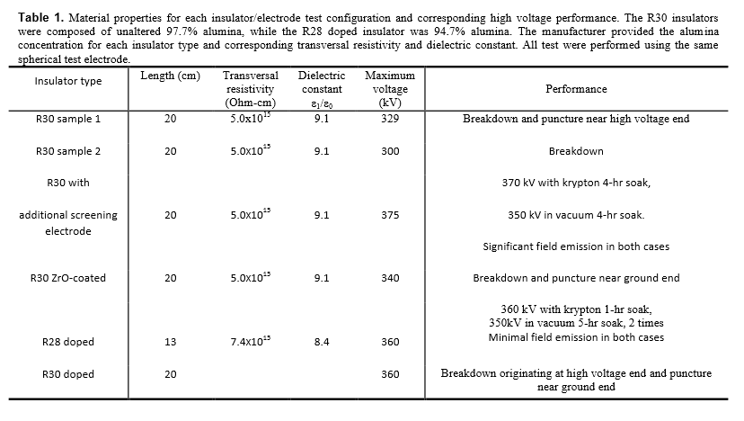
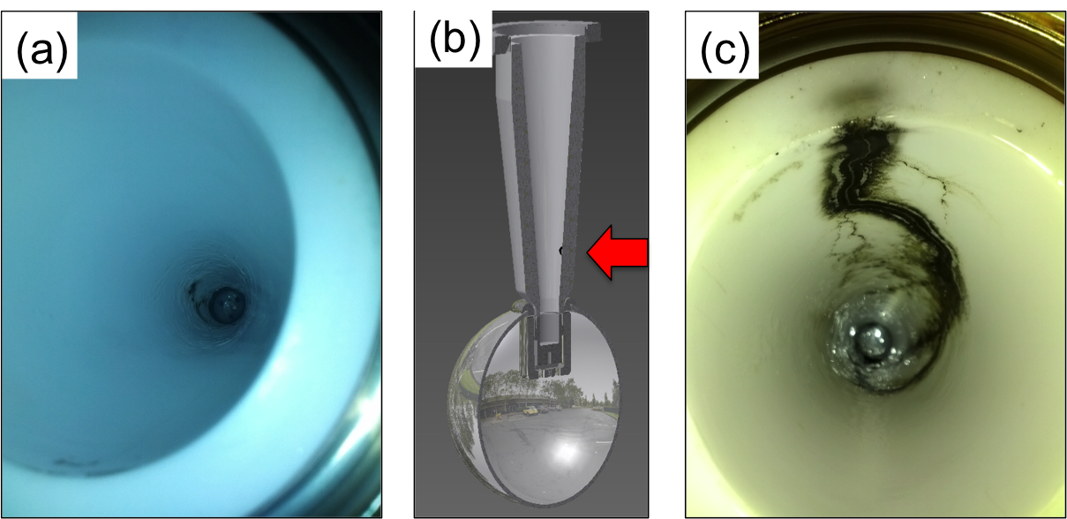
Notes:
Interior Page Design 2

Slide 34
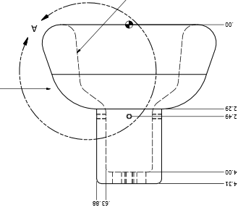
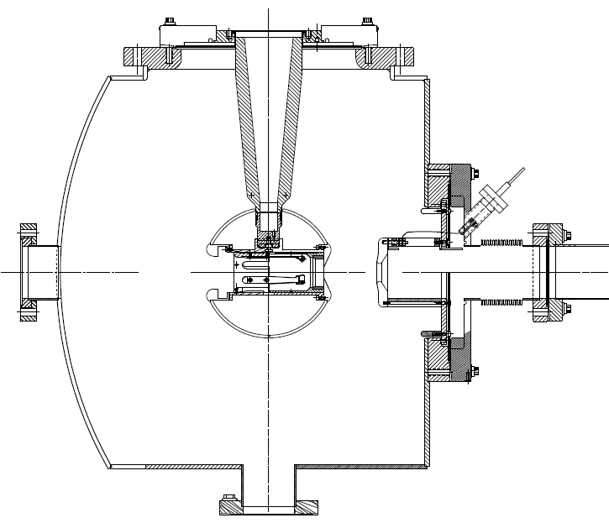
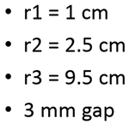
Next test late September
Combine the two features that provided incremental success: shed and doped insulator

Slide 35
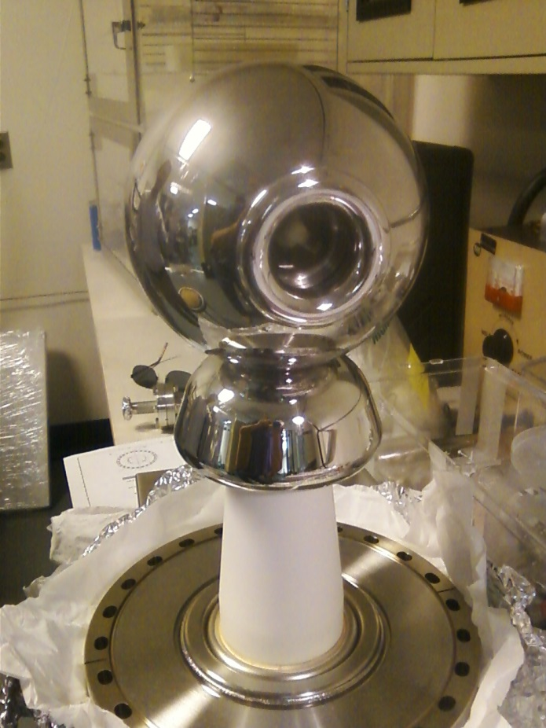
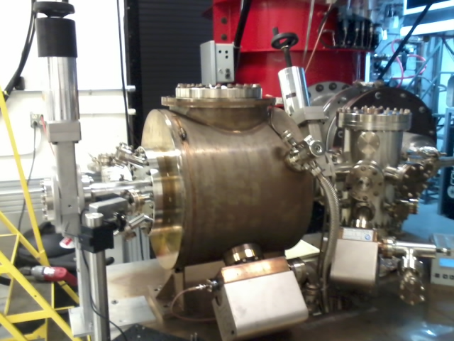
Building the electron gun at LERF GTS
The new gun happy at 325 kV, stopping at this voltage for now. Shifting focus to building the beamline and photocathode deposition chamber (LDRD magnetized beam tests)

Slide 36
Status SSG
ODH system relatively simple: but need the power box removed from Cave2
PSS system more complicated: need Cave2 with a door, to install maglocks
Henry thinks his group can do the work if CEBAF work doesn’t get in the way (Hall A ion chambers, Hall C in spring?)

Slide 37
Schedule Ramifications
Commission ¼ CM (no beam), scheduled for Feb 2016
Electric/FM – ($78k + $23k for com. conduit) 101 k$
Control room – -
SRF checkout of ¼ CM present condition – -
Low Level RF – 16 k$
High Power RF – 25 k$
Network controls – 33 k$
Software control of RF – -
adequate shielding (Cave2 with a roof) – -
Cryo – (controls and pipe) 68 +/- k$
Installation group 9 k$
ODH - SSG 2 k$
EHS&Q approvals… -
Total 254 k$

Slide 38
FY16 Procurements?
 | ~ required | spent in FY14 FY15 | To purchase in FY16
Facilities: | 300 | 56.2 | 245
Cryo | 90.8 | 0 | 90.8 | waiting for update
RF | 252.5 | 121.4 | 131.1
Gun | 451.2 | 265.5 | 130 | includes beamline components + contract designer
I&C | 219.5 | 7.6 | 211.9 | Hope to reduce this number using PLC technology
SSG | 45.7 | 1 | 44.7
DC power | 144.5 | 100 | 8 | Trim cards…
Magnets | 120 | 119.3 | 0 | shop to make quads, assumed 100k but could be less Still need three dipoles
Network | 58 | 58 | 0
Total | 1682 | 671 | 862 | Of course, hope the number comes in lower: 750 k$

Slide 39
Original vs Current Cost Estimate
Presented at UITF meeting May 13, 2015:
Direct $
Loaded $
Original Est. by Hari Areti |  | FTEs | Labor | Proc | Total |  | Labor | Proc | Total
on 2-7-2014 | FY14 | 3.7 | 462.54 | 478.95 | 941.49 |  | 682.70 | 671.23 | 1,353.94
 | FY15 | 2.5 | 312.08 | 557.10 | 869.18 |  | 465.00 | 830.07 | 1,295.07
 | FY16 | 0 | - | - | - |  | - | - | -
 | Total | 6.2 | 774.62 | 1,036.05 | 1,810.66 |  | 1,333.458 | 1,501.306 | 2,649.011
Revised Est. |  | FTEs | Labor | Proc | Total |  | Labor | Proc | Total
by Matt Poelker | FY14 | 1.2 | 160.32 | 189.48 | 349.80 |  | 233.08 | 274.29 | 507.37 | 47.6%
on 5-13-2015 | FY15 | 8.6 | 937.36 | 611.17 | 1,548.53 |  | 1,396.67 | 907.95 | 2,304.62 | 49.0%
 | FY16 | 7.9 | 940.39 | 881.33 | 1,821.72 |  | 1,422.80 | 1,333.46 | 2,756.26 | 51.3%
 | Total | 17.7 | 2,038.07 | 1,681.98 | 3,720.05 |  | 3,052.56 | 2,515.70 | 5,568.26
Dfference from original estimate |  | (11.5) | (1,263.46) | (645.93) | (1,909.39) |  | (1,719.10) | (1,014.40) | (2,919.25)
Total cost estimate. The specific allocations for FY15 and 16 are not correct

Slide 40
Revised Estimates Breakdown
Original request to DOE: $2.6M (loaded)
Current estimate for completion: $5.6 M (loaded)
Delta increase of $2.9M (loaded)
Labor estimates
Underestimated effort by 11.5 FTEs
Increased labor by $1.7M (loaded)
Procurements
Underestimated by ~$1M (loaded)
Several sub-system components were not included in the original estimate and later determined were necessary to complete the scope

Slide 41
Comparison Procurement Estimates (Direct $)
System | Prev | Now | Delta | Comment
Facilities | 305 | 300 | -5 | (numbers are Proc and Labor)
Safety System | 59 | 46 | -13
RF Systems | 125 | 253 | +128 | rf control boards, klystron PS
Cryogenics | 40 | 91 | +51 | Pipe, heat exchanger
Polarized Source | 255 | 262 | +7 | Gun insulators, beamline parts
I&C | 131 | 220 | +89 | BPMs, viewers, picoammeters
DC Power | 0 | 145 | +145 | Trim cards and parts
Magnets | 58 | 120 | +62 | Addl. quads, correctors, dipoles
SRF | 50 | 0 | -50
HDIce | 5 | 0 | -5
Network, IOCs | 0 | 58 | +58
CIS FY14 Actuals | 0 | 189 | +189 | FY14 actuals
Total | 1,028 | 1,684 | +656

Slide 42
FY14 and FY15 UITF Procurements
FY14 |  |  |  | FY15 |  |  | Addl. expected FY15 procurements
Solid Works CAD |  | 2.2 |  | Insulator flange | 1 |  | Contract Mech Designer | ~ 30
450kV HV power supply |  | 31.1 |  | bpm components | 7.6 |  | stairs | ~ 20
semiconducting R30 insulators |  | 52.6 |  | semiconducting R30 insulators_v2 | 22.3 |  | trim cards | ~100
gun HV chamber |  | 7.8 |  | Klystron HV power supply | 55.5 |  | quad magnets (machine shop) | 70 to 130
ion pumps |  | 15.1 |  | concrete wall removal | 32 |  | Chopper rf amplifiers (x2) | 44
beamline Y chamber |  | 5 |  | LLRF parts | 15.1 |  | water skid for chopper | 3
photocathode prep chamber |  | 4.5 |  | steering magnets | 19.3 |  | keV beamline support structure | 6.5
drill penetrations in concrete |  | 4.2 |  | SF6 tank | 11.3 |  | Addl. FY15 procurement total | 303.5
assorted |  | 3.9 |  | waveguide | 3.8
Credit card |  | 21.8 |  | SSG sensor | 1
Machine shop |  | 40.8 |  | assorted | 9.4
total | 189 |  |  | total | 178.3
FY14 + FY15 Procurements: 670.8
UITF Total Procurements 1682

