Slide 1
XHV Cryopump Performance and Limitations for the Jefferson Lab Polarized Electron Source Marcy L. Stutzman, P. Adderley, and M. Poelker
Notes:
Title Page Design 3

Slide 2
Thomas Jefferson National Accelerator Facility
Dept. of Energy, 12 GeV electron accelerator for Nuclear Physics
Up to 90% polarization from DC photoemission source
Electron currents to 200μA beam (CW) to four experimental halls
Source
Hall D
Halls A, B, C

Slide 3
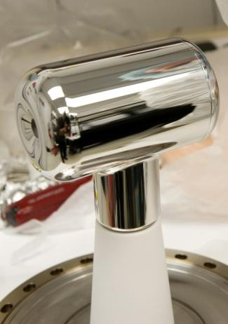
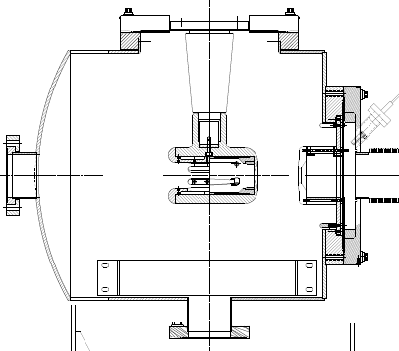
DC Photoemission Source
Strained superlattice GaAs/GaAsP photocathode
Residual gasses ionized, limit operational lifetime
SAES WP NEG modules
Gamma Vacuum SEM style ion pump
Base pressure approaching XHV
XHV ≡ P < 1x10⁻¹⁰ Pa = 1x10⁻¹² mbar = 7.5x10⁻¹³ Torr
GaAs
14 layers
-130kV
GaAsP
light in
0.36
electrons out
Strained
Superlattice
Photocathode
GaAs

Slide 4
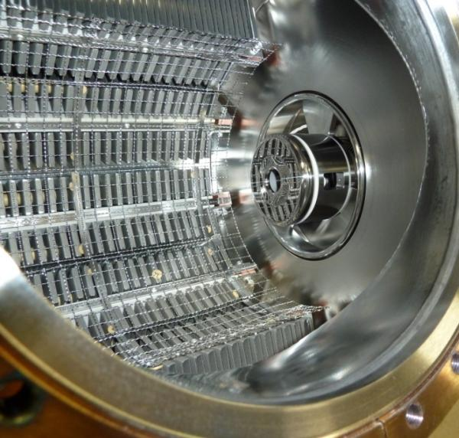
Existing Electron Source Pumping
Heat treat to reduce outgassing
400°C, 100 hours,
Q=1x10⁻¹³ TorrLs⁻¹cm⁻²
Installed pumping
SAES WP1250 modules x 10 (5600 L/s total)
Gamma SEM/XHV ion pump
(45 L/s)
Measured pressure ~1x10⁻¹² Torr
(extractor gauge, x-ray limit measured and subtracted)
CEBAF Lifetimes
~100 Coulombs = 10 days at 100 uA
Extrapolating e-RHIC to 10 mA:
100 Coulomb lifetime < 3 hours

Slide 5
Proposed future electron sources
Creative designs for future sources
10-50 mA polarized electron source for e-RHIC using “Gatling Gun” with up to 20 photocathodes
Enhanced vacuum still essential for high currents

Slide 6
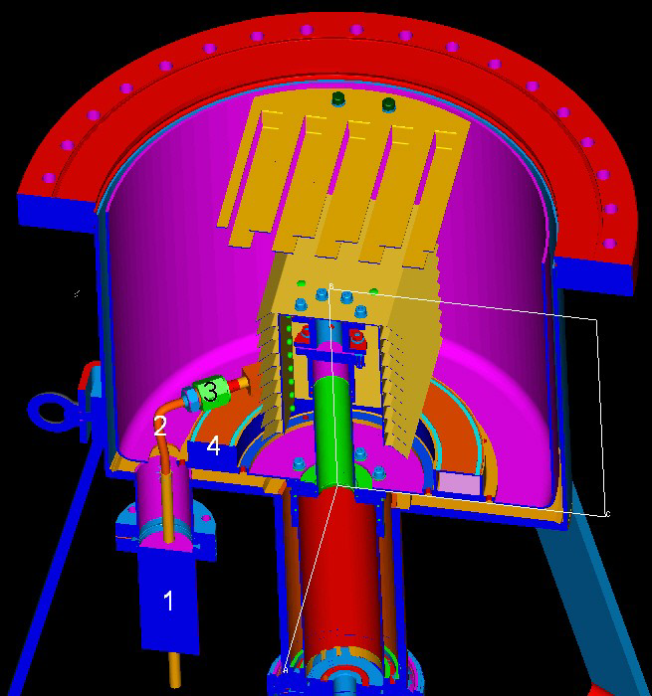
Leybold XHV Cryopump
LN₂ chill circuit
cools cryosorber panels and compressor
allows bake of cryopump body
Operation
10K pumping surface
30K baffles
Presented at AVS 55 by Dieter Mueller

Slide 7
Adding Leybold Pump to gun compatible NEG/ion chamber
Three pressure Gauges
Extractor, AxTran, 3BG
Chamber (NEG / Ion pumps)
Overboard bake ion pump
10” all metal gate valve
Bellows (12” to 10” adapter, vibration isolation)
Cryopump
Overboard bake ion pump
Compressor
ColdHead
LN₂ chill line / chill line evacuation system

Slide 8
Pressure Reduction: Cryopump
Gauge corrections not yet applied
All gauges see improvement in pressure with cryopump
Initial cooldown: not yet at equilibrium
Gauge calibration and offset issues

Slide 9
Leybold Residual Gas Species Analysis: 9K
XHV test chamber with NEG, ion pumps, gauges, VQM
Not fully baked for this gas analysis
(vented, moved, reconfigured, reassembled)
Cryopump cooled down, 4.5 days elapsed time
Pressure: 1x10⁻⁹ Torr
VQM spectrum shows partial pressures at 100 AMU

Slide 10
Drawbacks to Leybold Cryopump
Three separate backing pump systems
Main chamber pump
Pump system for cryo backing
Pump system for LN₂ lines during cold operation
Isolation valve surface area
Bakeout difficulty
LN₂ chill circuit
Residual gas spectrum: due to adhesive?

Slide 11
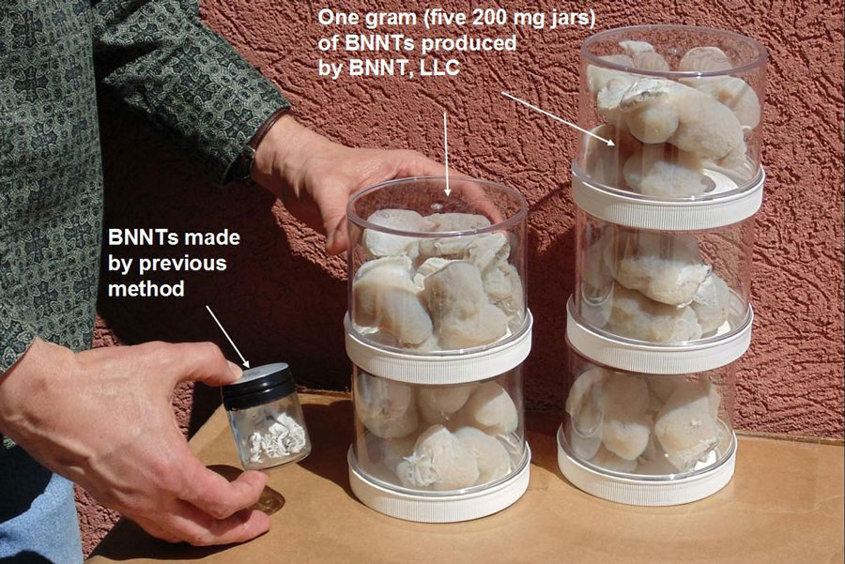
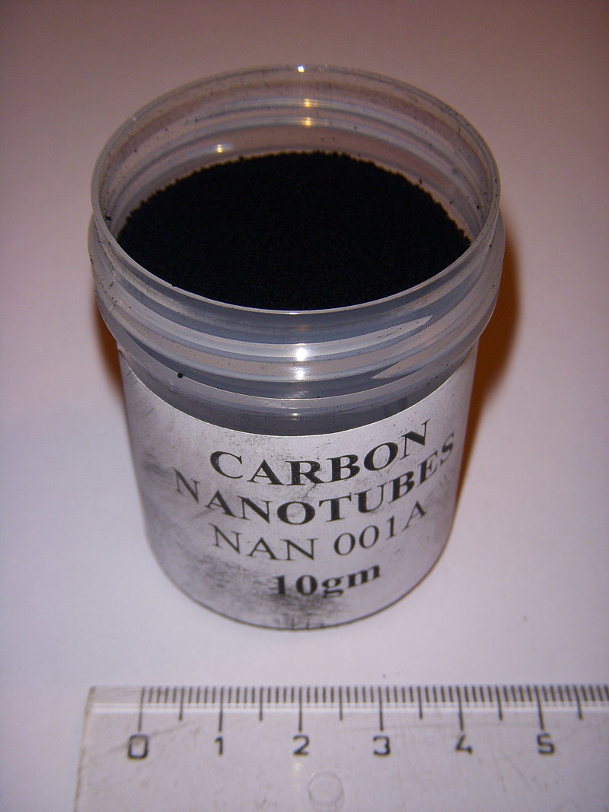
Fibril BNNT™ material
Freestanding boron nitride nanotubes
High thermal conductivity
Chemically inert
Very porous structure
Local JLab affiliated company
Cryosorber material?
CRADA research agreement
1 g BNNT
10 g CNT (similar scale)
www.bnnt.com
US Patent pending

Slide 12
BNNT properties
TEM
Purity | 40 to 50% by mass
Residual | hBN flakes and micro-droplets of elemental boron, by TEM
Walls | 1 to 5 walls, mostly 2 or 3 walled tubes
Tube Length | up to 200 microns by SEM
Surface Area | up to 300 m²/g by BET
Bundles | single through bundles of 5 tubes, TEM
Band Gap | 5.7 eV (semiconducting) EELS spectroscopy
Strength in air | 800°C (CNT is 400°C)
Thermal oxidation resistance | Stable to at least 920˚C in air
Thermal Conductivity | 3000 W/mK (Cu = 400 W/mK, CNT 60-40,000 W/mK)
Impurities: B and hBN
http://ntrs.nasa.gov/archive/nasa/casi.ntrs.nasa.gov/20140004051.pdf

Slide 13
BNNT cryosorption tests: Modified commercial cryopump
Sumitomo CP-8 cryopump, all welded or Conflat joints
Shipped to JLab for 400°C, 48 hour heat treatment prior to final welding
Motor/displacer assembly removable without venting
No installed charcoal
First cooldown: 14K

Slide 14
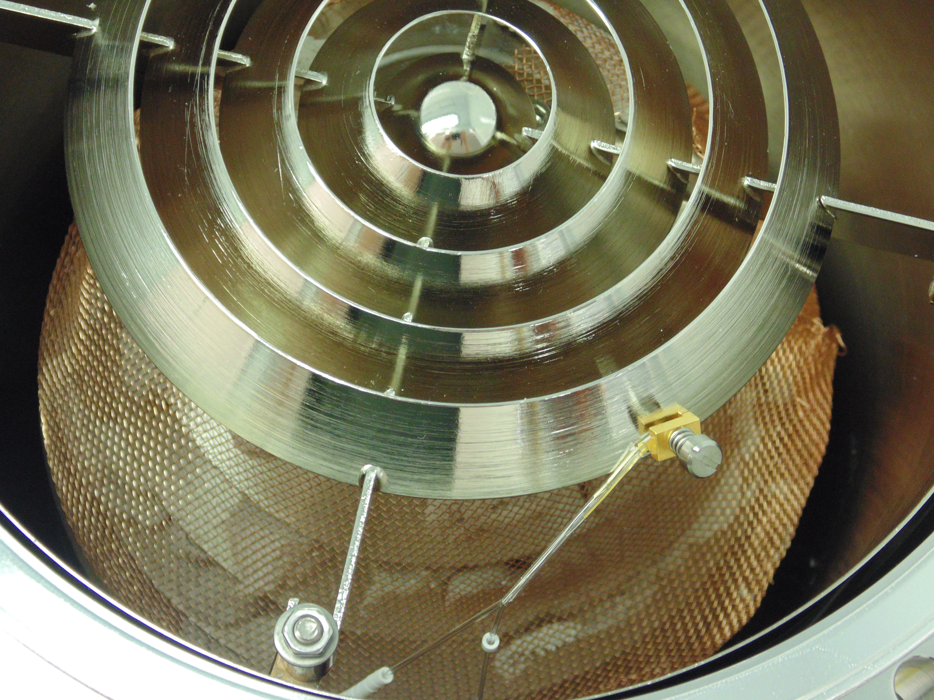
BNNT installed as cryosorber
Nanomaterial mechanically attached (no adhesive)
Copper mesh for retention
Glass tube / ceramic beads insulating diodes

Slide 15
BNNT cryosorber test setup
Ion pump
Removable cryopump motor, displacer: fully bakable
Gas inlet system, orifice for pump speed and capacity measurements
Potentially hydrocarbon free cryopump
VQM
Extractor
Stabilion
Test chamber
Cryopump
H₂
orifice
motor

Slide 16
BNNT cryopump: first cooldown
Baked 48 hours at or below 150°C
Coldhead temperature: 15.5K (14K before BNNT)
39K: pressure drop – Cryopumping!

Slide 17
Mass spectra comparison
GP VQM, total pressure with Leybold extractor gauge

Slide 18
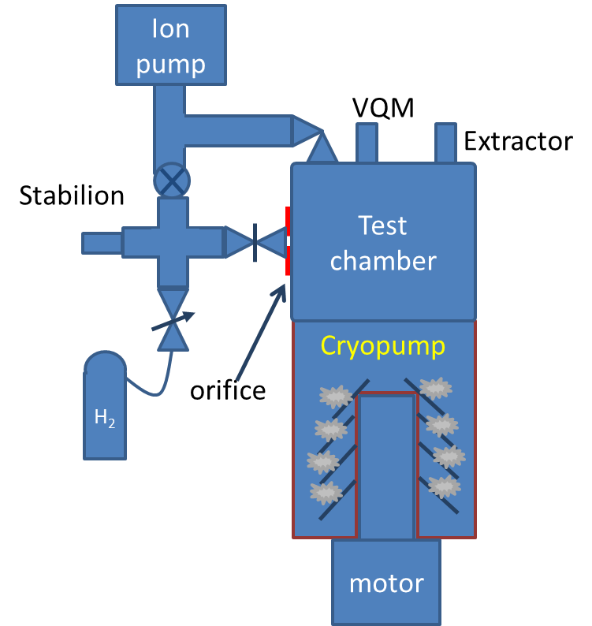
BNNT hydrogen pump speed tests
Base temperature only 15.5K with heavy copper grid
S: pumping speed
C: orifice conductance
P1: pressure leak side
P01: pressure leak side with leak closed
P2: pressure pump side
P02: pressure pump side with leak closed

Slide 19
H₂ pump speed vs. time, 1g BNNT, 15.5K
Preliminary

Slide 20
H₂ pump speed vs. time, 1g BNNT, 15.5K
Preliminary

Slide 21
Speed vs. gas dose, 1g BNNT, 15.5K

Slide 22
BET surface density comparison
Charcoal properties* | m²/g | Density (g/cm^3)
Roth | 1700 | 0.3
Chemviron GFF30 | 1600
Degusorb | 2300 | 0.44
Chemviron SCII | 1500 | 0.45
BNNT | 121-300 | 0.001
Lower surface area, but
Low density = high porosity: effect on capacity, speed?
*Christian Day, “The use of active carbons as cryosorbent”,
Colloids and Surfaces A 187 (2001) 187-206.

Slide 23
BNNT cryosorber open issues
Need a full bake to remove water vapor
Ultimate pressure tests
Cryopump base temperature hindered by heavy copper mesh – reduce load
Increase cryosorber volume to increase pump speed and capacity
Nanomaterial handling regulations at Jlab
Working with NIOSH and BNNT to streamline

Slide 24
Summary
Pumping requirements for CEBAF satisfied with NEG and ion pumps
New projects require higher current/longer photocathode lifetime
Investigations with Leybold cryopump show modest improvement over NEG ion pump combination, adhesive signature in residual gas
New BNNT material in cryopump being tested – potential hydrocarbon free cryopumping

Slide 25
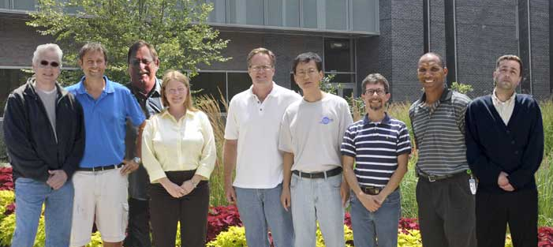
Acknowledgements
U.S. DOE Contract No. DE-AC05-06OR23177 and with funding from the
DOE R&D for Next Generation Nuclear Physics Accelerator
Facilities Funding Opportunity Number: DE-FOA-0000339
Jefferson Lab
Center for
Injectors and
Sources
Matt Poelker, Joe Grames, Don (Bubba) Bullard,
Marcy Stutzman, John Hansknecht, Shukui Zhang,
Carlos Hernandez Garcia, Philip Adderley, Riad Suleiman

Slide 26
 | Carbon nanotubes | Boron nitride nanotubes
Electrical properties | Metallic or semiconducting | Always semiconducting (about 5.5 eV band gap)
Mechanical properties (Young’s modulus) | 1.33 TPa | 1.18 TPa
Thermal conductivity | 60 – 40,000 W/mK | ~ 3000 W/mK (Cu = 400 W/mK)
Thermal oxidation resistance | Stable to about 480˚C in air | Stable to at least 920˚C in air
Neutron scattering cross-section | C = 0.0035 | B = 767 (B¹⁰ ~ 3800) N = 1.9 Excellent radiation shielding
Polarity | Covalent bond (No dipole) | Permanent dipole Piezoelectric (0.25–0.4 C/m²)
Surface morphology | Smooth | Corrugated
Color | Black | White
Coefficient_of Thermal Expansion | -1 x 10⁻⁶ | -1 x 10⁻⁶

