Slide 1
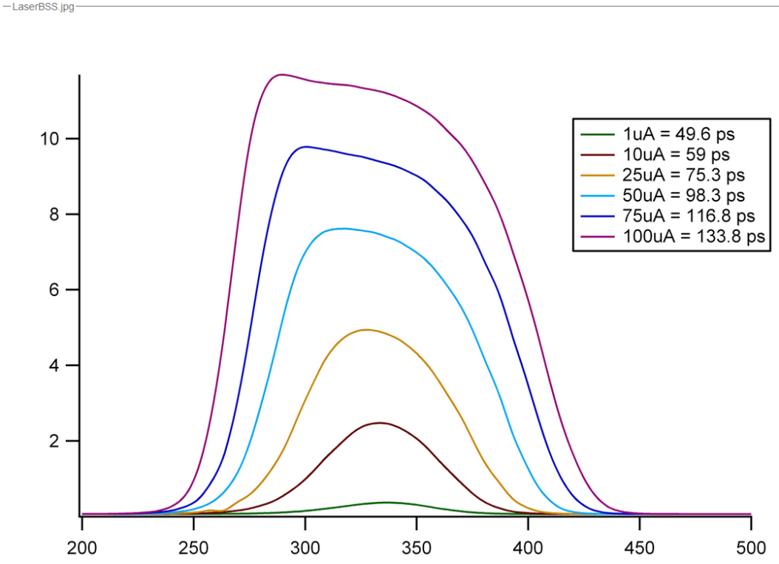
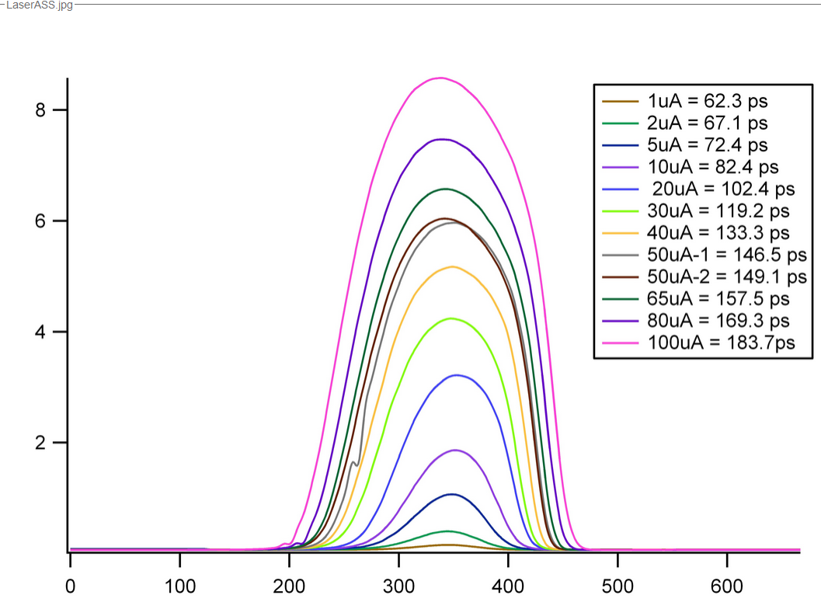
Why prominent distortion on B laser?
Did we all use Pcup current?
Was the 18 ps window deconvolved?
Consistent with 2014 results?

Slide 2
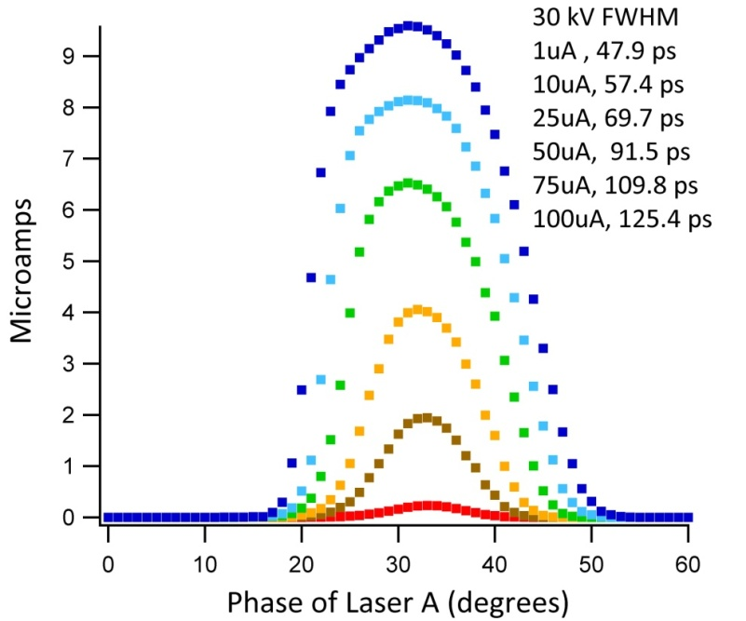

Slide 3
Did we all use Pcup current?
Was the 18 ps window deconvolved?
Consistent with 2014 results?
Plotted vs bunch charge, why the offset?

Slide 4
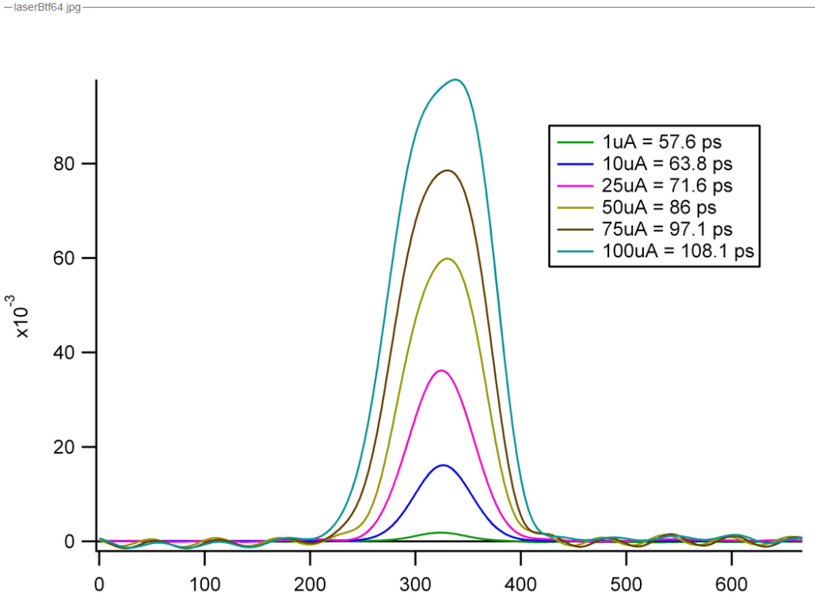
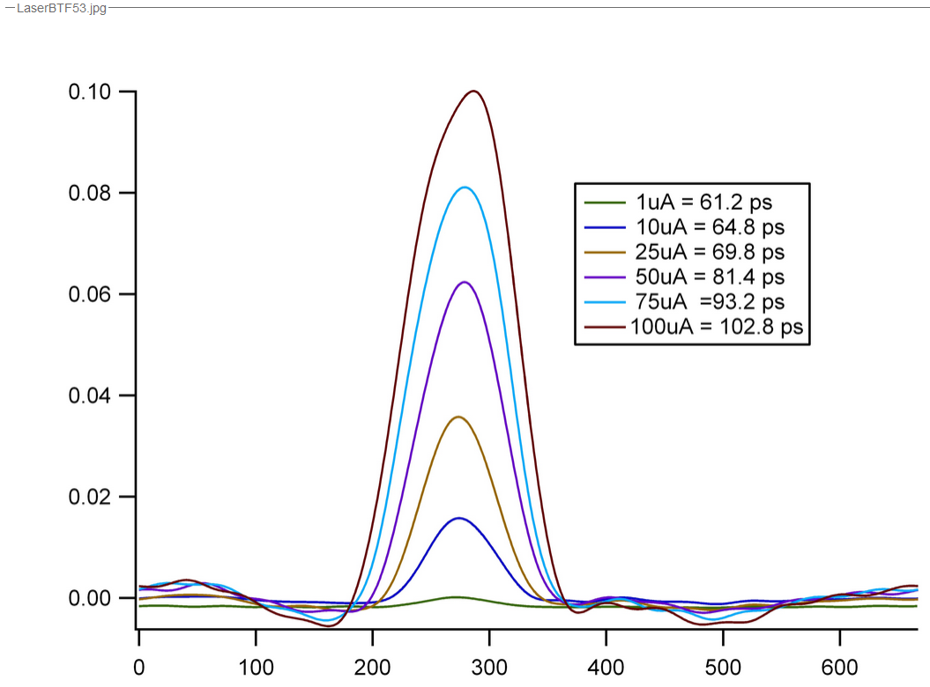

Slide 5
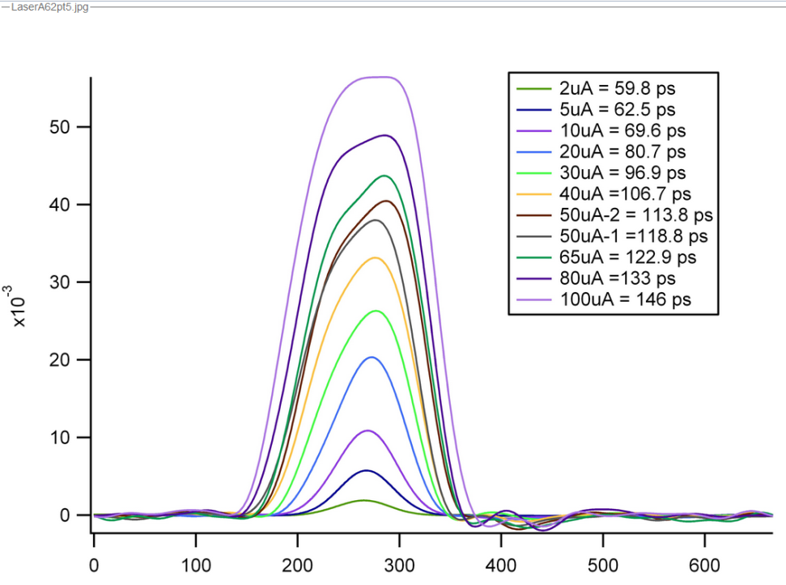
Did we all use Pcup current?
Did we deconvolve the scope bandwidth?
Why does harmonic cavity not see pulses < 60ps?

Slide 6
Why doesn’t the harmonic cavity see bunches < 60ps?

Slide 7
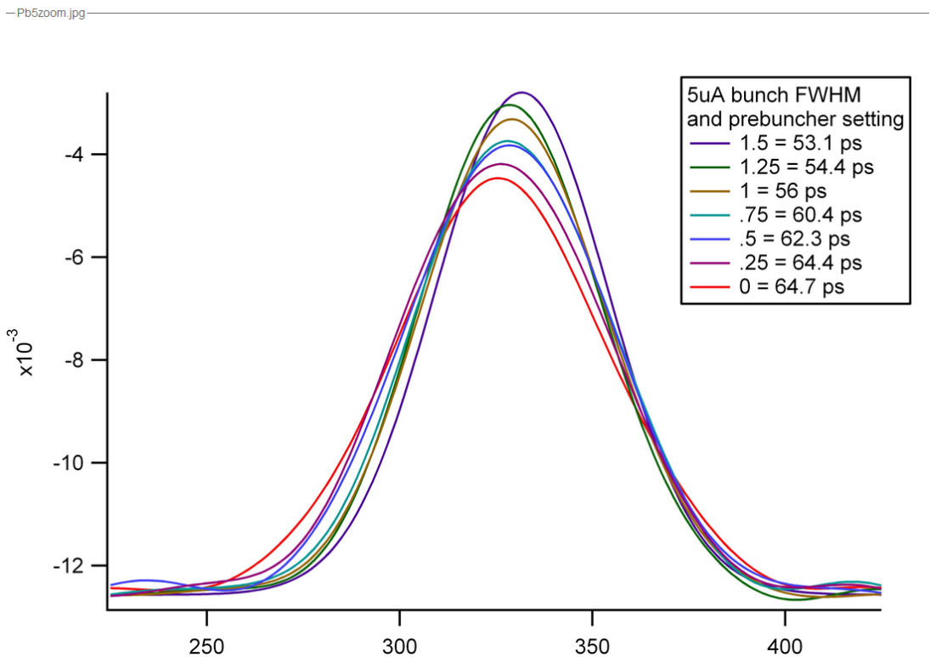
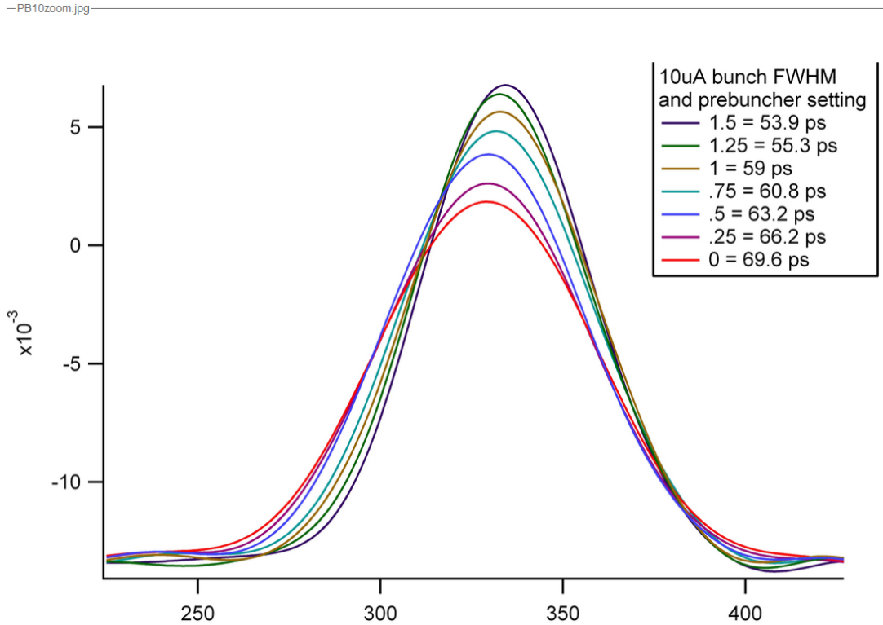
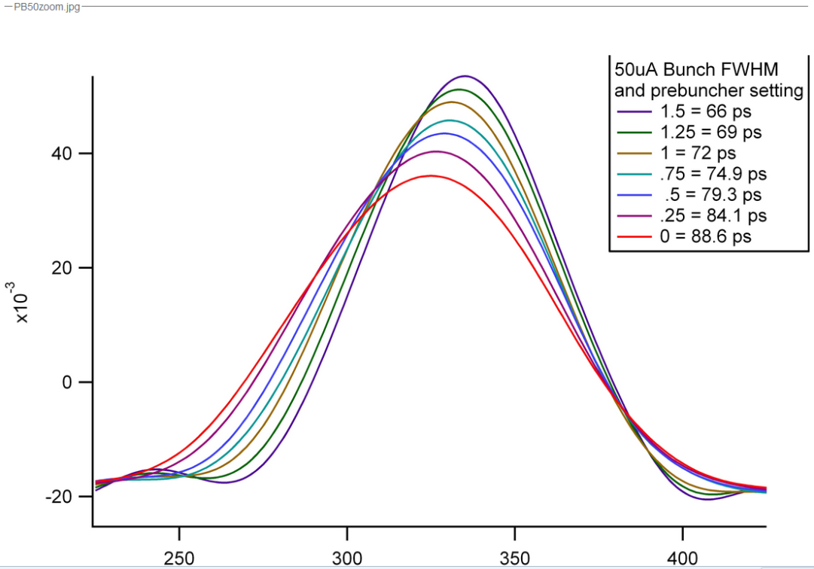

Slide 8
