Slide 1
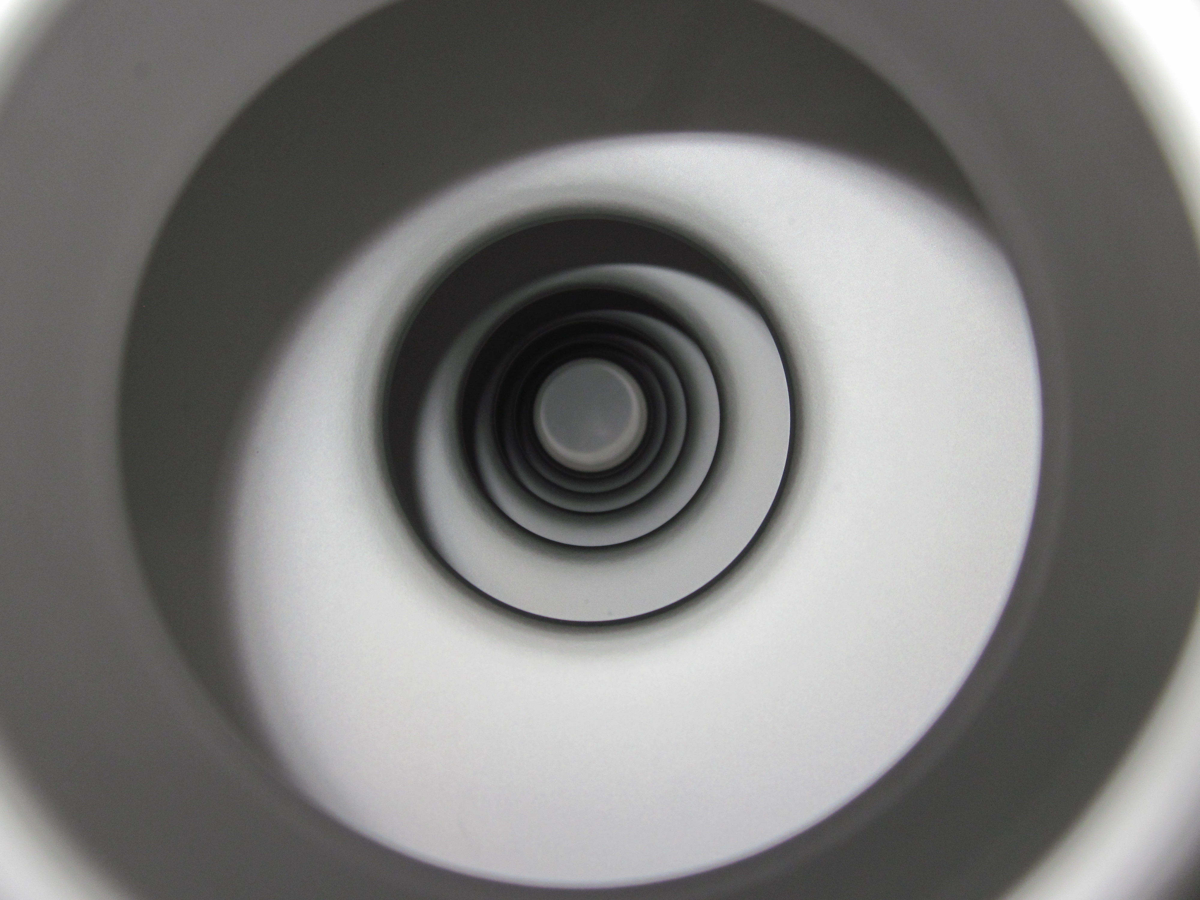
Nb₃Sn
Grigory Eremeev

Slide 2
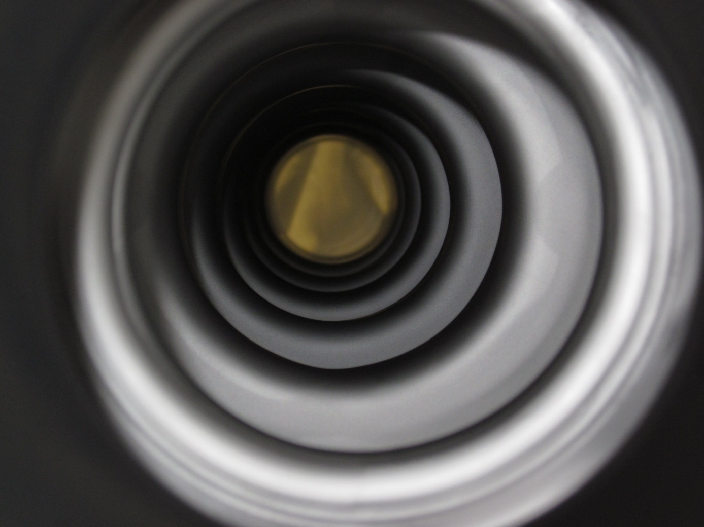
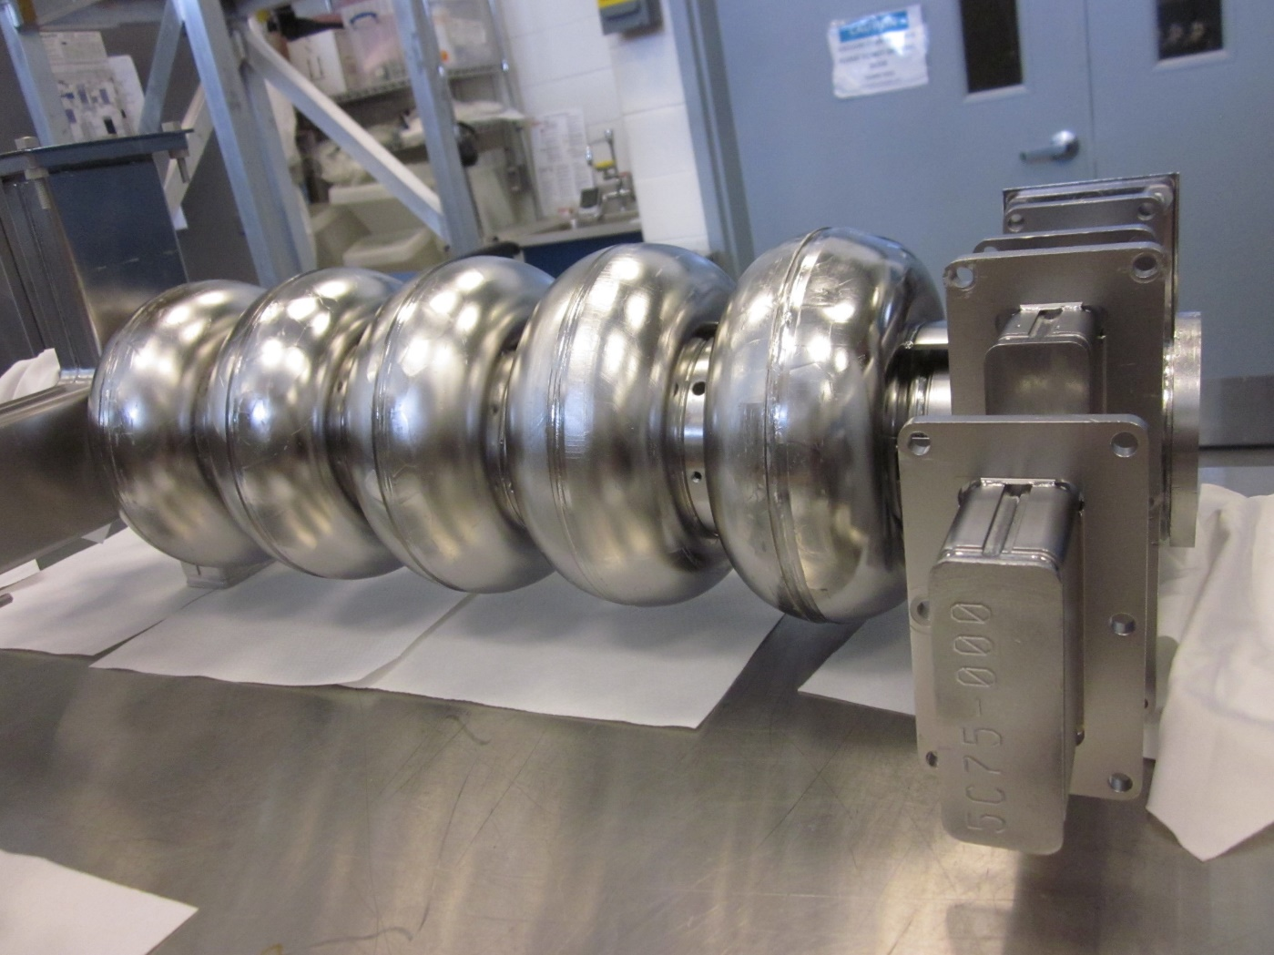
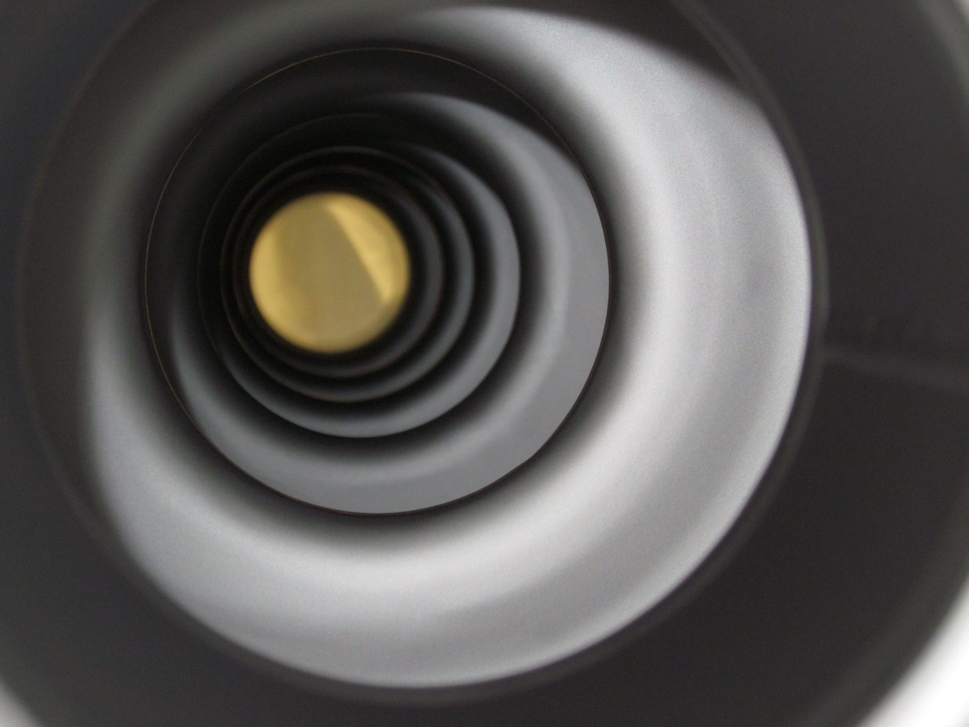
Goal#2 : JLab Nb₃Sn coating system upgrade
U. Pudasaini
1/7/2019
2

Slide 3
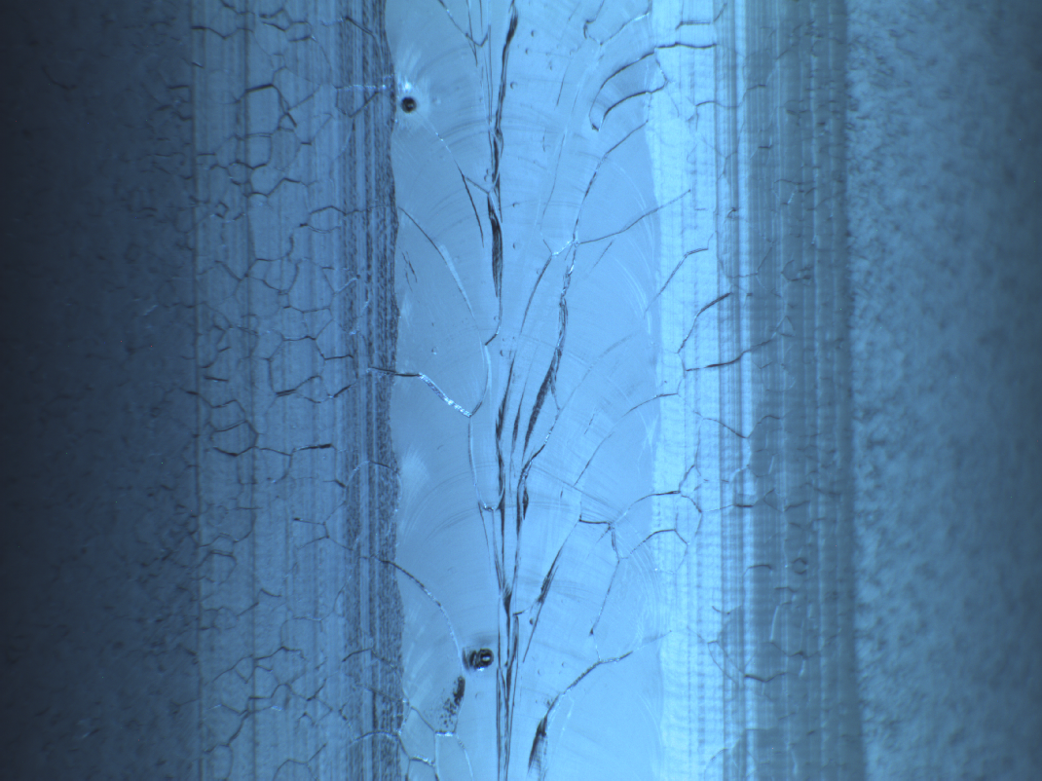
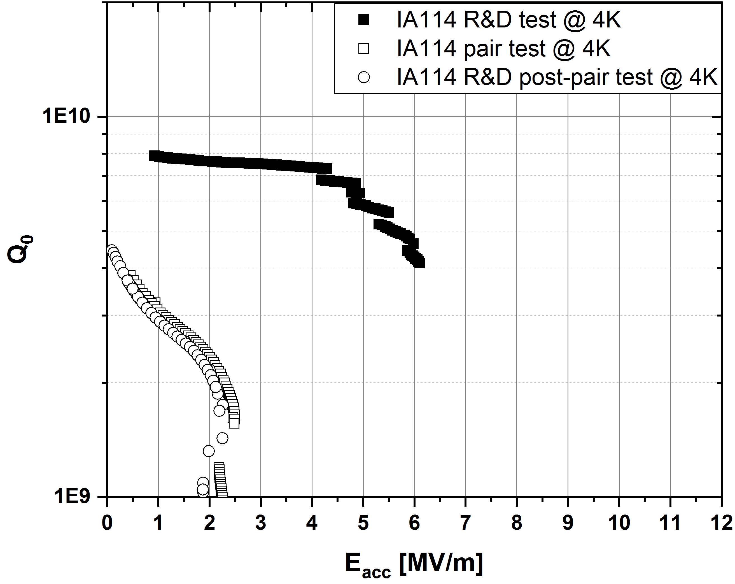
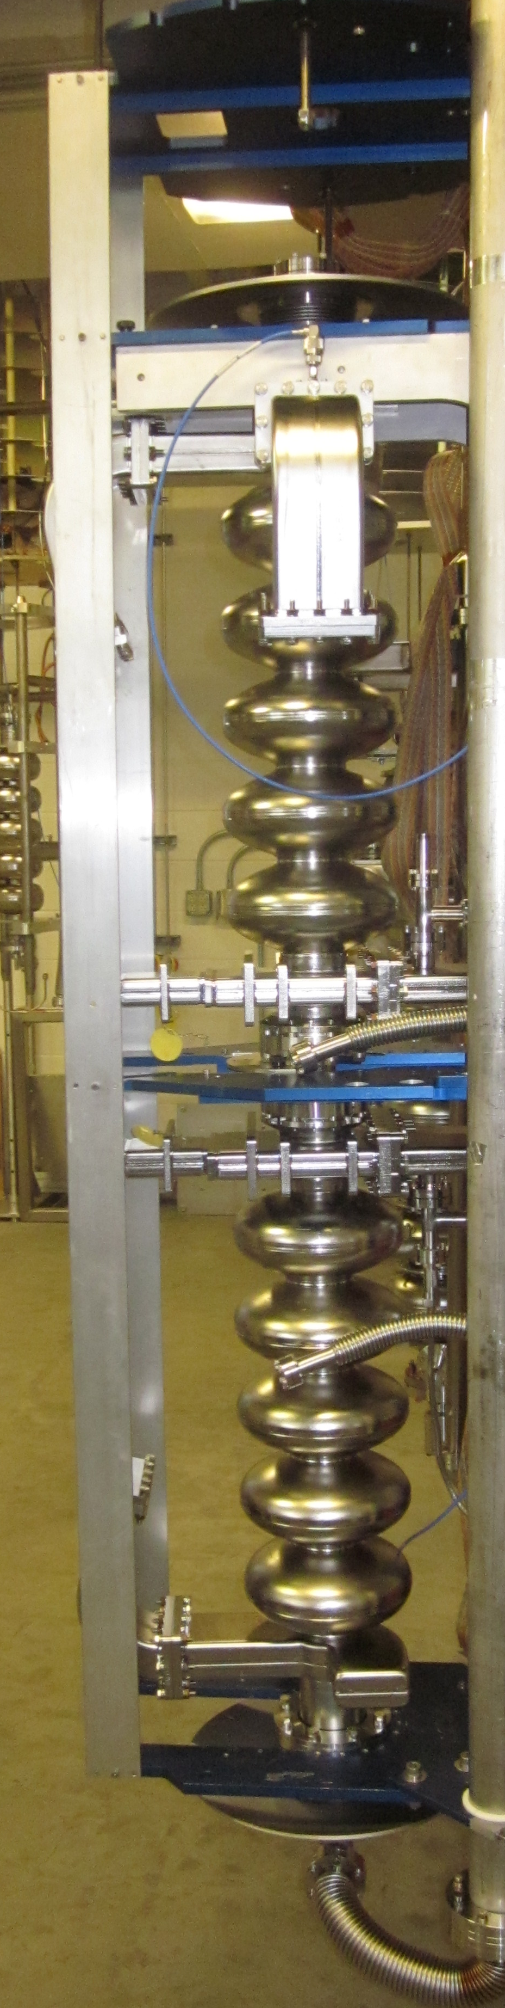
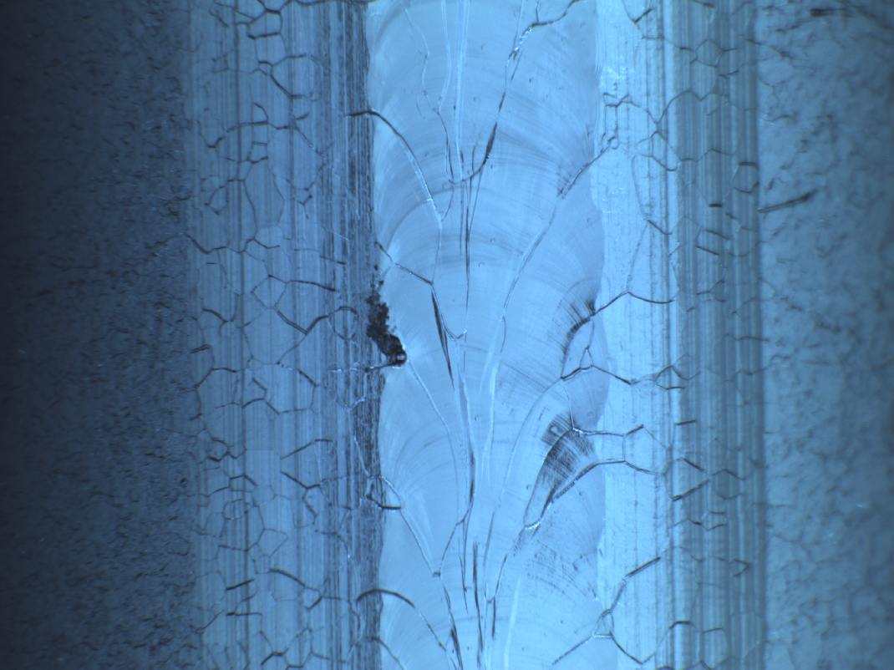
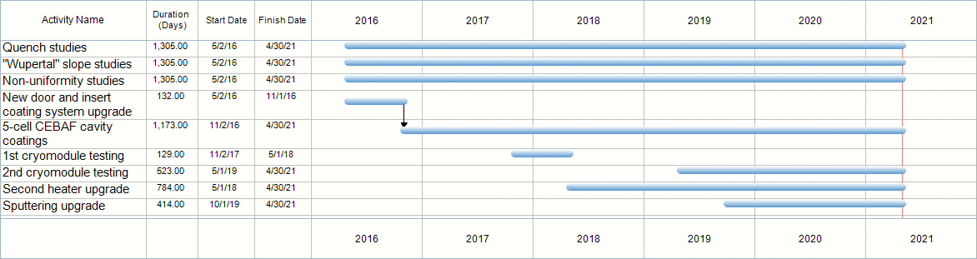
Current status
X
1/7/2019
3

Slide 4
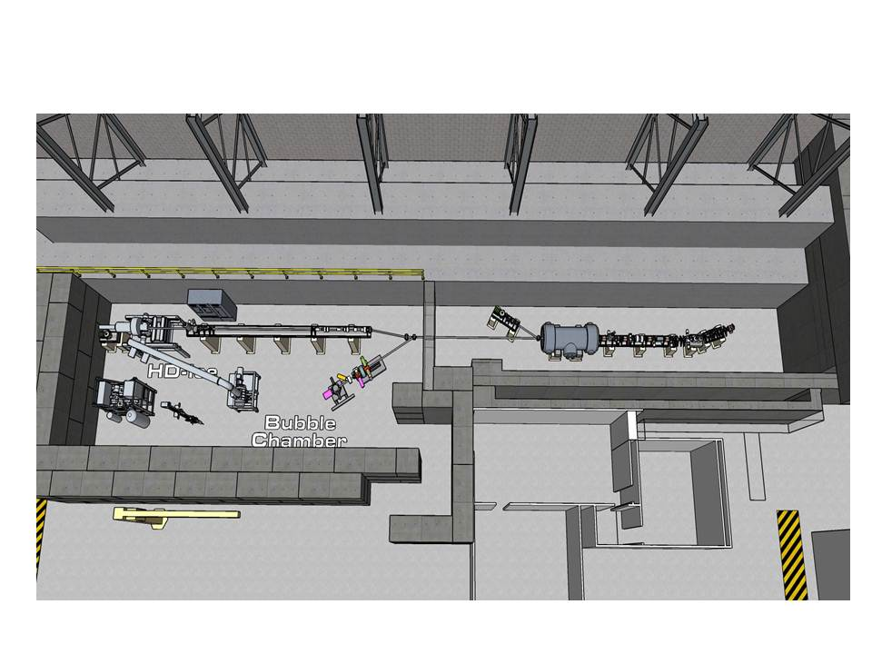
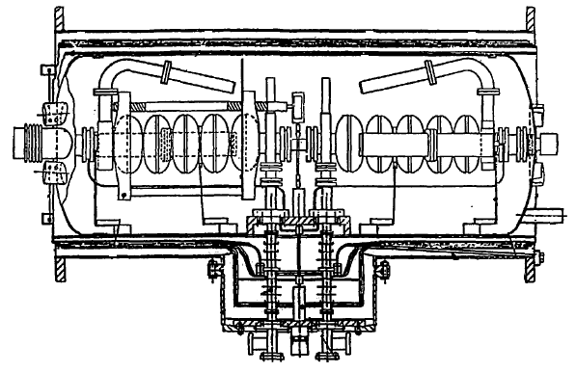
UITF use
Use Nb₃Sn-coated cavities to accelerate electron beams in a cryomodule with Q₀ of 10¹⁰ at E_{acc} = 10 MV/m at 4 K.
1/7/2019
4

Slide 5
Thank you!
1/7/2019
5

