Slide 1
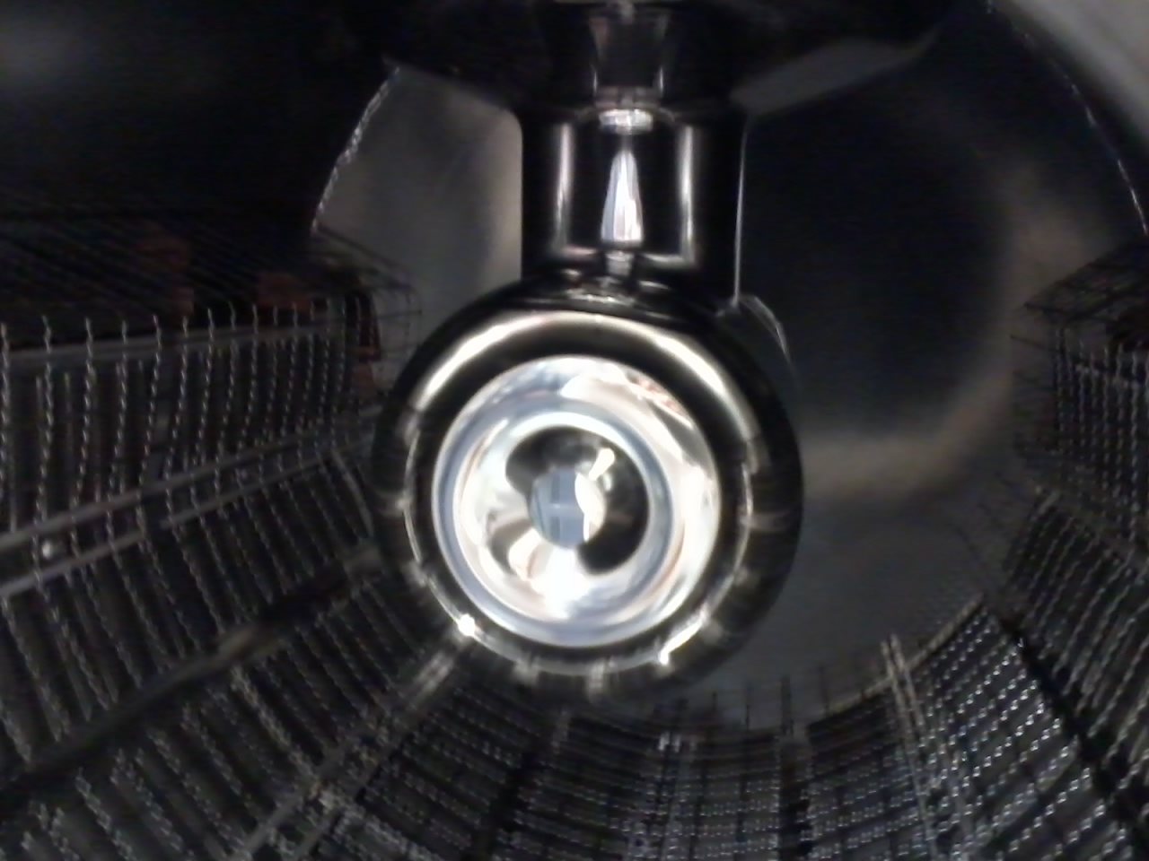
For HV processing: An Aluminum puck with explosion-bonded SS that Bubba polished to mirror surface finish was mounted.

Slide 2
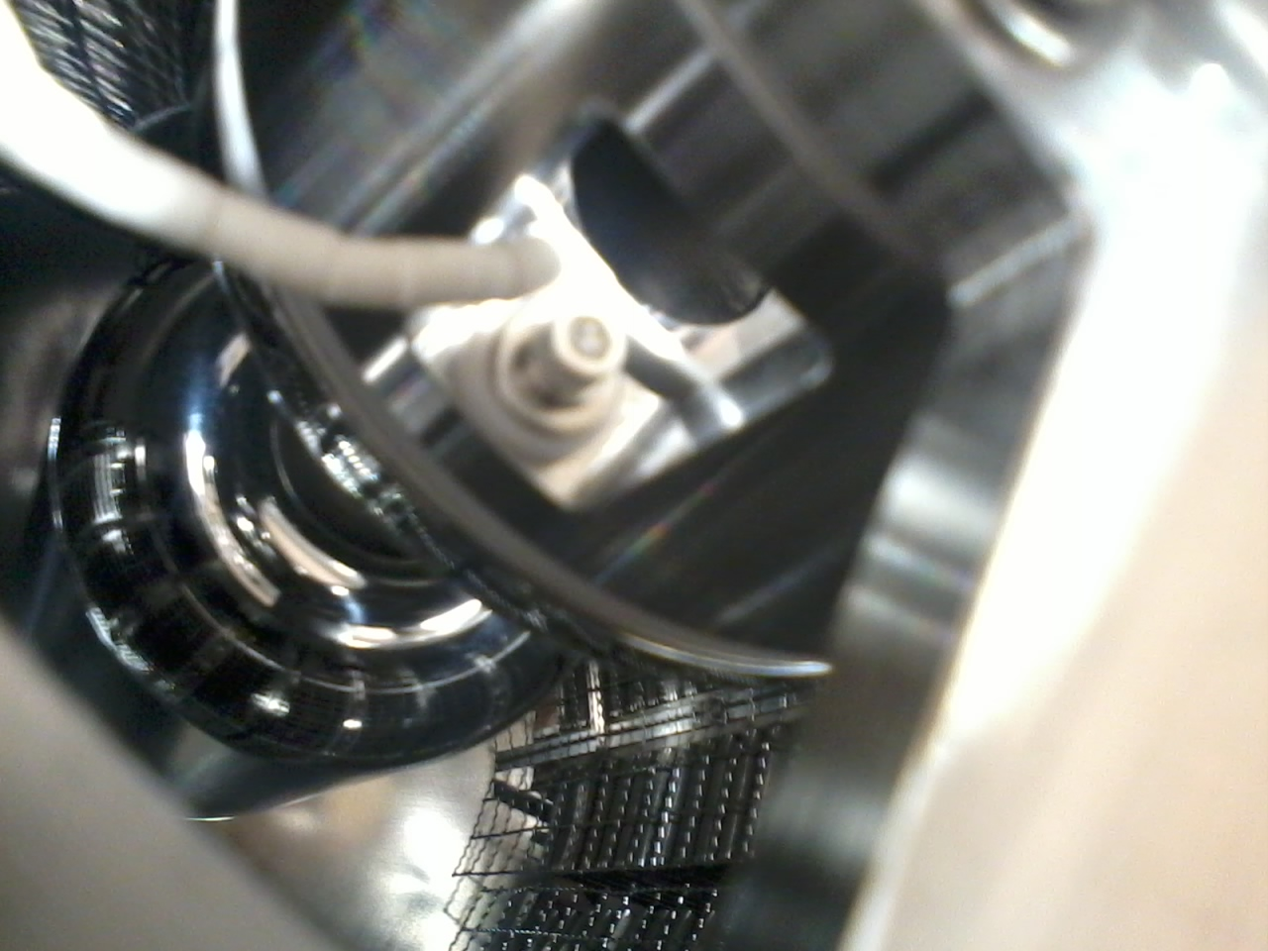
Cathode and anode mounted in the gun

Slide 3
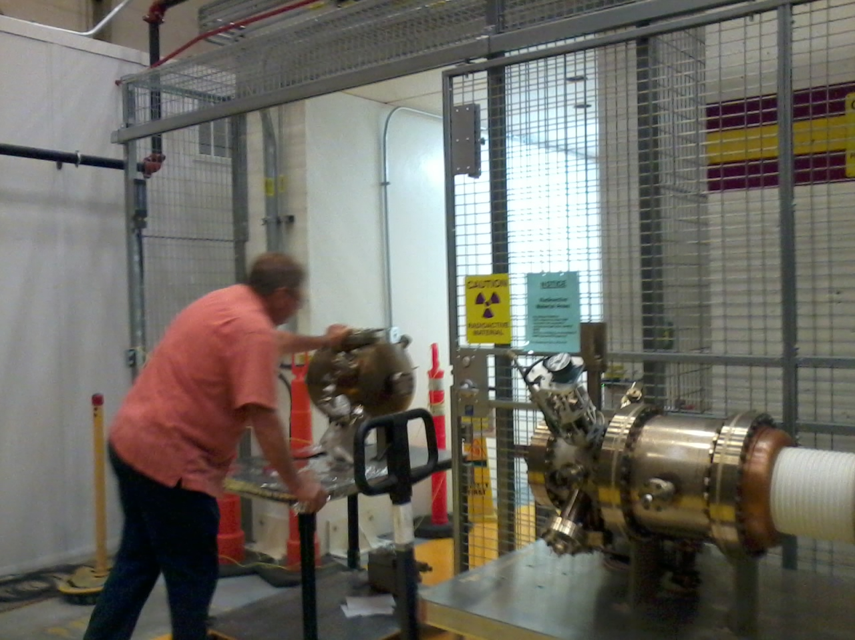
Retired
2017
Newborn
2017

Slide 4
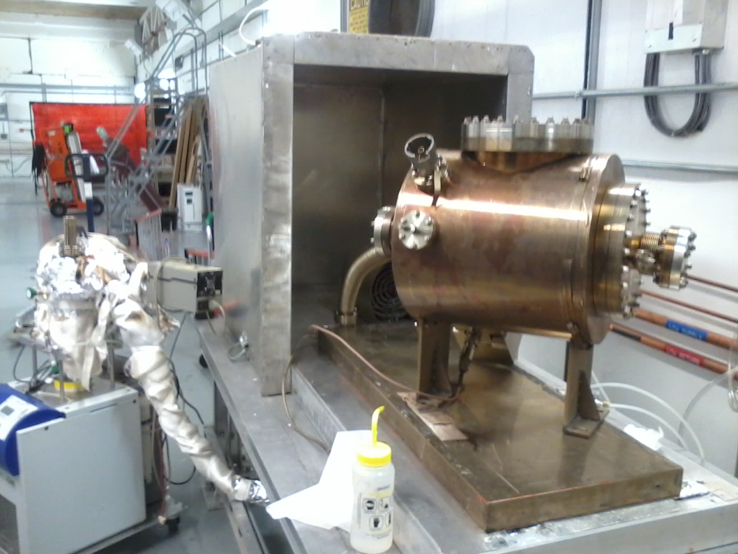
Getting ready for vacuum bake in the UITF

