Slide 1
Upgraded Injector Test Facility
The recent highlights:
RF applied to cold QCM! Reached desired operating gradients w/o field emission
Photogun operating reliably ~ daily at 200 kV, thanks to Carlos and Yan Wang of Operations
Survey and Alignment completed “2A” alignment of MeV beamline, Phil and Marcy nearly ready to pull vacuum
Three OSPs revised to address Cave2 roof tiles that can be removed

Slide 2
Tasks before running beam to HDIce for target commissioning
Mechanical design (Shaun Gregory), need to finish documenting as-built MeV beamline, design HDIce related components (dump, catwalk)
Gun Group: finish the MeV beamline, pull vacuum from gun to HDIce target, keep making 200 keV beam for CEBAF SAD work
Survey and Alignment “2B” alignment
Magnet group: wire up magnets, build a third trim-card rack
I&C: Cable-up the MeV beamline - valves, ion pumps, viewers, BPMs, harps, water flow meters, interlocks, current monitors, ….
SSG install BLMs
Operations Software group: more screens, MPS system, UED, etc.,
RadConGroup: document shielding requirements, install all CARMs and electronics, neutron probe rapid access system
Facilities implement north wall shielding solutions: purchase concrete, steel support structure, re-route electrical conduit
Safety and Approvals: OSP for roof tile removal, OSP for MeV beam, SCMB review, UITF Accelerator Operations Directive/Conduct of Operations, Accelerator Readiness review
Work with SRF, Cryo and Facilities to imagine CTF improvements to boost return flow, independent pressure control, etc., to operate UITF at same time as CMTF and VTA
Install, operate the raster magnets (C. Cuevas)
Re-install HDIce
Electrical engineering and SSG: design and build the PSS BCM, a "credited control" to limit beam current/loss and prevent accidental exposure to x-rays, add PSS BCM to circuitry, PSS BCM credited control documentation

Slide 3
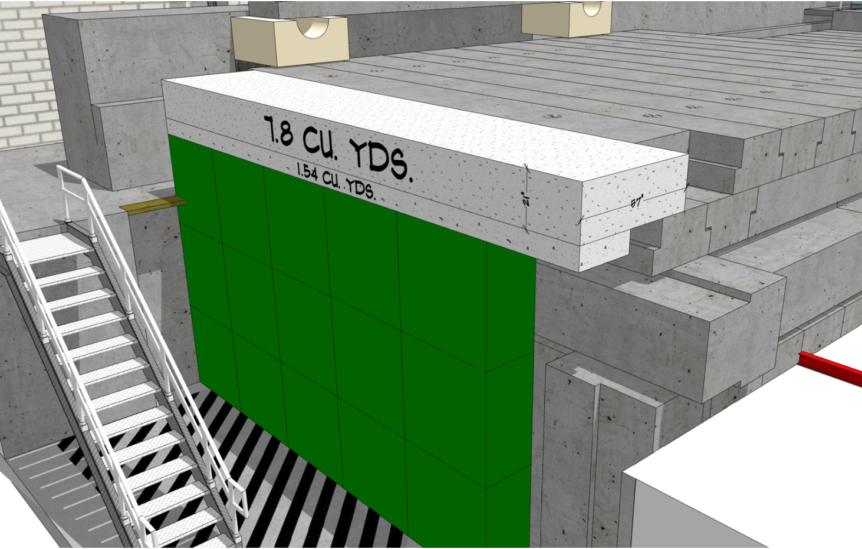
North Wall Shielding
thanks Walt Akers

